Slide 1
XMM-Newton EPIC-pn vs. NuSTAR
Gabriele Matzeu (Quasar SR for ESA)
F. Füerst, N. Schartel, M. Smith for the EPIC-pn IDT and SOC USG

Slide 2
Coordinated XMM-NuSTAR & NuSTAR sample
I took over from Felix in mid (and extremely hot) August 2023 at ESAC
Based on previous work by Felix Füerst.
GOAL: Reduce and analyze a large sample of “coordinated XMM-Newton & NuSTAR” targets (mostly XRBs) in a semi-automated pipeline for XMM-Newton (EPIC-pn in timing mode) and NuSTAR
26 targets – Thick Filter
12 targets – Medium Filter
30 targets – Thin Filter

Slide 3
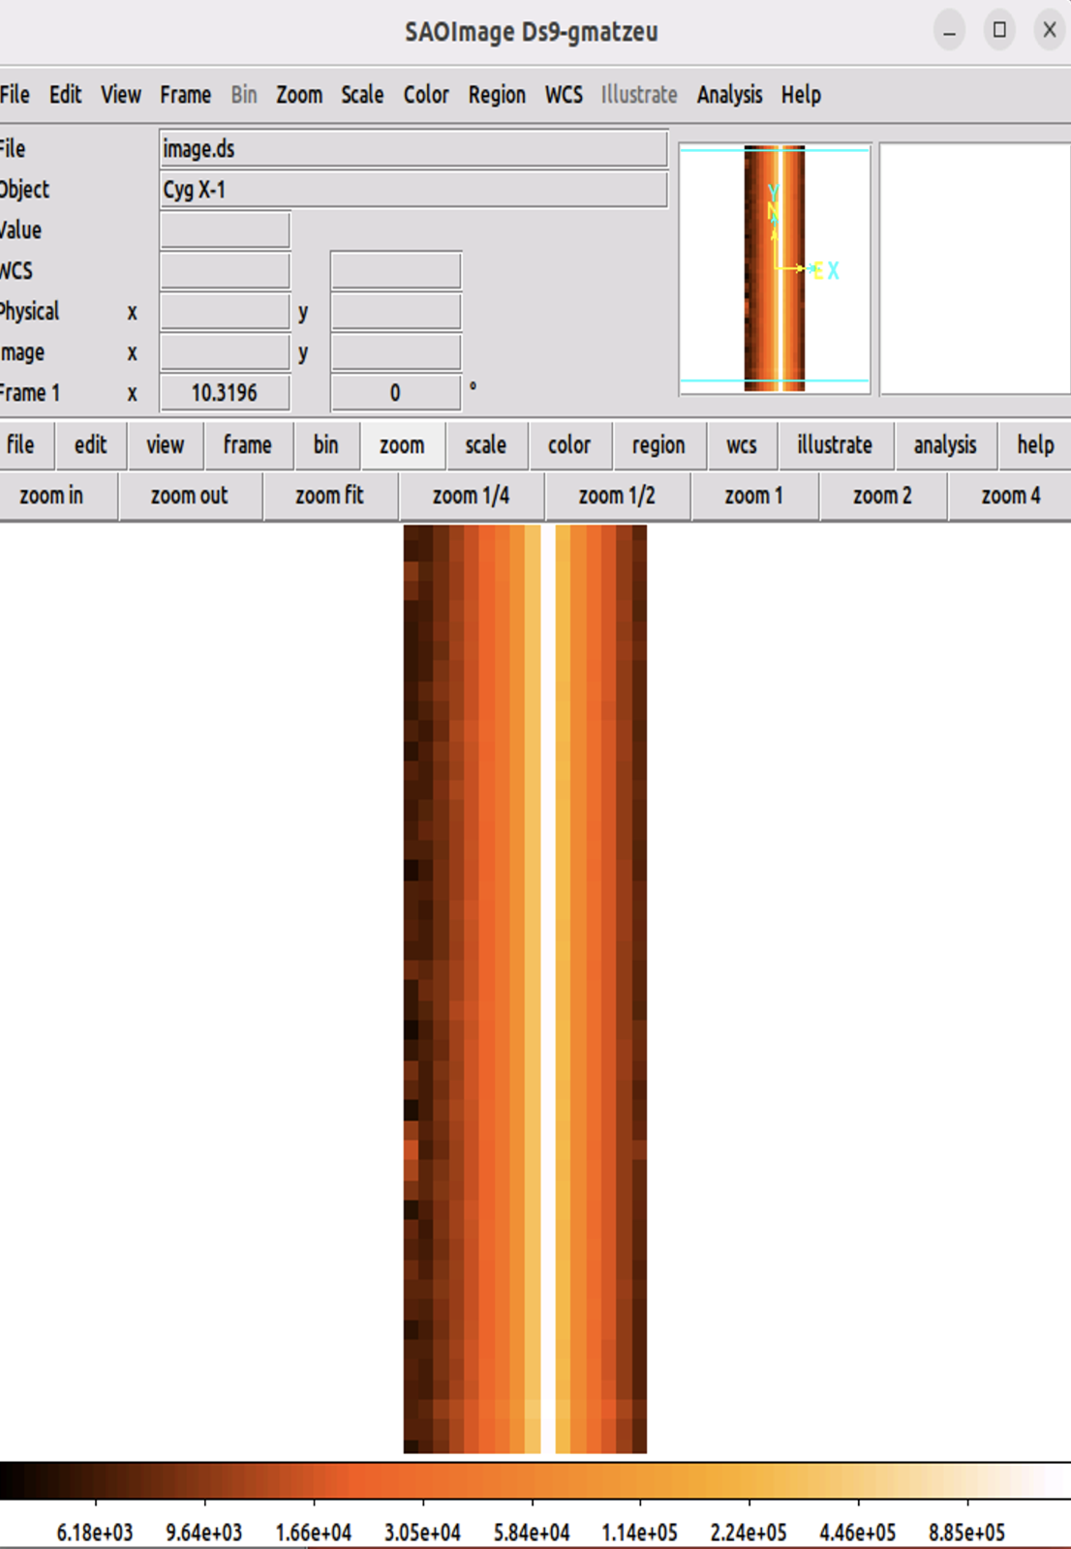
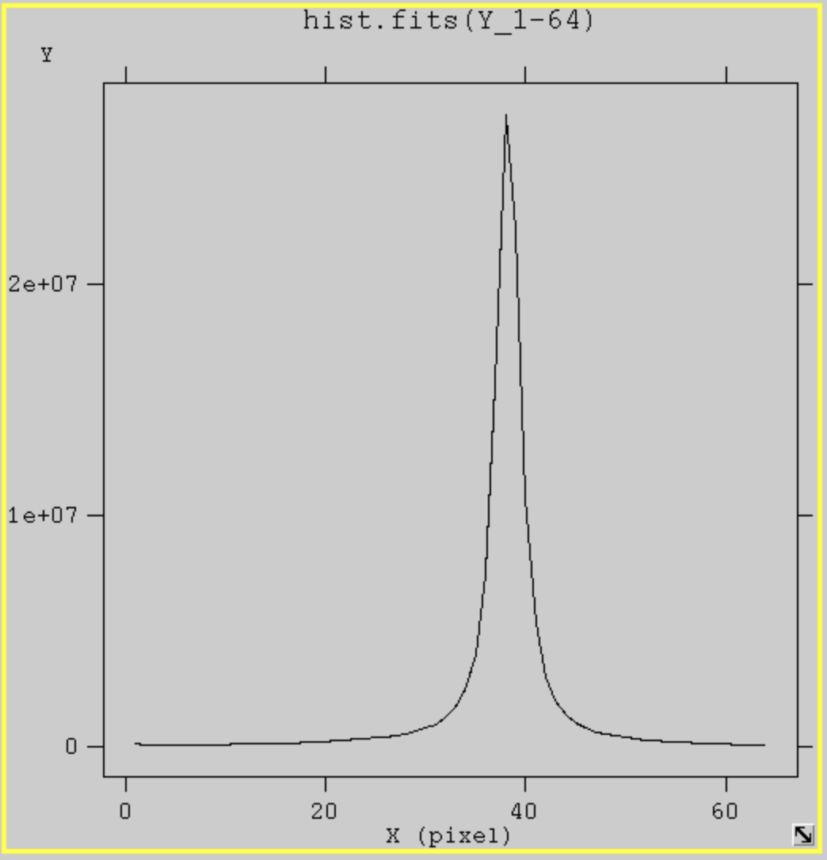
Reduction and analysis approach
XMM-Newton
EPIC-pn
Timing mode
RAWX =1-64
Using 3-10 keV
In the Timing mode, spatial information is maintained only in one dimension, along the column (RAWX) axis.

Slide 4
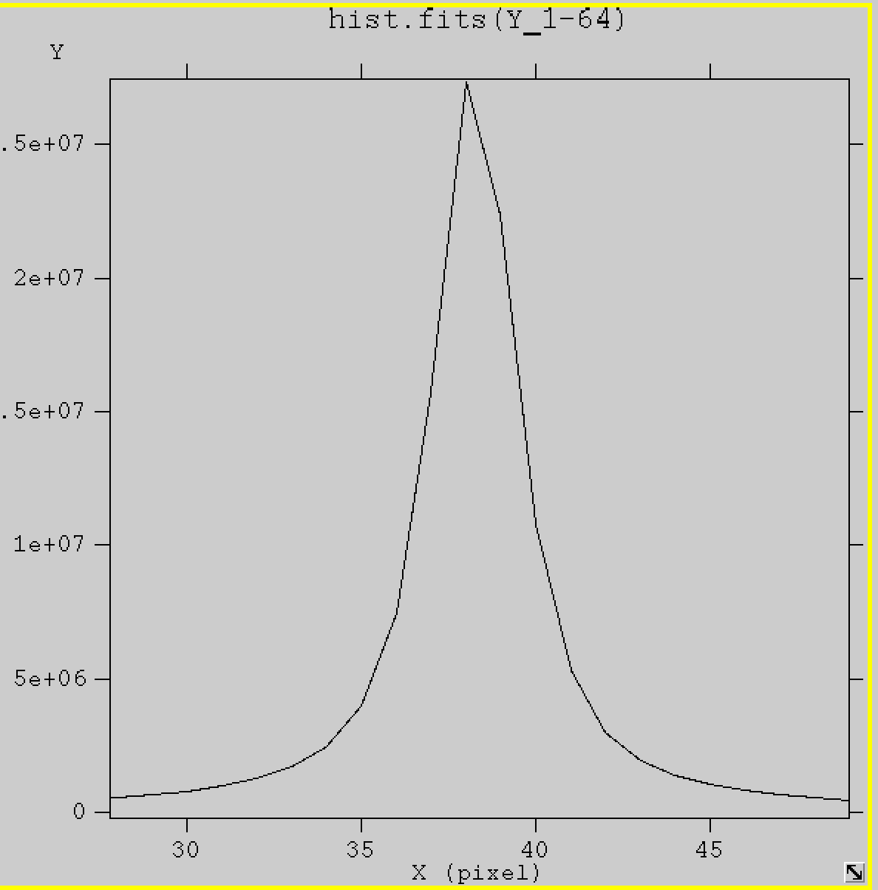
Reduction and analysis approach
XMM-Newton
EPIC-pn
Timing mode
RAWX by (central RAWX excl)
10by0 … 10by4 depending on pileup
Using 3-10 keV
Mincount=25 and oversample=3
Peak RAWX=38
e.g.,10by1
RAWX 37-39 removed
NuSTAR
Fitting FPMA and FPMB
90” extraction radius both src and bkg
Using 3-20keV
Mincount=50

Slide 5
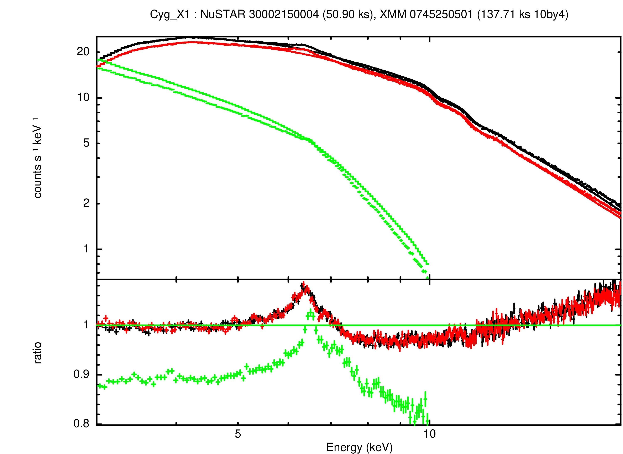
Example 1:
Find best-fit continuum model to NuSTAR data only
(in this case:constant*pow)
(XMM EPIC-pn not fitted)
HMXRB: CYG X-1
EPIC-pn photo-index wrt NuSTAR: harder
(XMM EPIC-pn not fitted)
arfgen applyabsfluxcorr=yes

Slide 6
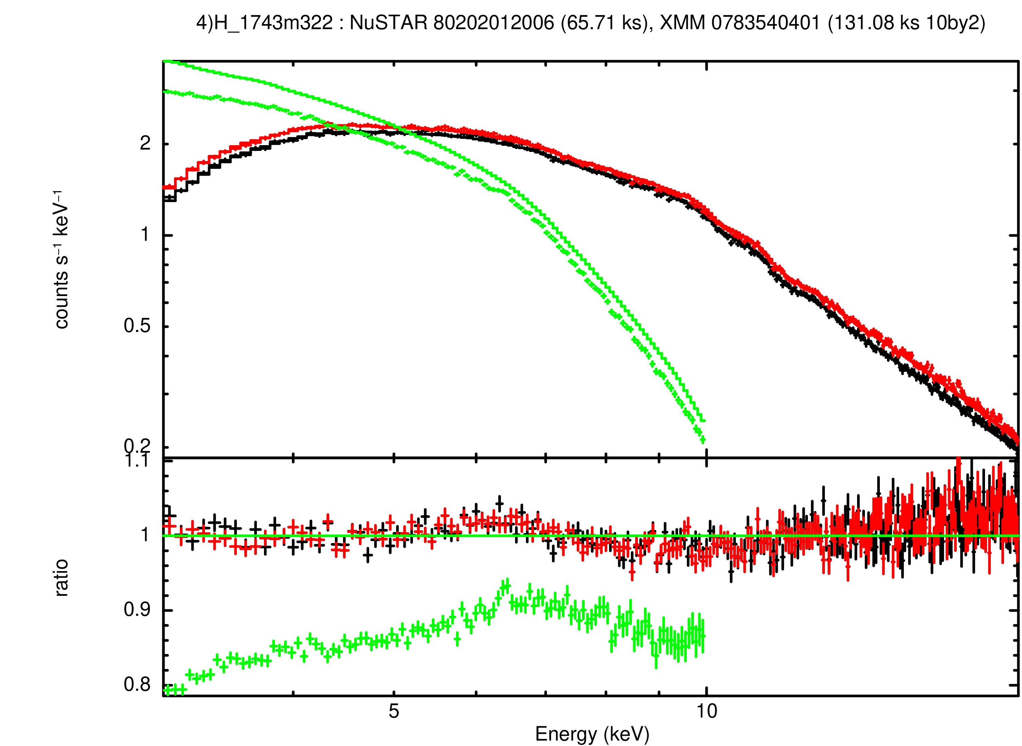
Example 2 :
Find best-fit continuum model to NuSTAR data only
(model:constant*Tbabs*pow)
(XMM EPIC-pn not fitted)
LMXRB: H 1743-322
EPIC-pn photo-index wrt NuSTAR: harder
(XMM EPIC-pn not fitted)
arfgen applyabsfluxcorr=yes

Slide 7
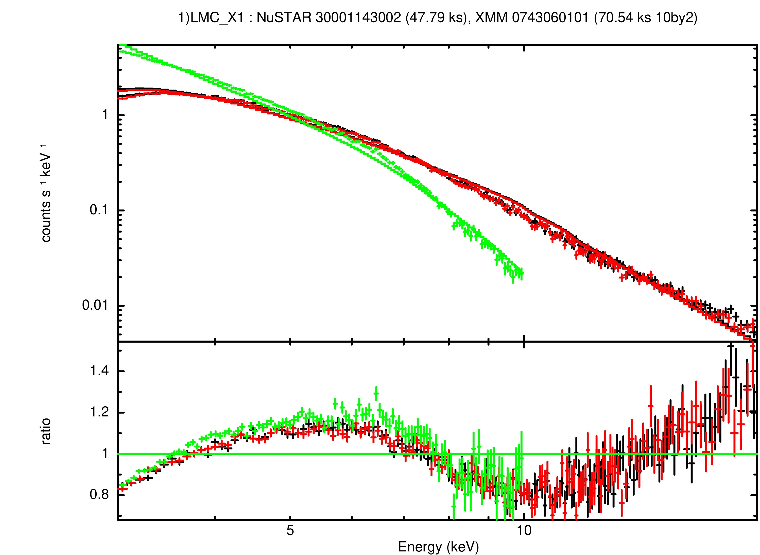
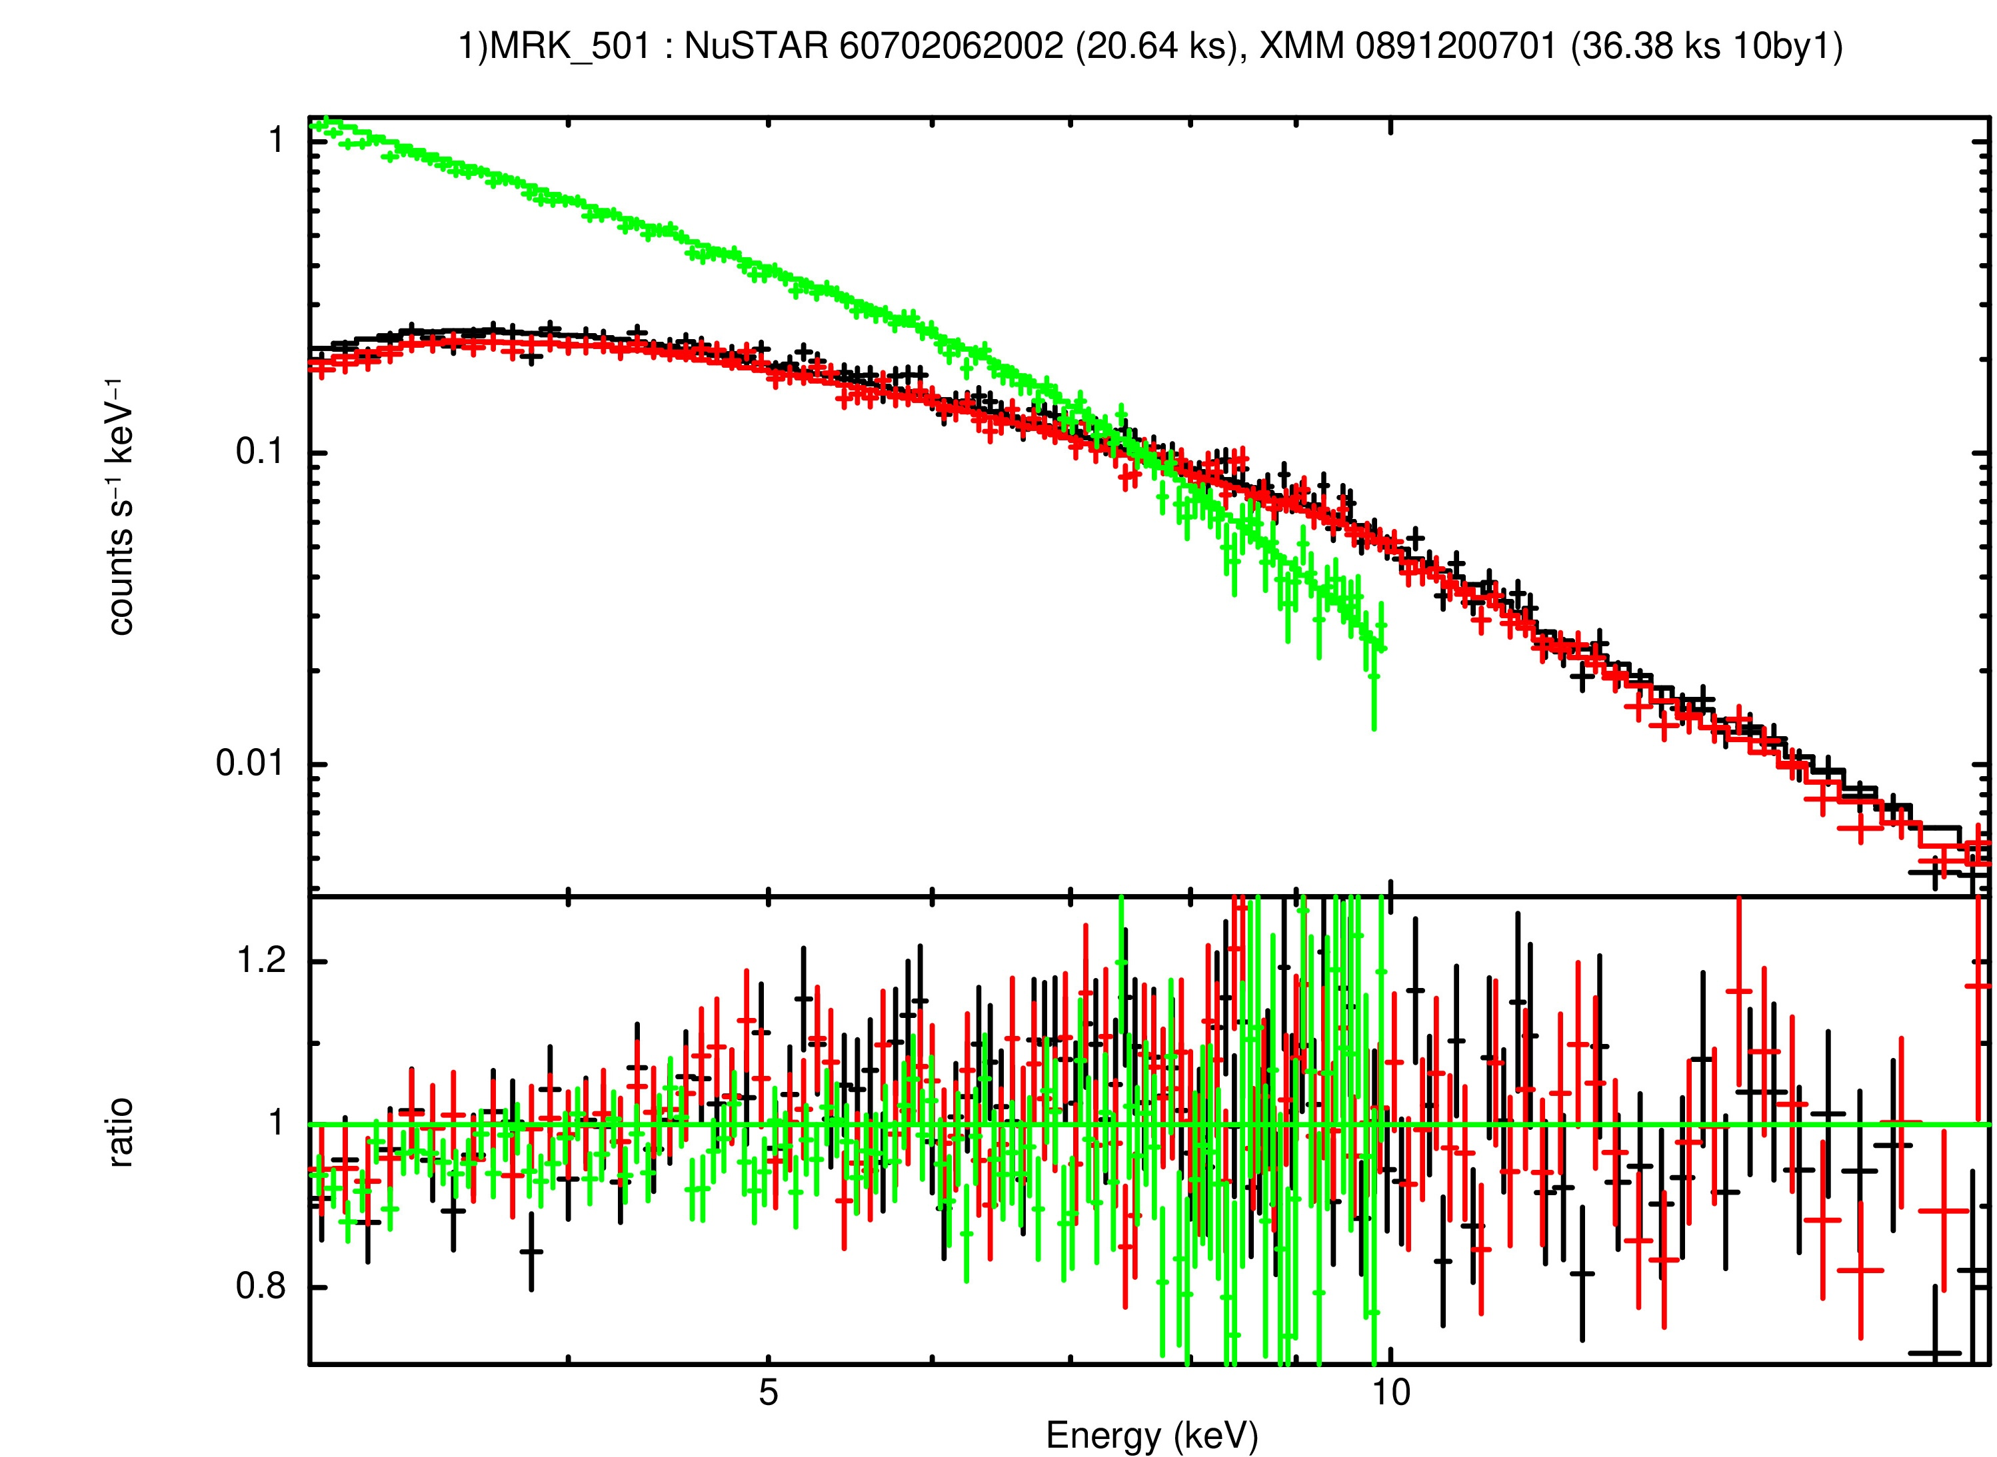
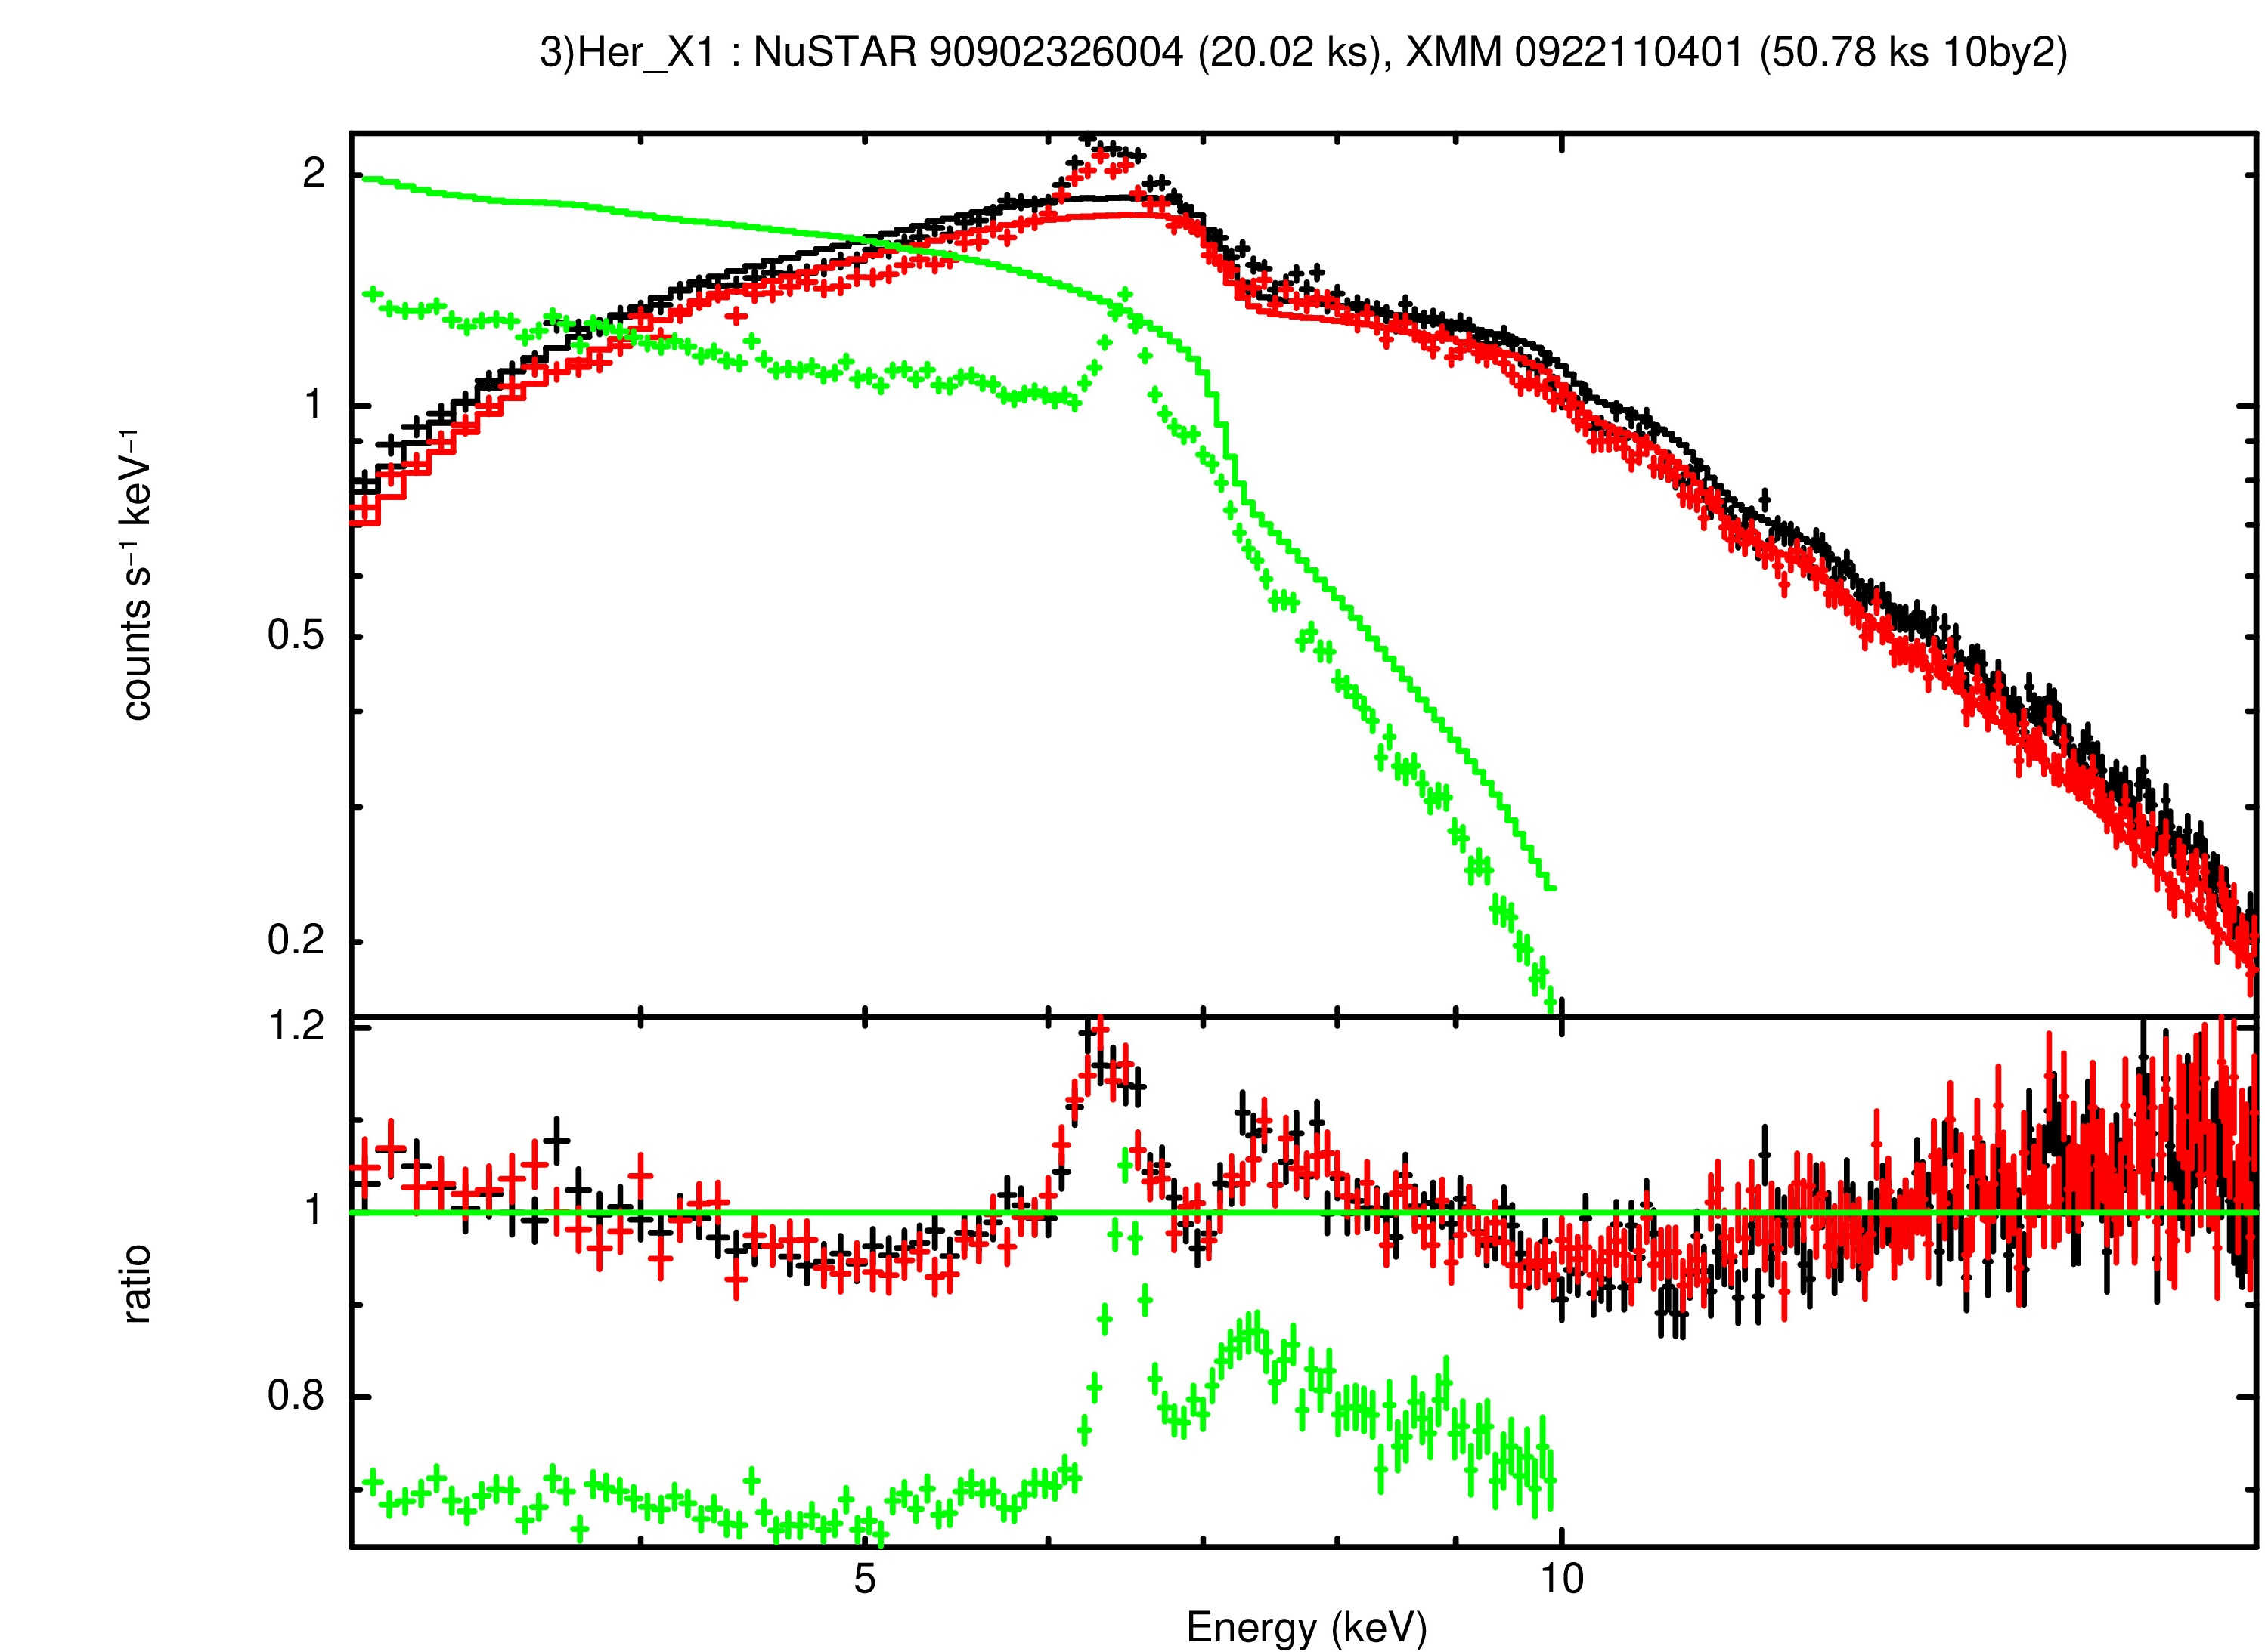
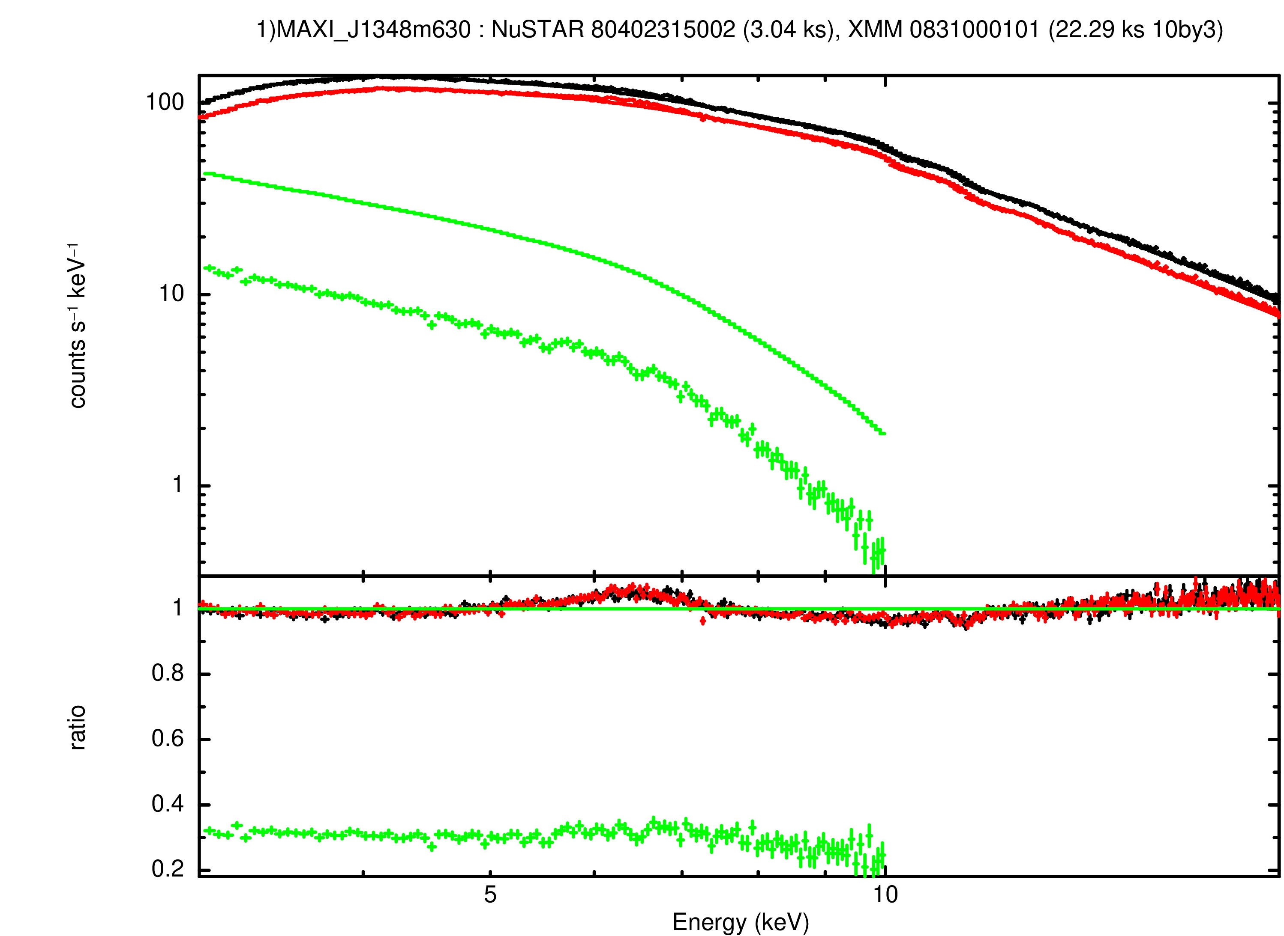
More examples: gallery
HMXRB: LMC X-1
BL LAC: Mrk 501
LMXRB: Her X-1
HMXRB? MAXI J 1348-639

Slide 8
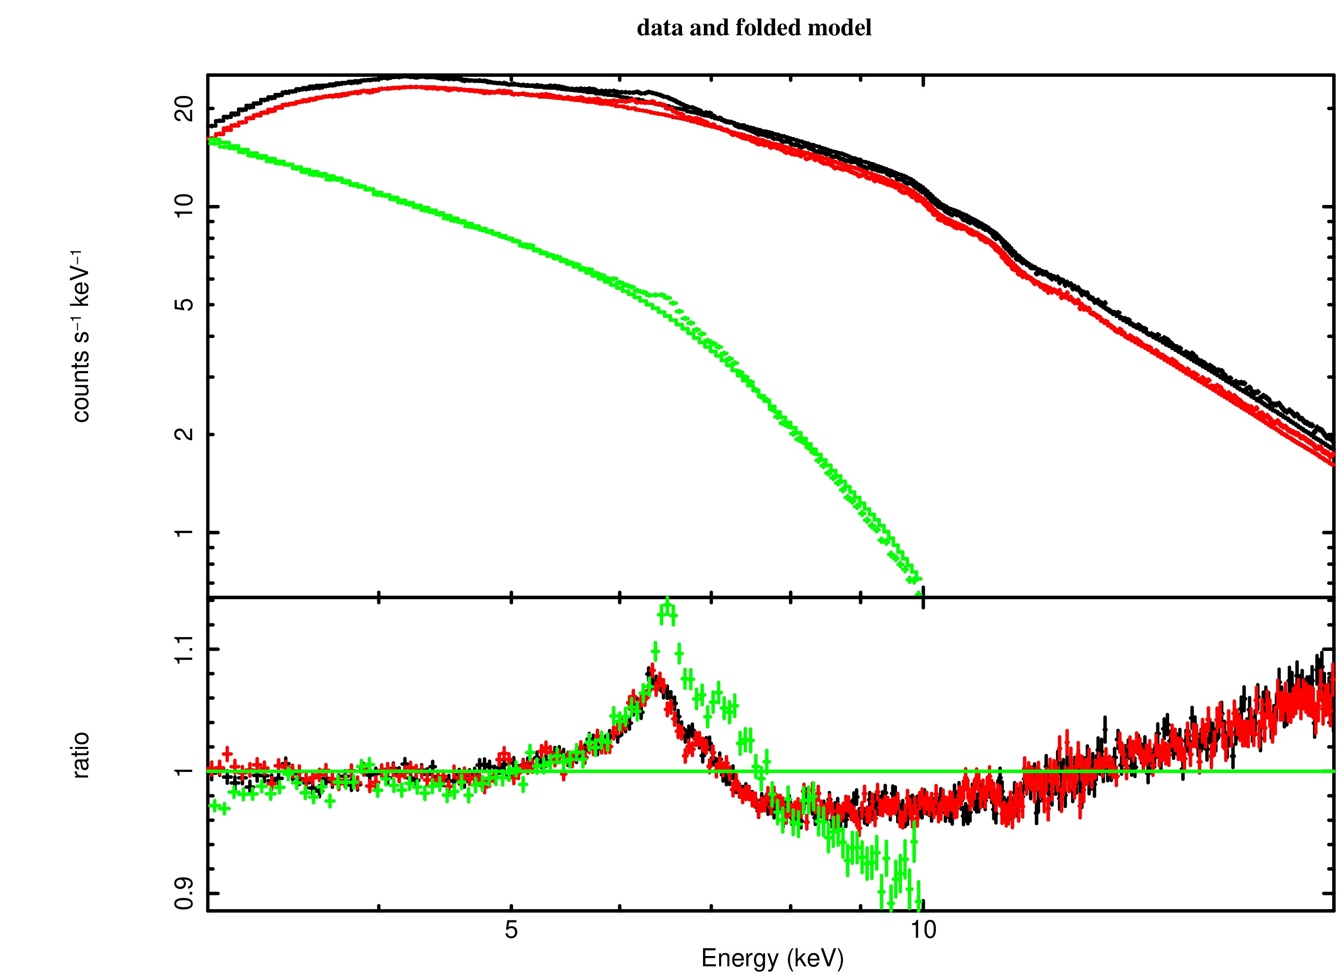
TEST 1 example – EPIC-pn VARIABLE CONSTANT
CYG X-1; An accreting high mass X-ray binary with strong iron Kα line.
Fe Ka centroid energy lines is shifted by ~10 eV
∆const = 1 – constant (EPIC-pn) = 0.09
-> work in progress.

Slide 9
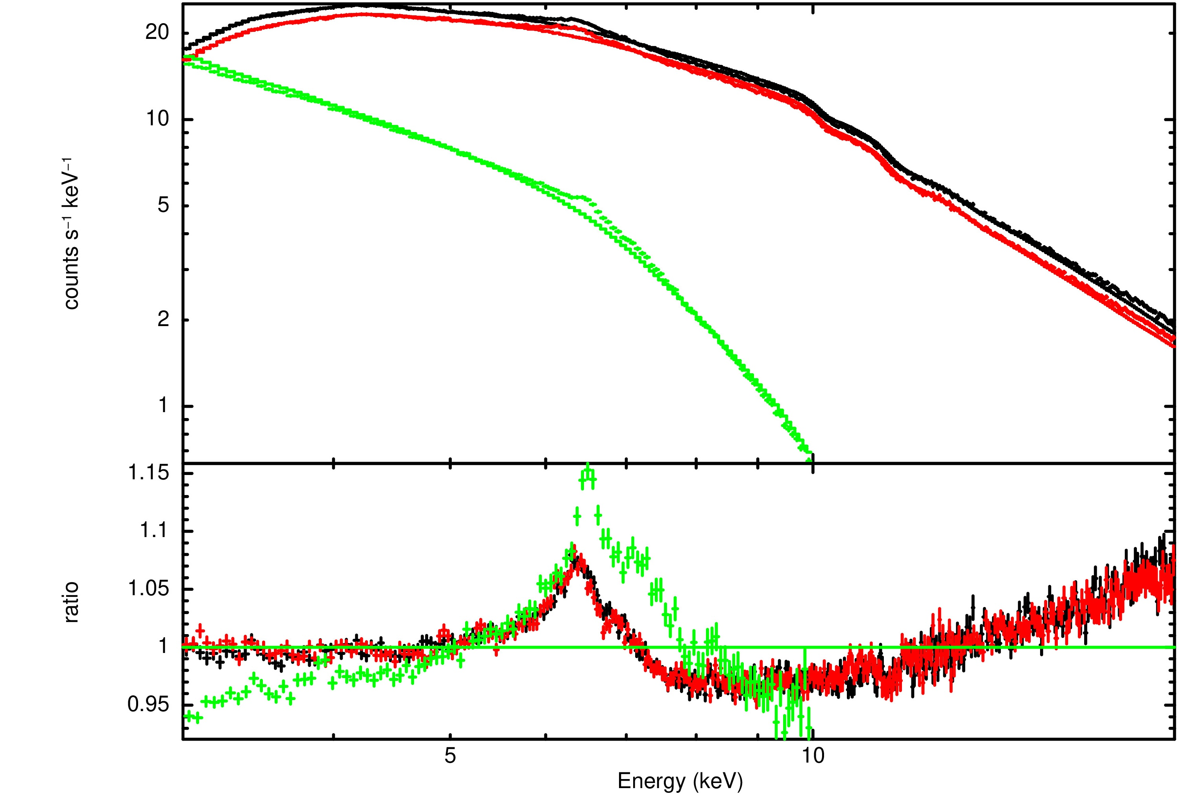
TEST 2 example – EPIC-pn VARIABLE Γ
CYG X-1; An accreting high mass X-ray binary with strong iron Kα line.
Fe Ka centroid energy lines is shifted by ~10 eV
∆Γ = Γ (FMPA) - Γ (FMPA) = 0.06
The majority of EPIC-pn slopes are softer w.r.t. NuSTAR FPMA/B
-> work in progress.

Slide 10
Results
Counts/s vs ∆constant
High S/N so 1-3% error
There is a considerable scatter without any recognizable correlation
Work in progress!
EPIC-pn and NuSTAR differences not always that large but mostly within 20%
20%

Slide 11
Results
Counts/s vs ∆Γ
High S/N so 1-3% error
There is also a considerable scatter without any recognizable correlation
Work in progress!
EPIC-pn and NuSTAR differences not always that large, see GRS 1739-278
10%

Slide 12
Current status and outlook
Outliers like MAXI J1348-630, HER X-1, 4U1636-53 will make my life even more complicated
Flux difference of ~20% obvious in most of the 28 sources with some outliers
Slope difference of ~10% for most of the 26 targets with some pronounced outliers
As this is in working progress we still have to find some form of correlation (if any!).
w.r.t. NuSTAR
XMM flux typically lower by ~ 20%
XMM spectrum softer (ΔΓ ~ 0.1)
Work is ongoing to create automated pipeline, add more sources. Any change to calibration can be immediately checked.

Slide 13
Conclusion
Short-term goal: Optimize the analysis by considering COMMON GTIs (when possible).
Investigate the ∆const, ∆Γ (and ∆NH) behavior w.t.r. to the number of columns removed for pileup sources (most of them)
Mid-term goal: Increase the sample by adding the XMM-Newton EPIC-pn in timing mode observed with Medium and Thick filter.
Long-term goal: Also investigate the change in centroid energy of Fekα emission line.
IACHEC cross-calibration observations and XRBs provide a good set to measure and test the cross-calibration between EPIC-pn in timing mode and NuSTAR.
Project only recently started (but based on lots of previous work done by Felix and IDT team).
Current cross-calibration is far from perfect, but hopefully stable and can be characterized well in the short-term.

