Slide 1
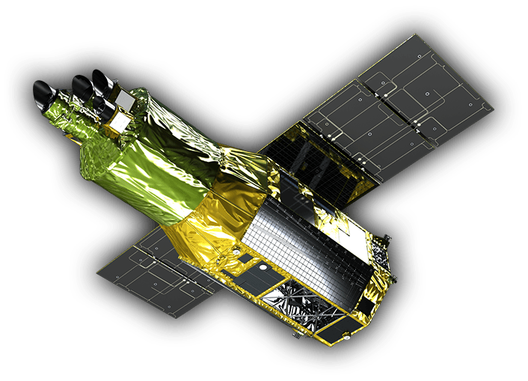


On-orbit calibration of XRISM/Xtend
Tomokage Yoneyama (Chuo University)
on behalf of XRISM/Xtend Instrument Team
Notes:
Allright, Buenos dias, I’m Tomokage Yoneyama from Chuo University, Japan.
I would like to talk about the on-orbit initial calibration and performance of XRISM/Xtend on behalf of the Xtend instrument team.
For the full member of the Xtend IT, refer to Suzuki-san’s presentation previous to mine.

Slide 2
Overview
On-orbit performance and calibration status for...
  Effective area
  Encircled energy function (angular resolution)
  Contamination (on- and off-axis)
  Energy range and energy resolution
  Response
  Non-X-ray Background
  Timing accuracy (absolute)
Notes:
This is the overview of my talk. Xtend has actually many items to be verified and calibrated.
Today I introduce a kind of a quick-look to the initial results.

Slide 3
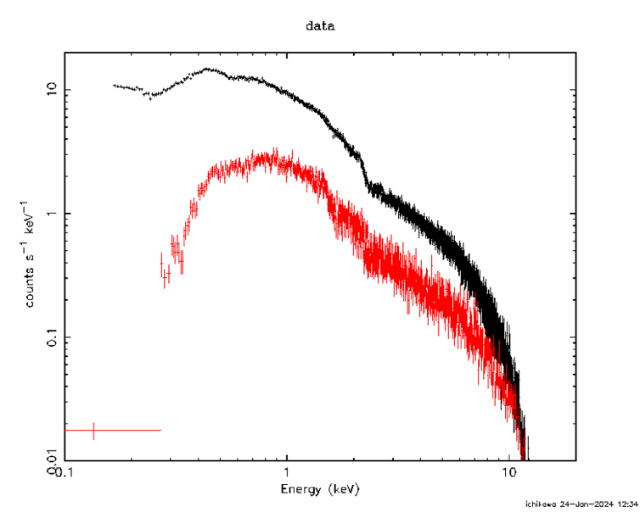
Effective area
 | 0.8-8 keV |  | 1-5keV |  | 3-7keV
 | Γ | F×10¹¹ (ergs/cm²/s) | Γ | F×10¹¹ (ergs/cm²/s) | Γ | F×10¹¹ (ergs/cm²/s)
Swift (by Inoue) | 1.41(2) | 4.88(10) | 1.40(2) | 3.04(5) | 1.44(8) | 2.29(8)
Chandra (by Inoue) | 1.60(3) | 5.60(15) | 1.57(5) | 3.69(11) | 1.73(16) | 2.42(17)
XMM (by Ichikawa) |  |  | 1.668(6) | 4.10(2) | 1.613(4) | 4.10(4)
XRISM /Xtend (by Inoue) | 1.57(1) | 4.69(3) | 1.55(1) | 3.03(2) | 1.56(3) | 2.21(2)
3C273
Preliminary
XMM/pn
XRISM/Xtend
Coordinated observations of 3C273 are utilized to calibrate effective area.
Photon indices and fluxes of SXI are within the range of variation among observatories.
Notes:
First, effective area verified with 3C273 three C two seventy three coordinated observation.
While this is a preliminary result, we see that the photon indices and fluxes of Xtend are within the range of variation among observatories like Swift, Chandra, and Newton.
It looks like moderate photon index and a little bit small flux.

Slide 4
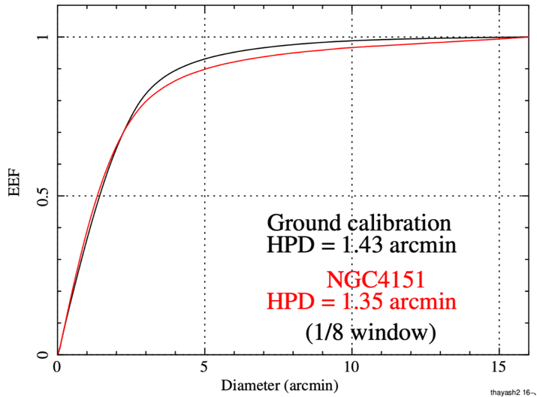
Encircled Energy Function
Preliminary
by Hayashi-san
EEF is estimated using 1/8 Window data (NGC4151) and verified that
the measured HPD is better than the requirement (< 1.7 arcmin).
Notes:
Next Encircled energy function. equivalent to the Point spread function.
The black and red lines correspond to ground and on-orbit measurement, NGC4151 with 1/8 window mode.
You see a slight variation between them both in the near aim-point and broad outskirt of the PSF.
It’s maybe due to a release of the gravitational stress on ground to the space. But I’m not sure.
Anyway, the on-orbit value of 1.35 minute meets the requirement of 1.7 minute.
Further detail will be presented by Hayashi-san, who is the expert of the XRISM mirrors.

Slide 5
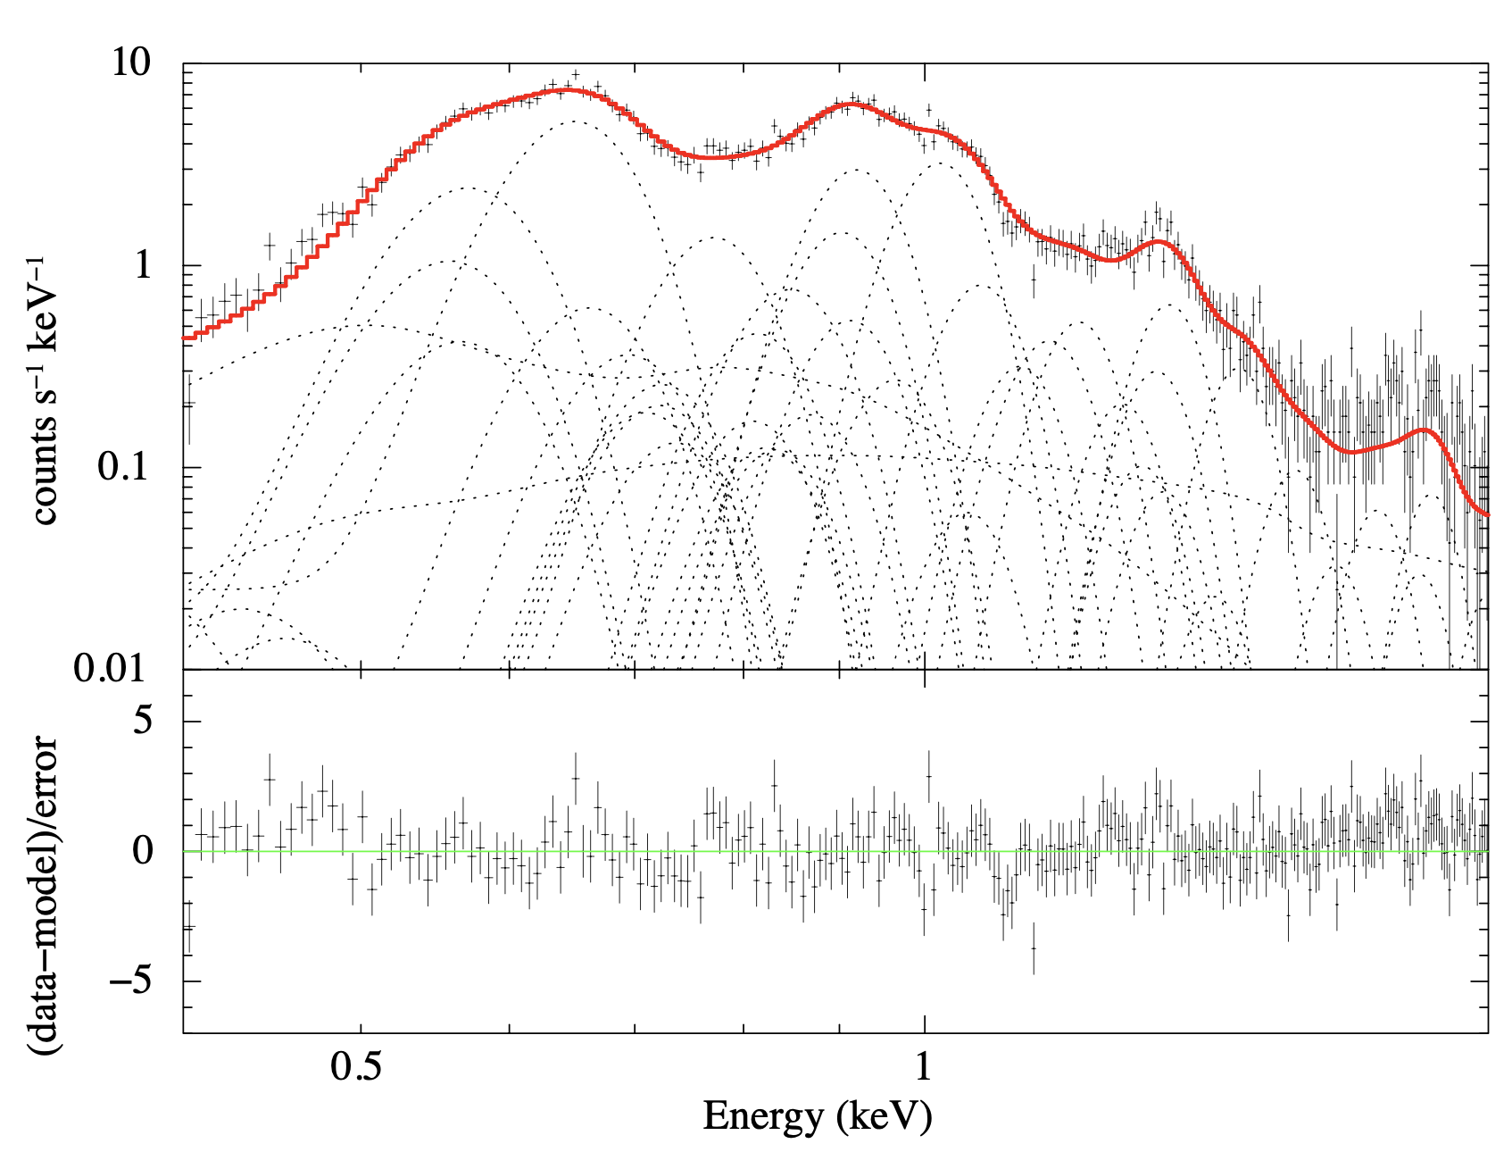
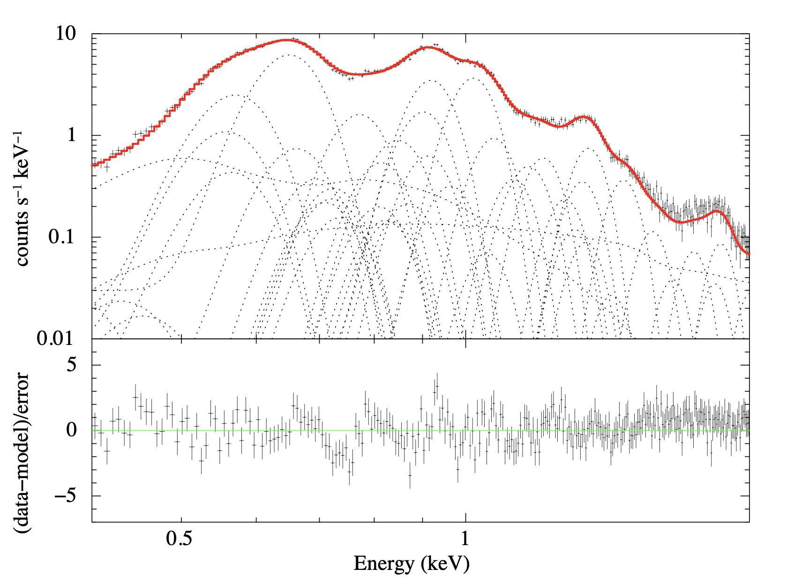
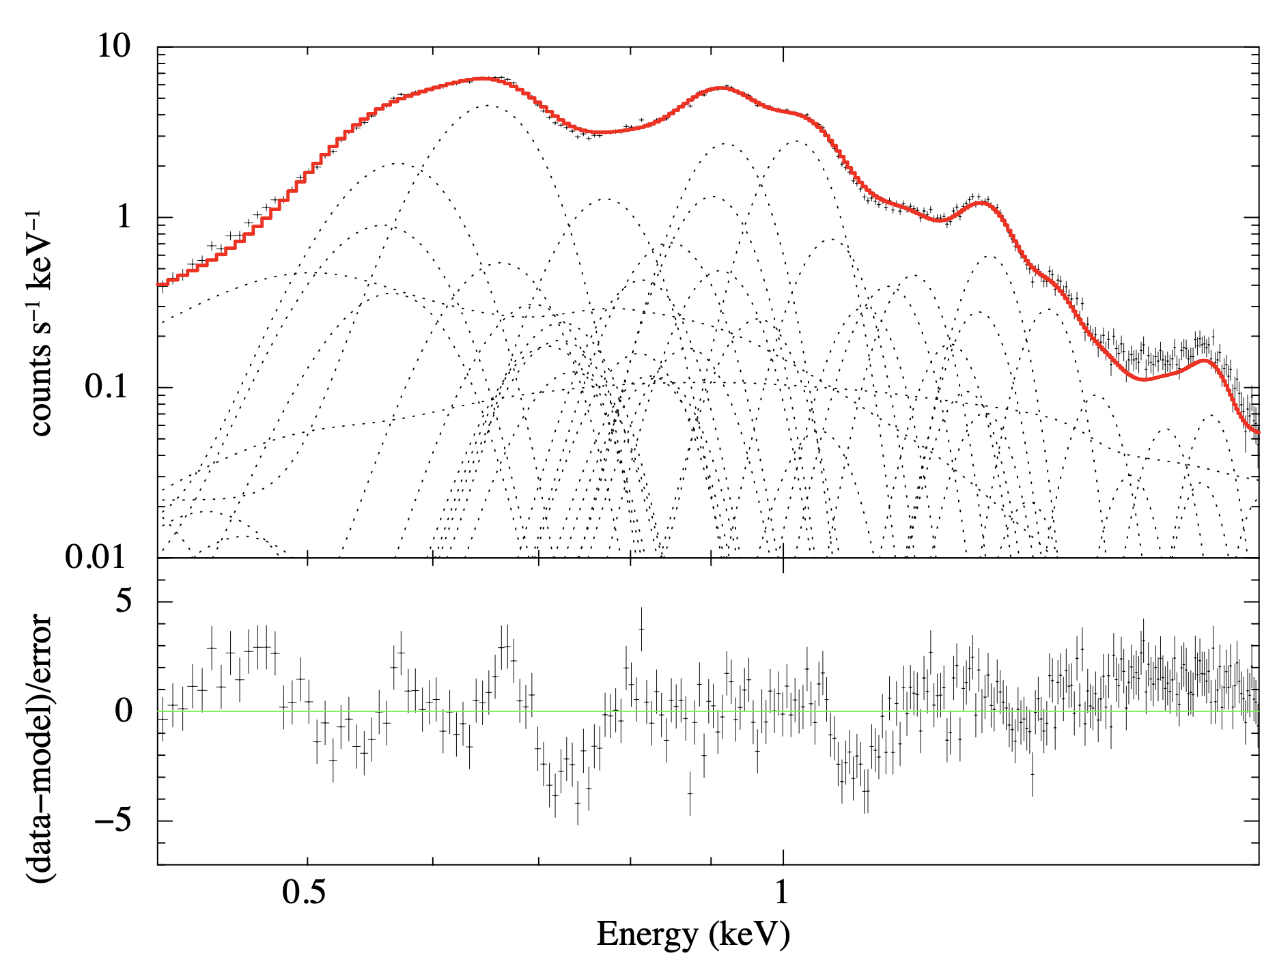
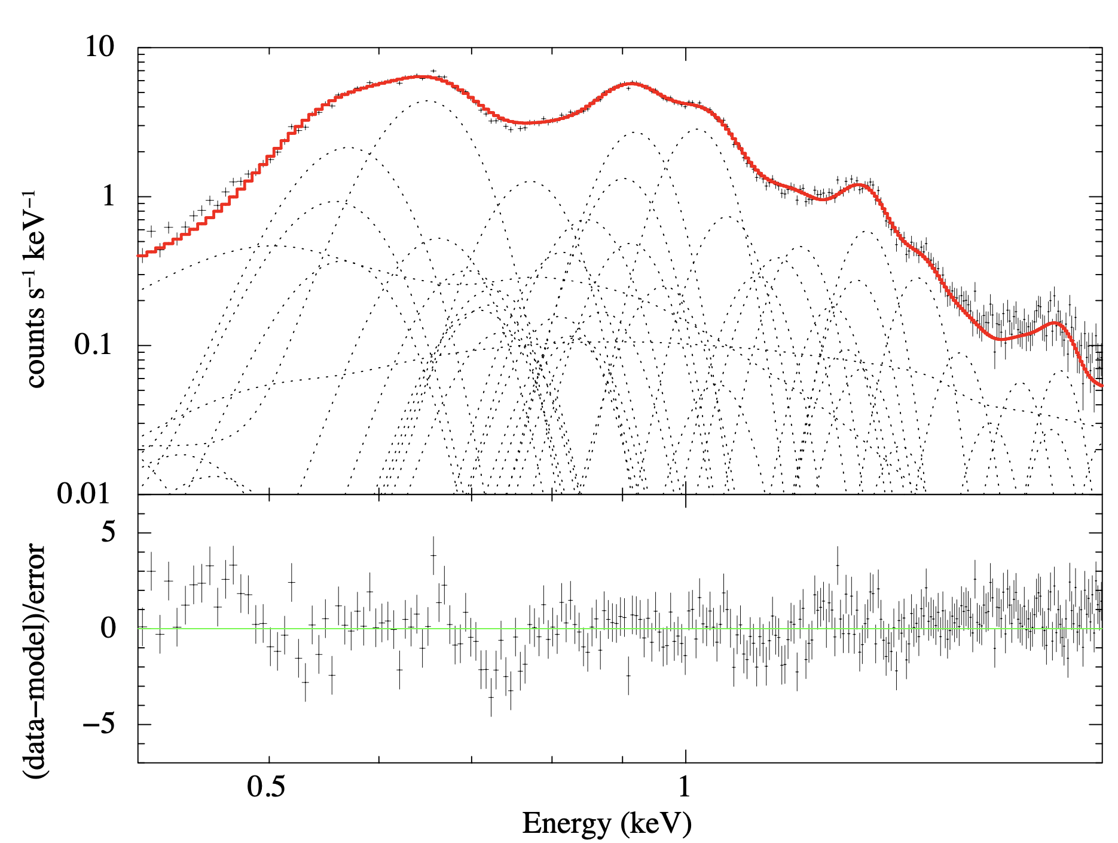
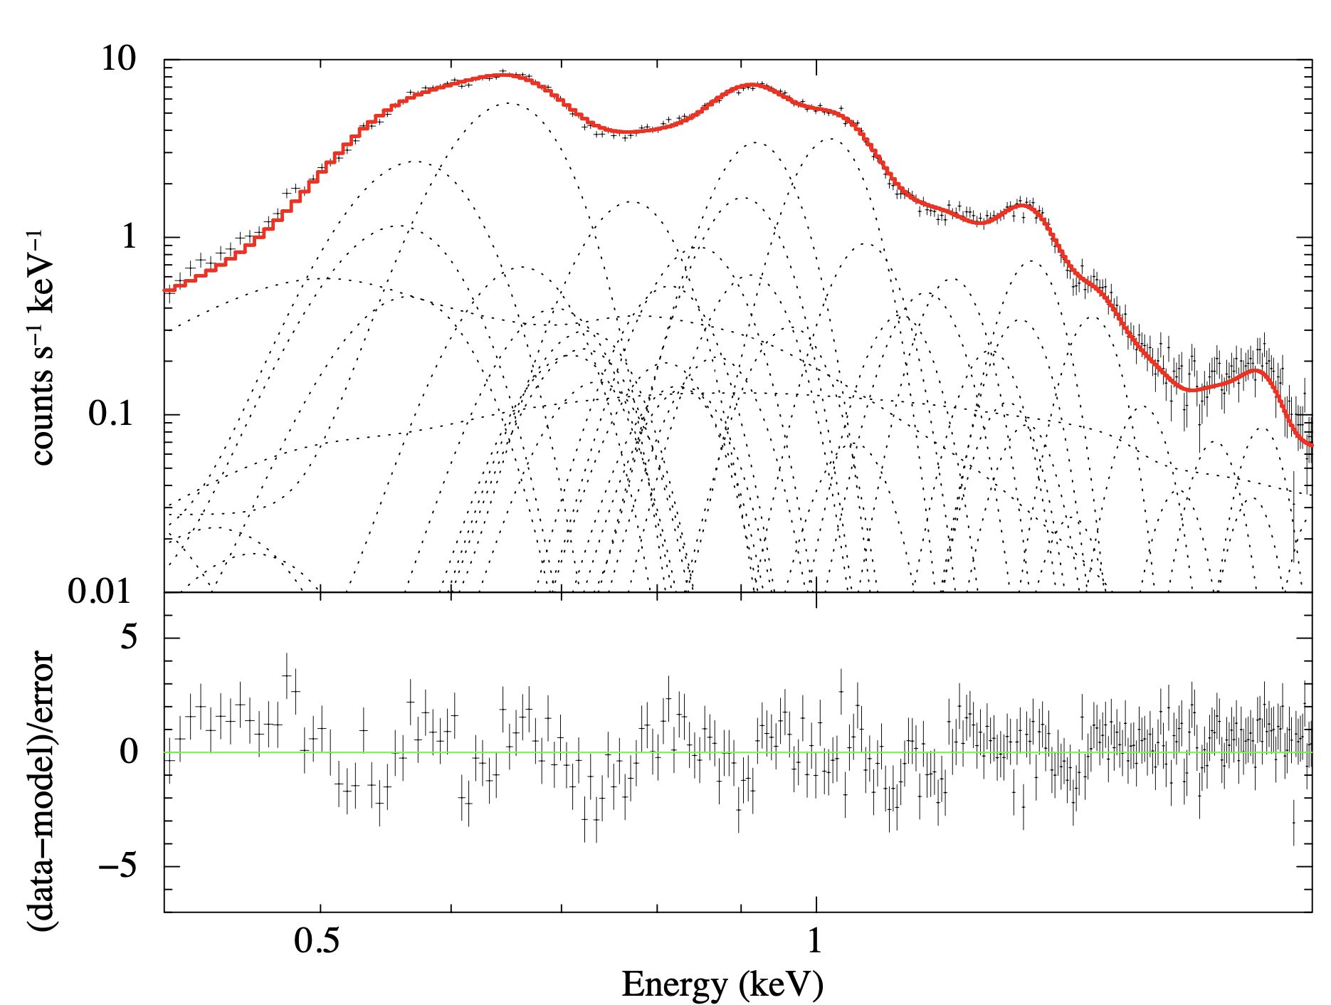
Contamination – On-axis (1/2)
On-axis contamination is evaluated with 5 observations of E0102
Model: IACHEC * constant * HCNOCOL (abs. edge of H, C, N, and O, assuming C₂₄H₃₈O₄)
Systematic residuals are due to RMF not optimized (that of Hitomi/SXI is used)
9.2 ks
28.9 ks
75.8 ks
2023-11-01 (full win)
2023-11-01 (1/8 win)
2023-11-19 (full win)
35.1 ks
26.7 ks
2023-12-25 (full win)
2024-02-19 (1/8 win)
by Aoki-san & Higuchi-san
Notes:
Next. Contamination. Xtend has heaters to avoid the contamination on the CCD hood, so we expected, we HOPED, zero-contaminants on orbit.
So we start the contamination evaluation for on-axis with 5 observations of E0102, one of the best friends to the IACHEC.
We applied the IACHEC model with the absorption edge model considering the contaminants C24H38O4.
These are the fitting results for each observations though November 2023 to February 2024. Note that we use the Hitomi rmf as the preliminary one.
The response is reported in other section of this talk.

Slide 6
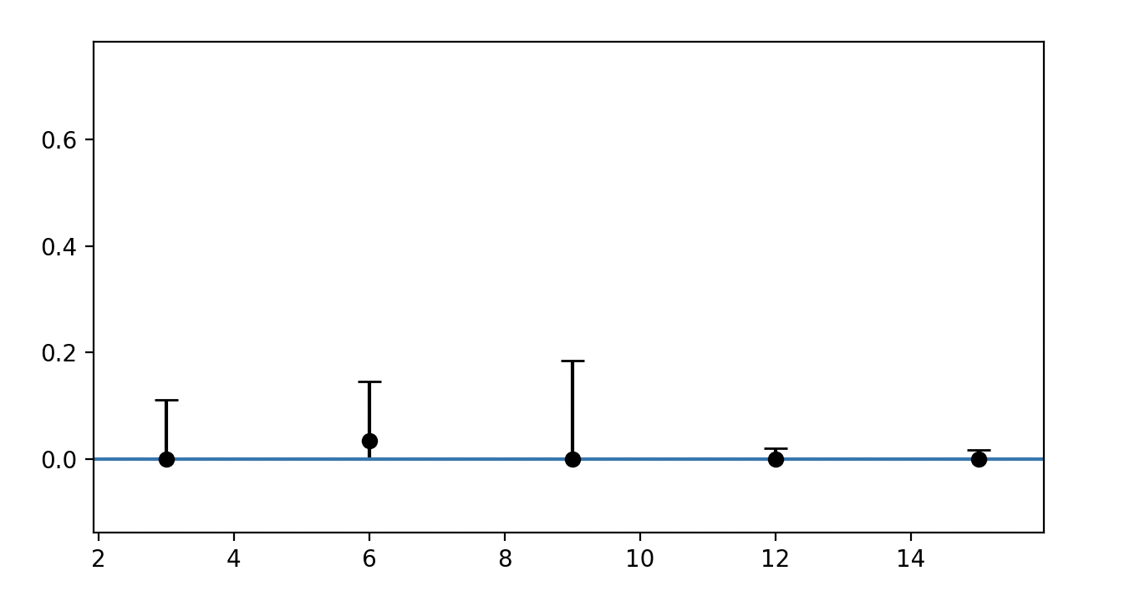
Contamination – On-axis (2/2)
C column density is not significant for all observations
No on-axis contaminants though Nov. 2023 to Feb. 2024
C column density [10¹⁸ cm⁻²]
Error : 1σ
2023-11-01
(full win)
2023-11-01
(1/8 win)
2023-11-19
(full win)
2023-12-25
(full win)
2024-02-19
(1/8 win)
by Aoki-san & Higuchi-san
Notes:
From the fitting we obtain the amounts of the on-axis contaminants as the carbon column density.
You see that all the 5 observations gives only upper limits.
We then conclude that the on-axis contamination is zero-consistent through November 2023 to February 2024 as we hoped,
while the response is not optimized yet.

Slide 7
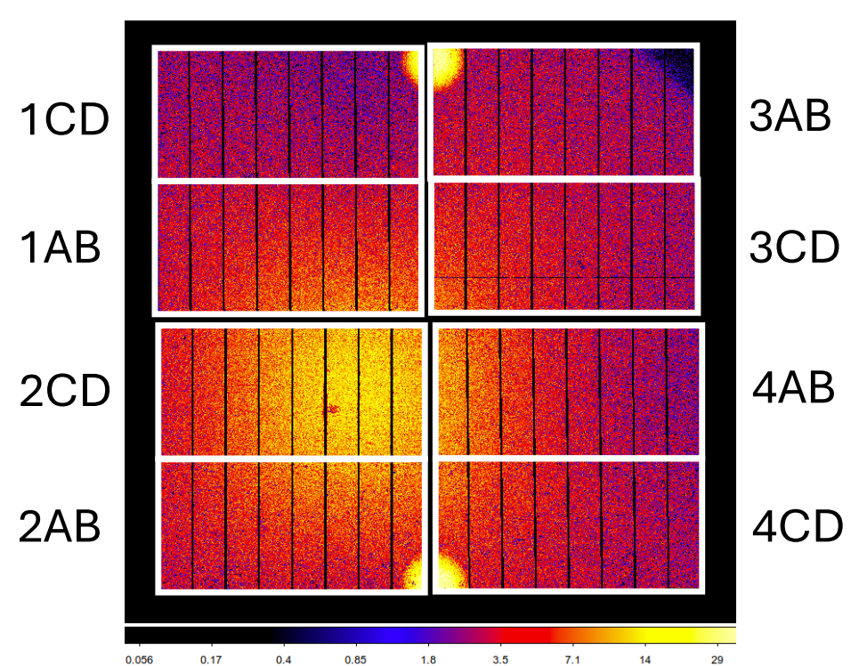
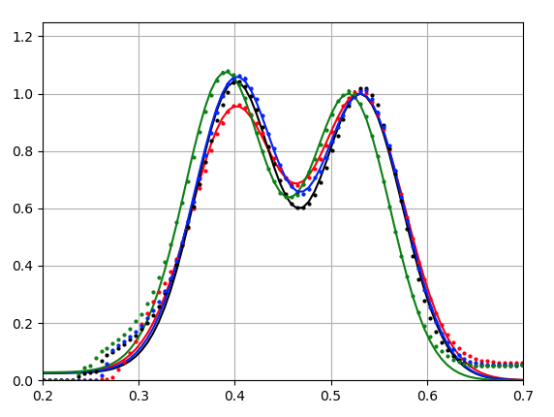
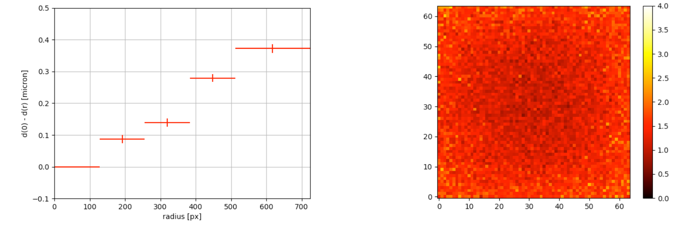
Contamination – Off-axis (1/2)
Off-axis contamination is evaluated with day-earth observations
Intensity ratio of N Kα and O Kα lines gives relative spatial distribution of contaminants
(as seen in Suzaku/XIS)
N/O distribution is coupled with the thickness of optical blocking layer (OBL; ~ 200 nm Al layer)
  CCD1 has relatively small N/O ratio because of thick OBL
Xtend day earth on Feb. 2024
Non-uniform N/O distribution of Suzaku
Image
Radial profile
- CCD1
- CCD2
- CCD3
- CCD4
N Kα
O Kα
*No light leak (different from Hitomi)
by Aoki-san & Higuchi-san
Notes:
We also verified the off-axis contamination with the day-earth observations.
The day-earth shows Nitrogen and Oxygen lines originate from the earth atmosphere. Their intensity ratio gives the relative spatial distribution of contaminants.
This is actually seen in the Suzaku/XIS.
But, we should note the N/O distribution is coupled with the thickness of optical blocking layer consists of aluminium layer of 200 nm thickness.
We found that CCD1 has relatively small N/O ratio because of the thick OBL than other chips.
By the way, from the day-earth image we confirmed that no light leak is occurred. This is an improvement of the OBL from Hitomi.

Slide 8
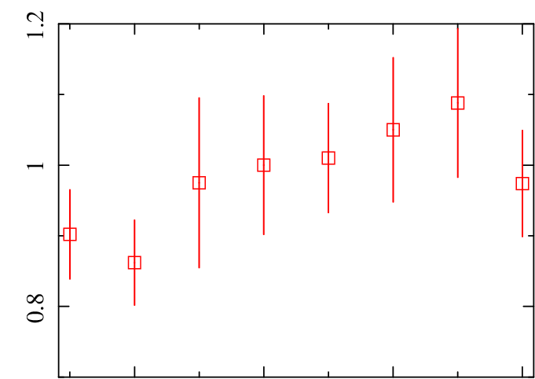
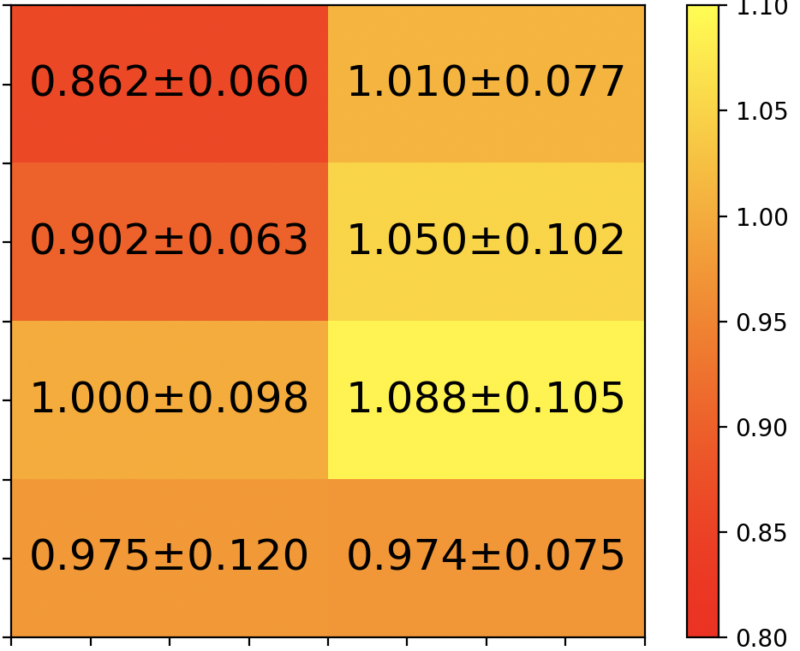
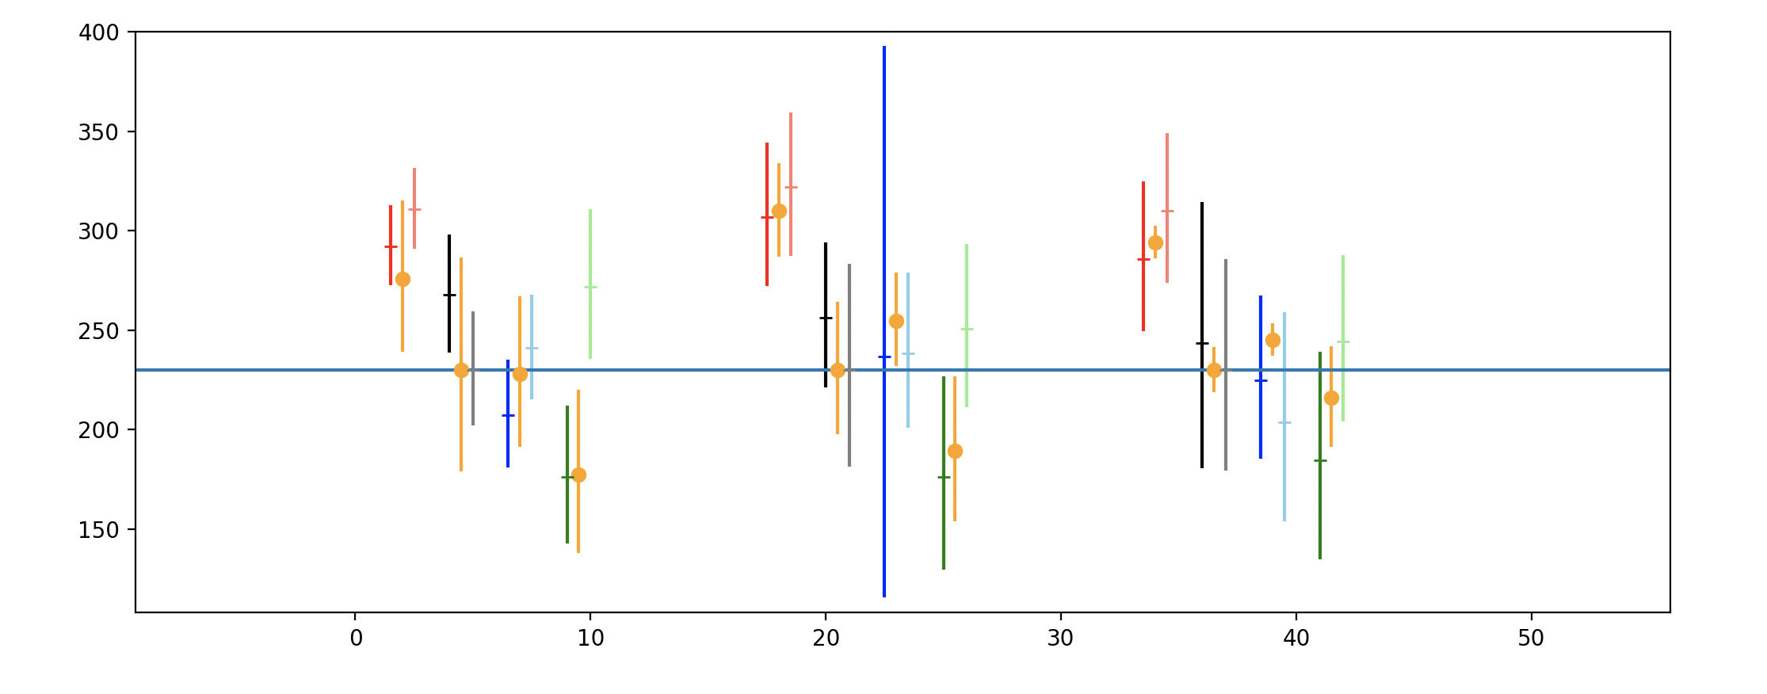
Contamination – Off-axis (2/2)
No spatial variation of N/O ratio other than CCD1
No OBL thickness variation though Dec. 2023 to Feb. 2024 ⬄ No contamination on entire FoV
CCD1_AB
CCD1_CD
CCD2_AB
CCD2_CD
CCD3_AB
CCD3_CD
CCD4_AB
CCD4_CD
CCD
NO ratio normalized to CCD2CD (aim point segment)
400
1CD
3AB
1AB
3CD
300
OBL thickness [nm]
Normalized NO ratio
2CD
4AB
200
aim point segment
2AB
4CD
AB
CD
AB
CD
AB
CD
AB
CD
2023-12
2024-01
2024-02
CCD1
CCD2
CCD3
CCD4
by Aoki-san & Higuchi-san
Notes:
Then, we confirmed that no spatial variation of the N/O ratio is seen in the Xtend day earth other than CCD1.
Also, we estimated the OBL thicknesses from the N/O ratio.
If contaminants piled up on the CCD, the effective thickness should increase.
We see no significant increase for each CCD segments through December 2023 to February 2024.
This indicates that no contamination is piled up on entire FoV, as we hoped.

Slide 9
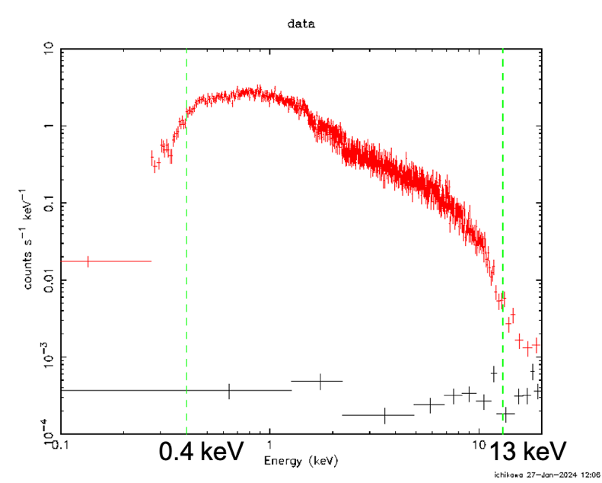
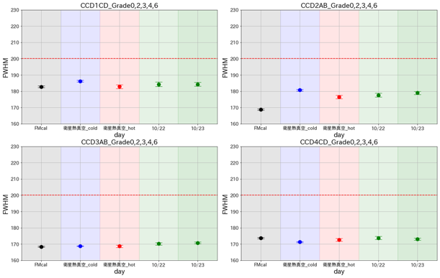
Energy range and Energy resolution
3C273
by Miyazaki
by Ichikawa-san
Effective energy band of 0.4 – 13keV has been verified.
Energy resolution meets requirement of <200eV @ 6keV.
Notes:
Energy range and energy resolution.
The sensitivity requirement is through .4 to 13 keV.
This is clearly satisfied as we see in the example of 3C273 spectrum.
The energy resolution is required to be better than 200 eV at 6 keV.
This is the FWHMs of Manganese K alpha line of the calibration source installed in Xtend,
through ground to on-orbit.
Xtend has 4 CCDs with 8 logical segments and here we show 4 segments as examples.

Slide 10
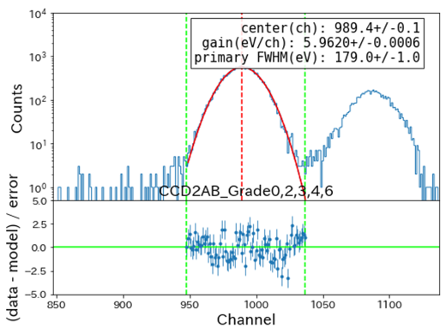
Energy range and Energy resolution
3C273
by Miyazaki
by Ichikawa-san
Effective energy band of 0.4 – 13keV has been verified.
Energy resolution meets requirement of <200eV @ 6keV.
Notes:
And this is the actual spectrum of the calibration source.
We confirmed that all the segments meet the requirement.

Slide 11
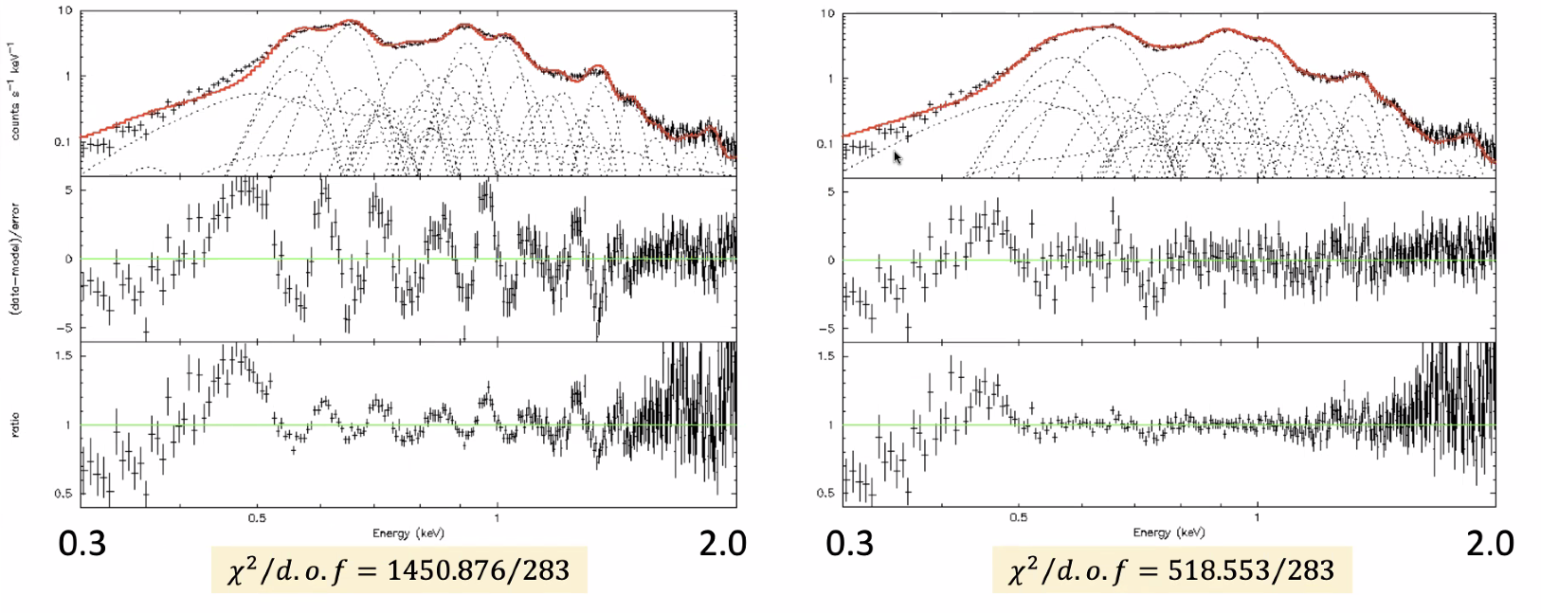
Response (1/2)
Latest CALDB (rmfparam)
xa_xtd_rmfparam_20190101v004.fits
ASTRO-H/SXI rmfparam
xa_xtd_rmfparam_20190101v002.fits
by Shima-san
E0102 spectrum is fitted using IACHEC model.
If you apply the response file made using the latest CALDB “rmfparam” to data,
it does NOT reproduce line widths adequately (too narrow compared with the data).
When you run xtdrmf, specify ”xa_xtd_rmfparam_20190101v002.fits” (ASTRO-H/SXI version).
Notes:
For the response we visit E0102 again.
We constructed the initial RMF for Xtend with the results of the ground test.
However, this RMF gives a significant residuals for E0102 with the IACHEC model on orbit.
We thus tested the Hitomi RMF and found that it fits better, although low-energy residuals remain.
We are now working hard to optimize the RMF.
If you analyse the early-release data of Xtend, you’d better to use the Hitomi response temporary.

Slide 12
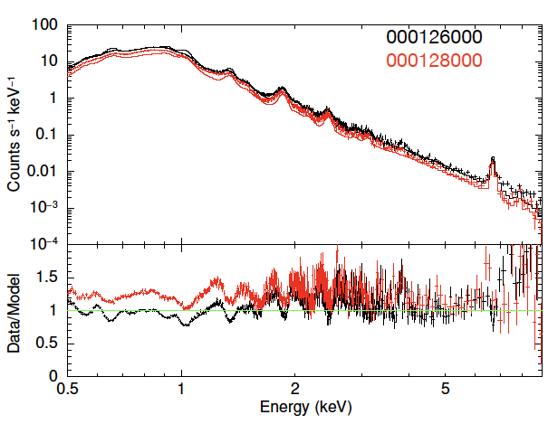
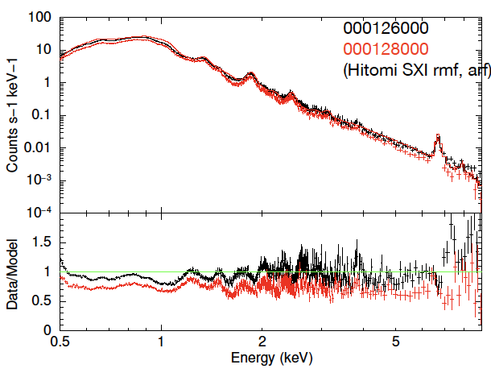
Response (2/2)
Latest CALDB (rmfparam)
xa_xtd_rmfparam_20190101v004.fits
ASTRO-H/SXI rmfparam
xa_xtd_rmfparam_20190101v002.fits
※no fitting
※no fitting
by Suzuki-san
IACHEC model is compared with N132D data (note that the model is not fitted).
The same trend can be recognized as E0102 data.
Notes:
And this is confirmation for the trend with other source, N132D, also the SNR.
The same trend is recognized as E0102.

Slide 13
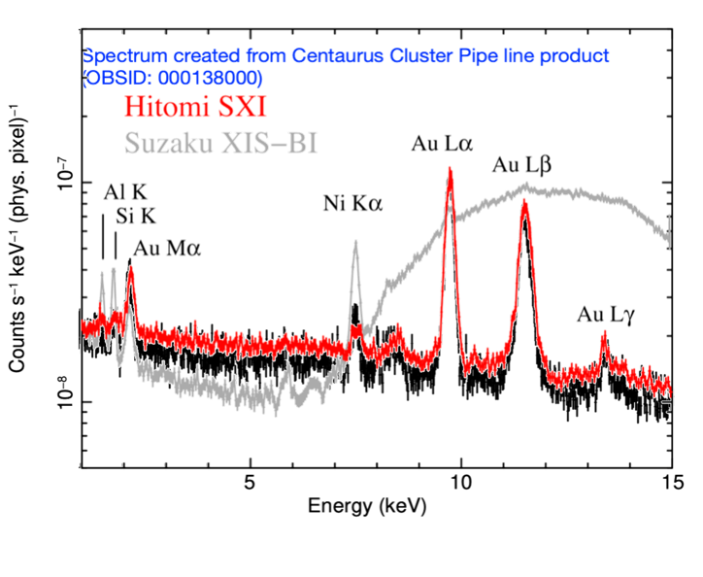
Non-X-ray Background (1/2)
XRISM/SXI (ObsID:000138000, PL product)
Preliminary
by Suzuki-san (on-site!)
Confirmed almost the same intensity as that of Hitomi/SXI.
Sky background intensity (measure of sensitivity for extended targets)
should be also the same level as that of Hitomi.
Notes:
This is the non-X-ray background of Xtend compared mainly to Hitomi SXI.
It is confirmed that almost the same intensity is given as Hitomi.
We have not confirmed yet, but we expect that the CXB should also be the same level as Hitomi.

Slide 14
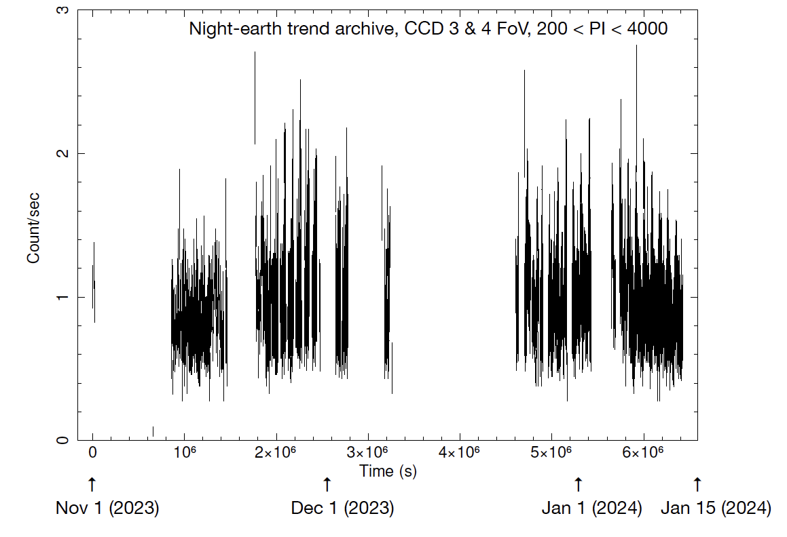
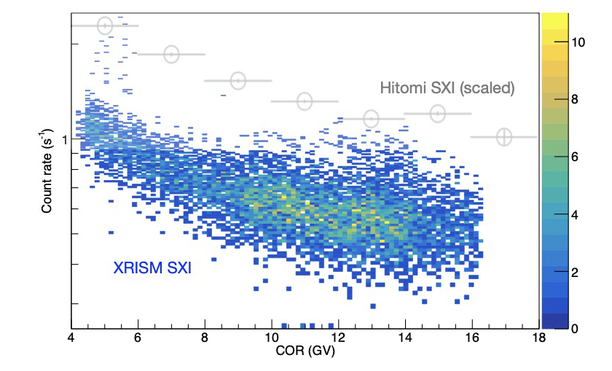
Non-X-ray Background (2/2)
Preliminary
Preliminary
by Suzuki-san (on-site!)
Background level is stable even in high solar activity period.
COR dependence is similar to Hitomi.
Notes:
And this is the time variability of the NXB counts taken from the night earth observations.
Recently the Sun is active and sometimes causes the magnetic storm. But the Xtend NXB is stable.
Also, the cut-off rigidity dependence of the NXB is similar to Hitomi.
The Xtend NXB is evaluated mainly by Suzuki-san there.
So you’d better to ask any questions of NXB to him rather than me.

Slide 15
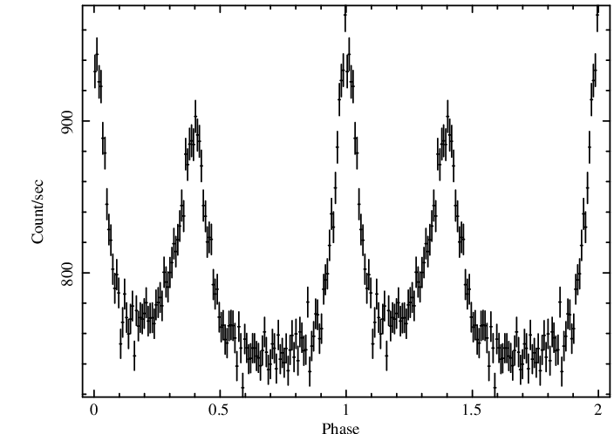
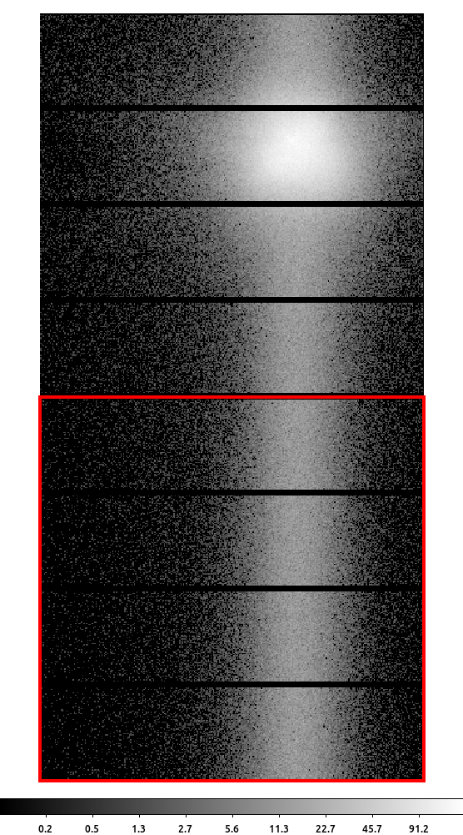
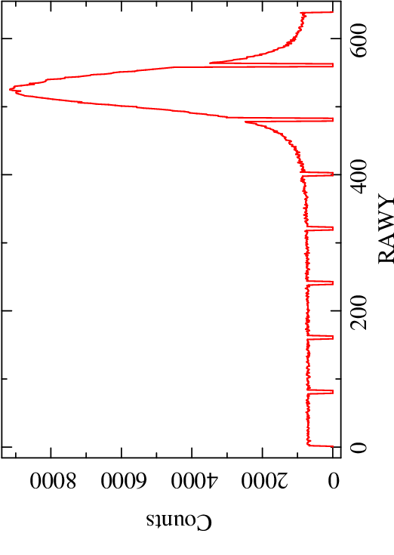
Timing Accuracy (1/2)
Xtend regularly has maximum timing resolution of 0.1 s (burst mode)
RAWY positions of out-of-time events detected during frame transfer have timing information
Timing resolution of OoT events is 5.76e-5 s = 1-line vertical transfer time
Absolute timing accuracy is verified with OoT events of the 5 Crab observations
See Terada-san’s report for detail (e.g. the Crab ephemeris and Resolve results)
Folded light curve
Crab
OoT events
Preliminary
by TY
Notes:
The final item is the timing accuracy.
Xtend regularly has maximum resolution of .1 second with the burst mode.
So we should perform a tricky analysis utilizing the out-of-time events of the Crab observations.
With this procedure we achieve about 60 micro-sec of resolution.
And the pulse profile of the Crab is successfully obtained.
The phase zero is defined by the radio ephemeris.
You see that the main peak is roughly aligned to radio.

Slide 16
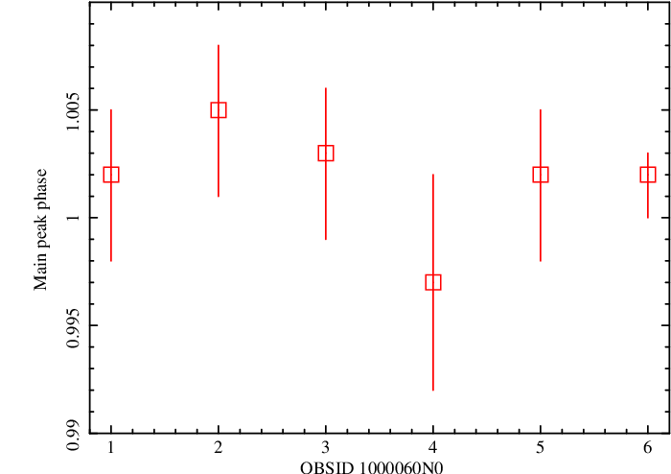
Timing Accuracy (1/2)
OBSID vs. Main peak phase
All obs. align on the radio peak
Merged data align on 1.002
Resolve data align on phase ~ 0.99
Phase difference of 0.012 between Xtend and others corresponds to 0.41 ms
=> Absolute timing accuracy of Xtend is ~ 0.4 ms
Although a preliminary result, the requirement of 10 ms is satisfied
Xtend average
Preliminary
Radio
Resolve
Merged
by TY
Notes:
This is the main peak phase for the 5 observations of Xtend and the merged data of the five.
It is known that the X-ray peak is forward about 1% from the radio.
Resolve data confirms this, but Xtend is slightly shifted behind.
This delay corresponds to .4 milli-second of uncertainty.
Although this is the preliminary result, we can conclude that the absolute timing accuracy of Xtend is about .4 ms.
This is far better value than the requirement of 10 ms.
The timing calibration including Resolve is reported by Terada-san, so you will see more detail there.

Slide 17
Summary
Xtend on-orbit calibration is in progress
All requirements are satisfied
Enjoy Xtend data!
Notes:
Allright, this is the summary.
We are glad to say that everything is going well. All requirements are satisfied.
We hope everyone enjoy the Xtend data as well as Resolve.
Xtend have already achieved several scientific results for X-ray transients via an on-ground alert system.
This is presented by Marina just after this talk. So stay tuned.
Gracias!

