Slide 1
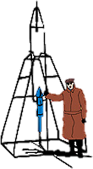
IACHEC May 2024
Cas A Whole-Remnant Useful Model Craig Markwardt (NASA/GSFC) & Andy Beardmore (U. Leicester)
GSFC

Slide 2
Motivations
Useful to have a quick way to model the entire Cas A remnant
Quick way to confirm energy scale
Swift XRT using to track charge traps
Compare response to spectral “shape”
Reference model for instruments with low spectral or imaging resolution
Caveats
Not an absolute flux calibration
Will be aperture dependent
Extraction of NuSTAR & XMM data in 2020; calibration has been revised since then

Slide 3
The Model
Andy Beardmore started out as “3 brems + pow + lines”
Craig tried to make more physical and apply to NICER and it snowballed from there
srcut-like supernova model using mdefine
Fixed ɑ=0.77, fbreak=3.1 x 10¹⁷ Hz (Reynolds & Keohane 1999)
Mdefine version removes segfault error associated with srcut when doing gain fitting
2 brems
kT=0.6 & kT=2.2 keV, similar to other science papers (Reynolds & Keohane 1999)
20 gaussians - to match all line-like features seen in NICER
Model
tbvarabs*( const*(srcutmod+brems+brems) + const*(0.6-5.5 keV lines) + const*(5.5-8.5 keV lines))
tbvarabs - only Ne abundance varying - nH ~ 1.1e22
Three const’s, allowing fitting of continuum, low energy lines and high energy lines separately
Const norms are fixed to 1 for NICER
Line centroids fixed by NICER
Some other missions have “gain fit” to adjust energy scale to match

Slide 4
The Lines
0.650 keV = O
0.825 keV = O
0.913 keV = O
1.021 keV = Ne
1.340 keV = Mg
1.460 keV = Mg
1.850 keV = Si
1.998 keV = Si
2.182 keV = Si
2.340 keV = Si?
2.445 keV = S
2.619 keV = S
2.893 keV = S
3.116 keV = Ar
3.880 keV = Ca
6.599 keV = Fe Ka
7.470 keV = Ni Ka
7.735 keV = Ni Ka / Fe Kb
8.235 keV = Ni Kb / Fe Kg
Avoiding the Ti44 lines!

Slide 5
The Data
NICER - 0.24-18 keV - processed in 2024
Diffuse radial profile ARF
XMM EPIC pn - 0.3-10 keV - processed in 2020
141” extraction radius - diffuse ARF
4’ extraction radius - diffuse ARF
XMM EPIC MOS - 0.3-10 keV - processed in 2020
141” extraction radius (small window) - diffuse ARF
Swift XRT - 0.3-10 keV - 2005 WT mode data processed in 2024
Effective extraction box size 2.4’x4.7’ (half width x half height)
RXTE PCA - 2-30 keV - processed in 2024 with new ARF calculator
NuSTAR FPMA/B - 3-30 keV - processed in 2020
4’ extraction radius - diffuse ARF
Swift BAT - 15-45 keV - processed in 2020
BAT 157 month survey - crab-weighted - only first three energy bins

Slide 6
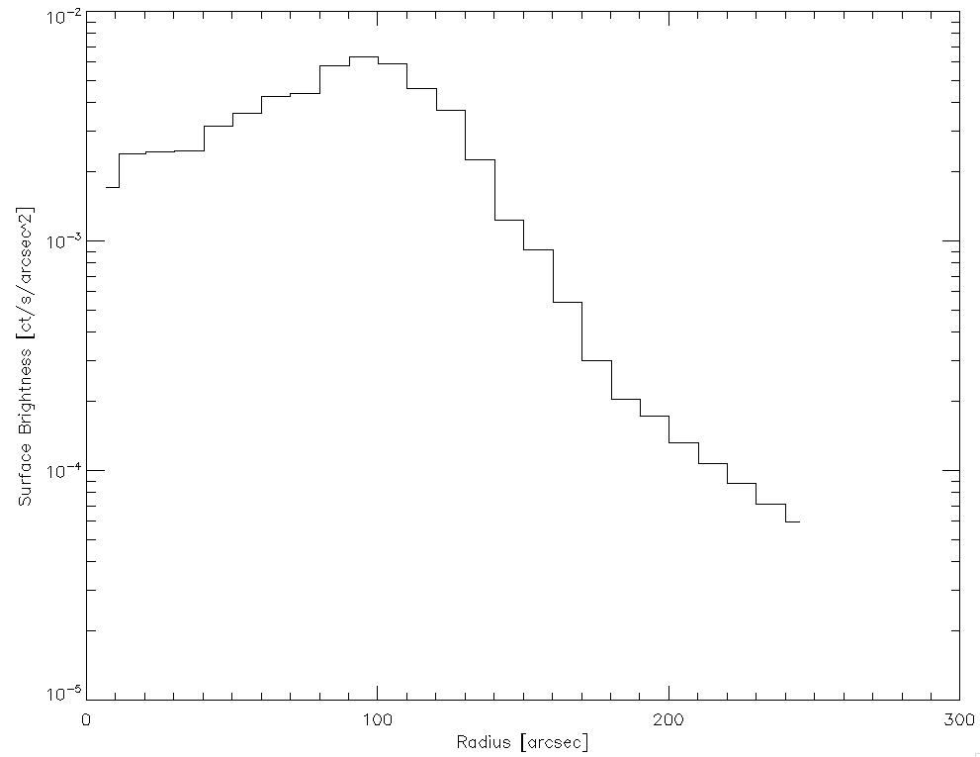
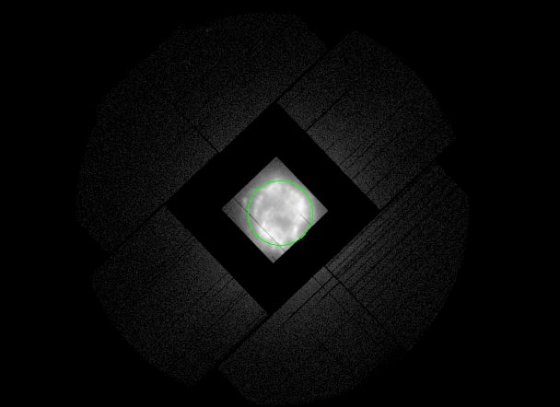
Data Oddities
Chandra Surface Brightness Profile
XMM EPIC MOS - Small Window Mode
141” Radius
Approx NICER Vignetting Curve
NICER single-pixel FOV (~180” HWHM) doesn’t quite capture remnant - used Chandra radial surface brightness profile to calculate ARF for “entire remnant”
XMM EPIC MOS data is in small window mode -> 141” radius region
XMM EPIC pn extracted with both 141” and 240” radius regions, allow comparison

Slide 7
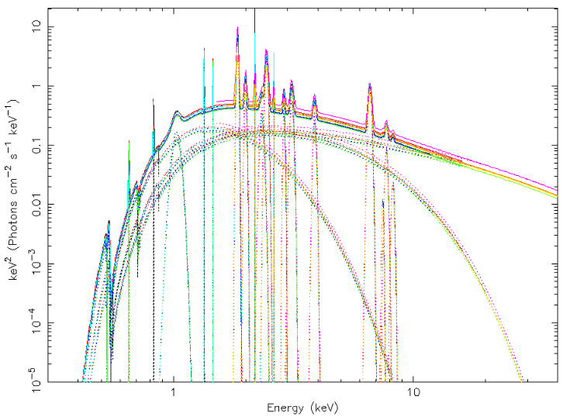
The Model

Slide 8
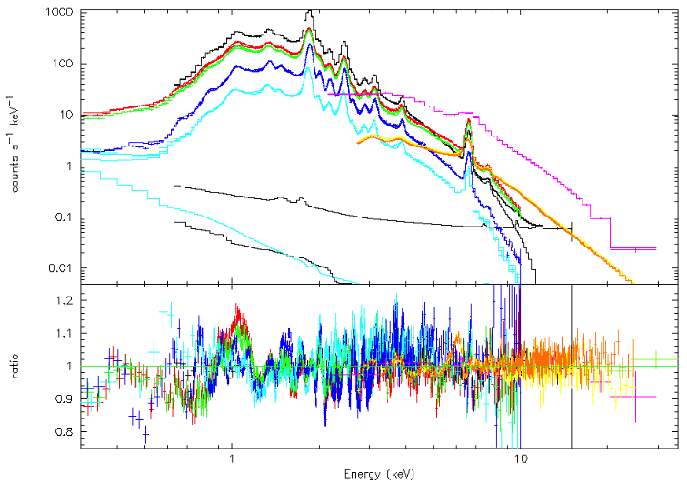
Multi-Mission Fit
NICER, XMM EPIC pn, XMM EPIC MOS, Swift XRT (WT), RXTE PCA, NuSTAR, Swift BAT

Slide 9
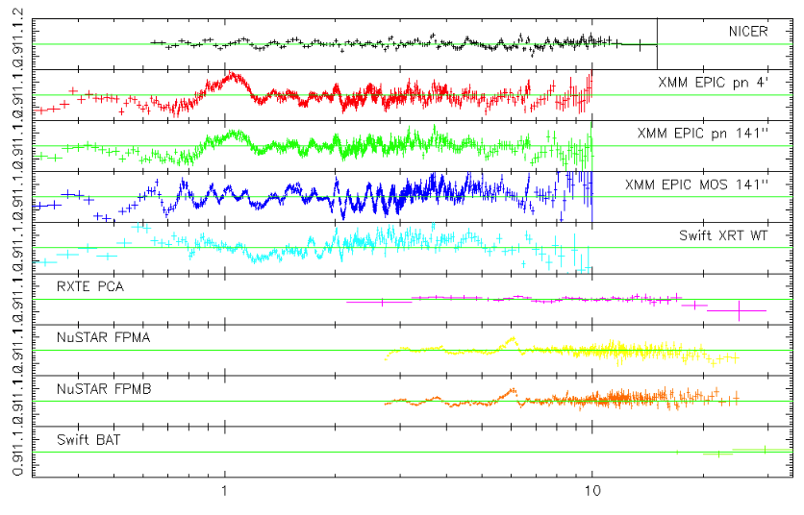
Per-Mission Residuals

Slide 10
Summary of Fitted Results
 | Energy Range (keV) | Cont Norm | Low E Line Norm | High E Line Norm | Gain Shift (eV) | Region Size | Analysis Vintage
NICER XTI | 0.6-18 | 1 | 1 | 1 |  | ~180” radius | 2024
XMM EPIC pn | 0.3-10 | 1.058 | 0.812 | 1.043 |  | 240” radius | 2020
Swift XRT (WT) | 0.3-10 | 0.992 | 0.932 | 1.044 | -11 |  | 2024
XMM EPIC pn | 0.3-10 | 0.877 | 0.745 | 0.883 |  | 141” radius | 2020
XMM EPIC MOS | 0.3-10 | 0.908 | 0.812 | 0.959 | +13 | 141” radius | 2020
RXTE PCA | 2.2-30 | 1.223 | 1.257 | 1.213 |  | 1 degree radius | 2024
NuSTAR FPMA | 3-30 | 0.972 | 0.648 | 0.881 | -16 | 240” radius | 2020
NuSTAR FPMB | 3-30 | 1.002 | 0.596 | 0.907 | -44 | 240” radius | 2020
Swift BAT | 15-45 | 0.893 | 1 | 1 |  | Point (~15’) | 2020
Full
Partial
High Energy

Slide 11
Fluxes
 | 0.5-1 | 1-2 | 2-5 | 5-8 | 8-15 | 15-35 | Region Size
NICER XTI | 0.60 | 7.6 | 8.2 | 1.87 | 9.9 |  | ~180” radius
XMM EPIC pn | 0.61 | 7.3 | 7.9 | 1.97 | 9.5 |  | 240” radius
Swift XRT (WT) | 0.59 | 7.4 | 7.9 | 1.88 | 6.6
XMM EPIC pn | 0.51 | 6.3 | 6.8 | 1.64 | 7.9 |  | 141” radius
XMM EPIC MOS | 0.54 | 6.6 | 7.1 | 1.72 | 6.0 |  | 141” radius
RXTE PCA |  |  | 10.1 | 2.29 | 10.1 | 5.5 | 1 degree radius
NuSTAR FPMA |  |  | 7.0 | 1.77 | 8.7 | 4.4 | 240” radius
NuSTAR FPMB |  |  | 7.0 | 1.83 | 9.0 | 4.5 | 240” radius
Swift BAT |  |  |  |  |  | 4.0 | Point (~15’)
Full
Partial
High Energy
(units of 1 x 10⁻¹⁰ erg/s/cm²)

Slide 12
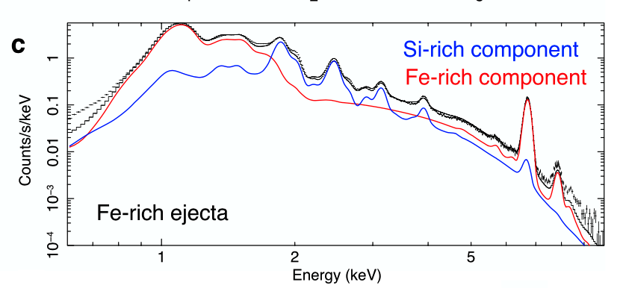
Discussion & Conclusions
Difficult to craft Cas A into a standard candle without reconciling the spatial and spectral variations across the remnant
~200” radius seems to be the minimum to capture the “full” remnant
RXTE PCA has ~20-25% higher fluxes and the 1 degree aperture
PCA is now within ~10% of other missions for point-like targets, so not clear how this can be understood
Model is suitable for data taken with solid state detectors in 0.5-30 keV range
Grating and calorimeter data will be a whole new view
Not the final version, there is probably still some work to do
Example, const multiplier should tie Fe K and L lines versus low Z lines, instead of by energy
Sato et al 2020 (Nature)

