Slide 1
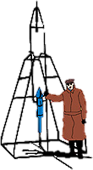
IACHEC May 2024
Crab Reference Model Craig Markwardt (NASA/GSFC)
GSFC

Slide 2
Motivations
Most observers use an absorbed power law for Crab nebula+pulsar observations tbabs * pow
Pro
It’s simple
It does work well >2 keV
Con
Doesn’t work as well at lower energies
We know that the pulsar and nebula have distinct spectra (Kuiper 2000)
Nebula has spatial variations (Mori et al 2001)
Would be nice to have a Crab reference model that covers larger range of energies and can distinguish contributions from nebula and pulsar
Goal: support X-ray observations in the 0.1-100 keV band
Recognize that for energy band < 2 keV absorption model matters
Recognize that dust scattering can be important
Timing studies can separate pulsar from nebula

Slide 3
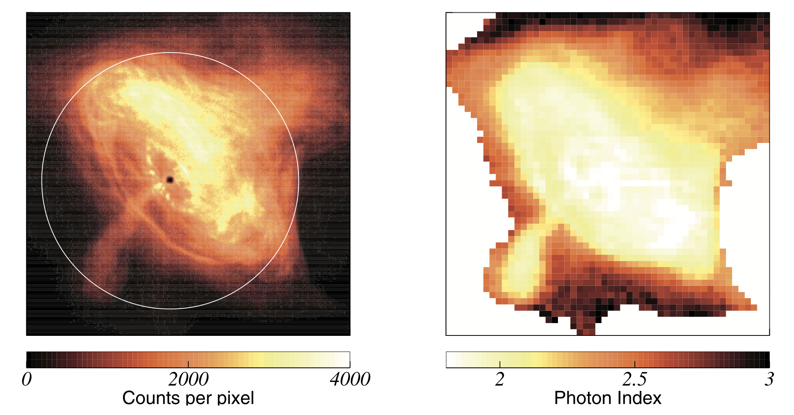
Spatial Variations
Mori et al (2001) Chandra

Slide 4
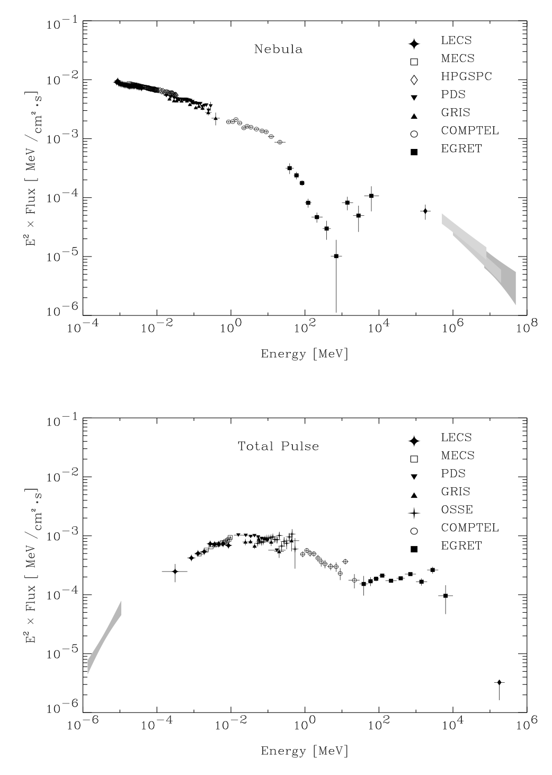
Crab Pulsar Versus Nebula
In band of interest, behavior of pulsar & nebula are pretty simple
But the sum is not really a simple power law
Kuiper 2000

Slide 5
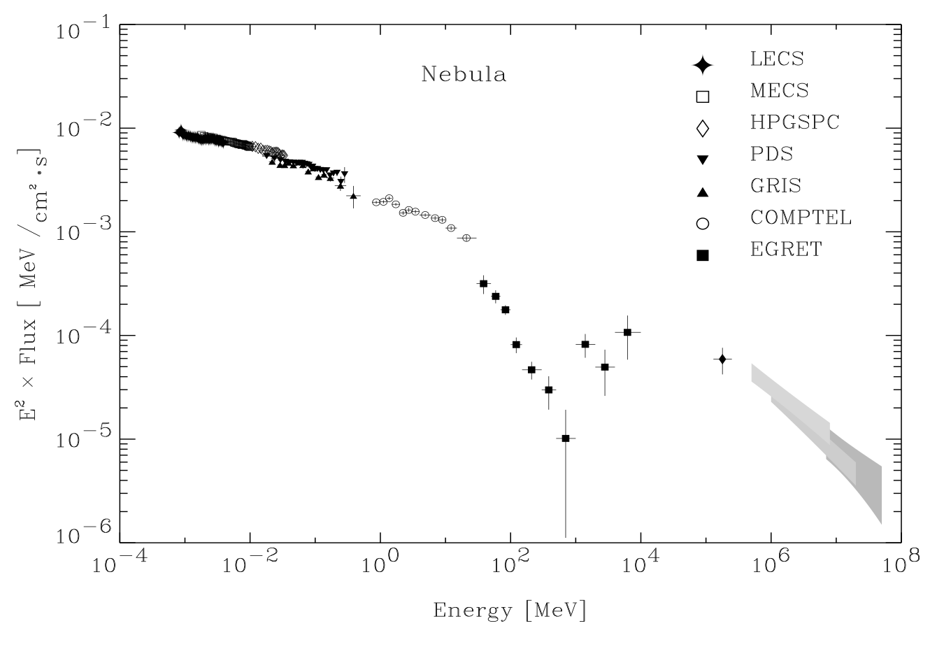
Proposal: Kaastra et al Model
Pulsar model (Kaastra fitting of Kuiper data)
Nebula model
At high energies, Kaastra uses a pure power law
RXTE PCA 2-60 keV residuals want some curvature at higher energies
>15 keV energy instruments (HEXTE, BAT) want steeper power law index
Kuiper indicates curvature
Not sure how to treat curvature
At low energies, “curvature correction”

Slide 6
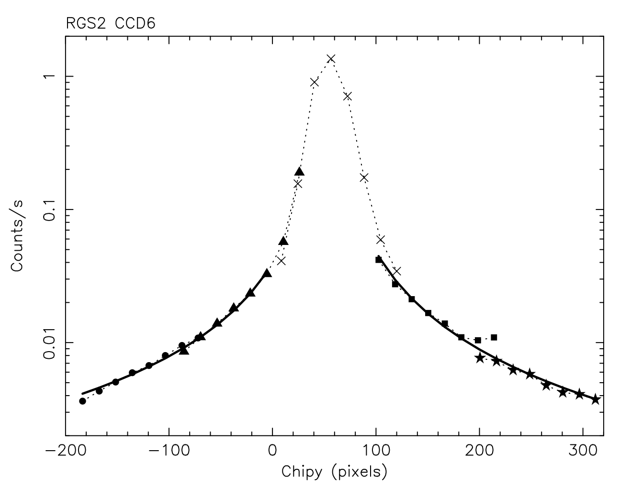
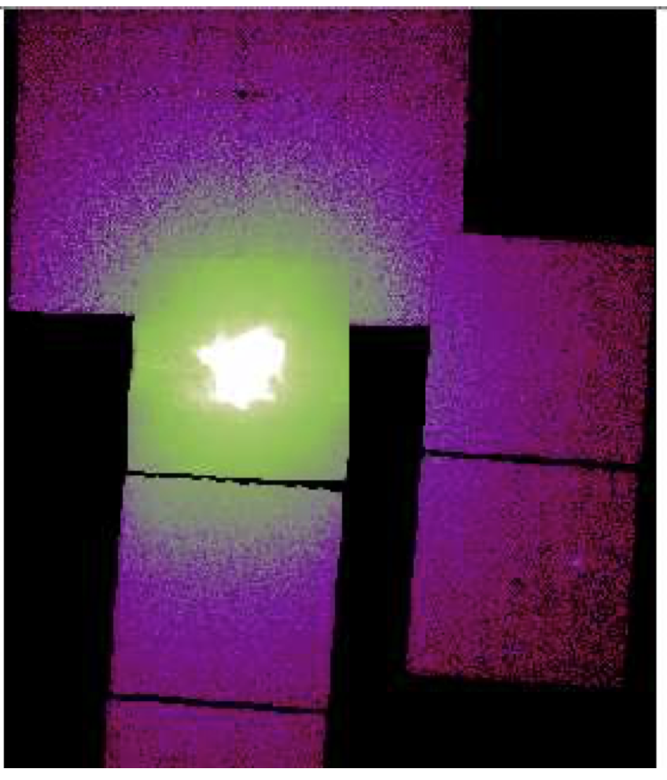
Dust is Important
Kaastra et al 2009
Seward et al 2005
Chandra dust halo detectable out to 30 arcmin
Direct emission is scattered out of line of sight by dust
In-FOV spectrum affected by aperture size

Slide 7
Craig’s Proposed Model
XSPEC model model TBvarabs*xscat*(curv*powerlaw + crab_pulsar) Absorption Dust Nebula Pulsar mdefine crab_pulsar (726*e^(-1.276)exp(-0.07*ln(e)^2)+1464*e^(-1.165)exp(-0.159*ln(e)^2)+2021*e^(-2.022))/10000 : add Crab pulsar model (Kaastra / Kuiper) mdefine curv (1.0+p1*exp(-e/p2)) : mul Curvature (Kaastra / Mori)

Slide 8
Absorption Parameters
Model Model Component Parameter Unit Value
par comp
1 1 TBvarrabs nH 10^22 0.345220 +/- 0.0
5 1 TBvarrabs O 1.07651 +/- 0.0
6 1 TBvarrabs Ne 1.30440 +/- 0.0
16 1 TBvarrabs Fe 0.600000 +/- 0.0
43 2 xscat NH 10^22 0.223362 +/- 0.0
44 2 xscat Xpos 0.200000 frozen
45 2 xscat Rext arcsec 200.000 frozen
46 2 xscat DustModel 1 frozen
Recommendations:
nH should be free parameter
Might be good to reframe relative abundance as absolute to match RGS results
Dust scattering absorption should be ~half neutral absorption
“Rext” is the aperture size and depends on selection/detector aperture radius

Slide 9
Crab Pulsar & Nebula Components
Model Model Component Parameter Unit Value
par comp
47 3 curv p1 0.410000 frozen
48 3 curv p2 0.460000 frozen
49 4 powerlaw PhoIndex 2.11001 +/- 0.0
50 4 powerlaw norm 9.27043 +/- 0.0
51 5 crab_pulsarnorm 1.00000 frozen
Recommendations:
Curvature p1 & p2 should probably be fixed at Kaasta/Mori numbers
Power law: add curvature (log-parabolic?)
Crab pulsar norm should probably be fixed when combining nebula+pulsar
Note: for detectors with >2 keV response and a simple powerlaw (no curvature or pulsar), the fitted power law index is steeper by about 0.05

Slide 10
Discussion

