Slide 1
White dwarf (WD) and Isolated Neutron Star (INS) Working Group
Vadim Burwitz (MPE) on behalf of the working group
16th IACHEC Meeting,
El Parador de la Granja de San Ildefonso, Segovia Spain
May 14, 2024
16th IACHEC Meeting, La Granja de San Ildefonso, Segovia, Spain, May 14, 2024

Slide 2
Working Group members
Vadim Burwitz (chair, Chandra LETG)
Jelle Kaastra (Chandra, Modeling)
Herman Marshall (Chandra)
Norbert Schulz (Chandra)
Vinay Kashyap (Chandra)
Brad Wargelin (Chandra)
Jeremy Drake (Chandra)
Jelle de Plaa (XMM RGS)
Craig Markwardt (NICER)
Vadim Burwitz (Chandra)
Tadayasu Dotani (Suzaku)
Eric Miller (Suzaku, XRISM)
Konrad Dennerl ( XMM pnCCD, eROSITA)
Michael Freyberg ( XMM pnCCD, eROSITA)
Steve Sembay
New Team Members for EP
TBD
16th IACHEC Meeting, La Granja de San Ildefonso, Segovia, Spain, May 14, 2024

Slide 3
Goals of the Working Group
Identify and characterise WD and INs standard candle objects
WDs:
HZ43
Sirius B
GD153
Objects
RX J1856.5-3754 (Work horse Spectrum)
PSR B0656+14
1RXS J214303.7+065419 (=RXJ2143) eROSITA
16th IACHEC Meeting, La Granja de San Ildefonso, Segovia, Spain, May 14, 2024

Slide 4
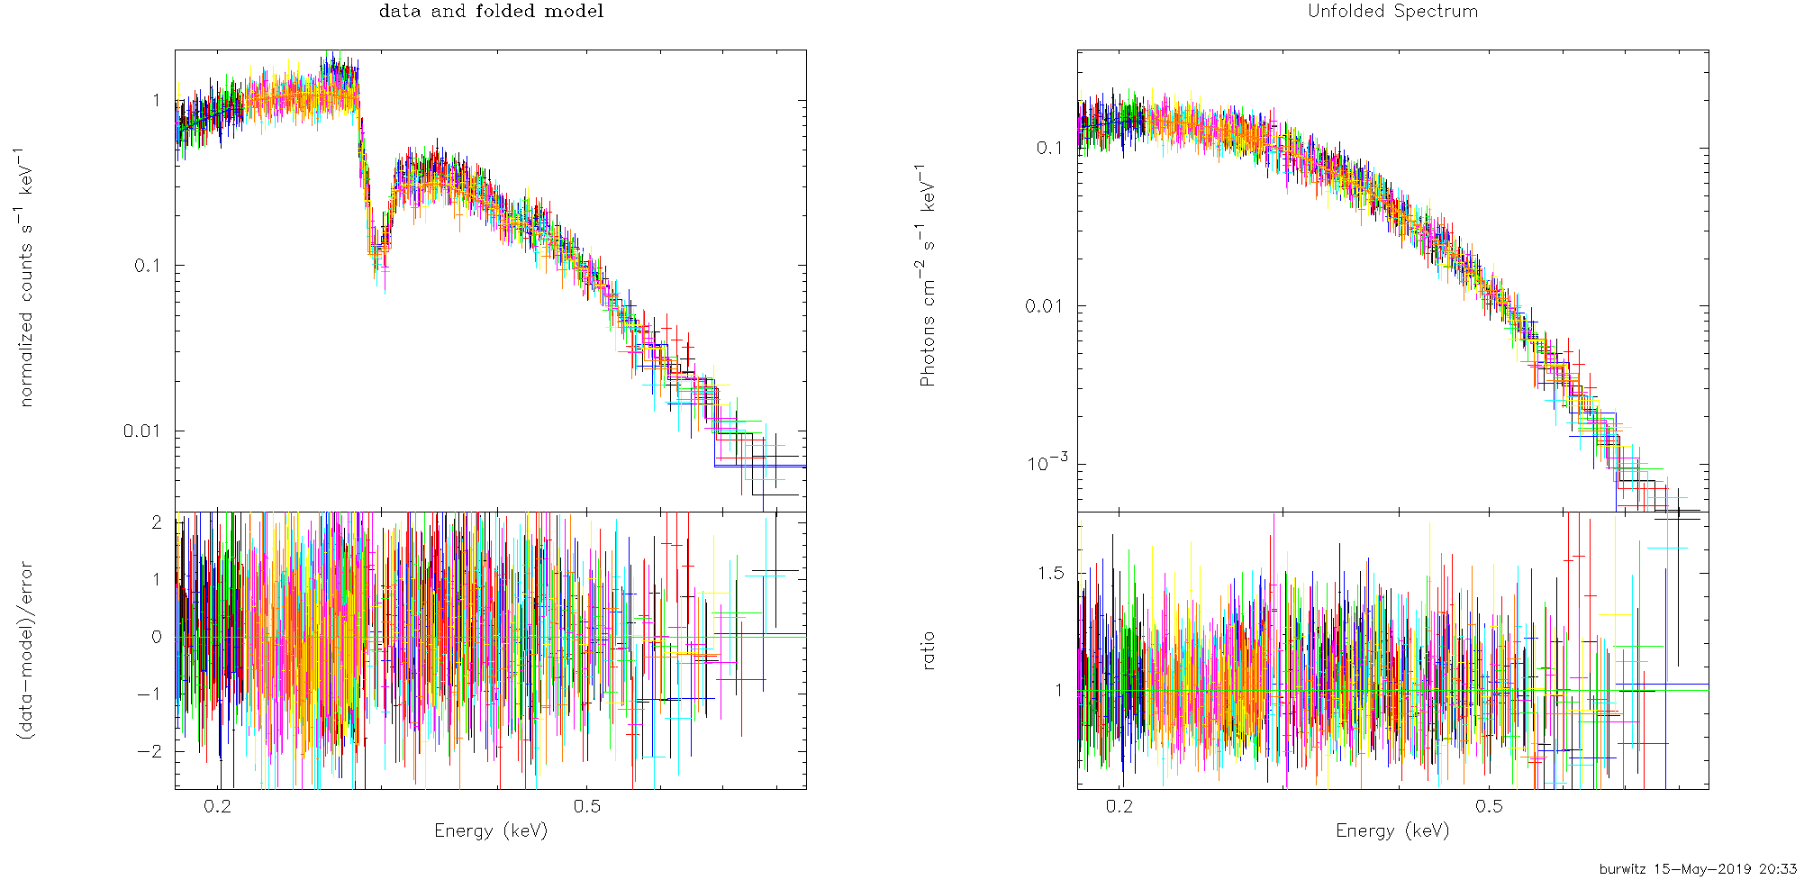
IACHEC WD + INS Wiki page
https://wikis.mit.edu/confluence/display/iachec/White+Dwarfs+and+Isolated+Neutron+Stars
16th IACHEC Meeting, La Granja de San Ildefonso, Segovia, Spain, May 14, 2024

Slide 5
RX J1856.5-3754 Current Missions Calibration Observations
Chandra: LETGS , ACIS
XMM: PN, MOS, RGS
SUSAKU: XIS
NICER
Einstein Probe
XRISM
16th IACHEC Meeting, La Granja de San Ildefonso, Segovia, Spain, May 14, 2024

Slide 6
RX J1856.5-3754 New Missions Calibration Observations
Recently Launched
XRISM 40 ksec planned (postponed, 0cts/s in GVC mode)
Einstein Probe FXT thin filter 40 ksec done last week medium filter 40 ksec planned WXT measured parallel to FXT measurements
To be launched
June 2024: SVOM MXT
16th IACHEC Meeting, La Granja de San Ildefonso, Segovia, Spain, May 14, 2024

Slide 7
Chandra Calibration
HZ 43 (Vinay Kashyap)
monitor low energy response LETG + HRC-S and HRC–I)
RX J1856.5-3754 (Herman L. Marshall)
Monitor contamination build-up on ACIS
16th IACHEC Meeting, La Granja de San Ildefonso, Segovia, Spain, May 14, 2024

Slide 8
Using HZ 43 for Chandra HRC Calibration
Vinay Kashyap (CXC/CfA)
Pete Ratzlaff (CXC/CfA), Brad Wargelin (CXC/CfA), Jeremy Drake (Lockheed-Martin)
16th IACHEC Meeting, La Granja de San Ildefonso, Segovia, Spain, May 14, 2024

Slide 9
HZ 43
DAwk White Dwarf at 60 pc, extremely soft source with most emission at λ>60Å (E<0.2 keV)
≳2.5 ct/s in HRC-I/LETG0, ≳6.5 ct/s in HRC-S/LETG0
Used for
QE (HRC-I) and QEU (HRC-S) updates at low E
Gain calibration for both HRC-I and HRC-S
PSF monitoring on both HRC-I and HRC-S
Observed at a cadence of at least once a year, plus every time there is a planned change in detector characteristics (like voltage changes)
16th IACHEC Meeting, La Granja de San Ildefonso, Segovia, Spain, May 14, 2024

Slide 10
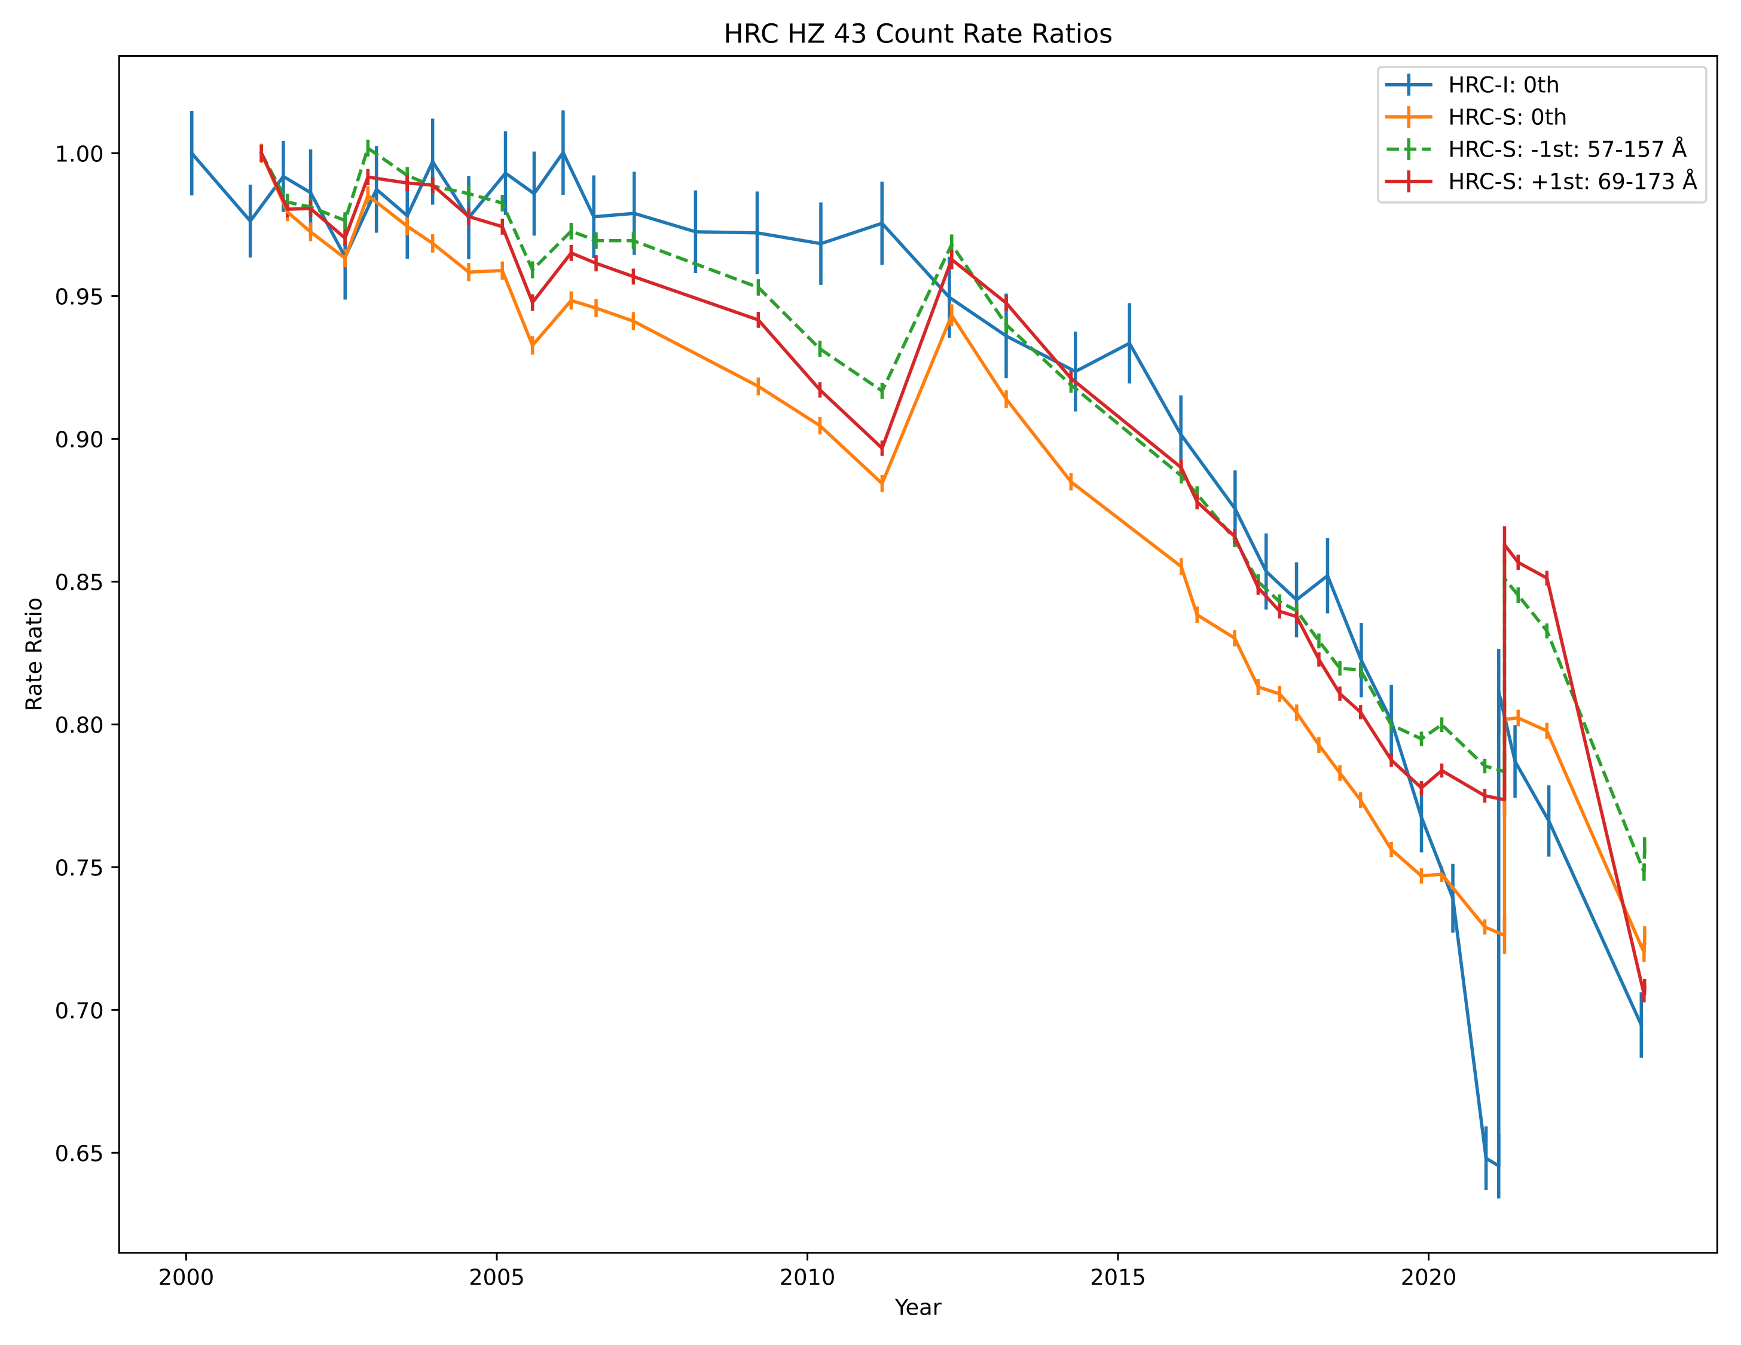
HZ 43
Countrate trends
16th IACHEC Meeting, La Granja de San Ildefonso, Segovia, Spain, May 14, 2024

Slide 11
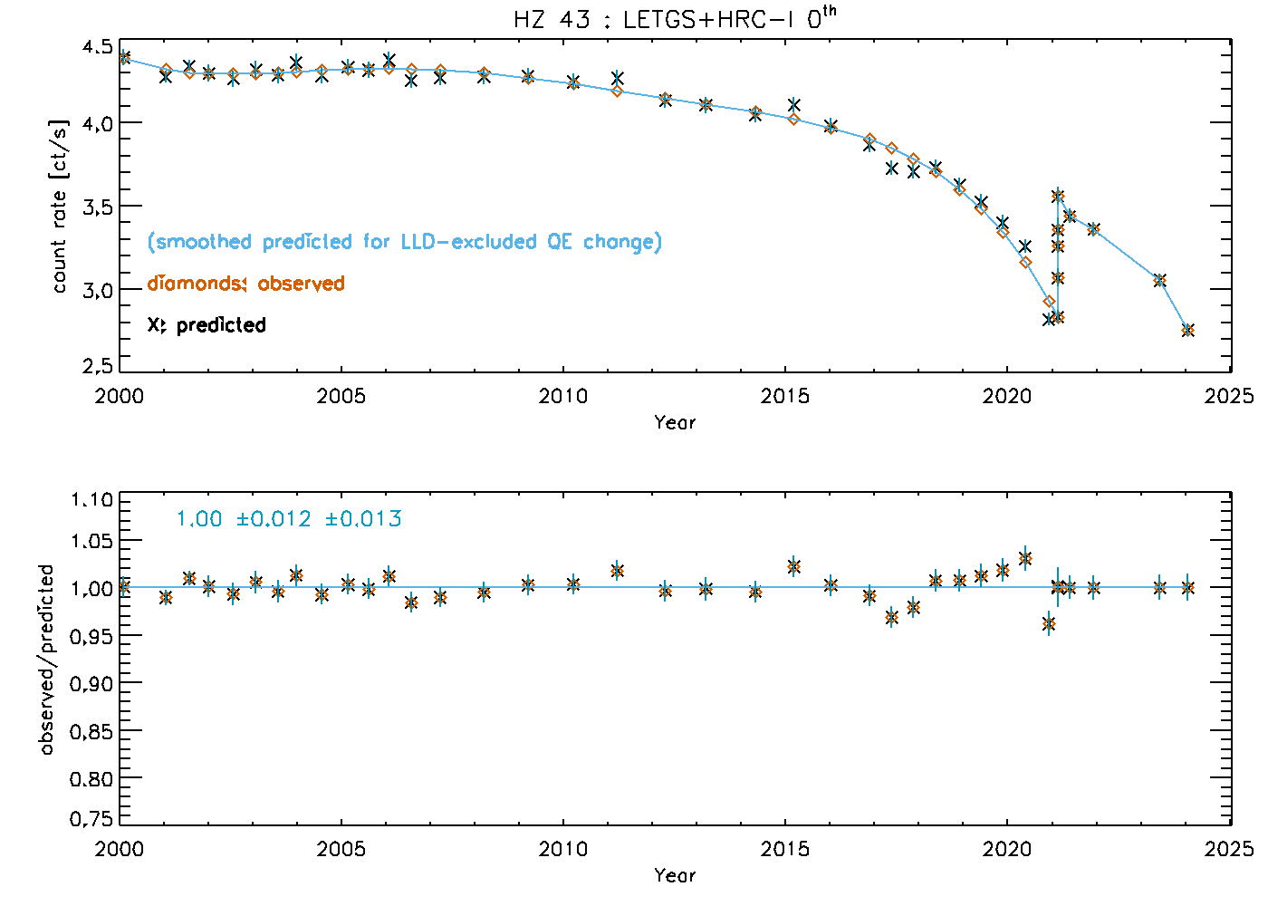
16th IACHEC Meeting, La Granja de San Ildefonso, Segovia, Spain, May 14, 2024

Slide 12
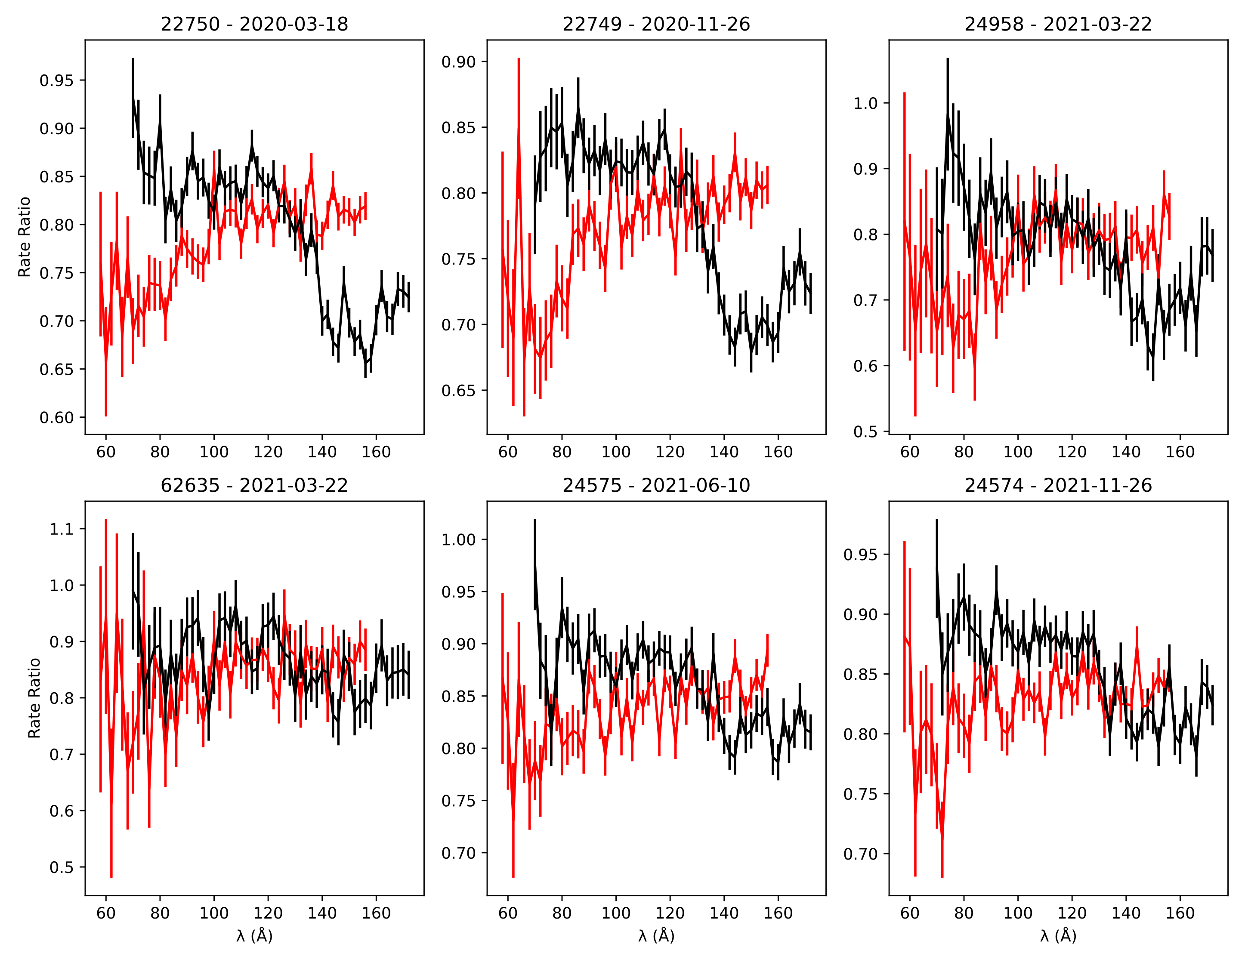

Slide 13
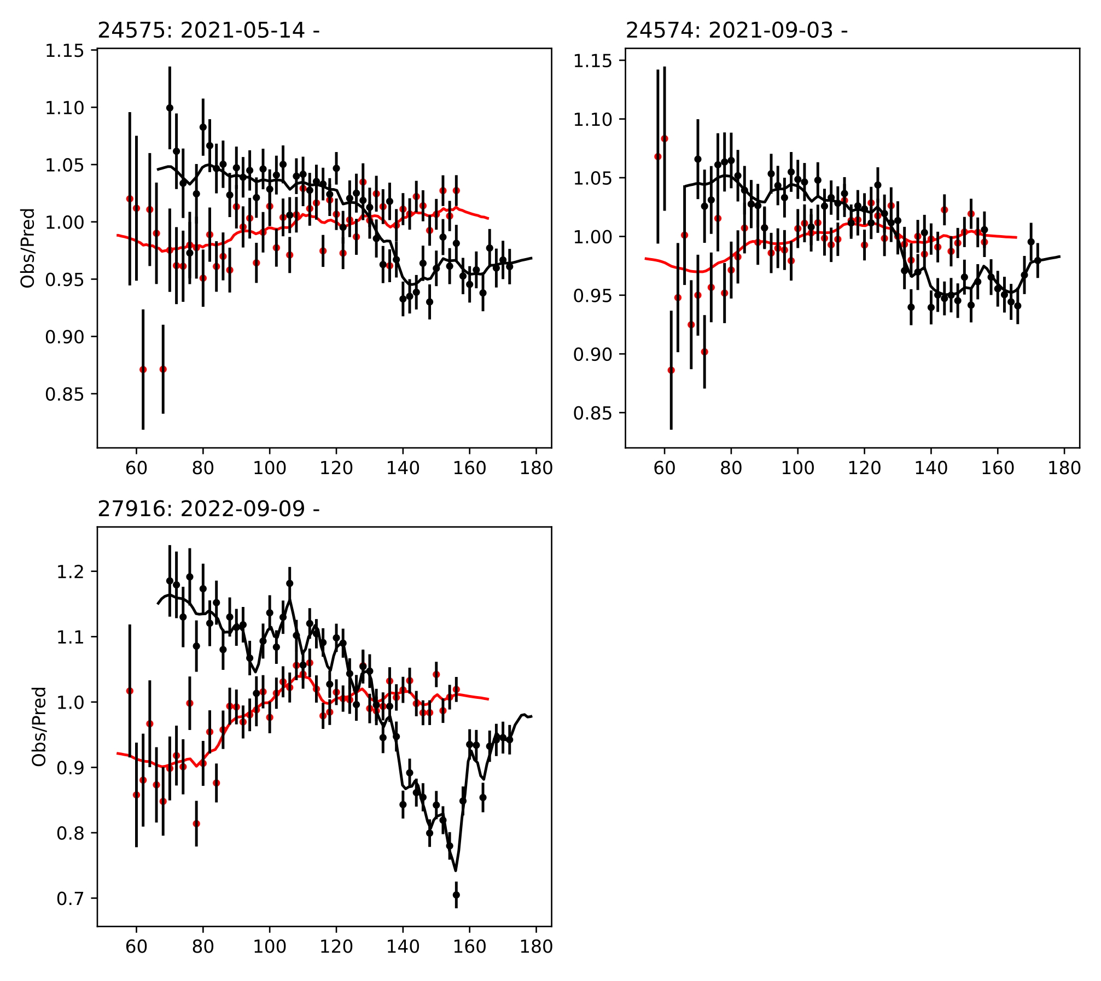
← dispersed count rate relative to 2001
CARMA fitted models after grey correction
← corrected count rates

Slide 14
Chandra ACIS contaminant update
Herman L. Marshall
16th IACHEC Meeting, La Granja de San Ildefonso, Segovia, Spain, May 14, 2024

Slide 15
Examining E < C-K
16th IACHEC Meeting, La Granja de San Ildefonso, Segovia, Spain, May 14, 2024
Herman L. Marshall

Slide 16
Contamination Corrected
Increased
exposure
16th IACHEC Meeting, La Granja de San Ildefonso, Segovia, Spain, May 14, 2024
Herman L. Marshall

Slide 17
ACIS Contamination Summary
Contaminant deposition rate continues
Increasing above the 2015-20 linear trend
Model looks good
Model does not need to be updated
Nearing limit of how useful RX J1856 is
Source is still detectable in 60 ks (5.4 sigma)
Not including extended soft X-ray ﬂux
Contaminant correction is low by 35% in 2023
16th IACHEC Meeting, La Granja de San Ildefonso, Segovia, Spain, May 14, 2024
Herman L. Marshall

Slide 18
Using RX J1856.5-3754 for improving the RMF and ARF of XMM/EPIC-pn and SRG/eROSITA Konrad Dennerl
16th IACHEC Meeting, La Granja de San Ildefonso, Segovia, Spain, May 14, 2024
Konrad Dennerl

Slide 19
Improving the ARF and RMF
ARF: „Ancillary Response File“, RMF: „Redistribution Matrix File“
observed spectrum of RXJ1856
spectral model of RXJ1856
RX J1856-3754
RMF
ARF
spectral model of 1E0102
observed spectrum of 1E0102
1E 0102.2-7219
16th IACHEC Meeting, La Granja de San Ildefonso, Segovia, Spain, May 14, 2024
Konrad Dennerl

Slide 20
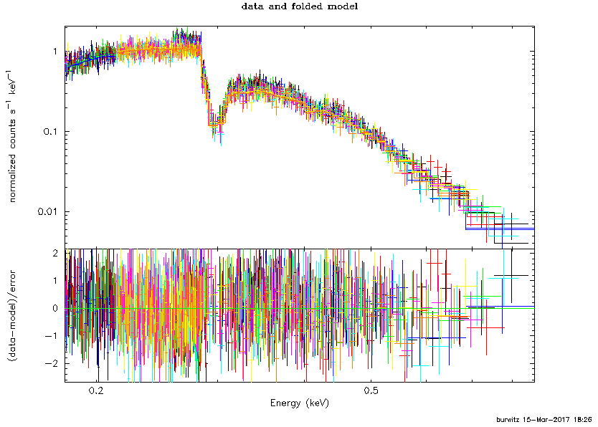
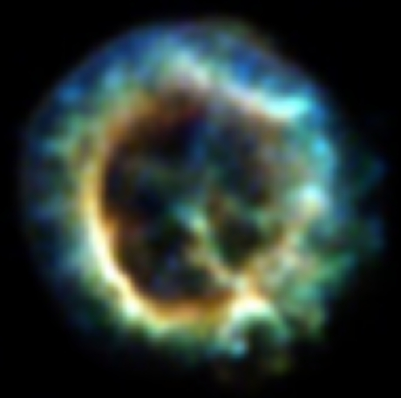
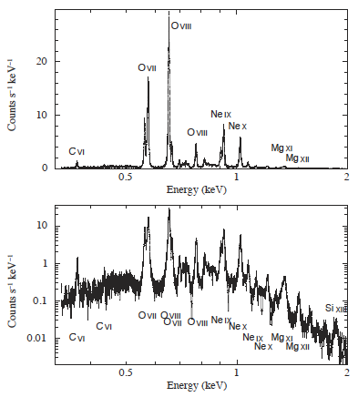
RX J1856-3754: Chandra LETGS
1E 0102.2-7219: IACHEC model
Plucinsky et al. 2017 (A&A 597)
RXJ 1856
Chandra LETGS
Χ² = 694, n_{dof} = 1251
V. Burwitz
nH = (7.2 +/- 0.3) × 10¹⁹ cm⁻² kT = 62.4 +/- 0.4 eV norm = (1.58 +/- 0.06) x 10⁵ [tbabs * bbodyrad]
16th IACHEC Meeting, La Granja de San Ildefonso, Segovia, Spain, May 14, 2024
Konrad Dennerl

Slide 21
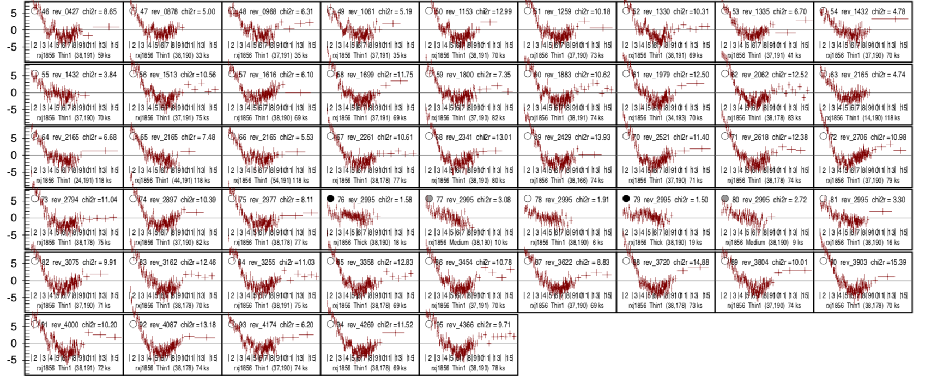
RZJ1856: XMM/EPIC-pn residuals resulting from Chandra model spectrum and RMFs/ARFs obtained with rmfgen-2.8.7 and arfgen-1.104
50 spectra covering 24 years (!)
16th IACHEC Meeting, La Granja de San Ildefonso, Segovia, Spain, May 14, 2024
Konrad Dennerl

Slide 22
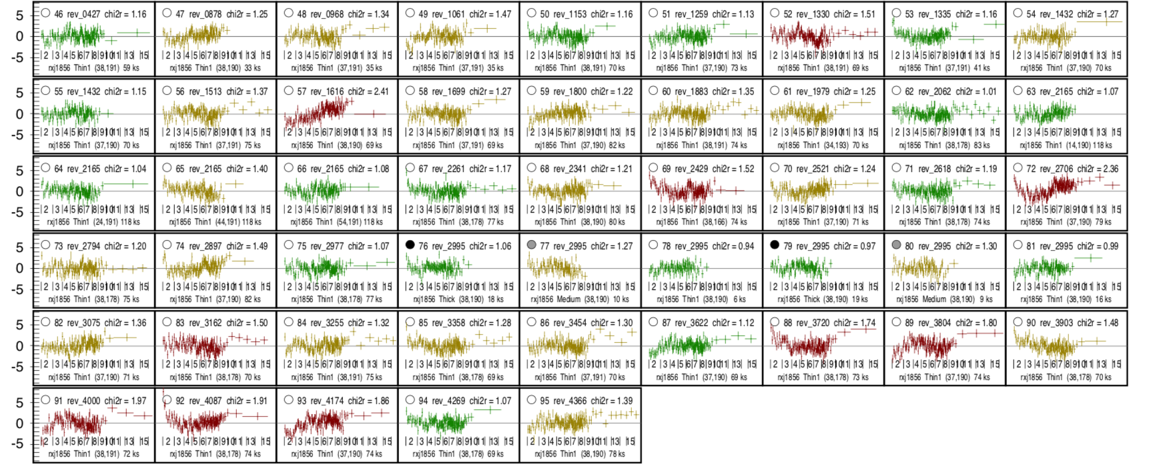
RZJ1856: XMM/EPIC-pn residuals resulting from Chandra model spectrum and RMFs/ARFs obtained with alternative parametric approach
50 spectra covering 24 years (!)
16th IACHEC Meeting, La Granja de San Ildefonso, Segovia, Spain, May 14, 2024
Konrad Dennerl

Slide 23
RXJ1856
XMM/EPIC-pn
residuals resulting from Chandra model spectrum and RMFs/ARFs obtained with
rmfgen-2.8.7 arfgen-1.104
and
alternative approach
16th IACHEC Meeting, La Granja de San Ildefonso, Segovia, Spain, May 14, 2024
Konrad Dennerl

Slide 24
SRG/eROSITA and RXJ1856: interplay between ARF and RMF
RXJ1856 TM8, all valid patterns
χ_{r}² = 2.49
best-fit spectrum with
unmodified RMF
unmodified ARF
(both from ground calibration)
16th IACHEC Meeting, La Granja de San Ildefonso, Segovia, Spain, May 14, 2024
Konrad Dennerl

Slide 25
SRG/eROSITA and RXJ1856: interplay between ARF and RMF
RXJ1856 TM8, all valid patterns
χ_{r}² = 1.59
best-fit spectrum with
unmodified RMF
modified ARF*
(both from ground calibration)
*Al layer reduced by ≈12 nm C layer reduced by ≈20 nm

Slide 26
SRG/eROSITA and RXJ1856: interplay between ARF and RMF
RXJ1856 TM8, all valid patterns
χ_{r}² = 1.35
best-fit spectrum with
modified RMF
modified ARF*
(both from ground calibration)
*Al layer reduced by ≈12 nm C layer reduced by ≈20 nm
16th IACHEC Meeting, La Granja de San Ildefonso, Segovia, Spain, May 14, 2024
Konrad Dennerl

Slide 27
Results obtained with parameterized RMF for SRG/eROSITA (‚TM8 sdtq‘)
RXJ1856, obs 1
RXJ1856, obs 2
RXJ1856, obs 3
‚TM8‘ = TM1 + TM2 + TM3 + TM4 + TM6 (sum of all CCDs with an on-chip Al filter)
‚sdtq‘: all valid pixel patterns
(sum of singles, doubles, triples, quadruples)
16th IACHEC Meeting, La Granja de San Ildefonso, Segovia, Spain, May 14, 2024

Slide 28
eROSITA
Summary
Track contamination after larger orbital manuevres → no cumulative effect detectable
RXJ1856 matches Chandra LETG → norm free, shape fixed to LETG
After ARF and RMF adjustment → good spectral fits for ‚TM8‘ & all valid patterns
Konrad Dennerl
16th IACHEC Meeting, La Granja de San Ildefonso, Segovia, Spain, May 14, 2024

Slide 29
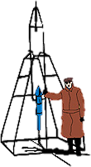
IACHEC May 2024
NICER Observations of WD & NS Craig Markwardt (NASA/GSFC) on behalf of NICER Team
GSFC

Slide 30
NICER Observations of Isolated NS & WD
RX J1856 – Isolated Neutron Star
HZ43 – White Dwarf

Slide 31
Summary
Various standard candle calibrators: NICER appears to have lower flux < 0.5 keV, could be consistent with additional absorption
RX J1856 (isolated neutron star black body)
HZ 43 (white dwarf)
Low energy flux offsets seem consistent with extra absorption, comparable to 1.0e19 /cm2

Slide 32
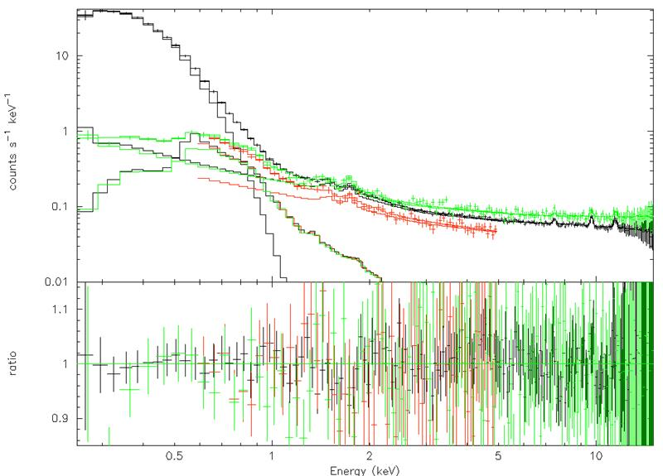
RX J1856
IACHEC Reference Model from Chandra LETGS
Good fit, but NICER norm is 14% low and nH is high by ~few x 10¹⁹
Background due to galactic bulge diffuse emission included

Slide 33
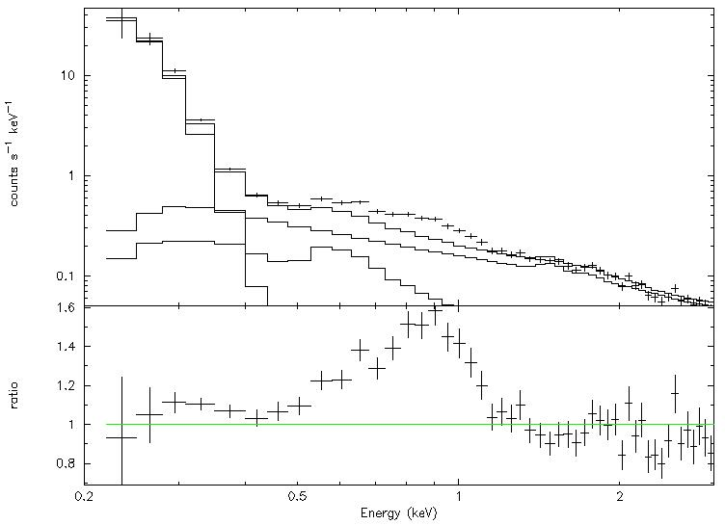
HZ43 – White Dwarf
Beuermann et al 2006 as reference model (very soft!)
Chandra LETGS + EUVE + ROSAT PSPC data combined
Fair fit but norm is low by 16-17%, poor residuals in-band
0.5-1.2 keV emission is from binary companion

Slide 34
Summary of Observations
~0.28 keV – NICER low by ~16% (HZ43 LETGS+EUVE)
~0.35 keV – NICER low by ~14% (J1856 LETGS)
0.56 keV – NICER low by 10% (E0102 line RGS)
0.63 keV – NICER low by 6% (E0102 line)
Add’l absorption 1.0e19 (E0102 continuum)
0.92 keV – NICER on par (E0102 line)
1.02 keV – NICER on par (E0102 line)
Could be consistent with a small amount of extra absorption not accounted for by responses

Slide 35
Magnitude of Absorption
The extra absorption column is about 1e19
small but significant
at 0.3 keV this would appear as a ~20% error, consistent with J1856 and HZ43
The material properties of filters were measured before launch
Difficult to understand how an additional absorption term of this magnitude could enter in

Slide 36
Context of Low Energy NICER Features
50-250 eV
350-2000 eV
Noise Peak Undershoots ct/s/FPM
500
400
300
Target Counts 0.35-2.5 keV (ct/s/52FPM)
200
10000
100
0
2000
200
Forced Trigger vs Under- shoots
500
5
NICER Array Average

Slide 37
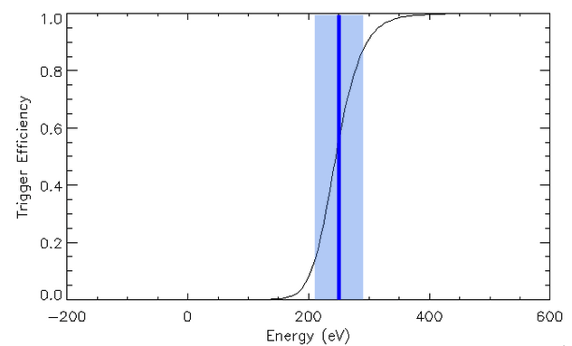
Partial Solution – Trigger Efficiency Curve
NICER low energy trigger is not a sharp curve but a smooth one (centroid ~0.25 keV, width 0.045 keV) Centroid is measured from astrophysical targets

Slide 38
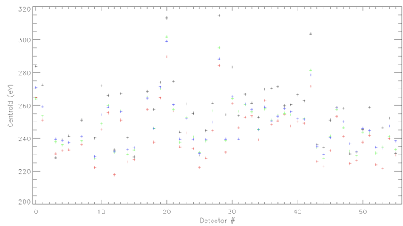
Trigger Efficiency Function Means
Range for one detector
Different measurement approaches from different astrophysical targets yielded a range of about 12 eV in each detector; the same bias for each detector
We chose to split the difference with the middle of the range
We can try the ends of the range instead of the center

Slide 39
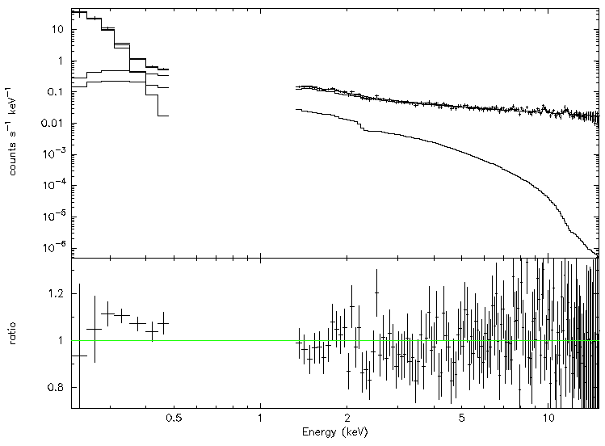
Trigger Efficiency
Lower end of the range (based on LMC X-3)
Fit gets worse, not better
Norm is 25% low instead of 17%
Residuals worse
Published CALDB
Lower Trigger Centroid

Slide 40
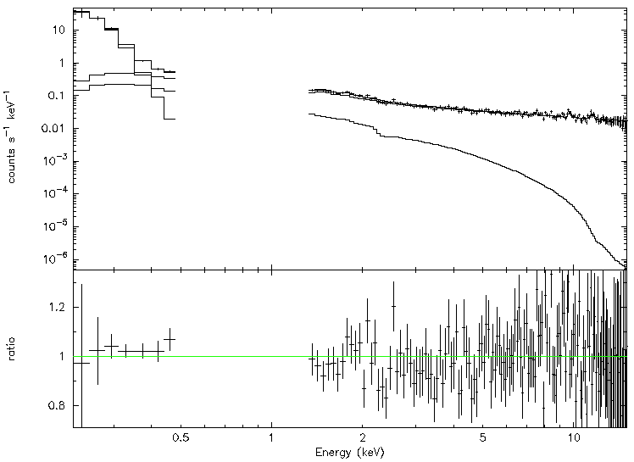
Upper End of Trigger Range
Choose upper end of trigger efficiency range (Crab)
Ratio becomes 93% instead of 82%
Residuals are good
There are still deficits of 5-7% in the 0.3-0.6 keV range for E0102
But it’s an improvement

Slide 41
NICER Calibration Plan
For next CALDB release, NICER will update the trigger efficiency centroids to match the upper end

Slide 42
Easier to Use HZ 43 Spectral Curve
The TMAP white dwarf atmosphere model for HZ 43 is available publicly, but it’s difficult to access and not immediately suitable for spectral fitting
Need to download from CDS, convert to a table model, etc
For the purposes of calibration fitting, it is not as important to get the physics perfect, as it is to develop usable standard candles, within tolerances
I constructed a fitting function that matches the TMAP model

Slide 43
Fitting Function
mdefine poly_hz43 e*(0.955968 + e*(-0.699684 + e*(0.555432 + e*(-0.292088 + e*0.069582))))+dummy mdefine hz43 8.0525*poly_hz43(0.0)**2/kT**4/(exp(poly_hz43(0.0)/kT)-1.0)
Consists of a blackbody-like curve whose energy variable is a polynomial function of true X-ray energy
Polynomial terms found by fitting to TMAP data
”mdefine” is suitable for use within XSPEC, or adaptable to any other spectral fitting code

Slide 44
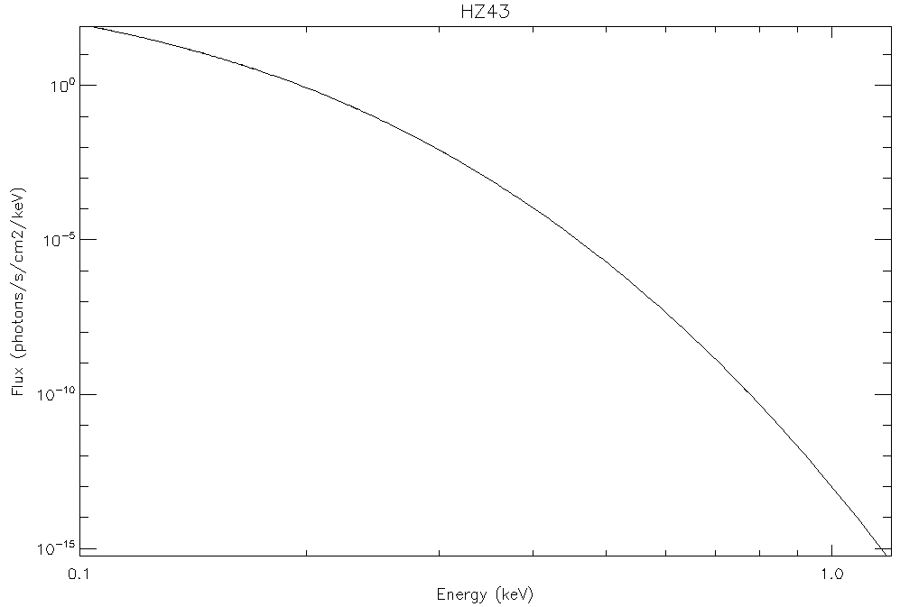
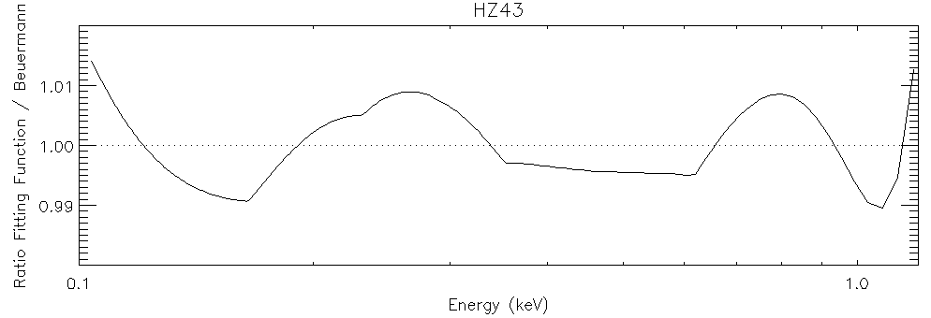
HZ 43 Fitting Function Performance
Worse case error is 1% over entire spectral band

Slide 45
HZ 43 Fitting Function Details
More details can be found on the IACHEC MIT Wiki page for White Dwarfs and Neutron Stars

Slide 46
E0102 as Contamination Monitor
Team continues to monitor E0102 as a proxy for degradation due to contamination
To date, there is no evidence of more than a few percent of contamination buildup, consistent with zero

Slide 47
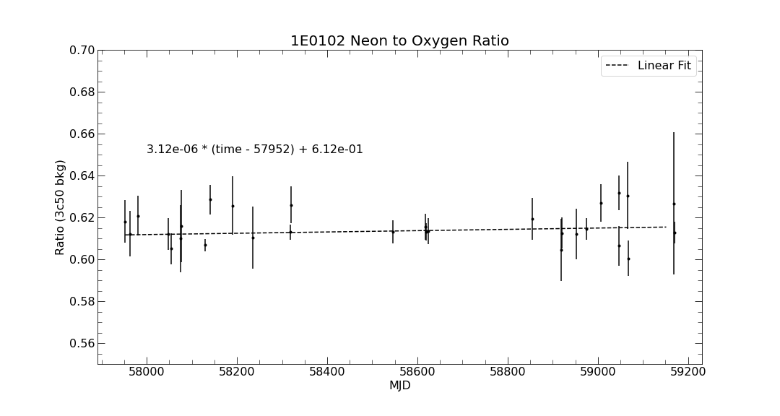
E0102 Neon / Oxygen Ratio
2017
2020
3year fit is consistent with flat within the errors

