Slide 1

VERT-X: a new facility for ATHENA optics
Alberto Moretti (INAF-OAB)
on behalf of the VERT-X project

Slide 2
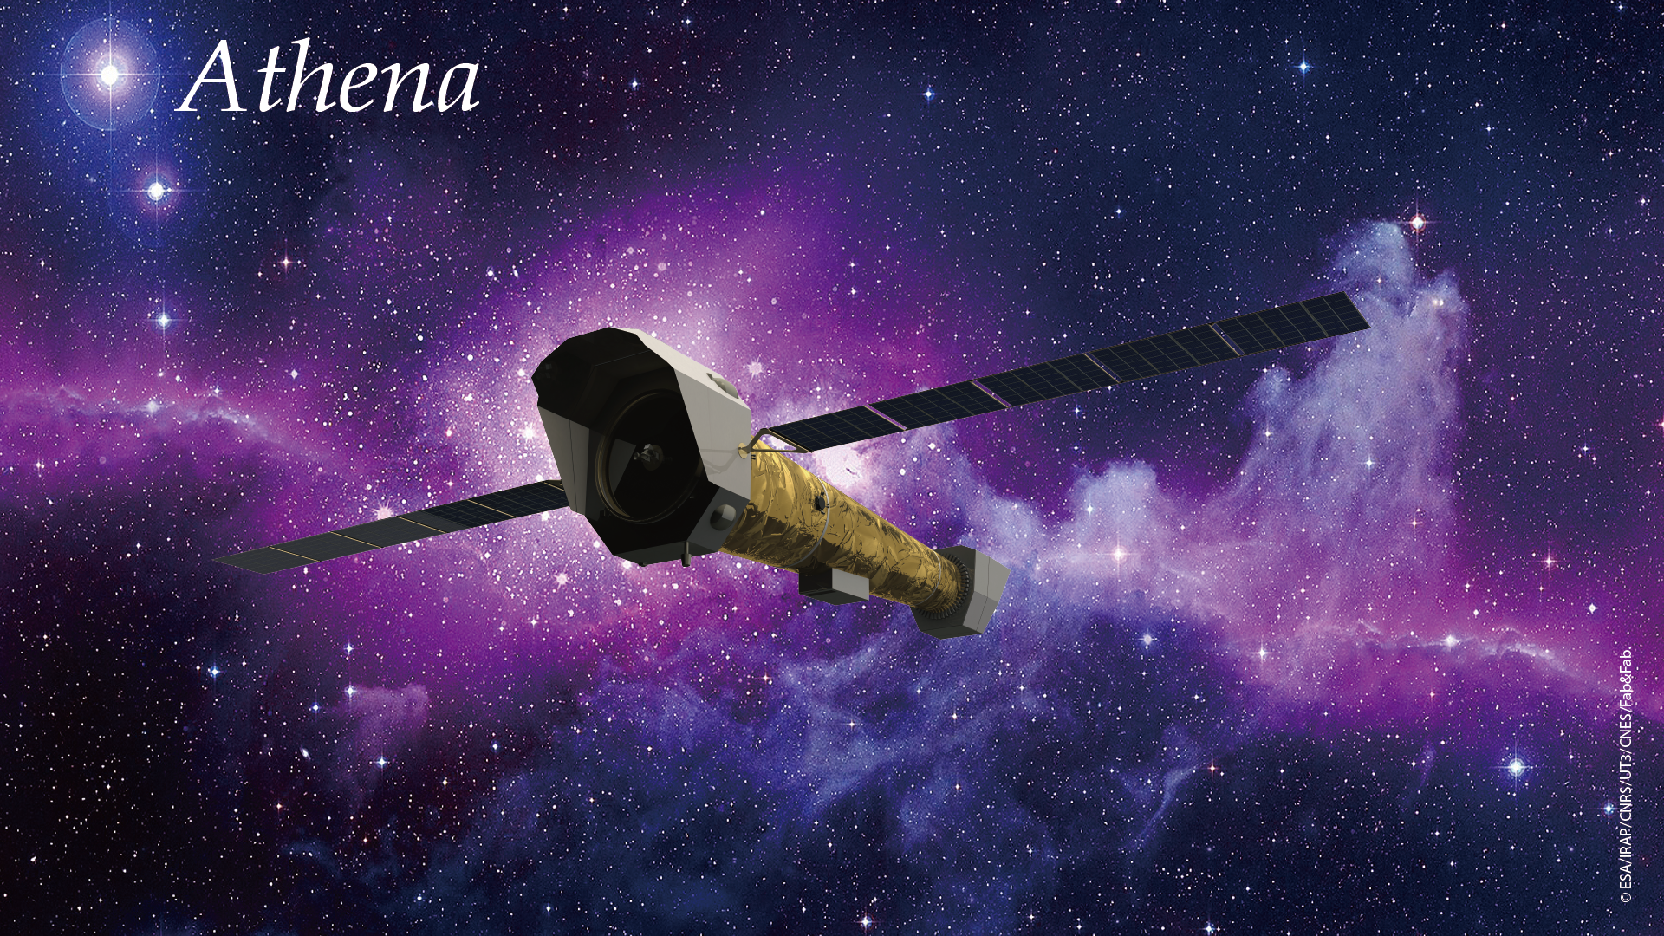
L-Class mission ESA Cosmic Vision program
The largest X-ray optics ( 1.2 m² )
WFI: 40’ FoV imager with high time resolution
XIFU: 4 eV spectral resulution

Slide 3

ATHENA mission
2014 -- 2019 : Phase A
2019 – 2022: Phase B (truncated)
Nov22 -- Nov23: Athena has undergone a “design-to-cost” process to reduce ESA costs < 1.3Geuro.
Nov 23: ESA SPC committee endorsed the New Athena as a flagship mission of the ESA Science Program.
Phase A industrial activities are restarting in the second quarter of 2024
Adoption is expected in 2027; with a planned launch in 2037.

Slide 4
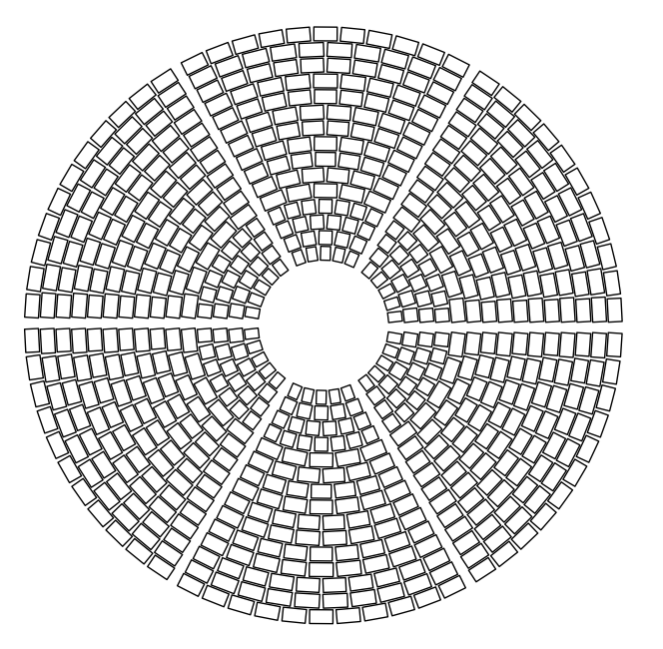
ATHENA optics
492
~2.2 m

Slide 5
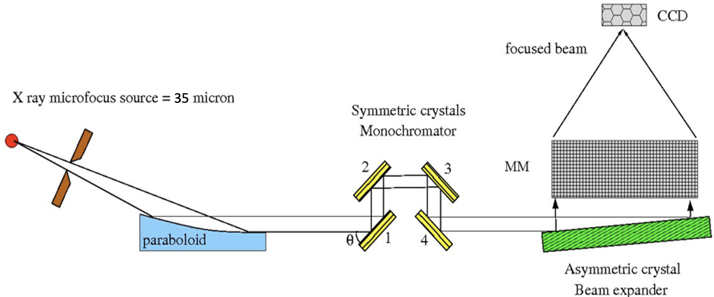
BEATRIX: VERT-X precursor
Collimated beam (2” divergent)
60 x 170 mm large
10 - 60 ph/s/cm2
Acceptance (before integration), of the 492 Mirror Modules, at their production rate (2MM/day).

Slide 6

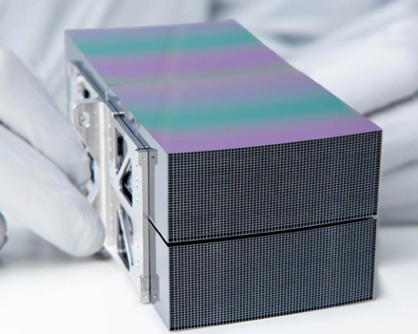
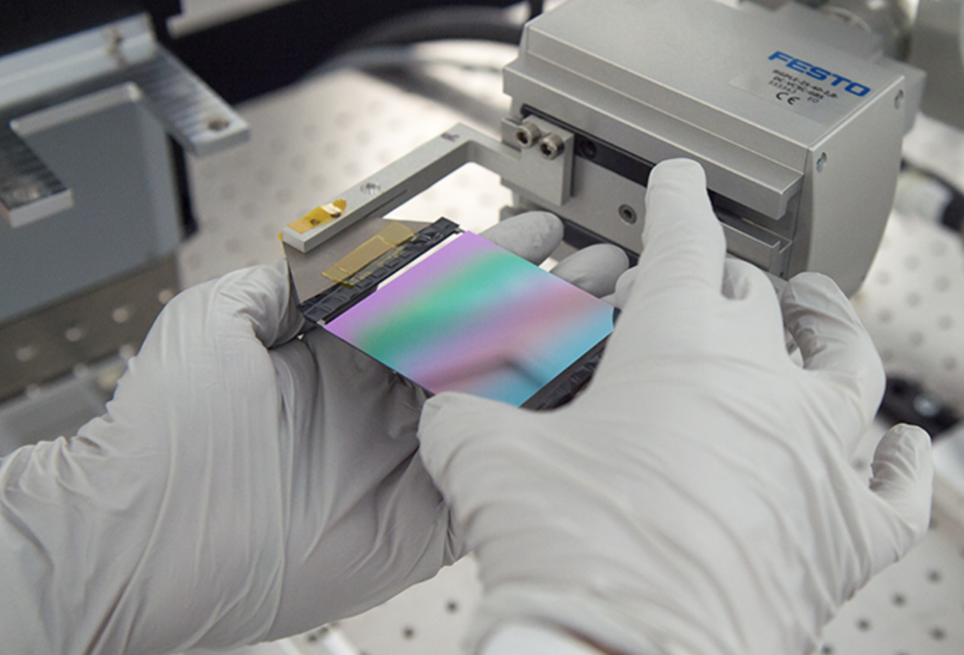
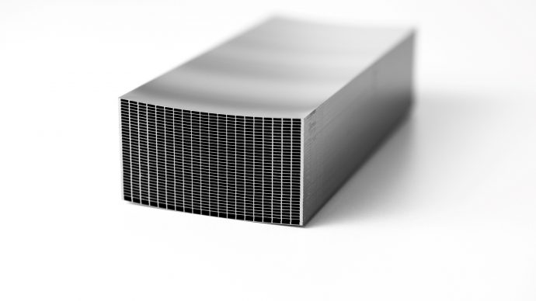
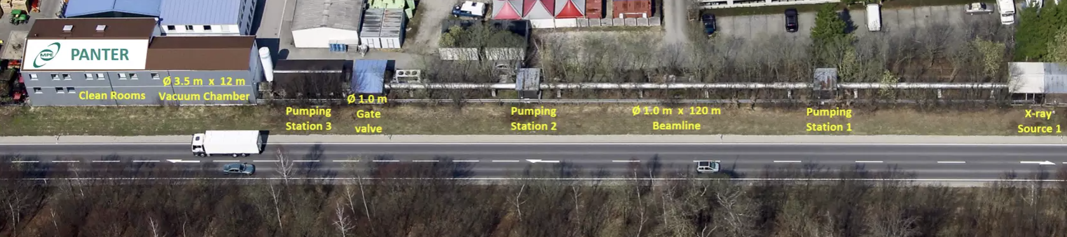


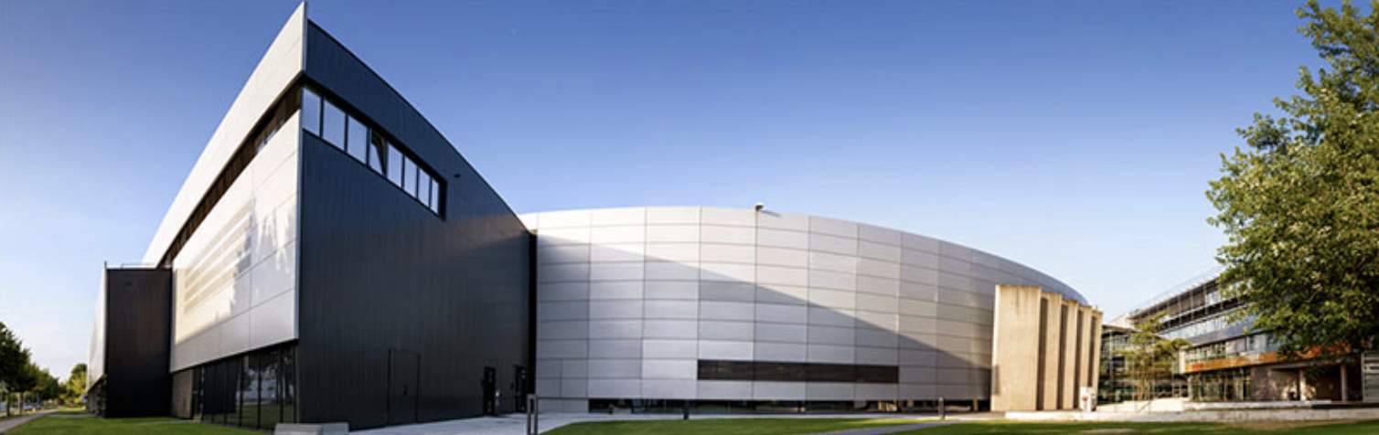

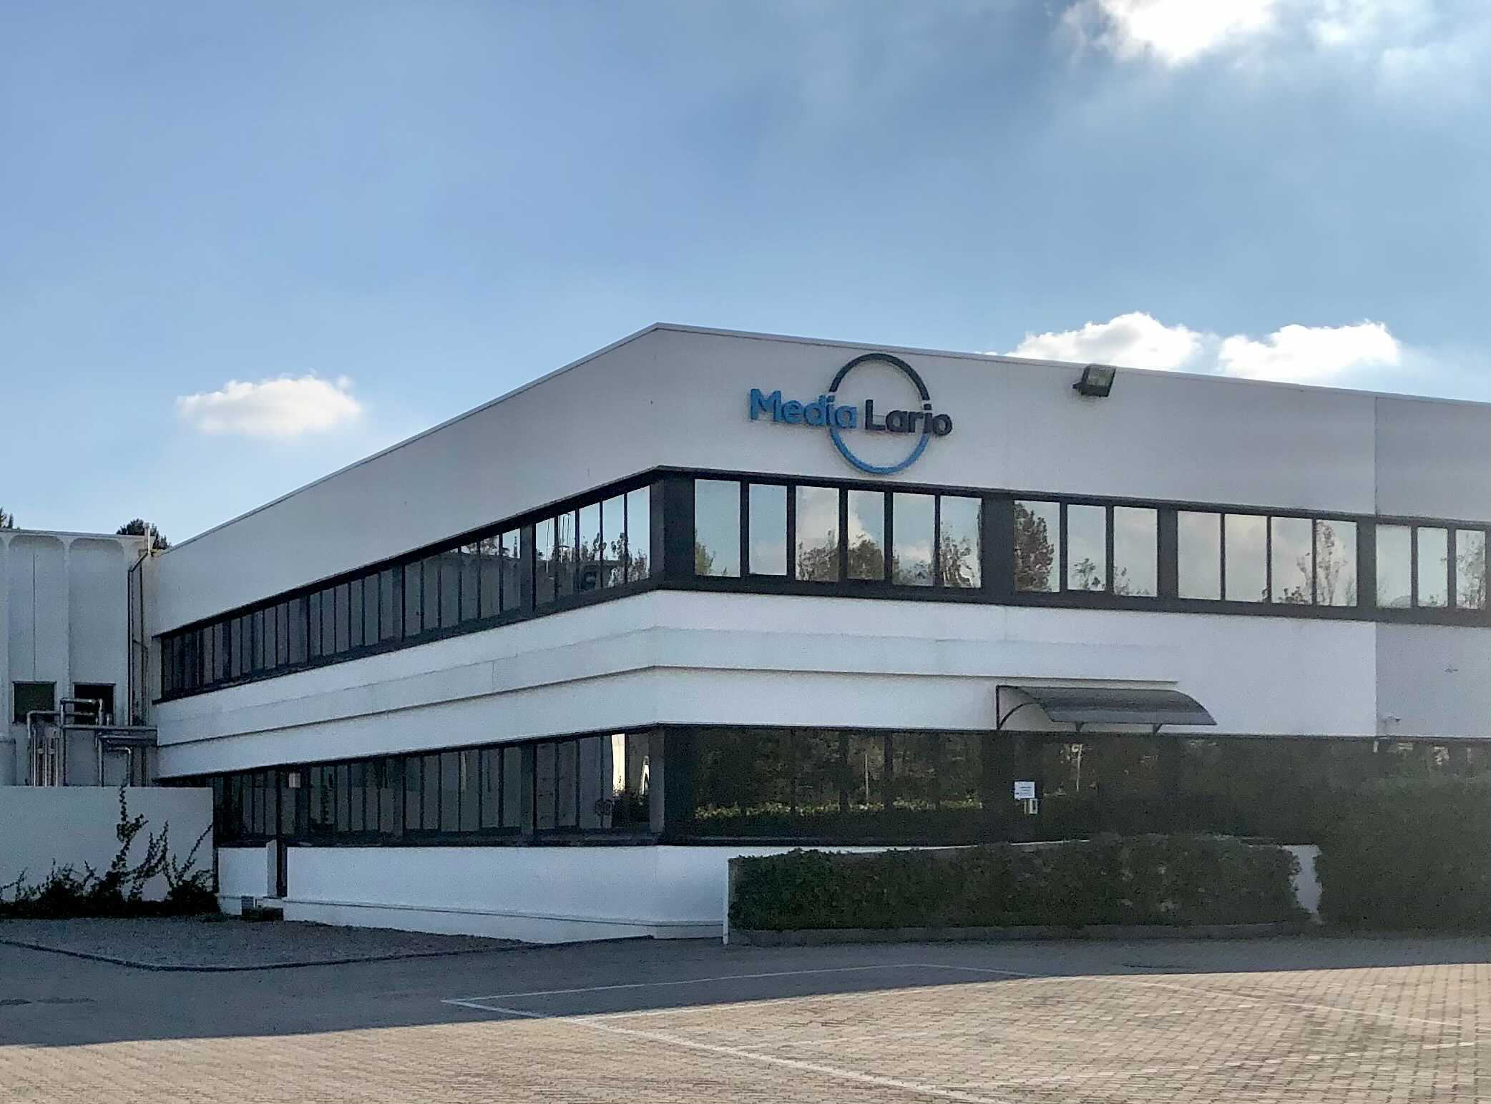
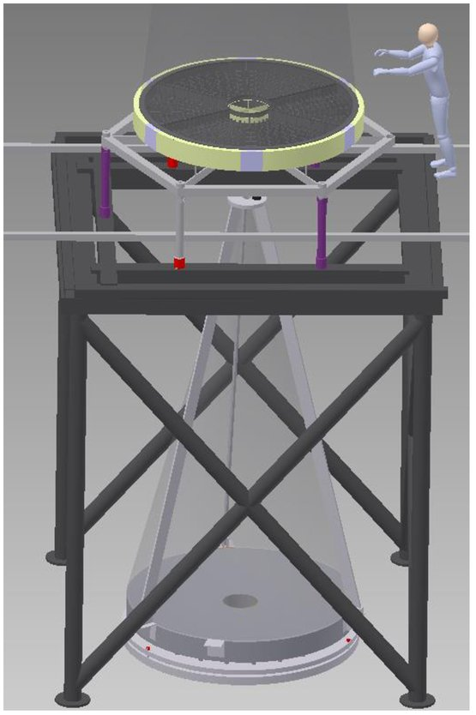


Slide 7
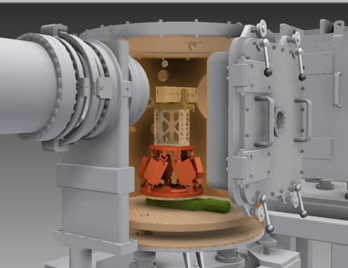
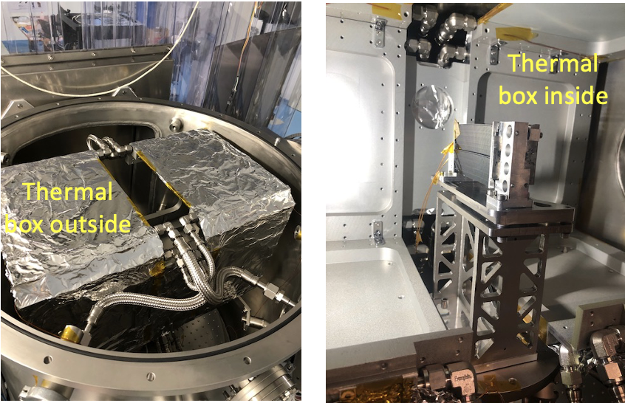
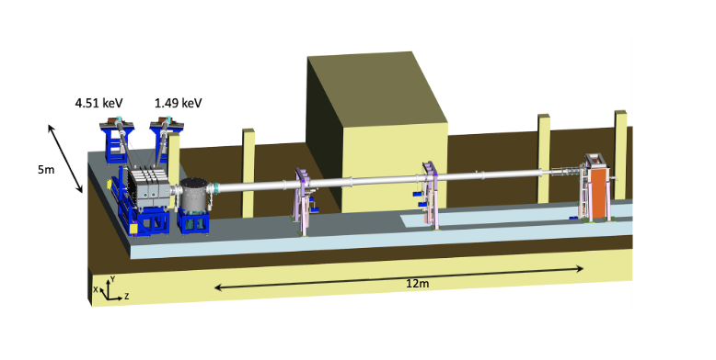
Possible measurements at BEaTriX
At 4.51 keV (1.49 keV coming)
Point Spread Function
Effective Area
Thermal tests
Experimental chamber size: ∅750mm × h718mm
Chamber apertures: front door (std) top cover possible
Thermal box size: 350 mm × 350 mm × 600 mm
Thermal ranges: 20±25°C
Hexapod load capacity: 5 kg
Focal length: 12 m (std) – 10 m – 8 m
For more information
bianca.salmaso@inaf.it

Slide 8
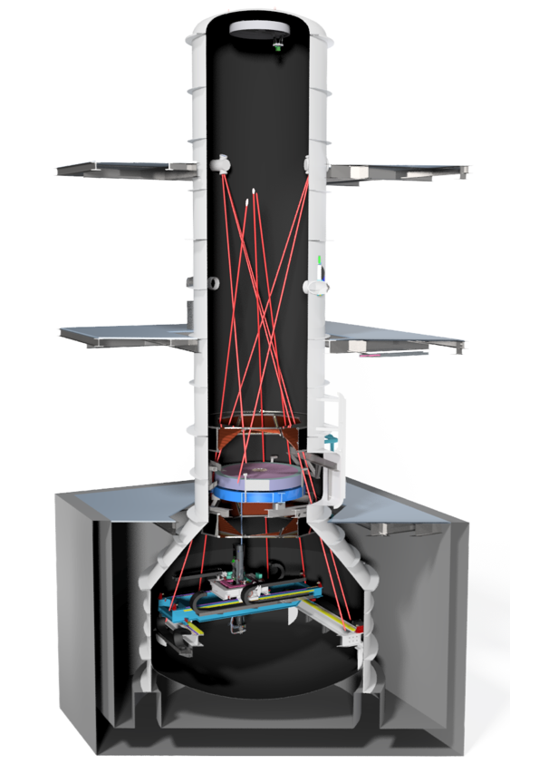
The VERT-X design
Focal plane
Compact design
Low-divergence beam
Vertical geometry (no lateral gravity)
Possibility of characterizing each MM
Adaptable to different locations
ATHENA mirror
Raster
scan
Notes:
These are the characteritstics of the mirror …. In the design we fully exploited the exoerience of beatrix …

Slide 9
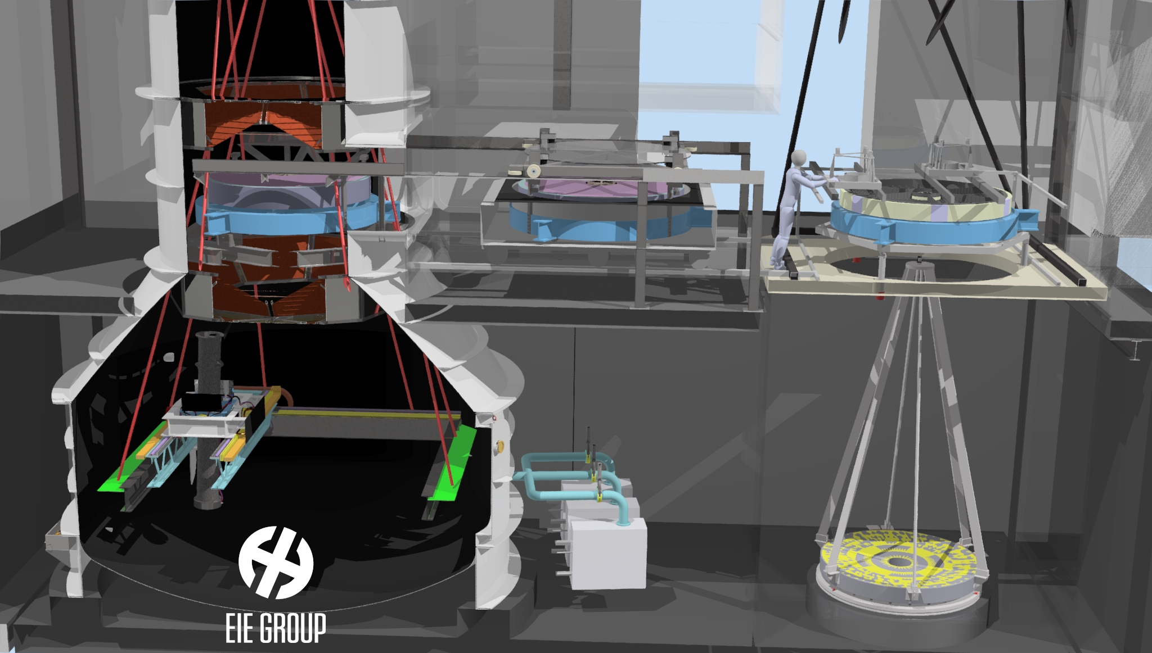

VERT-X and the integration facility
Notes:
These are the characteritstics of the mirror …. In the design we fully exploited the exoerience of beatrix …

Slide 10
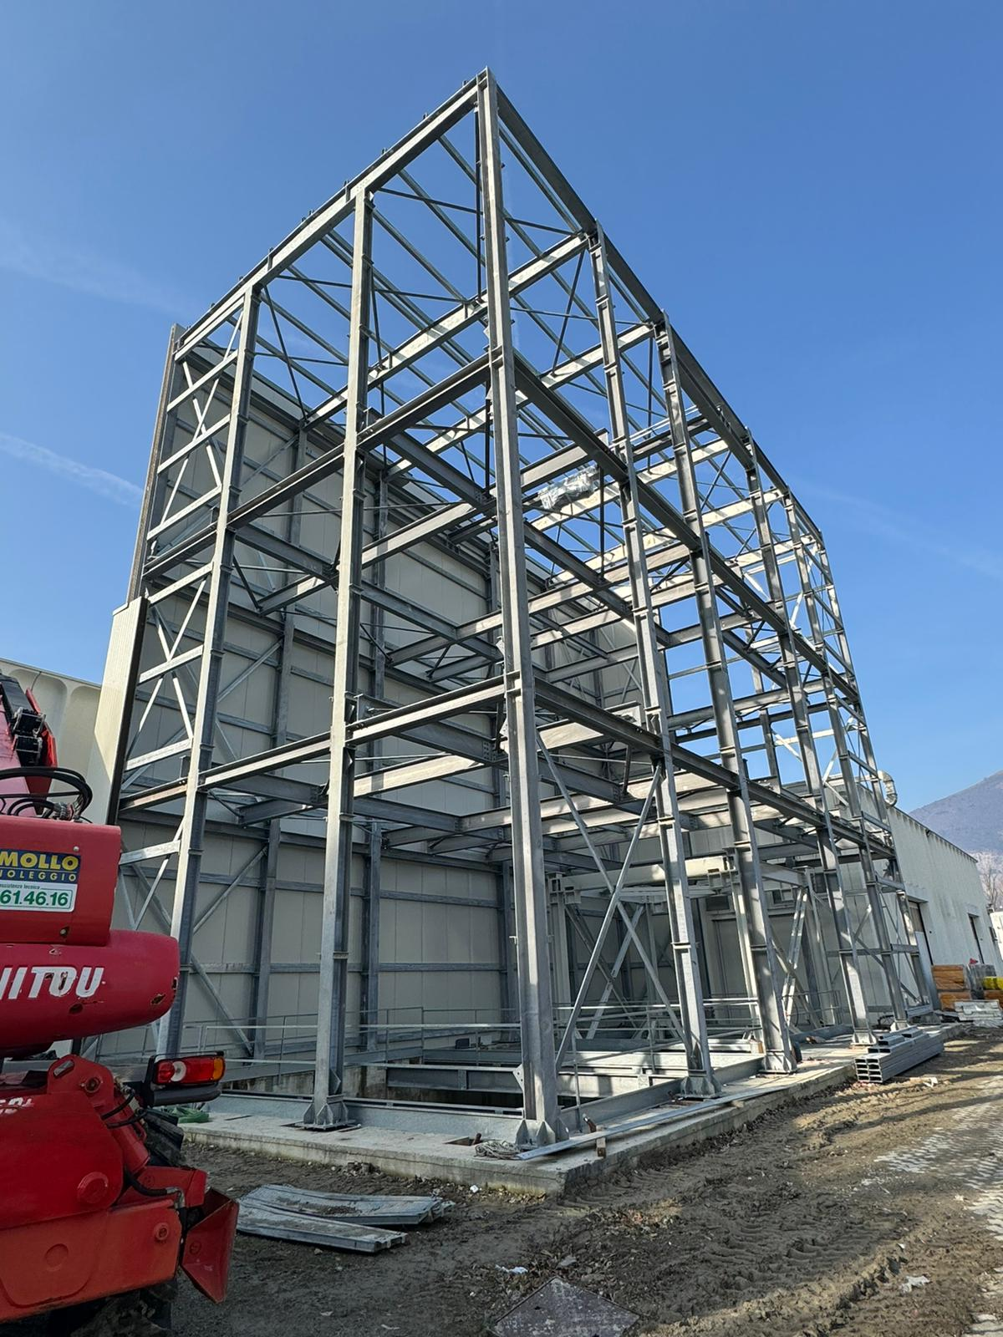
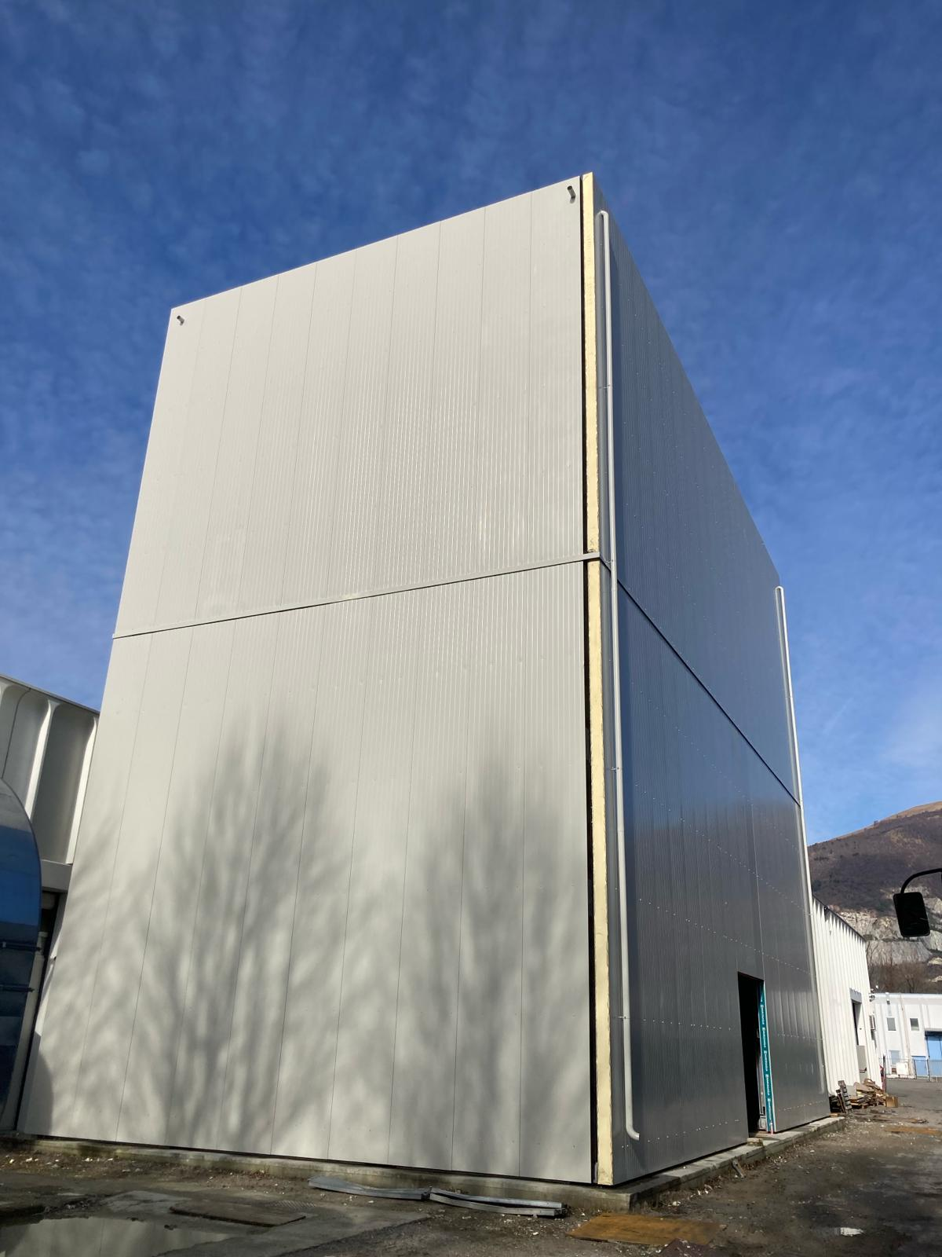
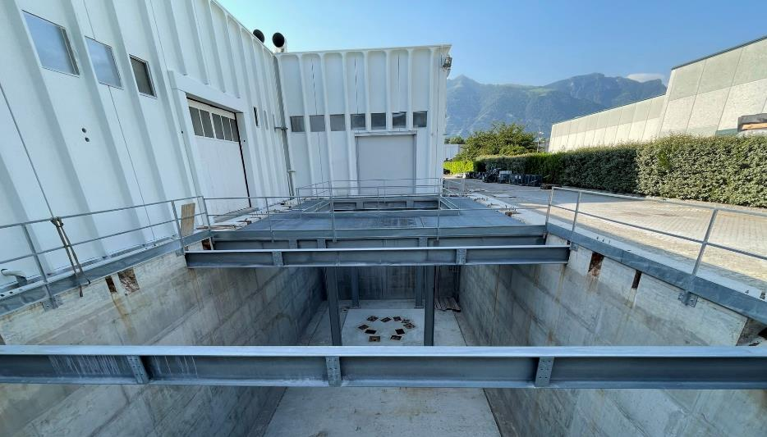
VERT-X building
Notes:
These are the characteritstics of the mirror …. In the design we fully exploited the exoerience of beatrix …

Slide 11
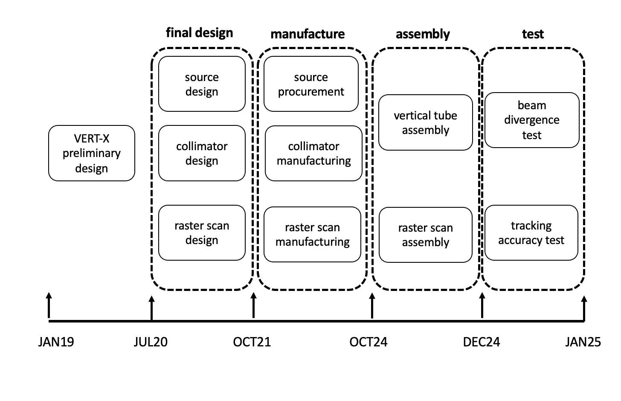
The VERT-X time-line

Slide 12
The x-ray tube assembly (XTA)
parallel beam
The tube is the very core of the raster- scan structure: it rotates inside the Gimbal and it supports X-ray source and collimator, keeping them in place.
collimator
x-ray source
Notes:
These are the characteritstics of the mirror …. In the design we fully exploited the exoerience of beatrix …

Slide 13
The raster-scan
The base in stainless steel is the fixed part. It lays on rigid points of the vessel and discharge the loads directly on the vessel foundations.
The bridge is the first moving part of the Raster Scan (translation along X).
The trolley is the second moving part of the Raster Scan (translation along Y). It slides over the Bridge and it constitutes the fixed part of the Gimbal mount.
The tube is the very core of the raster- scan structure
90% of the elements have been manufactured.

Slide 14
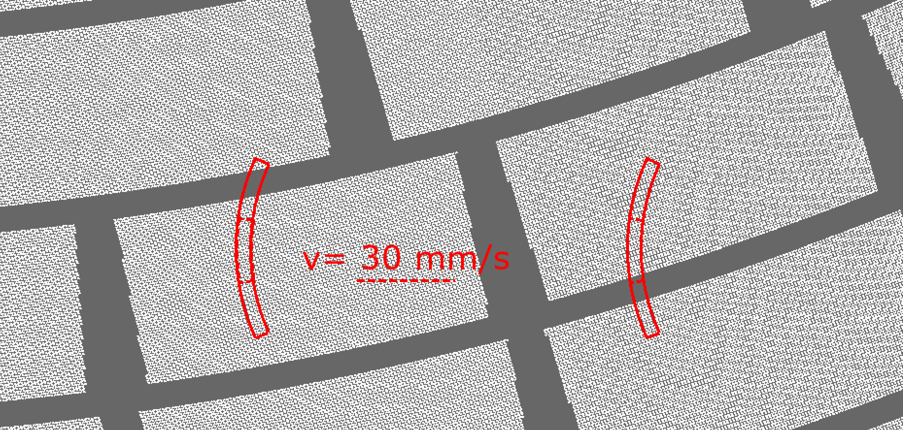
Raster-scan timescale and expected performance
Scan velocity 30 mm/s
Tot.scan time 1.0 hr
Accel. time 10 s
Settling time 4 s
Inclination 3 deg.
Tracking error < 0.5’’

Slide 15
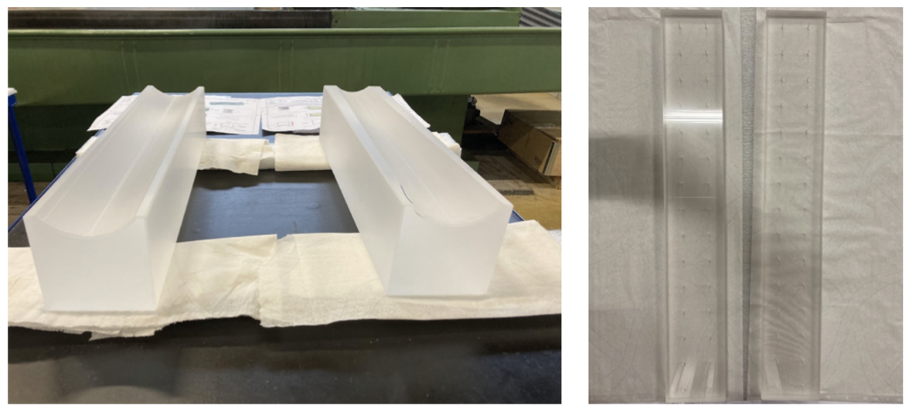
The collimator
Wolter design
Hyp and Parab (manufactured separately)
1.1 m long
Focal length ~ 2m
Fused silica (Corning 7980)
Eff. 83% (1keV) 52% at 10keV
HEW ~ 1.0’’ @ 2keV
Notes:
These are the characteritstics of the mirror …. In the design we fully exploited the exoerience of beatrix …

Slide 16
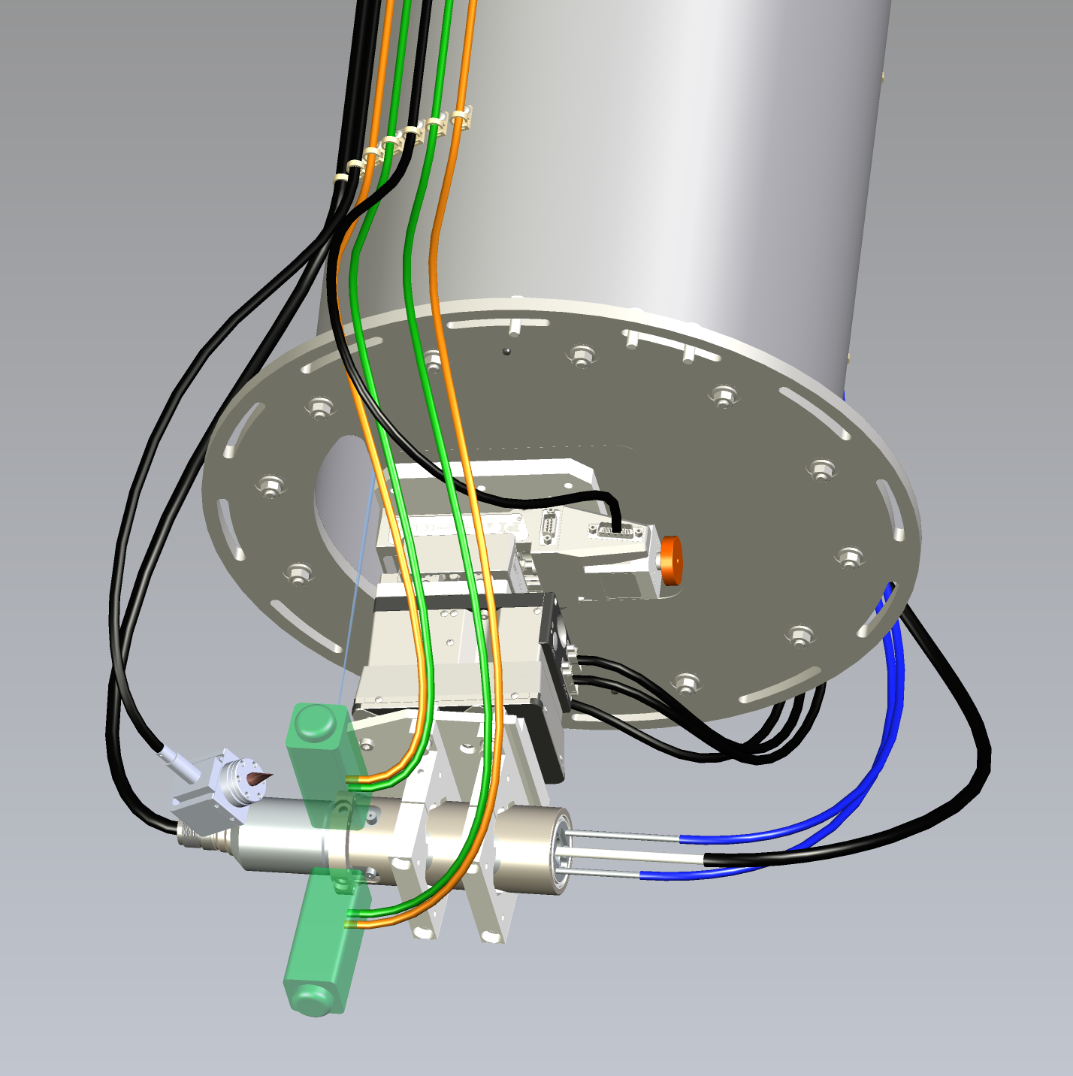

The X-ray source
Non-standard requirements:
- micro-focus (~10 micron)
- fully operational and movable in vacuum
- liquid based cooling system
- ion-pump vacuum system
- very long and flexible vacuum cables
X-ray source will be movable to be positioned in the collimator focus. Movement along the 3 axis will be provided by a combination of three linear stages.

Slide 17
The VERT-X HEW error budget
CAL-PSF-R-001: The absolute knowledge error (AKE) of the encircled photon (enclosed energy) fraction of the mirror PSF shall be smaller than 0.1 arcsec with a confidence level of at least 68.27% in the "core".
${{HEW}_{VTX}^{2} = HEW}_{MA}^{2} +$ ${HEW}_{BEAM}^{2}$
$σ_{HEWMA}^{2}=\frac{{HEW}_{VTX}^{2}}{{HEW}_{MA}^{2}} σ_{HEWVTX}^{2} +$ $\frac{{HEW}_{BEAM}^{2}}{{HEW}_{MA}^{2}} σ_{HEWBEAM}^{2} <0.1”$ calibration requirement
statistical [0.07”]
Systematic [~1.5”+/-0.2]
ACCUMULATED PHOTONS
Exposure time
Detector sustainable rate
Operation strategy
BEAM DIVERGENCE Source size (0.8”)
Collimator errors (1.2”)
Raster-scan tracking accuracy (0.4”)
Sou/coll. displacement (heat induced) (0.1”)

Slide 18
Conclusions
ATHENA mirror ground calibration will be a challenging task
VERT-X is an innovative concept of X-ray calibration facility, exploiting the BEATRIX heritage.
The detailed design showed the compliance with the ATHENA calibration requirements.
The most critical parts of the system are under development and will be tested in Q4 2024.
We expect to have a beam divergence ~ 1.5” moved by the raster scan with a tracking accuracy of < 0.5”
This will allow to measure the ATHENA HEW with a precision of ~0.1” as required
Notes:
These are the characteritstics of the mirror …. In the design we fully exploited the exoerience of beatrix …

