Slide 1
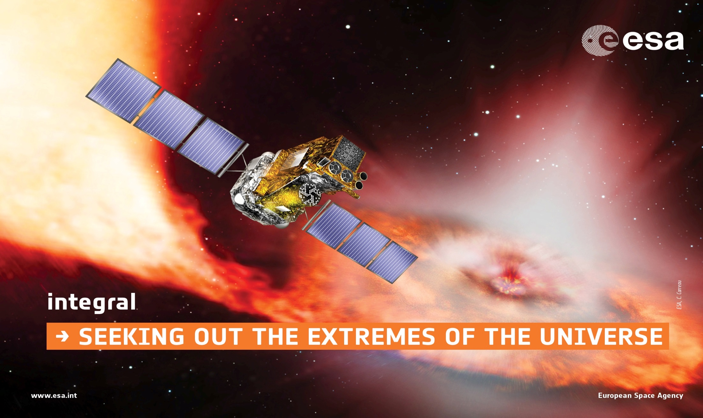
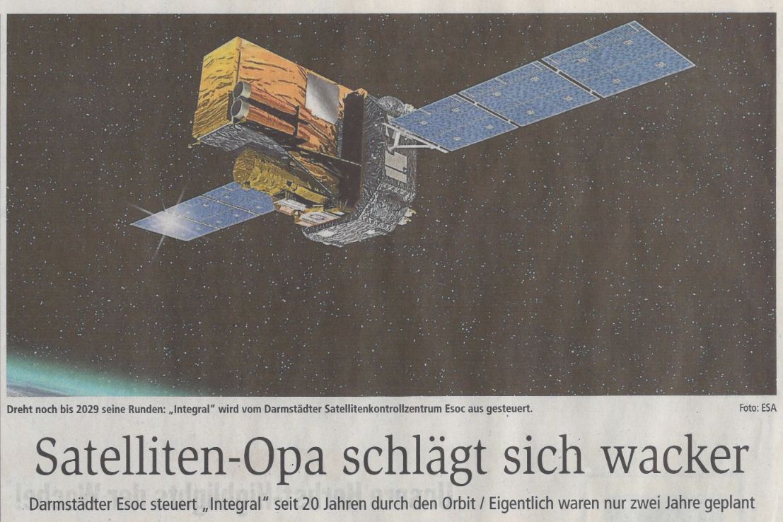
INTEGRAL – Status
Erik Kuulkers (ESA/ESTEC)
IACHEC #16 - 13-16 May 2024

Slide 2
Who am I?
2002 – 2020: INTEGRAL Operations Scientist
2013 – 2023: INTEGRAL Project Scientist
2018 – Present: ESA Einstein Probe Project Scientist
2021 – Present: NewAthena Mirror Calibration Scientist (+ deputy Study Scientist)
2022 – Present: THESEUS Study Scientist
My job time → NewAthena : THESEUS : Einstein Probe = 50% : 25% : 25%
Main scientific interest: X-ray transient/variable science [e.g., Type I X-ray bursts, GRBs, (transient) X-ray binaries]

Slide 3
INTEGRAL in a nutshell
INTErnational Gamma-Ray Astrophysics Laboratory
Medium-sized mission (Horizon 2000) - Launched 17 October 2002
Highly elliptical orbit (~64 hrs); ~47 hrs of continuous science per orbit
Weight: 4000 kg!
Dimensions:
5 x 3.7 x 3.7 m
Solar panels: 16 m
153 000 km
Notes:
INTEGRAL stands for INTErnational Gamma-Ray Astrophysics Laboratory. It was launched in 2002; it has been operating successfully for almost 17 years now! The satellite is very heavy, about 4 tons; it, therefore, had to be launched by a Russian Proton rocket, from Baikonour. Most satellites weigh a few tons or less.

Slide 4
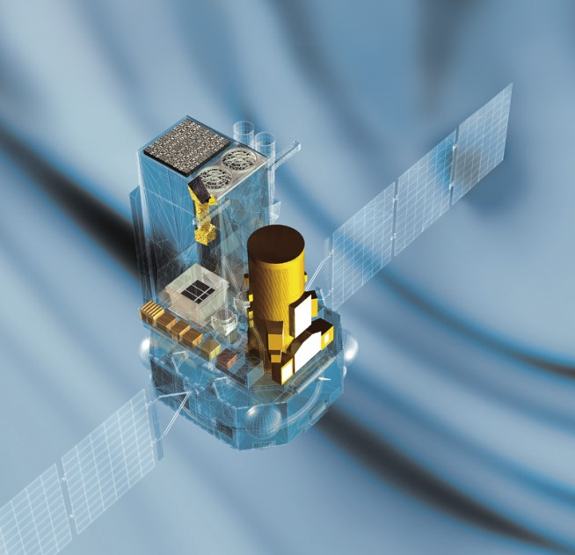
INTEGRAL in a nutshell
4 instruments:
IBIS: 15 keV-10 MeV
hard X-ray/γ-ray imaging [angular resolution: 12’]
SPI: 20 keV-8 MeV
hard X-ray/γ-ray spectroscopy [ΔE = 3 keV @ 1.7 MeV]
JEM-X: 3-35 keV
2 identical X-ray monitors [angular resolution: 3’]
OMC: 500-600 nm
Optical monitor (V-band)
OMC
JEM-X
IBIS
Radiation Monitor (IREM)
SPI
All operating simultaneously
IBIS, SPI, JEM-X: coded masks instruments
Lower sensitivities but large FoVs (30°x30° & 7.5°)
Long exposure times needed (hrs – weeks)
Notes:
INTEGRAL is in a highly elliptical orbit around the Earth, which allows for very long, uninterrupted, observations, of about 47 hours per orbit.
It has 4 instruments onboard, which are operating simultaneously. 2 main instruments are working in the hard X-ray / gamma-ray regime; IBIS is mainly optimized for imaging, SP for spectroscopy.
And then there are complimentary monitors for X-rays and optical, providing a broad wavelength coverage.
INTEGRAL is in continuous contact with the ground stations, and so the data centre receives a continuous data stream, which allows fast near-real time access to the data.

Slide 5
Key science capabilities
Large FOV (~900 square degrees) + arcmin localisation
X-ray & γ-ray transient discovery space + multi-source monitoring
Omni-directional view through shields
γ-ray transients + counterparts of GRBs, GW & high-energy neutrino events, FRBs
γ-ray line spectroscopy and imaging
Positrons in the Galaxy: annihilation with electrons (511 keV emission) & Nucleosynthesis: lines from elements formed in massive stars, SNe & (X-ray) novae
Target of Opportunity capability
allows rapid follow-up observations after alerts from GW, neutrino or EM facilities (response times < day, down to ~4 hrs)
Synergy
Connects X-ray missions (e.g. eROSITA, HXMT, NICER, NuSTAR, Swift, XMM-Newton) with higher-energy γ-ray facilities (e.g. Fermi)
Notes:
Here I list part of the key science capabilities. Both SPI and IBIS have a large FOV, of about 900 square degrees; IBIS can do arcmin localisation.
These capabilities allow for discovery and localization of new transients. It also allows for multi-source monitoring, for example, when we look at the Galactic Centre, the whole bulge region is visible.
By using the anti-coincidence shields around SPI and IBIS, INTEGRAL basically has access to the whole sky,
and allows for the detection of various transients such as GRBs and searching for prompt emission related to gravitational wave events, high-energy neutrino events, and fast radio bursts.
Both SPI and IBIS can perform hard X-ray polarisation studies on bright sources such as during gamma-ray bursts and X-ray transient outbursts.
INTEGRAL performs Target of Opportunity follow-up observations, with response times of less than a day.
Because of INTEGRAL’s wavelength coverage, it provides also synergy with other missions, such as the X-ray missions listed here and with gamma-ray missions like Fermi.

Slide 6
E-coverage of current & future high-E Missions
Joint programmes & coordinated observations with (hard) X-ray missions
INTEGRAL & Fermi span similar energy ranges, but observing efficiency for Fermi is <50%, while INTEGRAL is >80%
Future missions focus on hard X-ray and/or gamma-ray range (mostly GRBs)
INTEGRAL spans both X-ray and gamma-ray regime, with a unique energy range in the middle
INTEGRAL is the only mission providing high-resolution gamma-ray spectroscopy

Slide 7
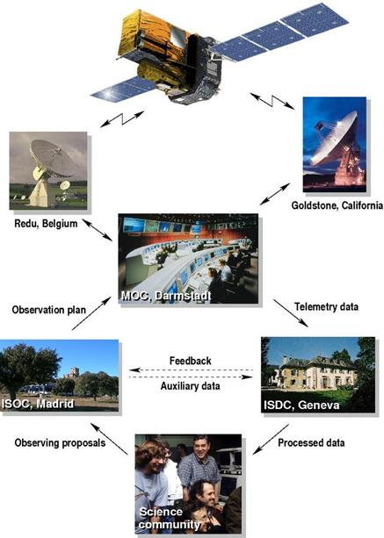
INTEGRAL Ground Segment
Nearly continuous stream of telemetry from the spacecraft to ground
Data processed and analyzed on the fly at the ISDC (Switzerland) and distributed to the community few hours after the observation (Near- Real-Time data)
Kiruna, Sweden

Slide 8
INTEGRAL – Calibration status?
Asked INTEGRAL User’s Group (IUG) for update
SPI: calibration status for SPI is unchanged [thanks Jean-Pierre!]
IBIS:
ISGRI: Calibration status from ISDC – see next slides [thanks Carlo!]
December 2023: PICsIT time resolution of spectral timing mode (8 bins, 208-2600 keV) increased to 3.9ms (previously 7.8ms). This improves science return for bright & short events → latest results of Crab with PICsIT, see talk by James Rodi (Room 2, this evening)
JEM-X long-term calibration update from DTU – see next slides [thanks Jérôme!]
Notes:
Here I list part of the key science capabilities. Both SPI and IBIS have a large FOV, of about 900 square degrees; IBIS can do arcmin localisation.
These capabilities allow for discovery and localization of new transients. It also allows for multi-source monitoring, for example, when we look at the Galactic Centre, the whole bulge region is visible.
By using the anti-coincidence shields around SPI and IBIS, INTEGRAL basically has access to the whole sky,
and allows for the detection of various transients such as GRBs and searching for prompt emission related to gravitational wave events, high-energy neutrino events, and fast radio bursts.
Both SPI and IBIS can perform hard X-ray polarisation studies on bright sources such as during gamma-ray bursts and X-ray transient outbursts.
INTEGRAL performs Target of Opportunity follow-up observations, with response times of less than a day.
Because of INTEGRAL’s wavelength coverage, it provides also synergy with other missions, such as the X-ray missions listed here and with gamma-ray missions like Fermi.

Slide 9
INTEGRAL/ISGRI Calibration Status
Updates on instrument evolution and current work On behalf of the ISDC, University of Geneva
(Prepared by Oliver Pedros and Volodymyr Savchenko
Approved by Carlo Ferrigno)
Notes:
⅔ slides
Focus on compression at lower energy, which we correct for in the calibration process

Slide 10
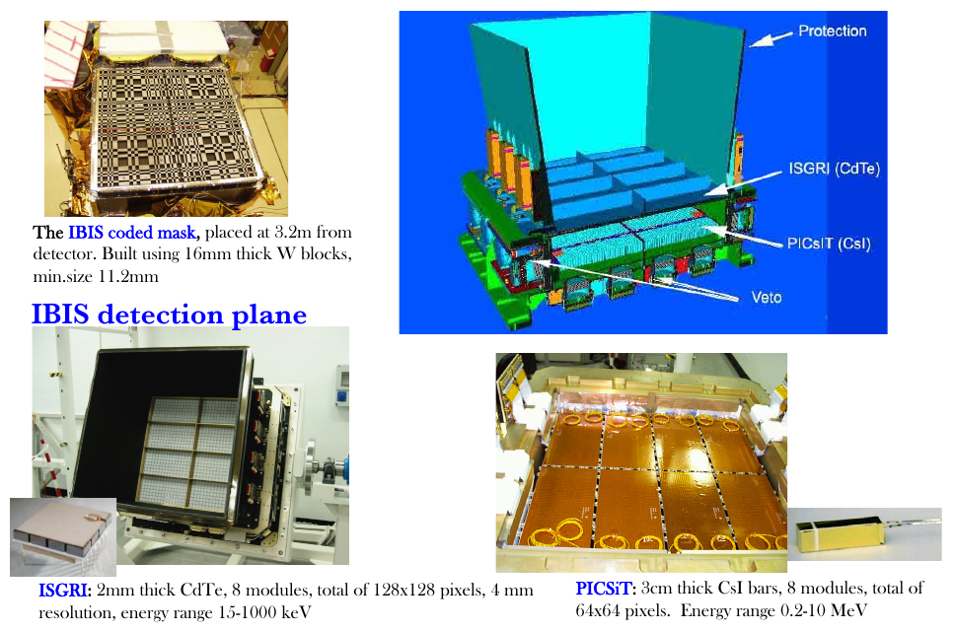
IBIS/ISGRI spectral response calibration challenges
For each incident photon ISGRI measures Pulse Height (PH) and Rise Time (RT). A single incident energy occupies a 2D region in the PH-RT space. These regions have complex properties.
Low-energy regions converge with high-energy at high RT: source of major problems until 2021.
Effective gain is non-linear in whole energy range, and getting worse with time, while response at 20 keV must be determined from extrapolation from ~60–511 keV region.
Low-energy calibration lines are in most non-linear region, where detector becomes transparent.
Calibration process involves fitting 6 detector parameters: gain, offset, hole/electron lifetime/mobility
147 keV
511 keV
Rise Time
59 keV
Pulse Height
Count rate in PH-RT bins

Slide 11
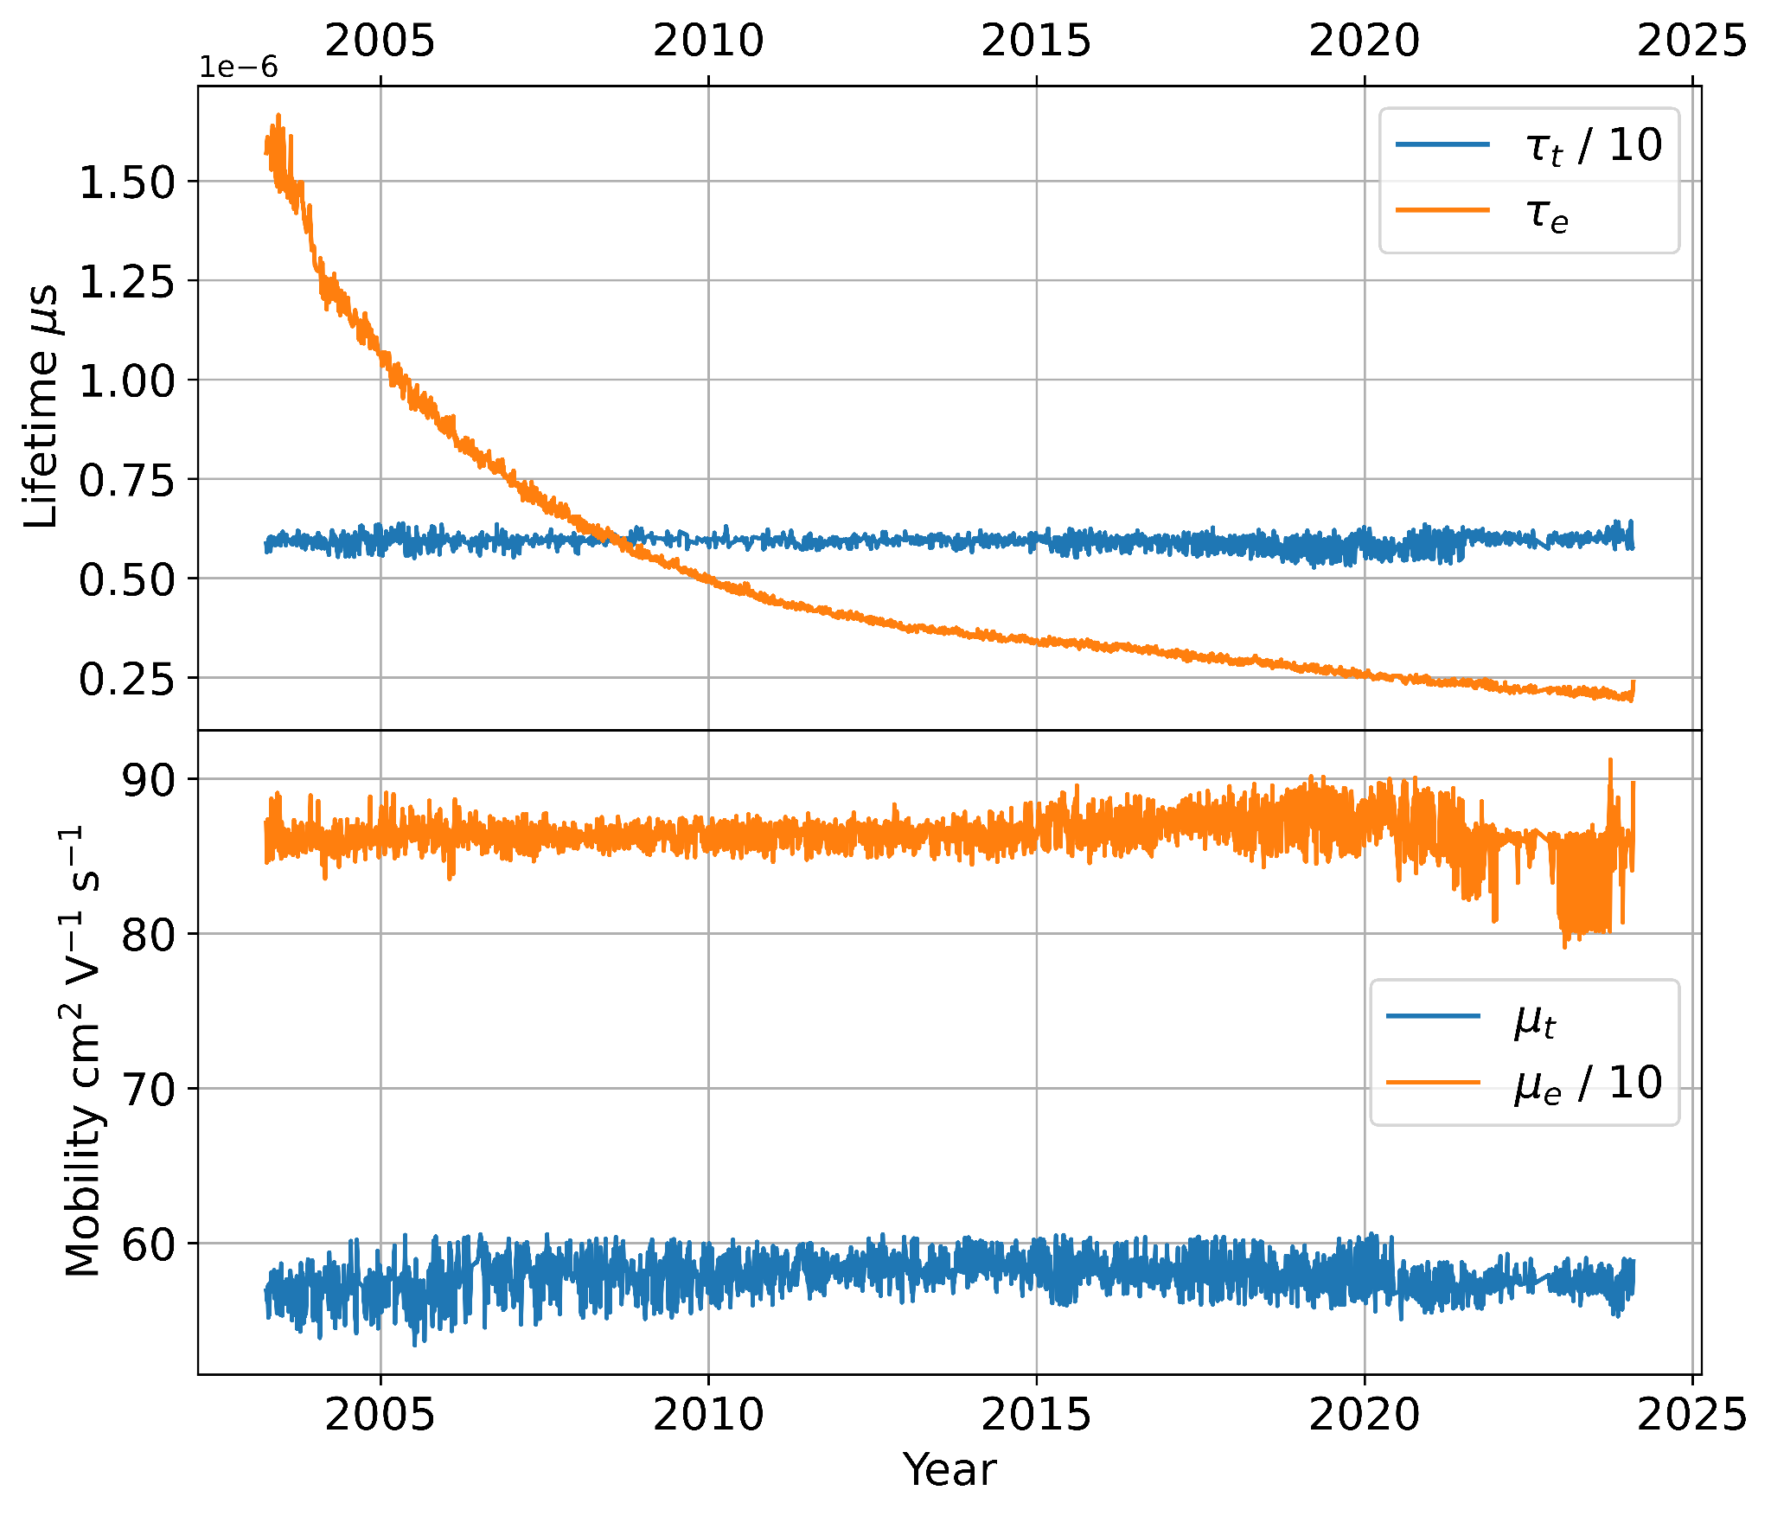
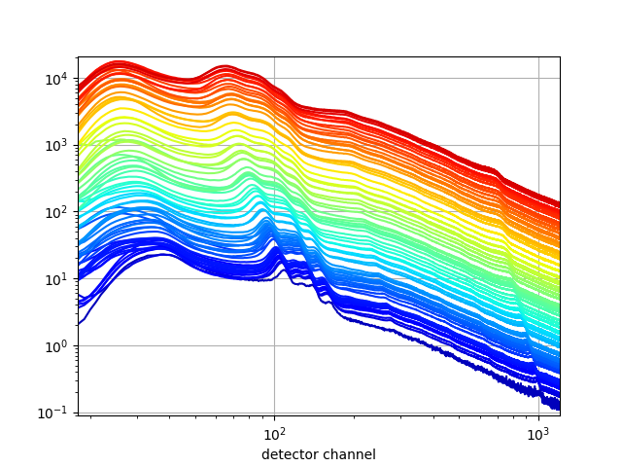
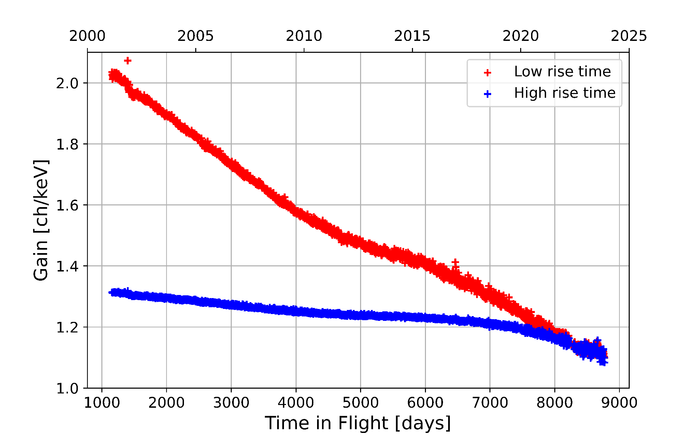
IBIS/ISGRI – detector evolution
In >20 years gain of ISGRI has decreased by factor ~2, driven by loss of electron lifetime in CdTe with irradiation
Low Threshold is fixed in Pulse Height; gain drop implies rise of the Low Threshold in keV. Resolution in the first approximation also degrades just because of gain drift.
2018
Meuris et al. (in prep)
2003
Evolution of uncorrected background spectrum
IJD [days]
Meuris et al. (in prep)

Slide 12
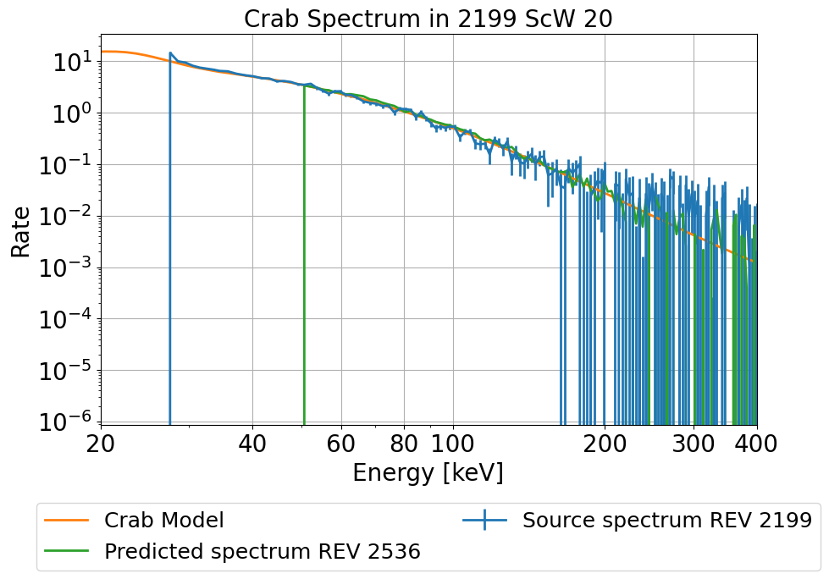
IBIS/ISGRI – Calibration
Above ~60 keV, mostly rely on models. However, two principal aspects are derived from data: low-energy efficiency and low-energy resolution. Focus on minimal number of parameters over long term: 5 + 1 parameters in each pixel subset in 3 years.
Phenomenological model that captures effects which are
understood in principle, but hard to model exactly.
Whenever possible, ISGRI efficiency fit is done with several
very bright sources of different spectral shape, using
INTEGRAL/SPI as a reference.
Energy cut-off due to detector evolution at lower energies with a marked significant evolution over last 5 years.
Current work focuses on updating calibration for ISGRI for recent data, from beginning of revolution 2020 to now. The predicted spectrum in green shows the expected Crab spectrum for revolution 2536 based on fitted efficiency.
New ISDC archive revision 4 in progress, reprocessing energy corrected events, GTIs, dead times for ISGRI, PICsIT, JEM-X and Compton events.

Slide 13
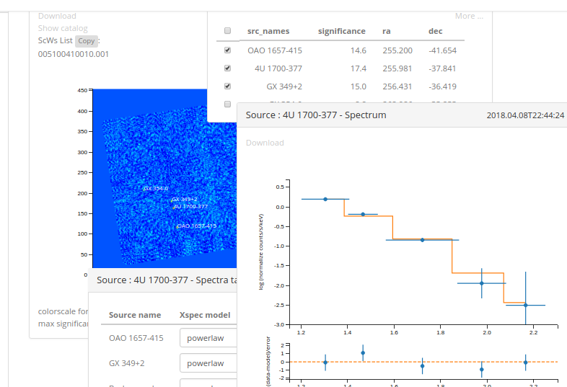
MMODA
Regular performance updates couple with long-term response model are expressed in Instrument Characteristics (IC), generated in a calibration pipeline.
Aiming towards final software release and eventual transitioning in legacy phase, special effort is made to handle the software, including calibration workflow, in a reproducible and maintainable way. Both source code and live containers are being provided.
Finally, as a part of a larger project, ISDC integrated this analysis workflow in the MMODA online analysis interface.

Slide 14
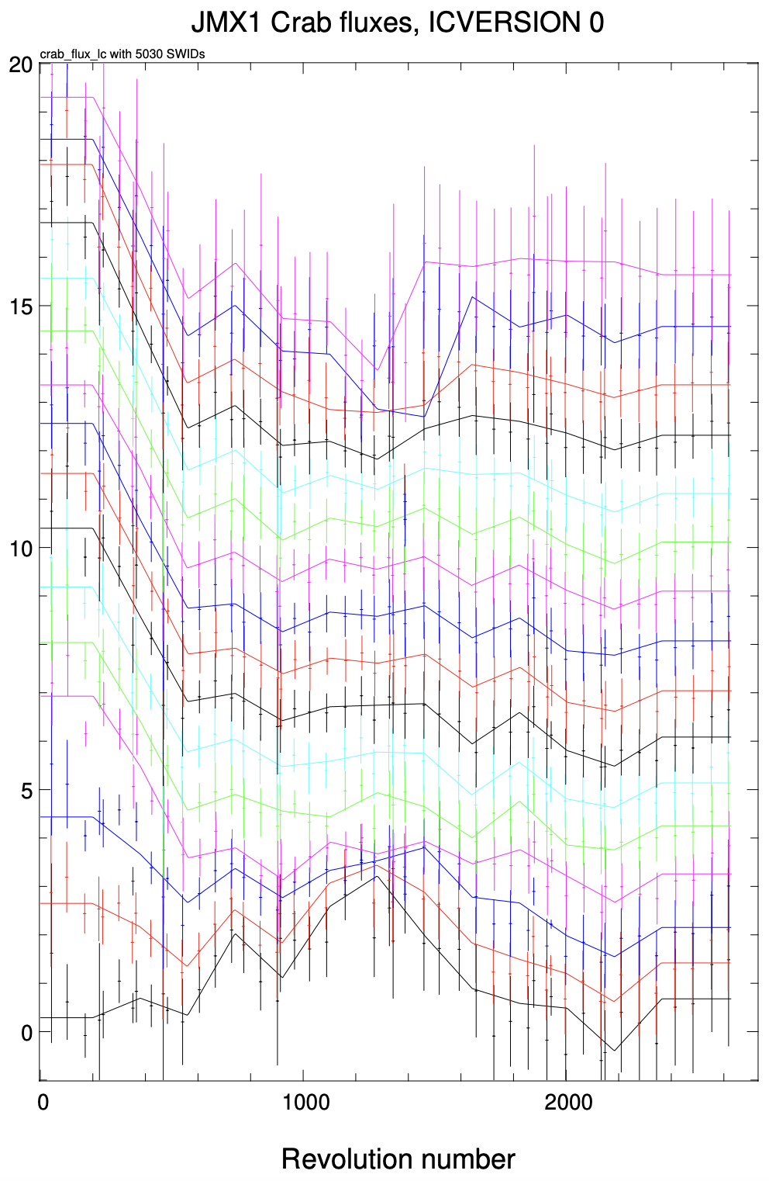
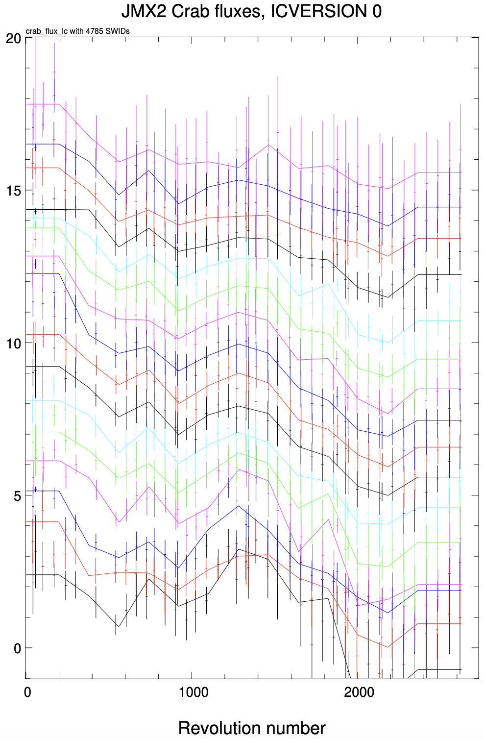
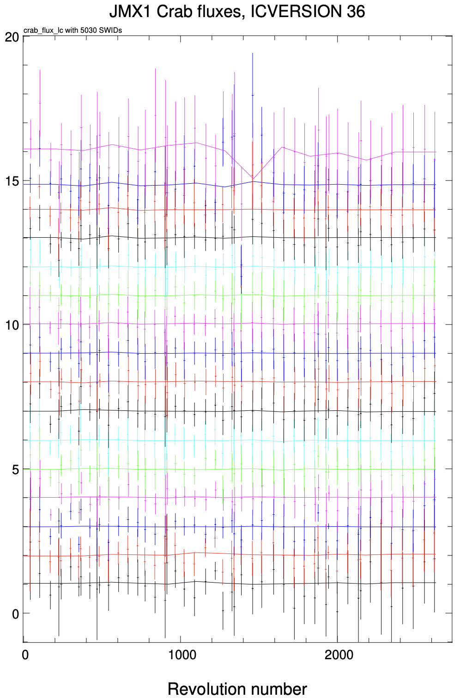
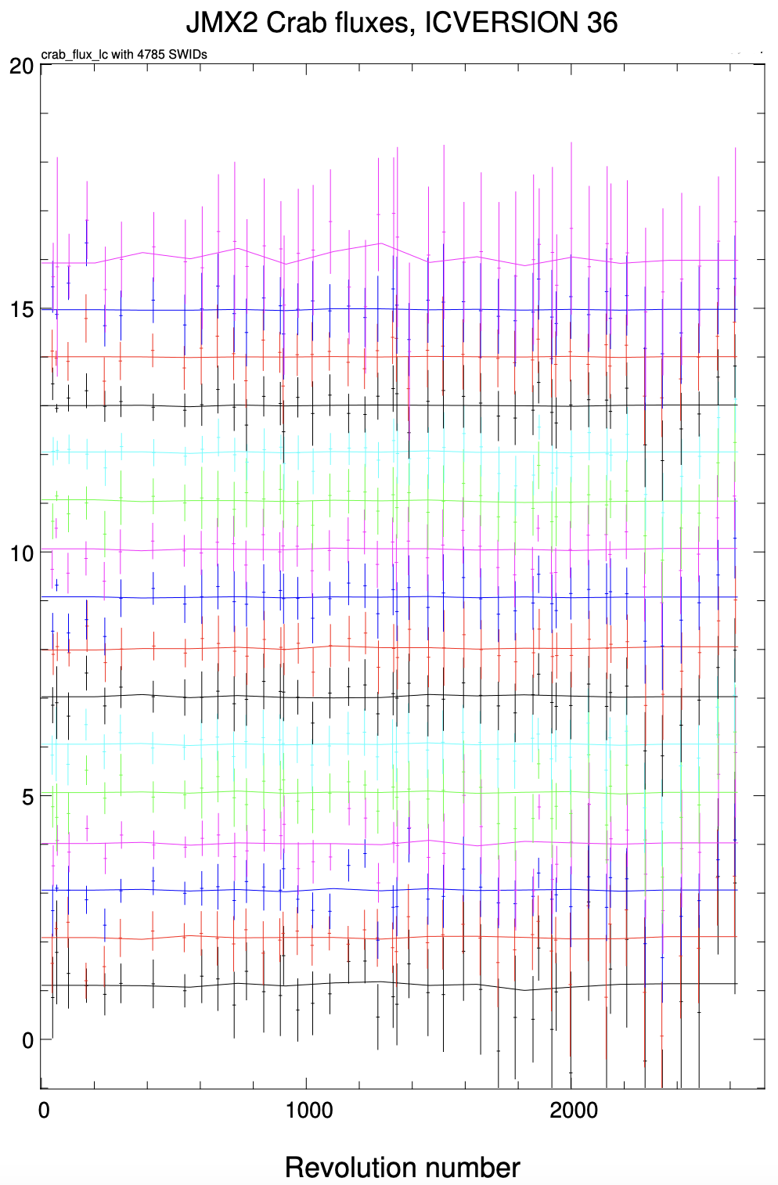
JEM-X long term calibration update I
27
27
Figure 1: Crab time-evolution of JEM-X relative count rates in 16 energy channels w/o long-term calibration correction accounting for the aging of detector plates and loss of anode strips.
Figure 2: Same as Fig. 1 after correction of the Instrument Model (IMOD) calibration.
The JEM-X performance appears normal, without abrupt changes in the instrument parameters based on the on-axis Crab calibration observations.
Credits: Gaurava Jaisawal, DTU Space
Notes:
IMOD: instrument model database.
The 16 energy channels are plotted vertically-offset for visibility purpose (from low to high energy).

Slide 15
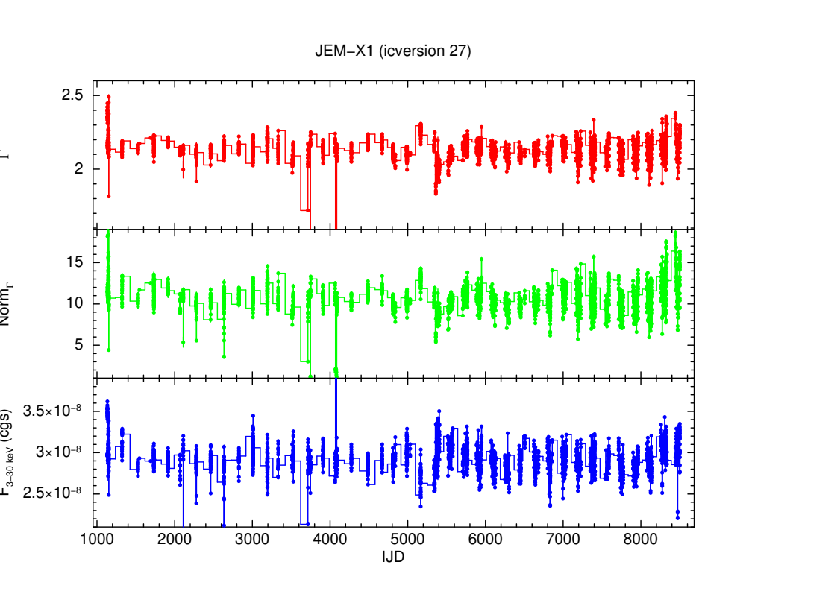
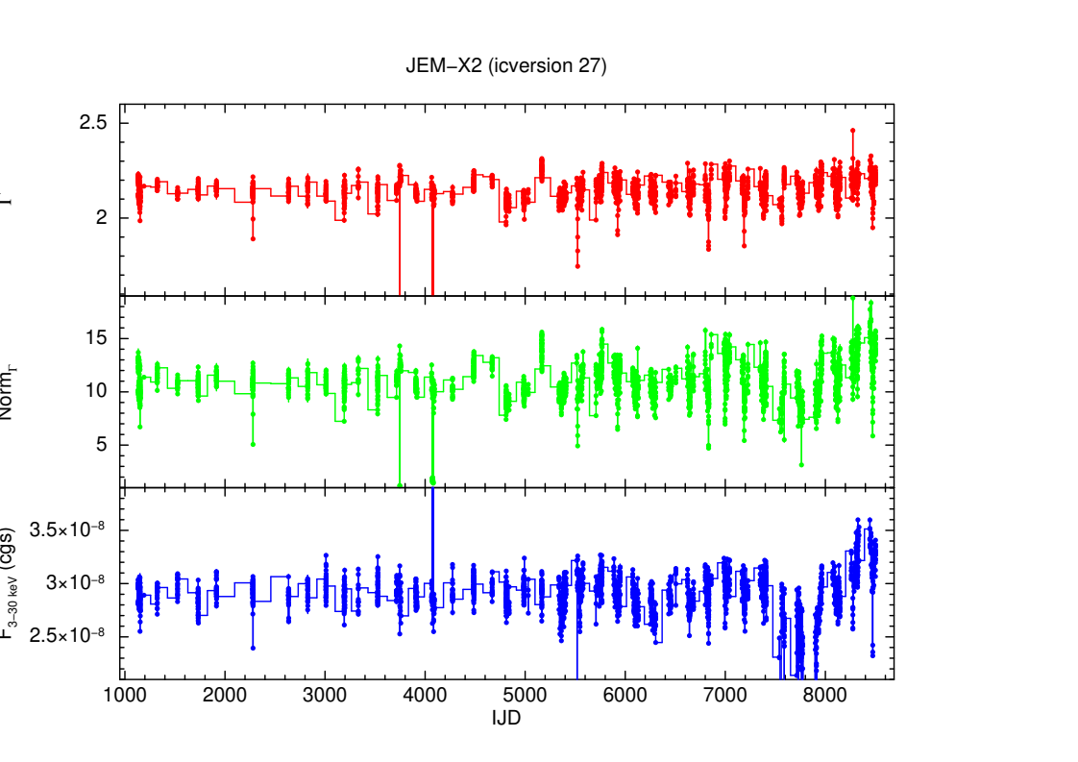
JEM-X long-term calibration update
Evolution of Crab spectral parameters after fitting JEM-X spectra from each ScW using latest instrument model update
JEM-X performance appears normal, without abrupt changes in Crab spectral parameters, except for extreme off-axis situations
Credits: Gaurava Jaisawal, DTU Space
Notes:
IMOD: instrument model database

Slide 16
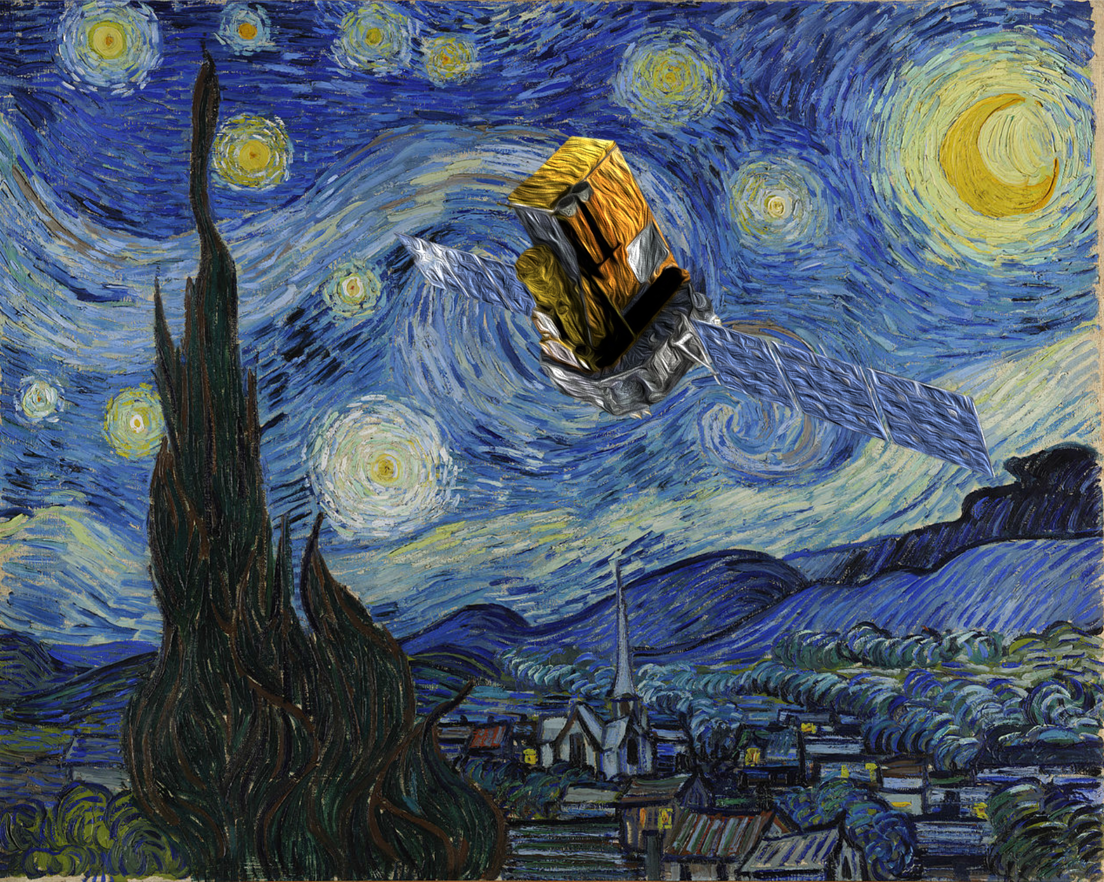
INTEGRAL – What next?
AO-21 January - December 2024
SPI annealing (last one!) May 2024
INTEGRAL 2024 Workshop "22 years of INTEGRAL: catching results and discoveries” 21-25 October 2024
End of science operations 31 December 2024
Post-operations phase 2025 – 2026: prepare for the Legacy archive
Re-entry February 2029...
Courtesy: Arash Bodaghee
Notes:
Here I list part of the key science capabilities. Both SPI and IBIS have a large FOV, of about 900 square degrees; IBIS can do arcmin localisation.
These capabilities allow for discovery and localization of new transients. It also allows for multi-source monitoring, for example, when we look at the Galactic Centre, the whole bulge region is visible.
By using the anti-coincidence shields around SPI and IBIS, INTEGRAL basically has access to the whole sky,
and allows for the detection of various transients such as GRBs and searching for prompt emission related to gravitational wave events, high-energy neutrino events, and fast radio bursts.
Both SPI and IBIS can perform hard X-ray polarisation studies on bright sources such as during gamma-ray bursts and X-ray transient outbursts.
INTEGRAL performs Target of Opportunity follow-up observations, with response times of less than a day.
Because of INTEGRAL’s wavelength coverage, it provides also synergy with other missions, such as the X-ray missions listed here and with gamma-ray missions like Fermi.

