Slide 1
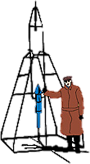
IACHEC May 2024
NICER Calibration Status Craig Markwardt (NASA/GSFC) on behalf of NICER Team
GSFC

Slide 2
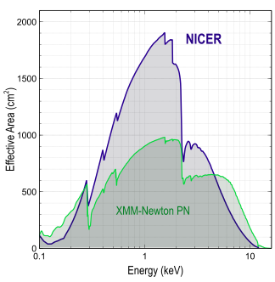
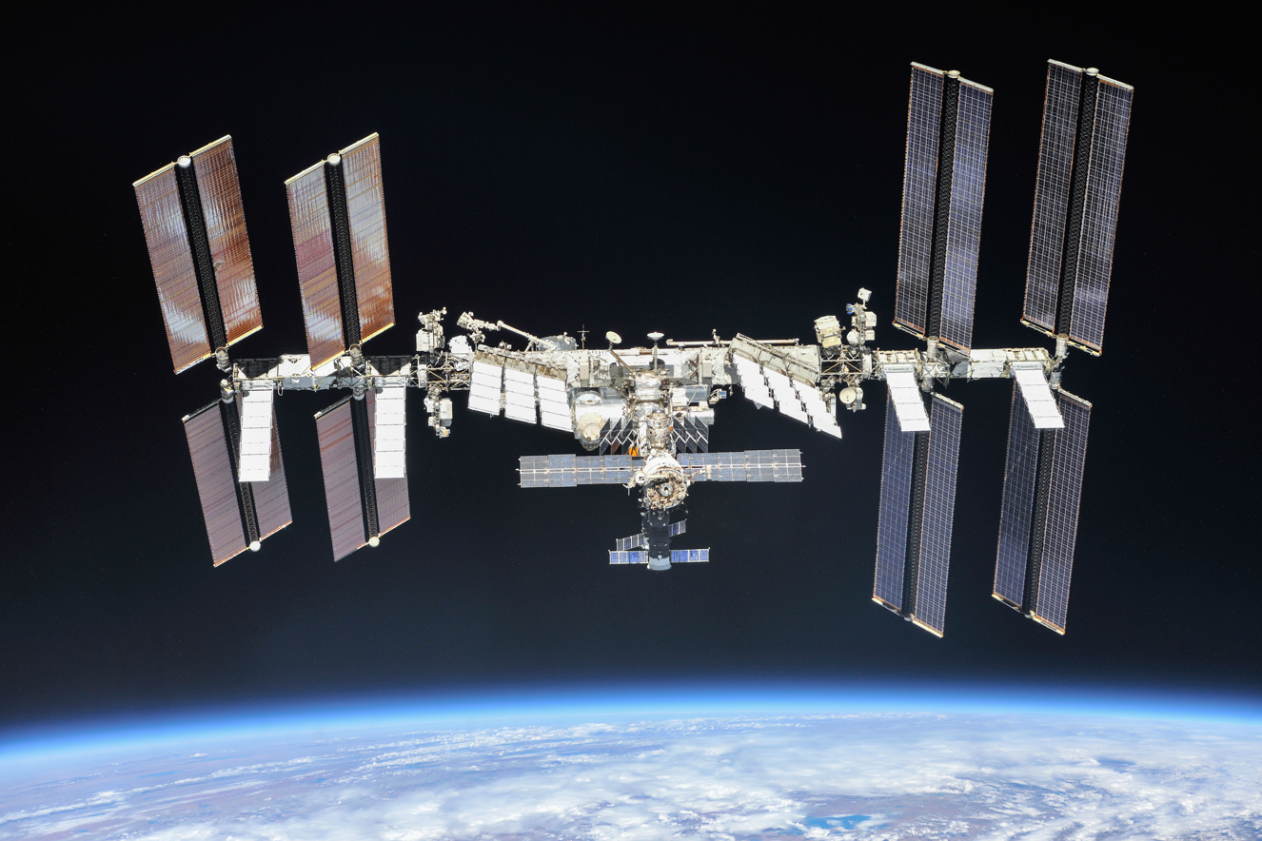
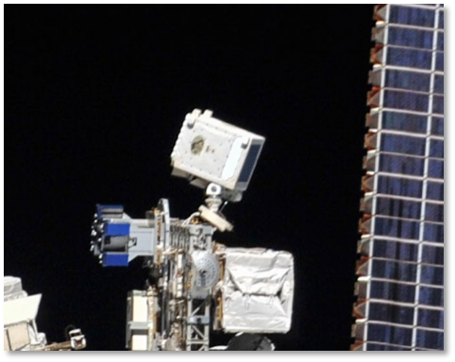
NICER’s Unique Capabilities
Launched June 2017 to International Space Station
Spectral band: 0.2–12 keV
52 operating single-pixel silicon detectors
Energy resolution: < 150 eV @ 6 keV
Comparable to X-ray CCDs
Timing resolution:
100 nsec RMS absolute
Non-imaging field of view (“single-pixel”)
6 arcmin diam. (half-max)
High throughput (3.5 Crabs with no pileup)

Slide 3
Outline
NICER Calibration Status
Optical Light Leak and Repair
SCORPEON background model update
Future Calibration Plans

Slide 4
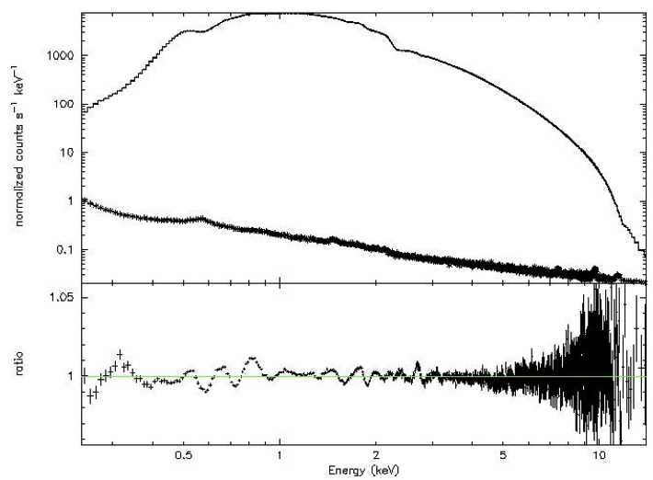
NICER Calibration Status
NICER calibration remains very stable
No appreciable changes since 2021
Major impact of optical light leak
Other calibration aspects
Energy scale: monitoring drifts of few eV / yr
ARF: systematic feature errors <1.5% (0.4-10 keV)
RMF: Scholze & Procop X-ray silicon model
NICER Crab

Slide 5
NICER Optical Light Leak
Onset
Impacts
Repair

Slide 6
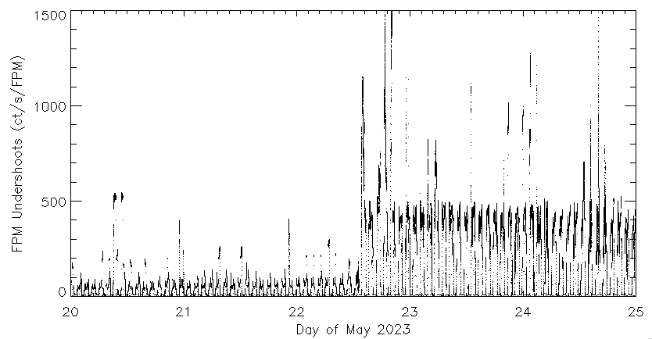
Light Leak Onset
Onset is apparent near 13:15 UTC on 2023-05-22
Increased levels of optical light loading (“undershoots”) during orbit day

Slide 7
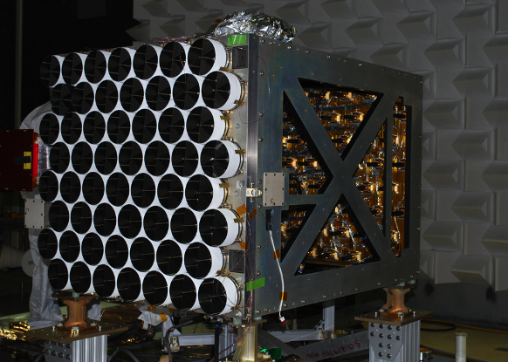
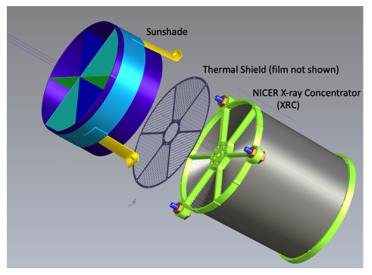
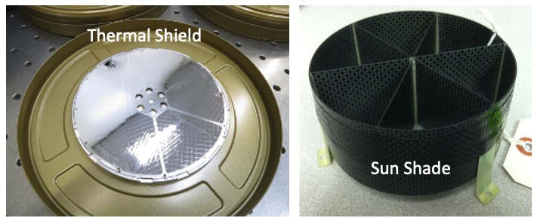
NICER X-ray Concentrator Assembly

Slide 8
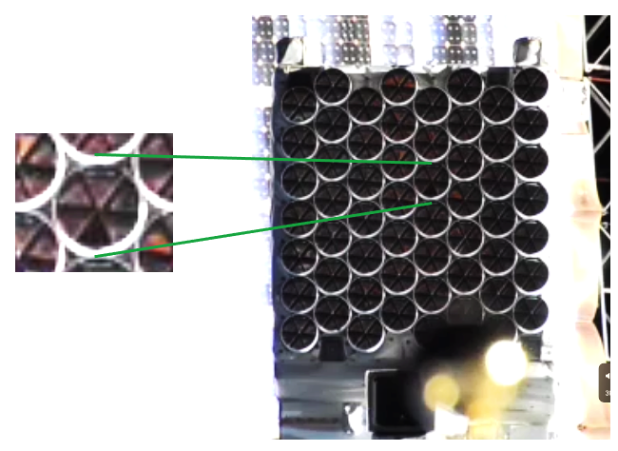
NICER Damage Due to Light Leak
Photographic survey shows damaged optical films
Higher fidelity surveys have been performed

Slide 9
Light Leak Impacts
Primary impact is increased optical light loading
Increased optical light by factor of 5x-10x during orbit day
Much higher telemetry loads
Extreme loading can push energy scale out of calibration
Consequences
NICER avoids targets within ~100 deg of sun during orbit day
Reduced ToO and long-term monitoring opportunities
Lower level X-ray threshold increased to ~0.43 keV during orbit day to avoid noisy telemetry
X-ray performance is unchanged!
Data during orbit night is still excellent, much of orbit day data is excellent as well, within observing constraints
No detectable change to X-ray throughput for modules with known holes, to within few percent (Jeremy Hare work)

Slide 10
Other Calibration/Software Impacts
Response and background calculators re-parameterized to handle day/night threshold adjustments
Better screening for science data

Slide 11
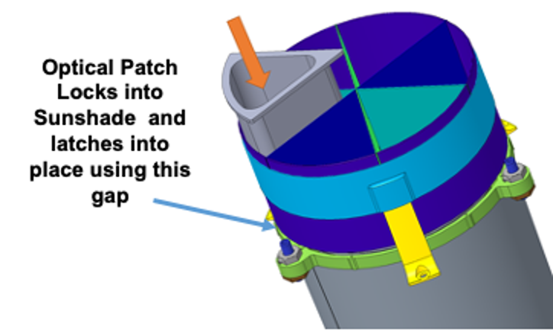
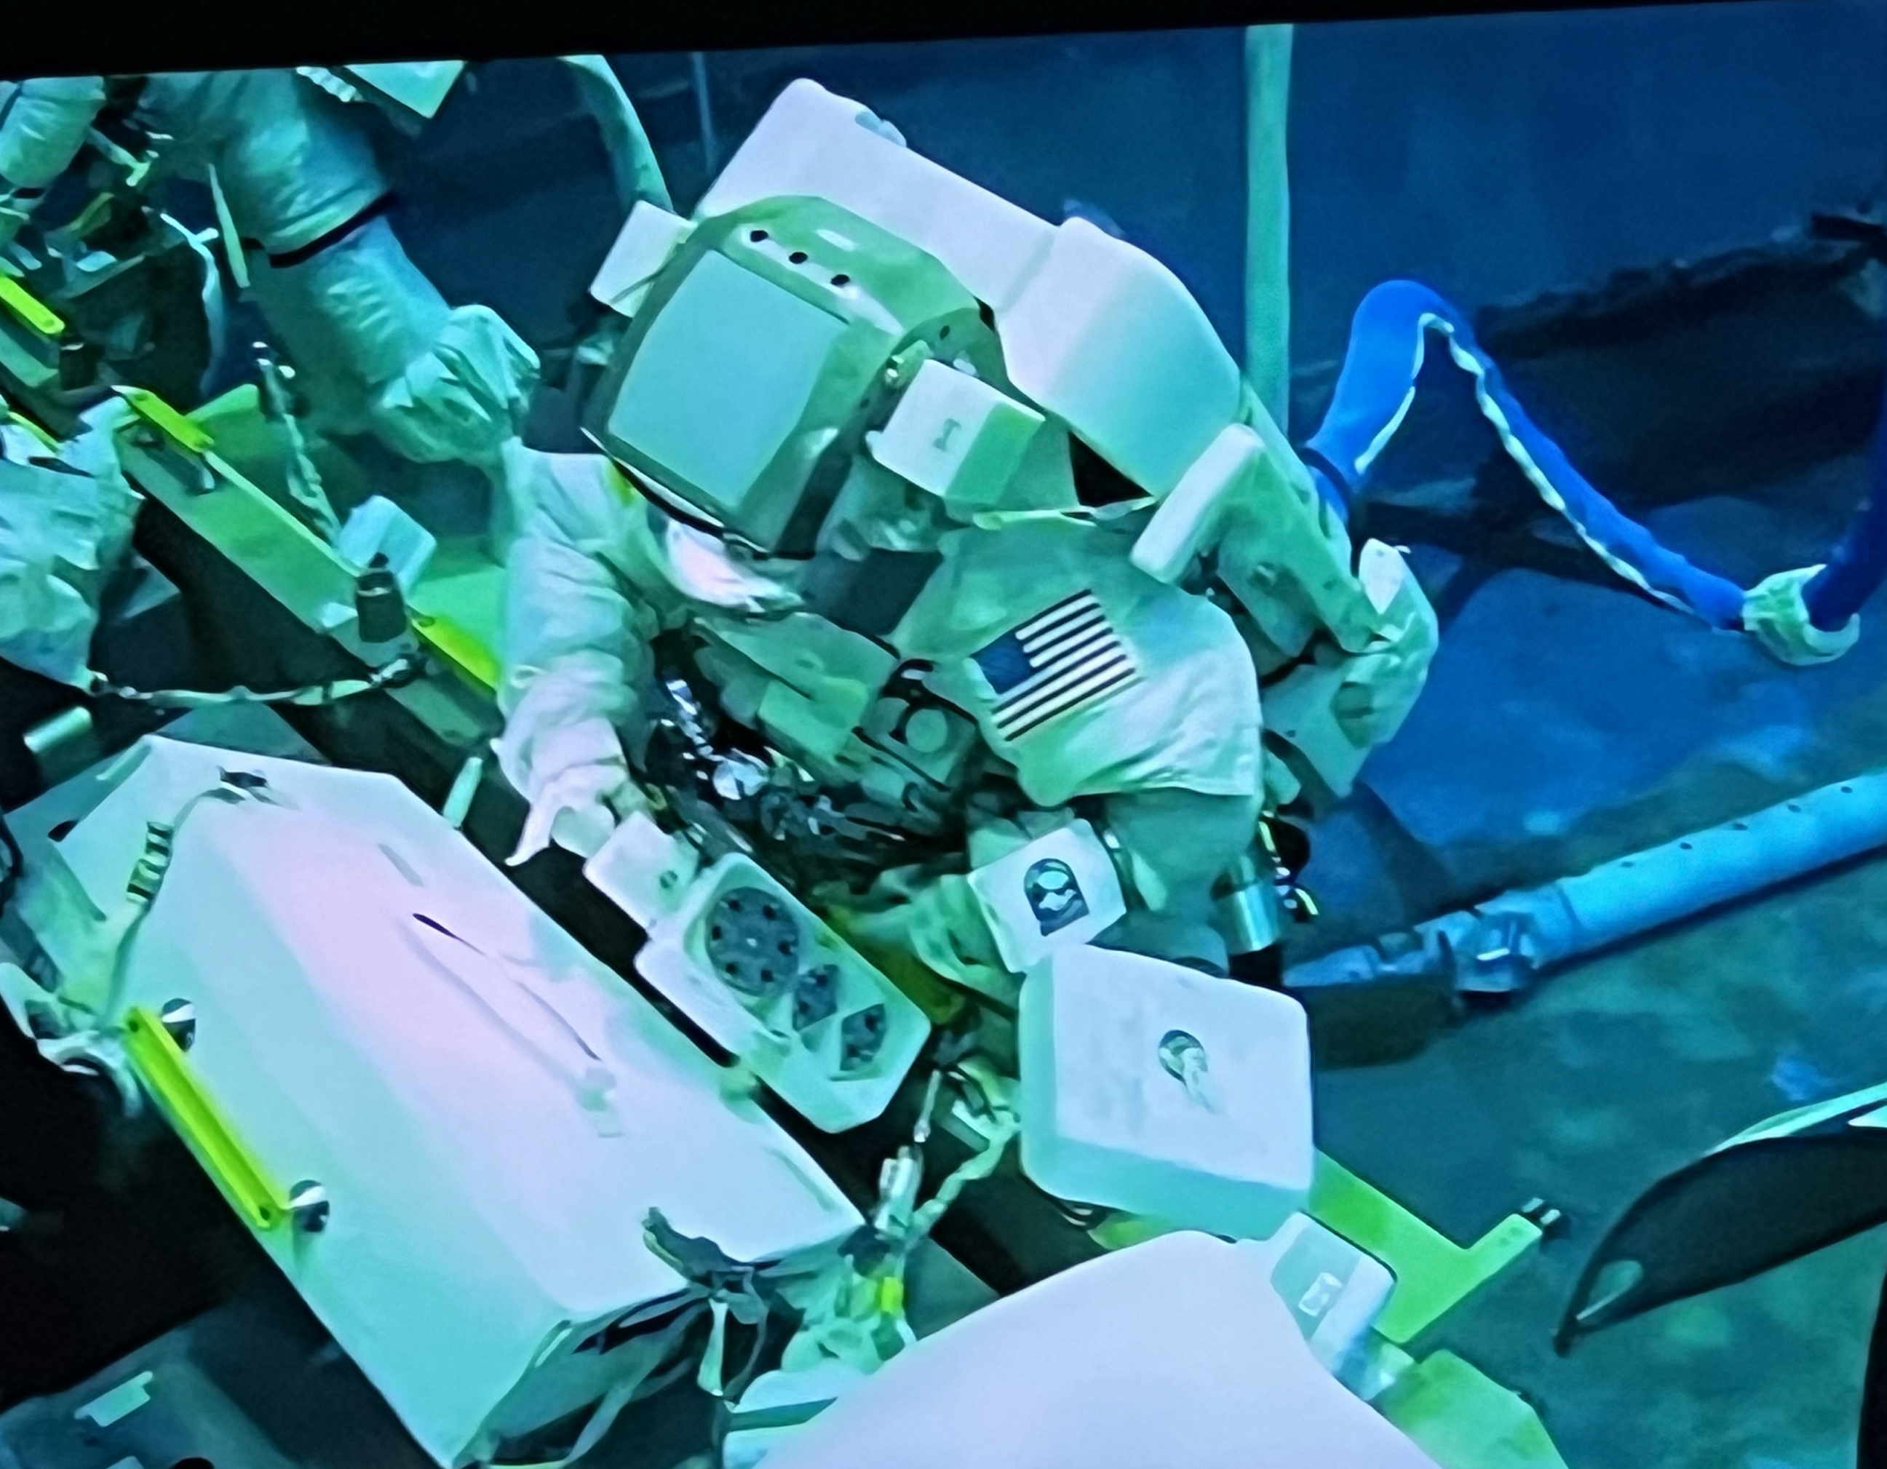
NICER Repair is Approved
Repair patches installed during EVA (“space-walk”)
Jan – approved
May – flight hardware completed
May-Jul – testing
Aug 3 – planned launch
Nov – possible installation EVA
Install locations based on photo survey (5 targets, 7 spares)
NASA Neutral Buoyancy Lab Testing

Slide 12
Post-Repair Calibration Plans
Each patch removes exactly 1/6th of module effective area
”Delta” calibration plan
Verification of successful patch by pointing near sun during orbit day, noting reduction in optical loading
Observation of bright X-ray target (Crab, if visible) to verify effective area losses in repaired modules

Slide 13
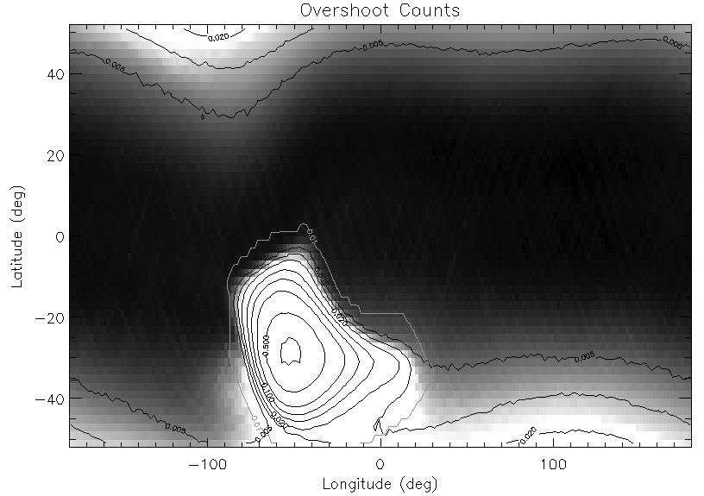
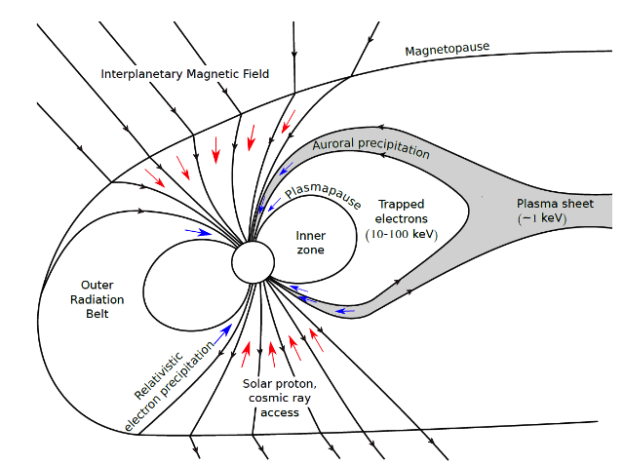
NICER SCORPEON
Trapped Electrons
(TREL)
SCORPEON is a parameterized NICER background model
Attempt at physically motivated components
A-priori estimated norms, but XSPEC fitting allowed
Released Jan 2023
Feedback: SCORPEON becoming popular, primarily it always provides an estimate
21 refereed pubs
Cosmic Rays (COR)
SAA
Precipitating Electrons (PREL)
Thorne et al 1980 Tyssoy presentation

Slide 14
Summer 2024 Calibration Updates
Several known minor problems in response generation
Expect ~5% change in flux scale
Based on improved deadtime understanding
Expect 0.05 change in power law shape
Remove non-physical fit of optic geometric area
Expect low energy threshold shift ~5 eV
Based on observations of HZ43, RX J1856, Crab
Deal with NICER patch repair (loss of area due to patch blockage, 5-7 pie wedges)
The goal will be to maintain “old approach” and “new approach” calibration in parallel for some time

