Slide 1
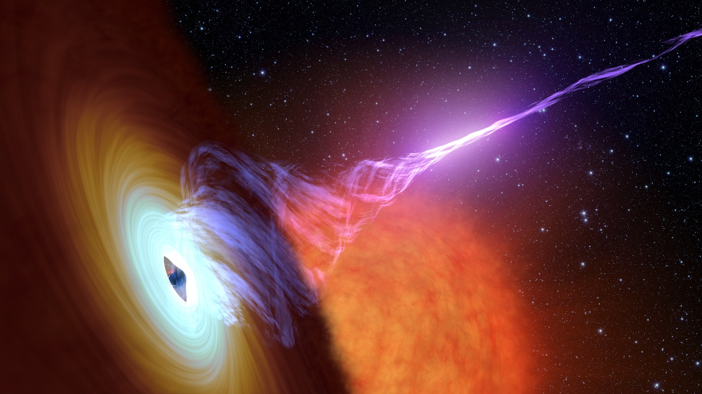
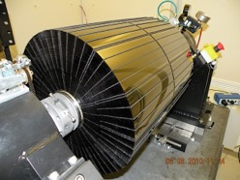
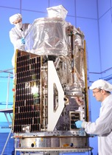
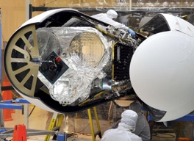

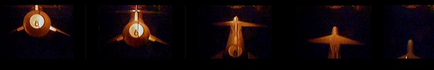
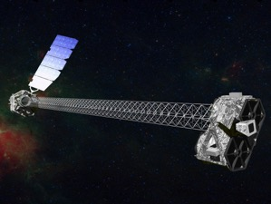
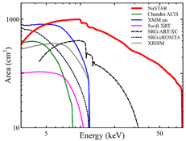
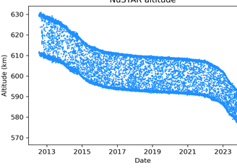
NuSTAR
Observatory
Status
16th IACHEC meeting
Parador de La Granja
May 13 - 17, 2024
Karl Forster, NuSTAR SOC

Slide 2
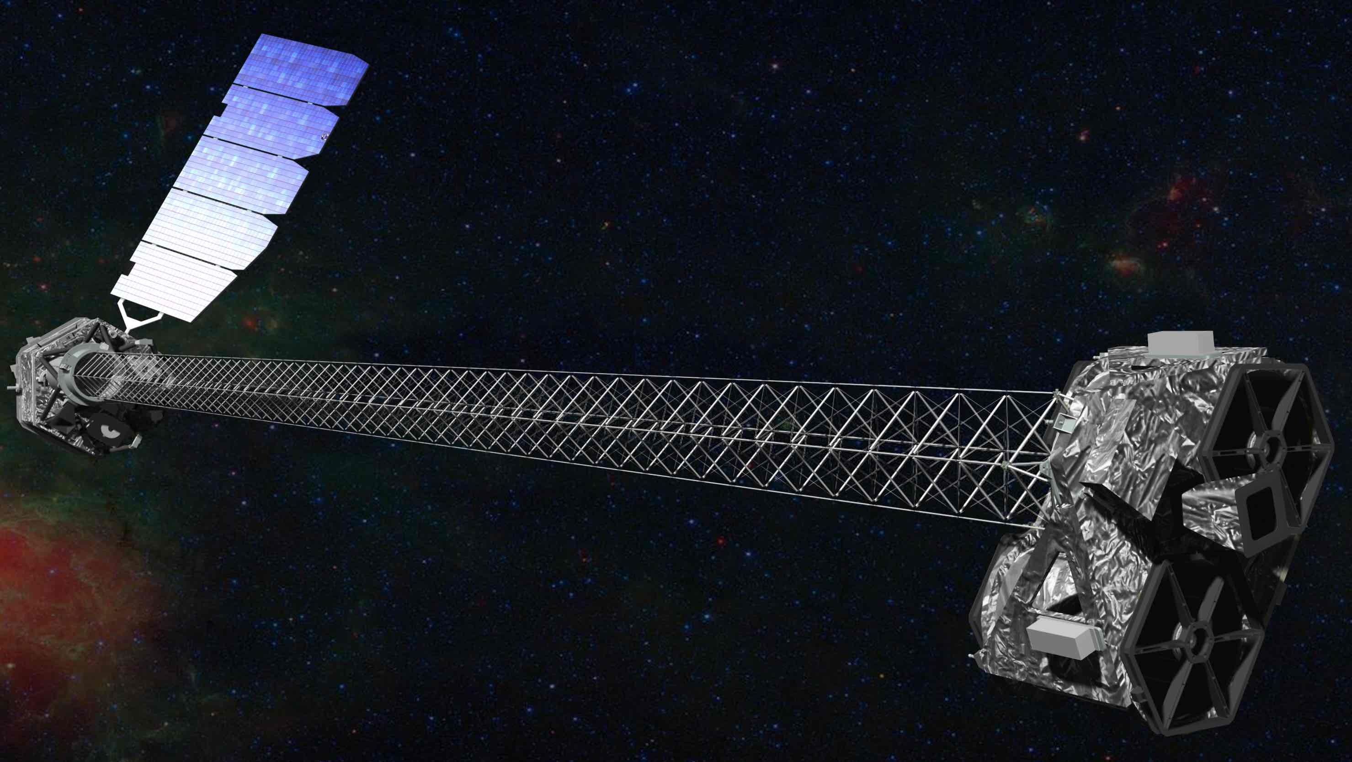
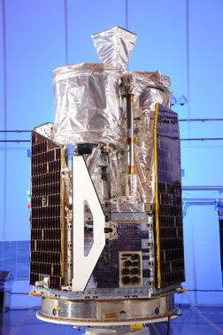
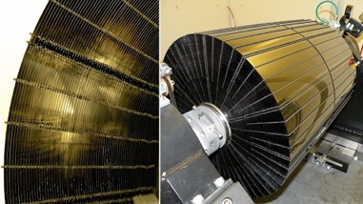
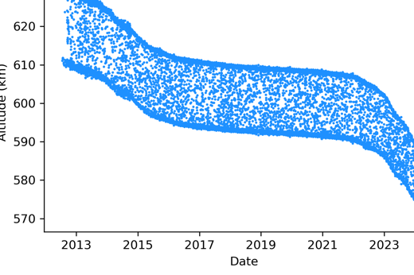

NuSTAR Observatory
NASA small explorer astrophysics mission
PI Fiona Harrison (Caltech)
Partners: ASI, SSDC, DTK, HEASARC, UCB-SSL
Launched on June 13th, 2012, 620 km, 6° orbit
Northrop Grumman LeoStar-2 spacecraft bus
Science Operations at Caltech
Mission Operations at UCB-SSL
NASA approved funding to 2025 (3-year renewal)
2 Optics Modules
Conical Wolter-I approximation
  133 shells (43 W/Si, 90 Pt/C)
  HPD = 1 arcminute
  FOV = 12’ x 12'
10.14m focal length
deployed Mast
CdZnTe detectors
4x(32x32 pixels)
Resolution:
400 eV @ 6 keV
900 eV @ 60 keV
2 ms time resolution
60 $μ$s with clock correction
No consumables
Single string
> 20 year orbit lifetime
NuSTAR status – IACHEC, Parador de La Granja, May 2024 – Karl Forster

Slide 3
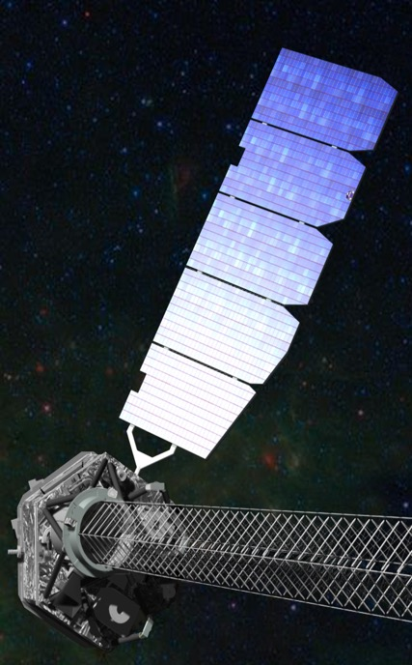
NuSTAR Observatory
Nominal
NuSTAR status – IACHEC, Parador de La Granja, May 2024 – Karl Forster

Slide 4
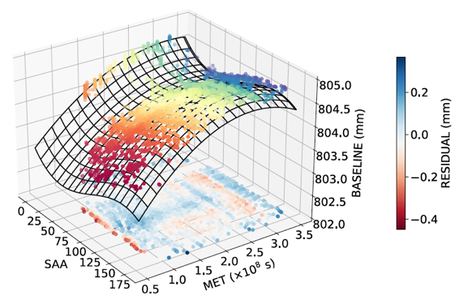
NuSTAR Observatory
Laser Metrology System
stabilized
Implemented an adjustment of the operating duty cycle of the lasers in 2020 Produced significant improvement in rate of decline of laser intensity
Indicates that, with no further changes, the metrology system should remain nominal for another 9 years
Additional adjustments can be made to extend laser lifetime
Earnshaw et al. 2021 JATIS 8.1.014009
Laser Metrology System tracks the relative motion of optics with respect to CZT X-ray detectors (10m mast!)
  Metrology data is used by ground processing software to reconstruct:
    Location of optical axes
    With star tracker camera on optics bench the sky position of events recorded in CZT
NuSTARDAS release - summer 2024
Continue analysis if single laser operations are ever implemented (SSDC + Hannah Earnshaw)
NuSTAR status – IACHEC, Parador de La Granja, May 2024 – Karl Forster

Slide 5
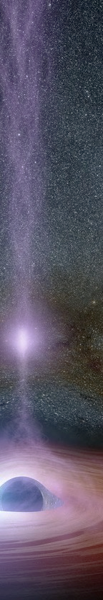
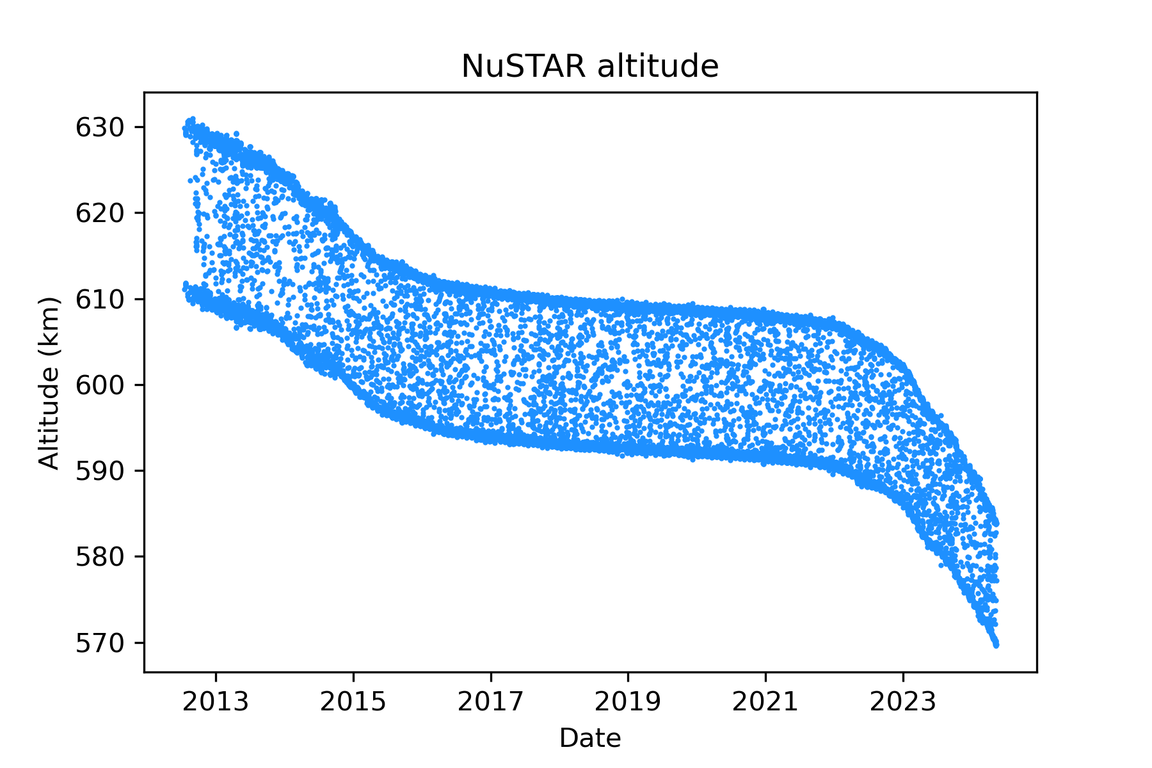
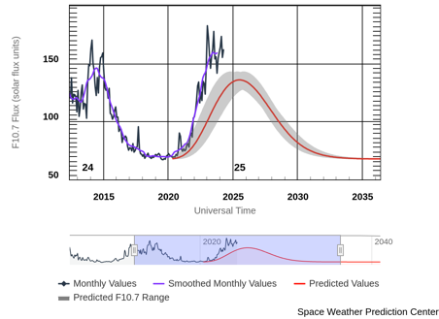
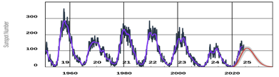
NuSTAR orbit
NuSTAR Orbit Altitude
Expect nominal operations past Solar maximum
Solar cycle 25 start
December 2019
Solar cycle 24 peak
April 2014
2024-05-12 update
NuSTAR status – IACHEC, Parador de La Granja, May 2024 – Karl Forster

Slide 6
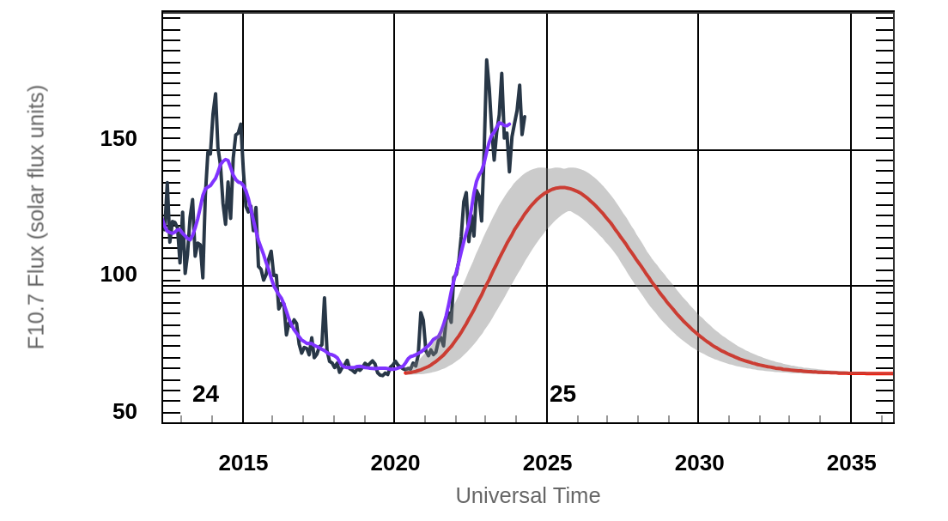
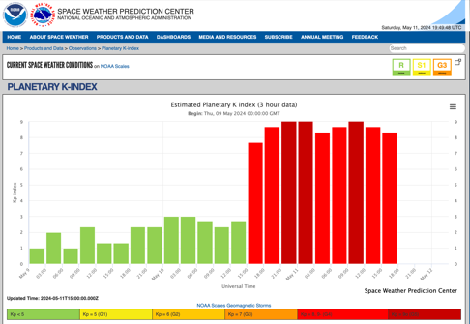
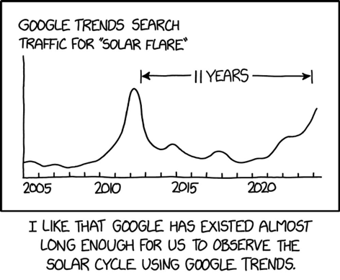

NuSTAR orbit
Expect nominal operations past Solar maximum
XKCD.com/2930
www.swpc.noaa.gov
NuSTAR status – IACHEC, Parador de La Granja, May 2024 – Karl Forster

Slide 7

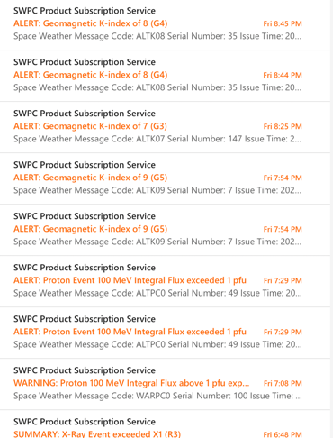
NuSTAR orbit
May 11th
SEVERE
EXTREME
NuSTAR status – IACHEC, Parador de La Granja, May 2024 – Karl Forster

Slide 8

NuSTAR Synergies
Energy Range: 3 – 78 keV
(pre-launch)
Stray light
~100 keV
NuSTAR status – IACHEC, Parador de La Granja, May 2024 – Karl Forster

Slide 9
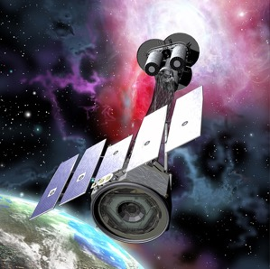
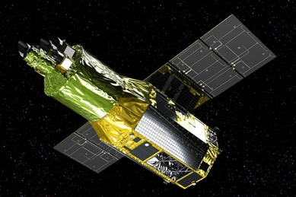

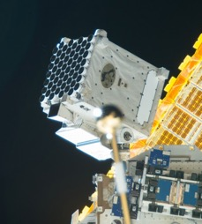
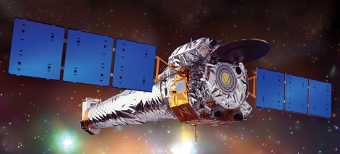
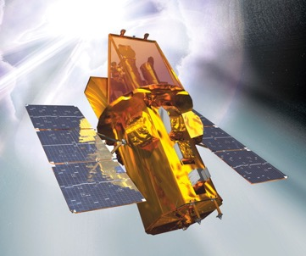
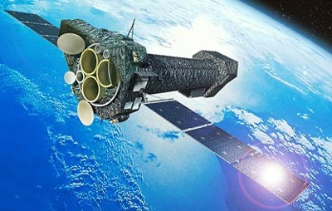
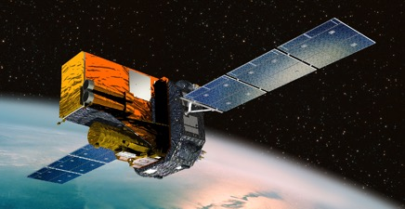
NuSTAR Synergies
Joint Observing Programs
Coordinated cross-calibration observations
XRISM
IXPE
Chandra
NICER
INTEGRAL
XMM-Newton
Gehrels-Swift
NuSTAR status – IACHEC, Parador de La Granja, May 2024 – Karl Forster

Slide 10

500 ks NuSTAR time provided to IXPE GO program
NuSTAR Synergies
Joint Observing Programs
Coordinated cross-calibration observations
XRISM
IXPE
Joint NuSTAR / XRISM GO programs?
Chandra
NICER
INTEGRAL
XMM-Newton
Gehrels-Swift
NuSTAR status – IACHEC, Parador de La Granja, May 2024 – Karl Forster

Slide 11
NuSTAR calibration history
https://nustarsoc.caltech.edu/NuSTAR_Public/NuSTAROperationSite/software_calibration.php#CALDB
Date | Description
2013-08-14 | Initial CALDB public release
2013-11-25 | ARF adjustment (-15% NuSTAR flux)
2014-01-17 | VIGN adjustment
2014-07-01 | Gain calibration improvement
2015-03-20 | Full mission Gain adjustment
2016-06-06 | Update gain, effective area, line of sight absorption
2019-12-13/19 | Update long term gain tracking
2020-05-06 | High resolution clock correction
2020-08-13 | Temperature-dependent ARF implemented
2021-02-23 | Observatory alignment update
2021-10-26 | Observatory calibration update based on 9-years of crab observations
2022-05-10 | FPMA DET2 long term gain adjustment
2024-03-11 | FPMA DET0 long-term gain adjustment. Remove temperature dependent ARF capability
1 year after start of science operations
Based on IACHEC cross-calibration to better match
XMM/Swift/Chandra measurements
allows 100 microsecond accuracy for some observations
NuSTAR status – IACHEC, Parador de La Granja, May 2024 – Karl Forster

Slide 12
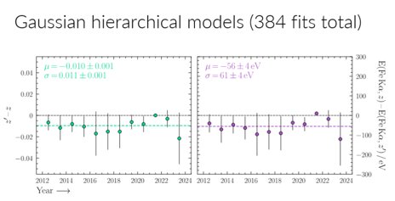
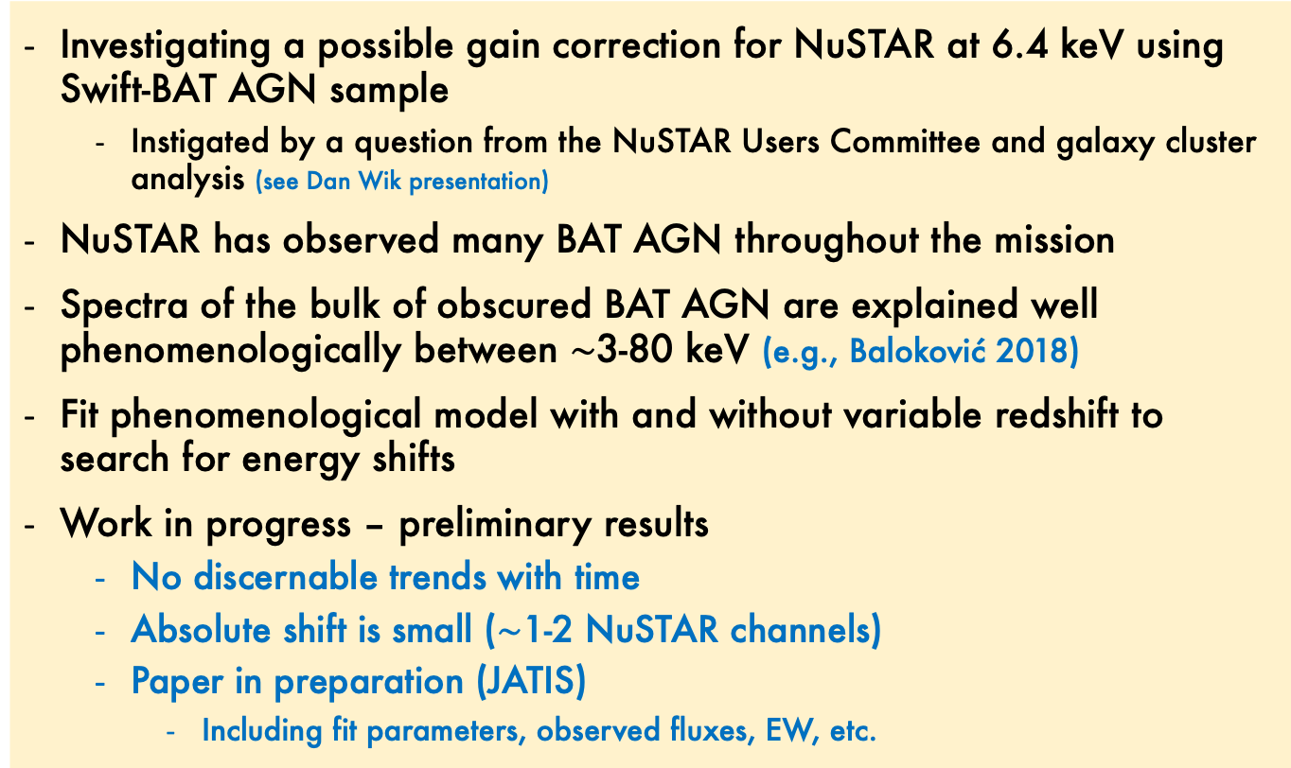
Estimating NuSTAR gain with BAT AGN
Peter Boorman (Caltech)
Investigating a possible gain correction for NuSTAR at 6.4 keV using Swift-BAT AGN sample
  Instigated by a question from the NuSTAR Users Committee and galaxy cluster analysis (see Dan Wik presentation)
NuSTAR has observed many BAT AGN throughout the mission
Spectra of the bulk of obscured BAT AGN are explained well phenomenologically between $\sim$3-80 keV (e.g., Baloković 2018)
Fit phenomenological model with and without variable redshift to search for energy shifts
Work in progress – preliminary results
  No discernable trends with time
  Absolute shift is small ($\sim$1-2 NuSTAR channels)
  Paper in preparation (JATIS)
    Including fit parameters, observed fluxes, EW, etc.
NuSTAR status – IACHEC, Parador de La Granja, May 2024 – Karl Forster

Slide 13


Estimating NuSTAR gain with BAT AGN
Peter Boorman (Caltech)
Investigating a possible gain correction for NuSTAR at 6.4 keV using Swift-BAT AGN sample
  Instigated by questions from NuSTAR Users Committee and galaxy cluster analysis
NuSTAR has observed many BAT AGN throughout the mission
The bulk of obscured BAT AGN are explained well phenomenologically between ~3-80 keV (e.g., Baloković 2018)
Fit phenomenological model with and without variable redshift to search for energy shifts
Work in progress – preliminary results
  No discernable trends with time
  Absolute shift is small ($\sim$1-2 NuSTAR channels)
  Paper in preparation (JATIS)
    Including fit parameters, observed fluxes, EW, etc.
mean blueshift
1 channel = 40 eV
NuSTAR status – IACHEC, Parador de La Granja, May 2024 – Karl Forster

Slide 14
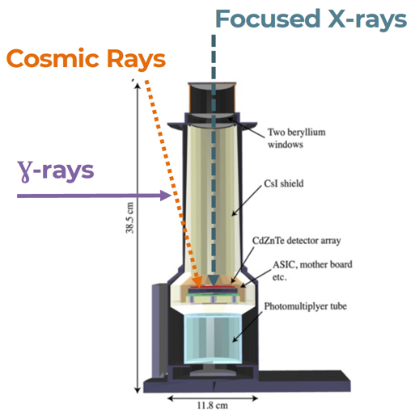
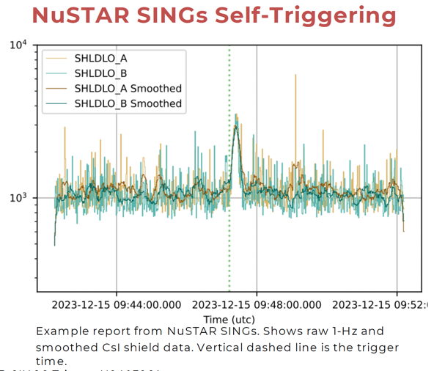
NuSTAR Search for INteresting
Gamma-ray Signals (SINGS)
Brian Grefenstette (Caltech)
NuSTAR SINGS uses the data from the NuSTAR CsI anti-coincidence shields and X-ray detectors to search from prompt emission from gamma-ray bursts.
  The CsI anti-coincidence shields provide a large effective area for GRBs far from the optical axis of the observatory.
Post-facto search for GRBs detected by other observatories in the 2022-2023 time range resulted in the detection of several "famous" GRBs - such as GRB 221009A and GRB 230307A.
This led to the development of a "real time" detection pipeline that searches the telemetry stream for signs of GRBs and has identified roughly one GRB per month.
  Self-triggering algorithm running on shield data (long GRBs) and CdZnTe events (“short GRBs”).
  Runs twice daily as data are received at the SOC
Visit nustarsoc.caltech.edu/NuSTAR_Public/grbs/ for more information
Post-facto Focused X-rays travel down the “barrel” of the shield
X-ray counts coincident with “shield hits” from cosmic rays veto’d on board or in software
“Shield rates” digitized at 1 Hz gives the combination of cosmic rays and Ɣ-rays on the shields.
No spectral information
  one low-level discriminator at ~30 keV
NuSTAR status – IACHEC, Parador de La Granja, May 2024 – Karl Forster

Slide 15
Multi-mission scientific investigations
Doug Van Orsow (GSFC)
NuSTAR publications reporting coordinated observations
Of the 1456 NuSTAR refereed publications from launch through March 2024 involving analysis of observations coordinated in time:
314 papers NuSTAR + Swift data
  not completely surprising since Swift performs coordinated snapshots for any NuSTAR observation that isn’t coordinated with another soft X-ray mission.
297 papers NuSTAR + XMM-Newton data
>60 papers NuSTAR + NICER or Chandra data
>30 papers NuSTAR + Fermi or Suzaku data
>10 papers NuSTAR + HST, IXPE, MAXI, INTEGRAL data
NuSTAR status – IACHEC, Parador de La Granja, May 2024 – Karl Forster

Slide 16
Multi-mission scientific investigations
Doug Van Orsow (GSFC)
NuSTAR publications reporting coordinated observations
Of the 1456 NuSTAR refereed publications from launch through March 2024 involving analysis of multi-mission observations:
734 papers NuSTAR + Swift data
  not completely surprising since Swift performs coordinated snapshots for any NuSTAR observation that isn’t coordinated with another soft X-ray mission.
635 papers NuSTAR + XMM-Newton data
372 papers NuSTAR + Chandra data
>100 papers NuSTAR + NICER, Fermi, Suzaku, MAXI data
>50 papers NuSTAR + HST, WISE, INTEGRAL, RXTE data
double!
NuSTAR status – IACHEC, Parador de La Granja, May 2024 – Karl Forster

Slide 17
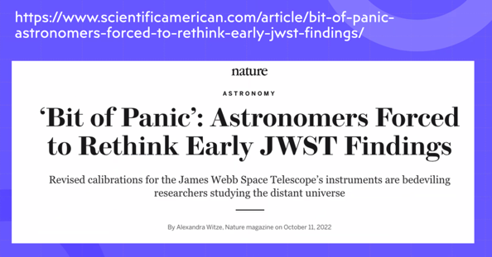
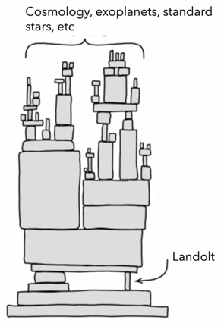
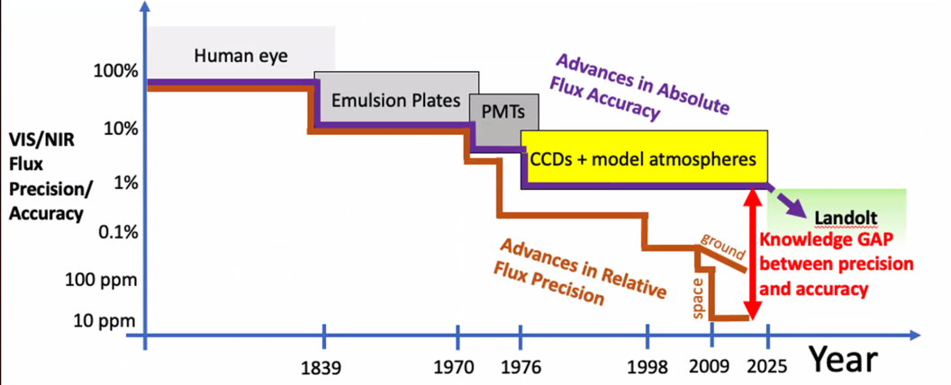
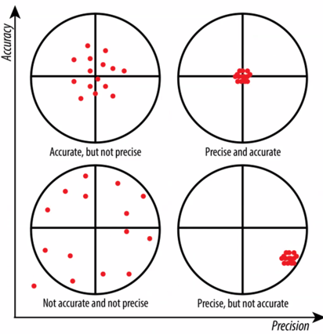
IACHEC is not alone...
...shamelessly stolen from presentation by:
Dr. Peter Plavchan, George Mason University
PI of Landolt mission (NASA PIONEERS) with NIST calibration
High accuracy NIST calibrated suite of single-mode fiber-fed laser beacons
Observable from selected ground-based observatory stations.
Landolt will improve the photometric accuracy to <0.5% at visible (VIS) and near-infrared (NIR) wavelengths for >60 target stars
  improving upon the half-century old techniques that use ground-based blackbodies and calibrated lamps along with model stellar atmospheres and sounding rocket measurements.
The Landolt mission will allow us to re-calibrate the brightness of millions of stars.
  Such measurements can only be achieved by a space-based orbiting artificial star, where the physical photon flux is accurately known.
XKCD.com
NuSTAR status – IACHEC, Parador de La Granja, May 2024 – Karl Forster

Slide 18
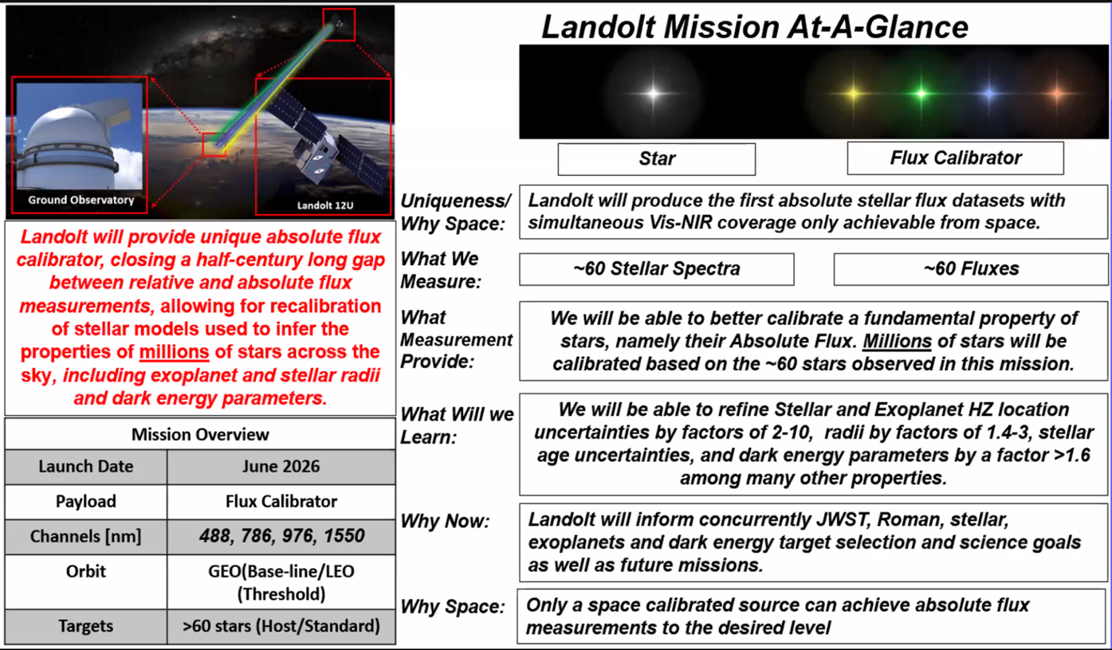

IACHEC is not alone...
Credit: Peter Plavchan (GMU)
STScI - abstracts due May 31
NuSTAR status – IACHEC, Parador de La Granja, May 2024 – Karl Forster

Slide 19
NuSTAR Summary
Observatory status is green
Observatory lifetime expected to extend into late 2020’s
  NASA approved continued operations until end of FY 2026
  Invited to submit proposal for continued operations to 2025 senior review
    Expanding synergies with new and upcoming missions IXPE 500 ks, XRISM
    Increase support for ToO triggers expected from ZTF -> LSST, LIGO/Virgo, IceCube
2025 and beyond...
NuSTAR is a community-driven observatory,
a key part of the NASA astrophysics portfolio
Proposal to NASA Senior Review for a three year extension of operations
  due early in 2025
Implement partnerships with IXPE and XRISM
Enhance and expand TDAMM capabilities
We continue to have access to a scientific instrument that is...
stable
well calibrated
operationally efficient
highly productive
with unique capabilities
...and responsive to the needs of the community
NuSTAR status – IACHEC, Parador de La Granja, May 2024 – Karl Forster

Slide 20
Backup slides...
NuSTAR status – IACHEC, Parador de La Granja, May 2024 – Karl Forster

Slide 21

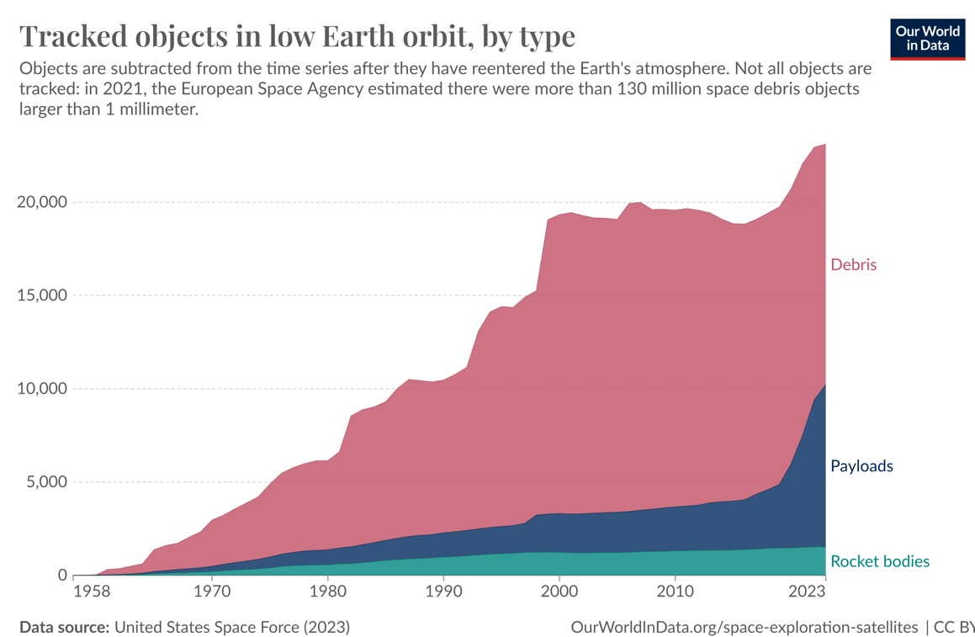
NuSTAR operations
Increasing number of Conjunction alerts
  Requires operations planning to minimize cross track cross section - sometimes on short notice
Issues with ground tracking of spacecraft in equatorial orbits
  e.g. NuSTAR, IXPE TLE products
  Contract with commercial vendor (LeoLabs) for TLE updates
NuSTAR status – IACHEC, Parador de La Granja, May 2024 – Karl Forster

Slide 22
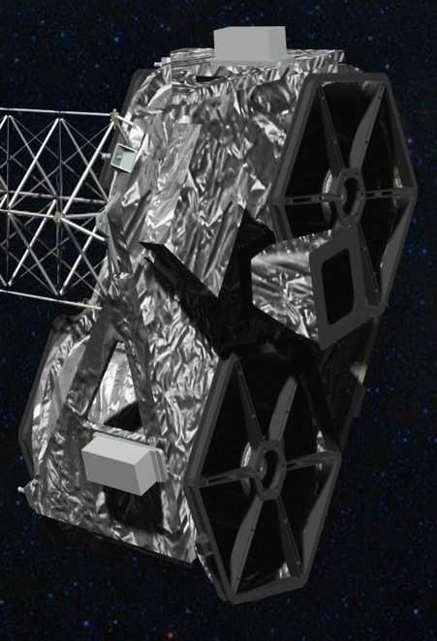
NuSTAR Observatory
Subsystem Status
Nominal
LeoSTAR-2 spacecraft bus has no consumables
Solar Array and SADA, EPS | No concerns
Attitude Control System IRU*, Star trackers*, TAM, MTB, CSS, Reaction Wheels | No concerns
RF Communications | No concerns
Thermal control | No concerns
Electronics CEU, APE* | No concerns
Battery Evaluation of end of discharge voltage shows normal ageing >20 years before any concerns | No concerns
*rare resets occur as expected
NuSTAR status – IACHEC, Parador de La Granja, May 2024 – Karl Forster

Slide 23

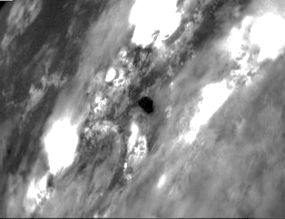
NuSTAR Observatory
Optics
Tear in MLI on rear of Optic-0 | Observe at SAA < 130º where possible
Higher Optic-0 temperature for SAA > 145º FPMA temperature dependent ARF available | Minor scheduling constraint
Astrometry Star Tracker (CHU4)
Low gain area in central 1º of 20º field of view | Only Solar observations at SAA < 20º | Solar observations only at SAA < 20º
Caused by repeated Solar observations Star Tracker performance remains nominal | Observations of bright point sources allowed* for 20º < SAA < 43º | Observations of bright point sources allowed* 20º < SAA < 43º
*Optimal astronomy solution is for Solar Aspect Angle (SAA) > 43º
CHU4 image taken during Earth occultation of science target
(cities beneath clouds)
NuSTAR status – IACHEC, Parador de La Granja, May 2024 – Karl Forster

Slide 24
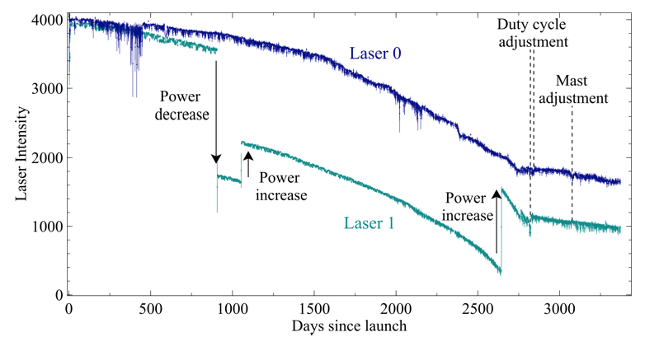
NuSTAR Observatory
Laser Metrology System
stabilized
Implemented an adjustment of the operating duty cycle of the lasers in 2020 Produced significant improvement in rate of decline of laser intensity
Indicates that, with no further changes, the metrology system should remain nominal for another 9 years
Additional adjustments can be made to extend laser lifetime
Laser Metrology System tracks the relative motion of optics with respect to CZT X-ray detectors (10m mast!)
  Metrology data is used by ground processing software to reconstruct:
    Location of optical axes
    With star tracker camera on optics bench the sky position of events recorded in CZT
NuSTARDAS release planned summer 2024
Continue analysis if single laser operations are ever implemented (SSDC + Hannah Earnshaw)
NuSTAR status – IACHEC, Parador de La Granja, May 2024 – Karl Forster

Slide 25
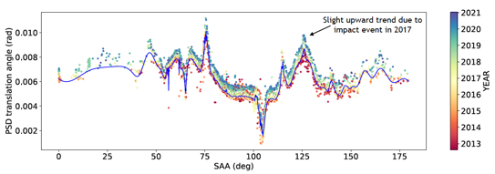
NuSTAR Observatory
Laser Metrology System
stabilized
Development of a predictive model of mast motion was completed in 2021 Earnshaw et al. 2021 JATIS 8.1.014009
The algorithm estimates position of a non-functioning laser spot based on historical data
Will be implemented in NuSTARDAS if one laser fails
Adjustments to model will be made as mast behavior evolves
The parameters required to estimate the distance between the laser spots (Z) are the time (X) and the Solar Aspect Angle (Y). The underlying model uses a third-order 2D polynomial fitted to the archival observations to predict the laser position in case of the loss of one
NuSTAR status – IACHEC, Parador de La Granja, May 2024 – Karl Forster

Slide 26
NuSTAR calibration history
https://nustarsoc.caltech.edu/NuSTAR_Public/NuSTAROperationSite/software_calibration.php#CALDB
  Details on NuSTAR SOC website: https://nustarsoc.caltech.edu/NuSTAR_Public/NuSTAROperationSite/software_calibration.php#CALDB
Date | Description
2013-08-14 | Initial CALDB public release
2013-11-25 | ARF adjustment (-15% NuSTAR flux)
2014-01-17 | VIGN adjustment
2014-07-01 | Gain calibration improvement
2015-03-20 | Full mission Gain adjustment
2016-06-06 | Update gain, effective area, line of sight absorption
2019-12-13/19 | Update long term gain tracking
2020-05-06 | High resolution clock correction
2020-08-13 | Temperature-dependent ARF implemented
2021-02-23 | Observatory alignment update
2021-10-26 | Observatory calibration update based on 9-years of crab observations
2022-05-10 | FPMA DET2 long term gain adjustment
Calibration update 2021-10-26 (CALDB v20211020)
Based on detailed analysis of more than nine years of observations of the Crab, utilizing both focused and stray light measurements.
  For details see Madsen et al. (2021) JATIS (on arXiv) and the SOC website.
The overall changes between to previous calibration are primarily off-axis dependent.
Users of the updated calibration may see the following changes compared to previous analysis:
  A flux increase of ~5% | ~10% | ~15% for sources < 1' | 1' to 2' | > 4' off-axis
  Slopes of power law model components may change by ~0.04 depending on off-axis angle
  More accurate high-energy and high off-axis angle corrections
  A better agreement in the FPMA and FPMB flux measurements
Little or no practical change expected in interpretation of results for most observations, especially for analysis of low signal-to-noise spectra.
This CALDB release also contained an update to the tracking of detector gain.
  Details are available in the calibration memo Grefenstette et al. (2021)
1 year after start of science operations
Based on IACHEC cross-calibration to better match
XMM/Swift/Chandra measurements
allows 100 microsecond accuracy for some observations
NuSTAR status – IACHEC, Parador de La Granja, May 2024 – Karl Forster

Slide 27
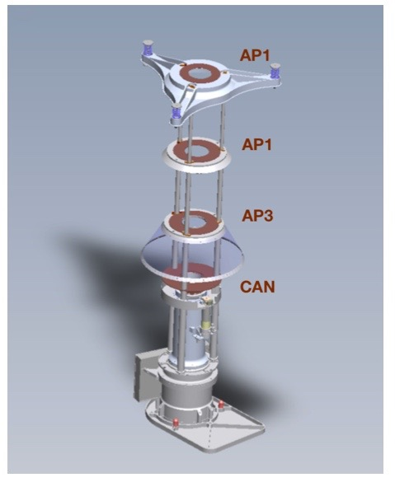
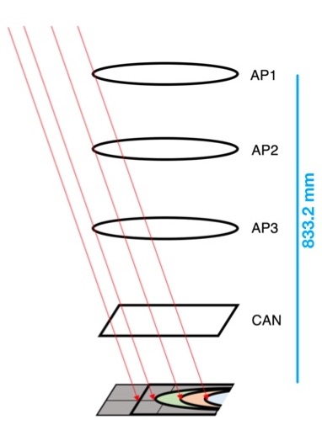
NuSTAR Stray light calibration
10.14 m
Schematic of the path of stray light photons. (Left) Observatory schematic illustrating how off-axis sources can directly illuminate the aperture stops and detectors. (Center) CAD rendering of the focal plane and the aperture stop assembly. (Right) Red traces show the stray light paths that survive to the focal plane after passing around the aperture stop rings (AP1, AP2, and AP3) and the “can” housing the detectors. Wik et al. (2014) ApJ 792,48 and Madsen et al. (2017a) JATIS 3, 044003.
NuSTAR status – IACHEC, Parador de La Granja, May 2024 – Karl Forster

Slide 28
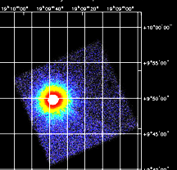
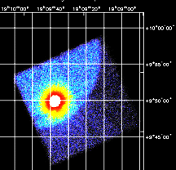
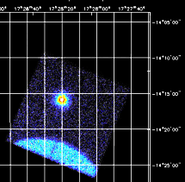



NuSTAR Stray light calibration
FPMA
FPMB
Stray light observations may extend NuSTAR science reach past 100 keV
  High energy limit of 79 keV determined by optics response
Annual Stray light observations of the Crab used for calibration
  Bypasses optics, based on well understood detector response
  Accurate measurement of Crab flux allows absolute calibration to 4% precision
    Measurement of the Absolute Crab Flux with NuSTAR, Madsen et al. (2017)
  Adjustment to cross calibration with other observatories
    (XMM-pn calibration update)
Originally a nuisance, now stray light observations are used to:
  Harvest transient light curves and spectra from Galactic center region
  Minimize data loss during observations of bright sources
    Allowing uninterrupted observations – avoiding overwrite of on-board storage buffer
StrayCats on github
  Grefenstette et al. (2021) ApJ 909, 30 and Ludlam et al (2022) ApJ 934 59
  https://nustarstraycats.github.io/straycats/
Extended SMC X-1 spin and orbit analysis
  Brumback et al. (2022) ApJ 296, 187
4U 1907+09
PDS 456
Sgr A* 2019-03-29 150 ks (FPMA)
NuSTAR status – IACHEC, Parador de La Granja, May 2024 – Karl Forster

Slide 29


NuSTAR Stray light calibration
From AAS-HEAD meeting poster: Gullo Mastroserio
Extend Stray light calibration above 100 keV
  NuSTAR detectors do not saturate until ~250 keV
Data for bright (> 0.1 Crab) sources are already present well above the 79 keV optics cutoff
Effective area is mostly the “geometric” detector area
  > 300 cm² focused
  < 8 cm² stray light
Updated calibration will allow simultaneous modelling with INTEGRAL-IBIS
Models must now work:
  over multiple decades in energy
  with very different statistics
  may need more sophisticated background model
See: Mastroserio, G. et al. (2022) ApJ 941, 35
INTEGRAL
Cyg X-1
NuSTAR
NuSTAR status – IACHEC, Parador de La Granja, May 2024 – Karl Forster

