Slide 1
XMM-Newton Calibration Updates
Michael Smith, ESAC
16th IACHEC Meeting, Segovia, 13-16 May 2024

Slide 2
XMM-Newton calibration releases over 2023/24
EPIC-MOS: Update of the CORRAREA Empirical EPIC Effective Area Correction XMM-CCF-REL-410
Update of EPIC MOS CTI and Gain XMM-CCF-REL-393 & 400
EPIC-pn: Updates to the EPIC-pn long-term CTI correction XMM-CCF-REL-407
See dedicated talk by I. Valtchanov in Detectors WG
Time-dependent width of the EPIC-pn spectral response XMM-CCF-REL-411
RGS: Update of the RGS Time-dependent Rectification Correction XMM-CCF-REL-401
Evolution of the RGS CTI XMM-CCF-REL-405
OM: Update of the Time Dependent Sensitivity Degradation XMM-CCF-REL-409
Astrometry: EPIC MOS astrometry XMM-CCF-REL-406
Update of time variable boresight XMM-CCF-REL-408
Release notes: https://www.cosmos.esa.int/web/xmm-newton/ccf-release-notes

Slide 3
Update of the MOS-to-PN empircal effective area correction
So-called “CORRAREA” correction introduced in 2014.
Empirical correction of MOS A_{eff} to match PN flux measurements.
Choice to normalise to PN essentially arbitrary.
Previous update in 2021: addressed the > 2 keV A_{eff}
New calibration extends the correction down to 0.15 keV
Same methodology, larger sample: ~ 200 observations of
On-axis point sources
Bright, but not piled-up
Determine the instrumental residuals to the best fit PN models
Stack the residuals for increased signal-to-noise
Normalise stacked residuals to those of PN

Slide 4
Update of the MOS-to-PN empircal effective area correction
Stacked data / model w.r.t. PN
So-called “CORRAREA” correction introduced in 2014.
Empirical correction of MOS A_{eff} to match PN flux measurements.
Choice to normalise to PN essentially arbitrary.
Previous update in 2021: addressed the > 2 keV A_{eff}
New calibration extends the correction down to 0.15 keV
Same methodology, larger sample: ~ 200 observations of
On-axis point sources
Bright, but not piled-up
Determine the instrumental residuals to the best fit PN models
Stack the residuals for increased signal-to-noise
Normalise stacked residuals to those of PN
MOS1
MOS2
keV

Slide 5
Update of the MOS-to-PN empircal effective area correction
Stacked data / model w.r.t. PN
For each MOS:
Define A_{eff} correction models:
Spline functions of multiplicative factors applied to standard A_{eff} file.
Derive the A_{eff} correction functions (simultaneous fit over all observations) that minimise the stacked residuals
MOS1
MOS2
keV

Slide 6
Update of the MOS-to-PN empircal effective area correction
Stacked data / model w.r.t. PN
For each MOS:
Define A_{eff} correction models:
Spline functions of multiplicative factors applied to standard A_{eff} file.
Derive the A_{eff} correction functions (simultaneous fit over all observations) that minimise the stacked residuals
MOS1
Previous
Aeff correction
MOS2
keV

Slide 7
Update of the MOS-to-PN empircal effective area correction
Stacked data / model w.r.t. PN
For each MOS:
Define A_{eff} correction models:
Spline functions of multiplicative factors applied to standard A_{eff} file.
Derive the A_{eff} correction functions (simultaneous fit over all observations) that minimise the stacked residuals
No attempt to correct features below 2 keV, which
could be due to residual calibration inaccuracies
Effective area
Redistribution
Energy scale
MOS1
Previous
Aeff correction
Updated
Aeff correction
MOS2
keV

Slide 8
Update of the MOS-to-PN empircal effective area correction
Stacked data / model w.r.t. PN
Applying correction significantly reduces residuals in joint MOS-PN spectral fits, on average and in majority of individual observations.
Features at ~5% level mainly below 2 keV remain
Could be due to residual calibration inaccuracies
Effective area
Redistribution
Energy scale
Up to now, the correction is not applied by default
(needs to be explicitly invoked in the arfgen task).
As of SAS 22 (~ summer 2024) the correction will be applied in the default processing:
arfgen applyxcaladjustment=yes
MOS1
W/o Aeff correction
With Aeff correction
MOS2
keV

Slide 9
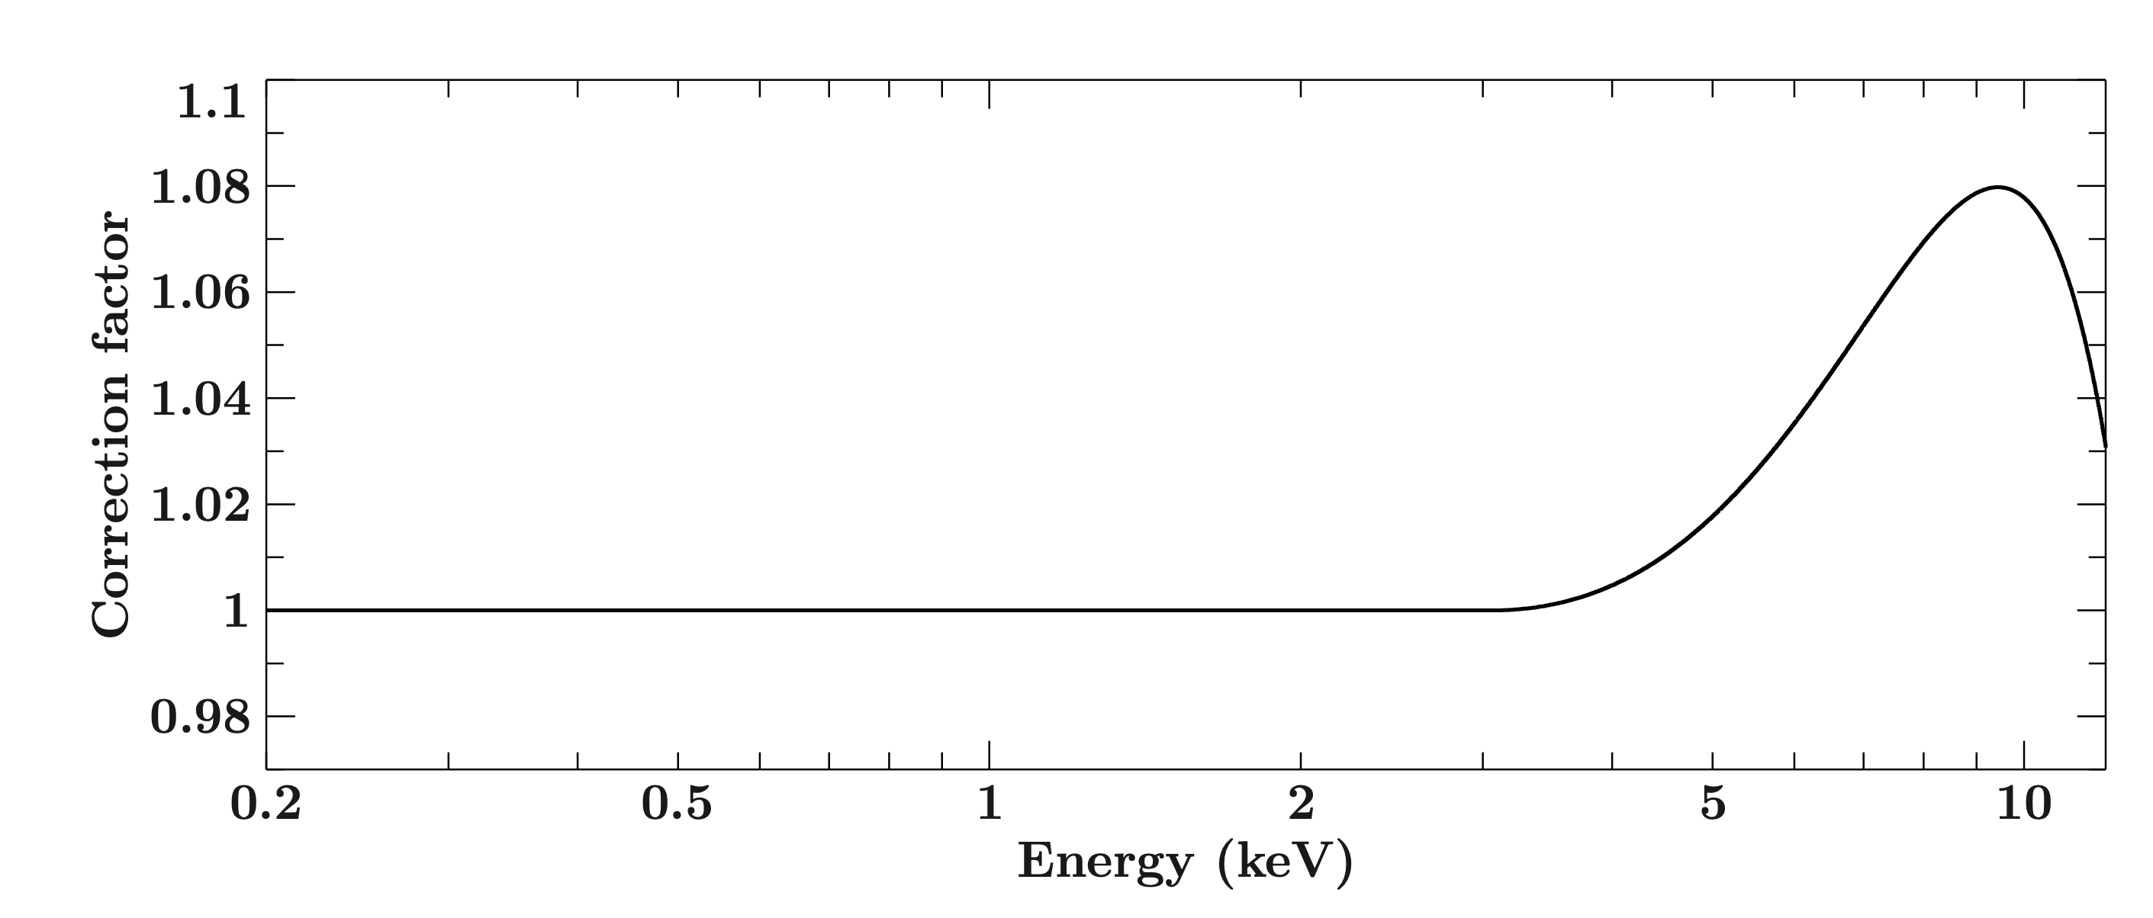
EPIC-NuSTAR empircal Aeff correction
EPIC-NuSTAR empirical effective area correction released in April 2022
Based on comparison of simultaneous PN – NuSTAR observations (above 3 keV):
3C 273 (PN SW mode), sample of AGN (PN SW mode), Crab nebula (PN Burst mode)
Findings showed discrepancies could be descibed by:
Difference in spectral shape (up to ~ 6% difference in terms of flux)
Overall cross normalisation offset (18%)
The correction contained in the calibration only contains the former.
The cross normalisation is not included.
Up to now, the correction is not applied by default
(needs to be explicitly invoked in the arfgen task).
As of SAS 22 (~ summer 2024) the correction will be
applied in the default processing:
arfgen applyabsfluxcorr=yes

Slide 10
EPIC-NuSTAR empircal Aeff correction
EPIC-NuSTAR empirical effective area correction released in April 2022
Based on comparison of simultaneous PN – NuSTAR observations (above 3 keV):
3C 273 (PN SW mode), sample of AGN (PN SW mode), Crab nebula (PN Burst mode)
Findings showed discrepancies could be descibed by:
Difference in spectral shape (up to ~ 6% difference in terms of flux)
Overall cross normalisation offset (18%)
The correction contained in the calibration only contains the former.
The cross normalisation is not included.
Up to now, the correction is not applied by default
(needs to be explicitly invoked in the arfgen task).
As of SAS 22 (~ summer 2024) the correction will be
applied in the default processing:
arfgen applyabsfluxcorr=yes
Investigations regarding origins of A_{eff} issues
ongoing; see e.g.
”XMM-Newton EPIC-pn single reflections from Sco X-1”, M. Freyberg

Slide 11
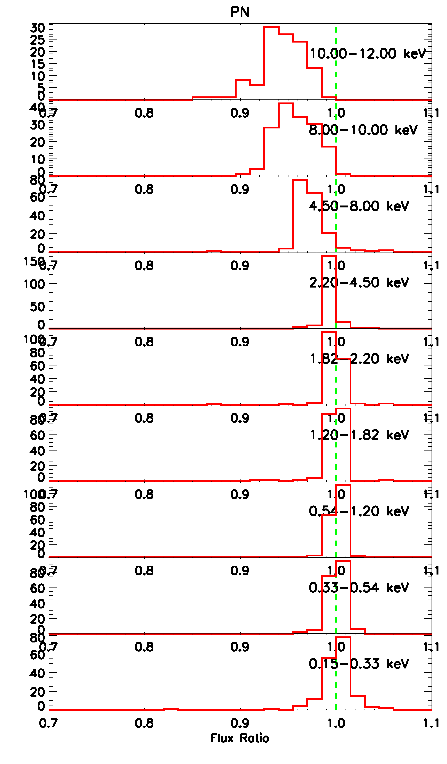
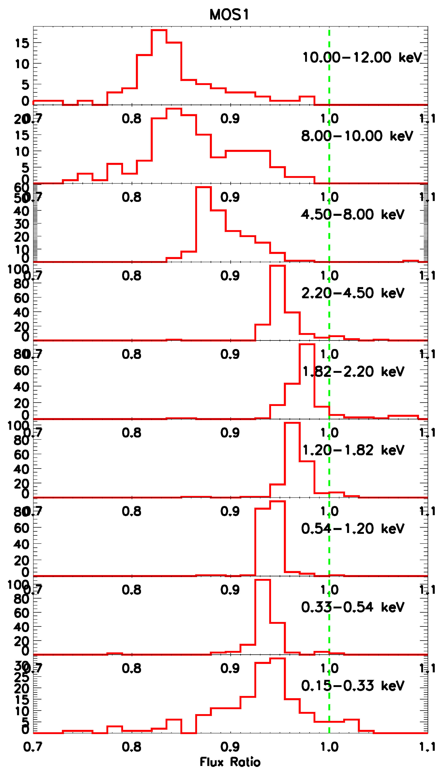
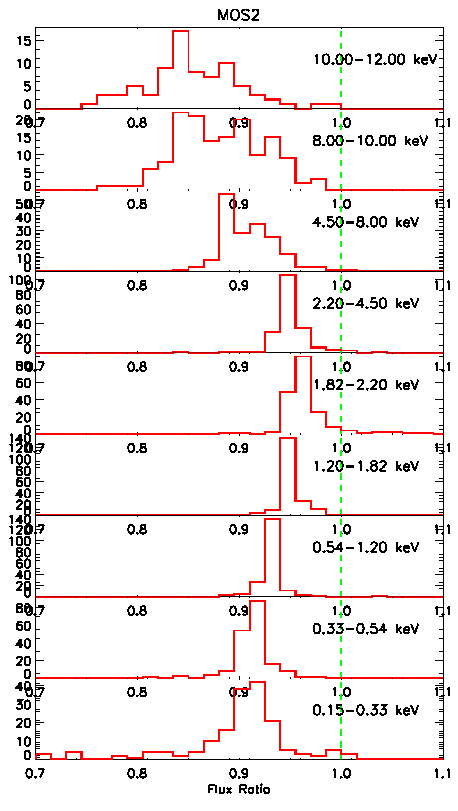
Relative changes in instrumental flux ratios comparing the default processing of SAS 22 w.r.t. current

Slide 12
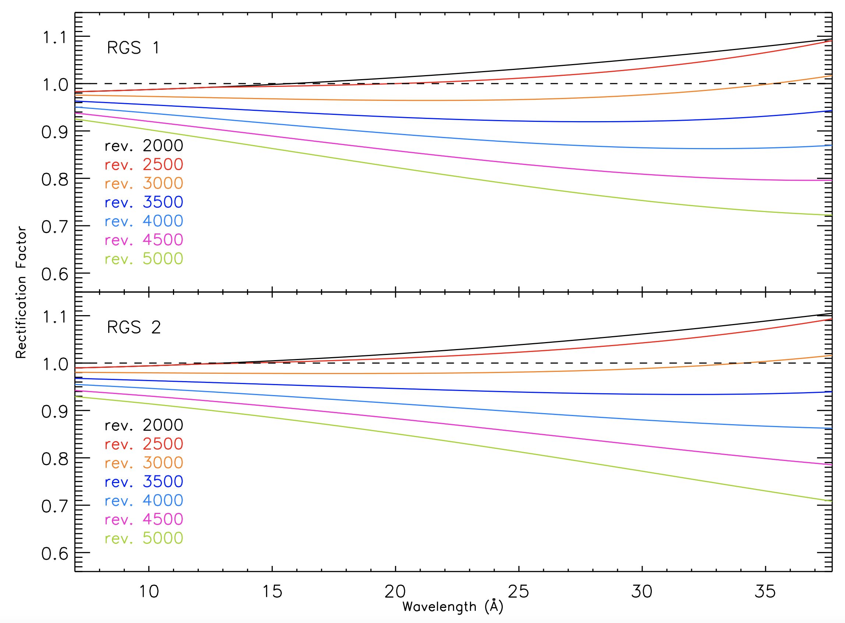
RGS Rectification factors
RGS “Rectification Correction” introduced in 2010.
Provides an empirical correction to RGS to match PN fluxes,
with time and wavelength dependencies.
Based on RGS and PN SW mode observations of
3C 273 and PKS 2155-304.
Latest calibration extends the observations database until 2022
and now also includes the PN observations taken in Thick filter.
Up to now, the correction is not applied by default
(needs to be explicitly invoked in e.g. rgsproc).
As of SAS 22 (~ summer 2024) the correction will be
applied in the default processing:
rgsproc withrectification=yes
R. González-Riestra

Slide 13
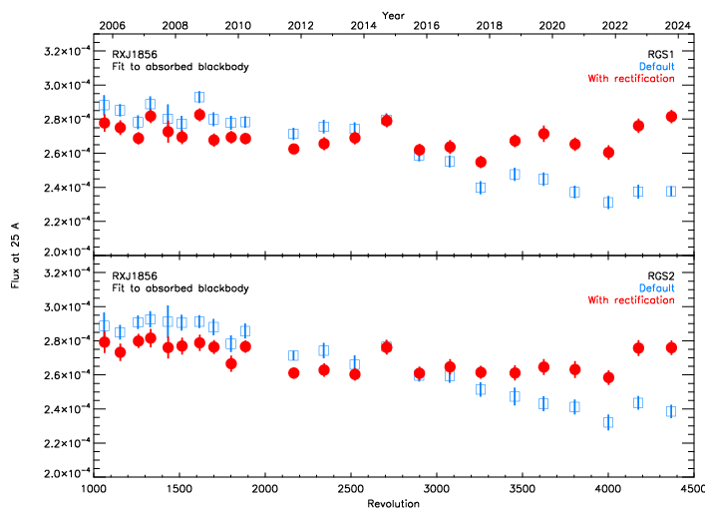
RGS Rectification factors
INS RX J1856-3754:
Flux @ 25Ǻ (from fit to absorbed BB)
Current default processing
Default processing as of SAS 22
RGS “Rectification Correction” introduced in 2010.
Provides an empirical correction to RGS to match PN fluxes,
with time and wavelength dependencies.
Based on RGS and PN SW mode observations of
3C 273 and PKS 2155-304.
Latest calibration extends the observations database until 2022
and now also includes the PN observations taken in Thick filter.
Up to now, the correction is not applied by default
(needs to be explicitly invoked in e.g. rgsproc).
As of SAS 22 (~ summer 2024) the correction will be
applied in the default processing:
rgsproc withrectification=yes
R. González-Riestra

Slide 14
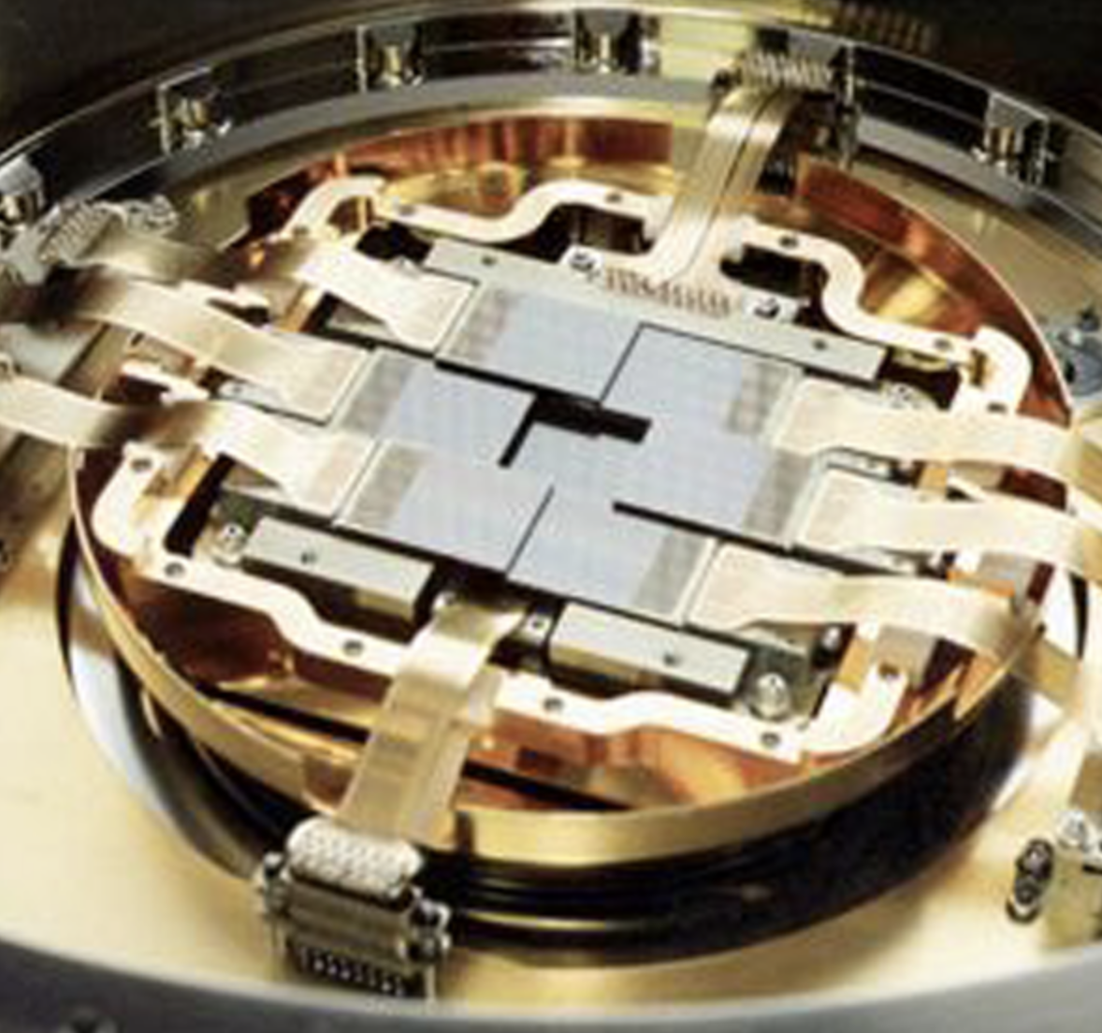
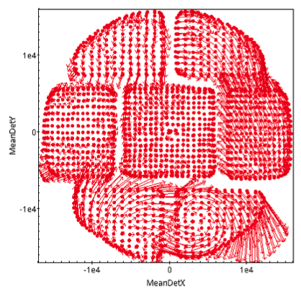
EPIC MOS astrometry
Investigation of residual offsets between EPIC source positions and optical catalogues:
E.g., cross correlation between 4XMM DR12 and Million-Quasar catalogues (50,000 matches) gives residual offsets of up to:
0.6” for PN
1” for MOS1
2” for MOS2
Also, when converting offsets into detector coordinates,
and avergaing over sources, patterns appear
resembling the individual MOS CCDs.
Example: MOS2
Average of ~1000 offsets per point
Vectors magnified x 100
J. Ballet et al.

Slide 15
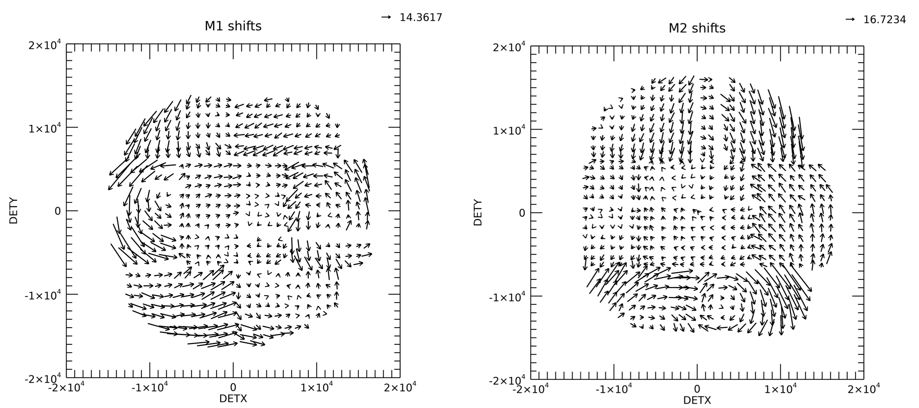
EPIC MOS astrometry
As 1st step to address this: align MOS CCDs with PN
Cross matching PN, MOS1 and MOS2 4XMM DR12 sources lists:
over common 220,000 entries.
Determine offsets between MOS1 & MOS2 source positions with respect to PN sources in respective detector coordinates:
Derive the required CCD rotations & translations.
Rotations of up to ~ 0.36 degrees
Translations of up to ~ 1.75”
J. Ballet et al.

Slide 16
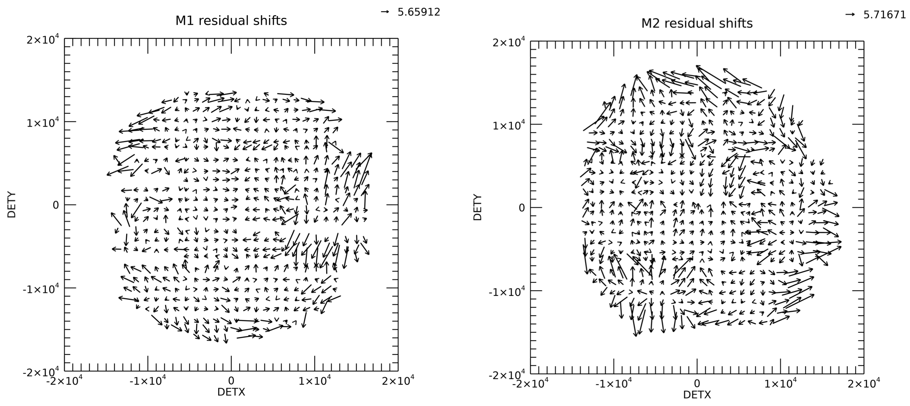
EPIC MOS astrometry
As 1st step to address this: align MOS CCDs with PN
Cross matching PN, MOS1 and MOS2 4XMM DR12 sources lists:
over common 220,000 entries.
Determine offsets between MOS1 & MOS2 source positions with respect to PN sources in respective detector coordinates:
Derive the required CCD rotations & translations.
Rotations of up to ~ 0.36 degrees
Translations of up to ~ 1.75”
Repositioning yields reduced relative offsets.
Also, improved alignment w.r.t. optical quasars.
Remaining residuals point to PN astrometry inaccuracies (under investigation).
J. Ballet et al.

Slide 17
OM time-dependent degradation
Optical Monitor (OM) affected by
general, filter-dependent sensitivity degradation (of up to ~23% in UVW2) due to
  contamination at early epochs
  ageing of the photocathode
  Corrected for in calibration + SAS
  New calibration based on somewhat revised approach.

Slide 18
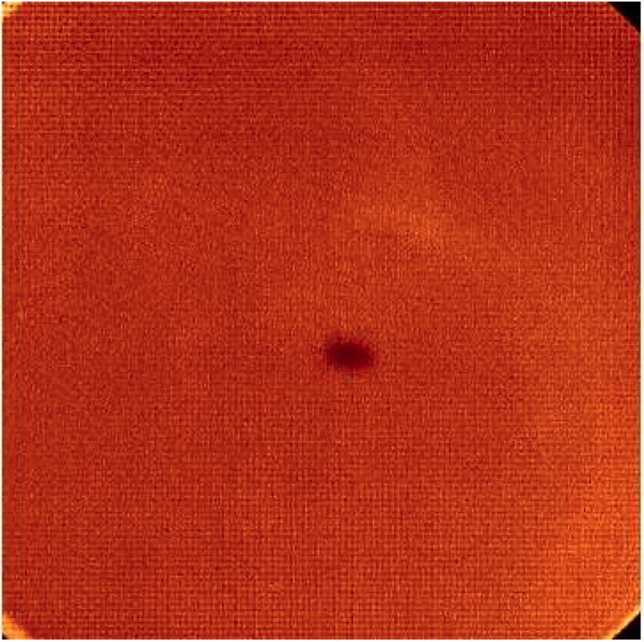
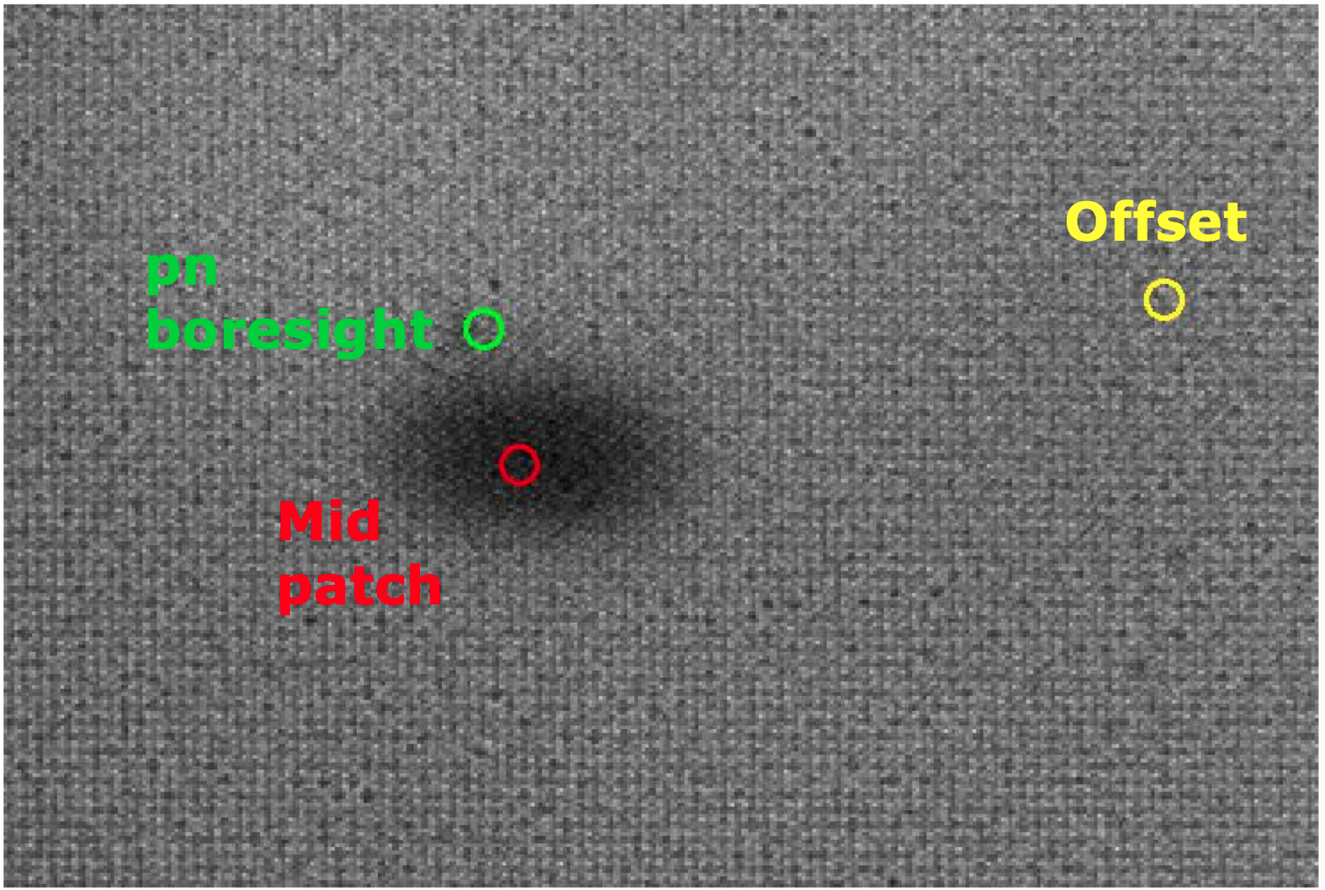
OM time-dependent degradation
Optical Monitor (OM) affected by
general, filter-dependent sensitivity degradation (of up to ~23% in UVW2) due to
  contamination at early epochs
  ageing of the photocathode
  Corrected for in calibration + SAS
  New calibration based on somewhat revised approach.
localised damage (“Jupiter patch”): targets at the pn boresight position (in the patch wings) by up to additional ~15% in V.
  Previously uncorrected.
  But, as of SAS 22 (~ summer 2024): correction is now made for the localised extra sensitivity loss, for sources at the pn boresight only.
  (A full correction for all objects in the Jupiter patch would need filter-dependent, time-dependent sensitivity maps)
Depletion patch
Full Frame:
Zoomed in:

Slide 19
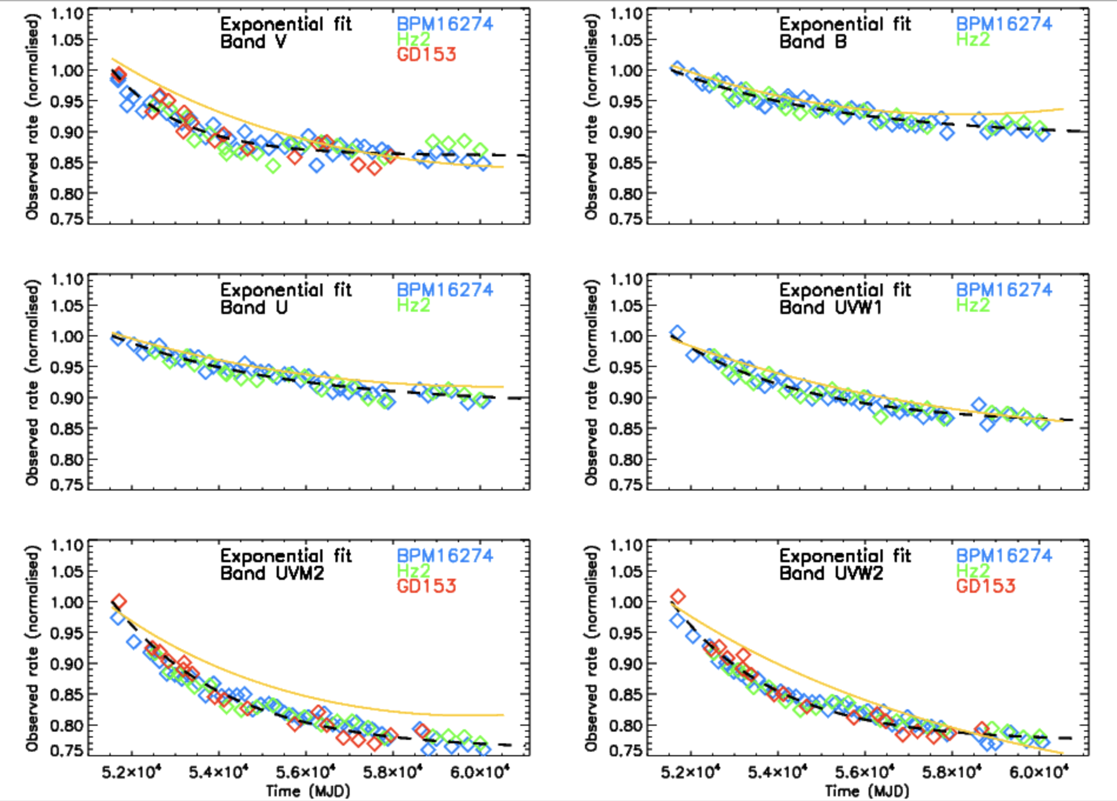
OM time-dependent degradation
General time-dependent degradation:
Simultaneous exponential fits to 3 standard stars (dashed black)
Based on
boresight measurements for revs <3224
offset data for rev >3224
Generally good fits – scatter < 2%
cf previous polynomial functions (orange) from ‘constant’ sources from the SUSS4 catalogue:
In worst case, UVM2, there is a systematic divergence of up to 4% => standards decline more (i.e. sources need larger correction).
S. Rosen

Slide 20
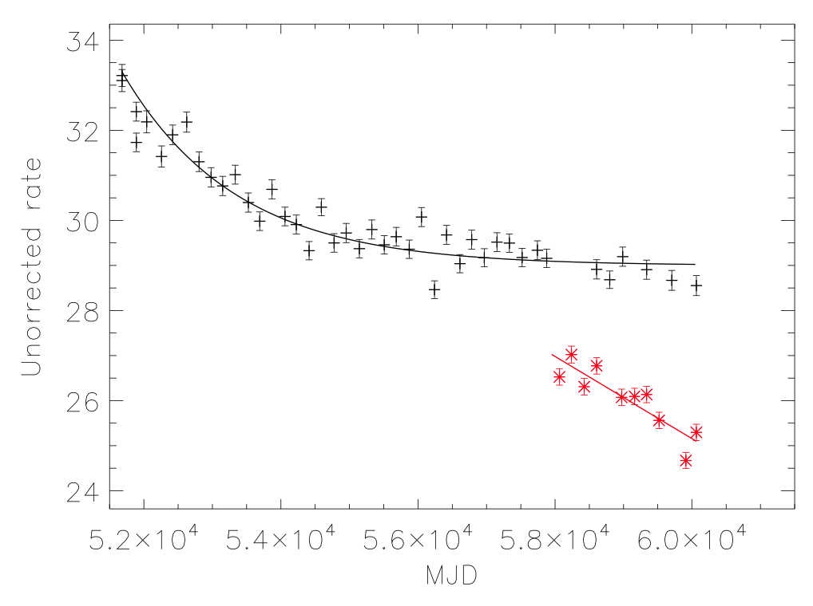
OM time-dependent degradation
General & local time-dependent degradation:
Measured count rates from observations taken at:
the OM boresight (revs < 3224), and
offset locations (revs > 3224)
(exponential decay curve for the V filter overlaid)
Measured count rates at the pn boresight after revolution 3224
(best-fit linear function overlaid)
Example: BPM16274, V band
S. Rosen

Slide 21
OM time-dependent degradation
Example: BPM16274
General & local time-dependent degradation:
Measured count rates from observations taken at:
the OM boresight (revs < 3224), and
offset locations (revs > 3224)
(exponential decay curve for the V filter overlaid)
Measured count rates at the pn boresight after revolution 3224
(best-fit linear function overlaid)
V
W1
B
M2
U
W2
S. Rosen

Slide 22
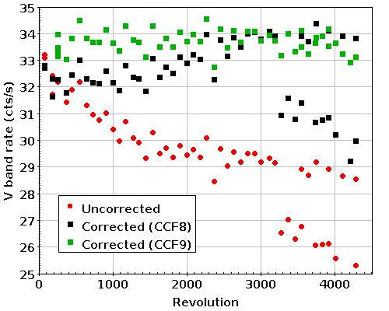
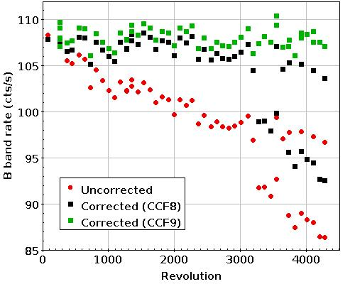
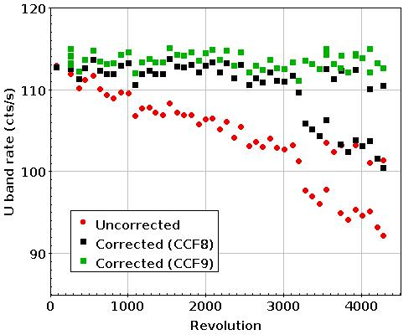
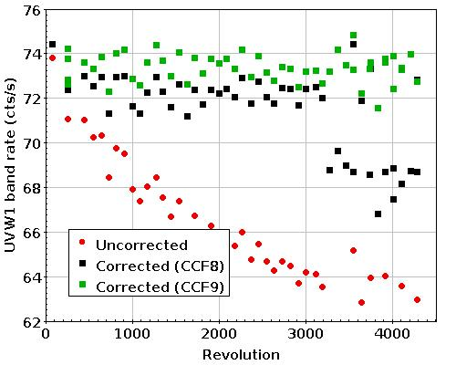
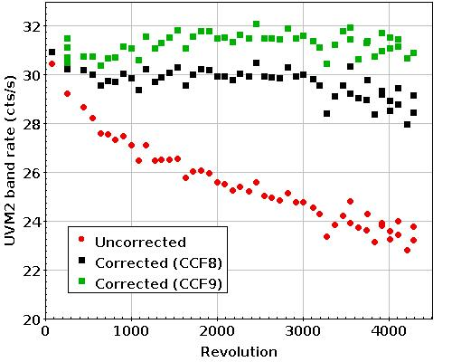
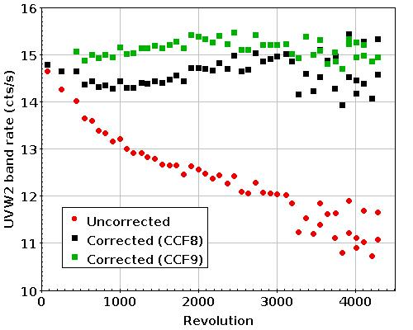
OM time-dependent degradation
Example: BPM16274
Corrections for time-dependent sensitivity degradation:
Red: Uncorrected data
Black: Corrected for general TD degradation with previous CCF
Green: Corrected with new CCF + pn boresight correction
Available as of SAS 22 (~ summer 2024)
V
B
U
W1
M2
W2
S. Rosen

Slide 23
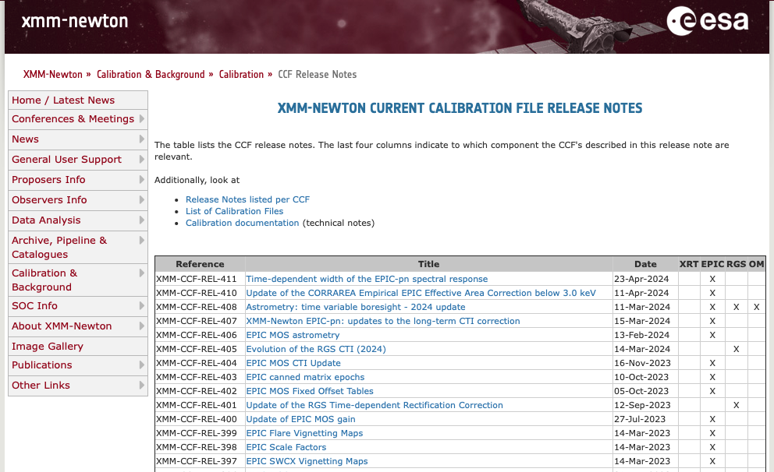
XMM-Newton calibration information
https://www.cosmos.esa.int/web/xmm-newton/ccf-release-notes

