Slide 1
Soft Gamma-ray Observations of the Crab with INTEGRAL/IBIS-PICsIT
James Rodi, A. Bazzano, L. Natalucci, P. Ubertini
INAF-IAPS (Rome, Italy)
14th IACHEC Workshop
Parador de la Granja, Spain, 12-16 May 2024

Slide 2
Crab Previous Results
Temporal variability
Earlier IACHEC comparison from Case (2017)
  RXTE, BAT, GBM, Suzaku, ISGRI, SPI, MAXI comparisons
  Flux can change of few % per year
Case (2017)

Slide 3
Crab Previous Results
Spectral variability
  Stable hard X-ray spectrum
  Used as standard candle
  Soft gamma-rays ~2.2 – 2.4 in SPI
Jourdain & Roques (2020)

Slide 4
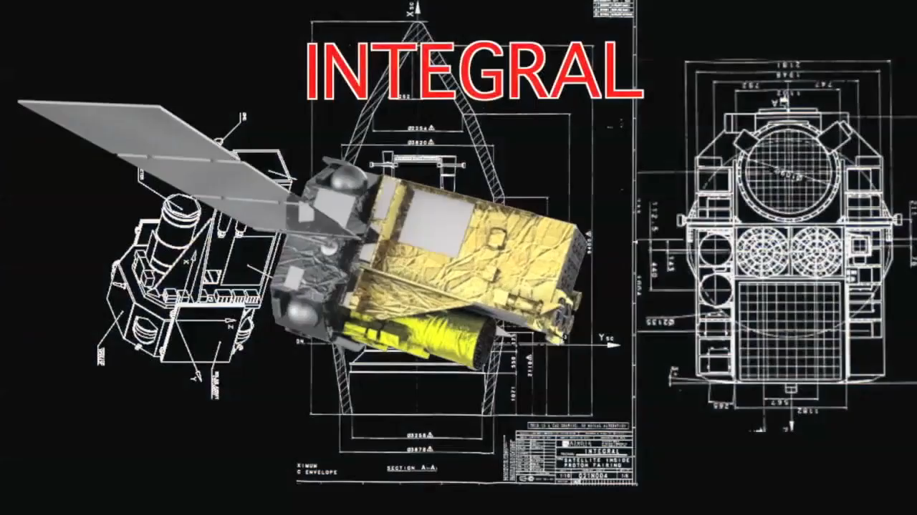
Overview of INTEGRAL
INTEGRAL launched in 2002
Instruments’ features:
  Elliptical orbit with >85% duty cycle
  Long uninterrupted obs: ~2.7 days
  All-sky monitor in ~80 keV – 2.5 MeV
  Instruments cover 3 keV – 14 MeV
  Wide FoV: ~100 – 1000 deg²
  High time res: < 120 𝛍s
  Arcmin resolution
  Polarimetry capability

Slide 5
IBIS-PICsIT Instrument Review
IBIS-PICsIT (Pixelated Caesium Iodide Telescope)
  High-energy imaging plane of IBIS
  Energy range ~175 keV – 14 MeV imaging
  Spectral-imaging: ~1800 – 3600 sec
Bird et al.(2003)
Savchenko et al.(2017)

Slide 6
Crab Analysis
Selected Crab observations < 6 deg of pointing dir.
Ran standard OSA analysis until imaging step
Stacked the images (varmosaic) for lc/spectra
Fit count-rate and significance images with 2D Gaussian (MPFIT2DPEAK) for source count rates and errors

Slide 7
Crab Light Curve
PICsIT light curves in 347 – 461 keV E band
  Revolutions time scale (~2 – 3 days)
  Consistent with constant flux
SPI 400-650 leV light curve
  ~0.5 – 1 hr time scale
  Consistent with constant

Slide 8
Crab Spectrum
SPI spectrum (Jourdain & Roque 2020) vs PICsIT single events
Flux difference ~2x in 300-2000 keV
  SPI:
    1.04 x 10⁻⁸ erg/cm²/s
  PICsIT:
    5.3 x 10⁻⁹ erg/cm²/s

Slide 9
Crab Spectrum
SPI spectrum (Jourdain & Roque 2020) vs PICsIT single events
Similar spectral shape
  SPI:
    High-E 𝝘 = 2.32 ± 0.02
  PICsIT:
    𝝘 =2.25±0.08 (350 - 1.9 MeV)
    𝝘 =2.36±0.08 (350 - 1.1 MeV)

Slide 10
Crab Spectrum
SPI spectrum (Jourdain & Roque 2020) vs PICsIT single events vs COMPTEL (van der Meulen 1998)
Flux difference: COMPTEL ~2x lower than SPI (closer to PICsIT)

Slide 11
Crab Spectrum
SPI spectrum (Jourdain & Roque 2020) vs PICsIT single events vs COMPTEL (van der Meulen 1998)
Spectrum:
  COMPTEL has harder spectrum
    Fit:
      𝝘 ~ 1.95, E_{cut} ~27 MeV (locally)
      Knodlseder (2022): 𝝘 ~ 2.0, E_{cut} ~39 MeV

Slide 12
Conclusion and Future Work
Analyzed PICsIT observations over ~20 years
  LC on rev. timescale --> no significant long-term variability
  Similar to SPI in comparable E range
Spectrum:
  PICsIT singles 𝝘 consistent with SPI, but N ~2x lower
    Understand 30% of difference (pixel/mask hole sizes)
  COMPTEL harder than SPI and ~1.75x lower
Next:
  Understand PICsIT singles cross-calibration vs SPI
  Update Monte Carlo for multiple events to extend spectrum
Interesting for COSI in MeV region

Slide 13
3rd INTEGRAL Data Analysis Workshop 2006

