Slide 1
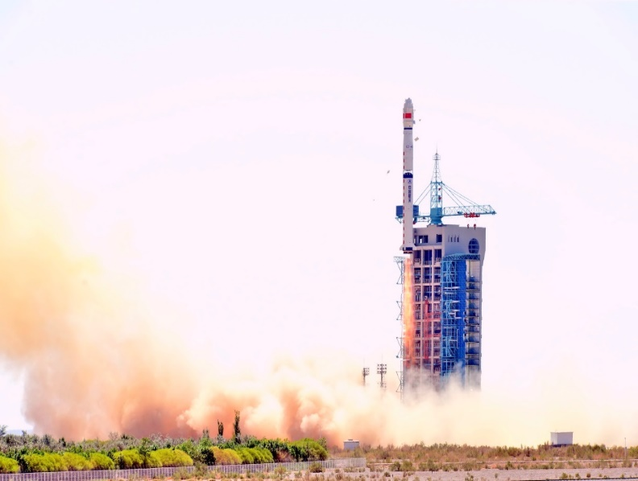
2025 IACHEC Meeting
Hard X-Ray Modulation Telescope
(Insight-HXMT)
Instruments & Calibration
Xiaobo Li on behalf of HXMT team Institute of High Energy Physics (IHEP), CAS May 12, 2025
11:00, June 15th, 2017, Jiuquan

Slide 2
01
HXMT instruments
02
Calibration Status of HXMT
OUTLINE
03
Summary

Slide 3
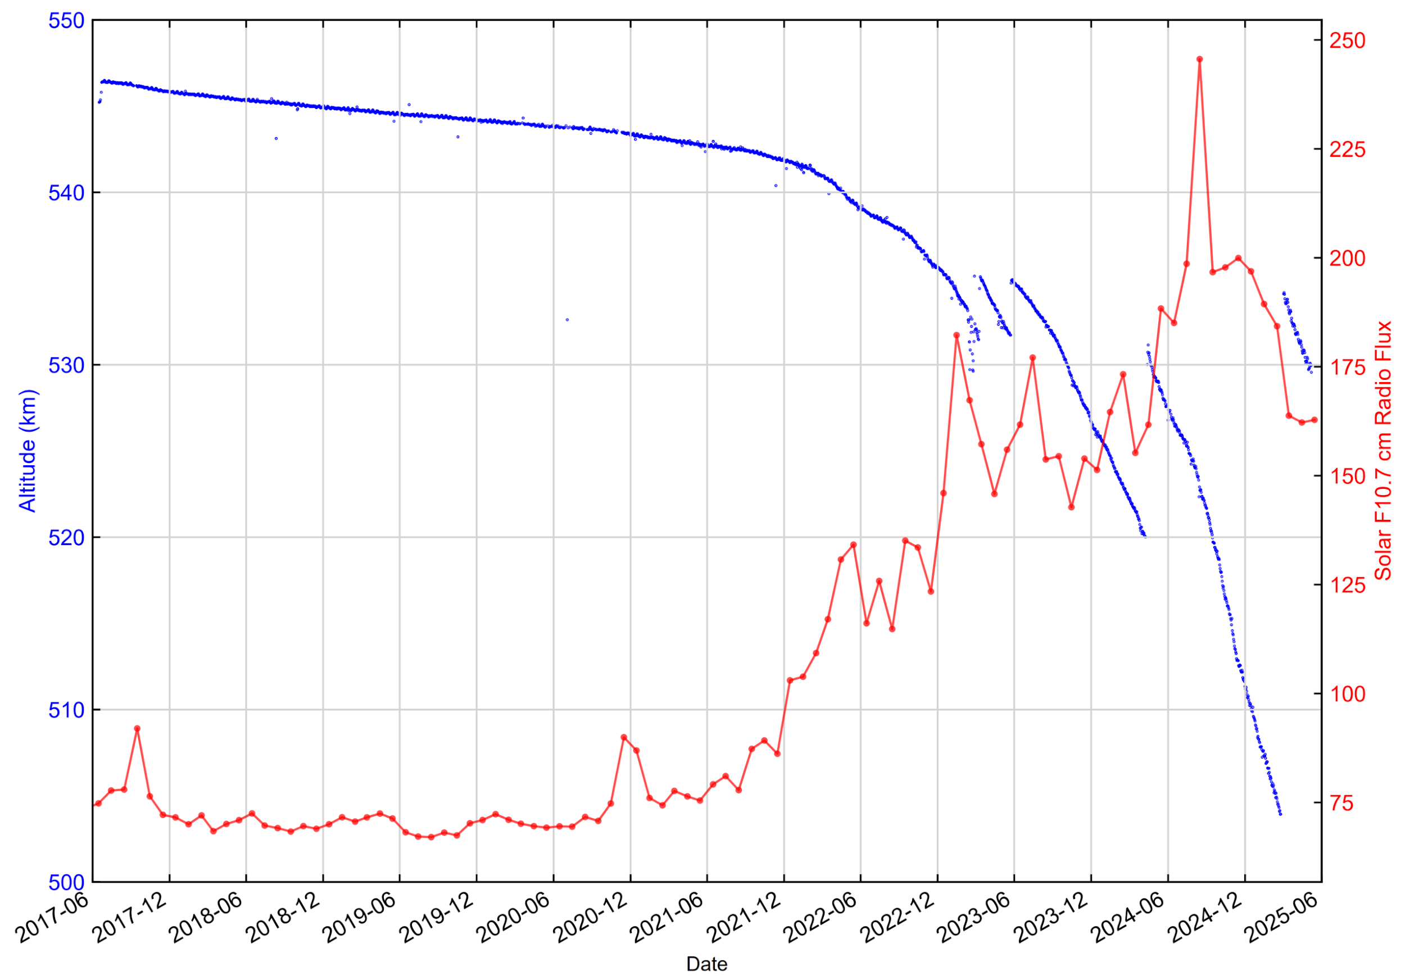
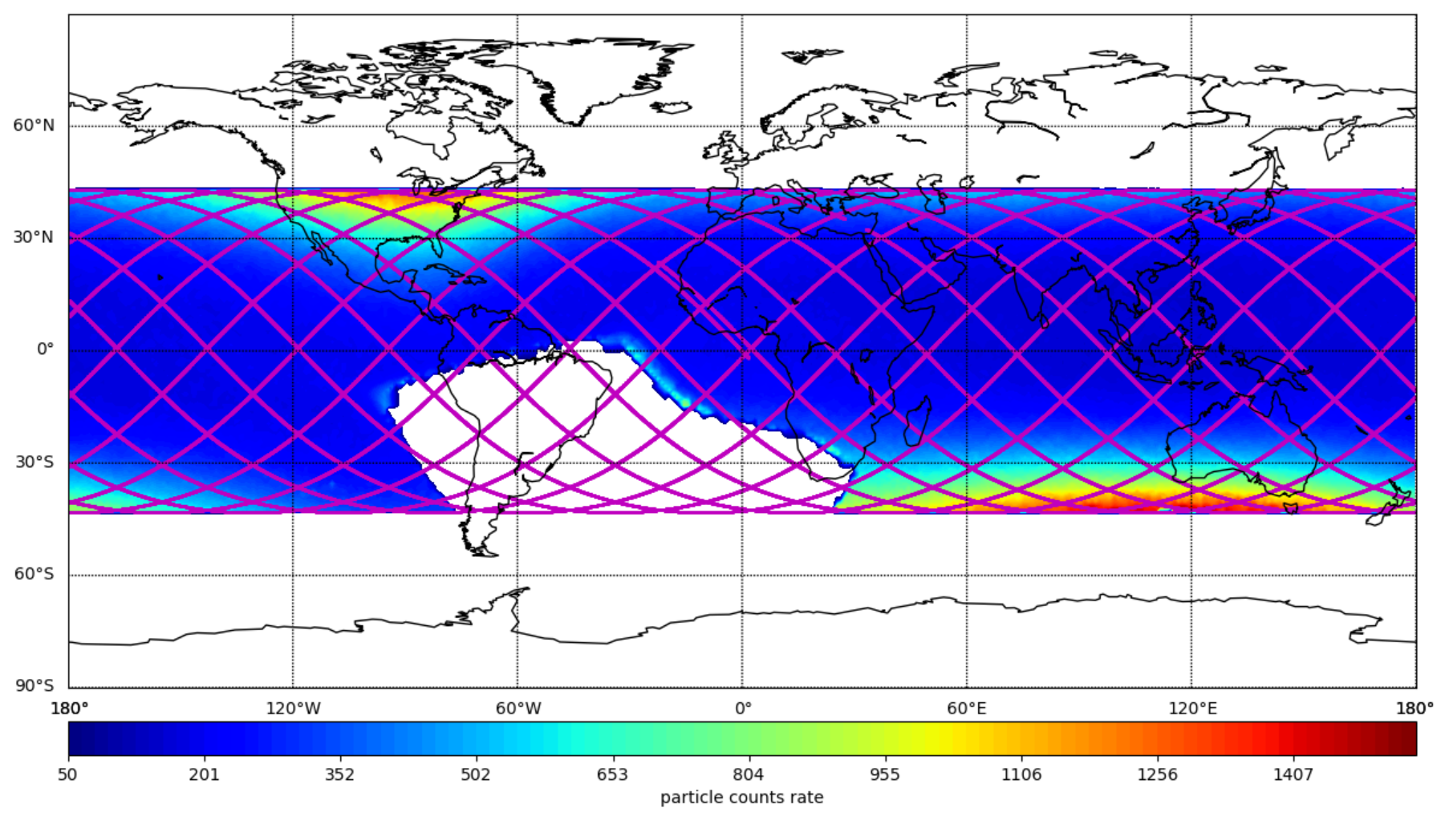
1.1 Insight-HXMT satellite
China’s first X-ray
Astronomy Satellite
Orbital altitude
Lifetime
~8 years
Altitude
~530 km, raised four times
Inclination
~43°
Weight
~2500 kg
Mode
Pointed丨 scanning丨GRB modes
Solar avoidance angle is more than 70°
Orbital inclination
Avoidance

Slide 4
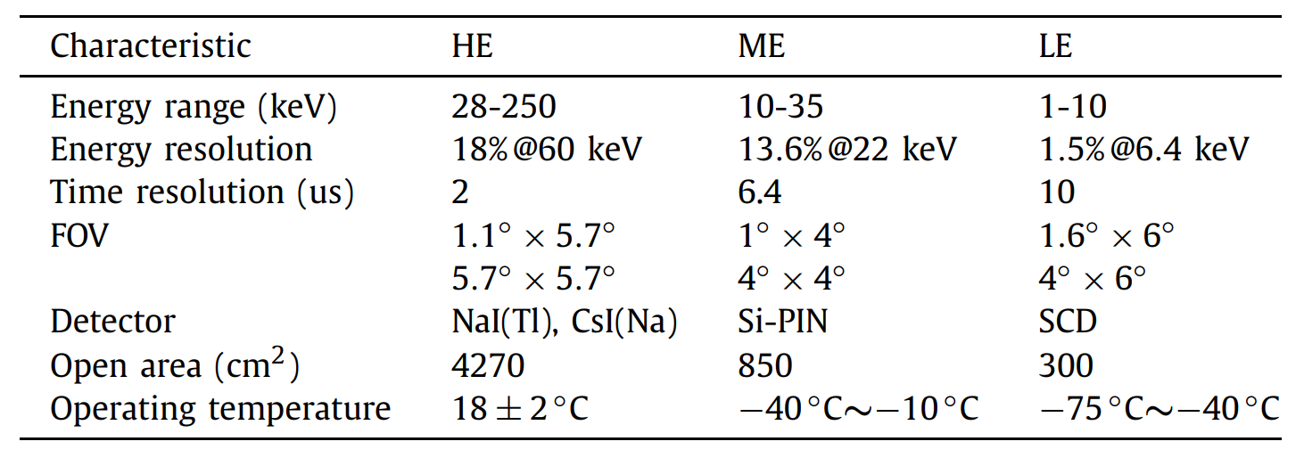
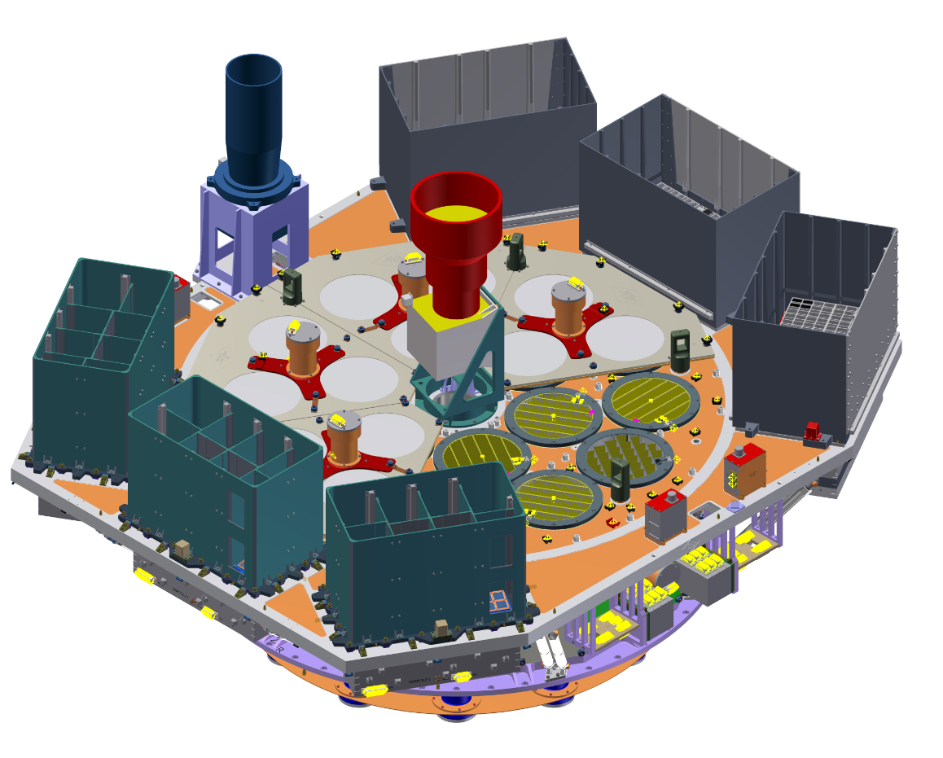
1.2 Insight-HXMT Instruments
Main properties of HXMT instruments
ME, 1728 SiPIN
10-35 keV
LE, 96 SCD, 1-10 keV
Broad energy band：1—250 keV
Large Areas：~4000 cm² @ HE
High time resolution: HE: 2 µs, ME: 6 µs
HE, 18 NaI(Tl)
28-250 keV
CsI(Tl) 80-700keV
Small Dead time：No pipe up effect

Slide 5
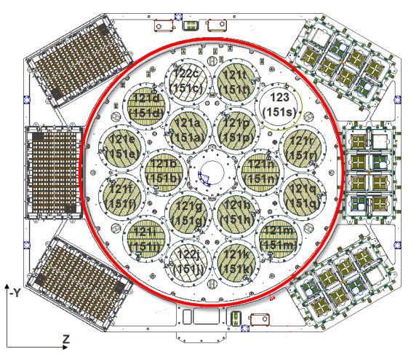
1.2 Field of View (FOV)
LE: 1.6° ╳ 6°
Swept Charge Device
1—10 keV
HE: 1.1° ╳ 5.7°
NaI/CsI
20—250 keV
ME: 1° ╳ 4°
SiPIN
5—30 keV
Blind Detectors

Slide 6
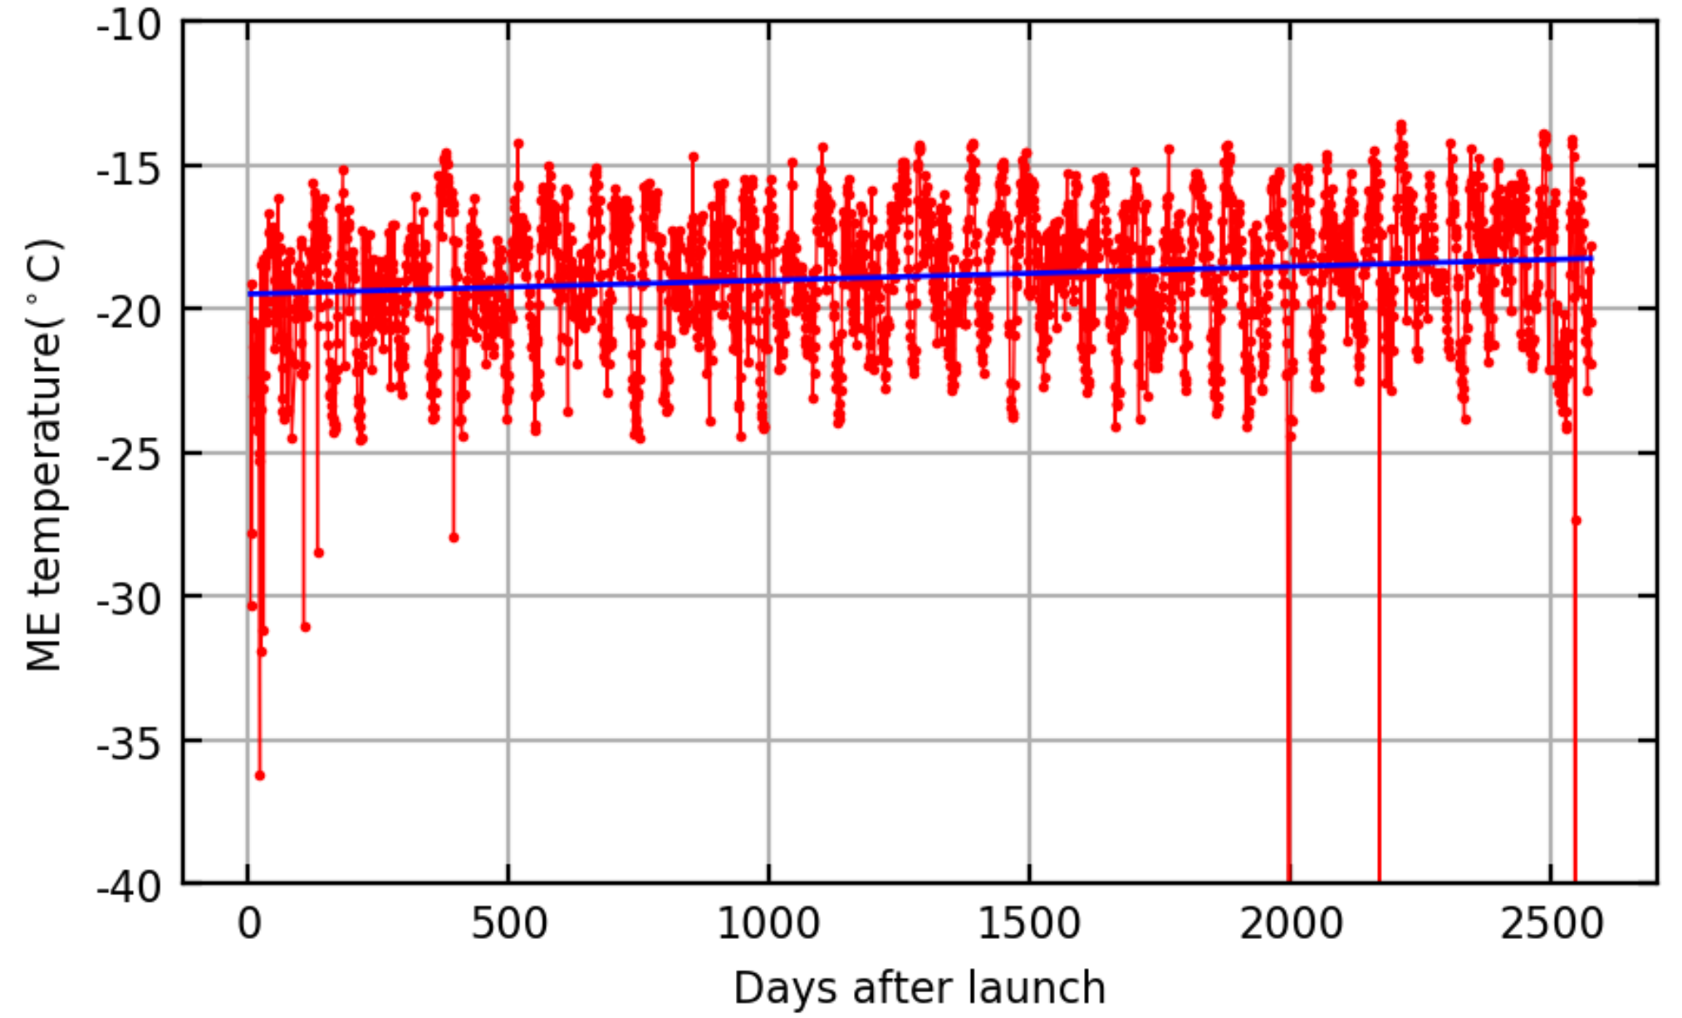
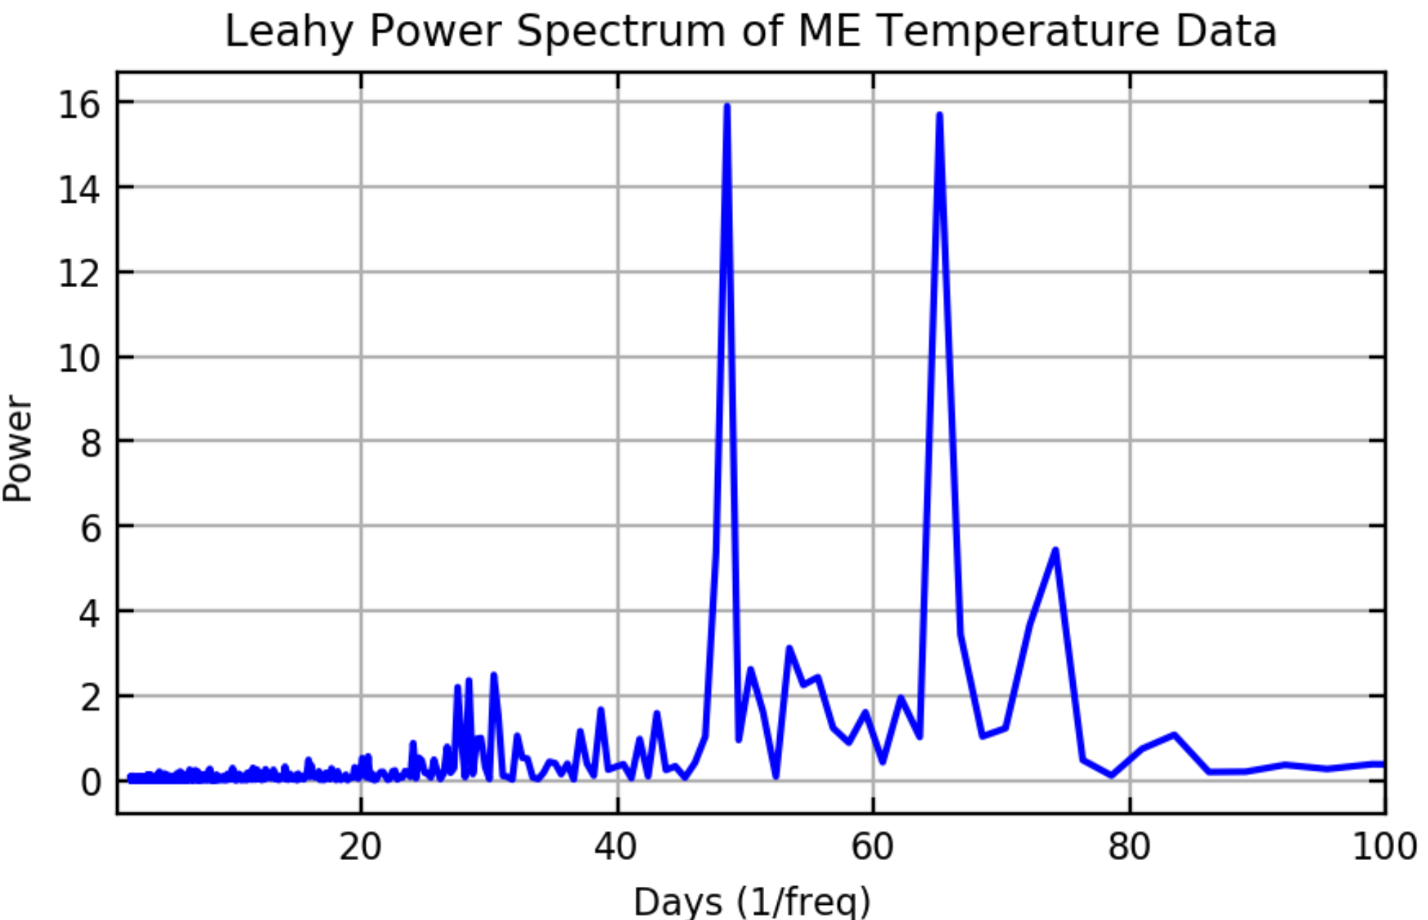
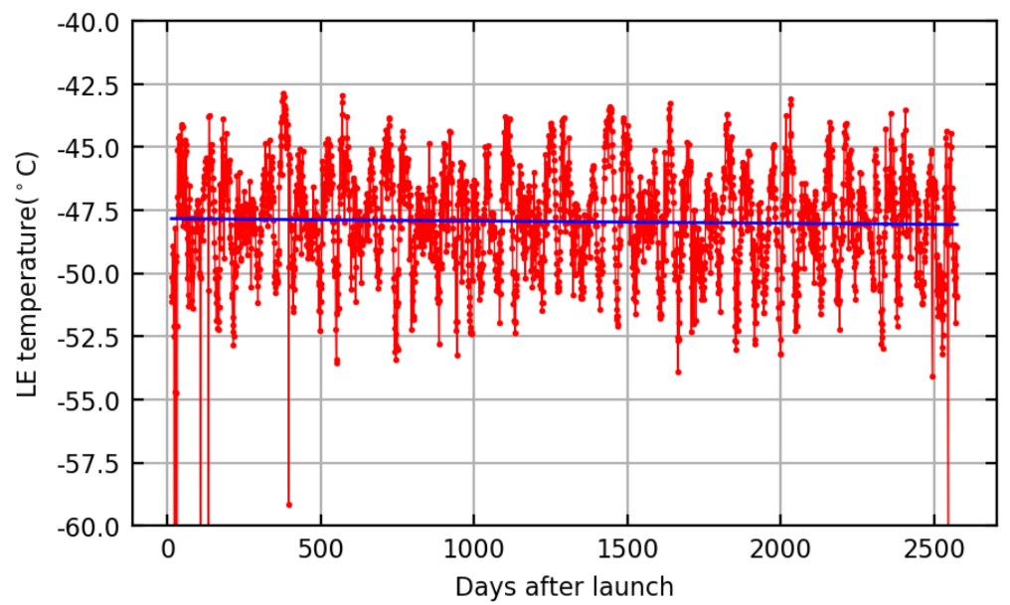
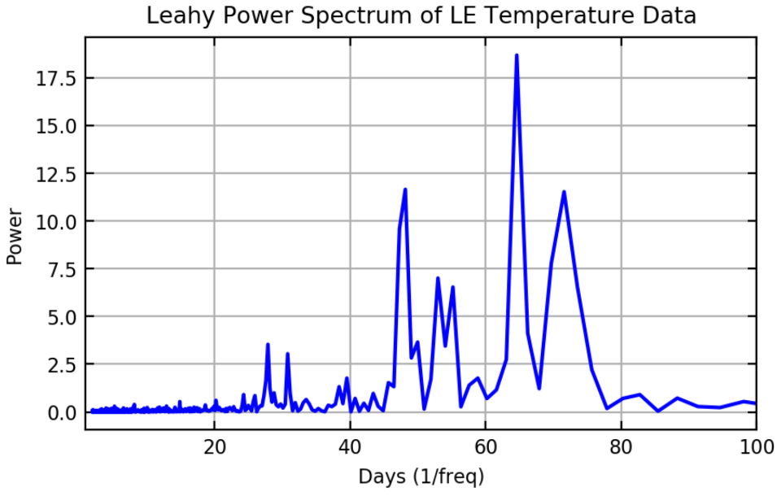
1.2 Temperature of the Instruments
ME and LE Temperature: ~65-day Period (Orbital Precession)
Temperatures：
HE
18 ± 0.2° Active Thermal Control
ME
-25° ~ -10°
Passive
Thermal
Control
LE
-55° ~ -40°
Orbital Precession Cycle
~ 65 days

Slide 7
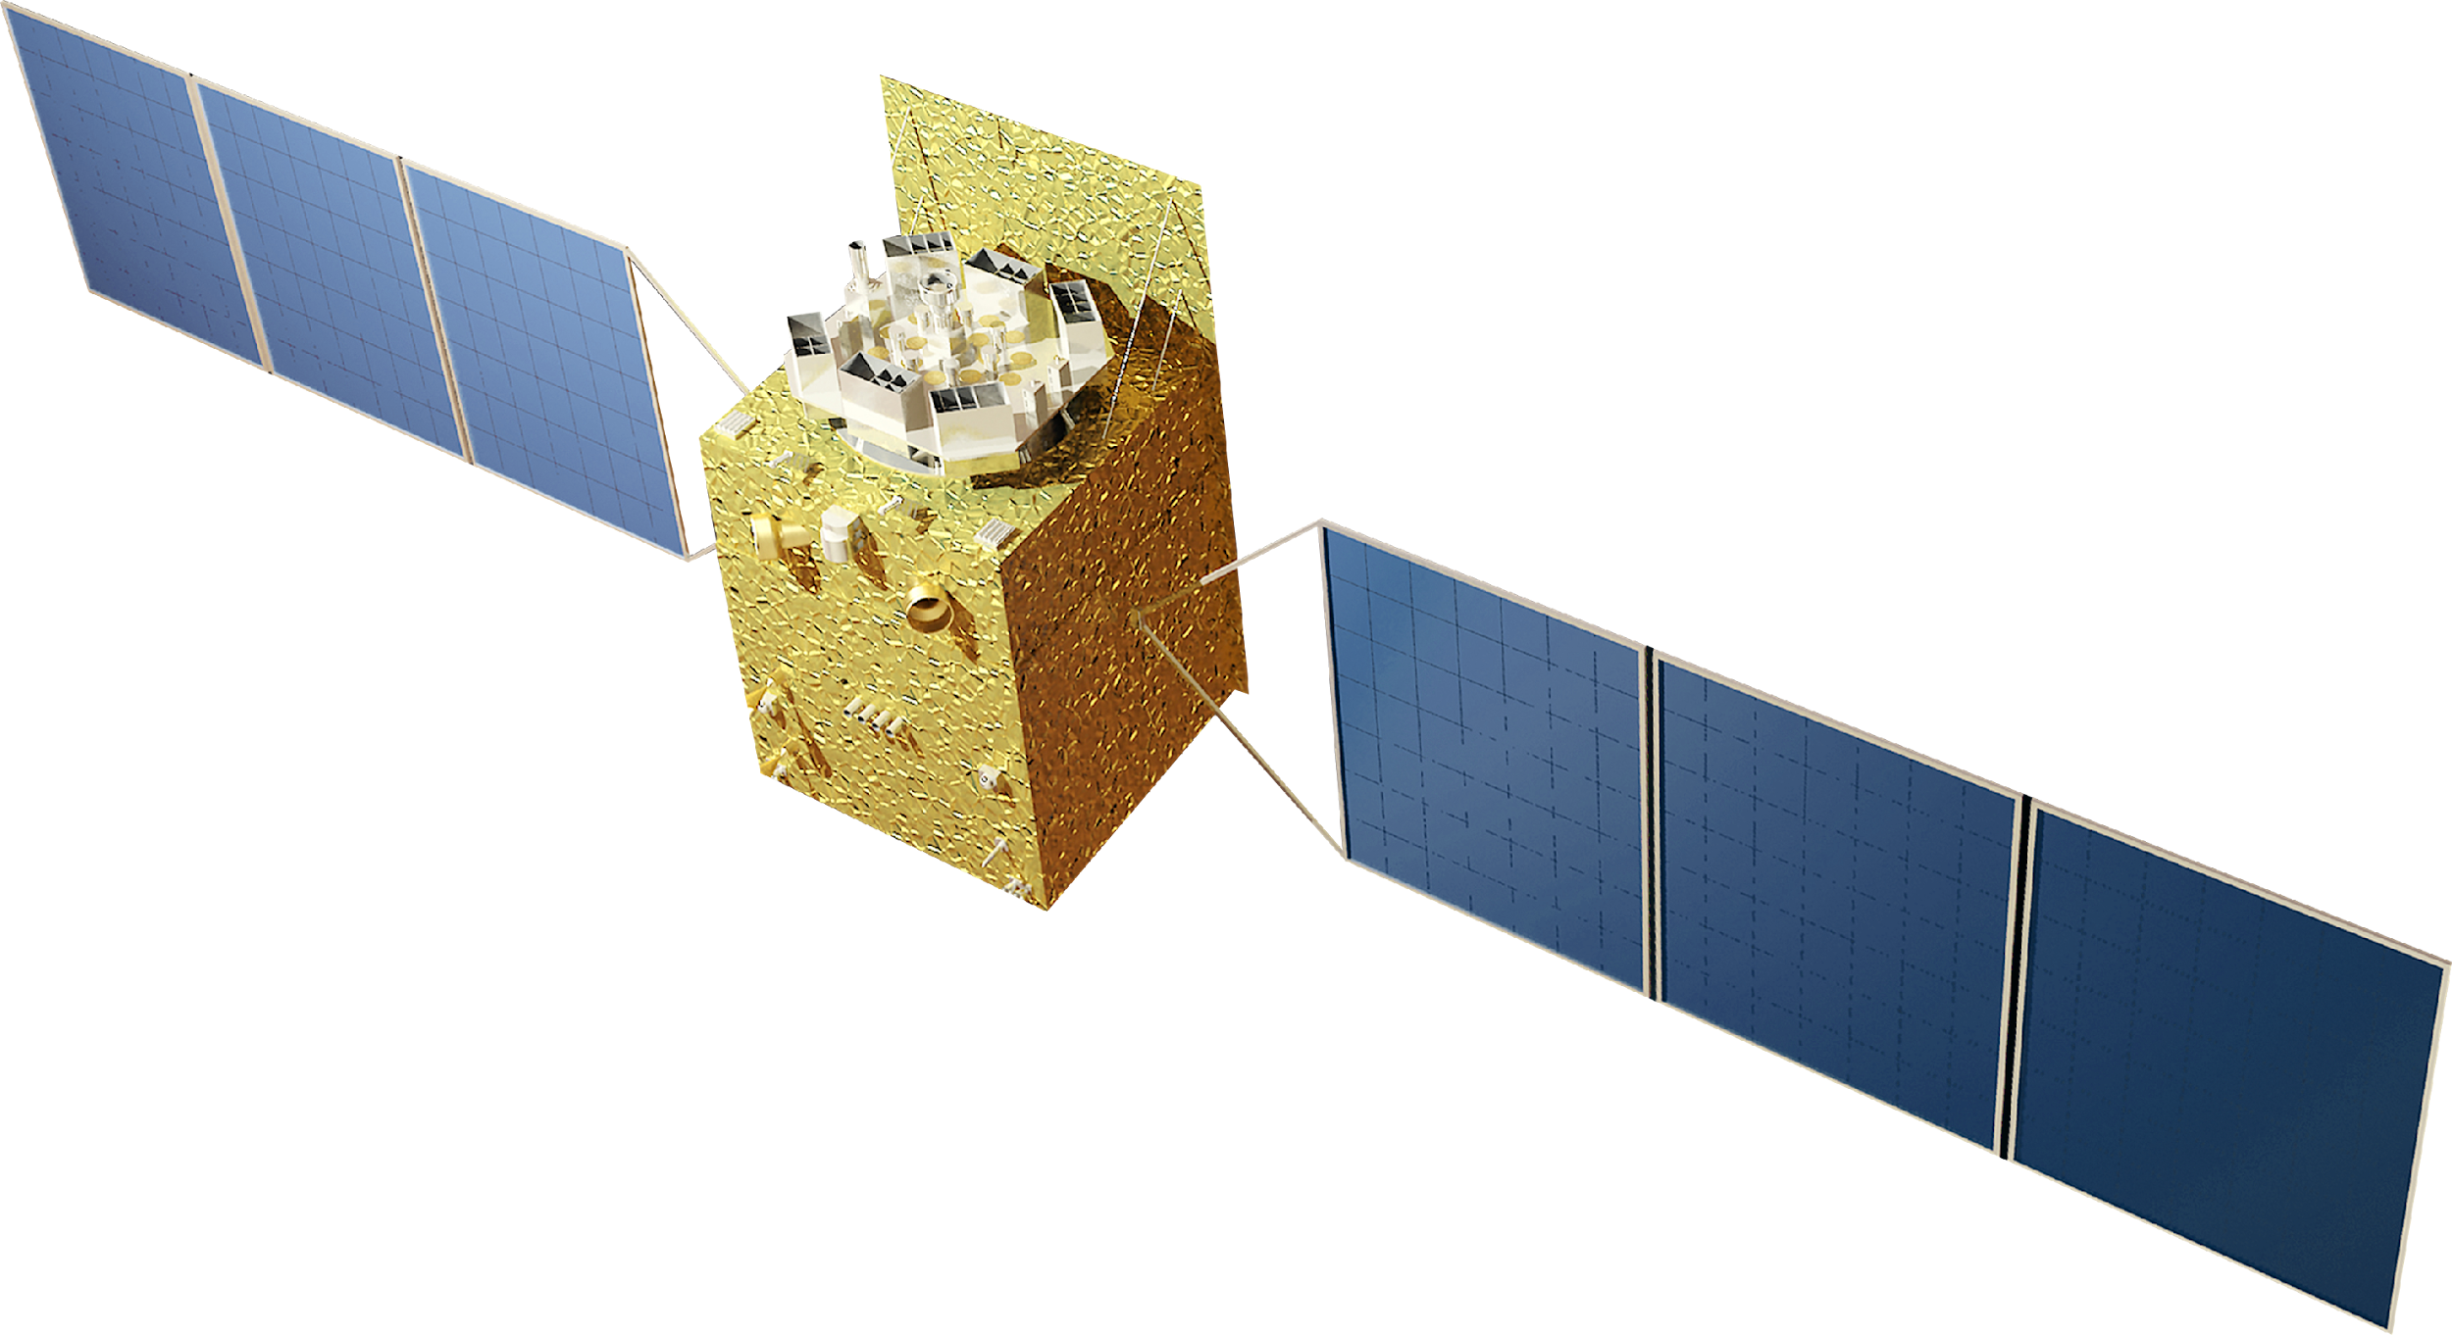
2
2
Collimator Calibration
1
2
Energy Calibration
Calibration status
3
Timing Calibration
Notes:
Next, we will look at the current status of HXMT

Slide 8
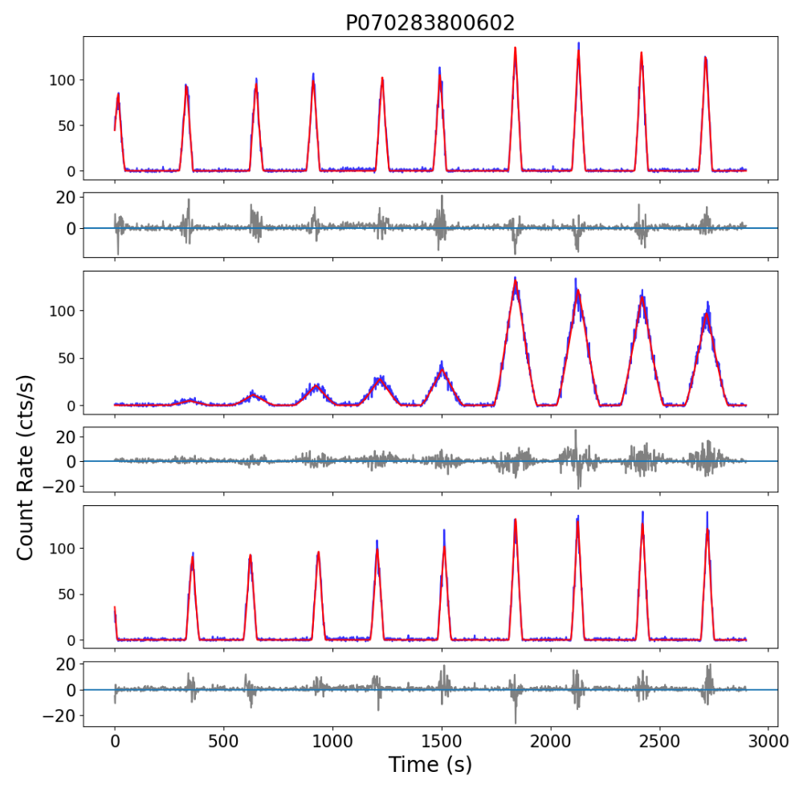
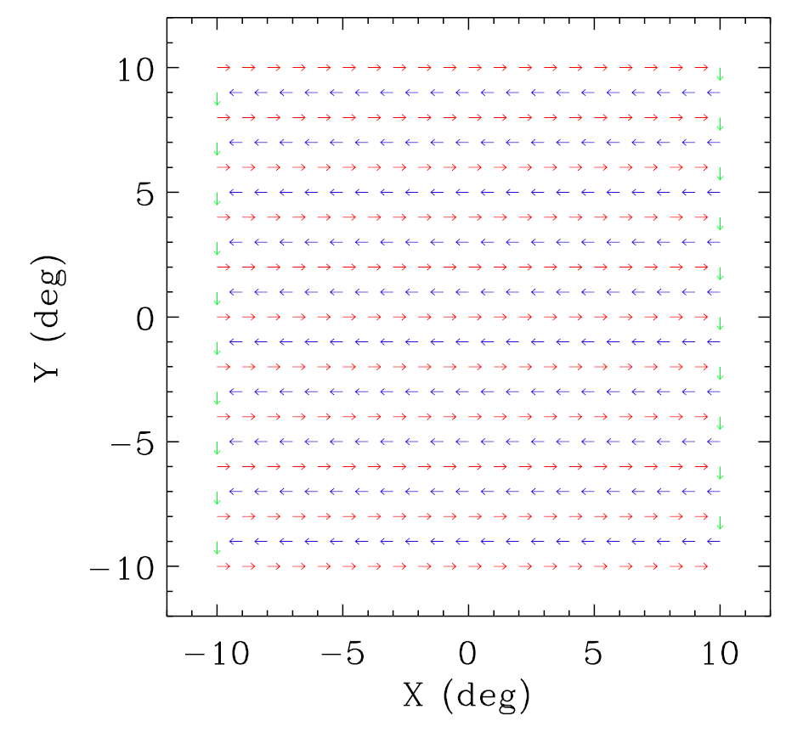
https://drive.google.com/drive/folders/1ipmEX6DvlkXAHnt7HjkP-l9lDiZzCoE5?usp=drive_link
2.1 Collimator Calibration: Small Area Scan of Crab
0.06 ̊ /s , 0. 1 ̊ step

Slide 9
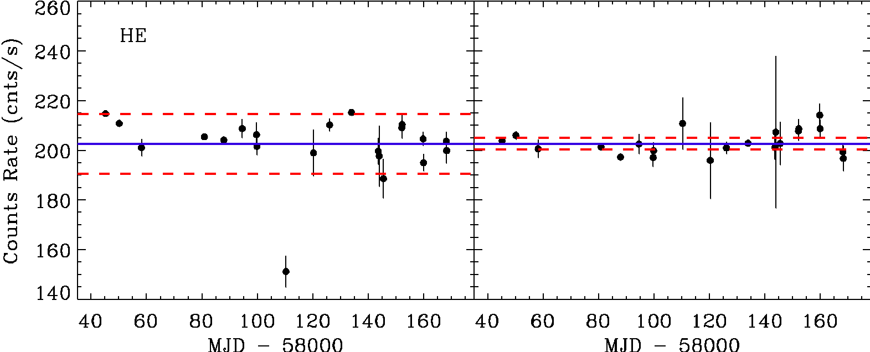
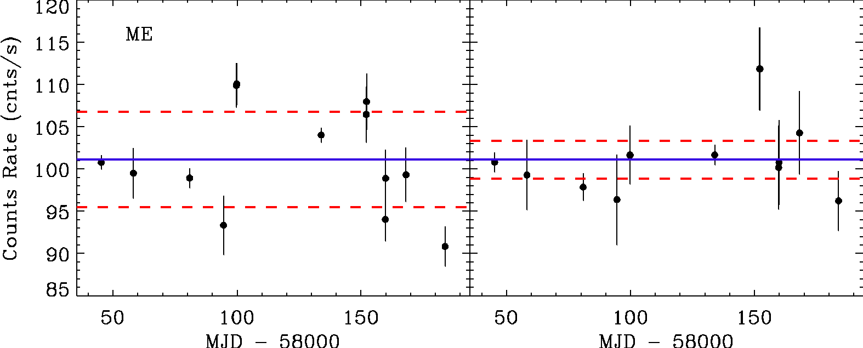
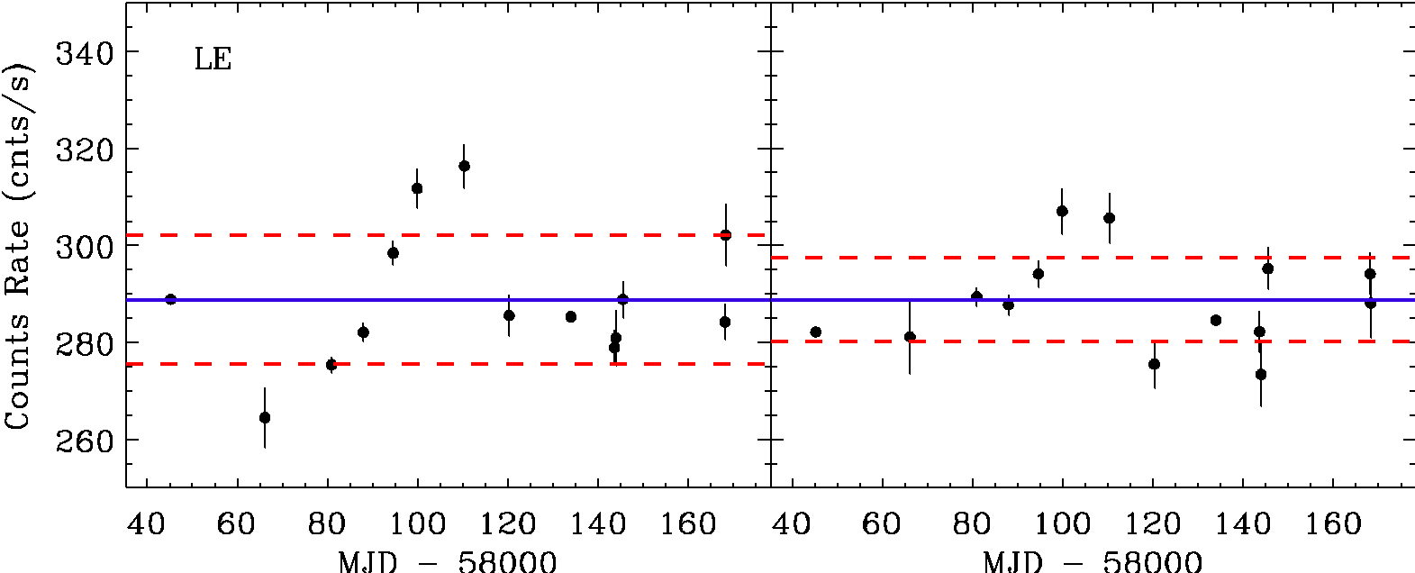
2.1 Collimator Calibration: Small Area Scan of Crab
Precision Check
— Crab Scan
Theoretical geometric predictions
 | HE | ME | LE
Sys_err | 6 % | 6 % | 5 %
After in orbit calibration
 | HE | ME | LE
Sys_err | 1 % | 2 % | 3 %

Slide 10
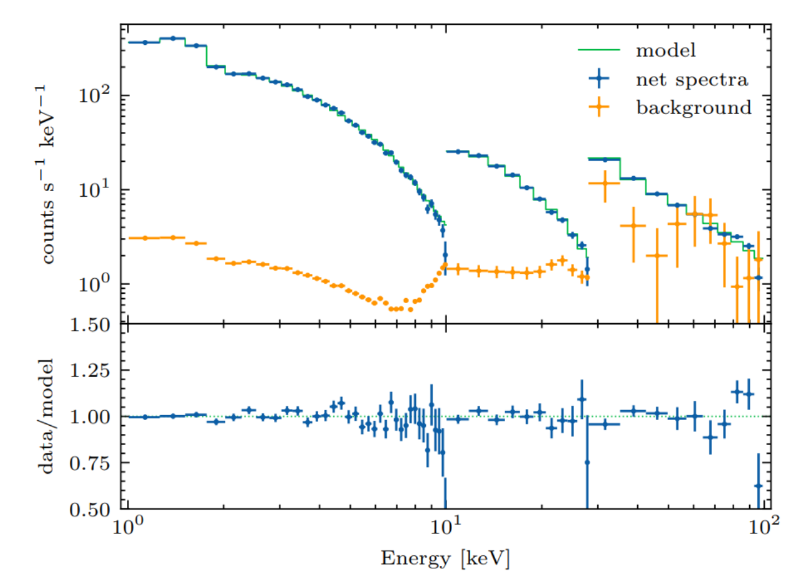
2.2 Energy Calibration
Detected Counts Rate
Crab spectrum observed by HXMT
Instruments | Crab (cts/s) (source +b.k) | Background (cts/s)
HE（28-250 keV） | 540+530 | 530 (~1Crab)
ME（10-35 keV） | 200+20 | 20 (~0.1Crab)
LE（1-10 keV） | 760+10 | 10 (~0.01Crab)
As a collimated telescope, HXMT has high background：
Blank
Sky
Crab
Cas A
Energy Scale，
Resolution
Effective Areas,
Response of collimators

Slide 11
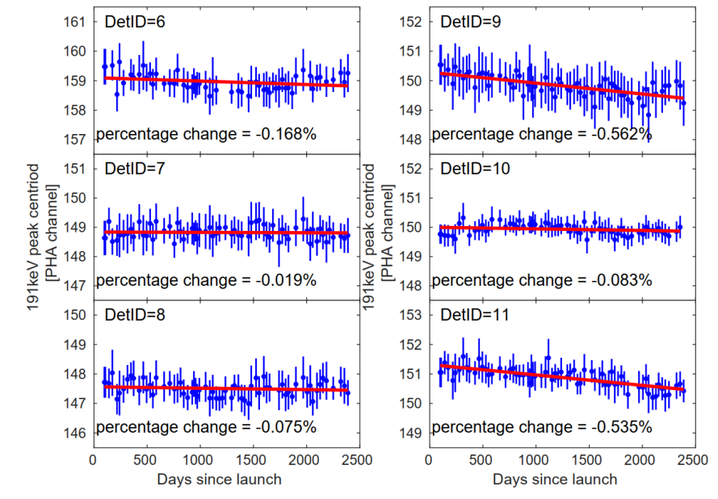
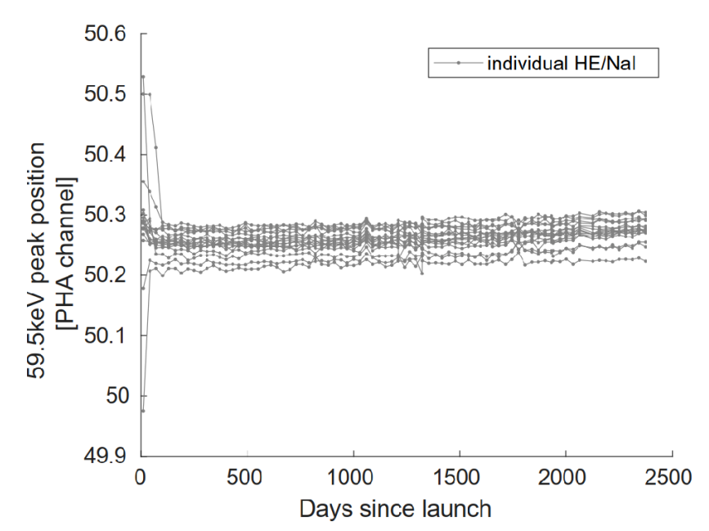
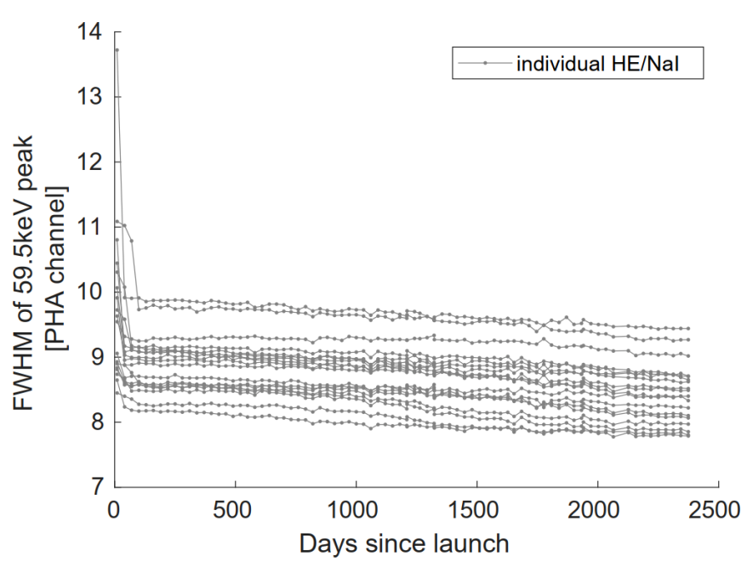
2.2 Calibration---HE
All 18 detectors are working
Energy Scale: keep stable (<1%) after three month in orbit
²⁴¹Am Source
Energy resolution：getting a little better
Automatic Gain Controller
Effective areas: keep stable
α and X-ray coincidence

Slide 12
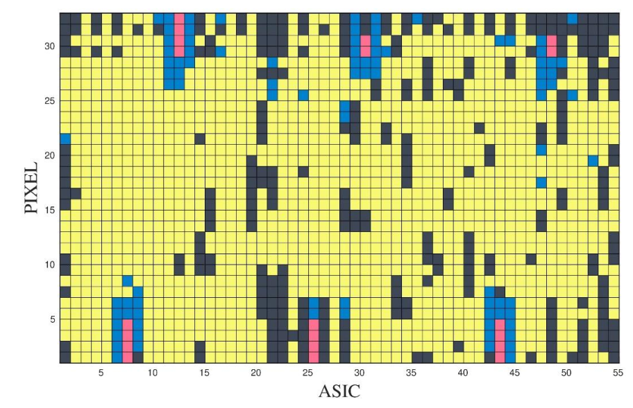
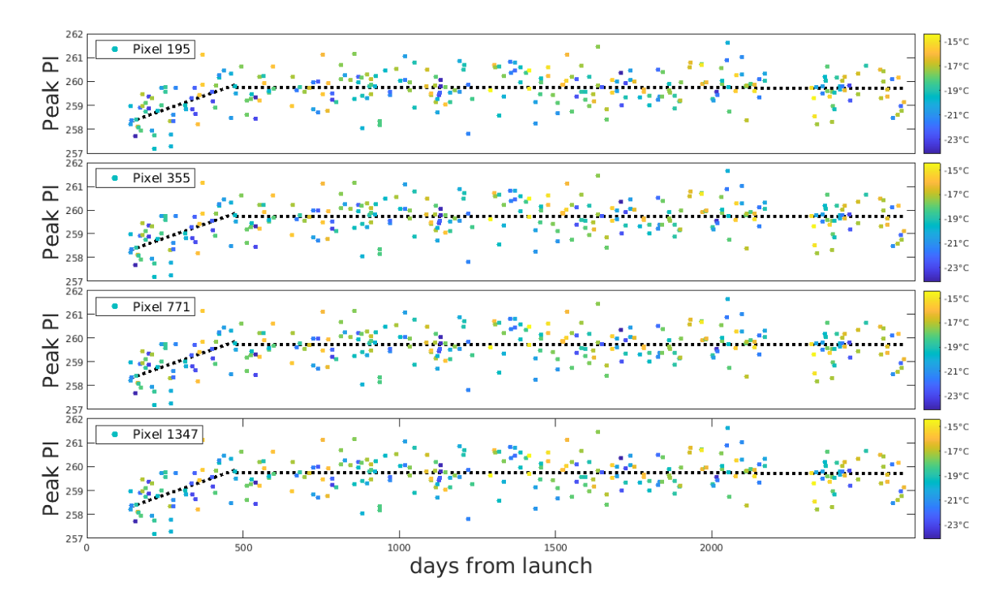
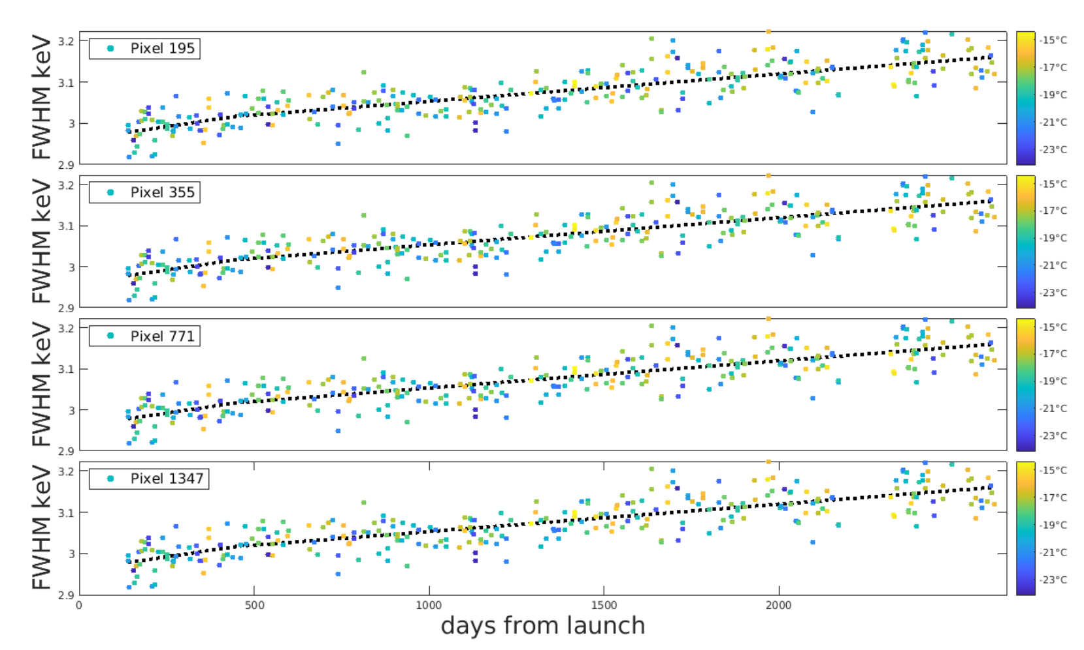
2.2 Calibration---ME
298 SiPINs (17%) are turned off
Energy Scale: keep stable after 500 days
Energy resolution：change less than 3%
Effective areas: keep almost stable

Slide 13
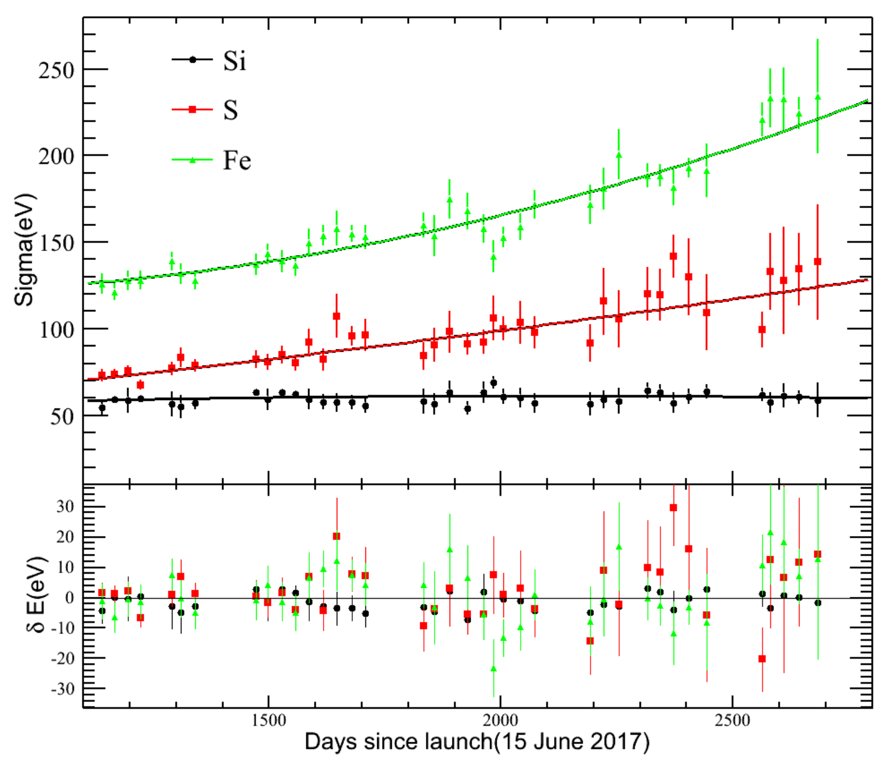
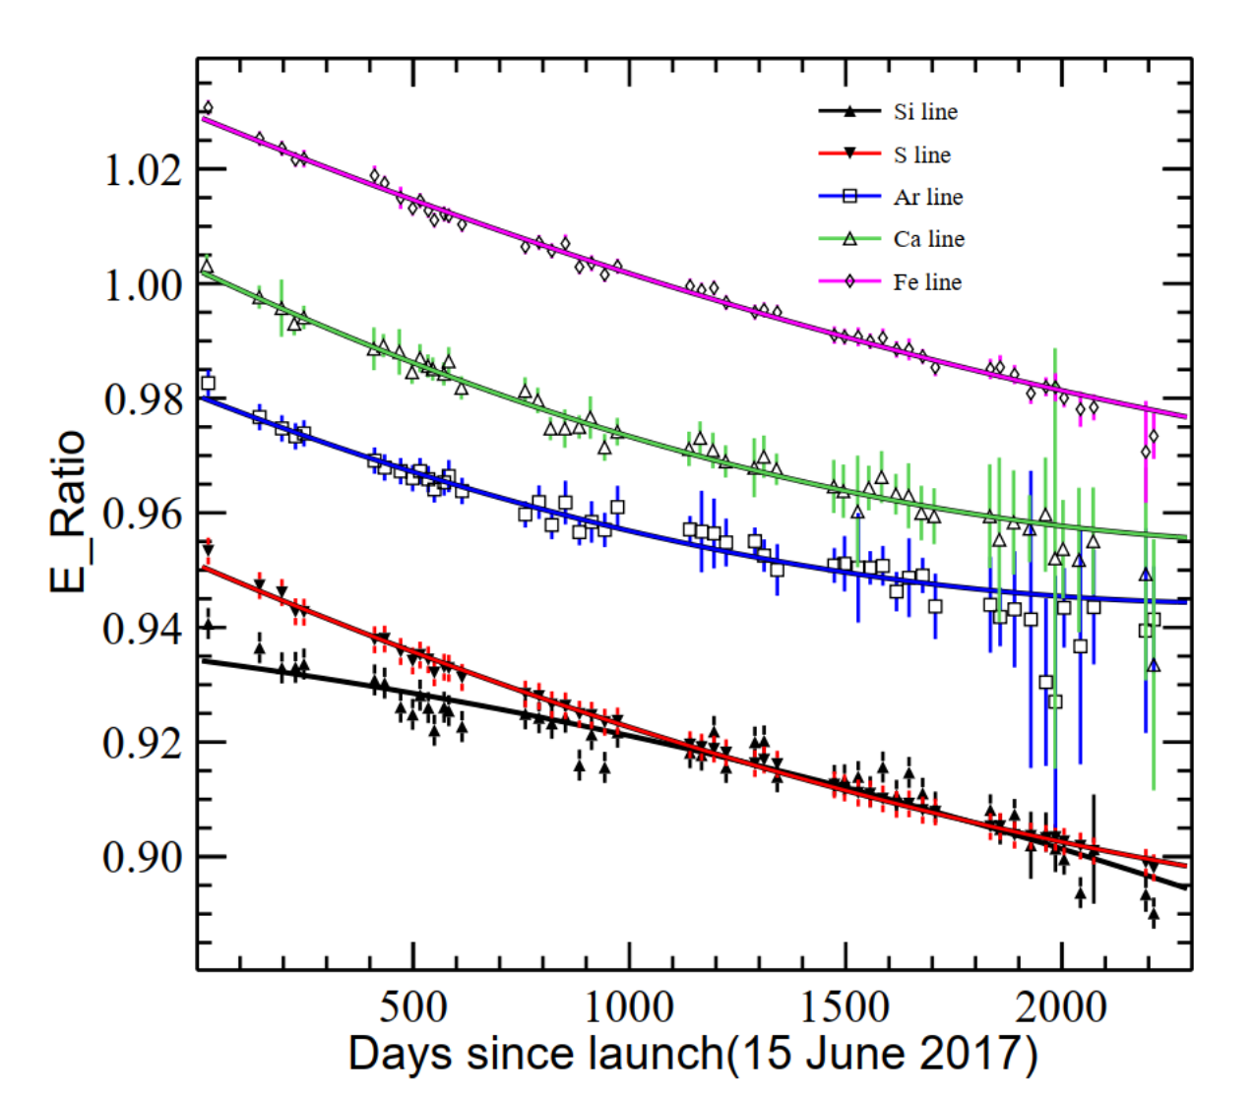
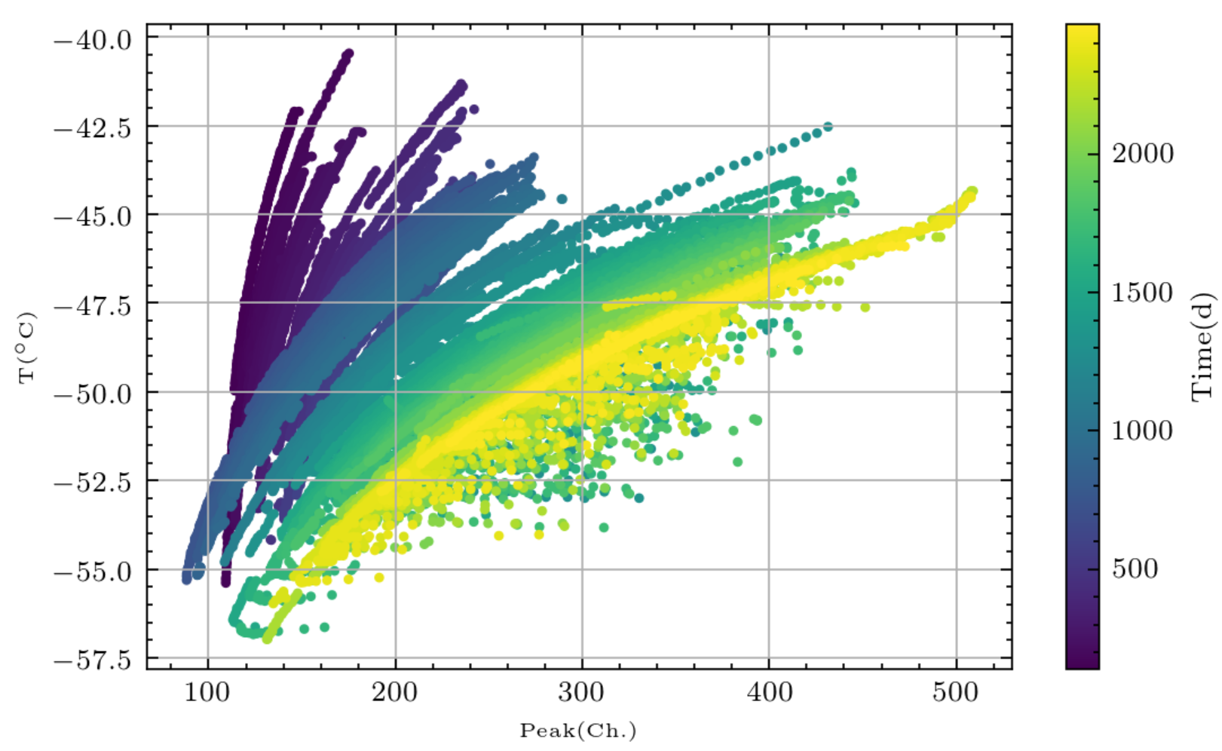
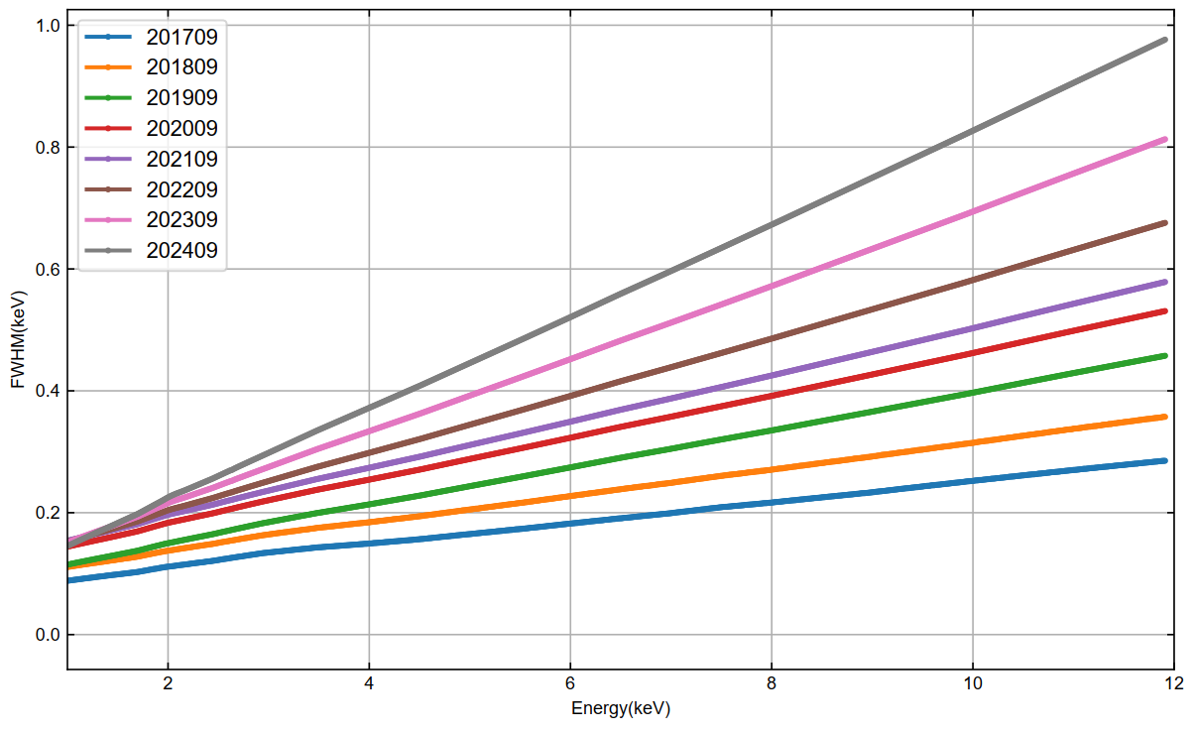
2.2 Calibration---LE
7 CCDs (8%) are turned off
Energy Gain: decrease month by month due to radiation damage
Energy resolution：getting worse each year
Effective Areas: relatively minor each year

Slide 14
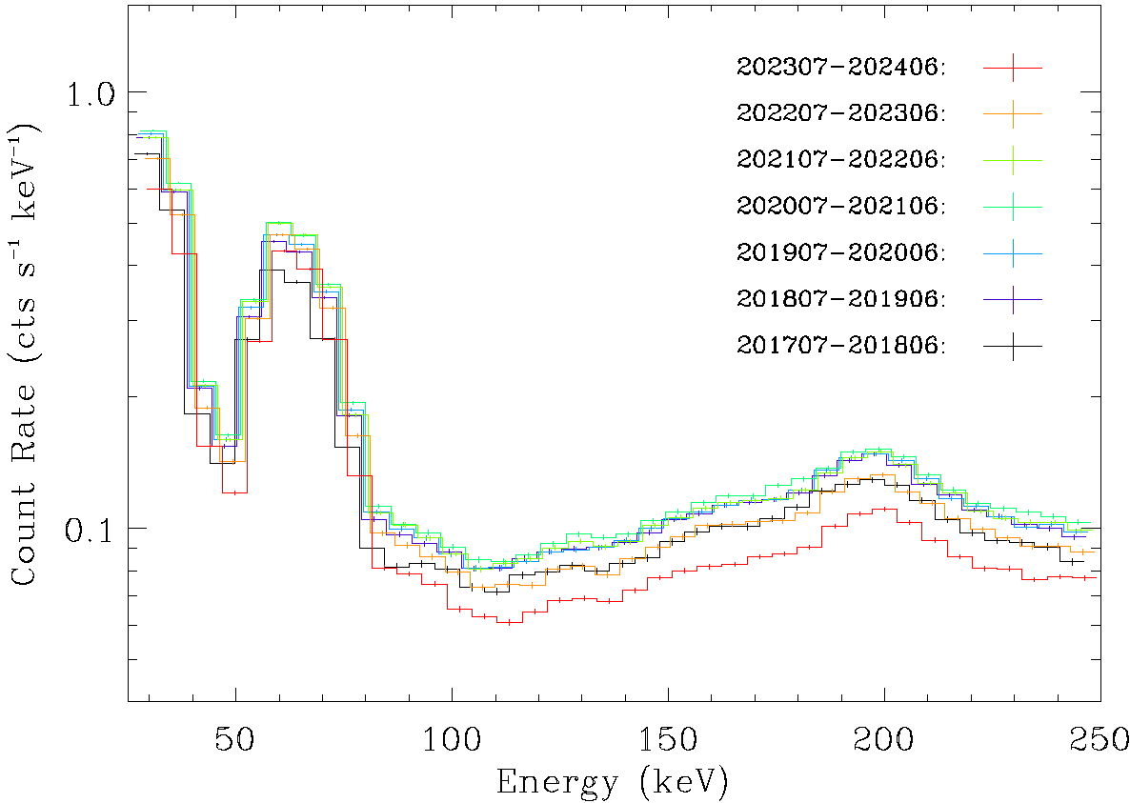
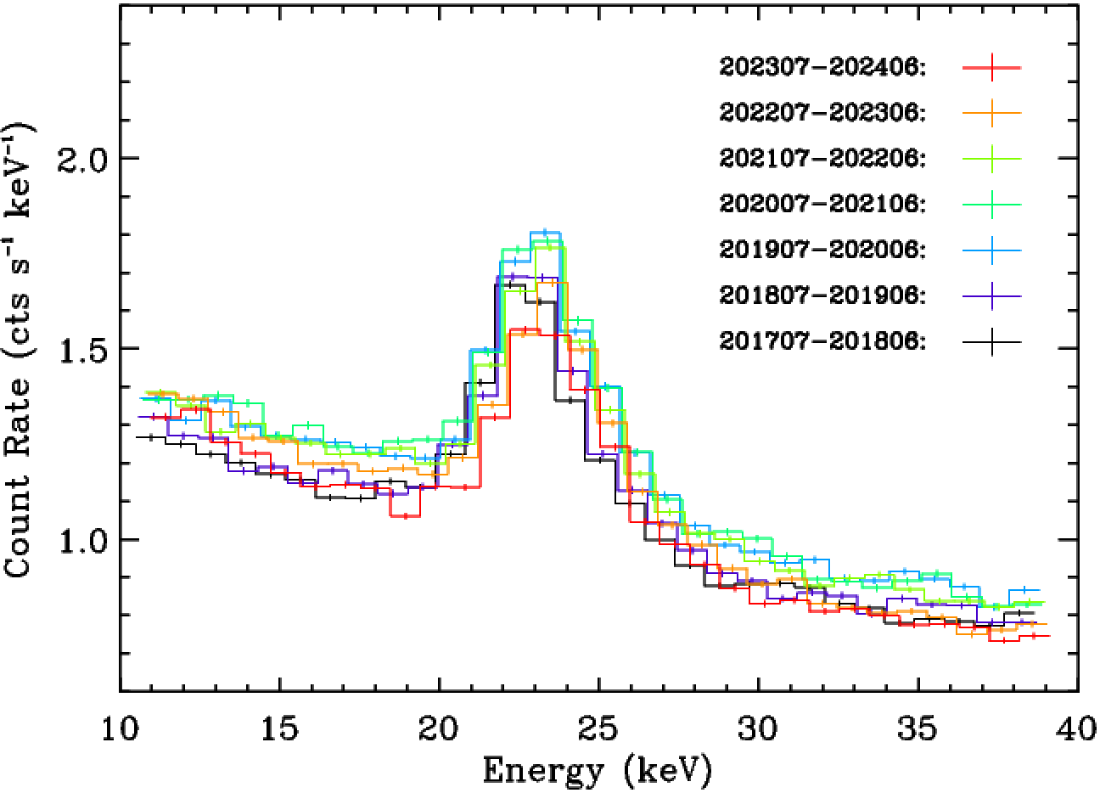
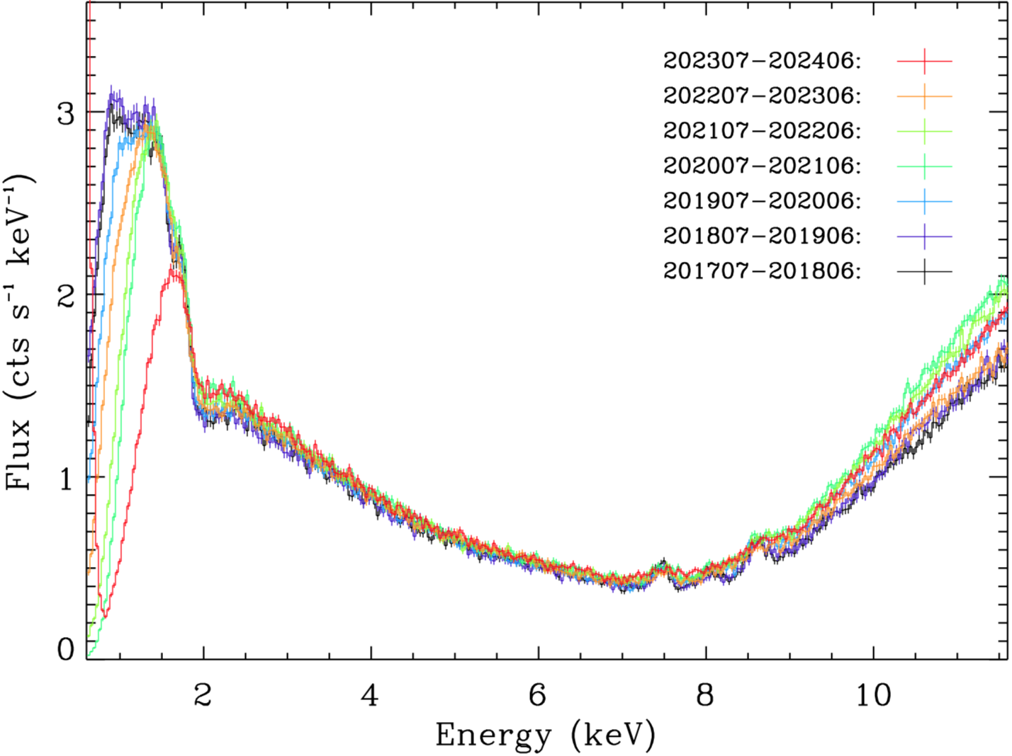
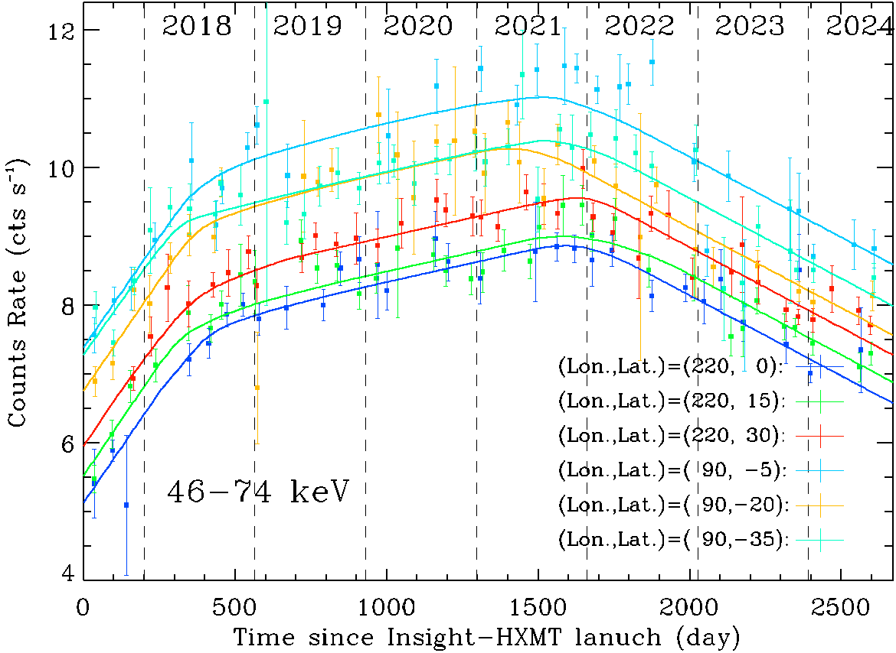
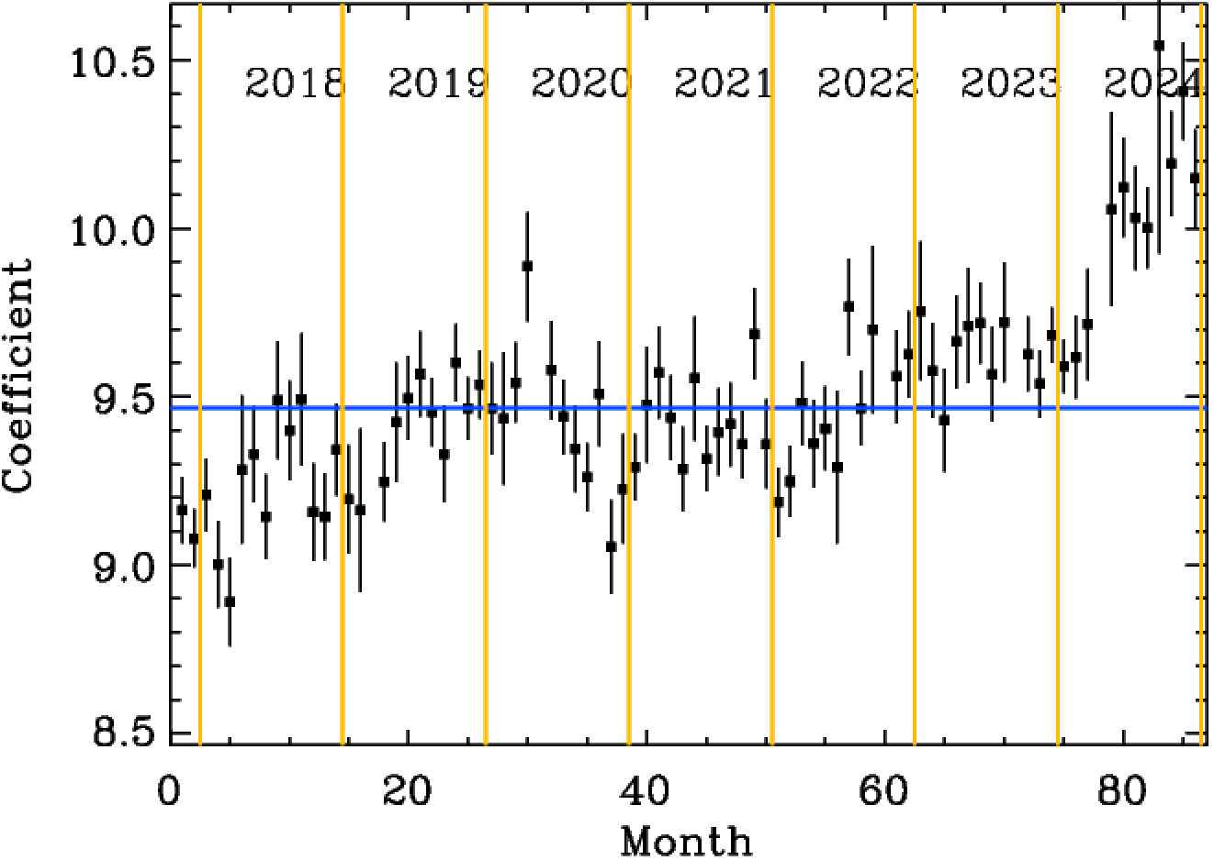
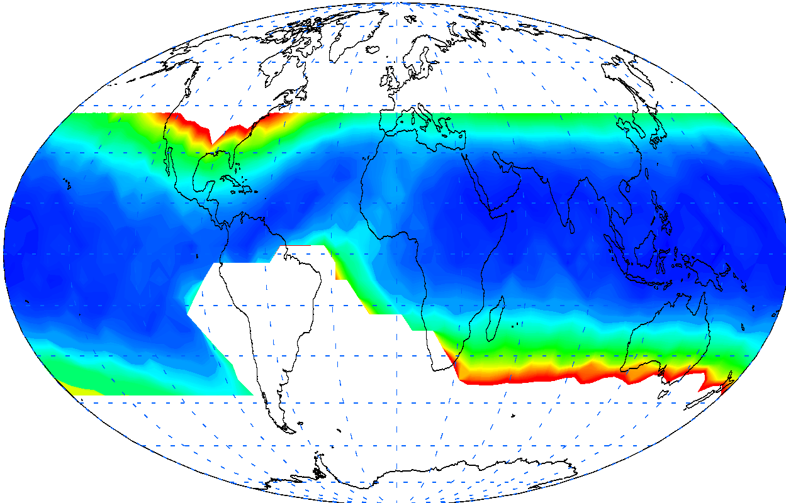
2.3 Background Model
The background model is estimated and verified by
blank sky observations and blind detectors.
HE
ME
LE

Slide 15
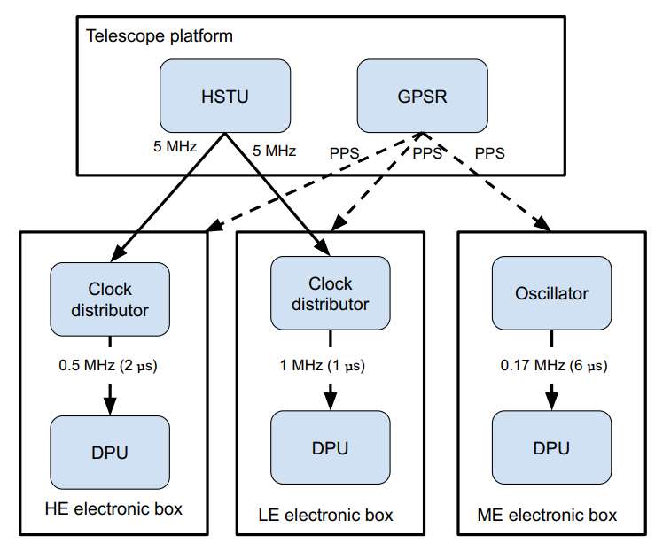
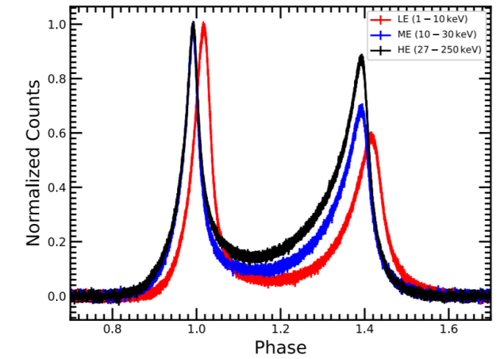
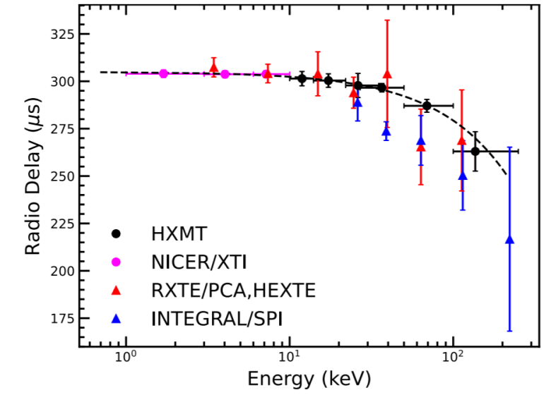
2.4 Timing calibration
GPS receiver + high-stability clock on board
The systematic errors of the timing systems is obtained by simultaneous observations of the Crab Pulsar with NICER. Three instruments are less than 20 µs;
Significantly improve the accuracy of the arrival time for the main pulse of the Crab Pulsar.
Tuo Y. et al, 2022, ApJS
0.26 ± 0.02 µs /keV

Slide 16
01
Introduction of HXMT
02
Calibration Status of HXMT
OUTLINE
03
Summary

Slide 17
3. Summary
1. Insight-HXMT has worked smoothly for about 8 years, and all the detectors of HE work well. ME and LE deactivated some detectors but also satisfy the scientific requirements.
2. HXMTSOFT , CALDB and background model are continuously updated.
3. With its combined advantages of large area, broad band, high timing and energy resolution, HXMT has opened a new window for the study of hard X-ray fast timing and energy spectra of black holes and neutron stars.
Thanks!

