Slide 1
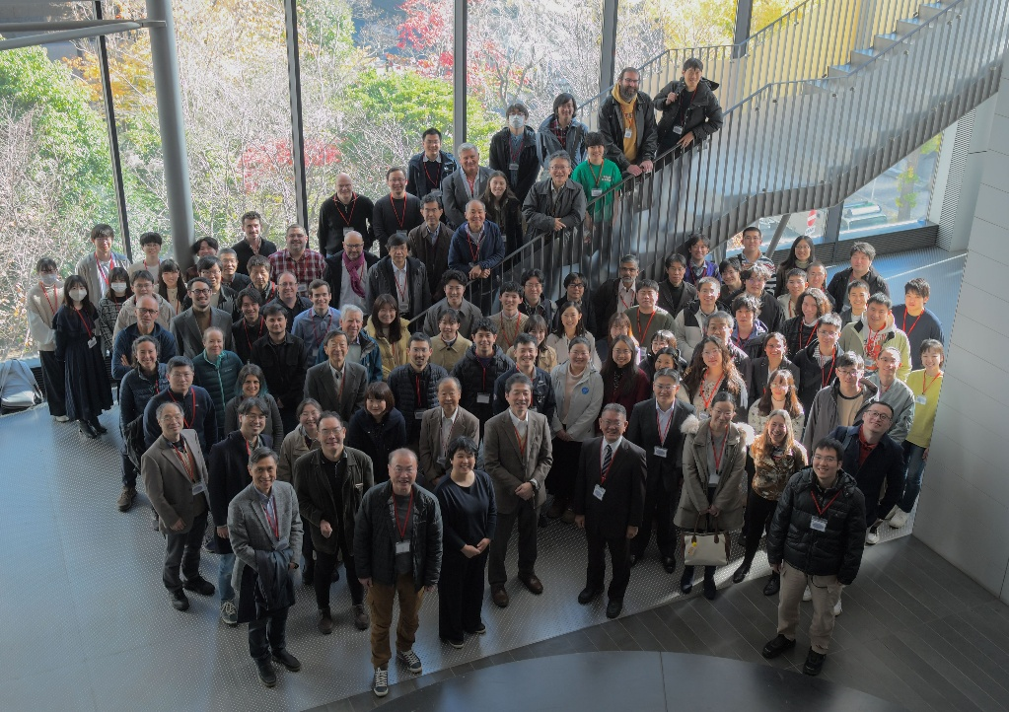
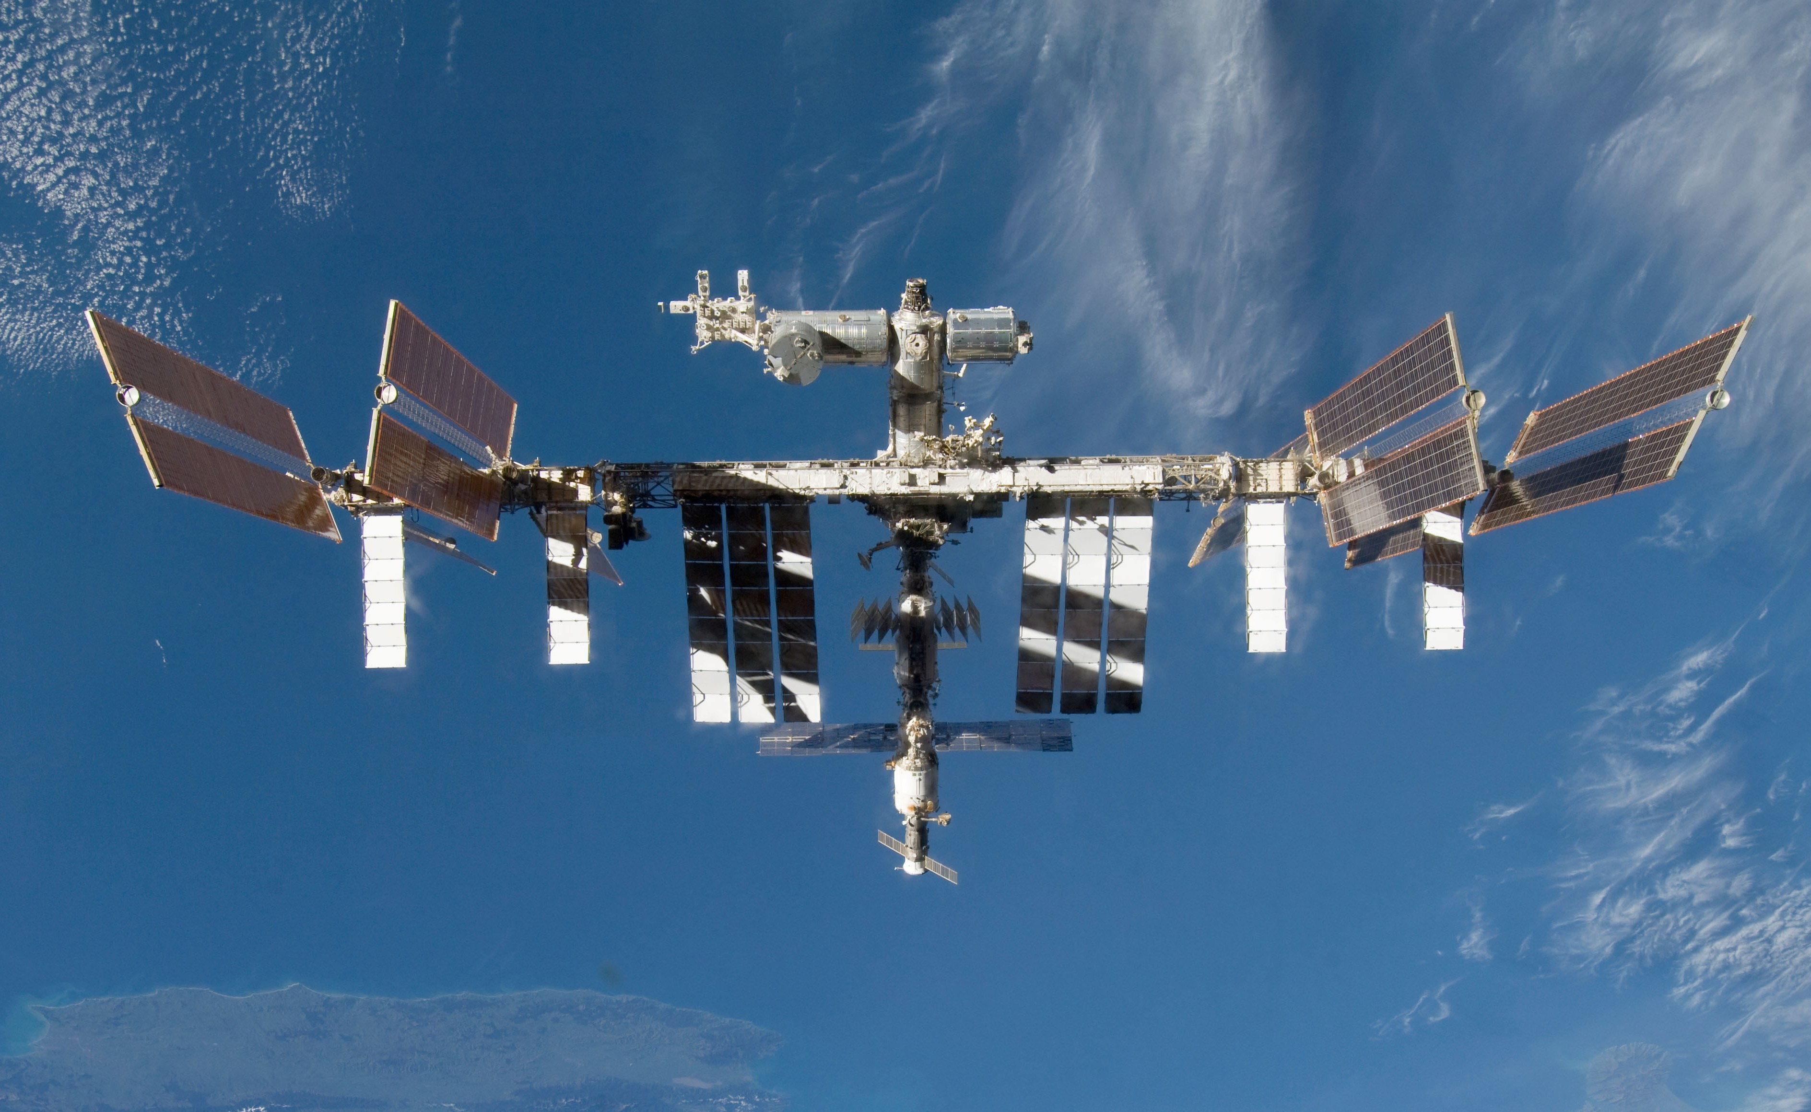
MAXI 15 years of instrument operation and calibration status
MAXI 15 years workshop at Tokyo
Overview of MAXI 15 years
GSC operation status
Calibration for solar-flare X-ray contamination
Summary
Mutsumi Sugizaki (Kanazawa Univ.) on behalf of MAXI Team

Slide 2
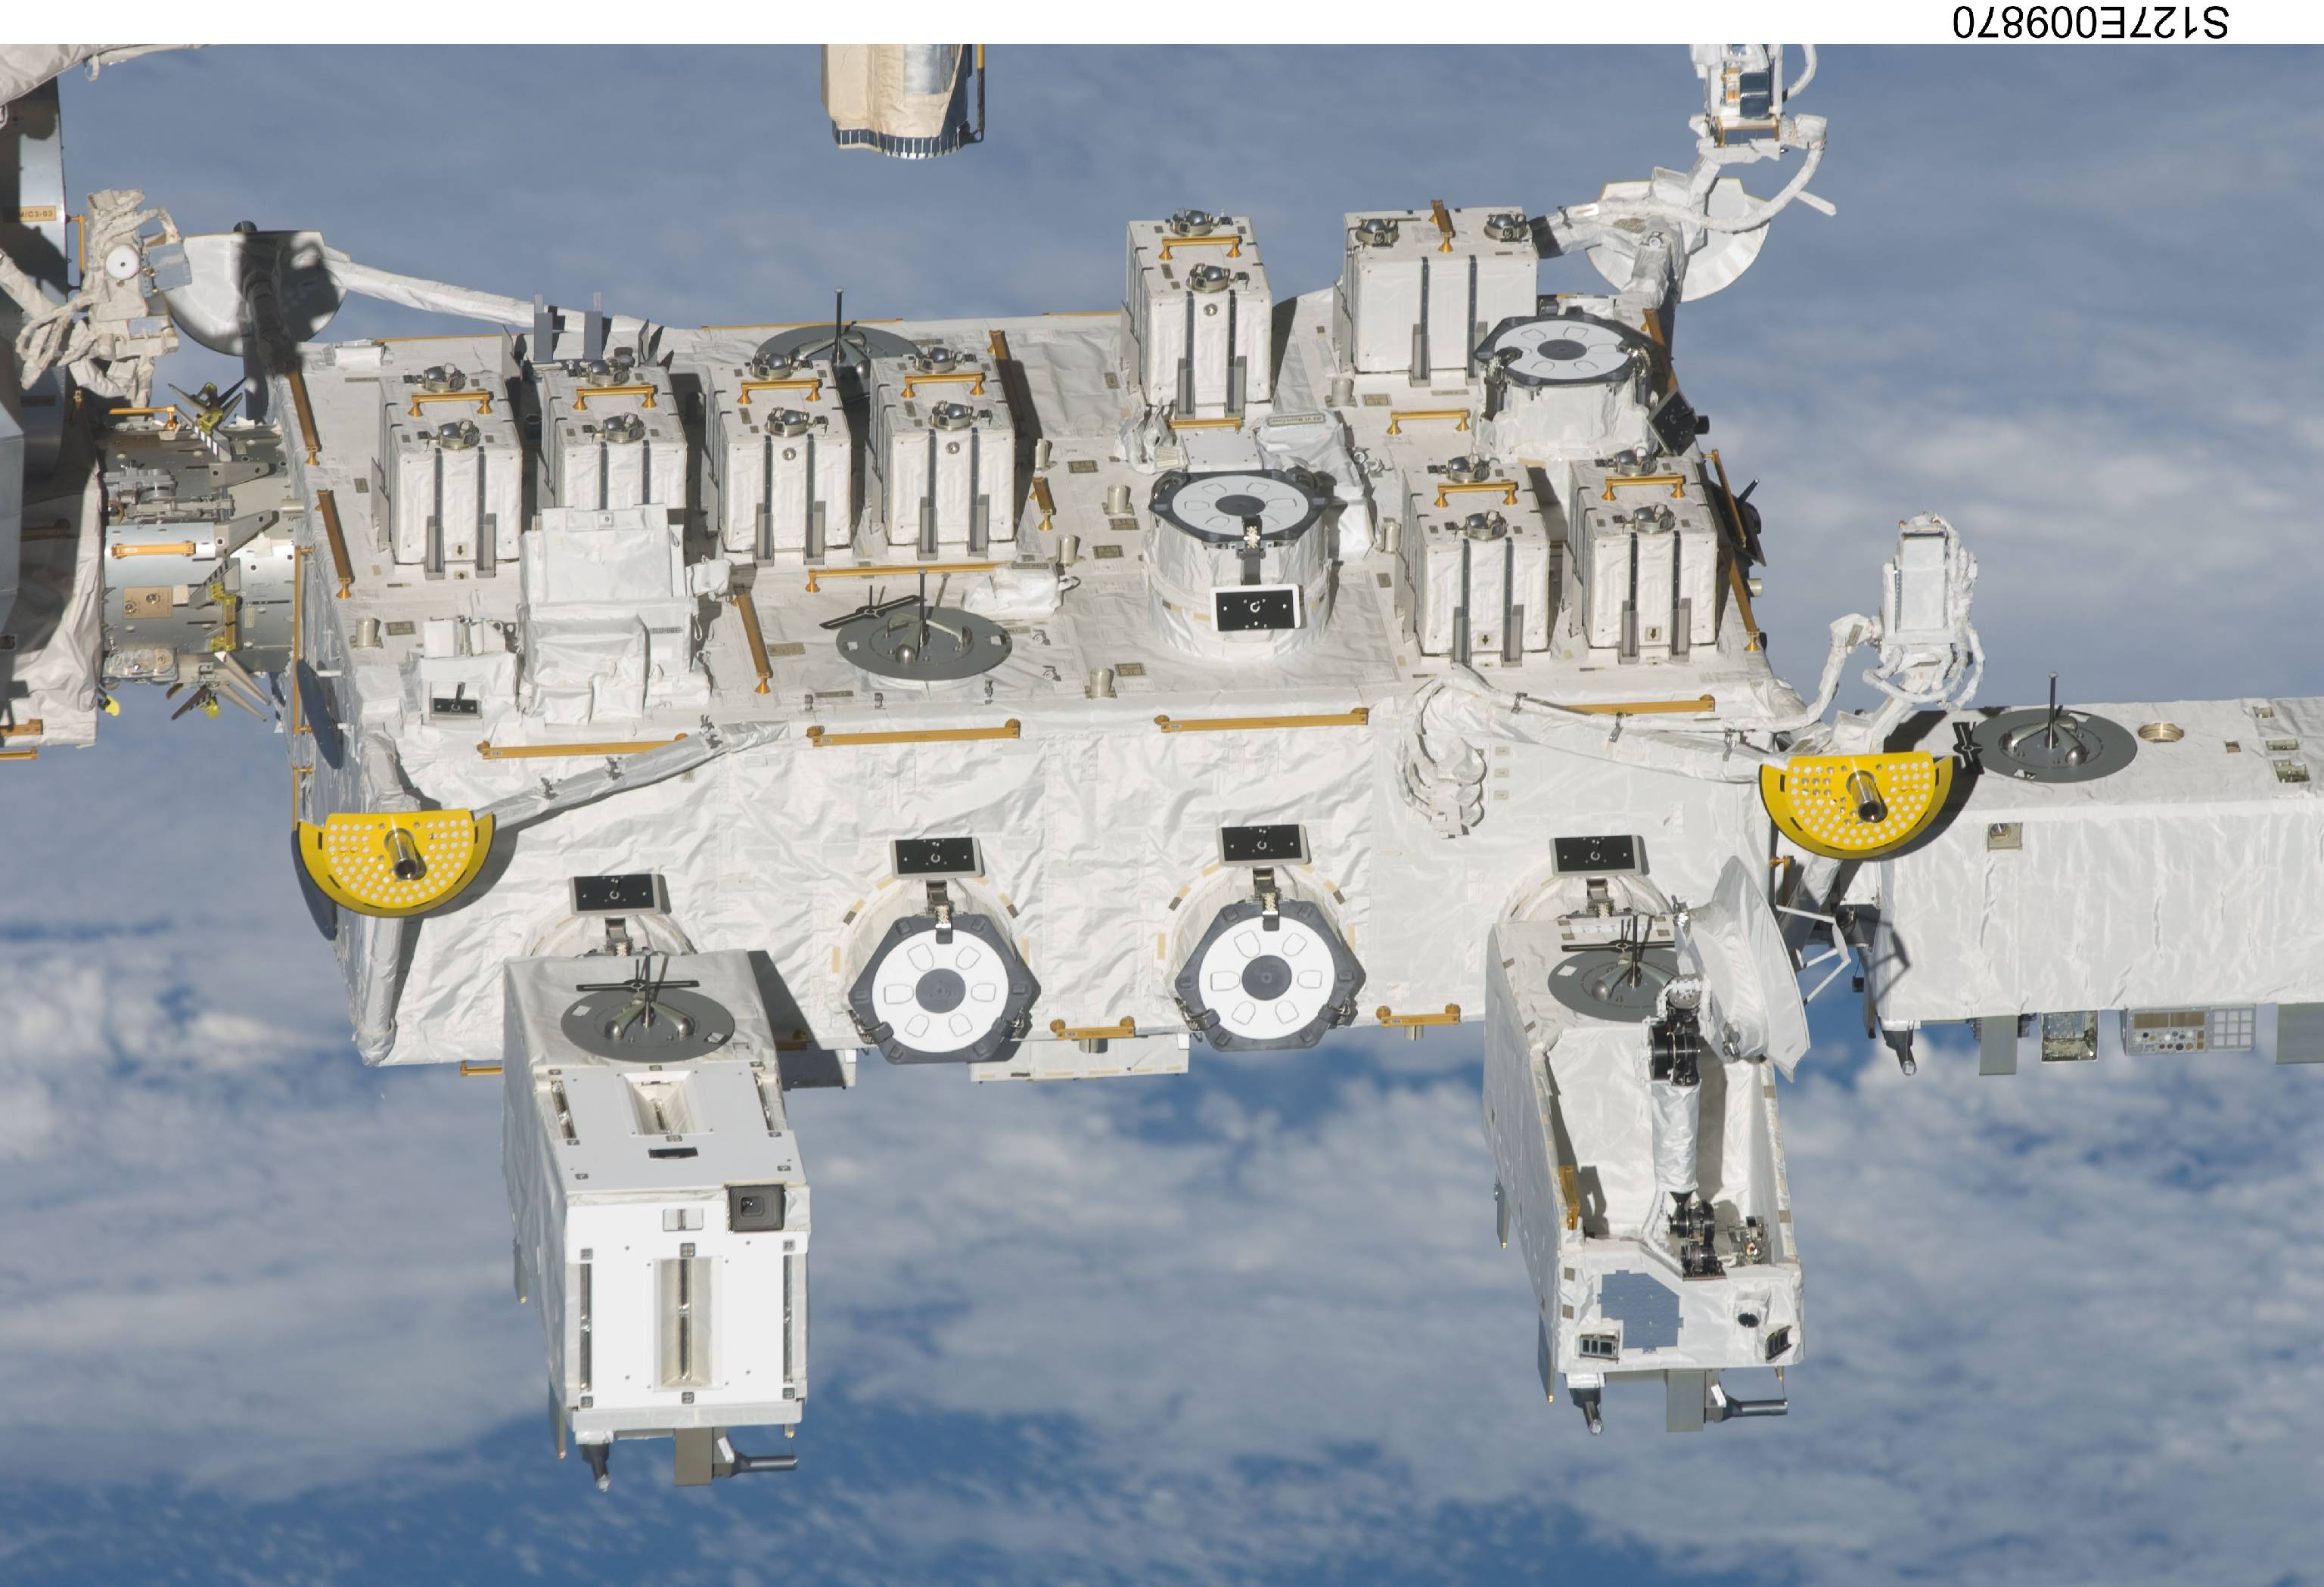
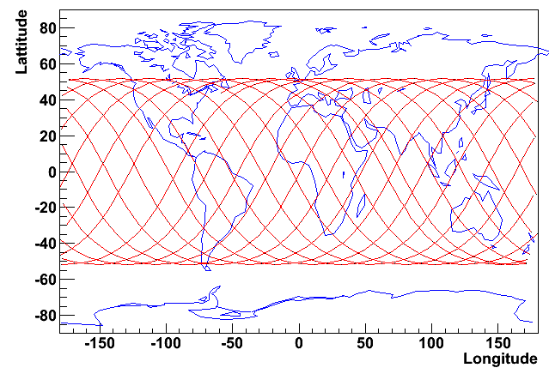
MAXI (Monitor of All-sky X-ray Image) on ISS
Direction
of Motion
Japanese Experimental Module
Exposed Facility
1m
1.8m
MAXI
JEM EF
MAXI 1-D slit camera has been scanning the whole sky according to the ISS orbital motion (90 min.) since 2009 August.
Large inclination angle (51.6 deg)
Various ISS structures sometimes interfere the MAXI FOV.
N.Magnetic pole
i = 51.6
SAA
S. Magnetic pole

Slide 3
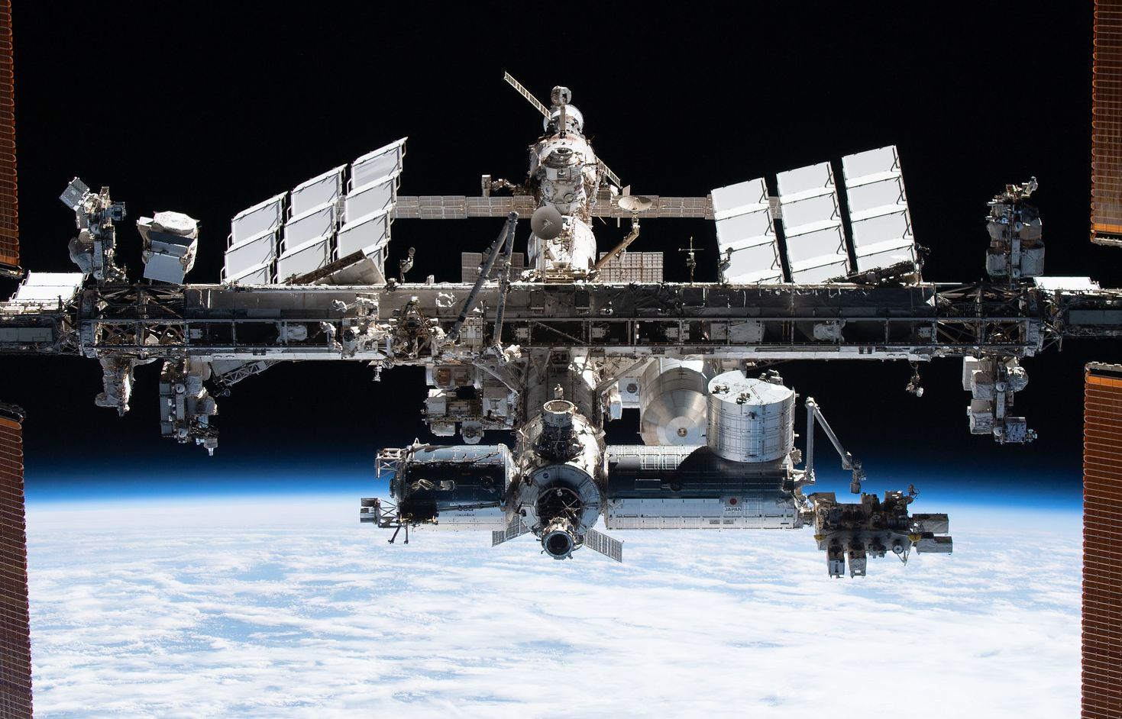
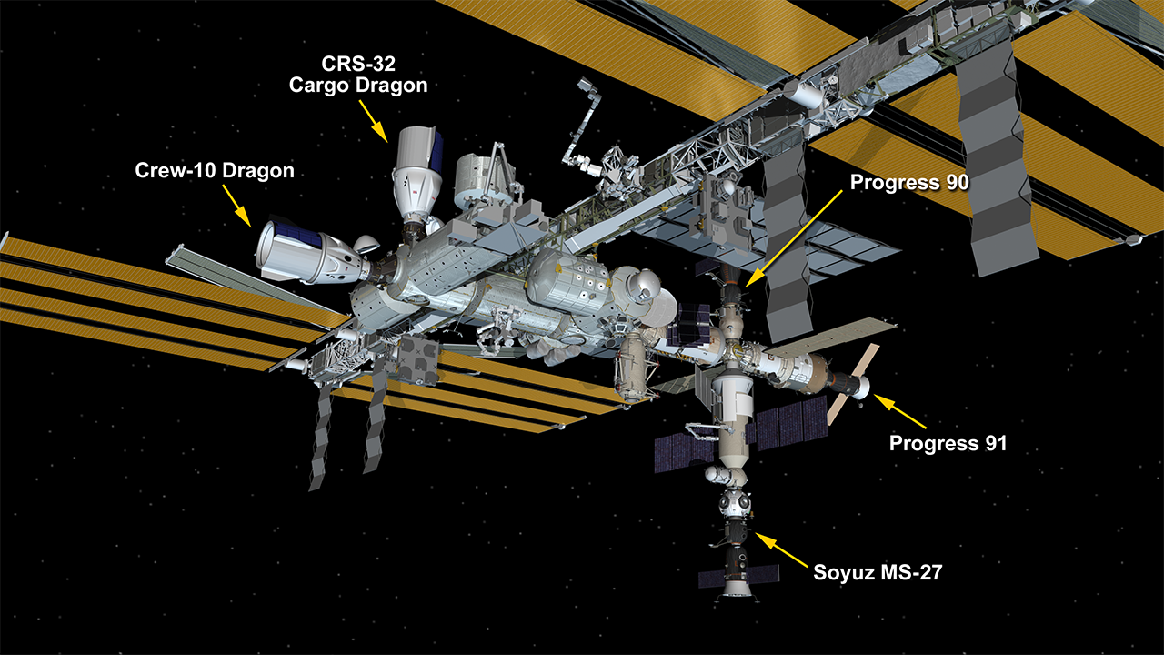
ISS configuration change
2017 Jul. NICER attached
Orbit direction
2009 Aug. MAXI attached
MAXI
2024 Apr.
MAXI

Slide 4
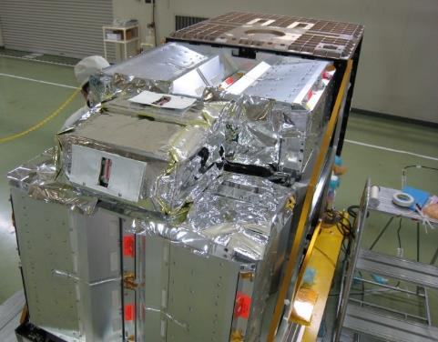
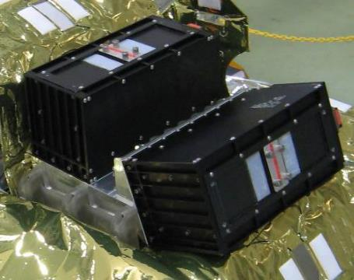
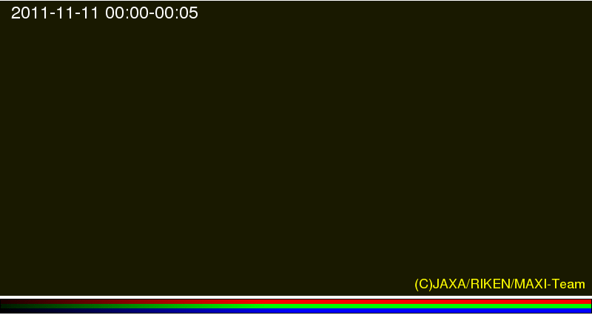
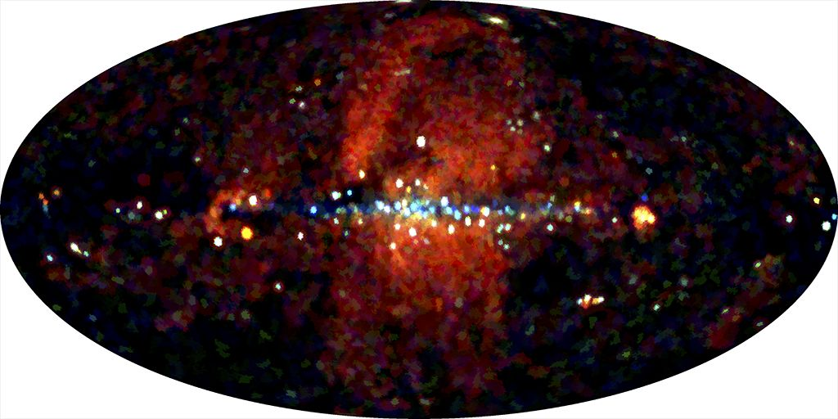
GSC (Gas Slit Camera) & SSC (Solid-state slit camera)
GSC image for 0-12 hours
SSC image for 2 years
(Nakahira+2020)
SSC is tentatively suspended since 2022 June to saving electric power and CPU load
GSC Scanning almost all (>80%) sky every 90 min for 14 years
Notes:
These figure shows typical observation data of GSC and SSC.
GSC is the main instruments employing large area gas proportional counters in the detector.
It scans almost entire sky every 90 minutes of the ISS orbital cycle.
The movie demonstrate the observation.
SSC employs CCD imagers.
Because of the radiation damage in orbit and optical light-leak problem,
the operation has been tentatively suspended since 2022.
The data in the initial two years were relatively good and the all-sky map was published in 2022.

Slide 5
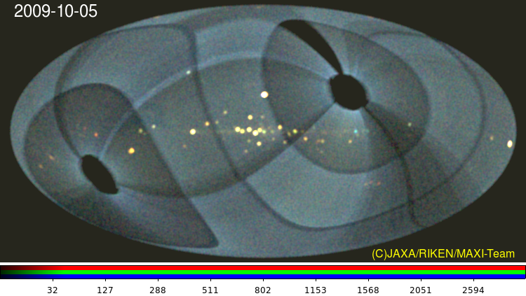
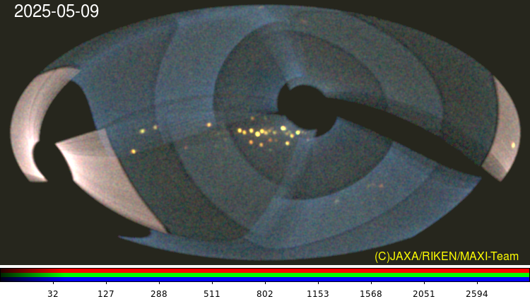
Daily GSC sky coverage
Shadow of Space-X Dragon
15 years
2009-Oct-05
2025-May-09
Sun
rotation axis
GSC_0 lost for gas leak
GSC_3 BGD veto is malfunctional.
BGD is ~10 times higher
The GSC still covers ~80% sky every 90 min of ISS orbital cycle
Notes:
This figure show the current daily GSC sky coverage.
Because a few gas counters out of 12 have have a critical damage of gas leak and anode-wire broken, some area are lost.
But, still 80 percent of the sky is covered every 90 minutes.

Slide 6
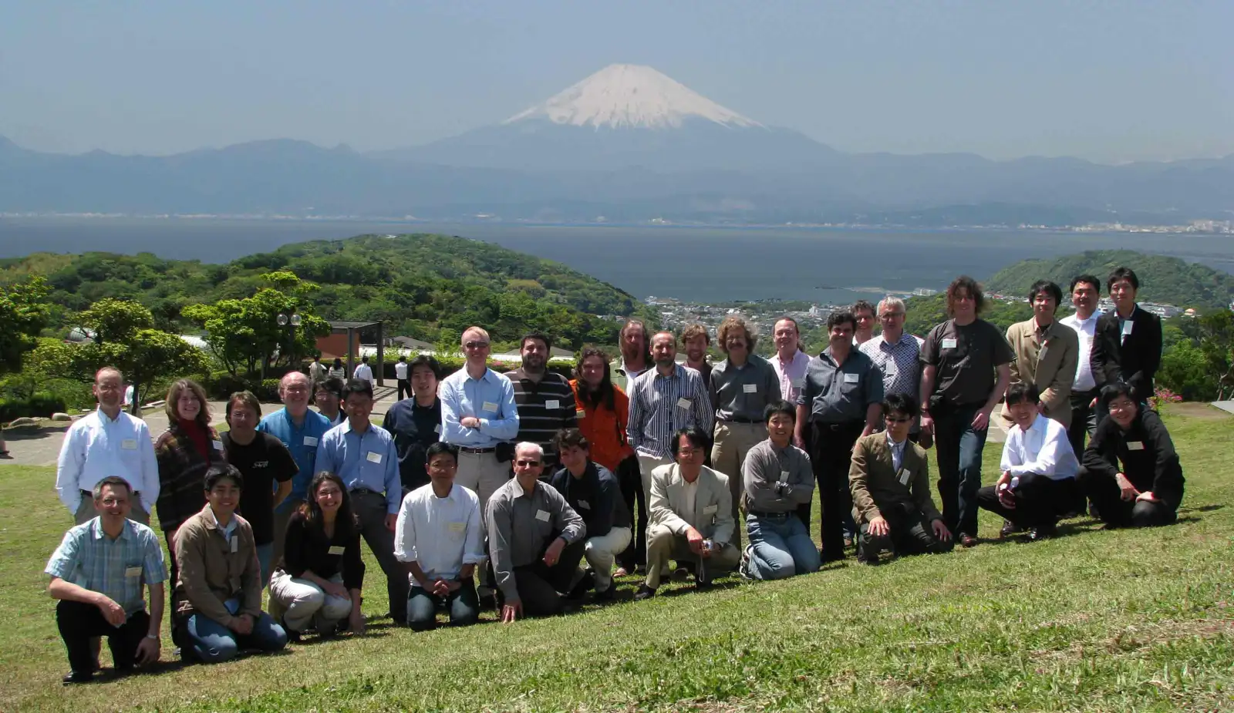
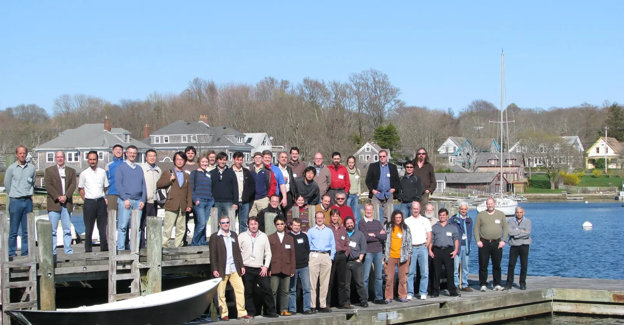
MAXI appearance in IACHEC meeting
2009 Shonan, Japan
2010 Woods Hole, USA
2012 Napa, USA
2019 Shonan, Japan
2025 Osaka, Japan
MAXI launch
We appreiatre for IACHEC collaboration!

Slide 7
GSC daily observation duty cycle for 15 years
GSC_5
GSC_4
GSC_B
12 Units
GSC_3
GSC_A
GSC_9
GSC_0
GSC_1
GSC_6
15 years
Working as a pair
GSC_7
2009
2025
GSC_2
GSC_8
Gas leak
No veto works
1500V
Normal ope.
1650V
Normal ope.
HV down to 1550V to slow the degradation
1550V
Stand by
No veto works
No veto works
Normal ope.
Stand by
Normal ope.
Stand by
These counters are operated under the limited functionality.

Slide 8
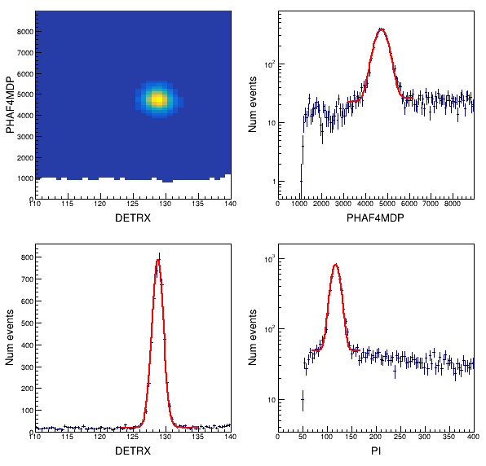
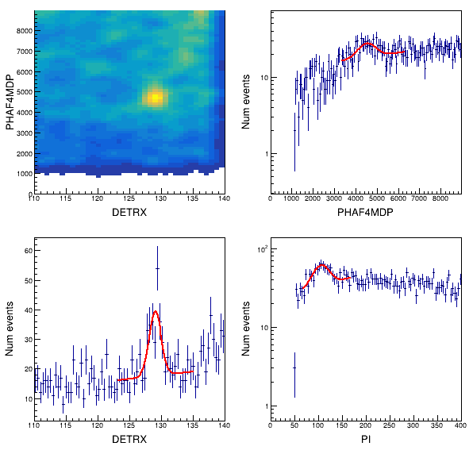
Gain & QE monitoring with ⁵⁵Fe 5.9 keV X-ray
15.7 yrs
2009-Aug-14
2025-May-05
T_{1/2} = 2.73 yr
The count rate decresed to the 0.02 times.
DetX
PHA
PHA
Counts
Gain, linearity correction
Counts
Counts
DetX
PI
Position resolution
Energy resolution

Slide 9
⁵⁵Fe 5.9 keV cal. X-ray rate (for QE, gas pressure)
15 years
2009
2025
T_{1/2}=2.73 year
Gas leak
Except for GSC_0, the X-ray rate change agrees with that expected from T_{1/2}=2.73 yr.

Slide 10
⁵⁵Fe 5.9 keV cal. X-ray PHA (for gas/amplifier gain)
15 years
2009
2025
1.6
1.0
Gas leak
0.9
1.0
1.0
1.0
0.9
0.9
1.0
1.0
0.9
0.9
Relative change from the nominal value
1.0
1.0
0.9
0.9
1.0
1.0
0.9
0.9
1.0
1.0
0.9
0.9
The gas gain is gradually decreasing, and its change rate seems to be increasing.
Are gas impurities increasing?

Slide 11
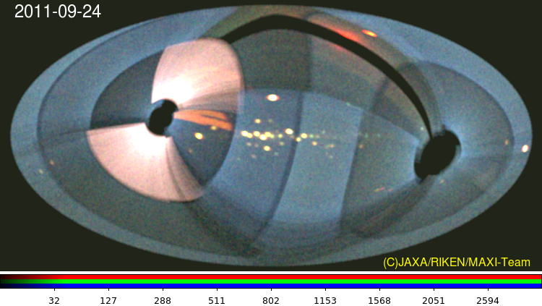
Leak / scattering of solar flare X-rays in GSC
Leak through the collimator edge
Scattered at Solar panel
Scattered at collimator
Mostly soft X-rays (<4 keV)

Slide 12

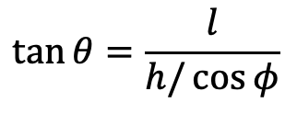




Expected leak paths
Leak path
GSC schematic drawing
Slat collimator
Cross section
Gas counter
$$l$$
$$φ$$
$$h=160 mm$$
$$\tan{θ}=\frac{l}{h/\cos{φ}}$$
$$θ$$
$$Relation between θ and φ$$

Slide 13
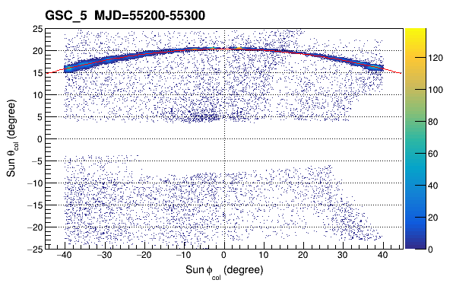

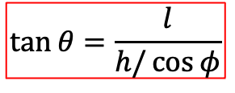




Stacked sun-scan data (in GSC_5 case)
Scan direction
Leak event
$$l$$
$$φ$$
$$h$$
$$θ$$
Incident sun angle $θ$
Counter FOV. Sun protection area
$$\tan{θ}=\frac{l}{h/\cos{φ}}$$
Incident sun angle $φ$

Slide 14
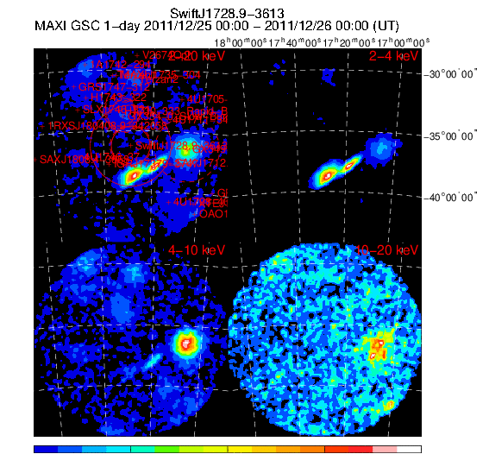
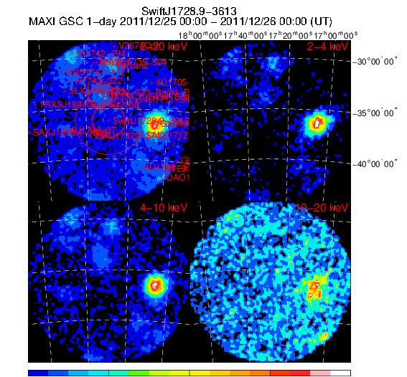
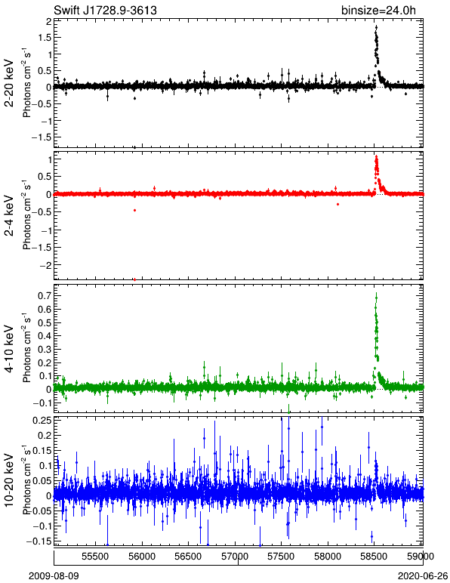
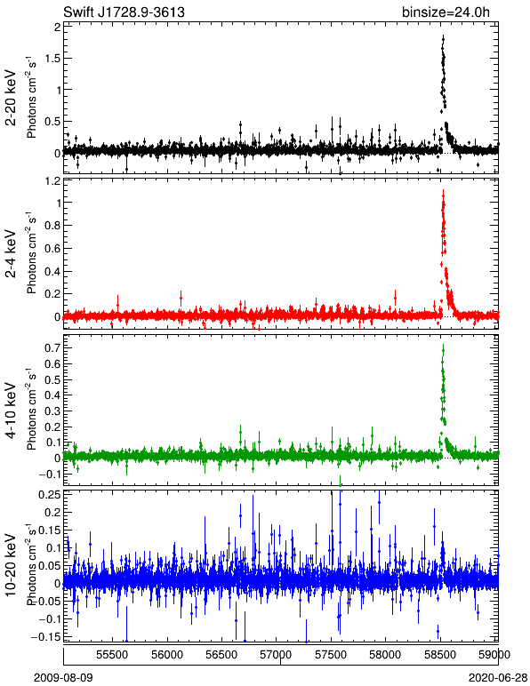
Data-process update to patch the solar flare events
(Updated in 2020)
Sun-leak cut

Slide 15
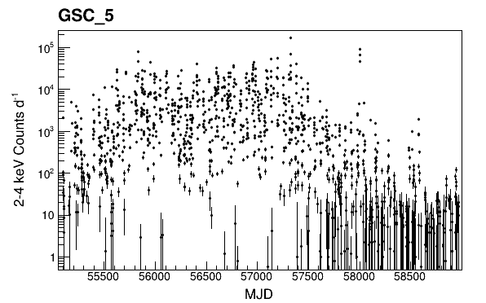
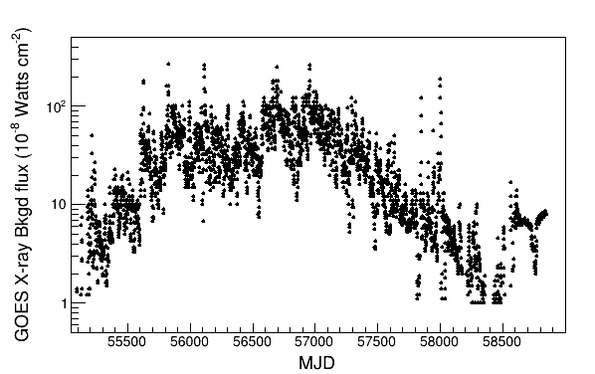
Monitoring Solar X-rays with leaked events
11 years
2009
2020
GSC_5 Sun-leak event counts
(not corrected for exposure, effective area)
The two profiles appear to correlate well.
GOES X-ray bkgd flux

Slide 16
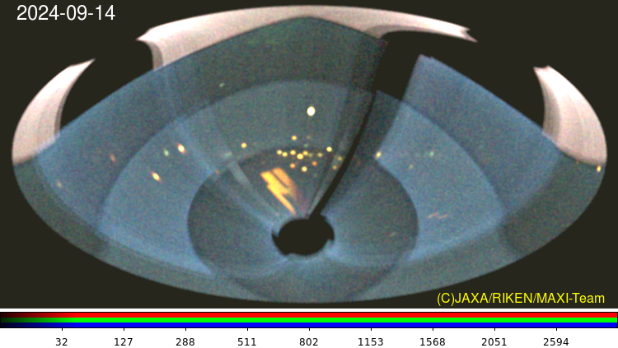
Reflected solar-flare X-rays from Moon
Scattered at Solar panel
Significant X-rays from the position of the Moon.
Reflection on Moon (Mihara)

Slide 17
Summary
MAXI operation is planned to extend until ~2030 (unless any major accident occurs) as it plays its important role in the era of time-domin / multi-messanger astronomy.
Contaneous equal-quality data for over 15 years (over 30 years if RXTE/ASM data are combined) will provide a unique research opportunity
The long heritage will be useful for current / new missions
The calibration works continue…

Slide 18
Backup

Slide 20
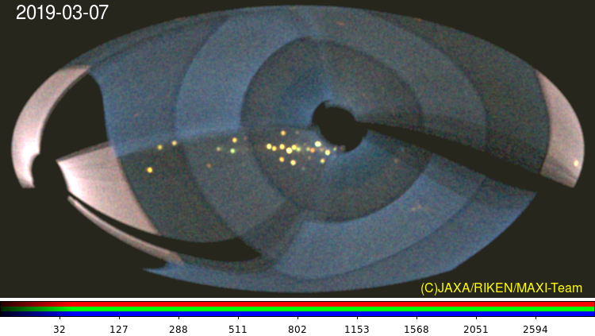
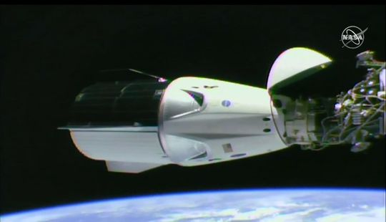
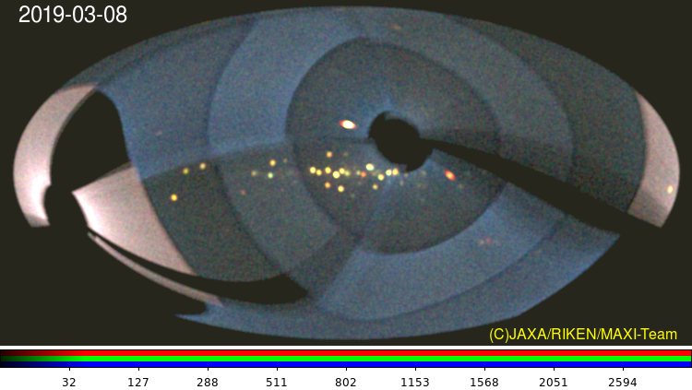
What caused the eclipse-like feature ?
2009-03-07
Shadow of Space-X Demo-1
2019-03-08
Sco X-1
Undocked
One example.
Careful inspections are still required.

Slide 21
MAXI on the ISS
Direction
of Motion
Japanese Experimental Module
Exposed Facility
MAXI (Monitor of All-sky X-ray Image) has been operated for 14 years on ISS
Two scientific instruments
  Gas Slit Camera (GSC) 2-20 keV
  Solid-state Slit Camera (SSC) 0.7-10 keV
Large field of view
  covering almost all sky every 90 min
All-time monitoring
  Data before the trigger are available
Nova alert in real-time
  Alert message is issued automatically to MAXI mailing lists, 294 subscribers
1m
1.8m
Leading Time domain astronomy
MAXI
JEM EF
Notes:
The MAXI is an all-sky X-ray survey mission on the internaional space station.
The in-orbit operation operated in 2009 so, it already passed 14 years.
The payload includes two scientific instruments,
Gas Slit Camera GSC and Solid-state Slit Camera
The mission is characterized by
Large field of view, All-time monioring for 14 years and nove alert in real-time thanks to the good telemetry connection between the ISS and the ground station.
In these points, MAXI has been partly leading the tmie domain astronomy.

Slide 22
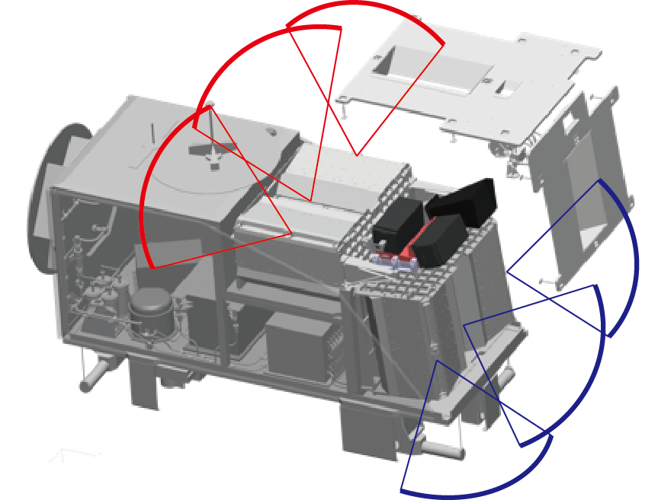
MAXI Mission Instruments
GSC (Gas Slit Camera) 2-30 keV band Large area
  1-D position-sensitive Xe-gas counters and slat collimators with slit
  Anti-coincidence BGD rejection (e.g. Ginga/LAC, RXTE/PCA, ASM)
  12 identical units to cover 1-D horizontal and zenithal FOVs.
SSC (Solid-State Slit Camera) 0.5-12 keV band Good energy resolution
  X-ray CCDs + Slat Collimator and Slit
SSC-Z unit
SSC-H Unit
ISS orbital motion
GSC 6 zenithal units’ FOVs
GSC 6 horizontal units’ FOVs
Earth horizon

Slide 23
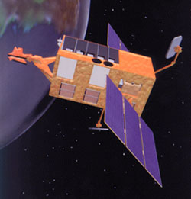
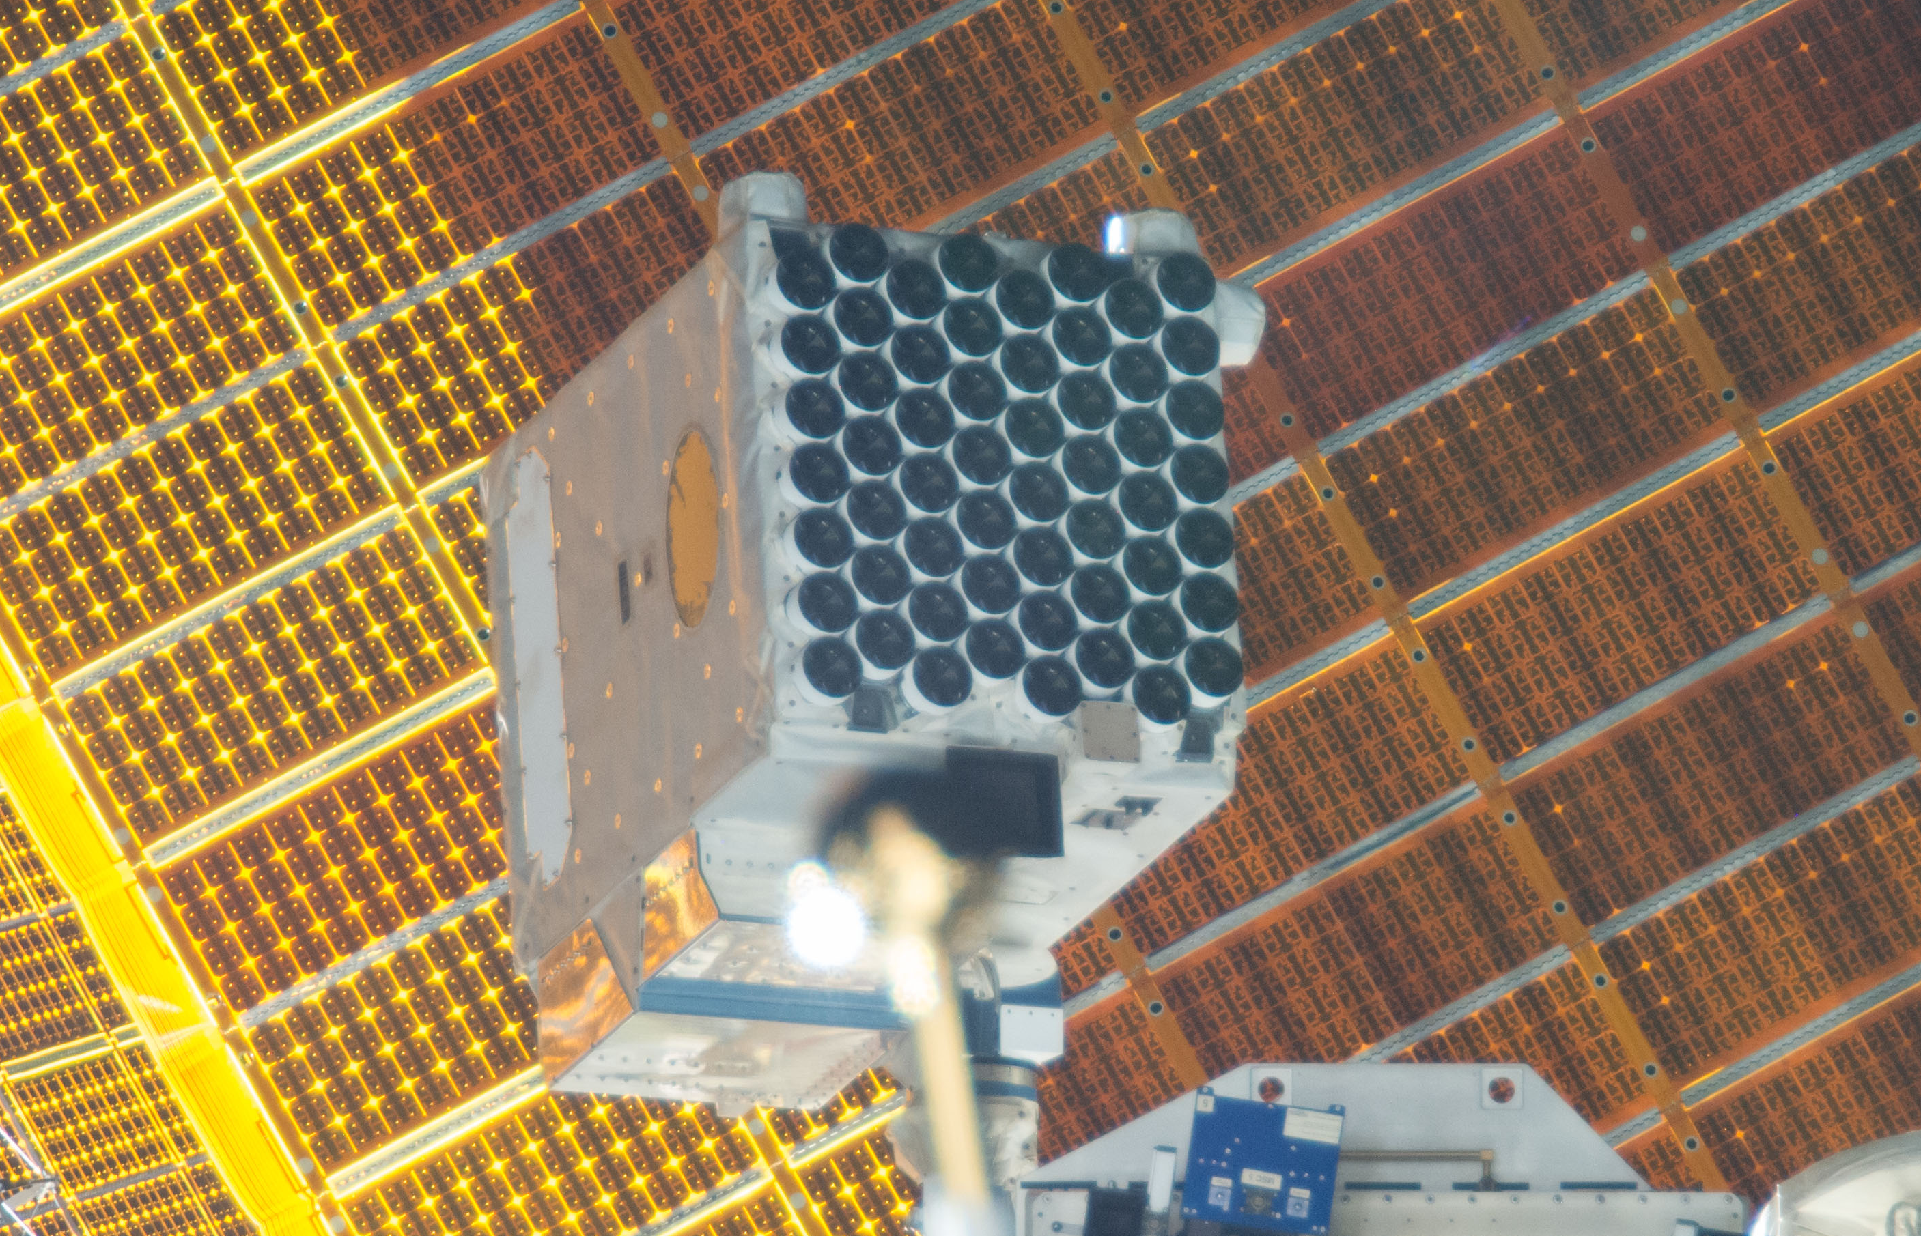
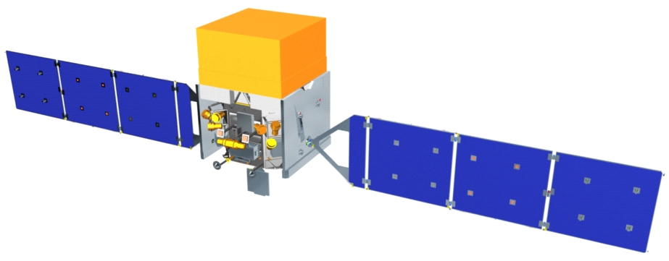
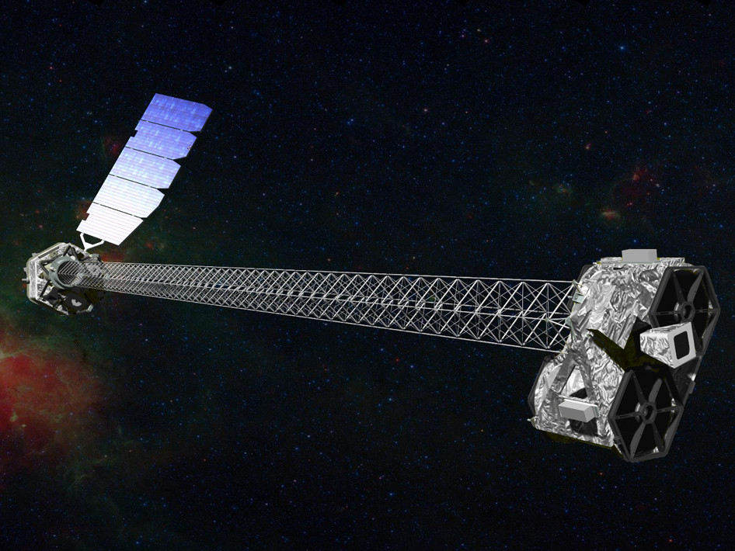
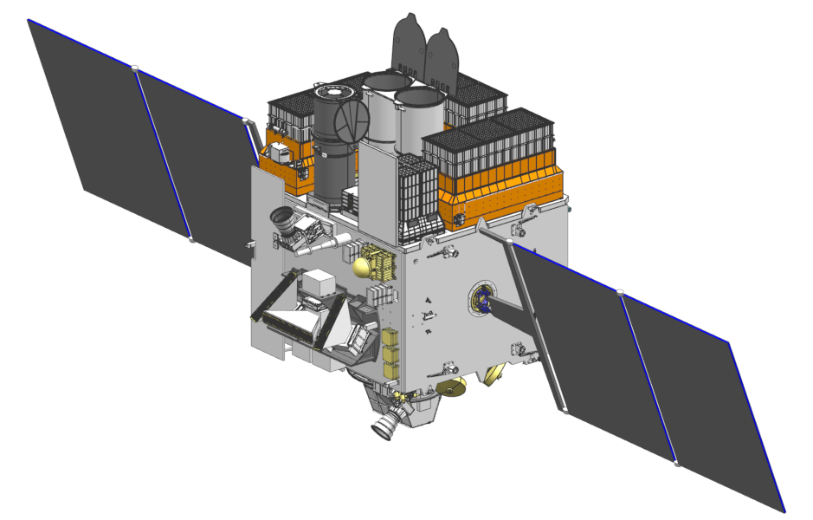
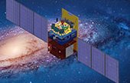
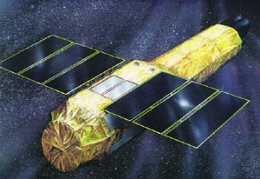
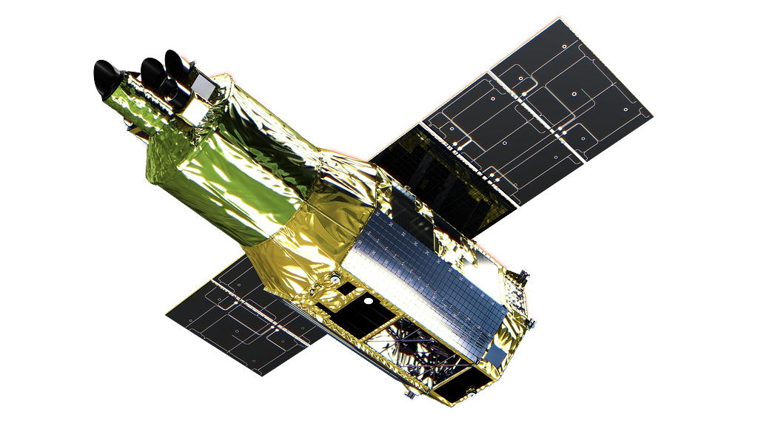
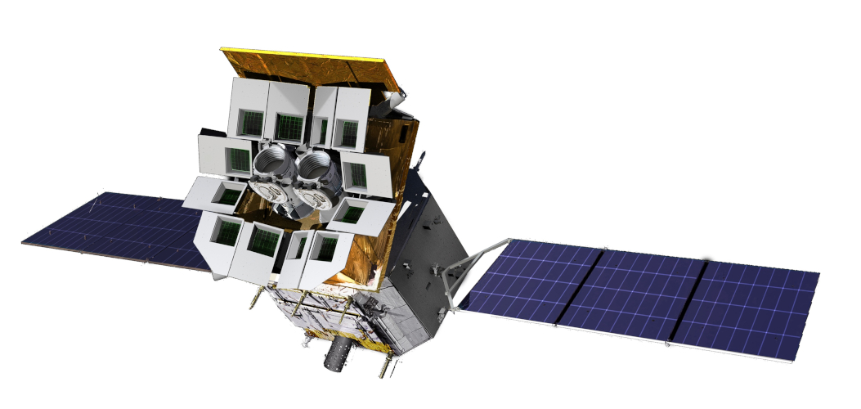
Cooperative / Competitive missions in 14 years
20
08 | 09 | 10 | 11 | 12 | 13 | 14 | 15 | 16 | 17 | 18 | 19 | 20 | 21 | 22 | 23 | 24
MAXI
RXTE
NICER
Swift
Fermi
NuSTAR
AstroSat
Insight-HXMT
Suzaku
XRISM
GW 150914
GW 170817
Einstein Probe
→ Multi-messanger astronomy
Notes:
The figure shows the cooperating and competitive missions with MAXI in these 14 years.
Because the MAXI is just an all-sky monitor and does not have a facility for detail obseravtion of new sources or new source candidates, we need collaborations..
In the early phase, RXTE helped us a lot.
Acualluy, RXTE has a lot of simularity in all-sky monitor, gas counter, so we leaned from the RXTE team.
Throughout 14 years, we have a good collaboration with the Swift team.
Since the NICER experiment stated on the same ISS platform, we started the cooordinating observation project which I introduce a little bit more later.
Suzaku is the same Japanese mission and we have a lot of common team members.
And, we have several frields in HXMT team.
The XRISM and Einstein proble are just stared.
We expect good collaboration in the future.
And, I think I should mention here about the first detection of the gravitaional wave in 2015 and the neutron-star neutron-star merger in 2017.
These events make it possible to extend the MAXI operation over 14 years.

