Slide 1
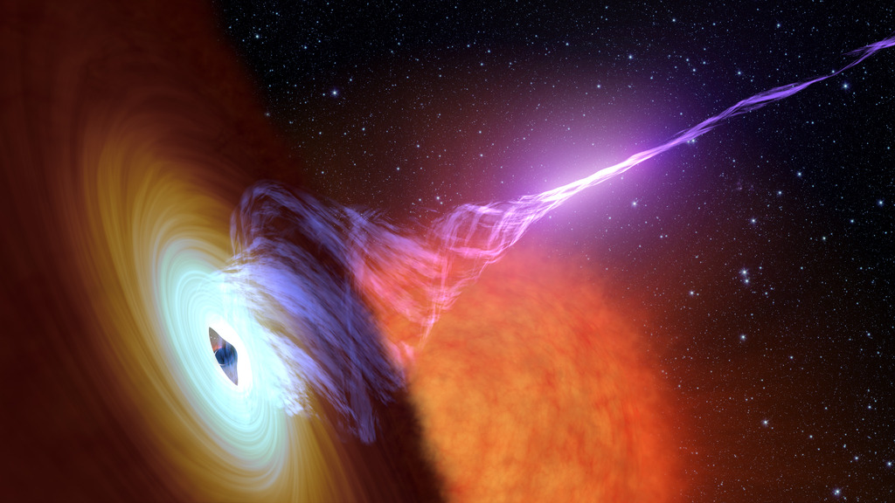
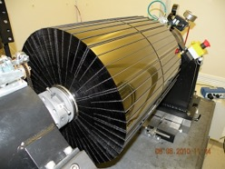
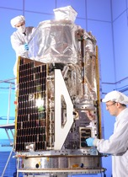
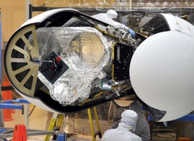
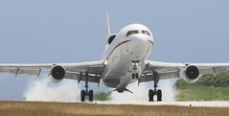
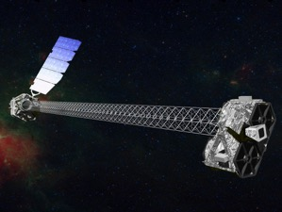
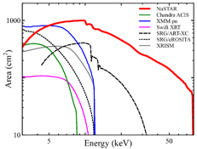
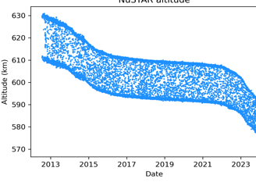
NuSTAR Observatory Status
17th IACHEC meeting
Osaka Bay
May 11 – 15, 2025
Hannah Earnshaw, for the NuSTAR SOC

Slide 2
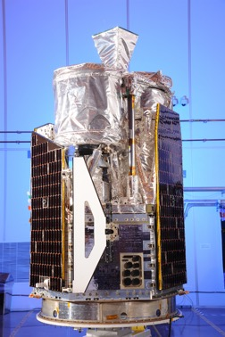
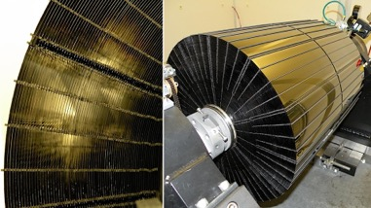
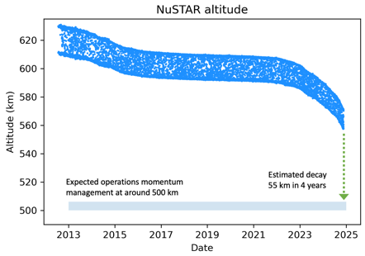
NuSTAR Observatory
NASA small explorer astrophysics mission
PI Fiona Harrison (Caltech)
Partners: ASI, SSDC, DTK, HEASARC, UCB-SSL
Launched on June 13th, 2012, 620 km, 6° orbit
Northrop Grumman LeoStar-2 spacecraft bus
Science Operations at Caltech
Mission Operations at UCB-SSL
NASA approved funding to 2025 (3-year renewal)
2 Optics Modules
Conical Wolter-I approximation
133 shells (43 W/Si, 90 Pt/C)
HPD = 1 arcminute
FOV = 12’ x 12'
Daniel Stern (JPL) - Deputy PI
Hannah Penn Earnshaw (Caltech) - Project Scientist
10.14m focal length
deployed Mast
CdZnTe detectors
4x(32x32 pixels)
Resolution:
400 eV @ 6 keV
900 eV @ 60 keV
2 ms time resolution
60 $μ$s with clock correction
No consumables
Single string
> 20 years orbit lifetime
NuSTAR status – IACHEC, Osaka Bay, May 2025 – Hannah Earnshaw

Slide 3
NuSTAR Observatory Status
Nominal
NuSTAR status – IACHEC, Osaka Bay, May 2025 – Hannah Earnshaw

Slide 4
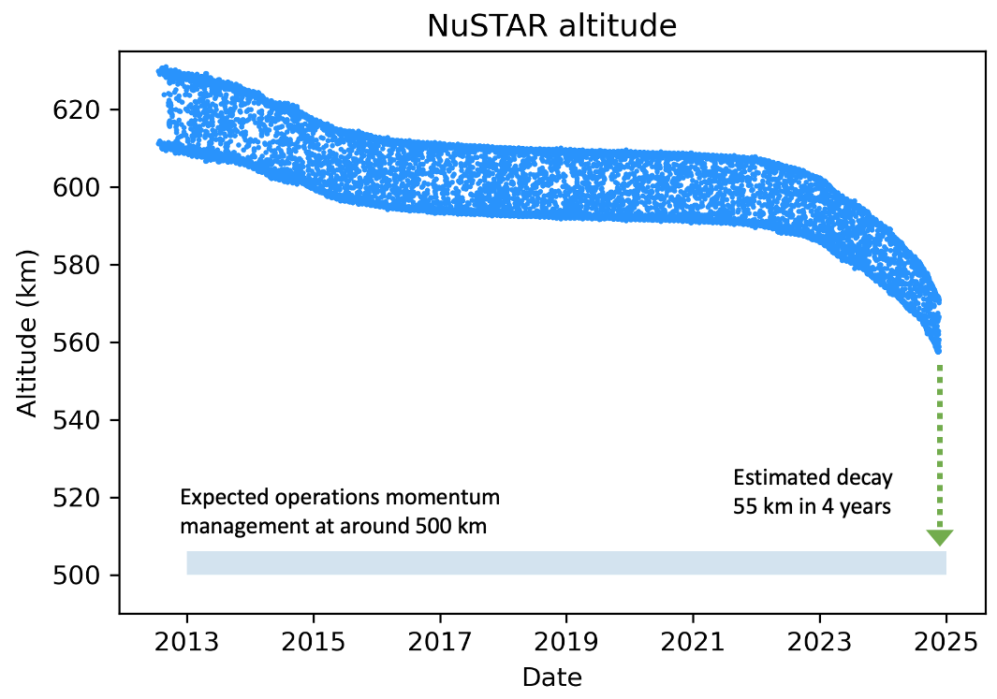
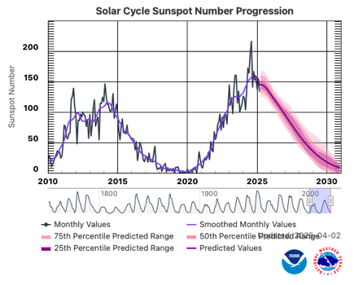
NuSTAR Observatory
NuSTAR Orbit Altitude
Expect nominal operations past Solar maximum
Solar cycle 24 peak
April 2014
Solar cycle 25 start
December 2019

Slide 5
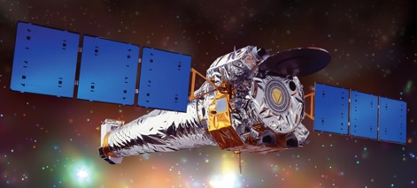
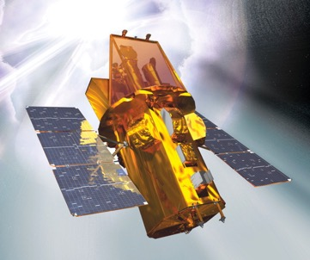
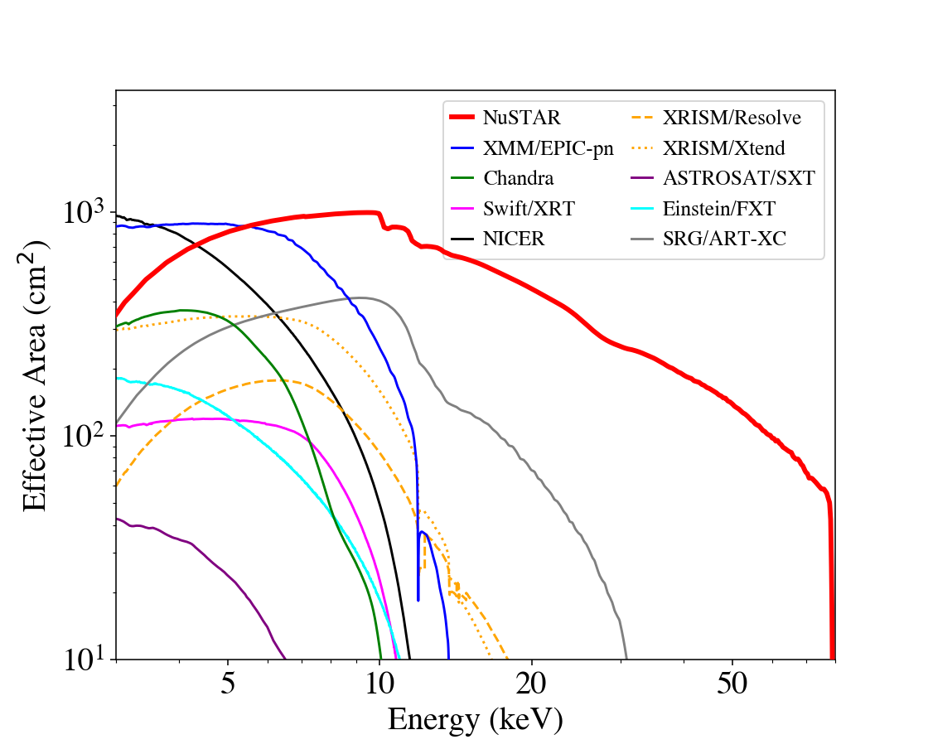
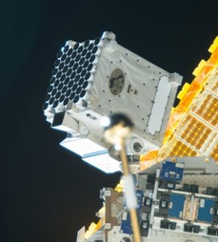
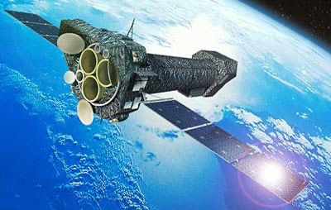
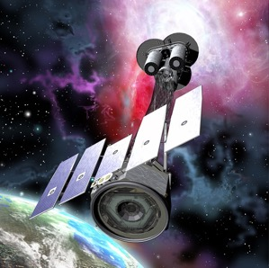
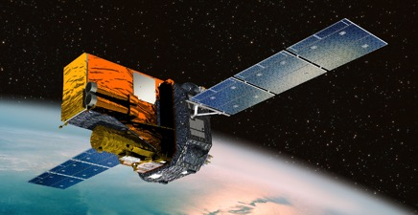
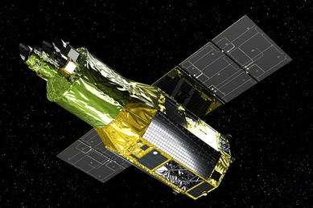
NuSTAR Synergies
NuSTAR Energy Range 3–78 keV
Chandra
Gehrels-Swift
IXPE
NICER
XMM-Newton
INTEGRAL
XRISM
Stray light
~100 keV

Slide 6
NuSTAR Synergies
NuSTAR Energy Range 3–78 keV
Chandra
Gehrels-Swift
IXPE
NICER
XMM-Newton
500 ks NuSTAR time provided to IXPE GO program
INTEGRAL
XRISM
Stray light
~100 keV
Joint NuSTAR / XRISM GO programs?

Slide 7
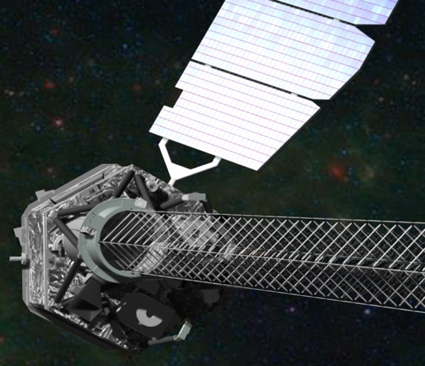
Mission Update
2024 Northrup Grumman review
LeoSTAR-2 spacecraft bus has no consumables
Solar Array and SADA, EPS | No concerns
Attitude Control System IRU*, Star trackers*, TAM, MTB, CSS, Reaction Wheels | No concerns
RF Communications | No concerns
Thermal control | No concerns
Electronics CEU, APE* | No concerns
Battery Evaluation of end of discharge voltage shows normal ageing >20 years before any concerns | No concerns
*rare resets occur as expected
Laser Metrology system tracks relative motion of optics with respect to CZT X-ray detectors (10m mast!)
Metrology data used by ground processing software to reconstruct:
Location of optical axes
With star tracker camera on optics bench the sky position of events recorded in CZT
Laser duty cycle adjustment in 2020 produced significant improvement in rate of decline in laser intensity
Indicates that with no further changes the metrology system should remain nominal for another 7 years
Additional adjustments can be made to extend laser lifetime
Laser Metrology system stable
More on that from Earnshaw on Wednesday, 14:20

Slide 8
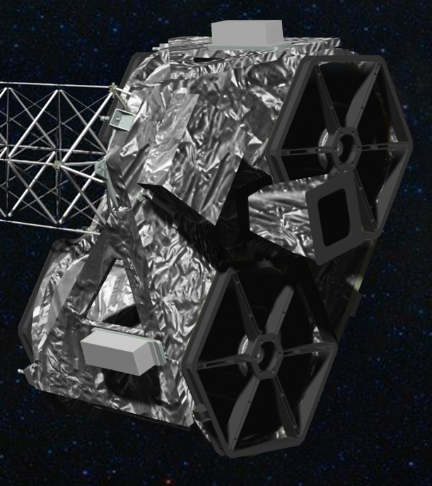
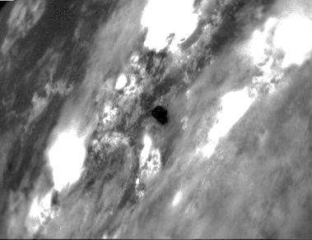
Mission Update
Optics - Rear
Tear in MLI on rear of Optic-0 | Observe at SAA < 130º where possible Limit of 24-hr duration SAA > 130º
Higher Optic-0 temperature for SAA > 145º | Minor scheduling constraint
Thermistor-5 disconnect from Optic-0 | Suspension of temperature dependent MLI correction to FPMA ARF in 2024
Astrometry Star Tracker (CHU4)
Low gain area in central 1º of 20º field of view | Only Solar observations at SAA < 20º | Solar observations only at SAA < 20º
Caused by repeated Solar observations Star Tracker performance remains nominal | Observations of bright point sources allowed* for 20º < SAA < 43º | Observations of bright point sources allowed* 20º < SAA < 43º
CHU4 image taken during Earth occultation of target
cities beneath clouds
*Optimal astrometry solution is for Solar Aspect Angle (SAA) > 43º

Slide 9
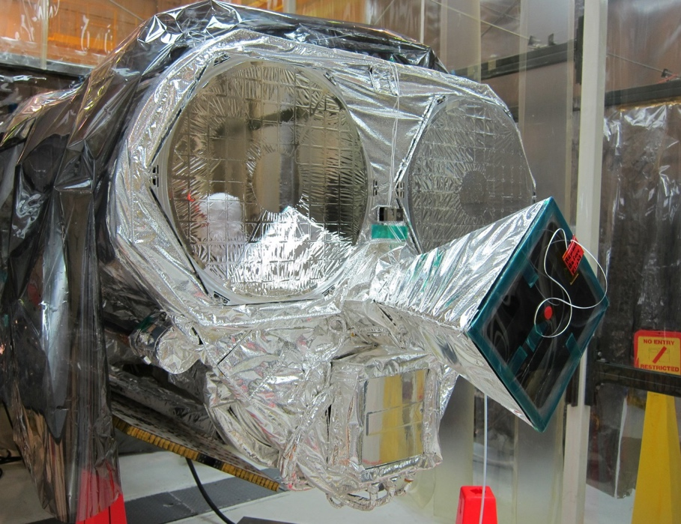
Mission Update
Optics - Front
New tear in the MLI Front of Optic-1 (FPMB) | Observe at SAA > 70º where possible Limit of 24-hr duration SAA < 70º
Higher Optic-1 temperature for SAA < 70º | Moderate scheduling constraint
No adjustment to thermal control of optic | Suspension of temperature dependent MLI correction to FPMA ARF 0m 2024
2025 Update
Low gain area in central 1º of 20º field of view | Only Solar observations at SAA < 20º | Solar observations only at SAA < 20º
Caused by repeated Solar observations Star Tracker performance remains nominal | Observations of bright point sources allowed* for 20º < SAA < 43º | Observations of bright point sources allowed* 20º < SAA < 43º
Suspended
Pre-launch photograph
Front of optics modules
and Star tracker
*Tests at low SAA are underway
A decision will be made before the start of cycle-11

Slide 10
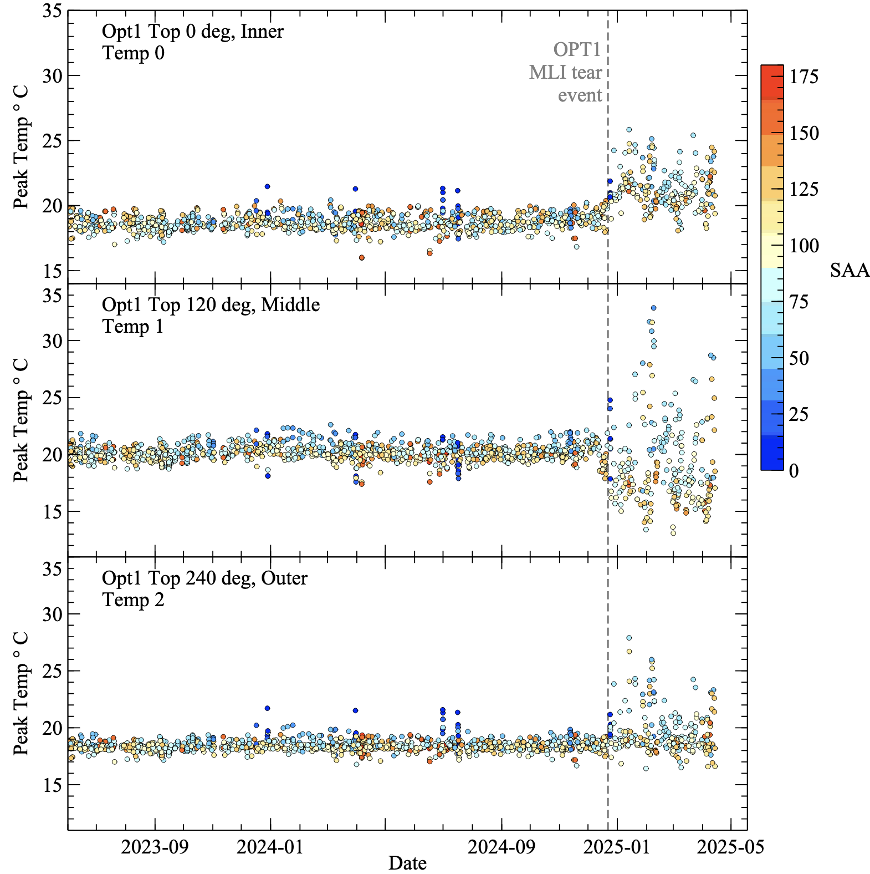
Mission Update
Optic-1 MLI tear 2025
Event occurred in December 2024
Discovered during regular review of instrument housekeeping data
Higher than normal temperatures on the top of optic-1 (FPMB)
FPMB can no longer be considered as the baseline for the FPMA MLI correction
FPMA ARF is has remained steady since 2024
Accounted for in current CALDB
Observations in 2025 of bright sources may require an additional mtable to the model
for energies 3 to 7 keV
adjustments are at ~few % to ARF
Detailed instructions available on NuSTAR SOC MLI webpage:
nustarsoc.caltech.edu/NuSTAR_Public/NuSTAROperationSite/mli.php
Regular observations of the Crab are being performed to characterize the behavior of the changing ARF
Expect updated CALDB in June

Slide 11
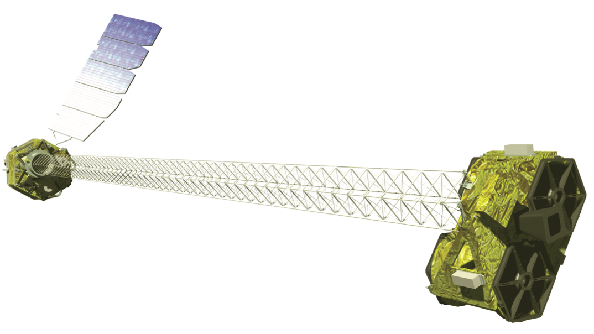
Mission Update
Automated ToO rapid response system
Goal: reduce standard ToO response times to < 24 hrs
Currently < 48 hrs best effort
Manual scheduling and command sequence upload
Operators required to drive into the UCB-SSL mission operations center
Automated systems undergoing final testing
Automated observation scheduling
Slew time set to be after next schedule contact, 5 contacts scheduled per day
Automated command sequence generation at SOC
Automated delivery of command sequence to MOC
Automated command validation and upload to spacecraft on next contact
No operator required to be in the MOC (remote monitoring)
PIs of ToO proposals requesting rapid response will need to provide a code to successfully submit a trigger to automated system
Messaging system alerts teams to triggering of rapid response ToO
Follow up scheduling by SOC and MOC to return to regular programming
Minimum exposure time for ToOs is 20 ks ~12-hour duration
Expecting to obtain approval to make system operational before start of cycle-11

Slide 12
Calibration History
Date | Description
2013-08-14 | Initial CALDB public release
2013-11-25 | ARF adjustment (-15% NuSTAR flux)
2014-01-17 | VIGN adjustment
2014-07-01 | Gain calibration improvement
2015-03-20 | Full mission Gain adjustment
2016-06-06 | Update gain, effective area, line of sight absorption
2019-12-13/19 | Update long term gain tracking
2020-05-06 | High resolution clock correction
2020-08-13 | Temperature-dependent ARF implemented for FPMA
2021-02-23 | Observatory alignment update
2021-10-26 | Observatory calibration update based on 9 years of crab observations
2022-05-10 | FPMA DET2 long term gain adjustment
2024-03-11 | FPMA DET0 long-term gain adjustment; remove temperature dependent ARF capability for FPMA
2025-02-24 | FPMA ARF MLI correction adjusted for observations after 2018
2025-03-31 | New temperature model for clock correction
For more on that, ask M. Bachetti

Slide 13
NuSTAR Summary
Observatory status is green
Observatory lifetime is expected to extend into late 2020’s
2025 senior review recommendations expected to be released soon
Expanding synergies with new missions: IXPE 500 ks and XRISM
Increased support for ToO triggers from ZTF -> LSST, LIGO/Virgo, IceCube
2025 and beyond...
NuSTAR is a community-driven observatory,
a key part of the NASA astrophysics portfolio
Proposed to NASA Senior Review for a three-year extension of operations
Extend operations to 2028
Implement partnership with XRISM
Automated rapid ToO response
We continue to have access to a scientific instrument that is...
stable
well calibrated
operationally efficient
highly productive
with unique capabilities
...and responsive to the needs of the community

Slide 14
Backup Slides
NuSTAR status – IACHEC, Osaka Bay, May 2025 – Hannah Earnshaw

Slide 15
GO Program
Proposals requesting NuSTAR observing time may be submitted to six GO programs
Due dates spread throughout the year
IXPE AO3
XRISM AO2
NICER
IXPE (500 ks)
IXPE
6-month
6-month exclusive-use period.
Executing about 100 proposals / year
= 70% of observing time
>50% observations coordinated with other observatories
>75% observations have time constraints
2026 - Plan to add XRISM joint GO program

Slide 16
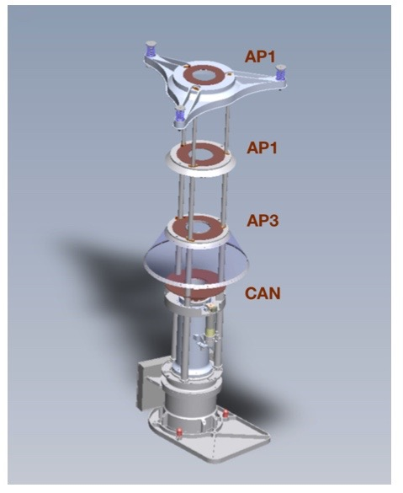
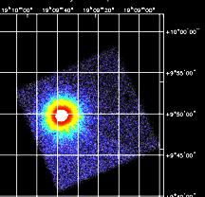
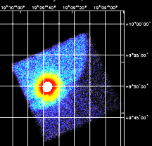
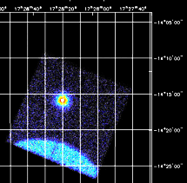
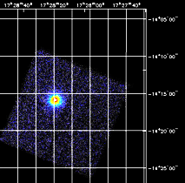
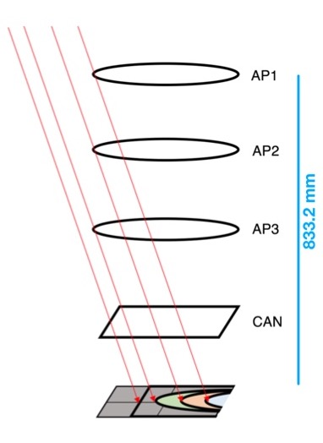
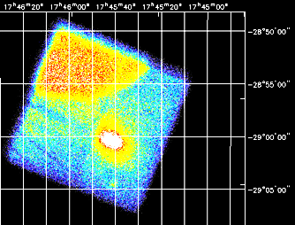
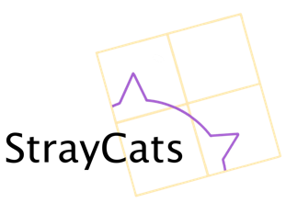
Stray Light Calibration
FPMA
FPMB
Stray light observations may extend NuSTAR science past 100 keV
High energy limit of 79 keV determined by optics response
Annual Stray light observations of the Crab used for calibration
Bypasses optics, based on well understood detector response
Accurate measurement of Crab flux allows absolute calibration to 4% precision
Measurement of the Absolute Crab Flux with NuSTAR, Madsen et al. (2017)
Adjustment to cross calibration with other observatories
(XMM-pn calibration update)
Originally a nuisance, now stray light observations are used to:
Harvest transient light curves and spectra from Galactic center region
Minimize data loss during observations of bright sources
Allowing uninterrupted observations – avoiding overwrite of on-board storage buffer
StrayCats on github
Grefenstette et al. (2021) ApJ 909, 30 and Ludlam et al (2022) ApJ 934 59
https://nustarstraycats.github.io/straycats/
Extended SMC X-1 spin and orbit analysis
Brumback et al. (2022) ApJ 296, 187
4U 1907+09
PDS 456
Sgr A* 2019-03-29 150 ks (FPMA)

