Slide 1
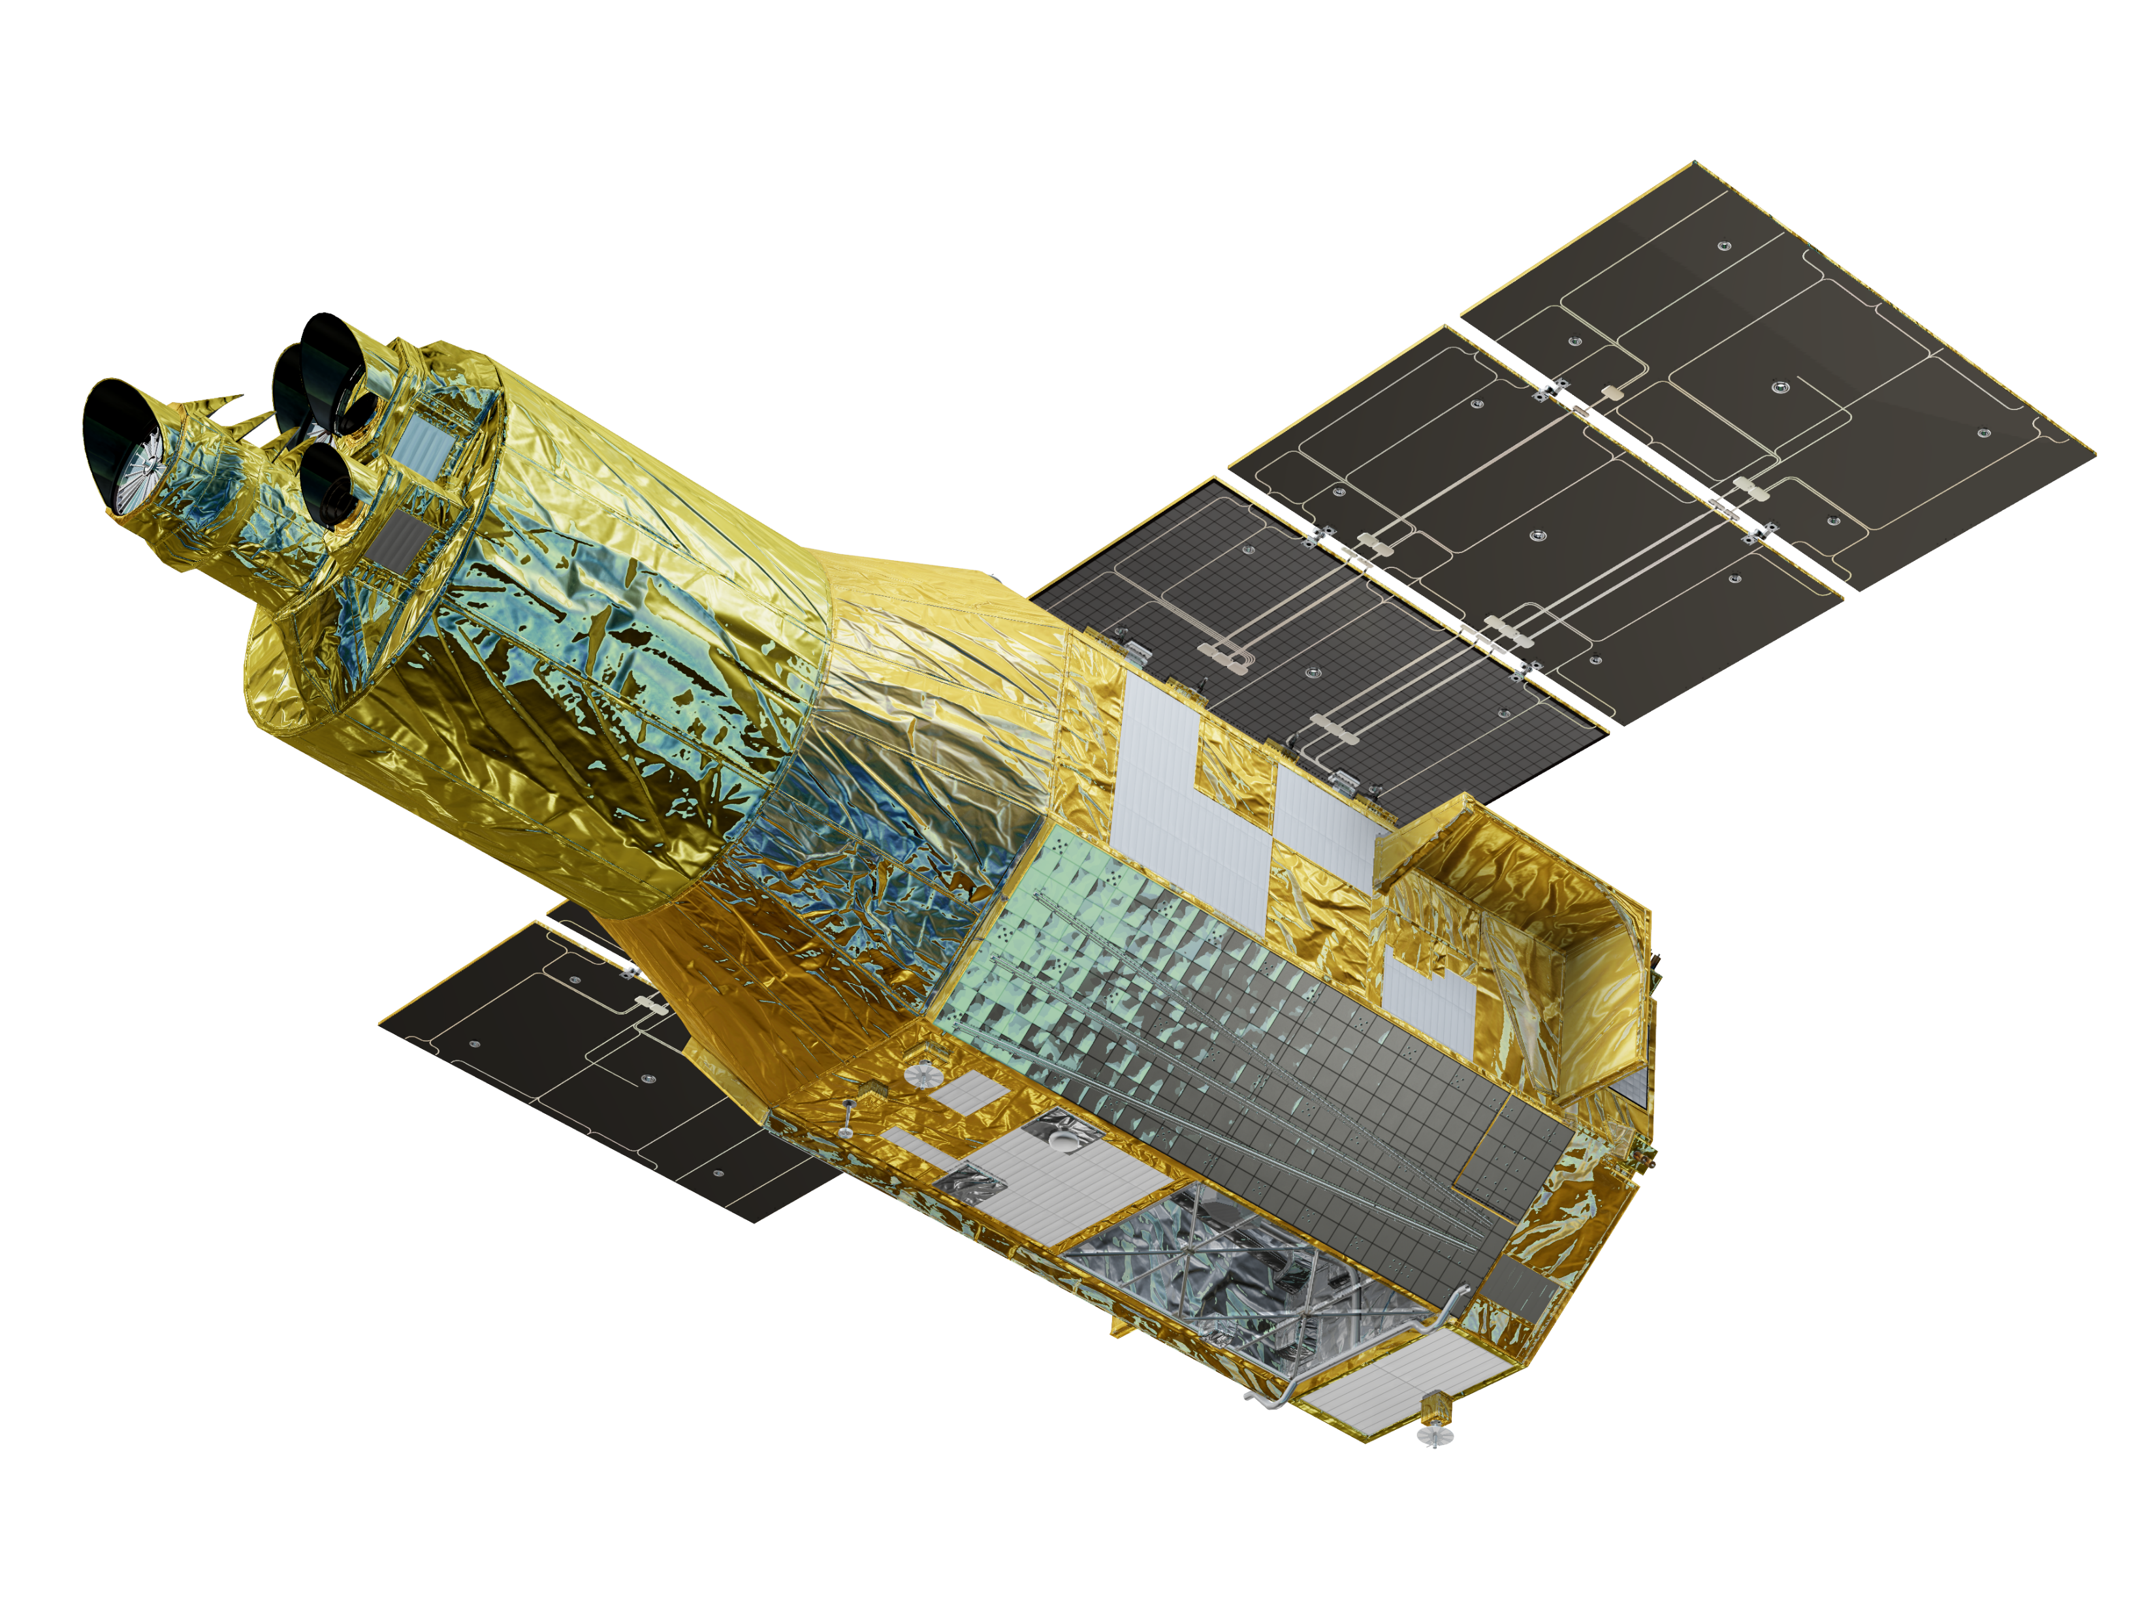
The XRISM mission status
Y. Terada (XRISM Science Operations Lead),
S. Watanabe (XRISM PM), M. Tashiro (XRISM PI),
and XRISM collaboration

Slide 2
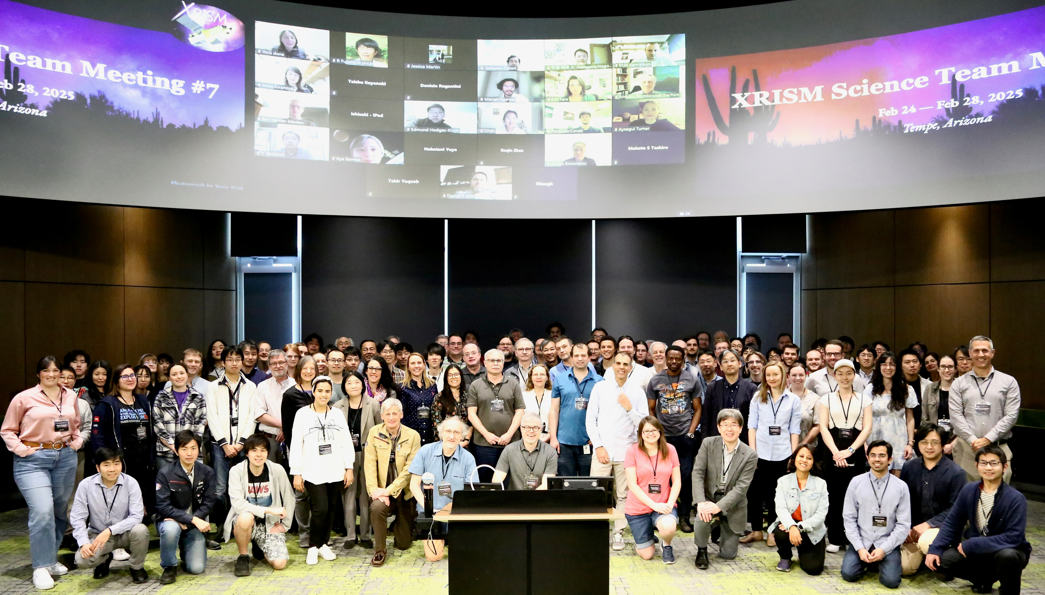
XRISM collaboration
354 Scientists
134 XRISM Science Team (79 JAXA, 43 NASA,12 ESA),
39 XRISM Guest scientist, 48 PD, and 133 Graduated students

Slide 3
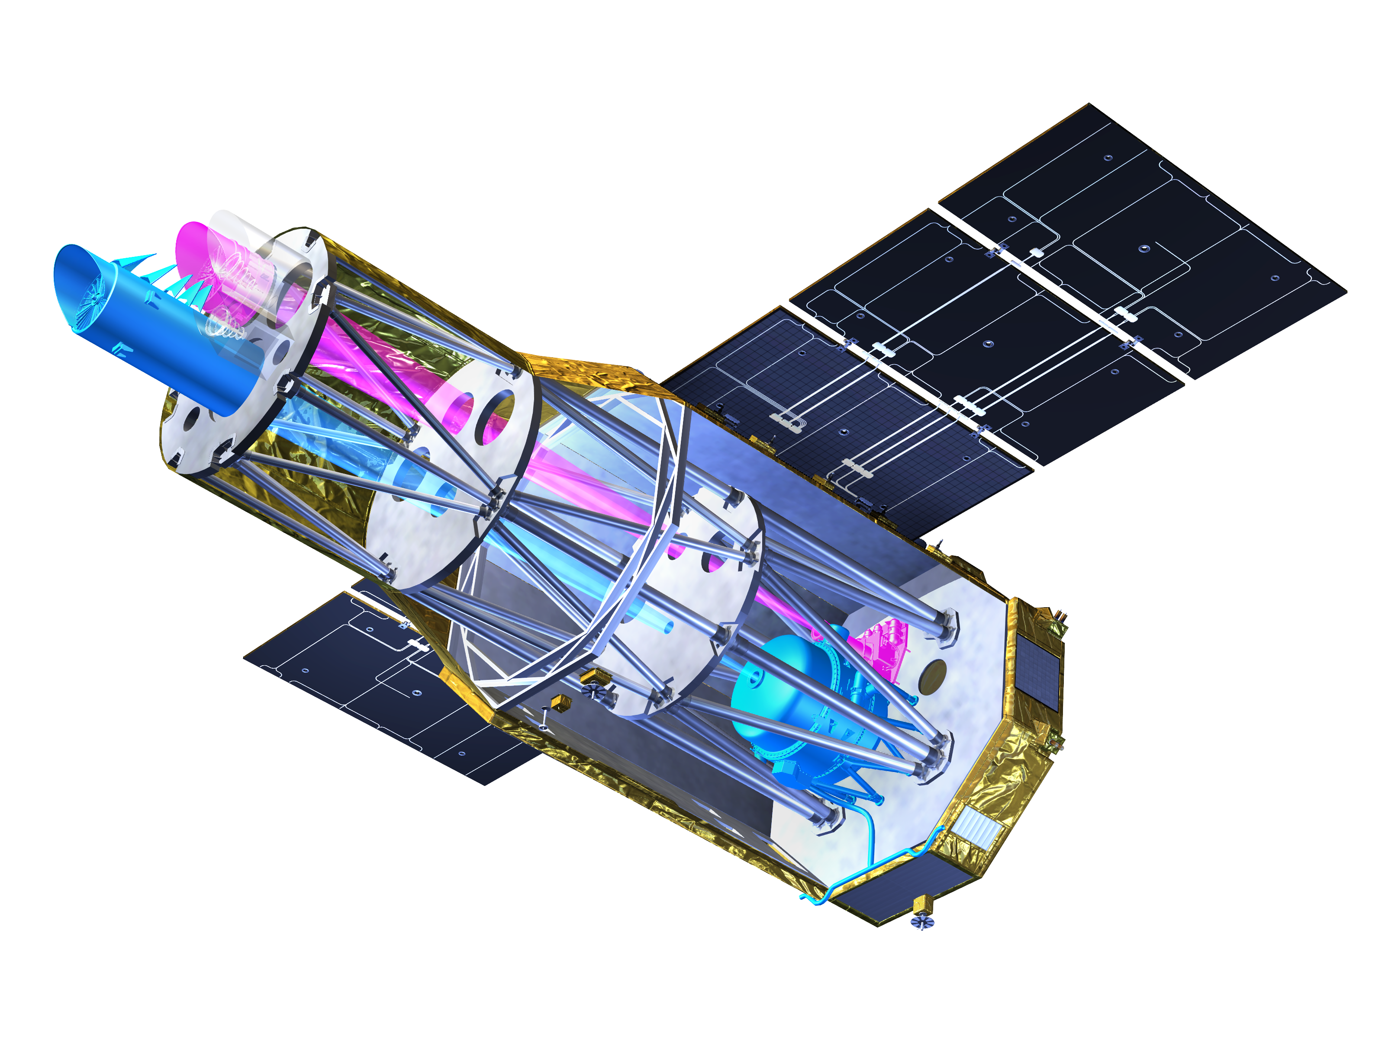
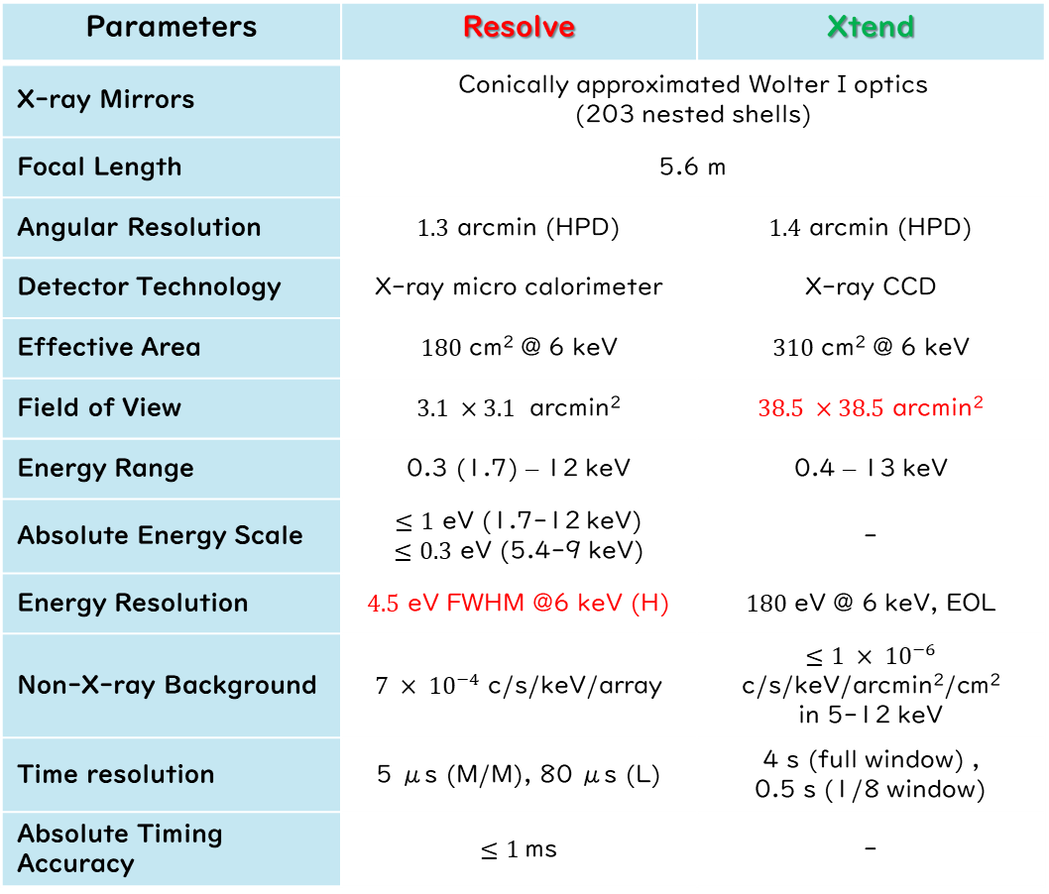
XRISM Payload Instruments
Tashiro et al. PASJ 2025
Parameters | Resolve | Xtend
X-ray Mirrors | Conically approximated Wolter I optics (203 nested shells)
Focal Length | 5.6 m
Angular Resolution | $1.3$ arcmin (HPD) | $1.4$ arcmin (HPD)
Detector Technology | X-ray micro calorimeter | X-ray CCD
Effective Area | $180$ cm² @ 6 keV | $310$ cm² @ 6 keV
Field of View | $3.1 ×3.1$ arcmin² | $38.5 ×38.5$ arcmin²
Energy Range | 0.3 (1.7) – 12 keV | 0.4 – 13 keV
Absolute Energy Scale | $≤1$ eV (1.7-12 keV) $≤0.3$ eV (5.4-9 keV) | -
Energy Resolution | $4.5$ eV FWHM @6 keV (H) | $180$ eV @ 6 keV, EOL
Non-X-ray Background | $7 × {10}^{−4}$ c/s/keV/array | $≤1 × {10}^{−6}$ c/s/keV/arcmin²/cm² in 5-12 keV
Time resolution | 5 μs (M/M), 80 μs (L) | 4 s (full window) , 0.5 s (1/8 window)
Absolute Timing Accuracy | $≤1$ms | -
Japan-US X-ray mission with ESA
Launch on 7 Sep 2023
Instruments; Resolve and Xtend
High-energy-resolution spectroscopy & large FOV imaging in keV band

Slide 4

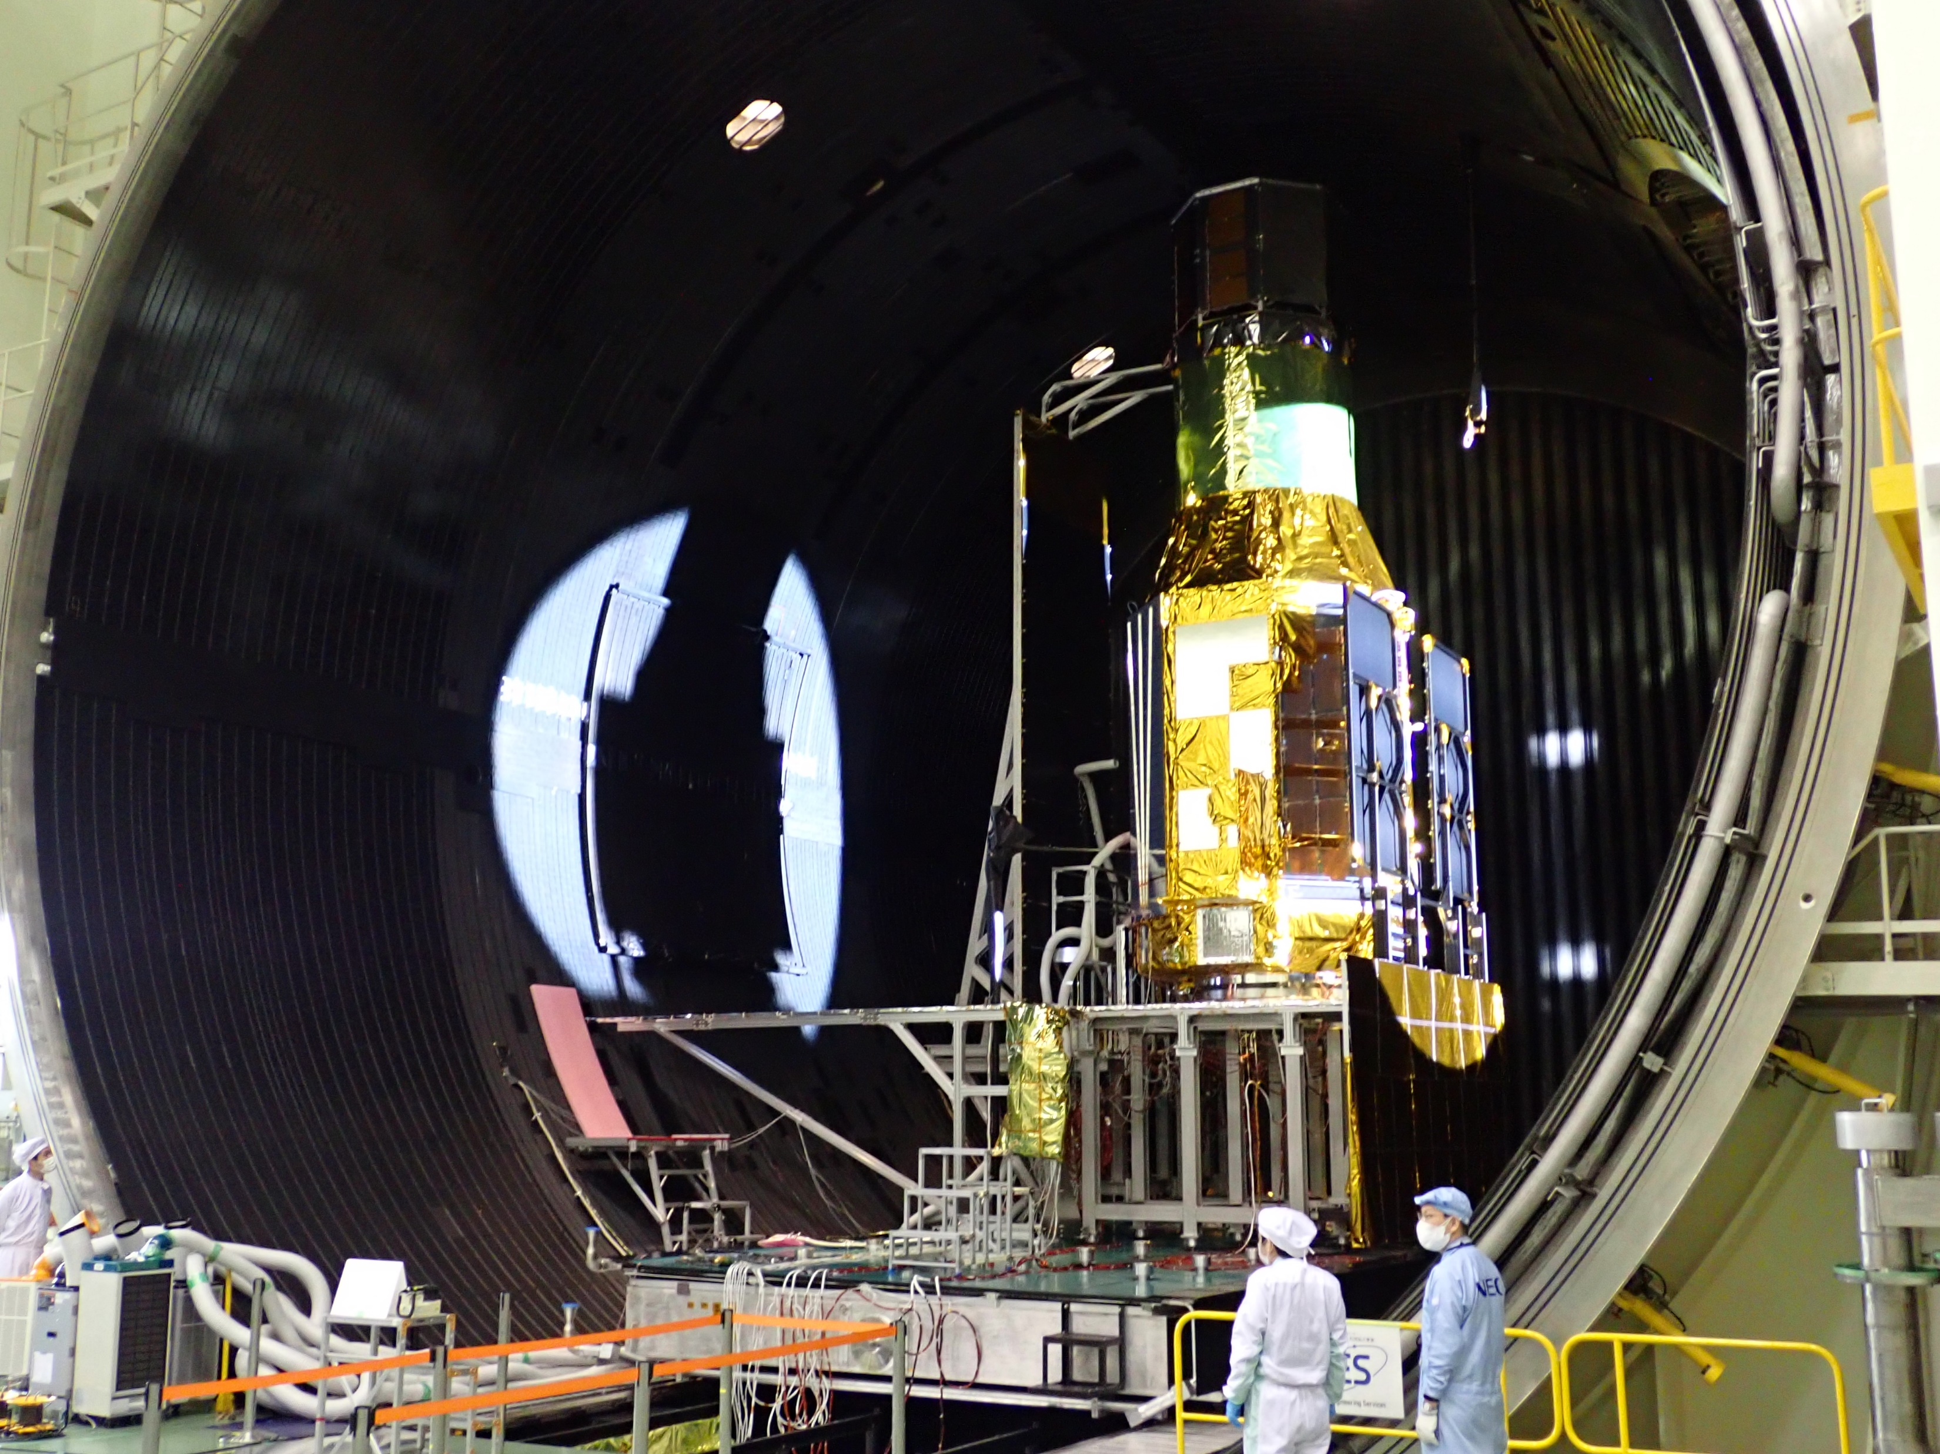
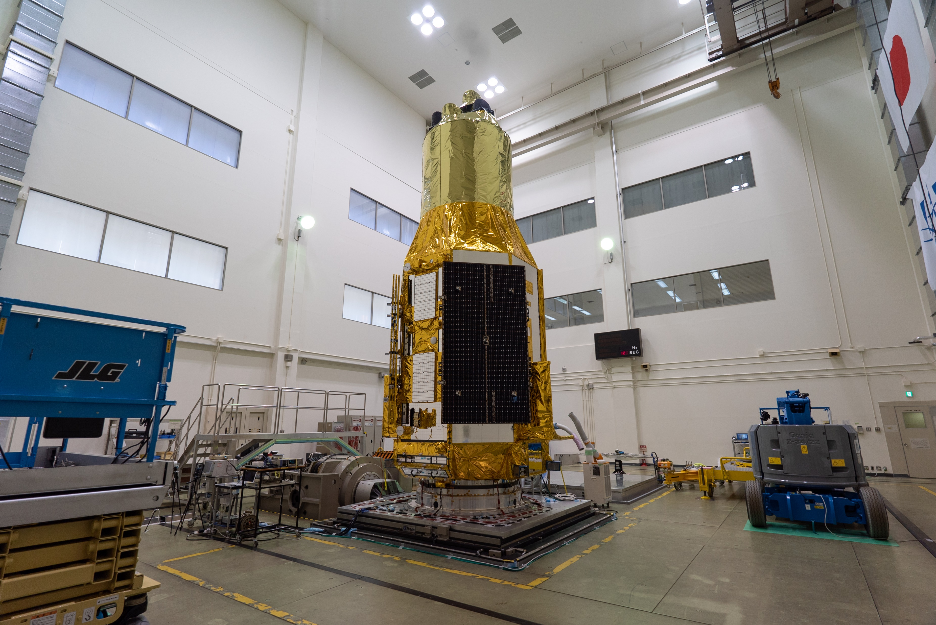
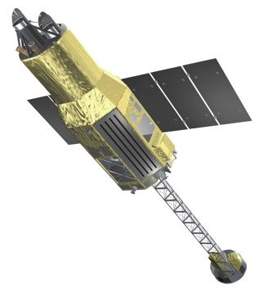
Developed from 2017
JAXA PQR/PSR
Launch!
JAXA CDR/MOR
2023
Verification Tests
JAXA CDR
2022
JAXA PDR
Integration
JAXA MDR/SRR
JAXA pre-project start
NASA project start / NASA CDR
Fabrication
2021
Ground Calibration
Detail design
2020
Basic design
Ship to TNSC
Hitomi Lessons
XARM proposal
JAXA-NASA collaboration
2019
NASA-JAXA
XARM Proposal
Lessons & Close
Investigation
Hitomi Failure
2018
XARM→ XRISM
2017
2016
© JAXA
Thermal Vacuum test @TKSC
Vibration test @TKSC

Slide 5

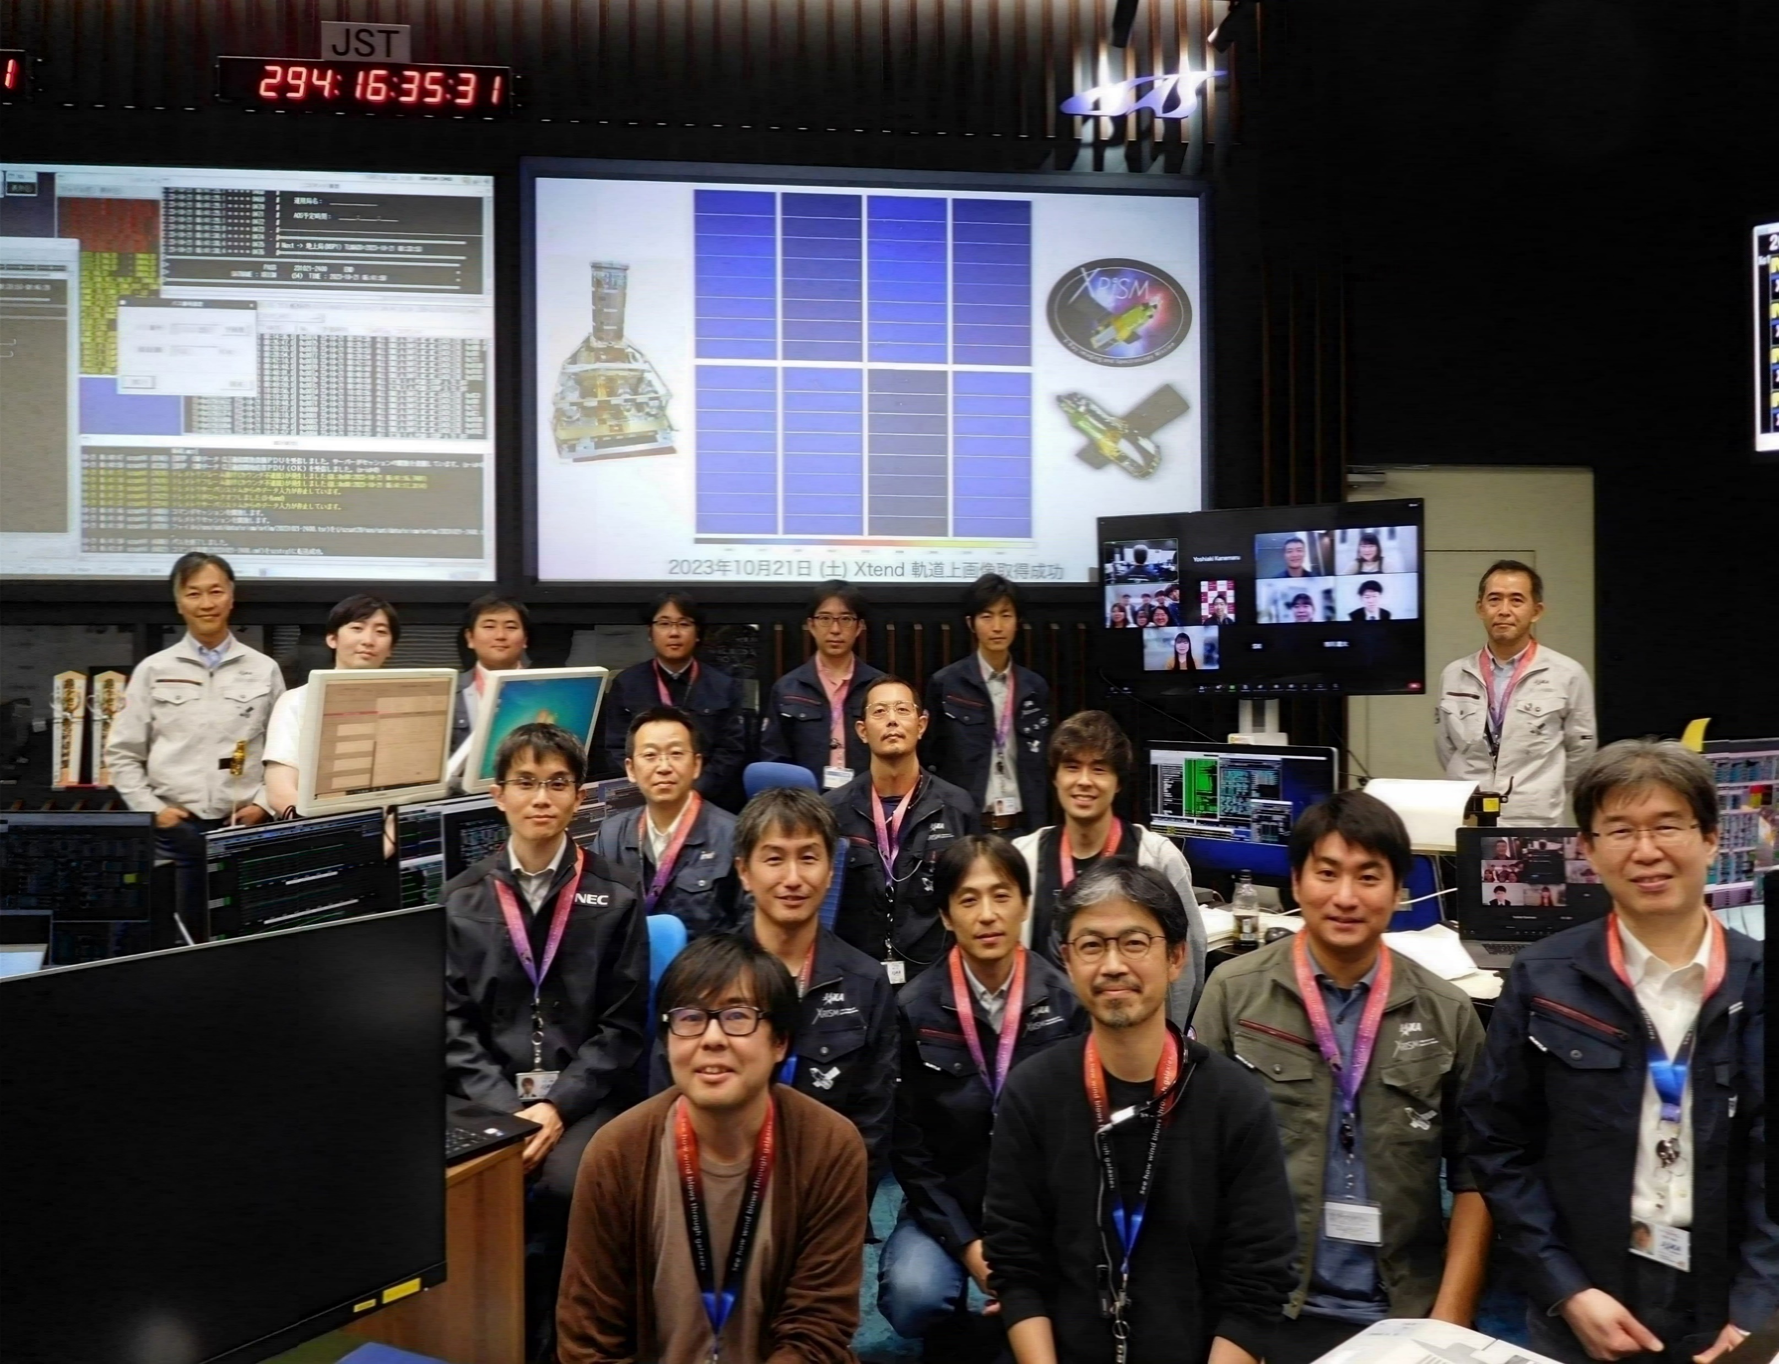
Nominal Operations Phase
We are here.
Sep
2023
Feb
2024
Aug
2024
Aug
2025
Nov
2025
May
2026
May
2027
Initial
Nominal Operation phase
Later phase
Time
Launch
Critical
Commissioning
(Later phase program ; TBD)
GV open operation & Calibration
Guest Observation prog. (cycle 1)
Guest Observation prog. (cycle 2)
Guest Obseravation prog. (cycle 3)
Performance Verification & Calibration
Thank you for collaboration in IACHEC
AO-1 observations are on going.
(15 May is the deadline for AO-2 proposal!! We can help)

Slide 6
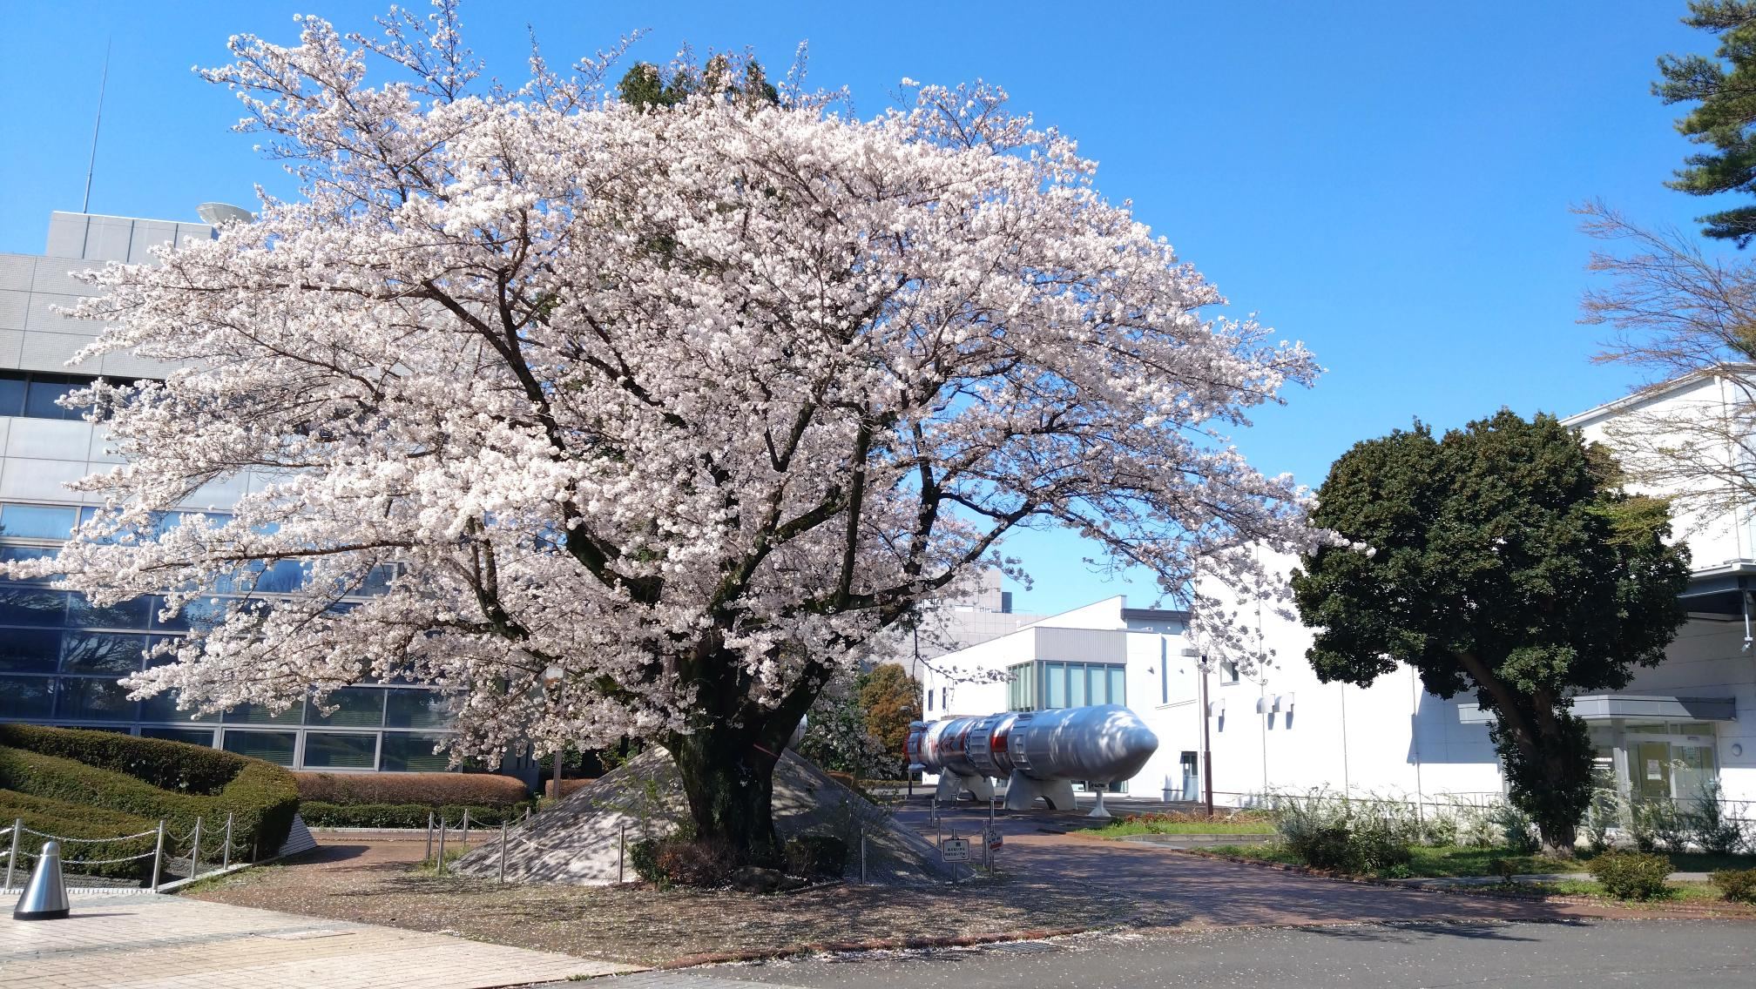
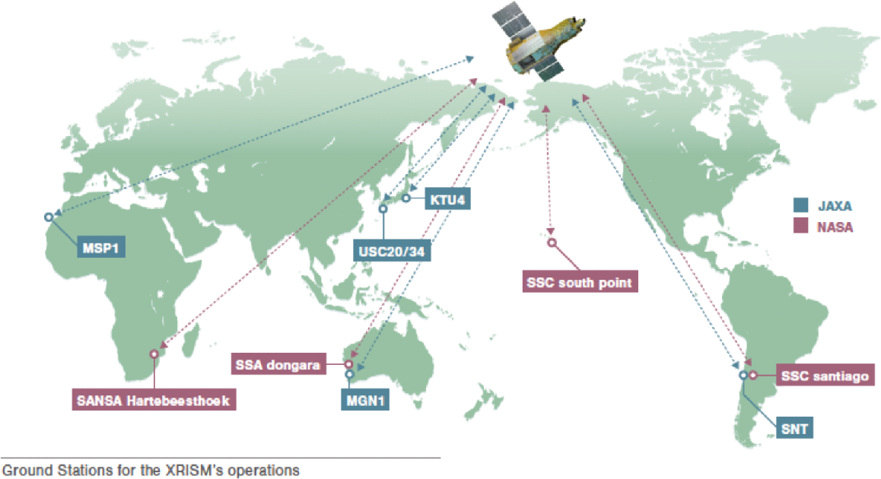
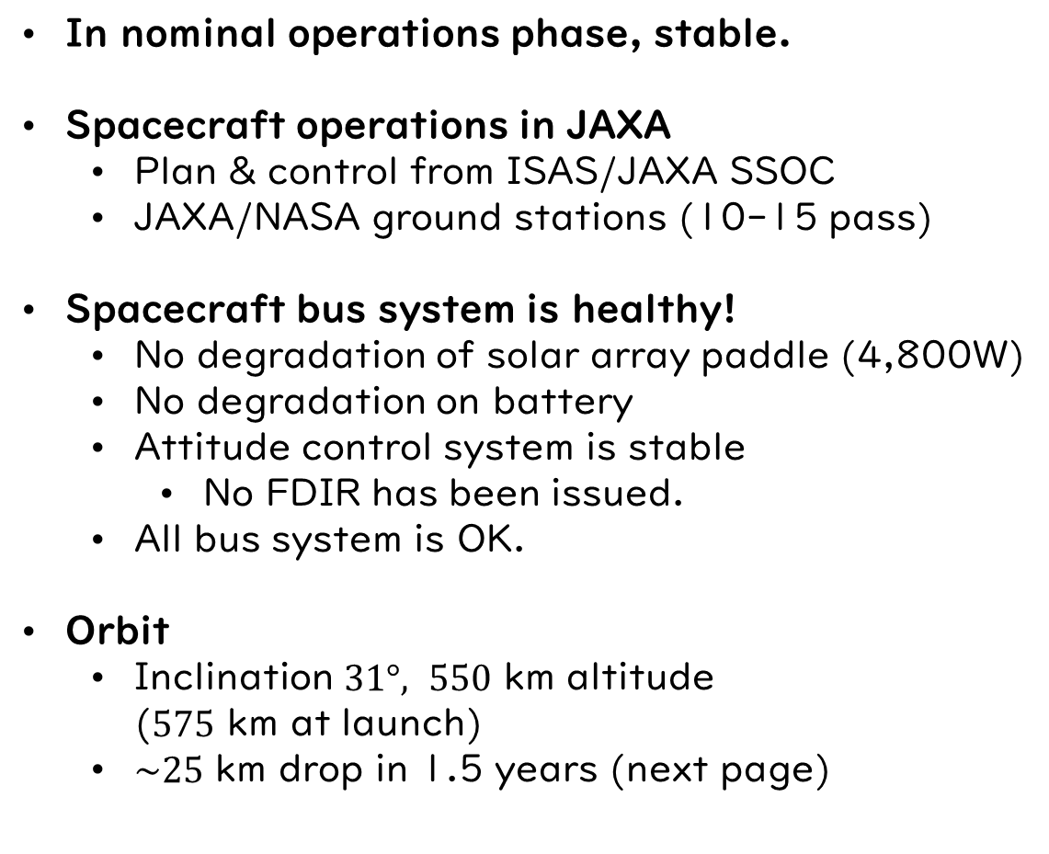
Mission Status
In nominal operations phase, stable.
Spacecraft operations in JAXA
  Plan & control from ISAS/JAXA SSOC
  JAXA/NASA ground stations (10-15 pass)
Spacecraft bus system is healthy!
  No degradation of solar array paddle (4,800W)
  No degradation on battery
  Attitude control system is stable
    No FDIR has been issued.
  All bus system is OK.
Orbit
  Inclination $31°, 550$ km altitude
  ($575$ km at launch)
  $\sim 25$ km drop in 1.5 years (next page)
ISAS in April 2025

Slide 7
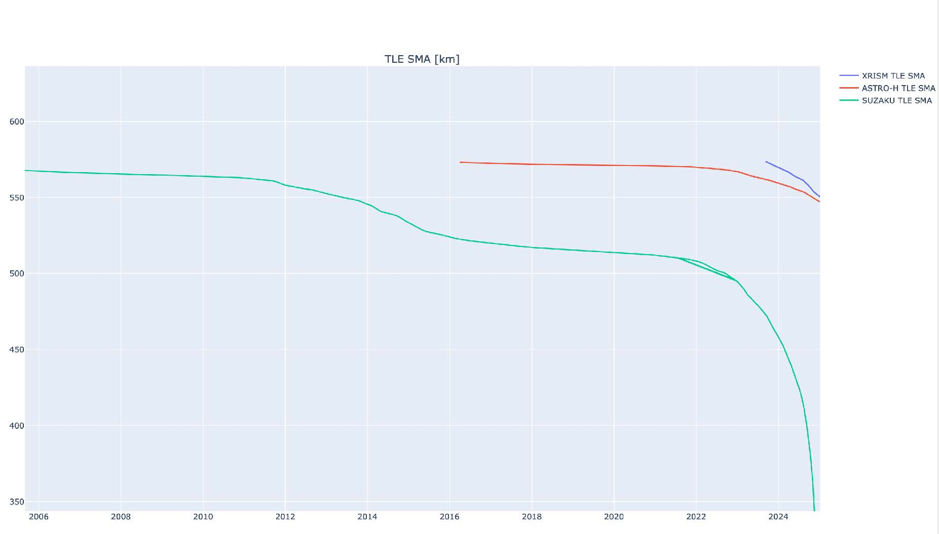
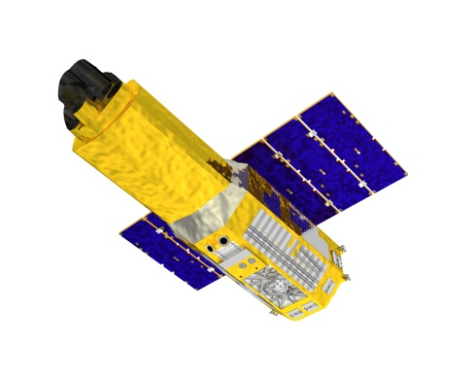
600
Suzaku
ASTRO-H
XRISM
550
500
Altitude
450
24th Solar maximum
25th Solar maximum
400
Suzaku re-entry
on 5 Jan 2025
350
© XRISM, S.Watanabe
2006
2008
2010
2012
2014
2016
2018
2020
2022
2024

Slide 8
Resolve Gate Valve
Gate Valve is still in closed condition
Midooka et al JATIS 2021
Fujimoto et al JATIS 2017
Gate Valve
Detector
He tank
Resolve Dewar & cryocoolers
We plan to try GV Open Operation in September 2025 (after AO-1 before AO-2)
The (original) calibration observations are required – next talk by Eric.

Slide 9



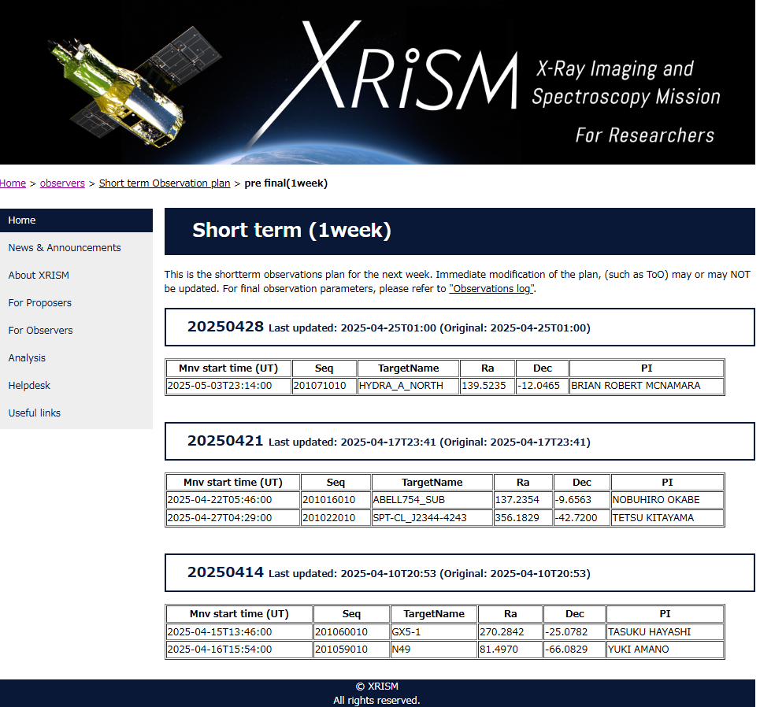
Science Operations Status
XRISM Science Operations – performed by three agencies
  JAXA Science Operations Center (SOC)
  NASA Science Data Center (SDC) and GOF
  ESA European Space Astronomy Centre (ESAC)
Science Observation Plan
  Long/short term schedules are available from the WWW
    Long term (release every 3 months)
      https://xrism.isas.jaxa.jp/research/observers/longterm/index.html
    Short term (1 week before observation)
      https://xrism.isas.jaxa.jp/research/observers/shortterm/prefinal/index.html
  For more detail, please contact us.
Pre-pipeline/pipeline process and Archive & Helpdesk
  No issue.
  Please use latest CALDB & HEAsoft for analyses.
Data Archive
  Early release data (N132D) & DDT data (V4641_Sgr, MAXI_J1744-294) are already in public.
  All during the mission commissioning & PV/Cal will be public at the end of August 2025.
  In AO-2, DDT & calibration OBSIDs will be public soon, GO data will open 1 year after the obs.

Slide 10
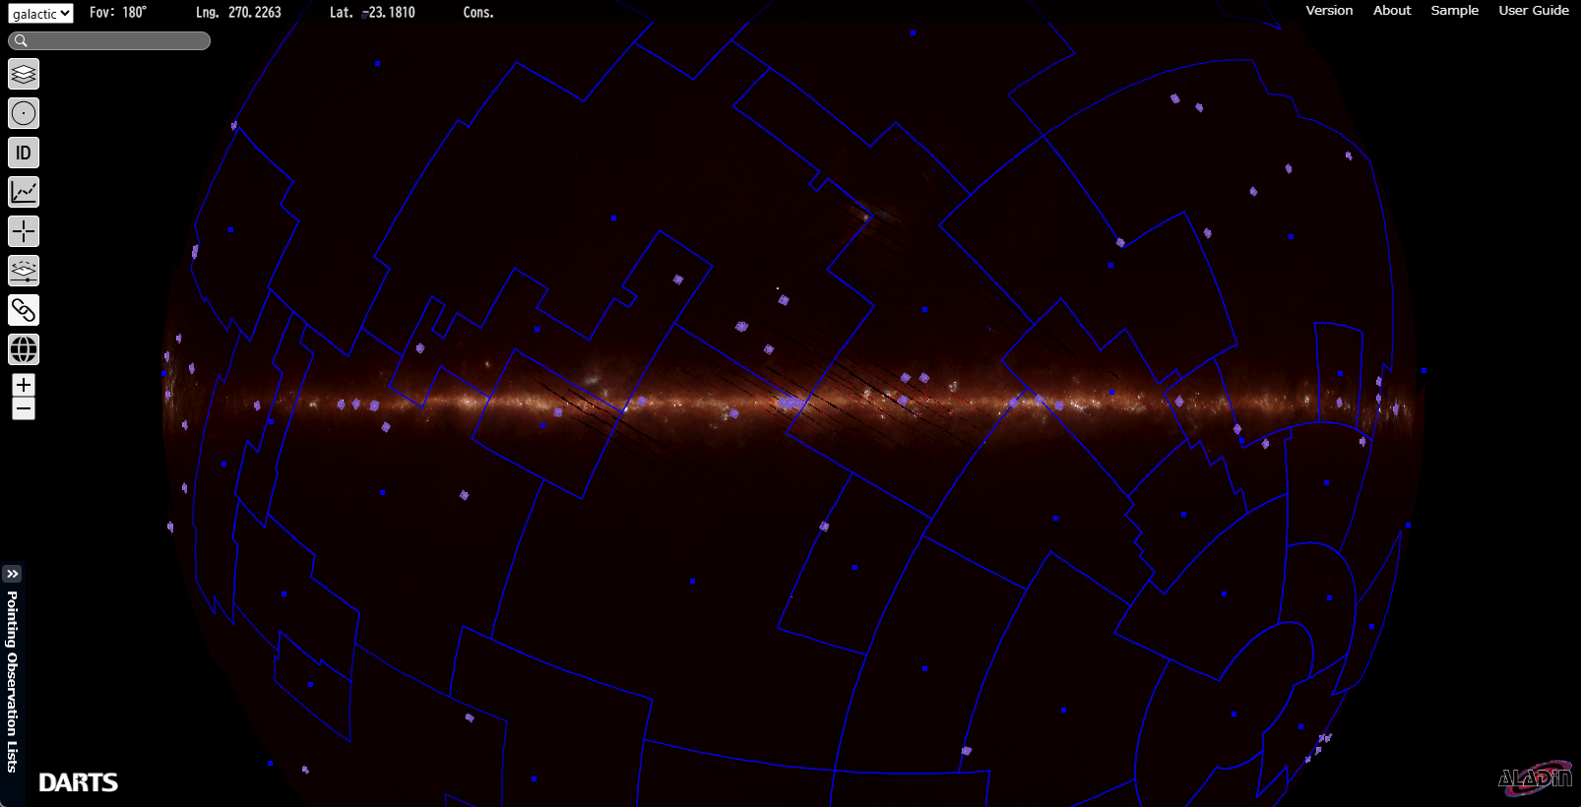
Science Operations Status
Total 263 OBSIDs are completed.
  155 observations in commissioning/PV and 108 observations in AO-1 (as of 30 Apr 2025)
XRISM FOV shown in purple (2 May 2025)

Slide 11
Science Operations Status
Response time of ToO (fast) is <48 hours (weekday) or <72 hours (weekend)
  ToO request www: https://xrism.isas.jaxa.jp/research/proposer/too/index.html
  DDT – 8 requests & 2 approved during the AO-1 period
  Summary of ToO observations
Period | Target | ToO type | Request date JST | Response time request | Response time executed
PV | 4U1630-472 | Reserved/DDT | Feb 8, 2024 (Thu) | 1-2 week | 8 days
 | SN2024iss | DDT | Mar 23, 2024 (Thu) | immediate | 32 hours
 | T Coronae Borealis | Reserved | May 21, 2024 (Mon) | a month | 36 days
 | SS Cygni | Reserved | Jun 3, 2024 (Mon) | immediate | 36 hours
 | GT Mus | Reserved | Aug 10, 2024 (Sun) | immediate | 51 hours
AO-1 | Hercules X-1 | Reserved | Sep 1, 2024 (Sun) | Phase defined | 9 days
 | V4641 Sgr | DDT | Sep 26, 2024 (Thu) | 1 week | 4 days
 | AM Hercules | Reserved | Oct 19, 2024 (Sat) | 1 week | 57 hours
 | MAXI J1744-294 | DDT | Feb 12, 2025 (Wed) | 3 weeks | 19 days
 | IGR J17091-3624 | Reserved | Feb 16, 2025 (Sun) | several days | 49 hours

Slide 12
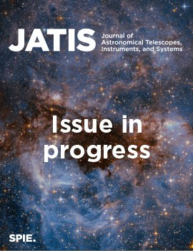
SPIE JATIS XRISM special issue 2025
JATIS vol. 11 no. 4 (October 2025)
https://www.spiedigitallibrary.org/journals/journal-of-astronomical-telescopes-instruments-and-systems/current
Accepted / Open access -- Enjoy !
  Resolve
    Optimization of X-ray event screening using ground and in-orbit data for the Resolve instrument onboard the XRISM satellite
    (Yuto Mochizuki et al.)
    Vibration isolation system for cryocoolers on the XRISM
    (Susumu Yasuda et al.)
    High-count rate effects in event processing for XRISM/Resolve X-ray microcalorimeter: I. Ground test
    (Misaki Mizumoto et al.)
  Xtend
    Initial operations of the Soft X-ray Imager onboard XRISM
    (Hiromasa Suzuki et al.)
    CCD driving technique to suppress anomalous charge intrusion from outside the imaging area for soft X-ray imager of Xtend onboard XRISM (Hirofumi Noda et al.)
  Science operations/calibration
    Development of the timing system for the XRISM
    (Yukikatsu Terada et al.)
Under review
  13 Resolve, 1 Xtend, and 6 Science Operations - Please wait for a moment.

Slide 13
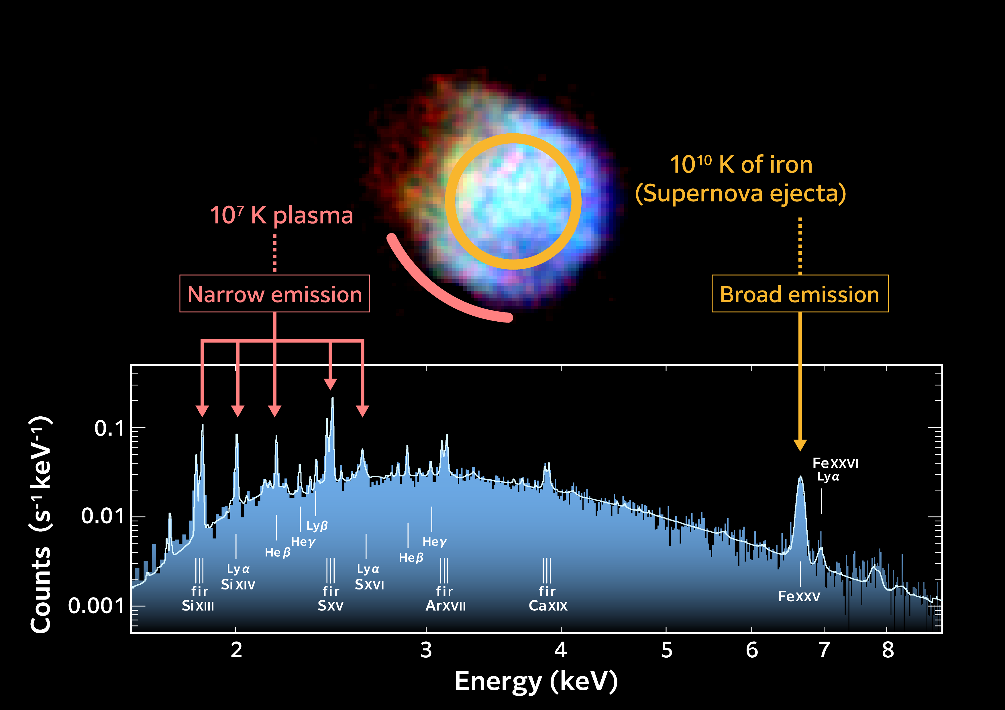
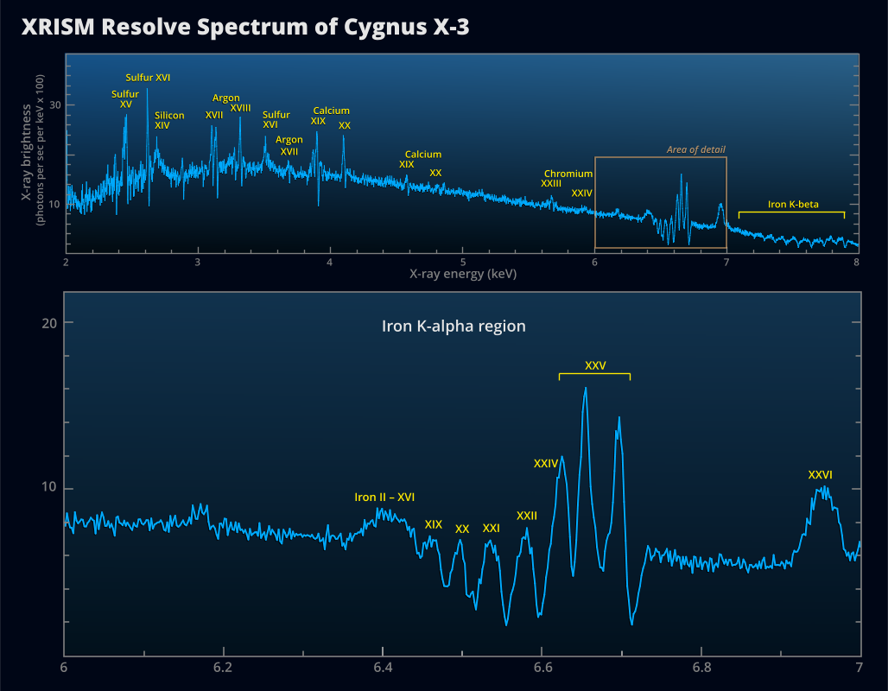
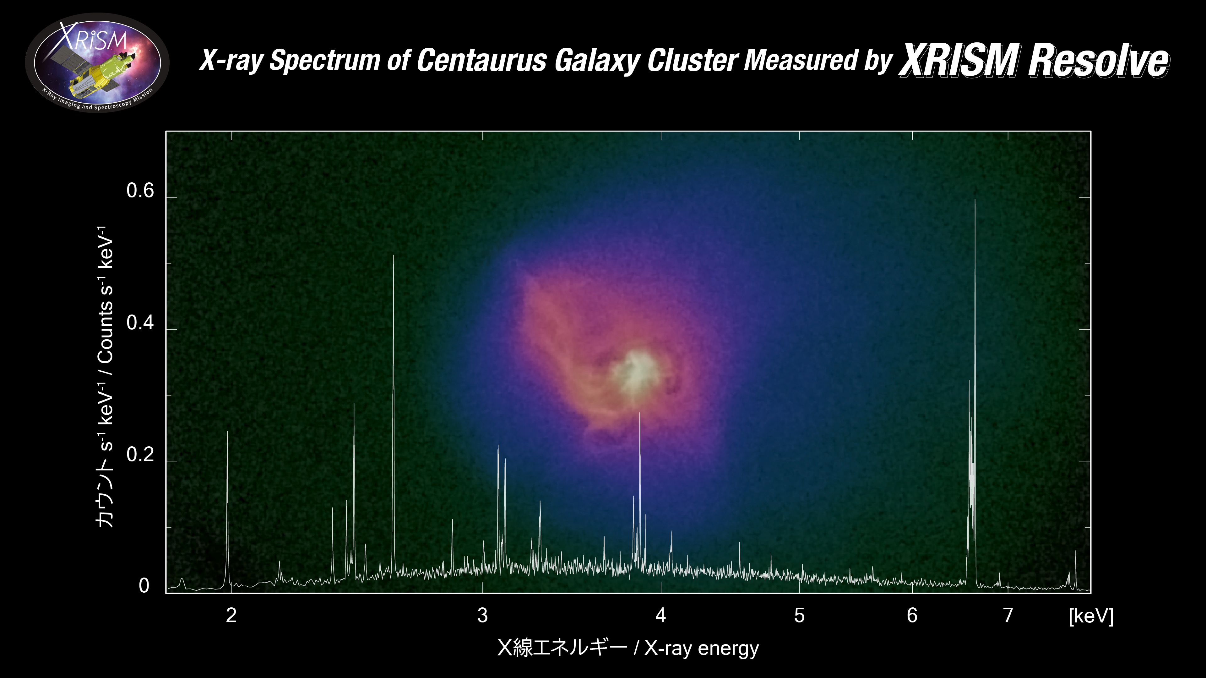
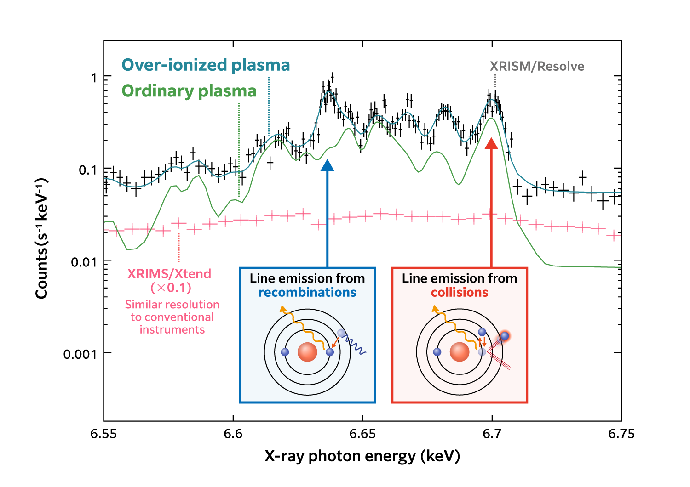
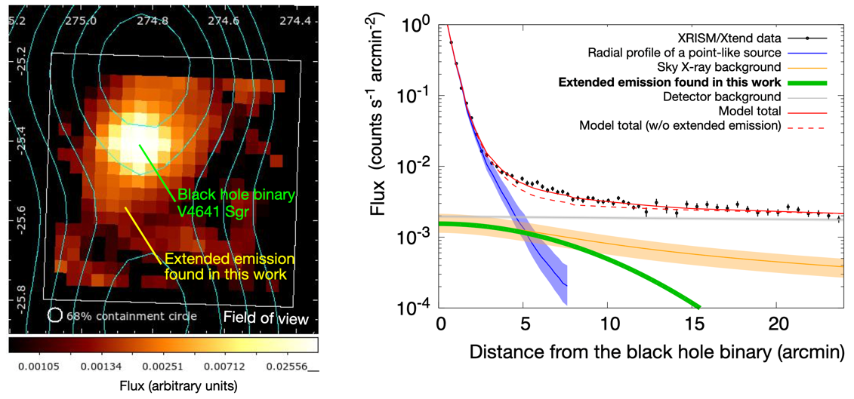
Science Outputs
Press-release (see https://www.xrism.jaxa.jp/en/ )
N132D (20 Sep 2024)
Cyg X-3 (29 Nov 2024)
Centaurus cluster (13 Feb 2025)
Early Release Science Data / IACHEC target
Sgr A East (3 Apr 2025)
V4641 Sgr (18 Apr 2025)
High impact papers are published as ‘XRISM collaboration’ papers.

Slide 14

Publications (except for JATIS special)
Publications (instrument & science)
Last update: 12 May 2025
Journal | Published/accepted | Under review | To be submitted soon (internal review)
Nature | Centaurus cluster, and 2 papers | 2 papers | 8 papers under internal review + more papers in prep.
PASJ | XRISM mission paper, Xtend (instrument), Xtend (in-orbit performance, N132D, Sgr A East, Cir X-1, Cas A(Si, S), Cas A (Fe), GT Mus, N132D CX, A2029, SN1987A | 9 papers
ApJ | NGC4151, Cyg X-3, Cen X-3, V4641 Sgr, A2029, Coma cluster | 2 papers
A&A | Cen X-3 (CLOUDY)
other | Cen X-3
PASJ XRISM special issue (2025)
--- coming soon.

Slide 15
Presentations in IACHEC
The XRISM mission status (Y.Terada)
XRISM in-flight calibration status (E. Miller)
Evaluation of the pointing accuracy of the X-Ray Imaging and Spectroscopy Mission (XRISM) during the first year (Y. Kanemaru)
Inflight calibration status of the X-ray Mirror Assembly (XMA) on XRISM (T.Hayashi)
In-orbit Performance of the Soft X-ray Imaging Telescope Xtend aboard XRISM (H.Uchida)
High count rate effects in event processing for XRISM/Resolve x-ray microcalorimeter (M. Mizumoto )
Particle-induced background of XRISM Resolve and Xtend (H.Suzuki)
Updated Standard Spectral Models for N132D and Cas A Based on XRISM Results (P. Plucinsky )
XRISM Resolve Observations of 1E 0102.2-7219 (H.Suzuki)
In-orbit monitoring of contamination on the XRISM SXI ( M. Higuchi )
In-orbit effective area and quantum efficiency of the Soft X-ray Imager for Xtend onboard XRISM (S.Inoue)
In-orbit calibration of pulse height difference between pixel patterns of X-ray CCDs onboard XRISM (Y.Aoki)
In-orbit performance verification of the Soft X-ray Imaging Telescope Xtend onboard XRISM for two observation modes (K.Takayama)
Improvement of charge-transfer efficiency of XRISM/Xtend CCDs due to un unintentional warming (K.Mori)
Status of XRISM/Xtend Transient Search (T.Yoneyama)
XRISM/XMM-Newton cross-calibration status ( M. Guainazzi )
Cross-Calibration of XRISM Resolve and Xtend: I. Temperature Measurements in Nearby Galaxy Clusters (I.Aihara)
Cross-Calibration of XRISM Resolve and Xtend: II. Line Ratio and Continuum-Based Temperature Measurements (K.Suda)
Cross-Calibration Comparisons using Galaxy Cluster Emission from NuSTAR, Chandra, XMM-Newton, Suzaku, and XRISM (D.Wik)
In-orbit timing calibration of XRISM Resolve (Y.Motogami)
Enjoy & discuss !

Slide 16


XRISM International Conference 2025
Registration is open now.
Please come to Japan again!
https://www-cr.scphys.kyoto-u.ac.jp/conference/xrism2025/index.html

Slide 17

Pick up one XRISM Pin budge & Stickers
and bring one or more poster(s) of XRISM conference

