Slide 1
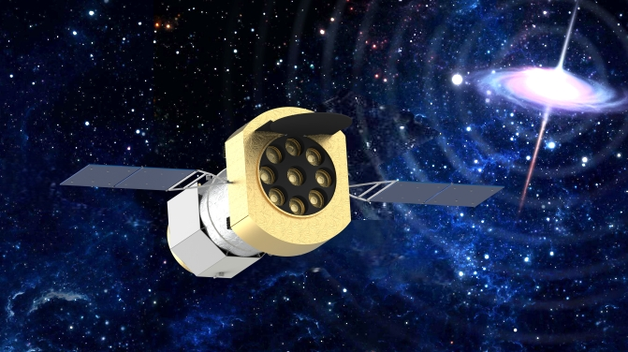
18th IACHEC meeting, Pelham, Germany, April 20-24 2026
The Spectroscopy Focusing Array Timing (SFA-T) payload onboard the eXTP mission：development status, preliminary ground calibration results and future calibration roadmap
Yuxuan Zhu
zhuyx@ihep.ac.cn
IHEP, CAS
2026-4-22
On behalf of the eXTP SFA-T Team
YuSa Wang¹, Wei Li¹, ZhenJie Li¹, LaiDan Luo¹, Jia Ma¹, Qiong Wu¹, ZiJian Zhao¹, XiongTao Yang¹, YuXuan Zhu¹, YiFan Zhang¹, Can Chen¹, ZiYu Bao¹, YaoGuang Liu¹, Wei Xu¹, Dong Xie¹, XueZhao Li¹, JunYi Tian¹, YiChen Lin¹, Fan Yang¹, XueYi Tang¹, Gang Li¹, Juan Zhang¹, LiQiang Qi¹ , TianXiang Chen¹, MaoShun Li¹, Bin Meng¹, HongWei Liu¹, XiaoJing Liu¹, YanJi Yang¹, Juan Wang¹, XiaoFan Zhao¹, WeiWei Cui¹, Yong Chen¹, YuPeng Xu¹, FangJun Lu¹, ShuangNan Zhang¹, HuiLin He¹, Hua Feng¹, CongZhan Liu¹, Bo Wang², LangPing Wang², DianLong Wang², Fei Ding², LiZhi Sheng³, PengFei Qiang³, Norbert Meidinger⁴,Thomas Bechteler⁴, Vadim Burwitz⁴, Kirpal Nandra⁴, Stefano Basso⁵, Giorgia Sironi⁵, Giovanni Pareschi⁵, Tagliaferri Gianpiero⁵. （Updated Aug.2025）
1. Institute of High Energy Physics, CAS, Beijing, China; 4. Max-Planck Institute for Extraterrestrial Physics, Giessenbach Strasse 1, 85748 Garching, Germany;
2. Harbin Institute of Technology, Harbin, China; 5. INFN-Brera Astronomical Observatory, Via E. Bianchi 46, 23807 Merate, Italy;
3. Xi’an Institute of Optics and Precision Mechanics, CAS, Xi’an, China;

Slide 2
Outline
1
Configuration of eXTP and SFA-T
2
Development status of SFA -T
3
Preliminary calibration results
4
Ground calibration strategy for future
5
Summary

Slide 3
Outline
1
Configuration of eXTP and SFA-T
2
Development status of SFA -T
3
Preliminary calibration results
4
Ground calibration strategy for future
5
Summary

Slide 4
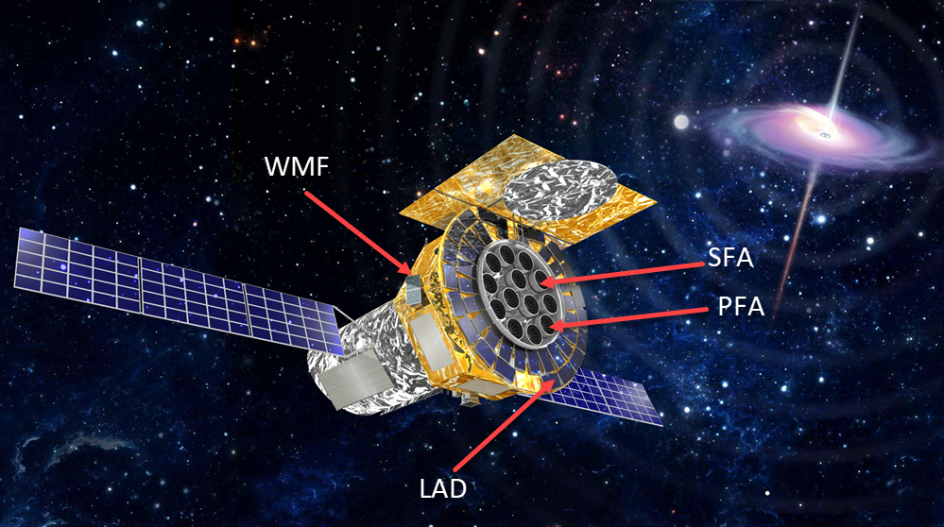
1. The configuration of eXTP
What are building？ eXTP: enhanced X-ray Timing and Polarimetry Mission
Scientific goal: eXTP is a science mission designed to study the state of matter under extreme conditions of density, gravity and magnetism.
Operation：Pointing observation with high accuracy and stability.
Configuration before 2024
Payload | Configuration | Optics | Detector | Eff. area (m²)
Spectroscopy Focusing Array (SFA) | 9 telescopes | Wolter-I, nickel | SDD, 0.5-10 keV 180 eV @ 6 keV | 0.6 m²(1-2 keV)
Large Area Detector (LAD) | 40 modules | MCP | SDD, 2-30 keV 180 eV @ 6 keV | 3.1 m² (2-10 keV)
Polarimetry Focusing Array (PFA) | 4 telescopes | Wolter-I, nickel | GPD, 2-8 keV 1.8 keV @ 6 keV | 380 cm² @ 3 keV
Wide Field Monitor (WFM) | 6 cameras | Coded mask | SDD, 2-50 keV 500 eV @ 6 keV | 3 Sr (FOV)

Slide 5
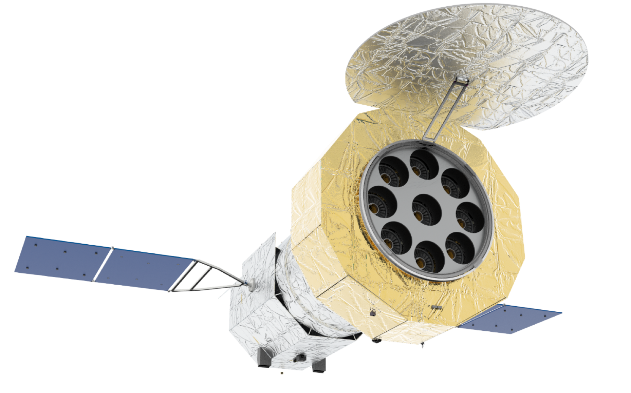
The configuration of eXTP
Scientific goal: eXTP is a science mission designed to study the state of matter under extreme conditions of density, gravity and magnetism.
Operation：Pointing observation with high accuracy and stability.
Orbit: Low Earth Orbit 610km 20°
Life: 5 years
Spectrum, Timing, Polarization, Imaging
Payload | Configuration | Optics | Detector | Eff. area (cm²)
Spectroscopy Focusing Array (SFA) | SFA-T 5 telescopes | Wolter-I, nickel | SDD, 0.5-10 keV 180 eV @ 6 keV | 3300 cm² @1.5 keV 2000 cm² @6 keV
 | SFA-I 1 telescope | Wolter-I, nickel | pnCCD, 0.5-10 keV 180 eV @ 6 keV | 3.1 m² (2-10 keV)
Polarimetry Focusing Array (PFA) | 3 telescopes | Wolter-I, nickel | GPD, 2-8 keV 1.8 keV @ 6 keV | 180 cm² @ 3 keV

Slide 6
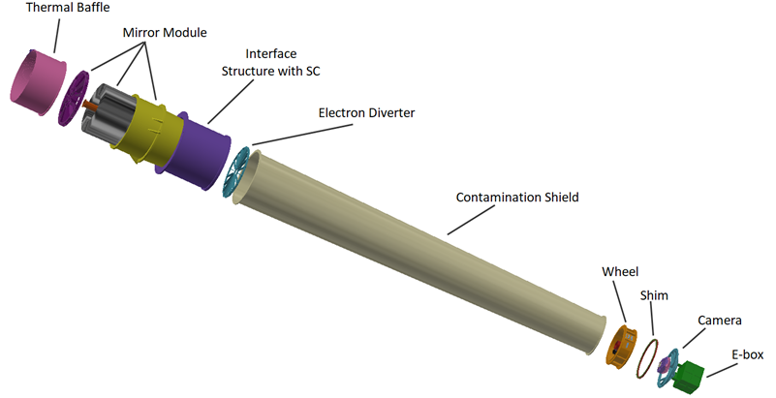
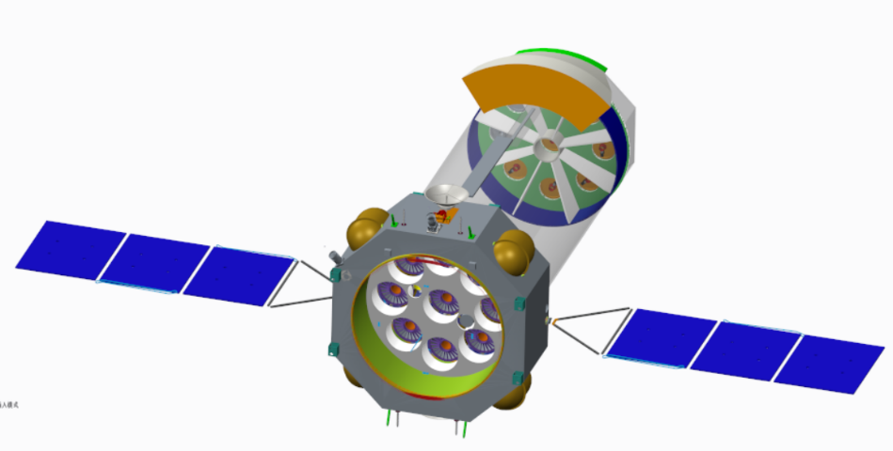


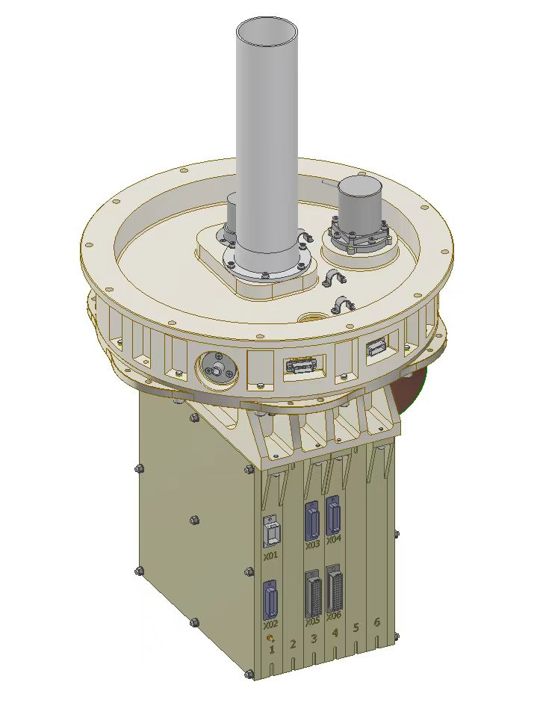
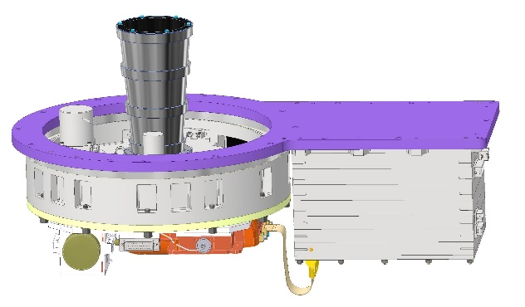
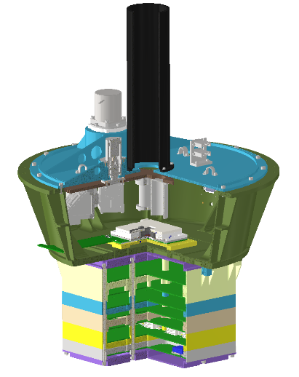
The configuration of eXTP
6 SFA & 3 PFA
9 Mirror Modules
X-ray
🛰️ Satellite Platform
• eXTP mission adopts satellite bus provided by Innovation Academy for Microsatellites, CAS, ensuring high reliability and streamlined integration.
🔍 Common Optics, Specialized Coatings
• All three payloads share an identical geometric optical configuration;
• Differentiation achieved solely through tailored reflective coatings, optimized for respective energy bands / scientific objectives.
SFA-T *5
SDD
SFA-I *1
pnCCD
PFA *3
GPD

Slide 7
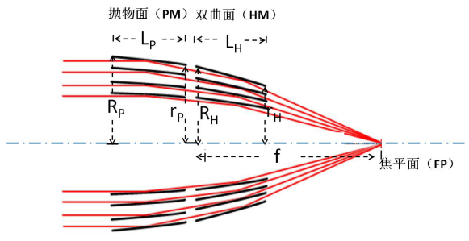
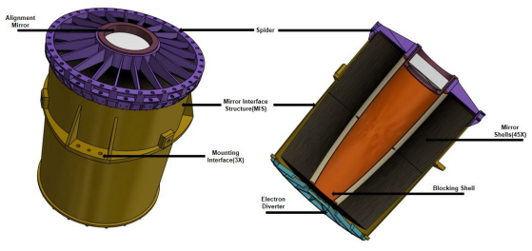
The configuration of the SFA-T
The X-ray optics for eXTP
 | SFA | PFA
Type | Wolter-I 47 shells 300mm + 300mm for P & H bolid
Focal Length | 5.25 ± 0.05 m
Coating | Au | Ni+Au
Effective Area | ≥820cm²@1.5keV ≥550cm²@6keV | ≥800cm²@3keV ≥550cm²@6keV
Energy Range | 0.3~10 keV
FOV | ≥ 12′
HPD | ≤ 1′ (HPD), ≤ 3′ (W90) | ≤ 30″（HPD）
Profile | ≤ 600 mm（Diameter）
Weight | 150 kg
Temperature | 20±1℃

Slide 8

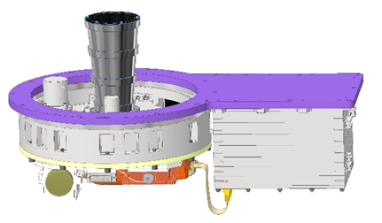
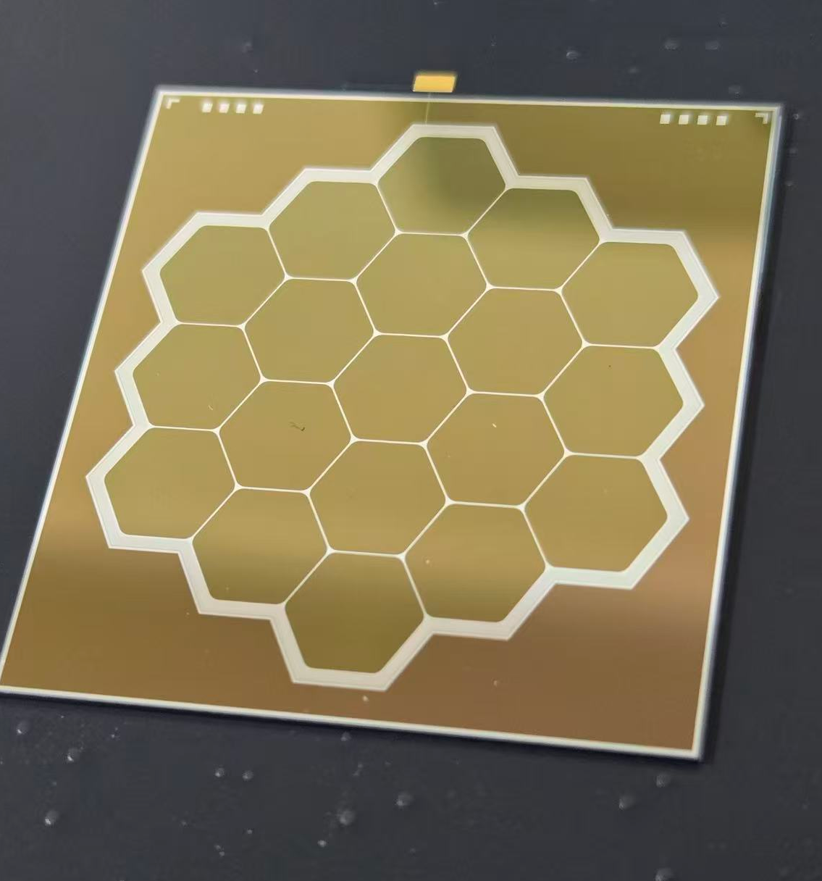
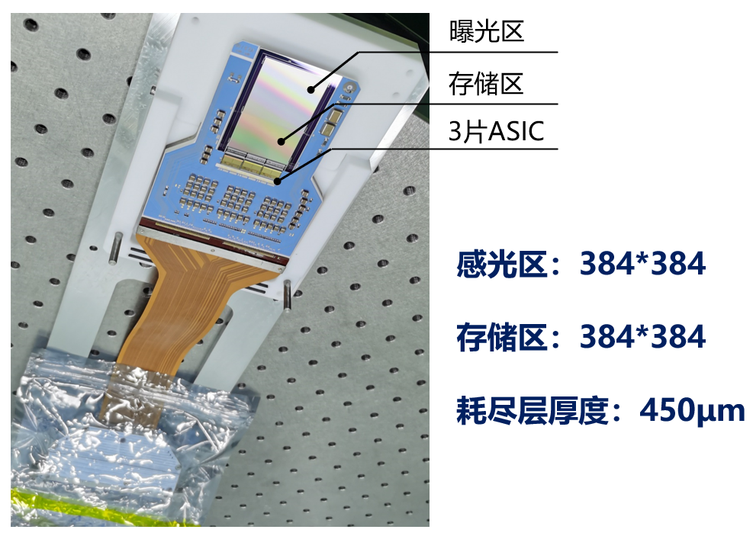
The configuration of the SFA-T
SFA-T | Multi-Cell SDD
Number of cells | 19
Size | ≥ 18×18 mm² (12′)
Energy range | 0.5-10 keV
Energy resolution | ≤180 eV@ 6 keV
Timing | ≤ 10 μs
SFA-I | pnCCD
Pixel num | 384*384
size | ≥ 28.8×28.8 mm² (12′)
Energy range | 0.5-10 keV
Energy resolution | ≤180eV@1.49 keV
Timing | ≤50 ms （FF） ≤ 240 μs （TM） ≤ 3 ms（PW）
Filter Wheel
Flange
Shield
Electronics
SFA-I camera assembly
SFA-T camera assembly
Six positions in FW：3 PI+Al filter、Fe-55、Close and Open.
SFA-T: 19-Cell SDD array
SFA-I: PN-CCD

Slide 9
The configuration of the SFA-T
The performance of SFA-T
The performance of SFA-I
Content | Requirements
Focal Length | 5.25±0.01m
Effective area （E±0.5keV） | ≥2750cm²@1.5keV ≥1670cm²@6 keV
Energy range | 0.5-10 keV
Energy resolution | ≤180eV@6 keV
FOV | ≥ φ12′
SDD pixel size | 6.4mm (4.2′)
HPD | ≤1′(HPD)，3′(W90)
Time resolution | ≤10μs
Absolute time accuracy | ≤ 2 μs
Dead time | ≤ 5% @ 1 Crab
Sensitivity | 4.5×10⁻¹⁵ erg cm⁻² s⁻¹ (0.5-10 keV, 5σ, 10⁶ s)
Content | Requirements
Focal Length | 5.25±0.01m
Effective area （E±0.5keV） | ≥550cm²@1.5keV ≥330cm²@6 keV
Energy range | 0.5-10keV
Energy resolution | ≤180eV@1.49 keV
FOV | 12′ ×12′
HPD | ≤1′(HPD)，3′(W90)
Time resolution | ≤50 ms （Full frame） ≤ 240 μs （Timing mode） ≤ 3 ms（Window mode）
Sensitivity | 4×10⁻¹⁵ erg cm⁻² s⁻¹ (0.5-10 keV, 5σ, 10⁶ s)
SFA-T (SDDs): Optimized for timing performance — high time resolution
SFA-I (pnCCD): Optimized for imaging capability

Slide 10
Outline
1
Configuration of eXTP and SFA-T
2
Development status of SFA -T
3
Preliminary calibration results
4
Ground calibration strategy for future
5
Summary

Slide 11
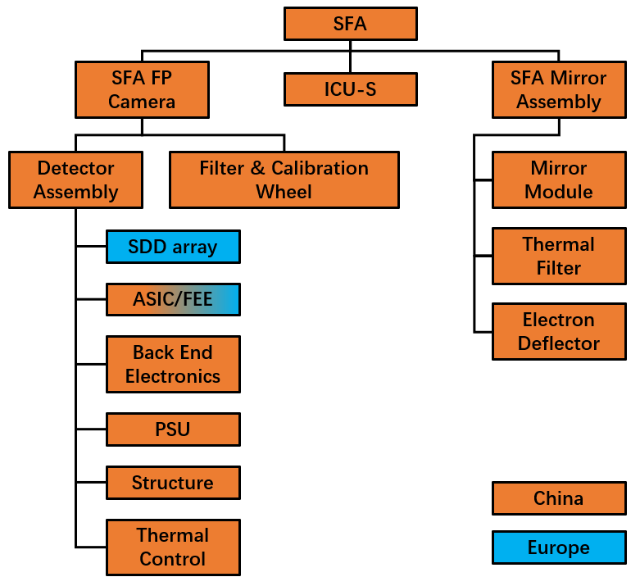





Development status
Who is building all this？
Lead Institution
• IHEP, CAS (China) — Overall project coordination, system integration & technical leadership
International Partners
• MPE, Germany — Provision of SDDs
• INAF, Italy — Technical support for optical component design
Chinese Consortium Responsibilities
✅ Electronics & Data Acquisition
✅ Thermal Control & Mechanical Structure
✅ Optical System Integration：Jointly developed by IHEP, HIT and XIOPM
✅ End-to-end Testing & Calibration

Slide 12

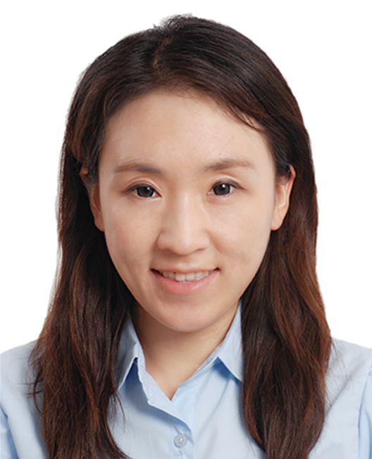









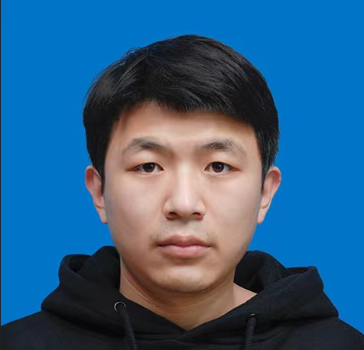

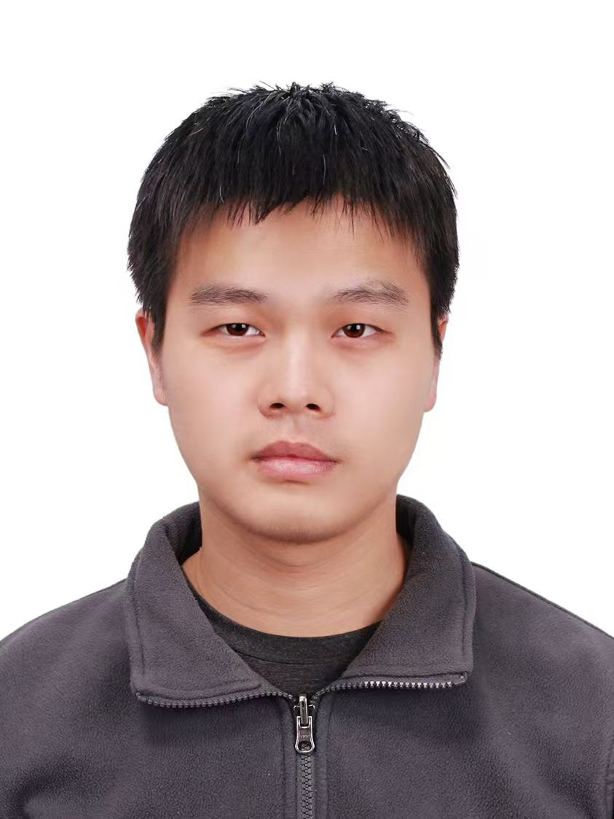

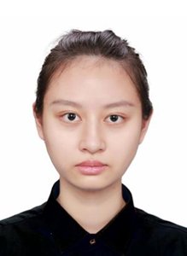


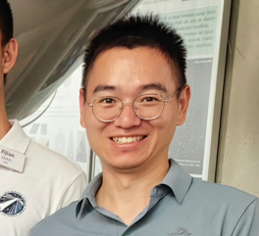
Manpower and resources
20+ experts for the payload development！
Dedicated Detector Team: Professional team specializing in detector design, fabrication, and end-to-end testing.
Calibration Capability: Payload team operates China's largest ground-based calibration facility; tailored calibration plan developed for SFA-T technical requirements.
Industry Partnership for Chip : Technical support secured from leading large-format semiconductor manufacturers, enabling full-cycle chip design and validation.
Cross-Calibration Access: Leveraging PANTER facility support for high-precision cross-calibration between optical system and detector subsystems.

Slide 13
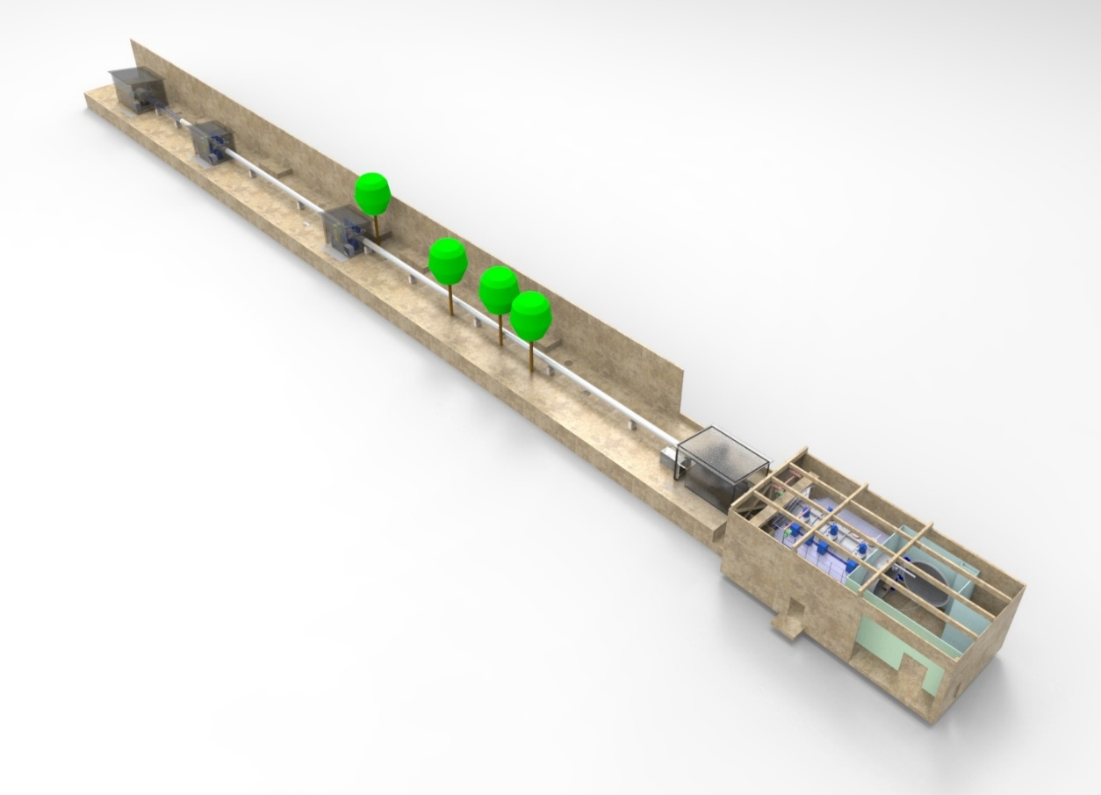
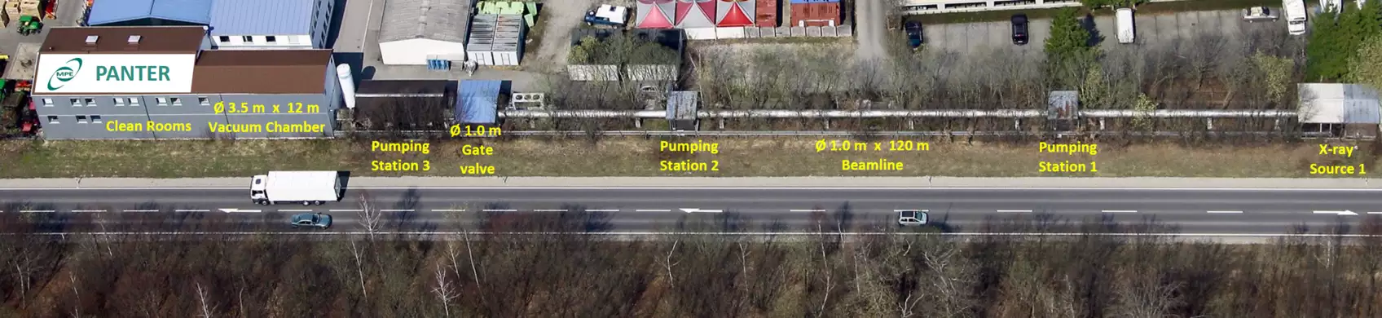
Calibration facilities
The biggest X-ray test facility in China
Calibrated the EP FXT and WXT well
100XF (100-m X-ray Test Facility):
  Mirror calibration (EA, PSF, Time resolution)
  Telescope calibration
PANTER Facility:
  Cross calibration of mirrors
X-ray
sources
Pump stations
Big Chamber

Slide 14
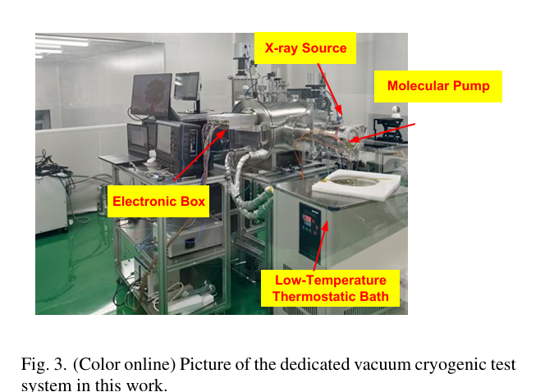
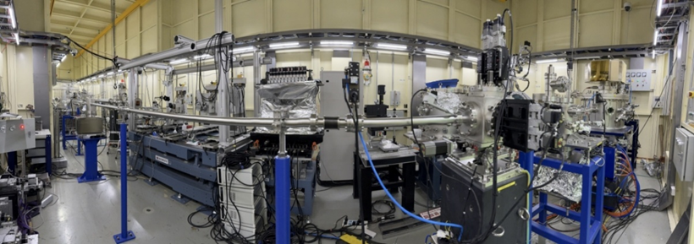
Calibration facilities
Individual chamber for the SDDs test and calibration
  Electronic development
  Time resolution
  Energy scale
  Edge block
  …
synchrotron radiation source:
  RMF
  QE
  Flux limitation
  …

Slide 15
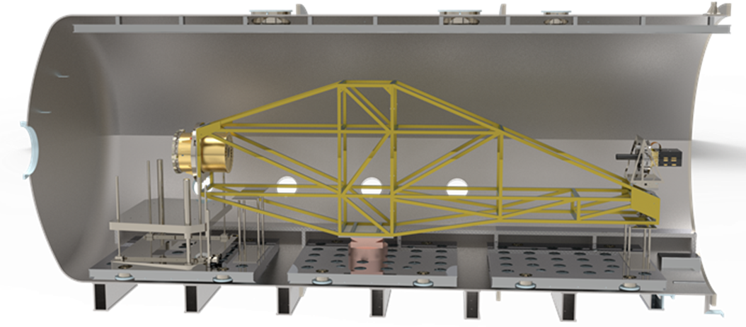
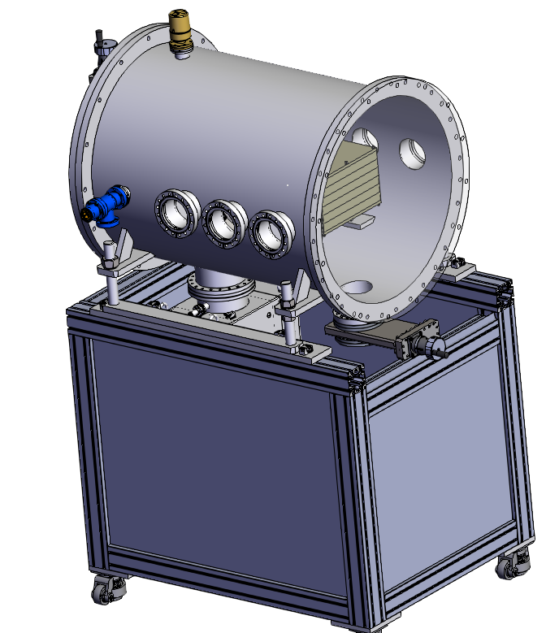
Calibration facilities
A big housing system is developed for the telescope calibration
  Material：Ti-TA1
  Load capacity: 850 kg
  Angular positioning accuracy: ≤5 ″
  Attitude Monitoring System with a position sensitivity of 10 μm（0.5″）
  Deformation variation with the angle changing (±1°)：0.04 mm(2″)
synchrotron radiation Cal chamber
  Equipped with a ion pump assembly, achieving ultra-high vacuum
  Integrated beam flux monitoring provides live feedback on detector exposure
  Upon safety thresholds, instantly close the valve, shielding the detector from beam damage.

Slide 16
Outline
1
Configuration of eXTP and SFA-T
2
Development status of SFA -T
3
Preliminary calibration results
4
Ground Calibration strategy for future
5
Summary

Slide 17
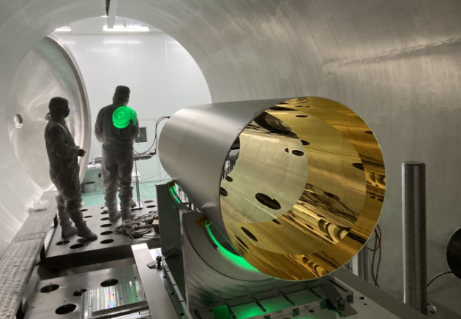
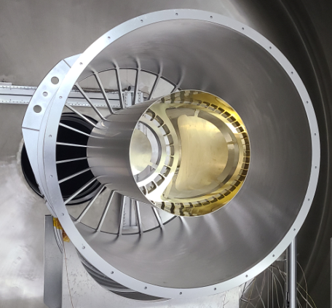
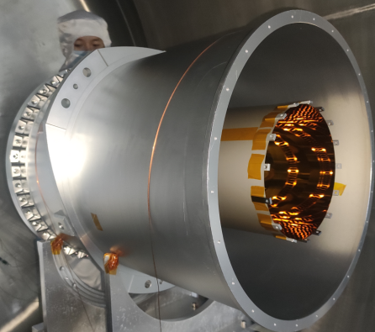
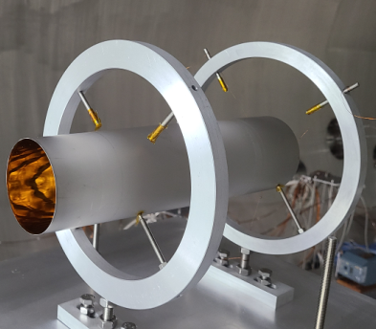
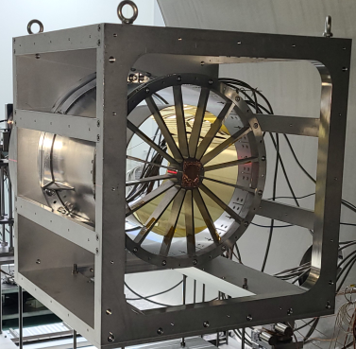
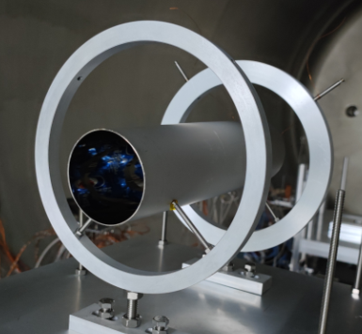
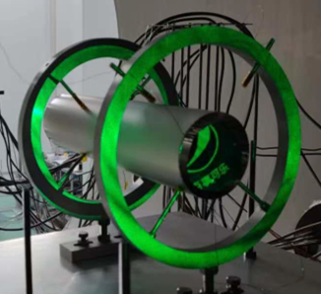
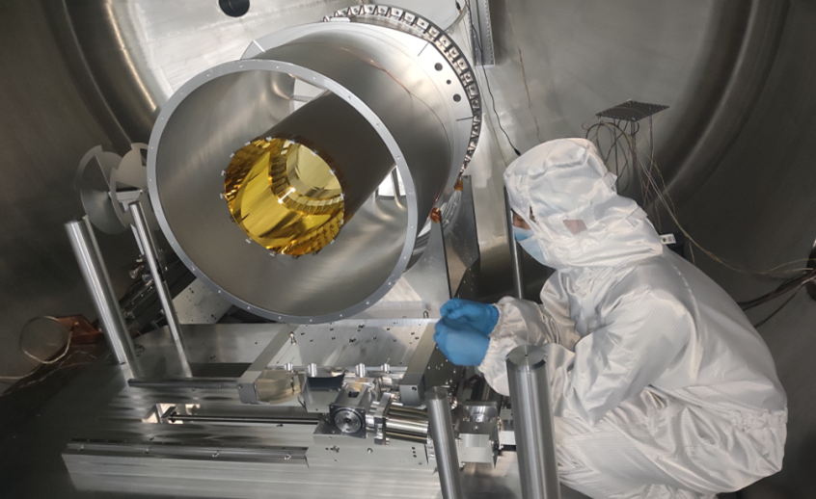
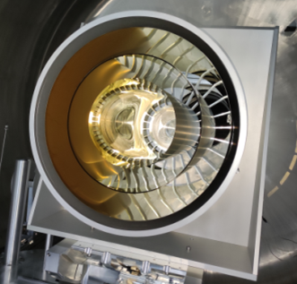
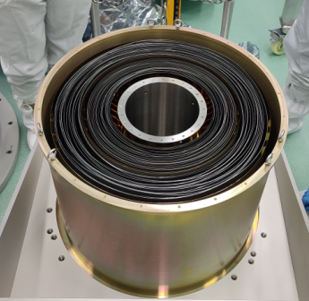
Preliminary cal. results
Many individual shells had been tested since the Phase A, and HPD ~26″ can be achieved!

Slide 18
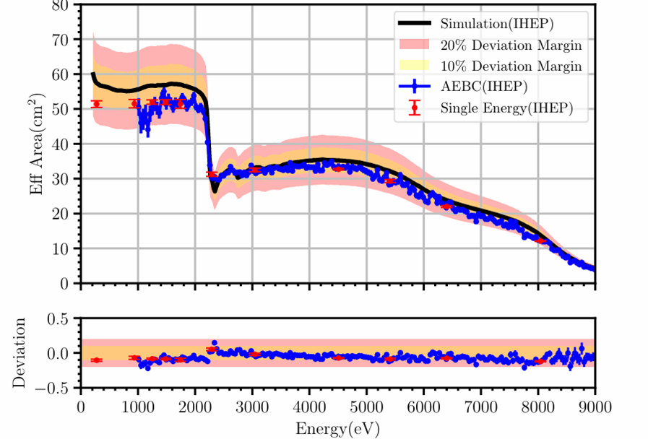
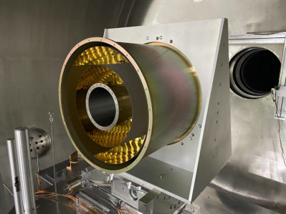
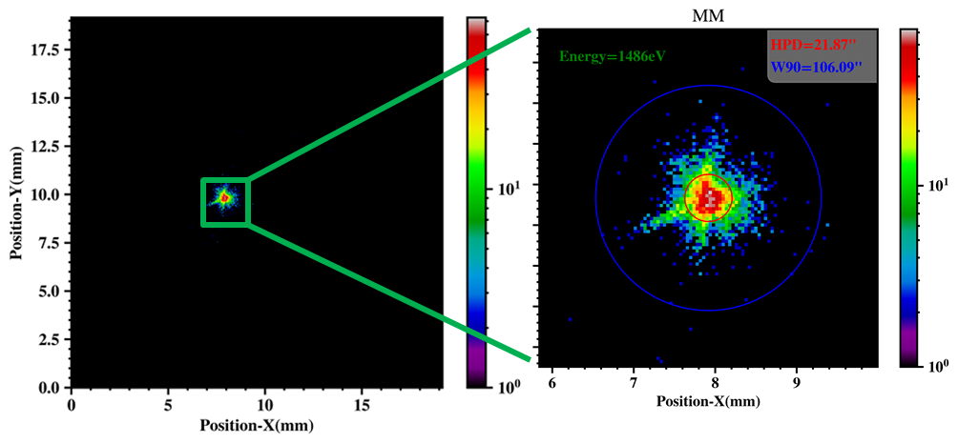
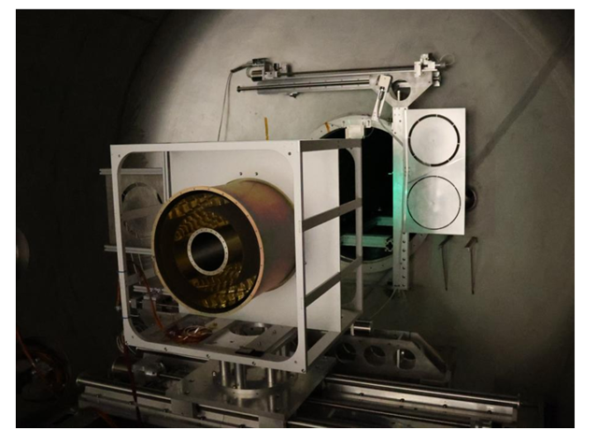
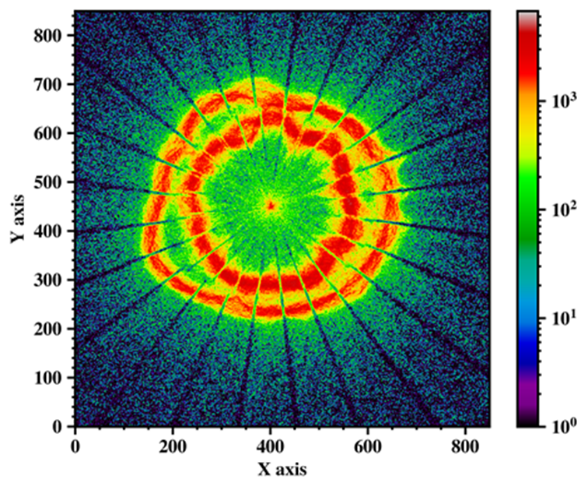
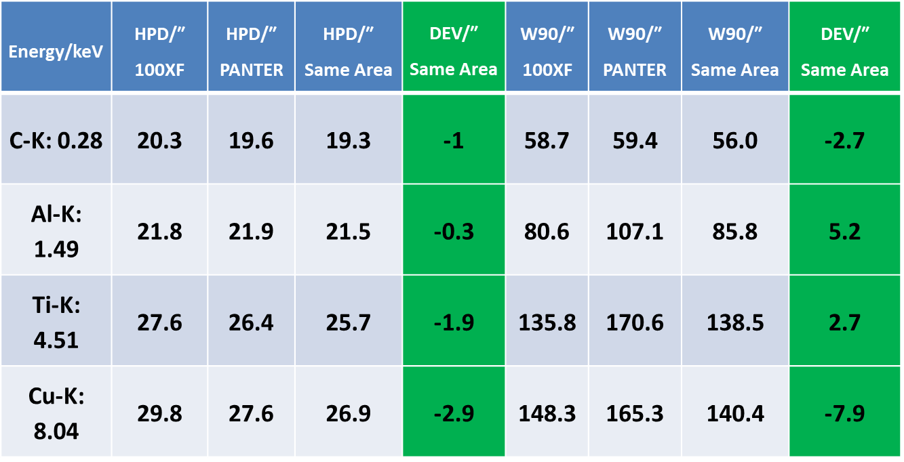
Preliminary cal. results
Mirror module#3 (MM3)had been cross-calibrated at both 100XF and PNATER
Calibration in IHEP, Beijing
2024.5
Calibration in PANTER, Munich
2024.8

Slide 19
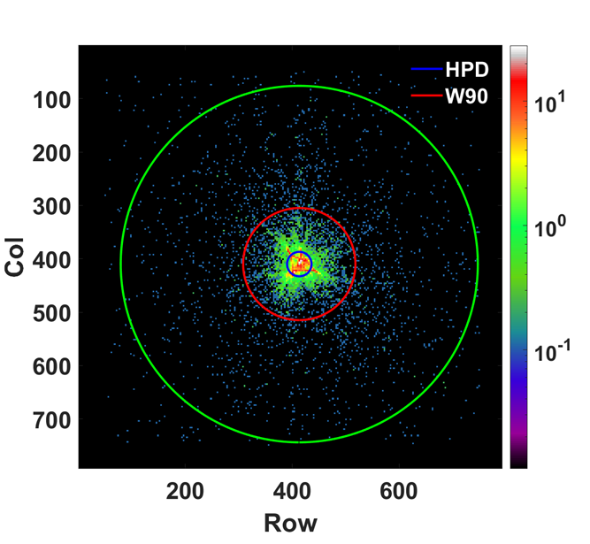
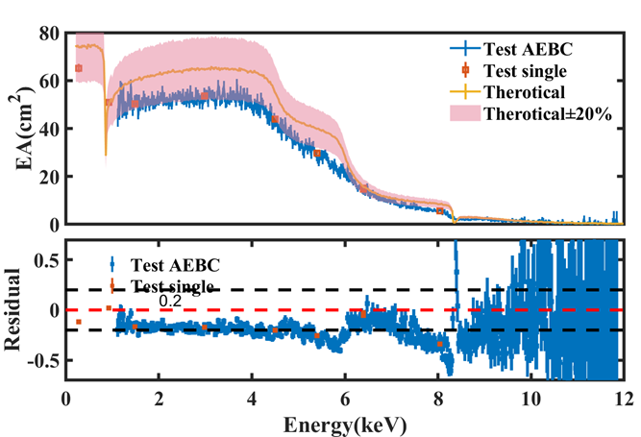
Preliminary cal. results
An Engineering module of PFA were also tested at 100XF
Calibration in IHEP, Beijing
2025.9
Energy/keV | HPD/″ | W90/″
0.28 | 26.34±0.45 | 113.01±1.62
0.93 | 27.17±0.33 | 119.51±1.22
1.49 | 27.36±0.34 | 125.51±1.32
2.98 | 28.78±0.32 | 150.24±1.40
4.50 | 33.01±0.38 | 178.41±1.73
5.40 | 40.38±0.56 | 205.26±2.39
6.40 | 43.40±0.69 | 197.93±2.64
8.04 | 41.22±0.67 | 155.07±2.11
A bit of worse than the MM3, but still meets the requirements of SFA-T

Slide 20
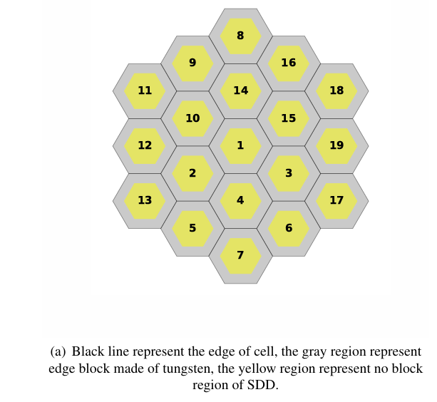

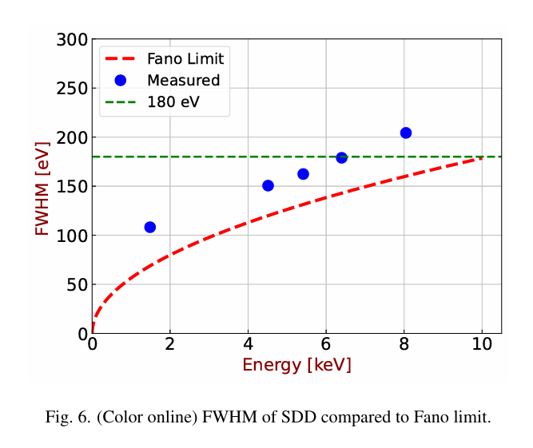
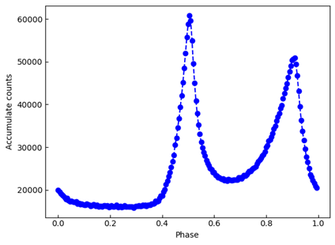
Preliminary cal. results
SDDs manufactured in IHEP is under calibration!
Even a chip with relative poor energy resolution was chosen, it still satisfies the energy resolution requirements of SFA-T
A capability of pulse profile observation
Time resolution remains to be verified!

Slide 21
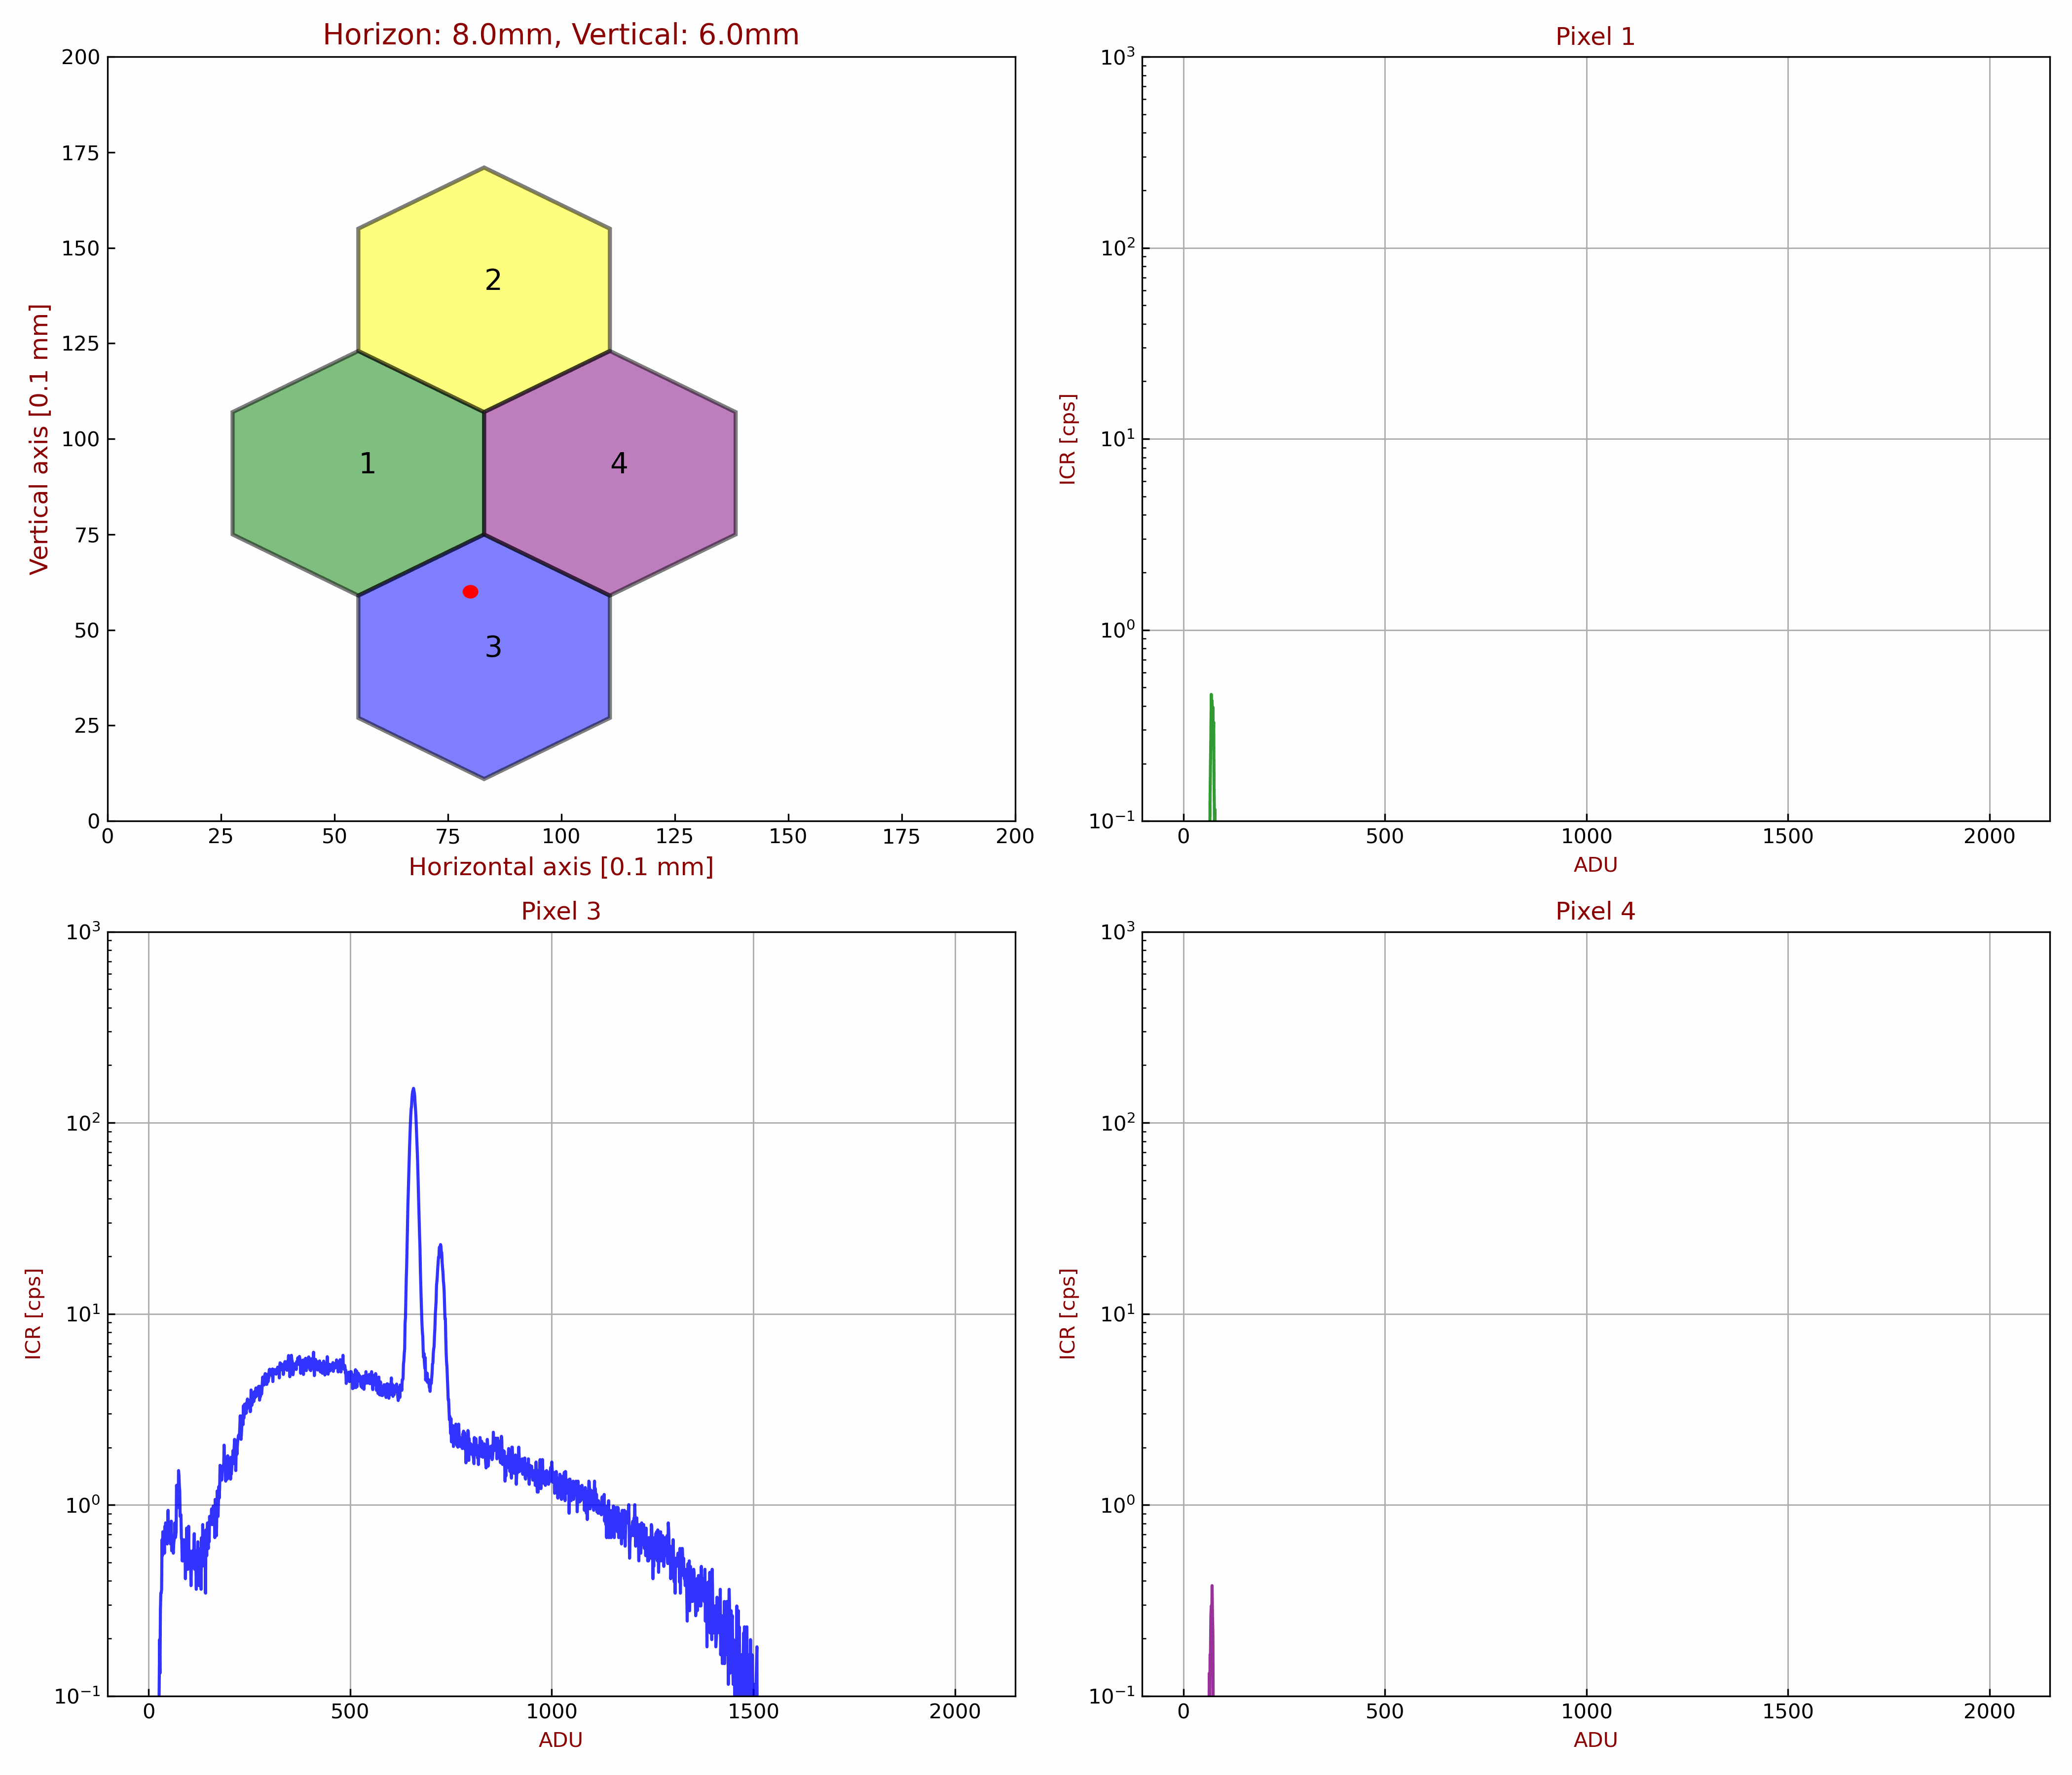
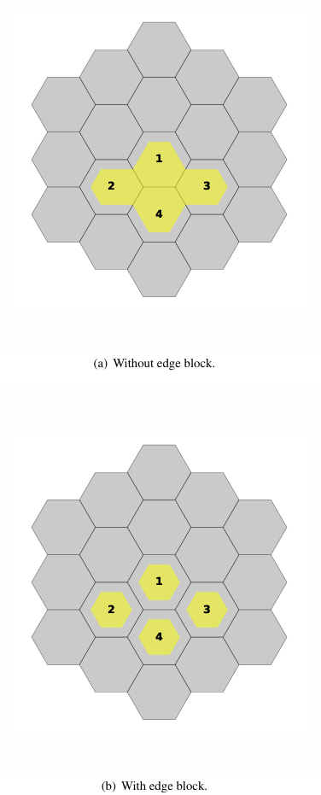
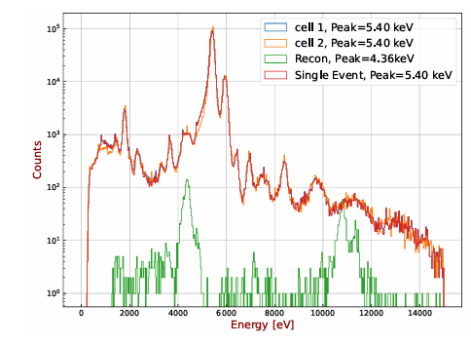
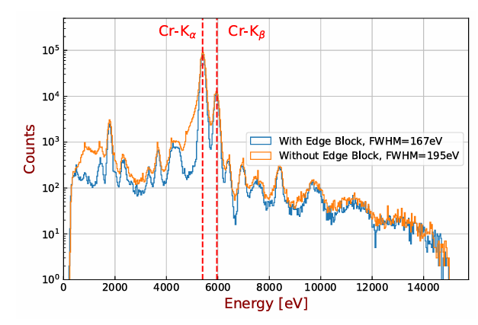
Preliminary cal. results
Pixel Edge Effect
When pixel edges are physically masked, the measured FWHM appears artificially improved (195 eV → 167 eV @ 5.9 keV);
Time-window-based event reconstruction fails for interactions near pixel edges;. There are some charge lost during the charge transfer!
A mask (edge block) will be installed above the SDDs chip.

Slide 22


Preliminary cal. results
Conservative Design (1 mm thickness wall)
PSF-convolved simulations show ≤3.5% eff. Area loss;
Optimized Solution (300 μm thickness wall)
Further analysis confirms 300 μm is sufficient to block invalid edge events;
Resulting effective area loss: only ~0.8% — statistically negligible for scientific performance.

Slide 23






Preliminary cal. results
The multi-cell SDD is being developed well in MPE!
150eV@6 keV

Slide 24
Outline
1
Configuration of eXTP and SFA-T
2
Development status of SFA -T
3
Preliminary calibration results
4
Ground calibration strategy for future
5
Summary

Slide 25
Ground calibration strategy for future
The calibration content is listed, huge calibration work, also test in the next 5 years.
Device | Items
Mirrors level | Effective area (E,φ)
 | PSF(E,φ)
 | FoV
Detector level | Edge effect
 | Energy threshold
 | QE(E)
 | Energy resolution, RMF(E)
 | Time resolution
 | Readout noise
Telescope level | ARF(Effe. Area of mirror, filter transmission, detector QE,etc)
 | Vignetting considering the edgeblock
High-volume calibration workload for 5 telescopes;
Beam divergence significantly biases mirror calibration (esp. eff. area);
Time constraints preclude fine-sector scans divergence correction.
Hybrid approach: Simulation model fits beam calibration data to extract physical parameters (mirror roughness, figure error);
Derived parameters feed into the CalDB, ensuring traceability and credibility.
Full telescope-level calibration cross-checks mirror + detector sub-system results, guaranteeing end-to-end data consistency.

Slide 26
Ground calibration strategy for future
End of 2026
March, 2027
Mid of 2027
2030
Cross calibration Maybe!
FM cal.(optics, detector, telescope) start
Adopt a "build-then-calibrate" pipeline: each FM telescope undergoes calibration immediately after integration;
Resource Estimate: 530 workdays for Calibration
QM cal.(optics, detector, telescope):
Facility & Equipment Qualification will be test
Calibration Strategy Validation & Iteration
Launch!

Slide 27
Outline
1
Configuration of eXTP and SFA-T
2
Development status of SFA -T
3
Preliminary calibration results
4
Ground calibration strategy for future
5
Summary

Slide 28
Summary
Experienced Team: Established a professional team with extensive development expertise from prior missions, including EP-FXT and HXMT.
Phase B Initiated: Officially entered Phase B; active QM development is underway for both cameras and optics.
Robust Calibration Facilities: Existing facilities (100XF, PNATER) fully meet requirements; other equipments are under development.
Comprehensive Test Schedule: Extensive testing and calibration campaigns will be conducted across 2026–2027, with an estimated total active duration of 2–3 months.
Clear Path to Flight Model: High confidence in successful QM completion, ensuring a seamless transition to final FM development.

Slide 29

Thank you!

