Slide 1
Ground Calibration across X-ray test facilities
Vadim Burwitz (MPE/PANTER) IACHEC #18 Pelham, Bavaria, Germany 21.04.2026
Vadim Burwitz (MPE)
Takashi Okajima (GSFC)
On behalf of the WG Members
21.04.2026
IACHEC #18, Pelham, Bavaria, Germany

Slide 2
Ground Facility Cross Calibration
Important for measurement and understanding of on- and off-axis:
PSF
Effective Area / Vignetting
Comparing measurements with simulations
Important to understand if optics perform as expected
Making predictions for parallel illumination in orbit
Needed to have a solid starting point for in orbit calibration
Vadim Burwitz (MPE/PANTER) IACHEC #18 Pelham, Bavaria, Germany 21.04.2026

Slide 3
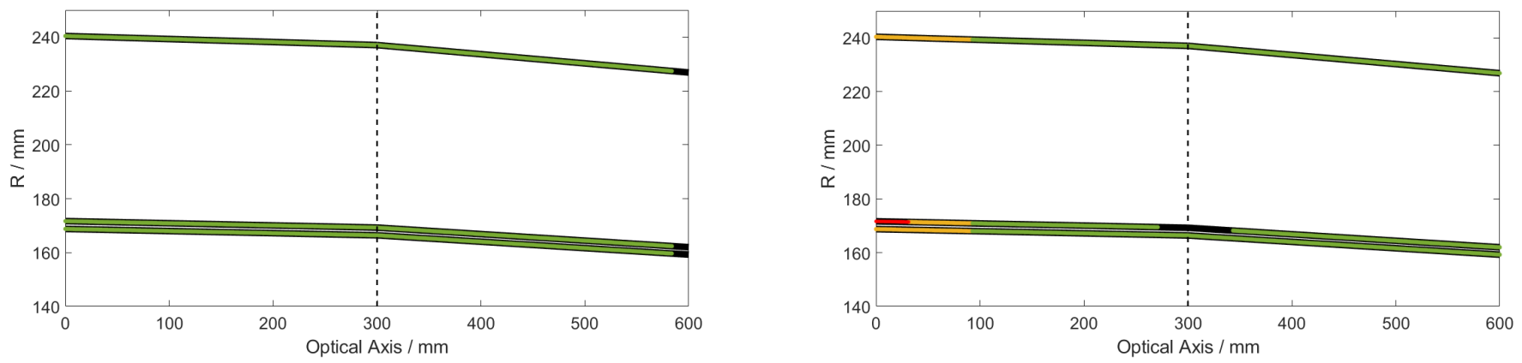
Illumination of Mirror Infinity vs. Finite Source Distance
Y. X. Zhu et al. 2025
eXTP MM3 prototype
Double reflections
Double reflections
Unilluminated
Unilluminated
Single reflections from primary
Double reflections intersect inner shell
Infinity
Finite
Vadim Burwitz (MPE/PANTER) IACHEC #18 Pelham, Bavaria, Germany 21.04.2026
primary
secondary
primary
secondary

Slide 4
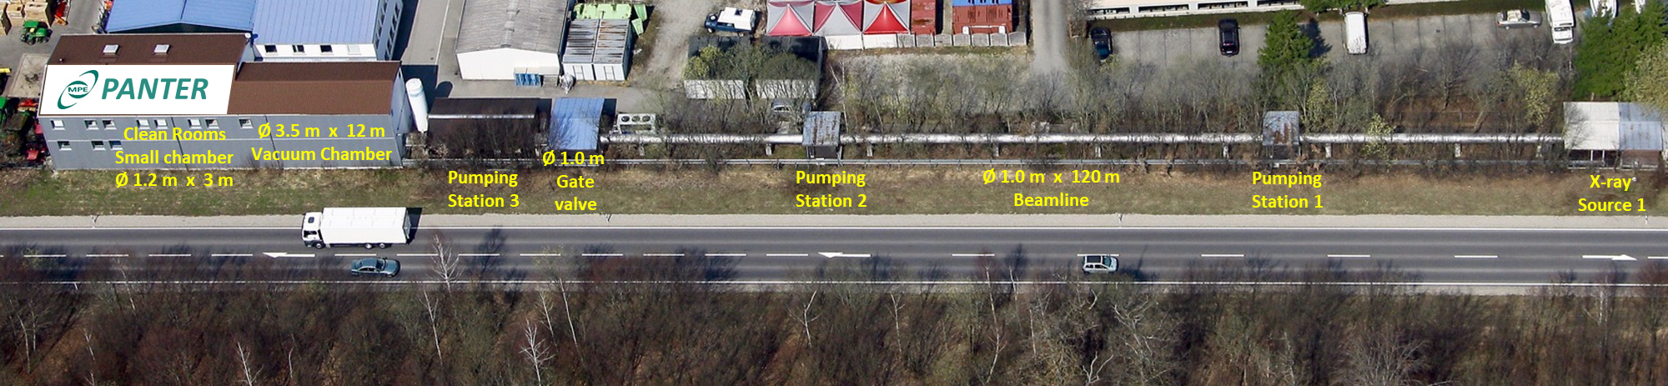
Overview of available X-ray Test Facilities
Japan
30m (ISAS) Pencil beam
China
XF100 (IHEP) Long beam
12-m (NAOC) Long Beam
Shanghai (Tonji) Pencil beam
USA
XRCF 518-m (MSFC) Long beam
100-m (MSFC) Long beam
100-m (GSFC) Long beam
47-m (PSU) Long beam
20-m Polarimetry (MIT) Long Beam
Europe
PANTER (MPE,DE) 130-m Long beam
LLBTF (Leicester, UK) 27.5-m Long beam
XACT (Palermo, IT) 35-m Long beam
IKI60 (IKI, RU) 60-m Long beam
BESSY (cosine, DE) Pencil beam
ALBA (cosine, SP) Pencil beam
BEaTriX (Merate, IT) 12-m Parallel beam
Vert-X (MLT, IT, design) 12-m Parallel beam
CSL (Liege, B) XMM Vertical EUV facility
Vadim Burwitz (MPE/PANTER) IACHEC #18 Pelham, Bavaria, Germany 21.04.2026

Slide 5
X-ray Ground Calibration Facilities
Can support
Development
Testing (Environmental)
Calibration
of X-ray
Optics
Detectors
Telescopes (optic + detector)
Vadim Burwitz (MPE/PANTER) IACHEC #18 Pelham, Bavaria, Germany 21.04.2026

Slide 6
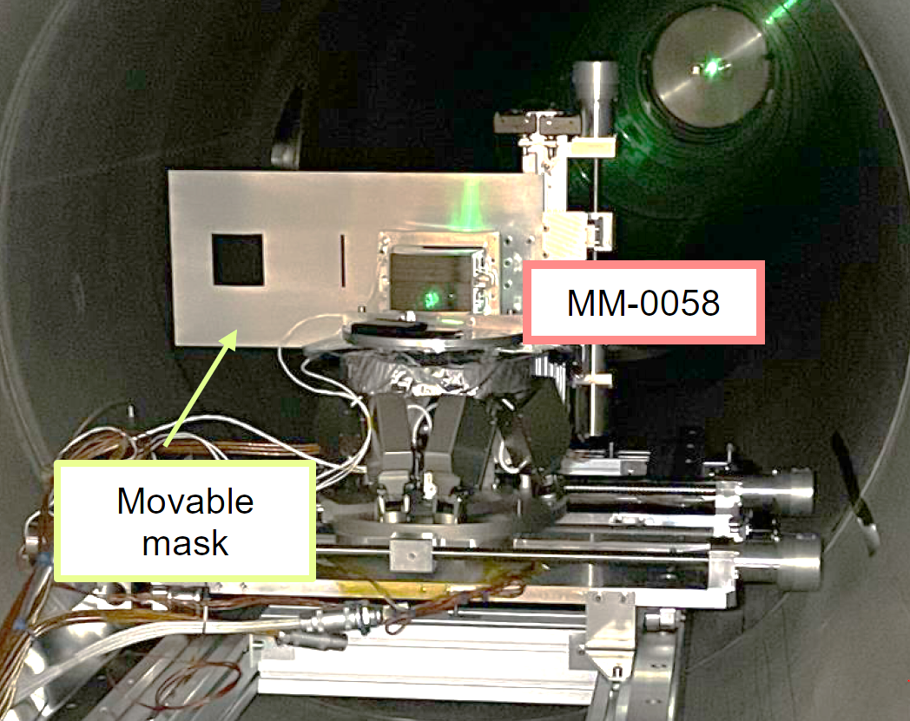
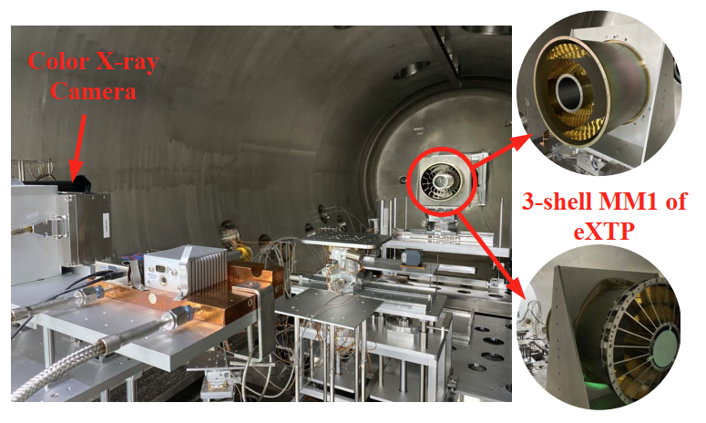
Current Ground Facility Cross Calibration I
NewATHENA
BESSY – ALBA – BEaTriX – PANTER
MM-0037 → mandrel-based optic (f = 12 m)
MM-0058 → first flight like Silicon Pore Optic (f=12m)
New coated Mandrel optic being prepared
New SPOs being prepared
XRCF – PANTER
MM-0036 → Silicon pore optic (f = 12 m, R=737 mm)
eXTP
XF100 – PANTER
MM3 prototype → 3 mirror shell eXTP prototype nickel optic
Optics development progressing, New tests upcoming
Vadim Burwitz (MPE/PANTER) IACHEC #18 Pelham, Bavaria, Germany 21.04.2026
XF100 IHEP

Slide 7
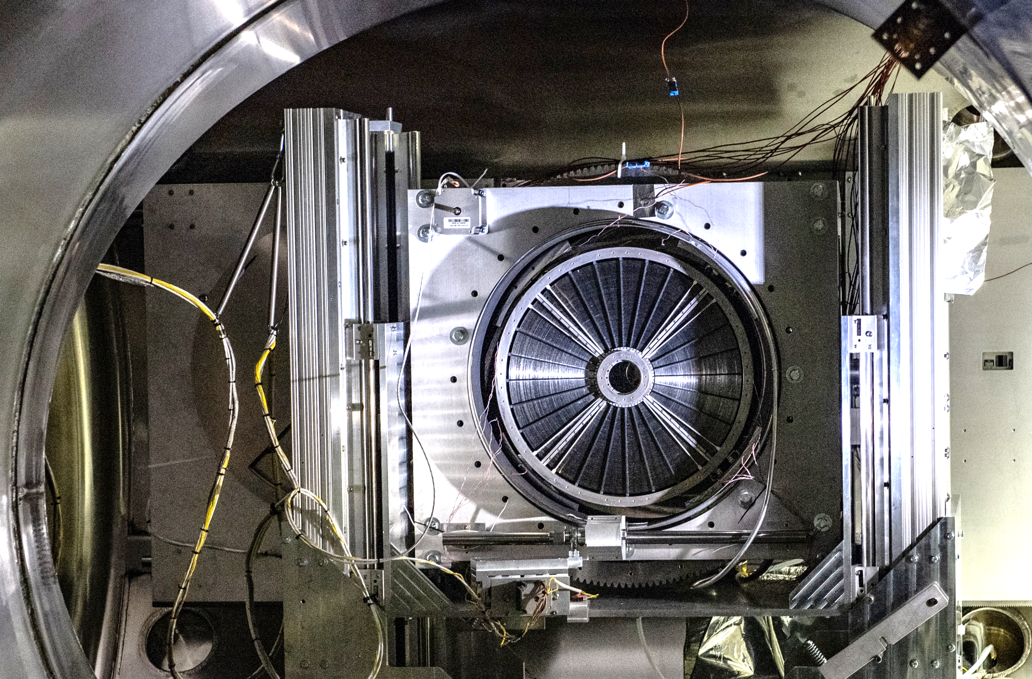
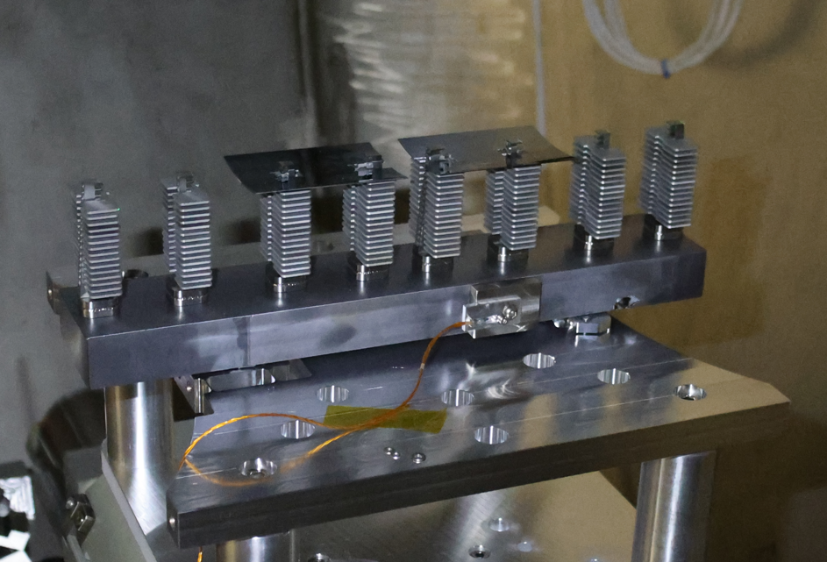
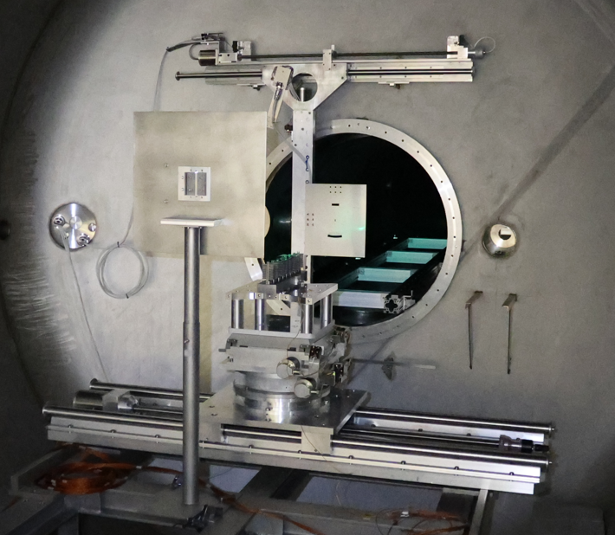
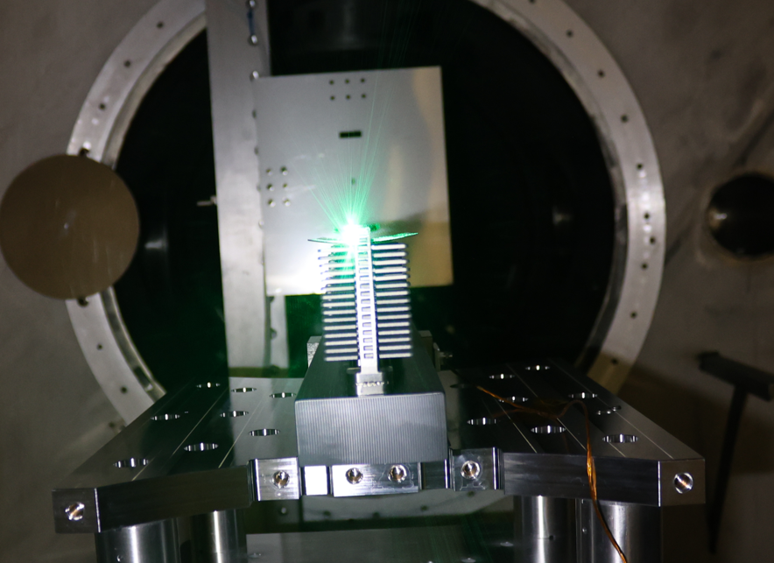
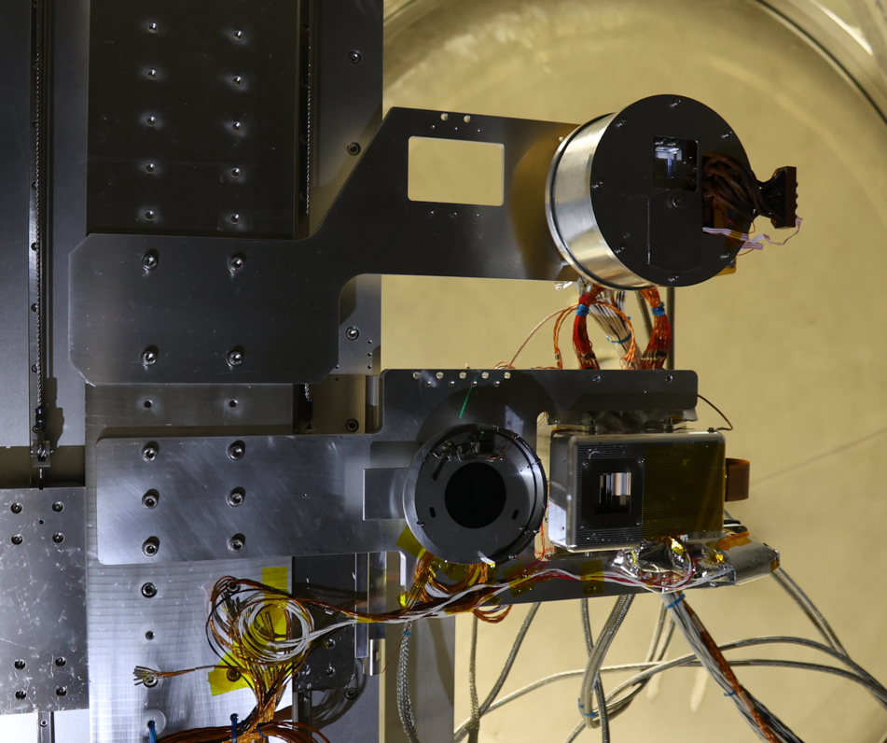
Current Ground Facility Cross Calibration II
100-m GSFC
XRISM
ISAS 30-m – 100-m GSFC
Mirror Module/s → Resolve And Xtend mirrors
AXIS / NGXO
100-m GSFC – PANTER (including environmental tests)
Mirror module tests ongoing at PANTER as we speak
PANTER
Vadim Burwitz (MPE/PANTER) IACHEC #18 Pelham, Bavaria, Germany 21.04.2026

Slide 8
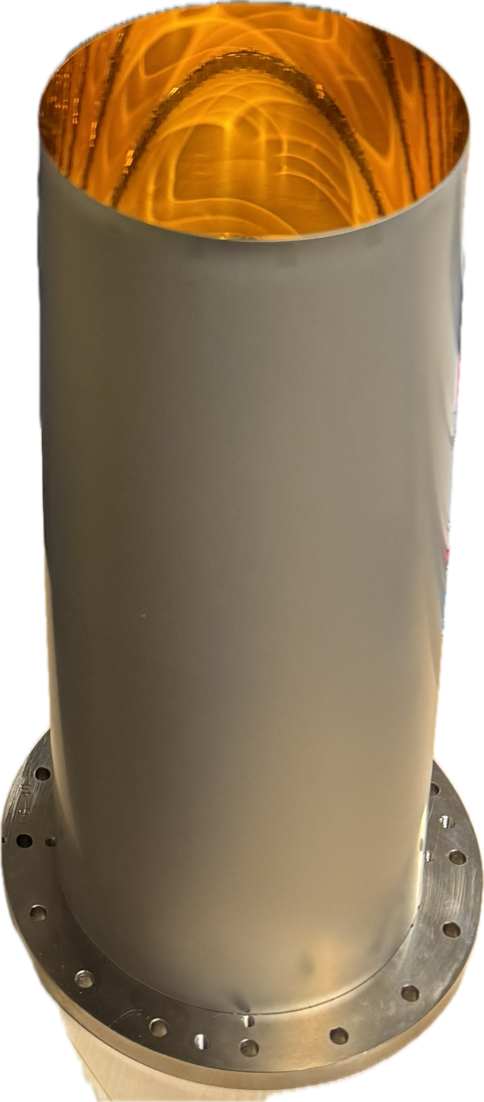
Current Ground Facility Cross Calibration II
Reference Optics for Cross calibration
eROSITA type electroformed mirror shell
Marshall type electroformed mirror shell
What is need for cross calibration tests
Compact (dimensions / mass) → Easy to transport
No export control issues!!
Detailed model
Geometry
Coating
Deformation under gravity
Vadim Burwitz (MPE/PANTER) IACHEC #18 Pelham, Bavaria, Germany 21.04.2026
Shell identified
for these tests
Available at PANTER

Slide 9
X-ray Ground Calibration: Simulation
Raytracing simulations for
Mirrors
Including shape errors
Surface roughness
Coating recipes
Raytracing packages
comparison using a reference model
Vadim Burwitz (MPE/PANTER) IACHEC #18 Pelham, Bavaria, Germany 21.04.2026

Slide 10
X-ray Ground Calibration: Data Analysis
Analysis Tools
Most critically PSF HEW determination for high spatial resolution PSFs
Generic PSFs need to be generated → distributed to different teams for analysis and later comparison
Effective area should also be verified
Vadim Burwitz (MPE/PANTER) IACHEC #18 Pelham, Bavaria, Germany 21.04.2026

Slide 11
Summary
The goals of the new “Ground Calibration Working Group”
X-ray test facilities – cross-calibration using a reference optic
Ray-Tracing packages – cross-check with a reference optic model
Analysis methods – verify using master data set
New Missions – guidance for ground calibration plans
Reasoning
Get the calibration starting point right → accurate prediction of in-orbit performance
Independent verification of the ground measurements
If needed, spread the calibration load between facilities.
Vadim Burwitz (MPE/PANTER) IACHEC #18 Pelham, Bavaria, Germany 21.04.2026

