Slide 1
WG group Isolated Neutron Stars and White Dwarfs
Vadim Burwitz (MPE/PANTER) IACHEC #18 Pelham, Bavaria, Germany 23.04.2026
Vadim Burwitz (MPE)
On behalf of the WG Members
23.04.2026
IACHEC #18, Pelham, Bavaria, Germany

Slide 2
Isolated Neutron Stars and White Dwarfs
RX J1856 Cross calibration work continuing (Surodeep Sheth)
Chandra LETG
XMM pn / RGS
eROSITA
AstroSat
Nicer
XMM MOS
XRISM
Vadim Burwitz (MPE/PANTER) IACHEC #18 Pelham, Bavaria, Germany 23.04.2026

Slide 3
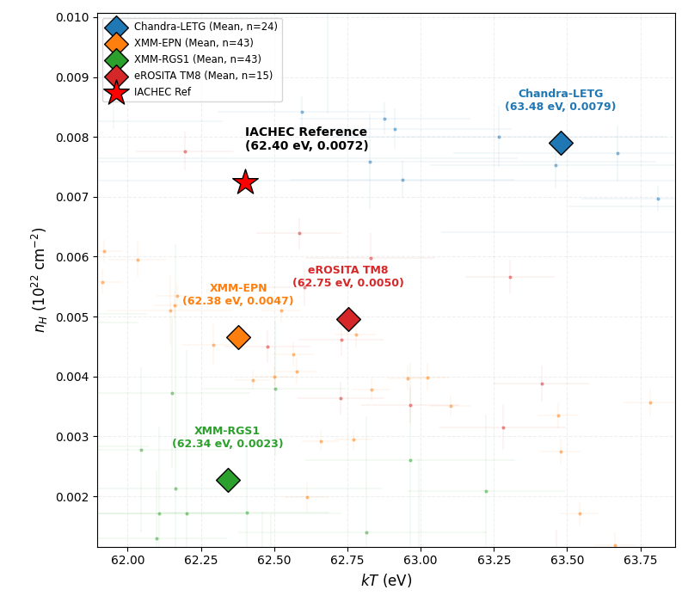
nH & kT scatter
vs IACHEC standard model
Telescope | n_obs | kT Mean (eV) | nH Mean
Chandra- LETG | 24 | 63.48± 2.54 | 0.0079 ± 0.0024
XMM-EPN | 43 | 62.38 ± 1.06 | 0.0047 ± 0.0022
XMM-RGS1 | 43 | 62.34 ± 0.82 | 0.0023 ± 0.0030
eROSITA TM8 | 15 | 62.75 ± 0.77 | 0.0050 ± 0.0026
IACHEC Reference |  | 62.40 ± 0.38 | 0.0072 ± 0.34
Surodeep Sheth
IACHEC Meeting, 19-23 April 2026
‹#›

