Slide 1


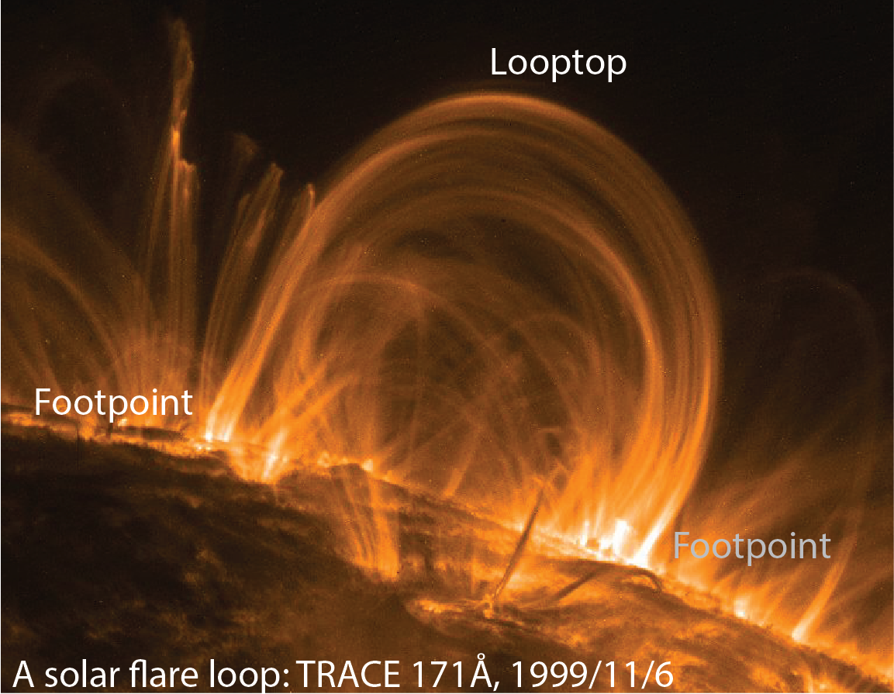
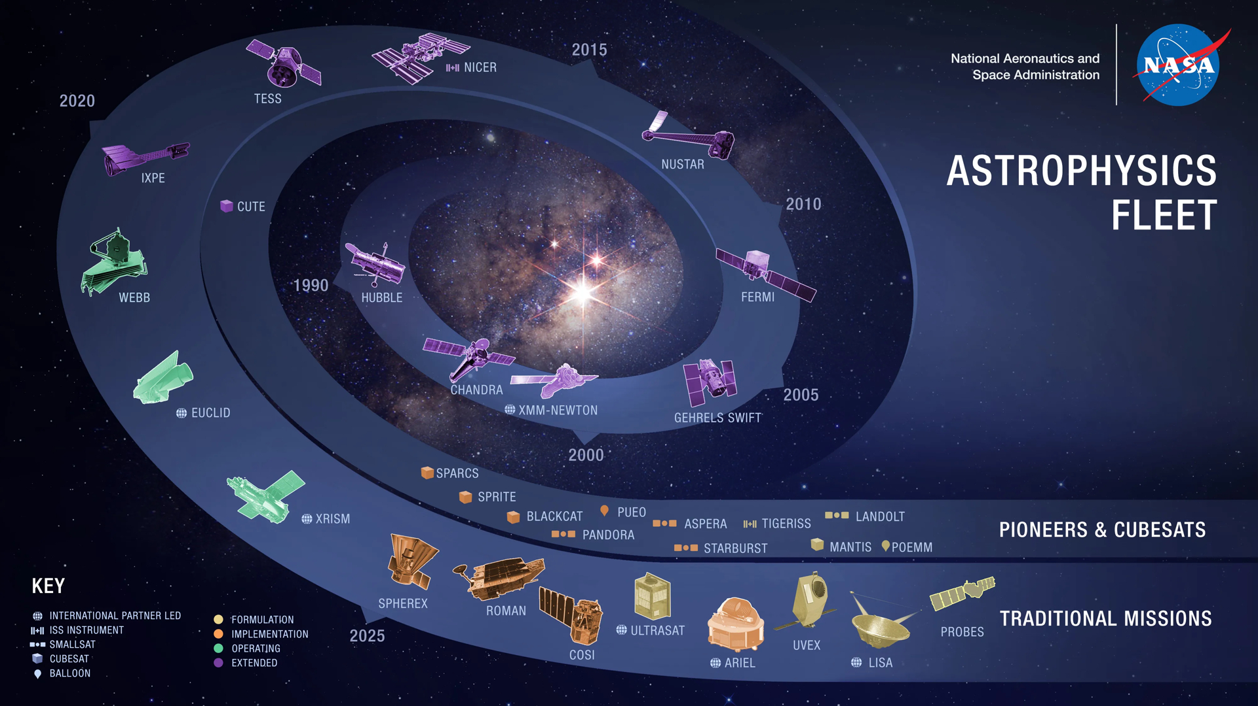

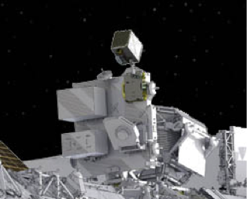
The Development of the NICER ToO Web Reporting System
Kenji Hamaguchi (NASA/GSFC & UMBC)
on behalf of the NICER operations team
Keith Gendreau, Zaven Arzoumanian, Elizabeth Ferrara

Slide 2
NICER had Flexibility in Scheduling
Excellent maneuvering capability
A snapshot exposure as short as ~100 seconds
All-time network connection to the ISS
Update the observation plan anytime if a planner and an operator are available
The NICER app can directly insert a snapshot, overriding the running plan.
The app available to limited members
NICER responded to ToO requests quickly, sometimes in an hour.

Slide 3
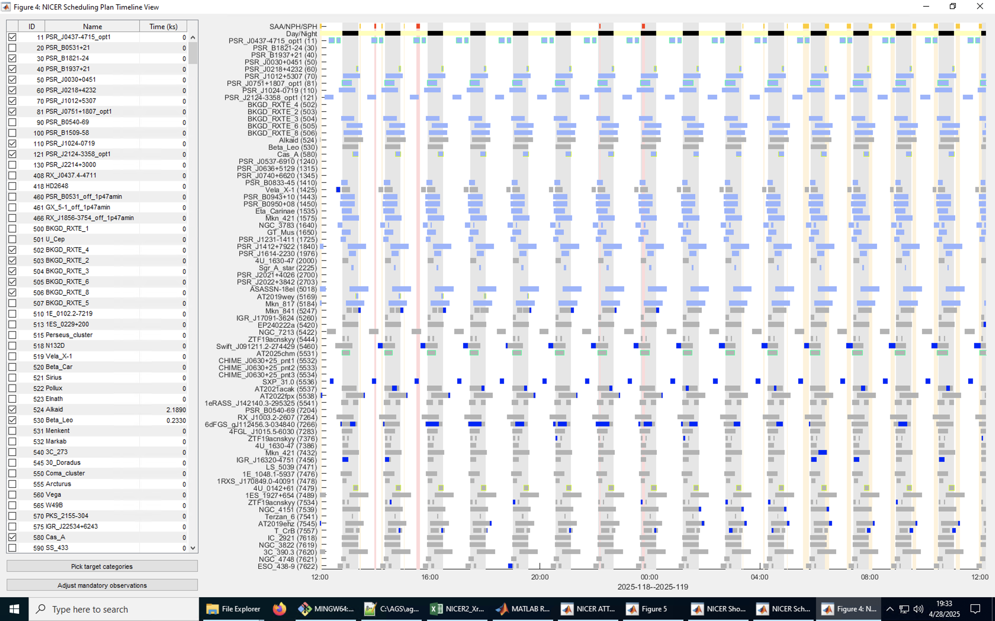
NICER Observation Planning Tool
Polar Horn
Target
night
day
SAA
….
MATLAB-based tool, running on Windows
The tool calculates
target visibilities
maneuver time
using ISS ephemeris and structure info.
Planner produces
a snapshot sequence for ~10 days
mainly using GUI
Visible
windows
Planned
snapshots

Slide 4
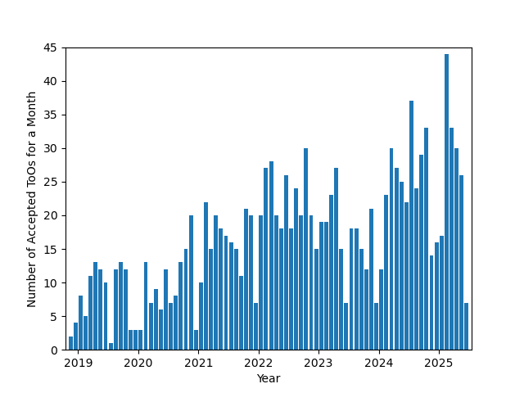
NICER Target of Opportunity (ToO)
on a
Policy: any non-reserved ToO requests are
accepted if they have an available observing window
conducted on a best-effort basis
NICER has accepted many ToO requests.
NICER performed 1333 ToO observations between 2018-2025

Slide 5
NICER ToO Request Summary Webpage
Requesters need to know their ToO disposition and status.
The team occasionally emails them for detailed planning.
But not all, as the team’s human resources are limited.
Setting a NICER ToO request summary webpage
Requesters find the request status through this page.
We initially tried to copy the system from Fermi.
https://fermi.gsfc.nasa.gov/ssc/observations/timeline/too/index.html
But the programmer didn’t recommend it as it’s customized for Fermi.
It is written in Perl.
We made our own system coded in Python 3.

Slide 6
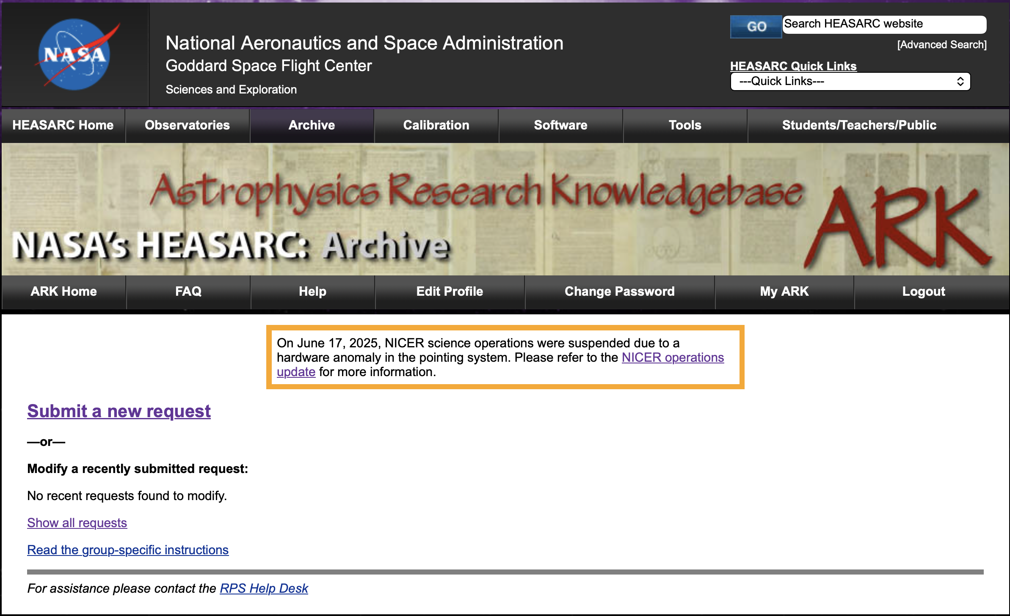
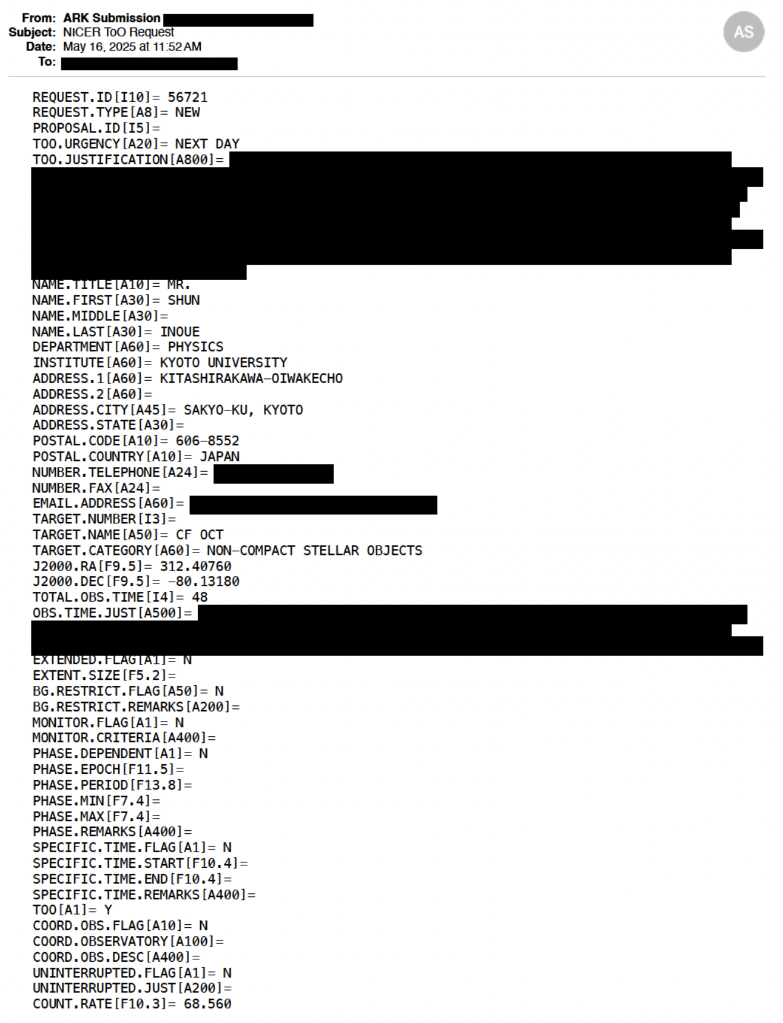
ToO Requests Are Received via E-mail
Requests are sent via ARK/RPS
Team receives it via email.

Slide 7
Requester
Linux (Mail) Linux (web) @ GSFC/ASD
www
4. too_html.py
extracts items for the webpage.
1. Procmail saves
emails on a disk in the mbox format.
3. too_request_
ingest.py stores ToO request info.
ARK/RPS
ToO
email
.nicertoo_
request.txt
Request_ID
31187 31191
…..
5. Input the decision w/ too_update*.py
1 min
2. chk_procmail.py
checks emails.
Operations
Team
Database
The “info” class in too.py controls I/O.
`nicerweb’ common account on the Linux cluster

Slide 8
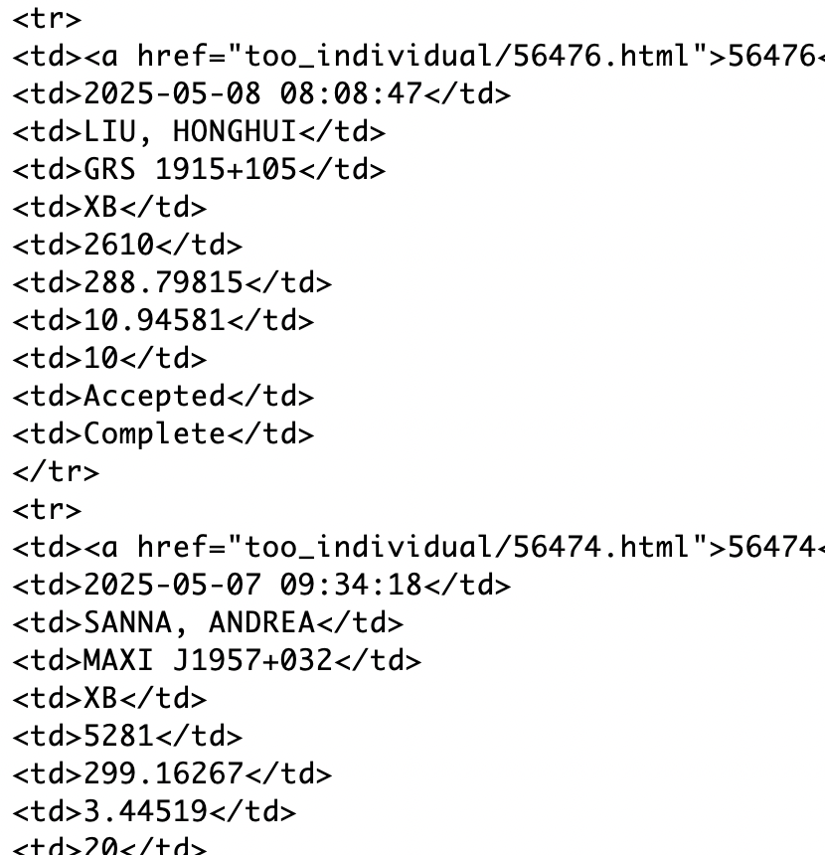
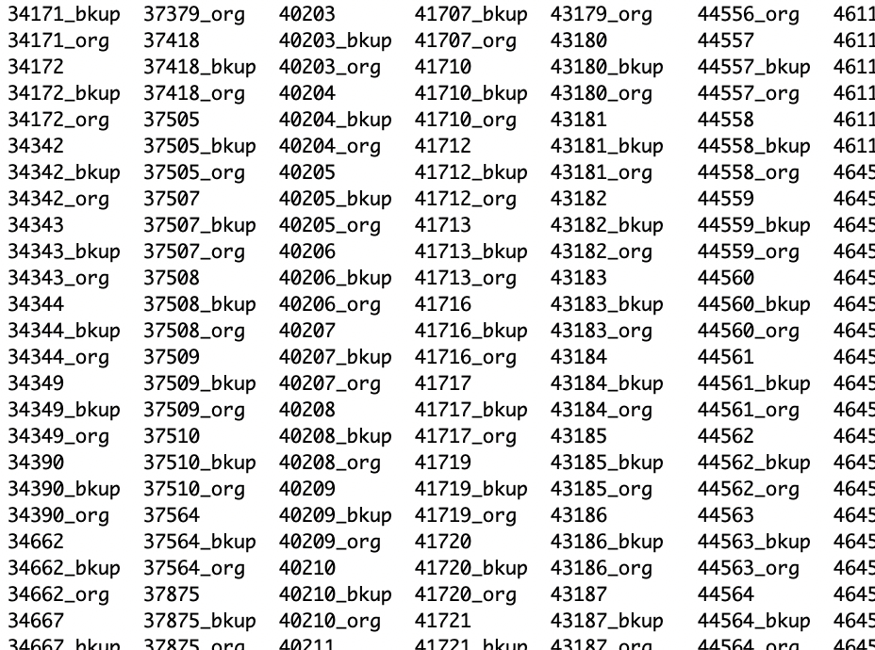
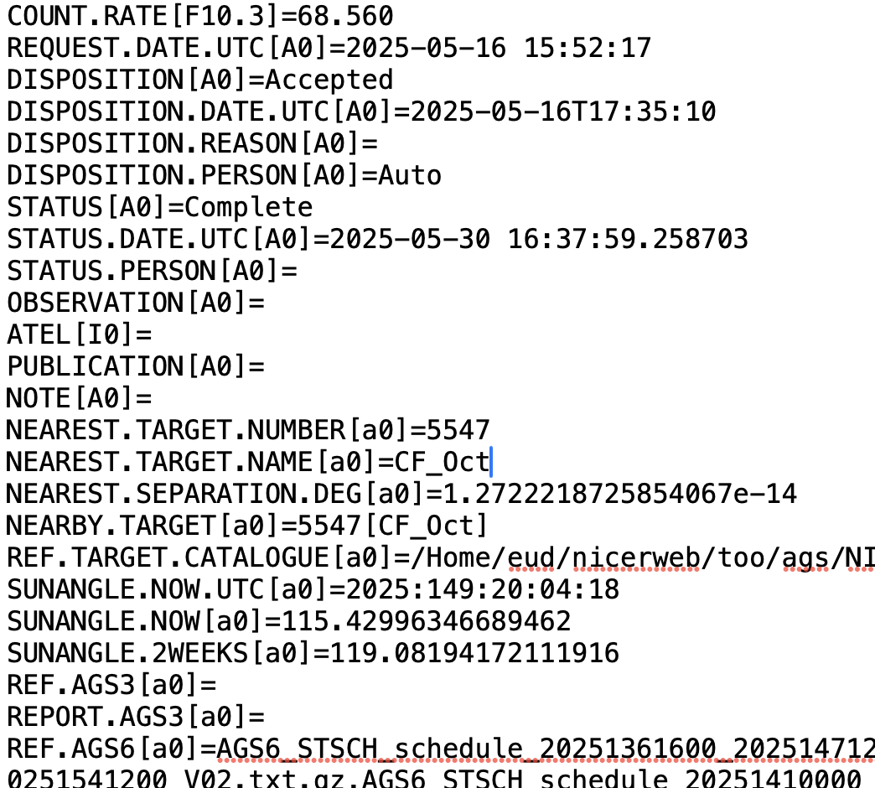
Organize Each Request
Extract the info into a table for jQuery tablesorter
Save each in a single file.
Remove the email header and add control Items.
Pros: easy to handle data manually.
Cons: longer computation time to open each file and extract information.

Slide 9
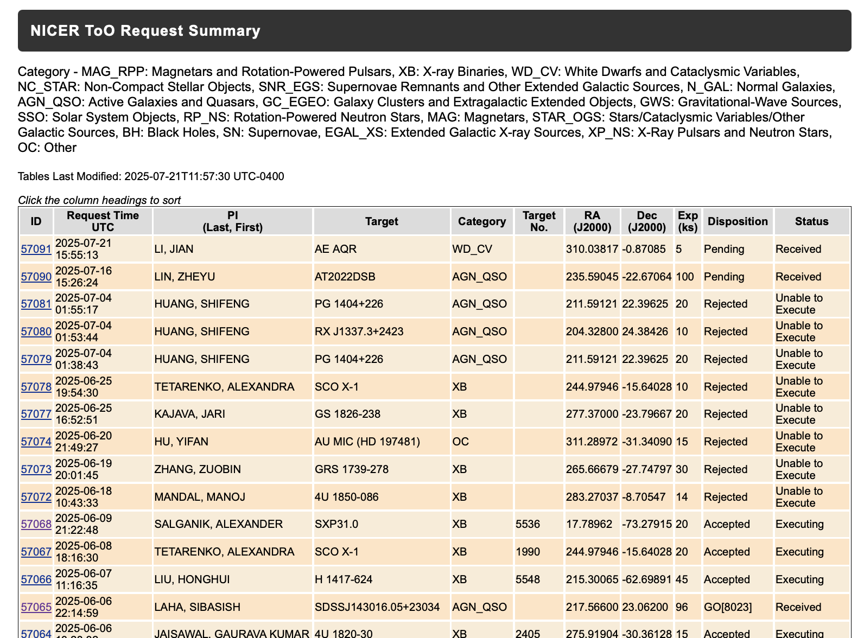
NICER ToO Request Summary Webpage
The operations team updates the decision, the status, and the target #.
Summary webpage.
https://heasarc.gsfc.nasa.gov/docs/nicer/schedule/nicer_too_request.html
Each target has a link to its detailed information page.
No personal information on the public page.

Slide 10
Requester
Linux (Mail) Linux (web) @ GSFC/ASD
www
4. too_html.py
extracts items for the webpage.
1. Procmail saves
emails on a disk in the mbox format.
3. too_request_
ingest.py stores ToO request info.
ARK/RPS
ToO
email
.nicertoo_
request.txt
Request_ID
31187 31191
…..
5. Input the decision w/ too_update*.py
1 min
2. chk_procmail.py
checks emails.
Operations
Team
Database
The “info” class in too.py controls I/O.
`nicerweb’ common Linux account

Slide 11
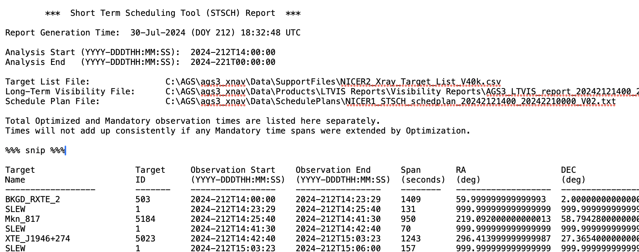
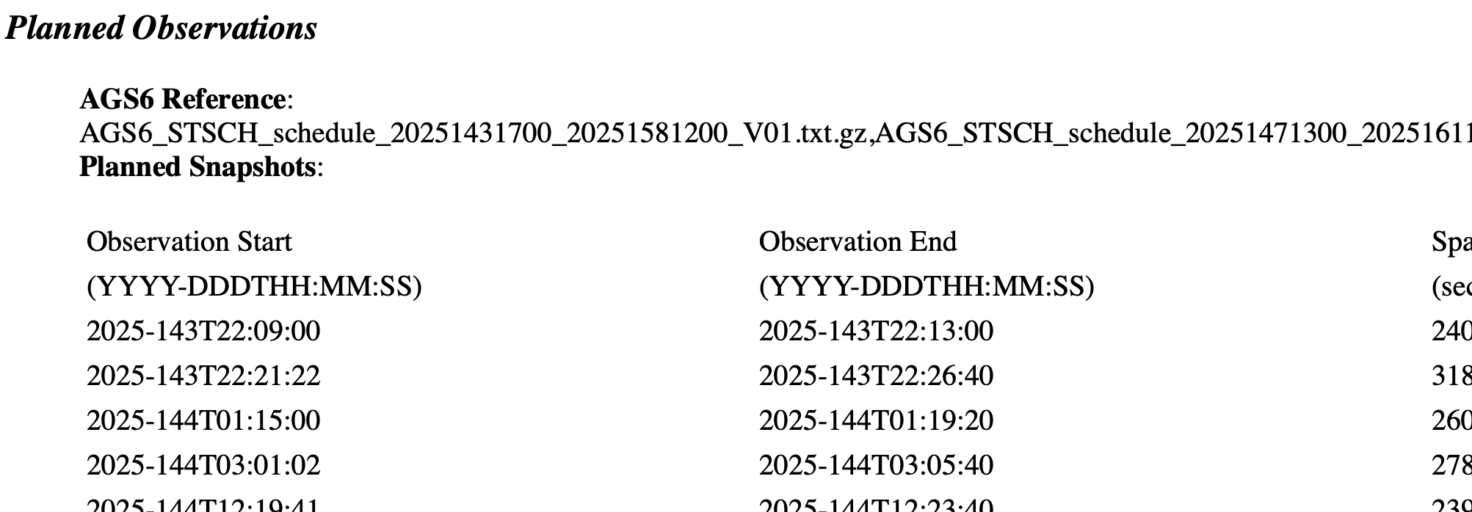
Extension 1 : Filling in Observation Information
Put more detailed observation information.
Nicerweb also receives planning information (visibility, snapshot sequences).
Collect observation information of each target.
List it in the detailed ToO information page.

Slide 12
Requester
Linux (Mail) Linux (web) @ GSFC/ASD
www
4. too_html.py
extracts items for the webpage.
1. Procmail saves
emails on a disk in the mbox format.
3. too_request_
ingest.py stores ToO request info.
ARK/RPS
ToO
email
.nicertoo_
request.txt
Request_ID
31187 31191
…..
5. Input the decision w/ too_update*.py
1 min
2. chk_procmail.py
checks emails.
3b’. obsplan.py
& visibility.py fill scheduling info of each requested target.
.nicer-sciplan_
target_plan.txt
Schedule
email
Target list
Visibility
Schedule
Operations
Team
3a’. sciplan_ags_
attach_save.py
stores scheduling
Updates.
scheduling system
Database
The “info” class in too.py controls I/O.
Scheduler
`nicerweb’ common Linux account

Slide 13
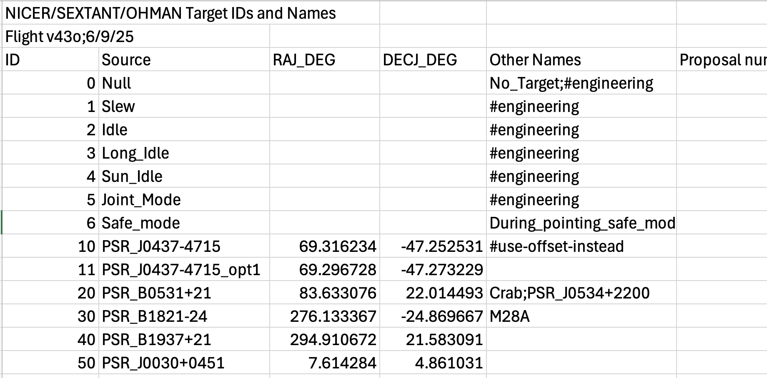
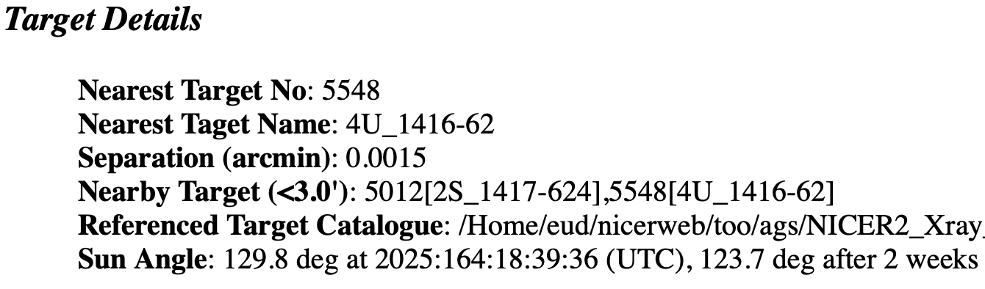
Extension 2 : Finding the Target Number of the Requested Target
Team maintains the target list
Initial PV targets.
Discretionary ToO targets (5000~)
GO targets (6001~)
Finding the corresponding target # isn’t easy.
~1200 non-GO targets in the list.
Requester may use an uncommon target name.
A function using astropy picks up targets within 3’ from the requested coordinates.

Slide 14
Extension 3 : Auto Disposition/Status Updates
Planners tend to be satisfied with scheduling ToO observations, failing to update the ToO summary webpage!
The requested target in the new plan = the request is accepted.
The tool automatically updates the status based on the new plan.
This function is turned off for reserved (GO) ToOs, as a GO target has a unique target number, and there can be multiple GO programs that observe the same target.
A planner still needs to change the status manually after the program completes.

Slide 15
Requester
Linux (Mail) Linux (web) @ GSFC/ASD
www
4. too_html.py
extracts items for the webpage.
1. Procmail saves
emails on a disk in the mbox format.
3. too_request_
ingest.py stores ToO request info.
ARK/RPS
ToO
email
.nicertoo_
request.txt
Request_ID
31187 31191
…..
5. Input the decision w/ too_update*.py
1 min
2. chk_procmail.py
checks emails.
3b’. obsplan.py
& visibility.py fill scheduling info of each requested target.
.nicer-sciplan_
target_plan.txt
Schedule
email
Target list
Visibility
Schedule
Operations
Team
3a’. sciplan_ags_
attach_save.py
stores scheduling
Updates.
scheduling system
Database
The “info” class in too.py controls I/O.
Scheduler
`nicerweb’ common Linux account

Slide 16
Backup

Slide 17
Python Tool Package
The I/O is controlled by the Python class, info, in too.py

