Slide 1
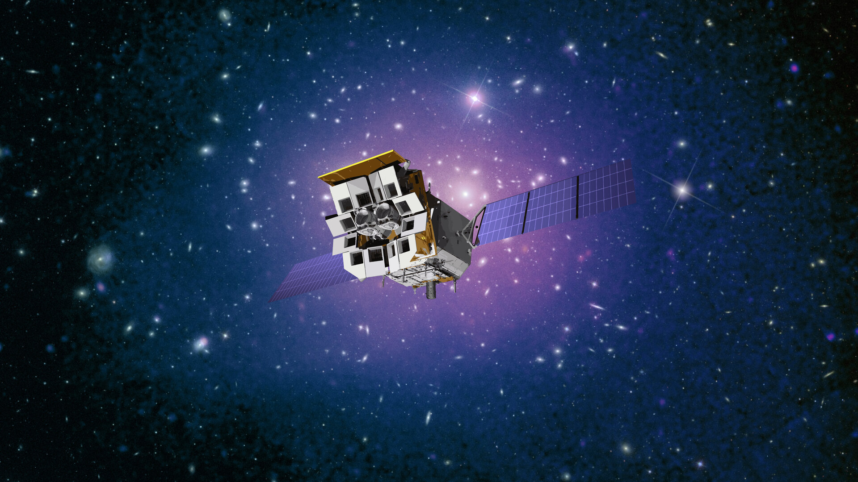



Einstein Probe mission status
Dr Zhixing Ling (WXT Instrument Scientist)
National Astro. Observatories, CAS
on behalf of the Einstein Probe consortium
2026-04-20 18th IACHEC meeting @Pelham
Image credit CAS/ESA

Slide 2

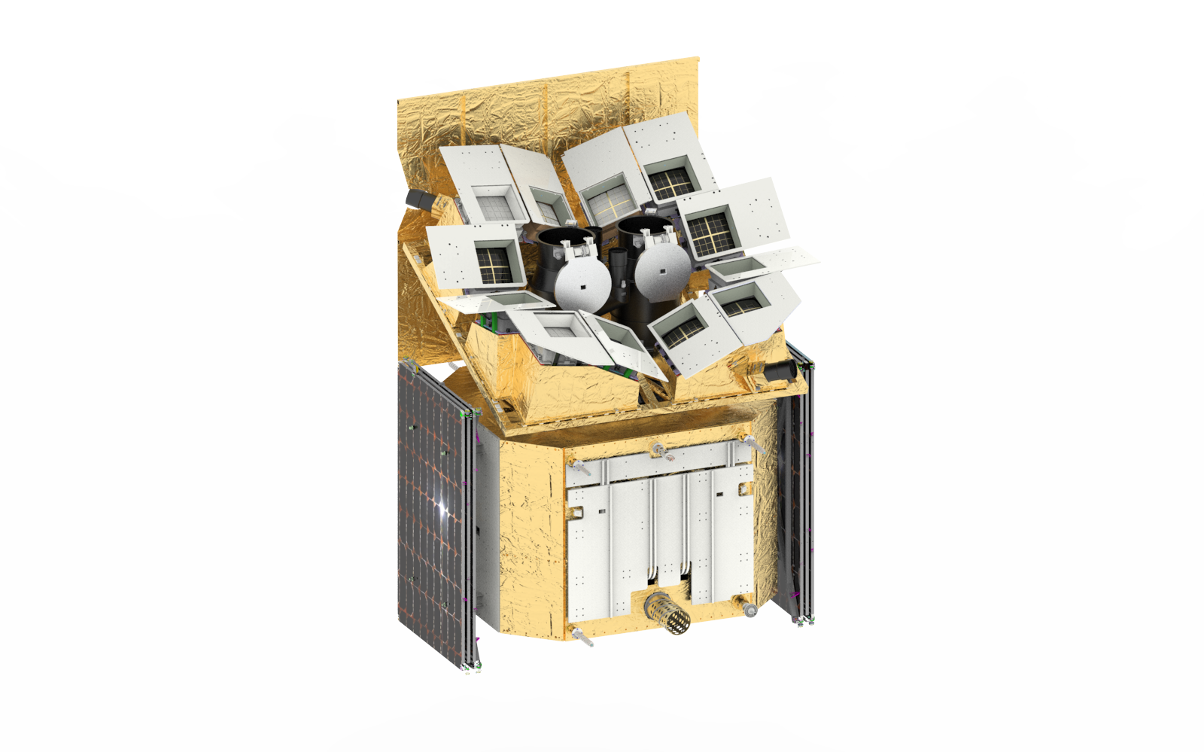

Instruments & spacecraft
Wide-field X-ray Telescope
WXT (12 modules)
Proposed in 2012
36 Lobster-eye MPO + 4 CMOS
FoV: ~3,600 sq deg (1.1 sr)
Band: 0.5 – 4 keV
Resolution: ~ 5’ (FWHM)
Sensitivity: ~1 mCrab @1ks
PI：Weimin Yuan
Spacecraft
On-board data processing
Quick slew & autonomous follow-up (15°/min)
Follow-up X-ray Telescope
FXT (2 units)
Wolter-1 + pn-CCD (eROSITA)
FoV: ~1 deg
Band: 0.3 -10keV
Resolution: 24” (HPD, on-axis)
Effe. area: ~300 cm² @1keV (x 2 units)
Telemetry
X/S-band (several hours)
B (down/up-link; minutes)
VHF (down-link; minutes)
2012
2017.12
2019.12
2024.01
2024.7
Mission Proposed
Mission Approved
Phase C
Launch
Cycle 1

Slide 3
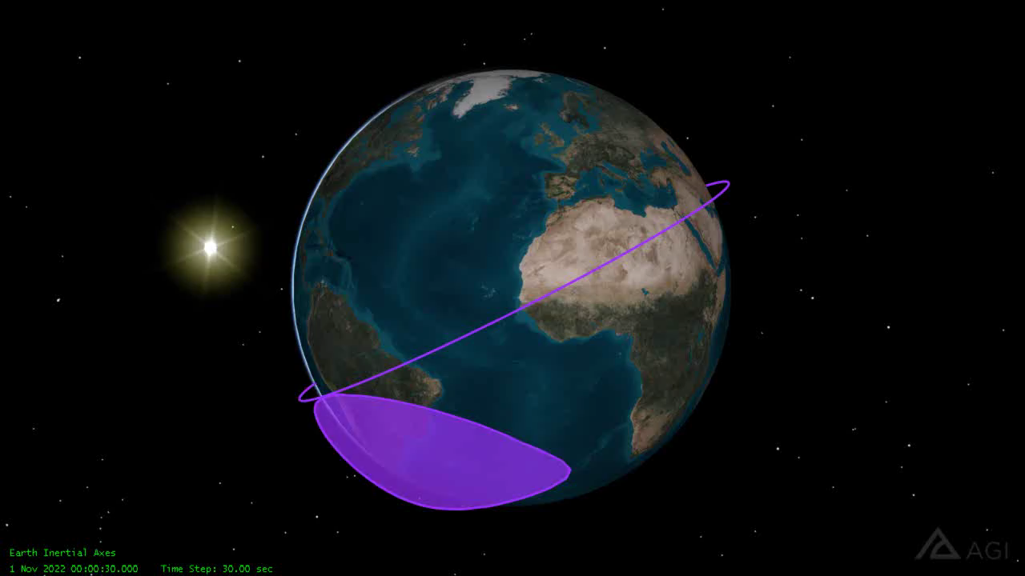

Observation modes
Observation modes
  Survey (primary WXT)
  Autonomous follow-up (FXT)
  ToO (FXT, WXT) – quick response
WXT survey mode
  Pointing to night sky
  3 pointings/orbit, ~20min each
  ~ 1/2 sky covered in 3 orbits (~ 5 hr)
  Whole sky coverage in ½ year
  FXT pointed to pre-selected targets
Equatorial coordinates
Notes:
~ 45 snapshots per day
FXT survey target observation (FSTO)

Slide 4

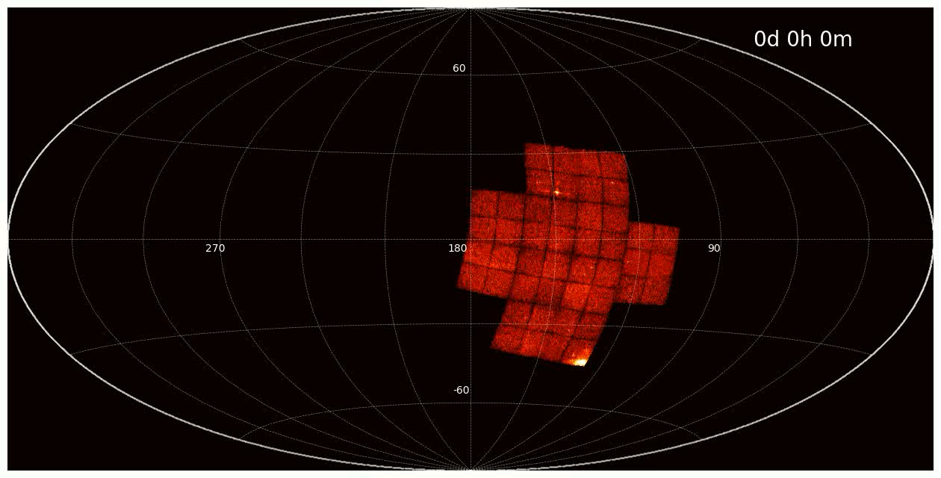
One day’s coverage of WXT

Slide 5
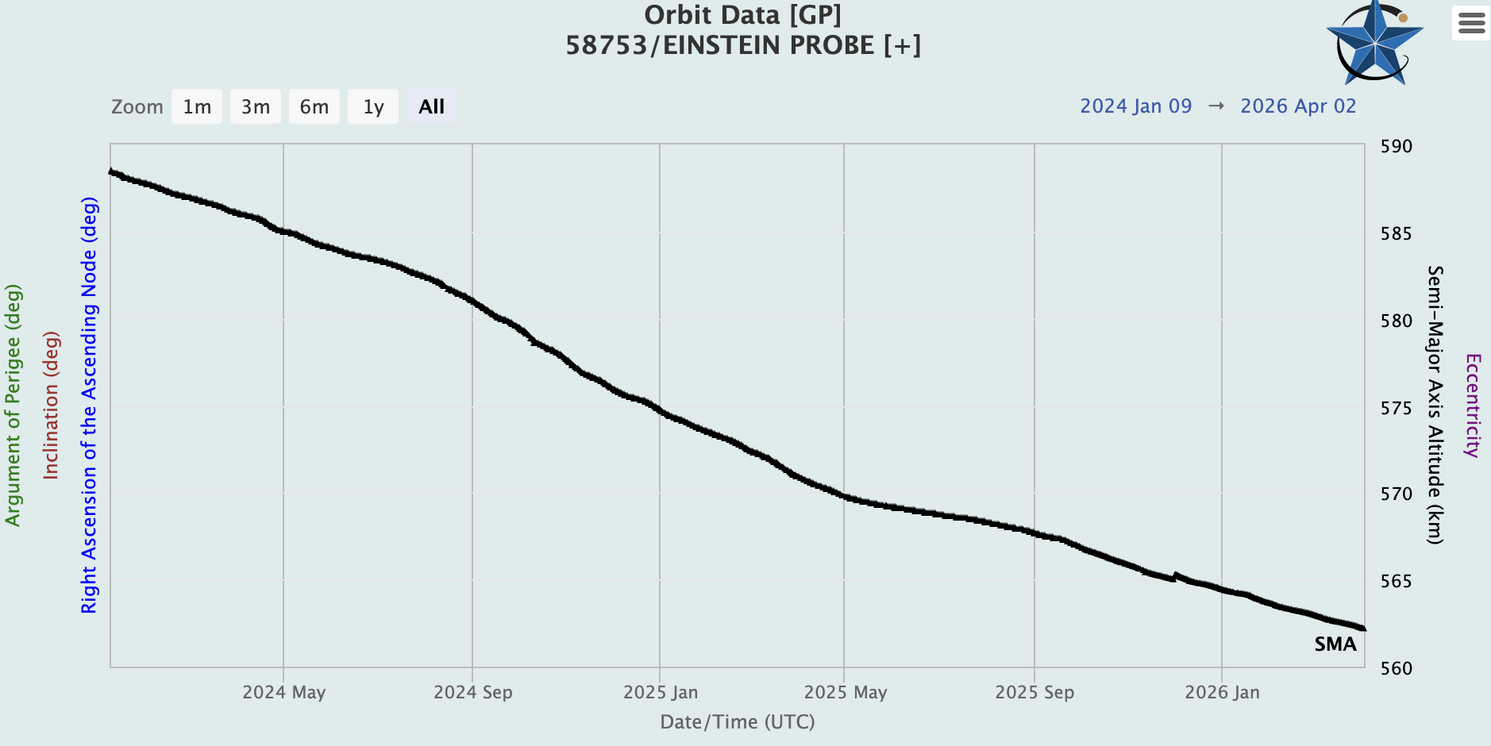
Mission status
Orbit: 560 km (30 km lower since launch)
Expected to run until 2040?
Inclination: 29°
Period： 95 min
200-meter orbit boost in Nov 2025
( a red collision warning )
Satellite status: health
FXT: 1 hitting. Date have been released since Nov 2025. (Chenegkui’s talk)
WXT : ~ 25 micro- meteoroid hitting, data will release very soon.
~ 3 severe hitting (1/4 of CMOS41 lost) (Huaqing’s talk)

Slide 6
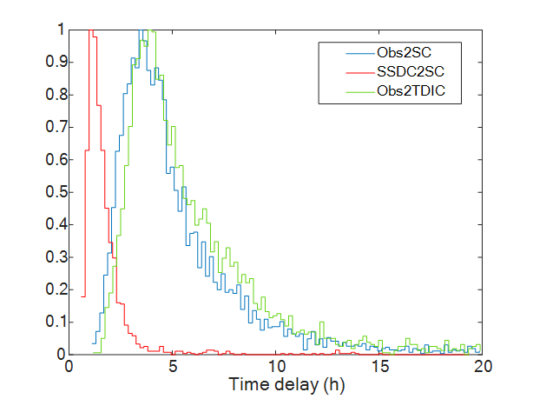
Data Real time performance
Data downlink：
Transient Alert ：~ minutes
GCN immediately
Whole data：5 ~ 10 hours
~ 10 Orbits download per day
Including China and ESA’s station.
Uplink: Too observation command in 1 minute.

Slide 7
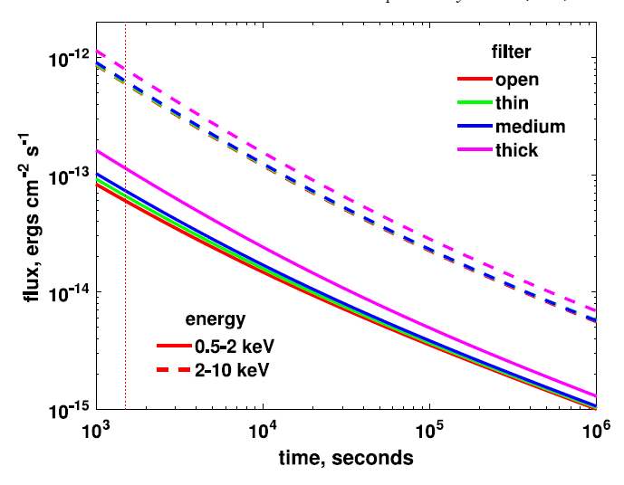
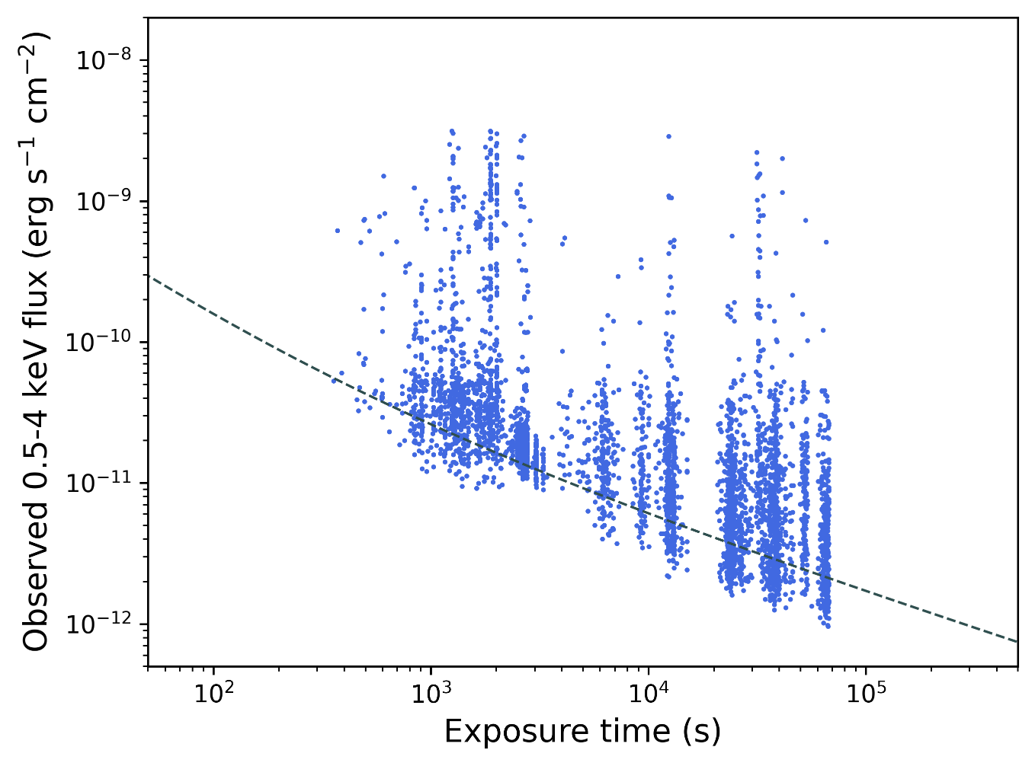
Sensitivity
WXT
FXT (1 unit)
flux vs. exposure for WXT sources
credit: EPSC
credit: EPSC

Slide 8
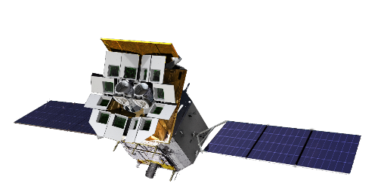
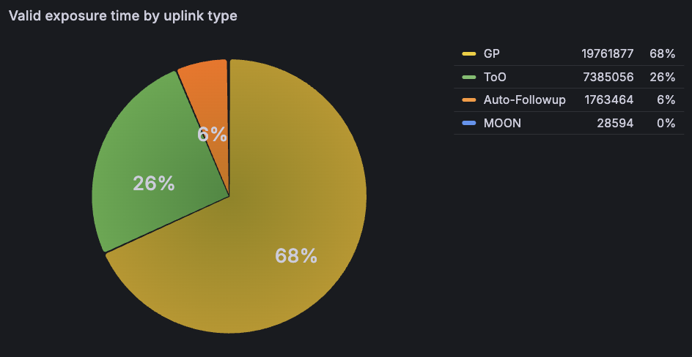

EP observations (2024.7-now)
Survey mode (Cycle-1&2 pre planned target): $8.2×{10}^{6}s$ observed
Onboard trigger: 507 autonomous FXT follow-up observations
Target of Opportunity (ToO): 1934 observations
Up to now: 19296 FXT observations

Slide 9
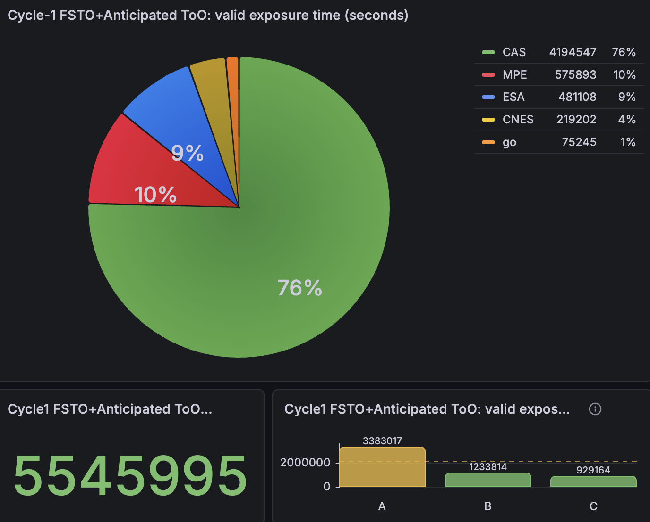
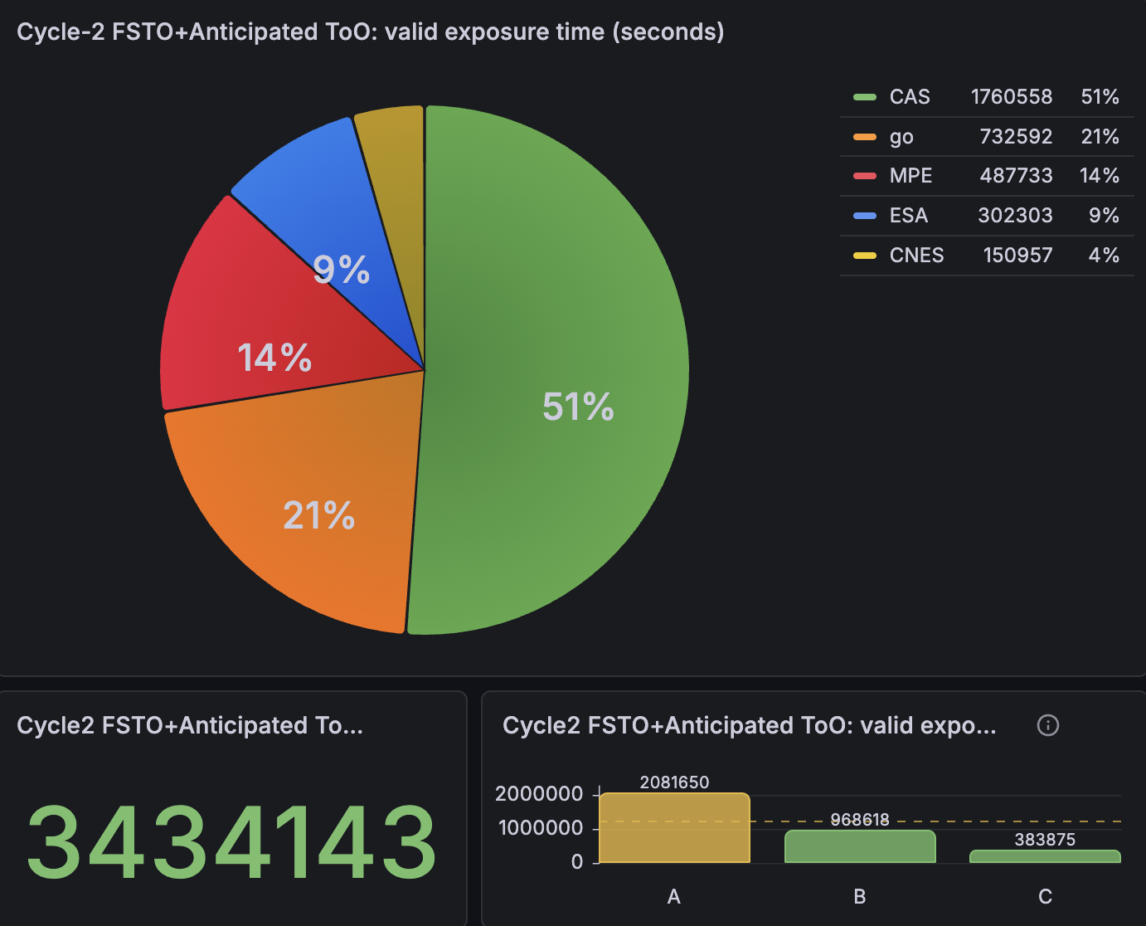
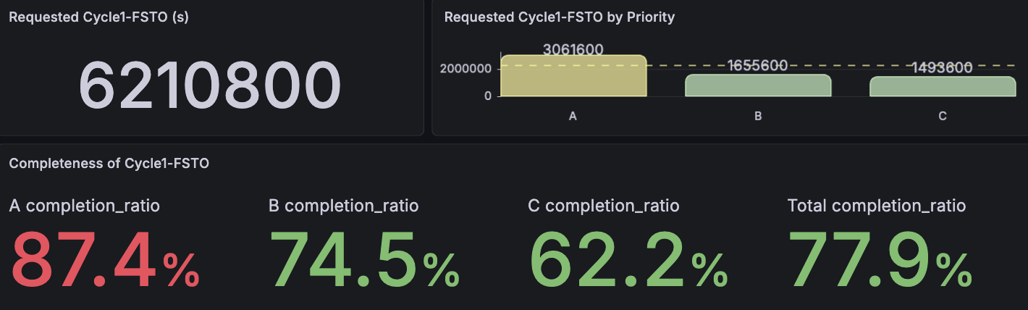
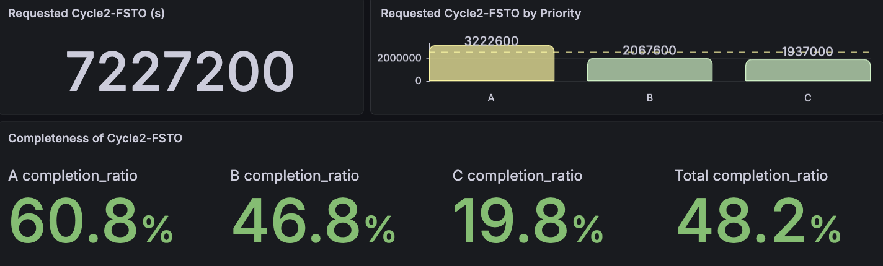
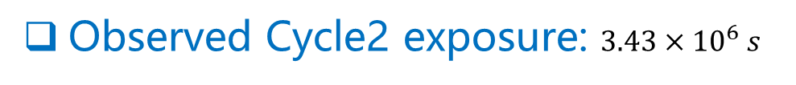
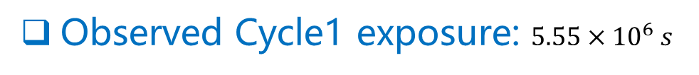
Cycle observations
Observation Time : 2024.7.9 ~now
Observed Cycle1 exposure: $5.55×{10}^{6} s$
Observed Cycle2 exposure: $3.43×{10}^{6} s$
Notes:
For priority-A sources without strict time constraints, if the final valid exposure time of these sources is less than the requested time after the Cycle-1 time range, we may contact the PIs of these proposals to confirm if these sources need to be rescheduled in the Cycle-2 time range.

Slide 10
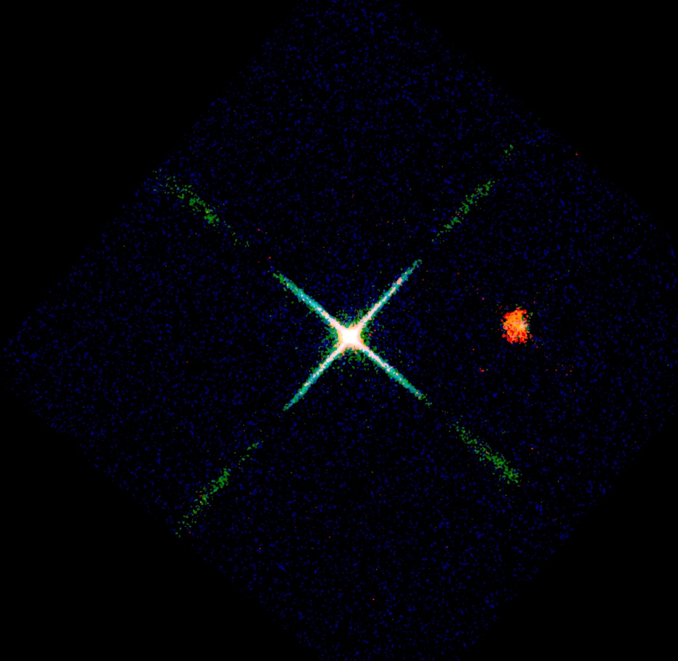
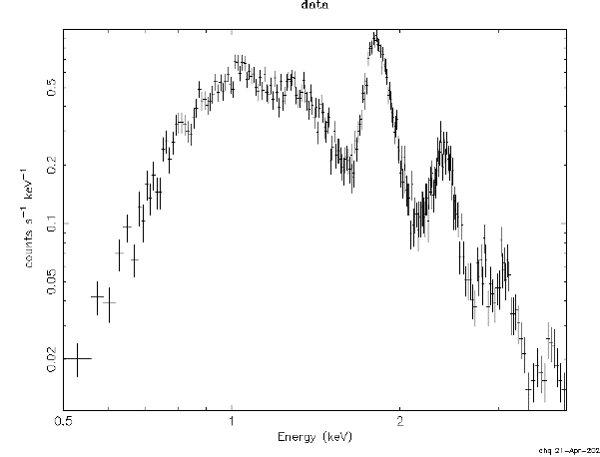

WXT X-ray First light Jan. 19, 2024
Cassiopeia A supernova remnant (nebula)
X-ray spectrum obtained at the same time
Si He 1.83
S He 2.41
X-ray data credit: EPSC
Counts/sec/keV
$Δ$E ~ 122eV @1.25keV
Energy (keV)
Red: 450 to 1000 eV
Green: 1000 to 2000 eV
Blue: 2000 to 5000 eV
X-ray data credit: EPSC, image credit: Chen Zhang, Huaqing Cheng.
Image size 9.3° X 9.3 °
exposure 22 kilo-seconds

Slide 11
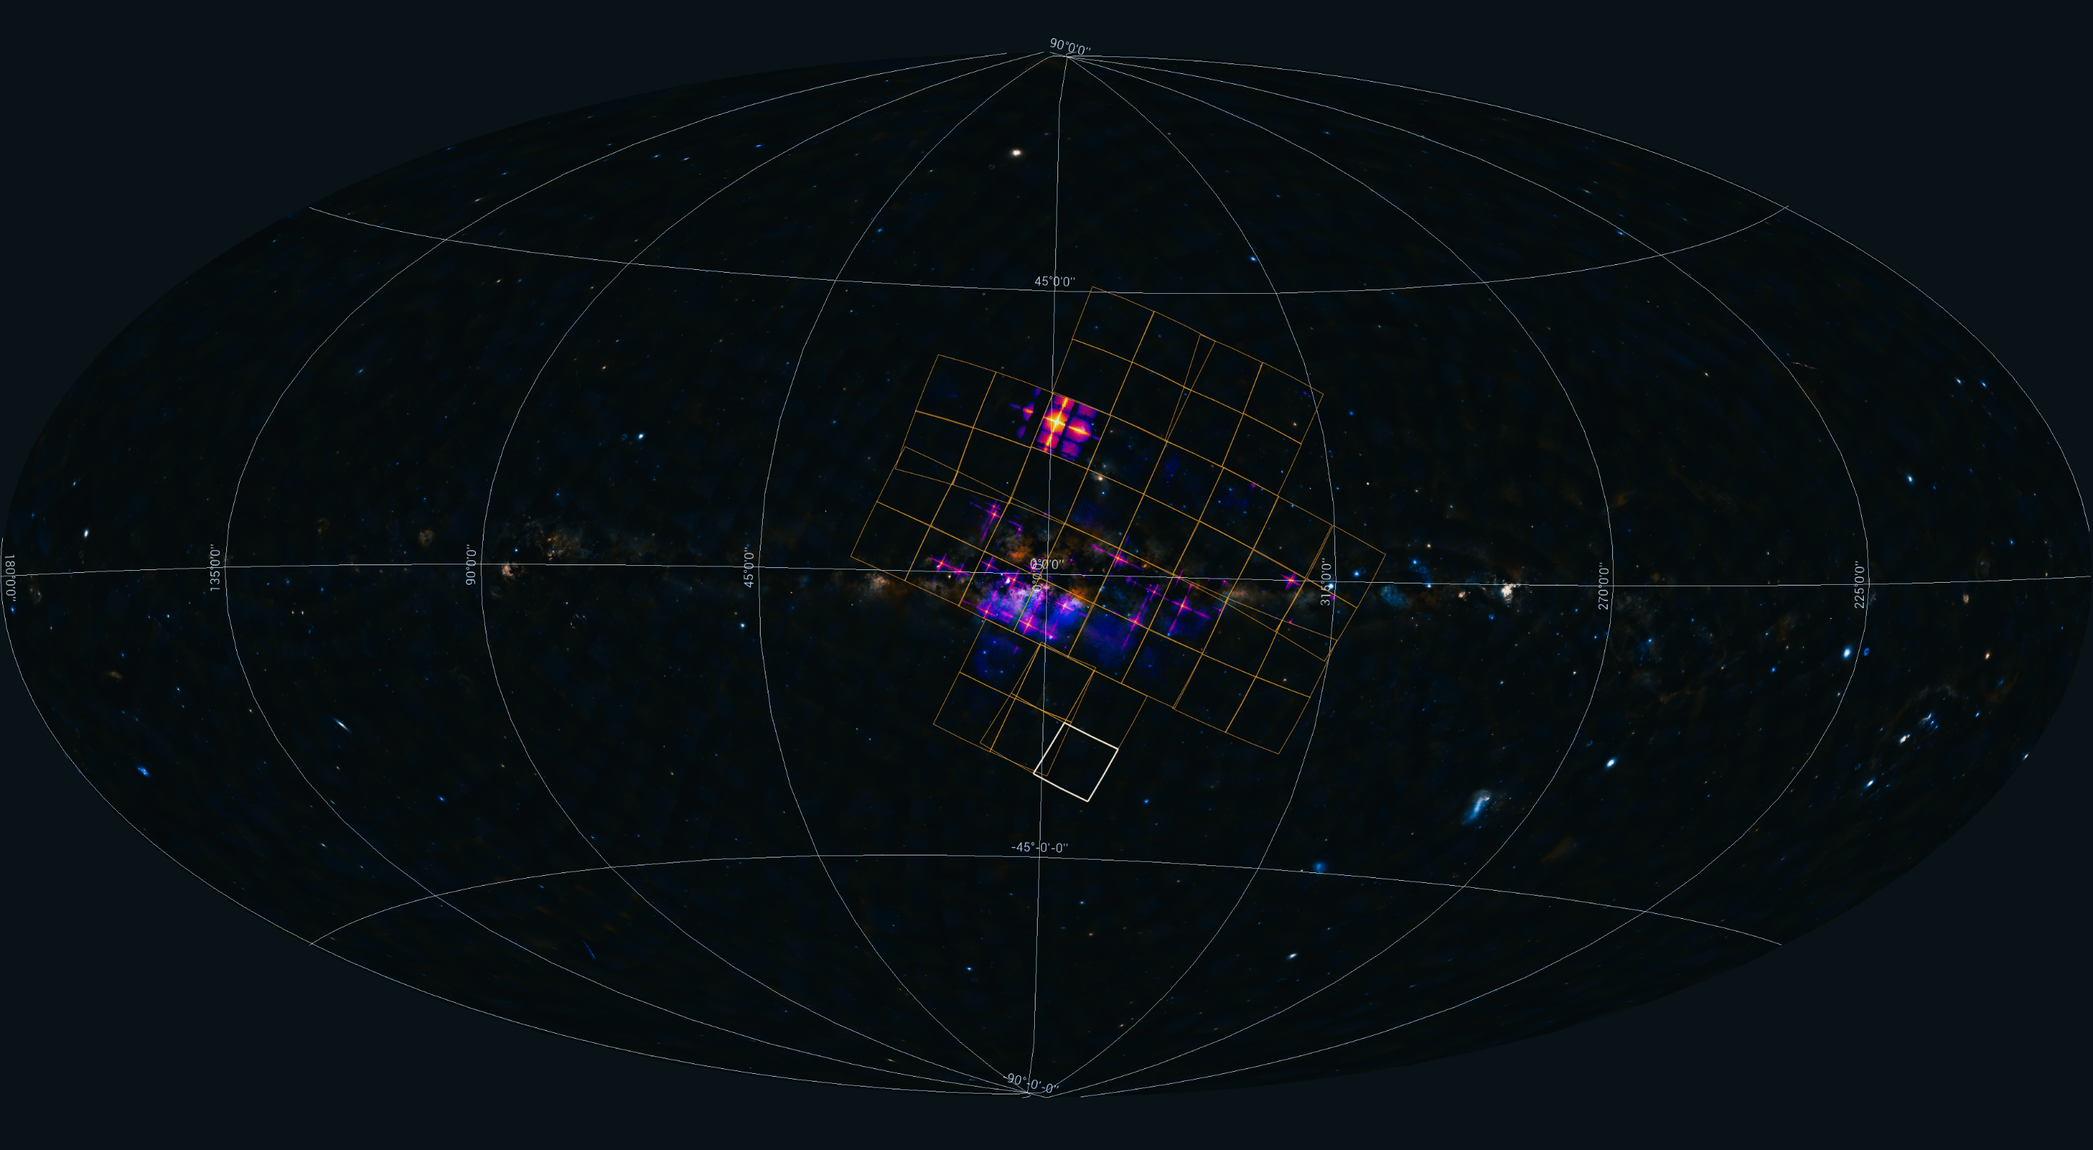
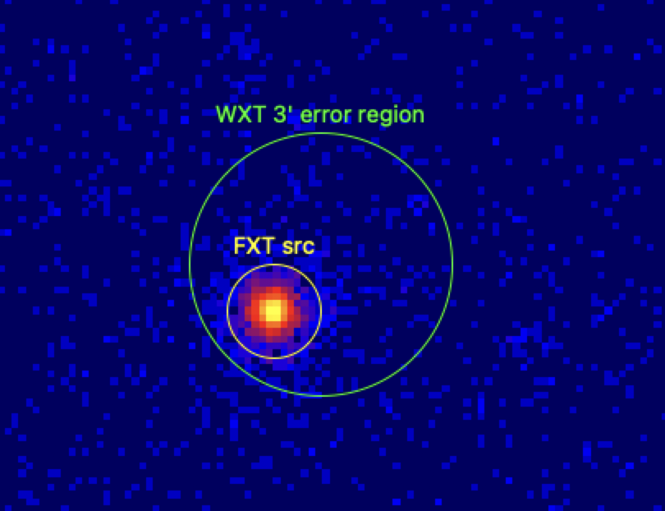
one WXT pointing
FoV: 3850 sq. deg (~1/10 whole sky)
40 ks exposure
FXT X-ray image
obs. started a few min after onboard trigger
expo 3.6 ks
FXT error radius: 5-8 arcsec
credit: EPSC, CAS

Slide 12
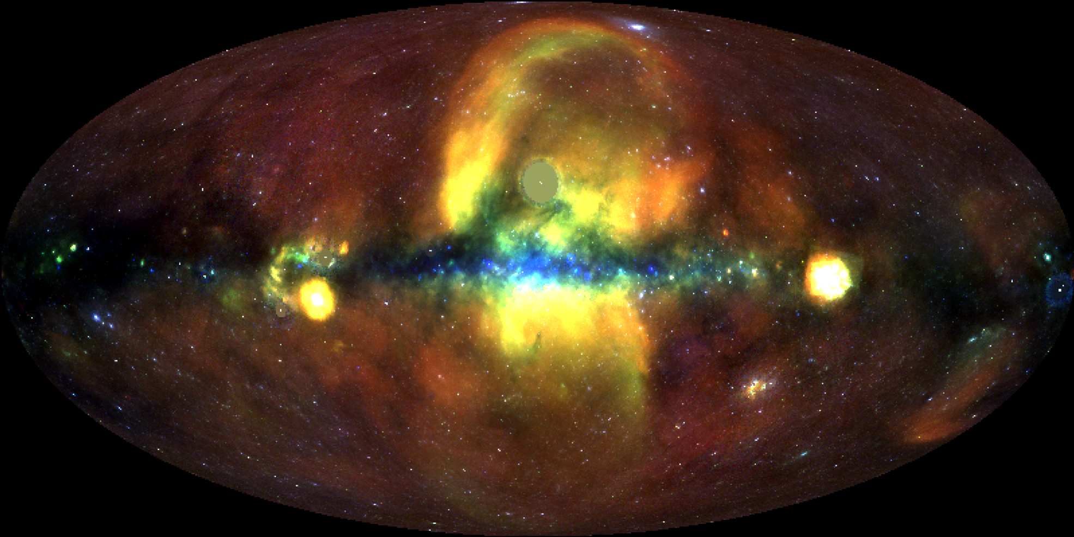
All sky map by EP-WXT
All-sky X-ray image obtained with EP-WXT (0.5-2keV)
~ 20 billion X-ray photons so far
Preliminary
credit: EPSC
Long-term monitoring of ~7000 sources
finding new extended sources/features

Slide 13
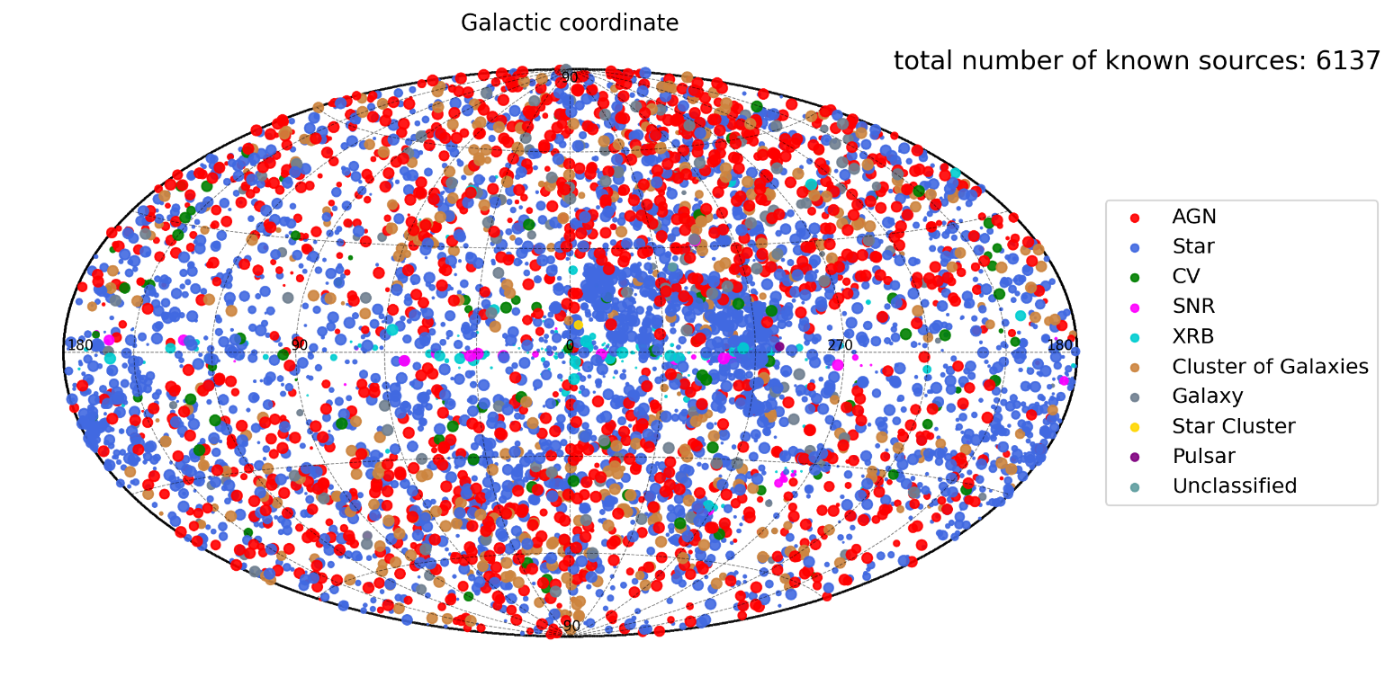
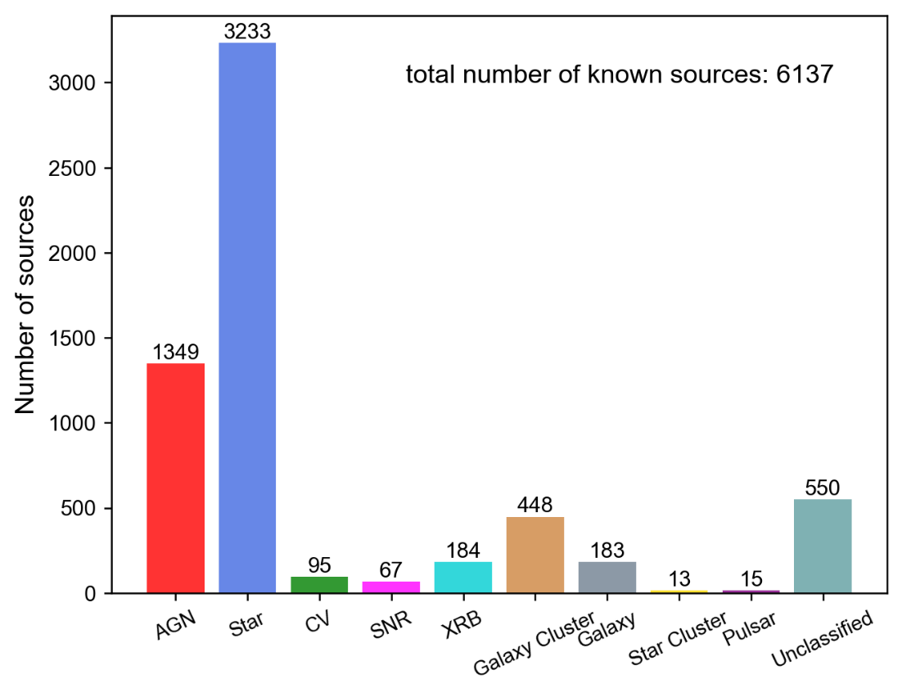
Statistics on X-ray sources detected with WXT
credit: EPSC
credit: EPSC

Slide 14
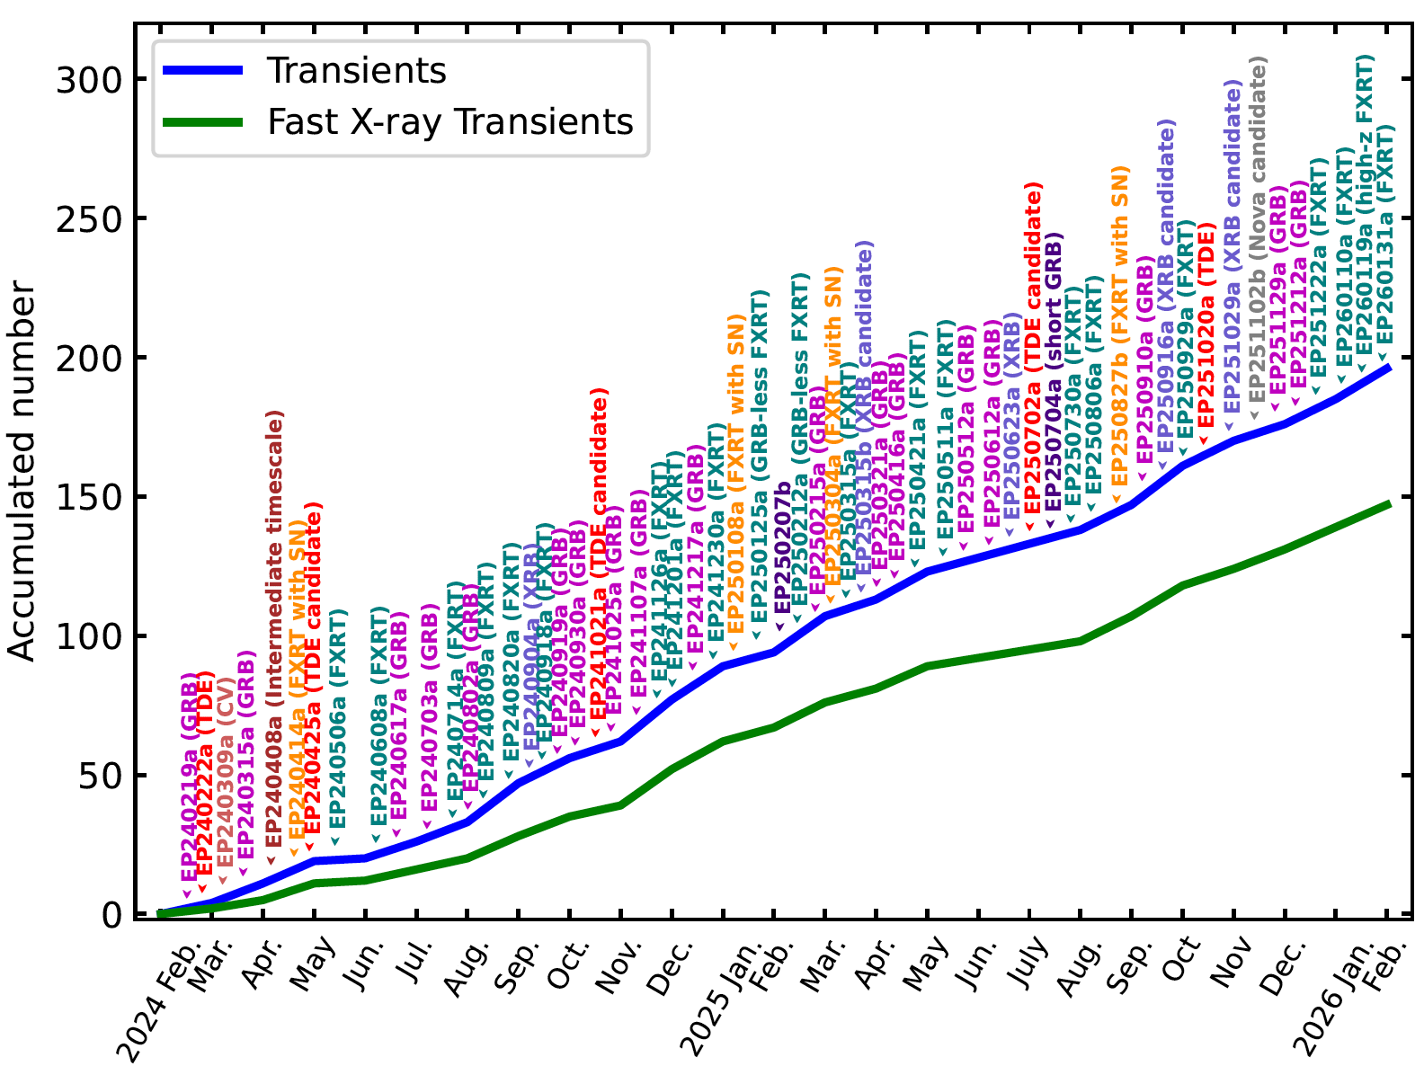
EP X-ray transients
198
~150 EFXT
various types
> 463 GCN/ATel alerts
enthusiastically responded by multiwavelength follow-ups worldwide --- crucial

Slide 15
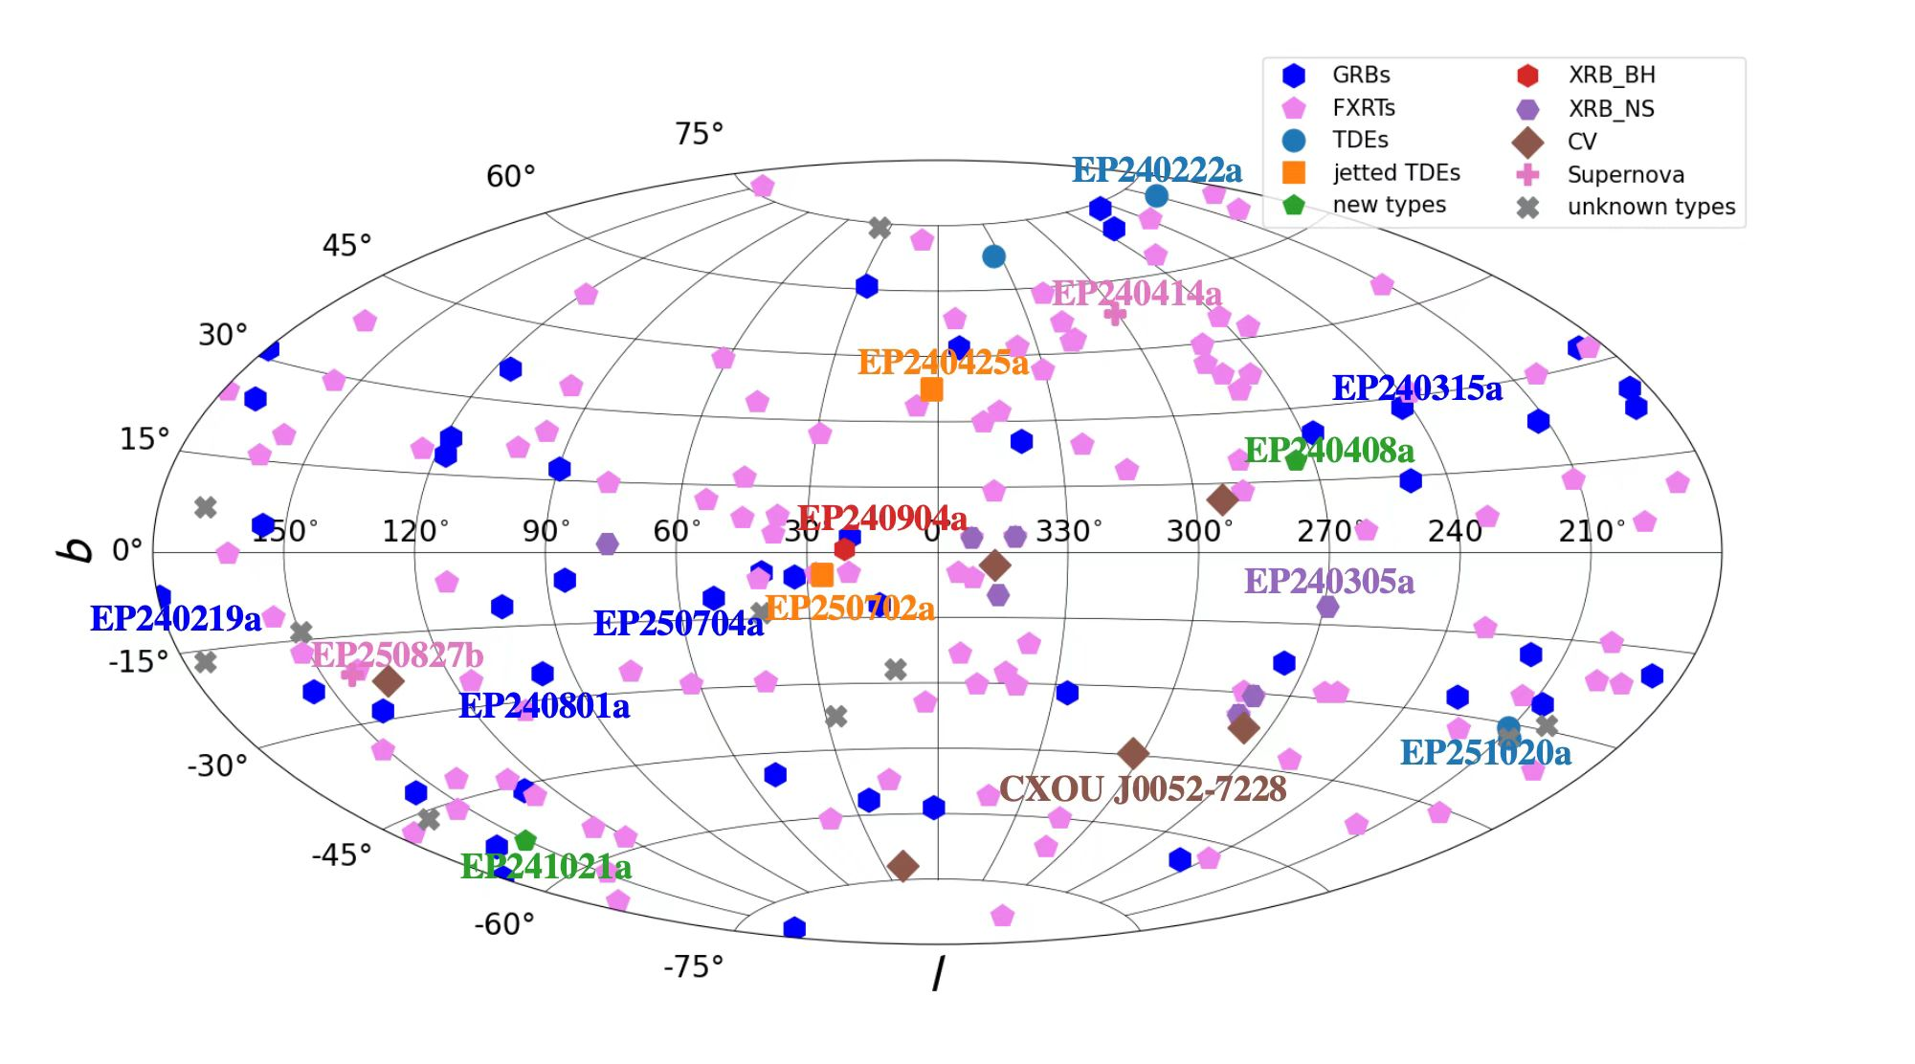
EP X-ray transients
Galactic coordinate system

Slide 16
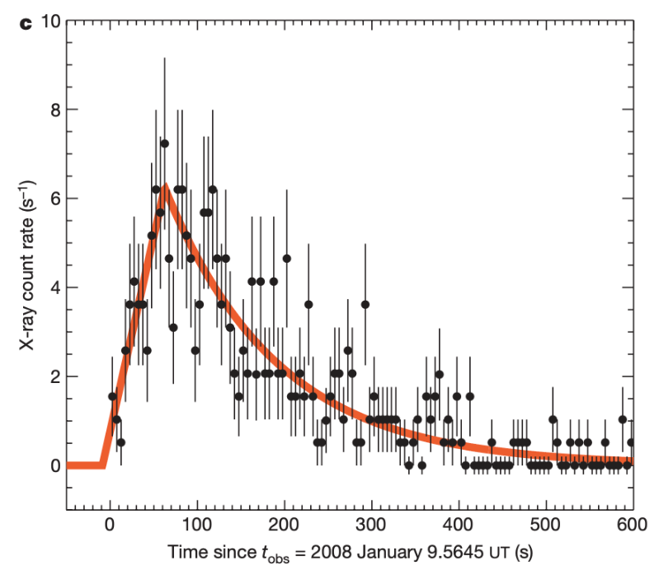
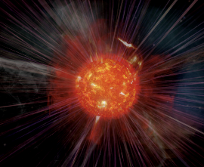
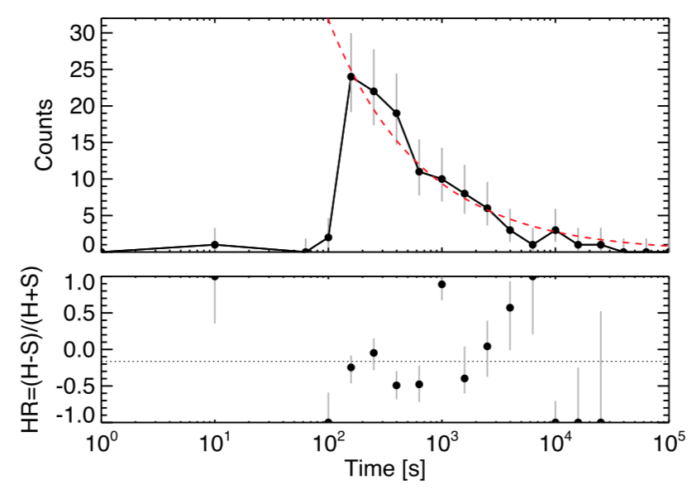
Extra-galactic fast X-ray transients (EFXT)
Fast X-ray transient mystery
  bursts lasting from seconds to hours, found since 1970’s
  detected by wide-field & narrow-field (serendipitously) instruments
  classifications, demography & origins remain unclear (stellar explosive process?)
EP has detected 148 EFXT
  No-GRB (X-ray flash):
  99 (c.f. 30-40 before EP launch)
  GRB in soft X-ray: new window
  6 with z>4
SN Shock breakout by Swift/XRT XRO 080109 (Soderberg+ 2008)
CDF-S XT1
z_{ph}~2.23, L_{p}~6.8e46 erg/s Bauer et al. 2017

Slide 17
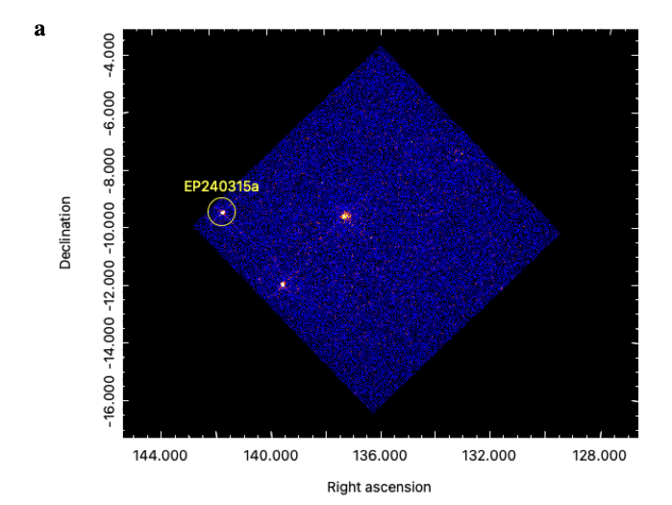
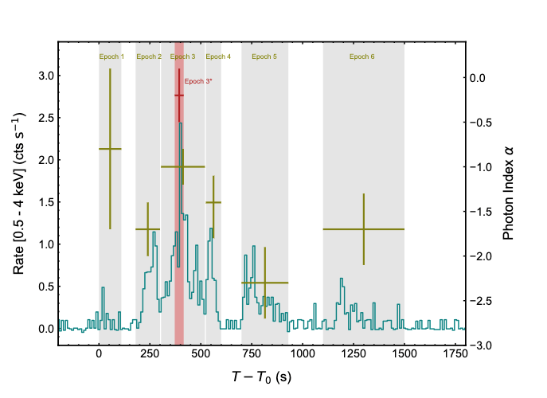
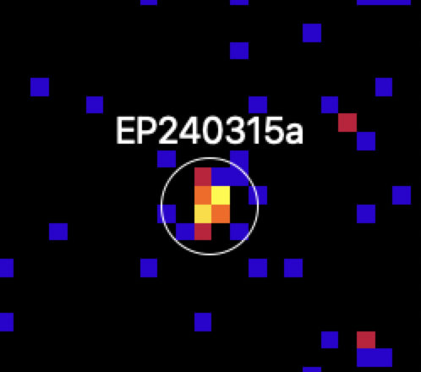
EP240315a: GRB @redshift 4.859
WXT image
Soft X-ray T90: 1000 s
Gamma-ray T90：<50 s
by Swift/BAT & Konus-Wind
FXT detection of X-ray afterglow
Onboard trigger, confirmed by on-ground analysis
Marked difference in LC of soft X-ray and hard X/γ rays
redshift 4.859 measured by VLT (Levan et al. 2024)
Levan A., et al. 2025 Nature Astronomy
Liu Y., et al. 2025 Nature Astronomy
detectable by WXT at z~7.5
EP’s potential of detecting high-z GRB !

Slide 18
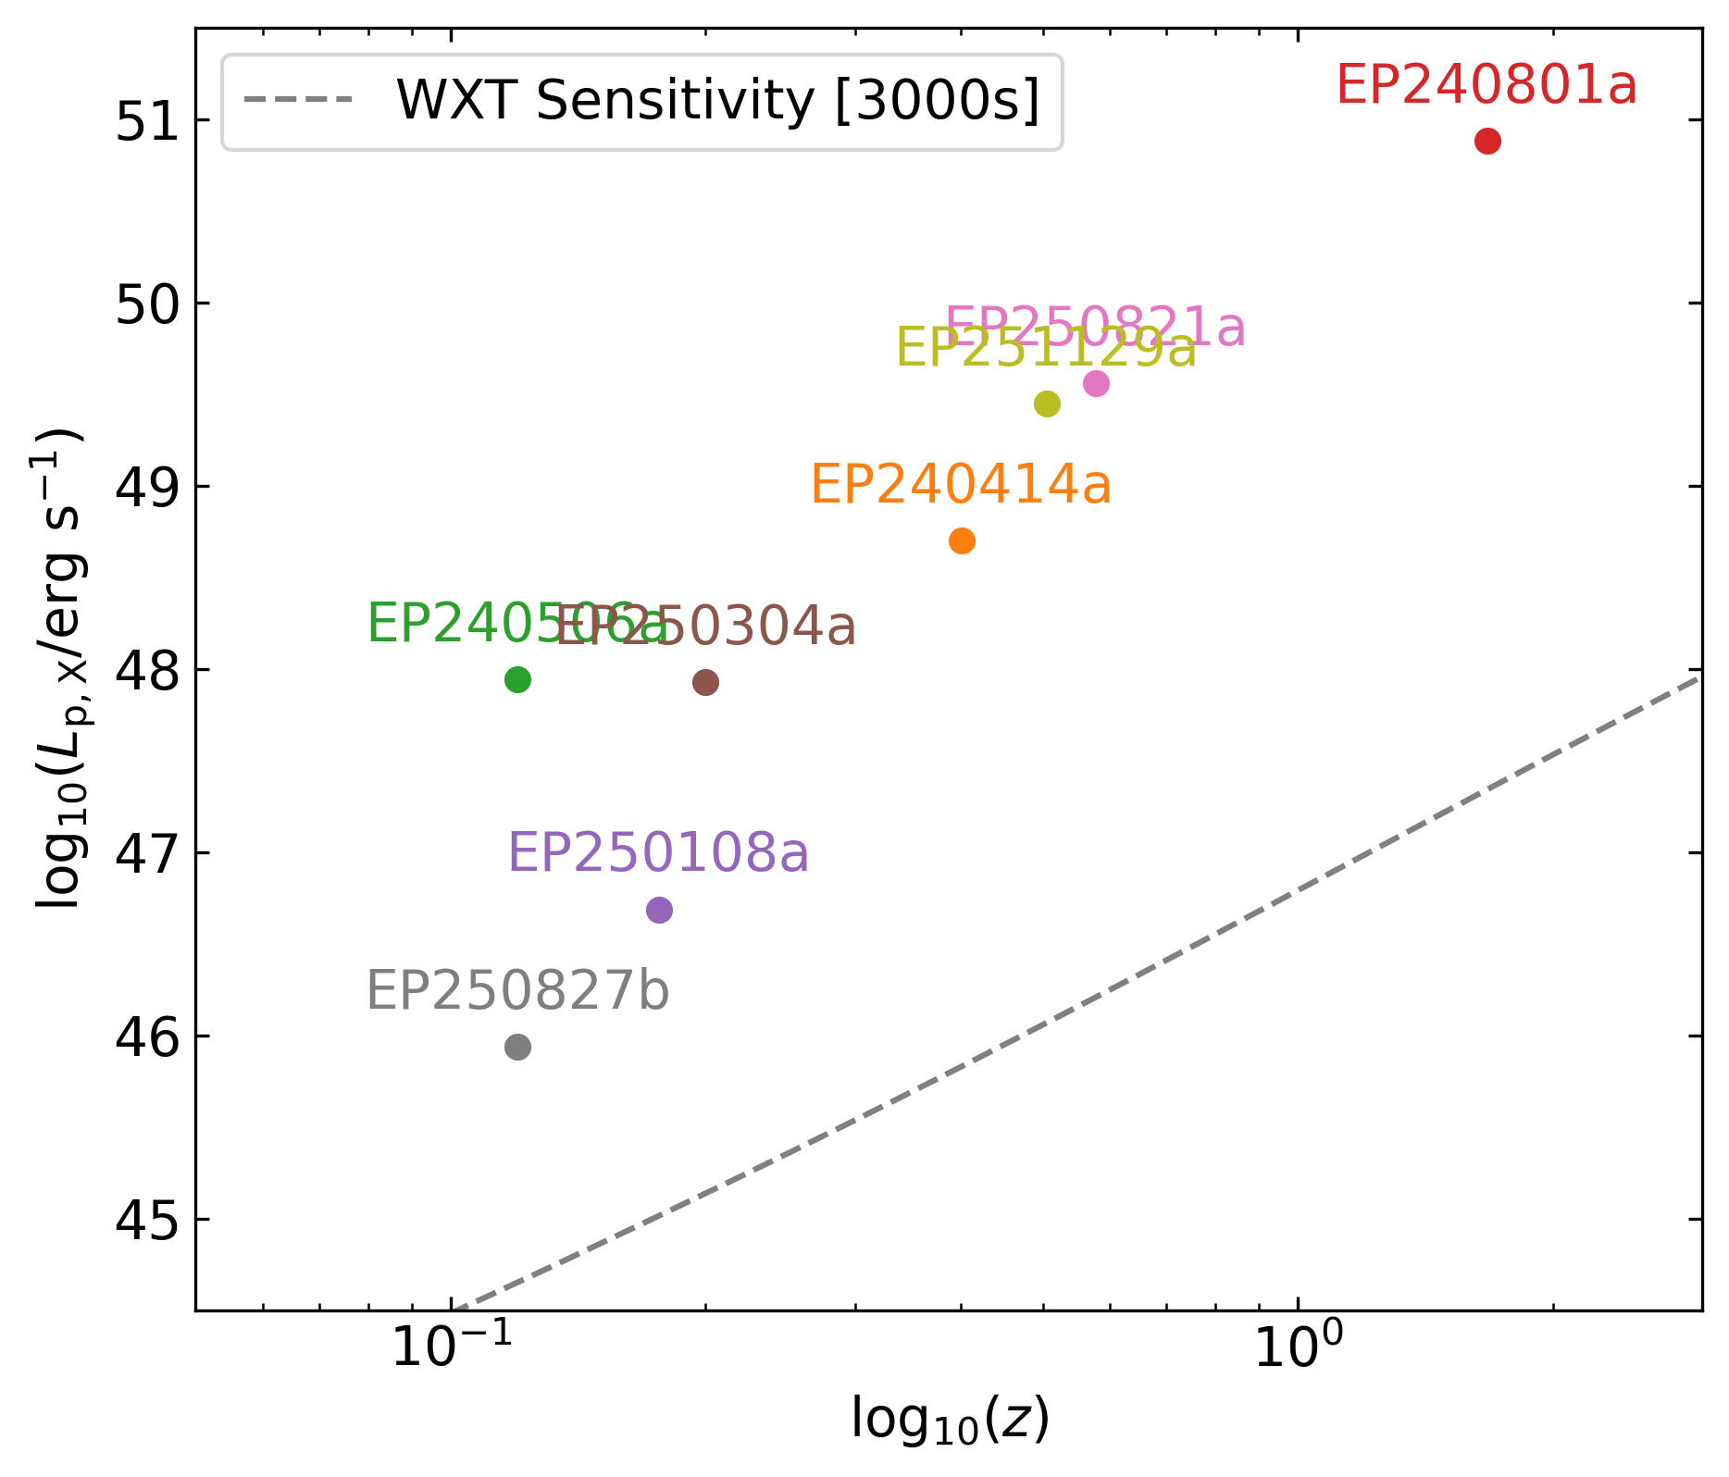
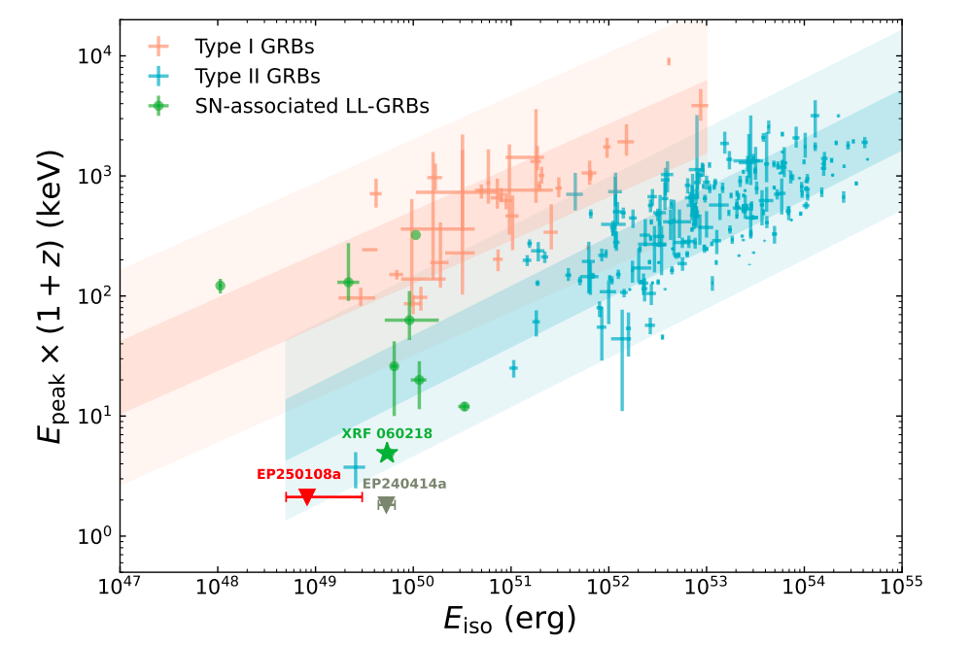
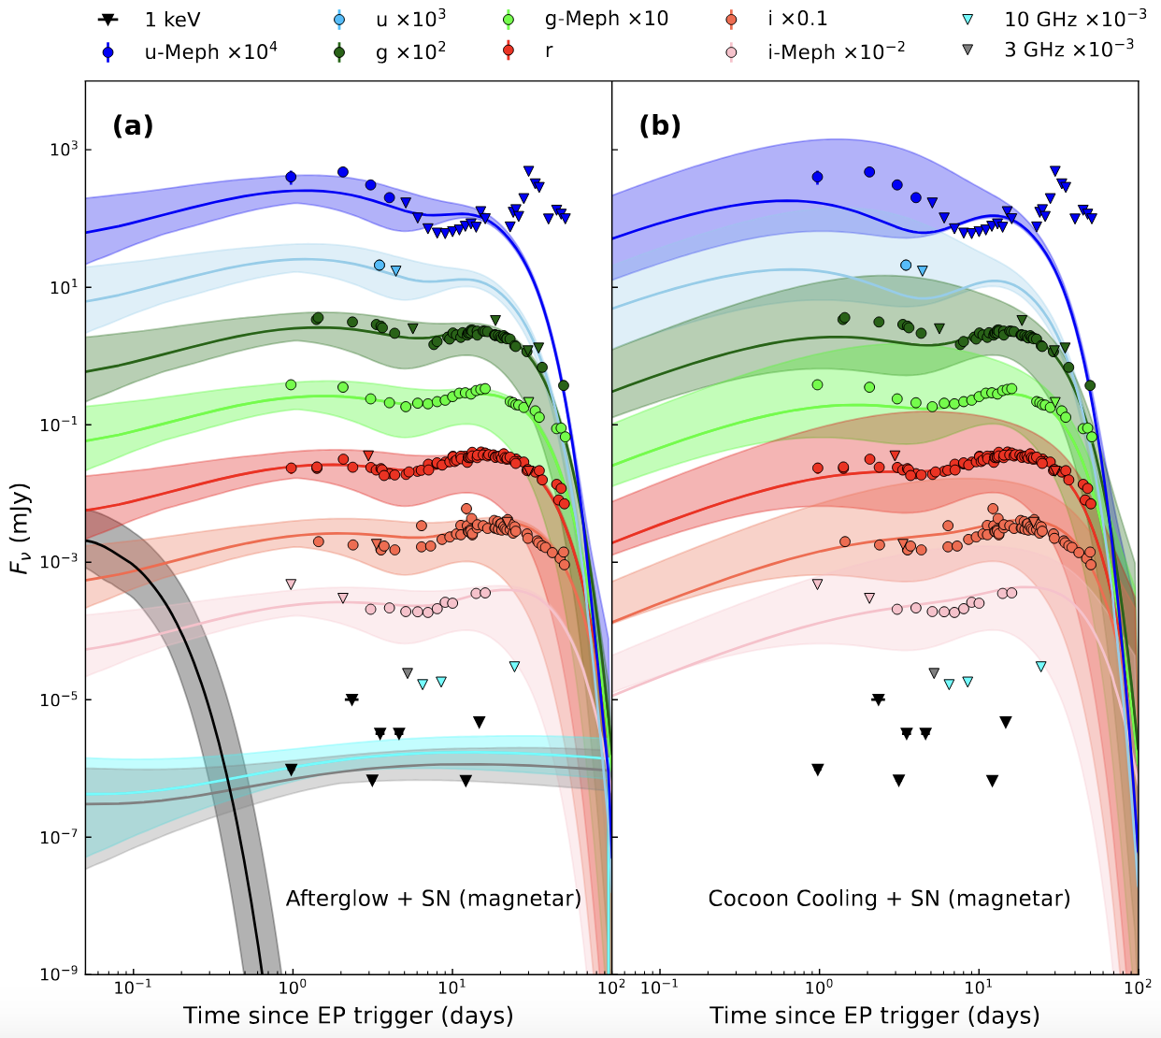
EP enabling multiple FXT–SN associations
8 confirmed FXT-SN, all Broad-line SN Ic
EP250108a / SN 2025kg
Type Ic-BL @ z ≈ 0.176 (Li+ 2025)
Extremely soft/weak
X-ray flash
A relativistic outflow origin (jet or shock)
Extreme of Amati relation
Jet
Shock
from Wenxiong Li (submitted)
Notes:
Dashed line is WXT sensitivity, means we miss some SNe above the line, probably due to the lack of optical resources. By Runduo.
250821a-SN association has not been public, Peter showed it in STP2 online meeting. We can omit it if needed.

Slide 19
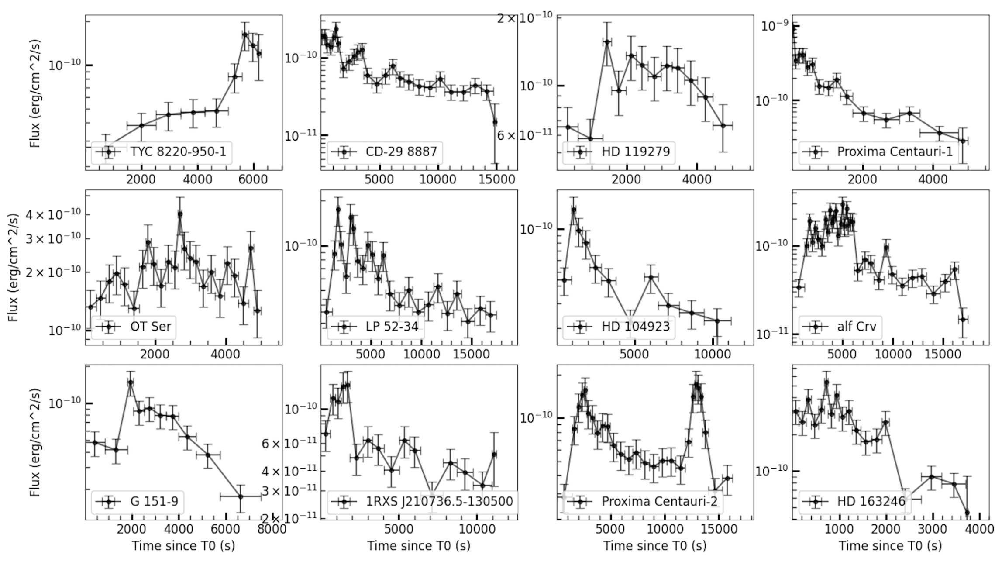
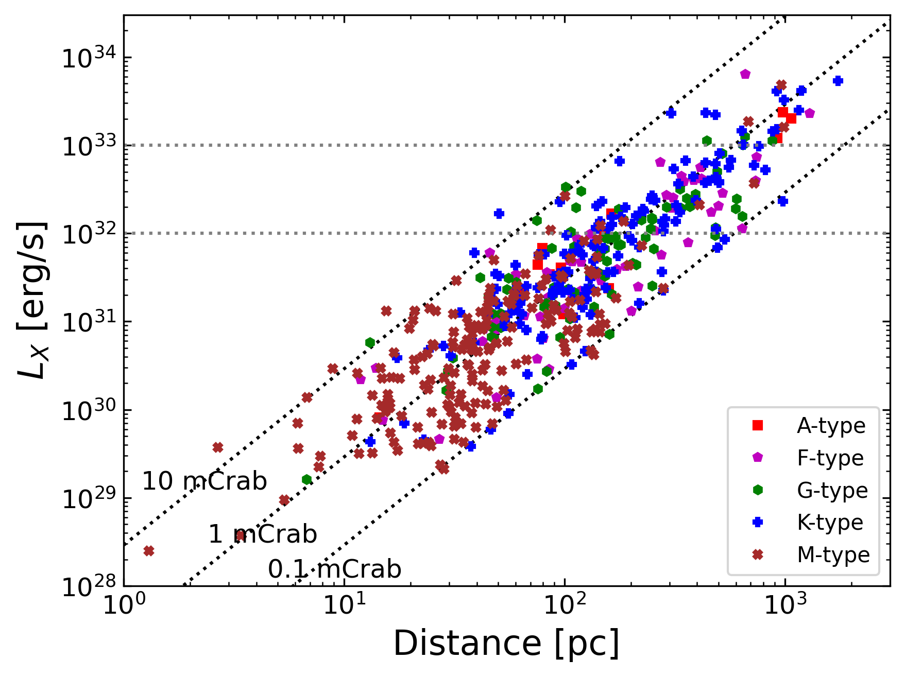
488 Stellar X-ray flares detected with EP-WXT

Slide 20
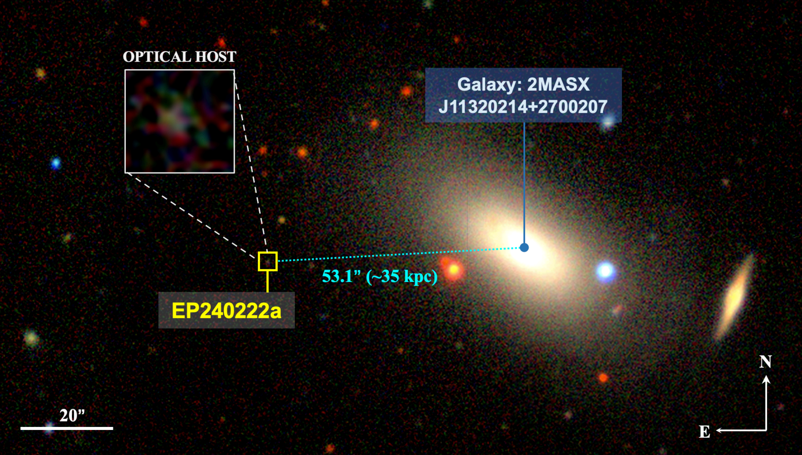
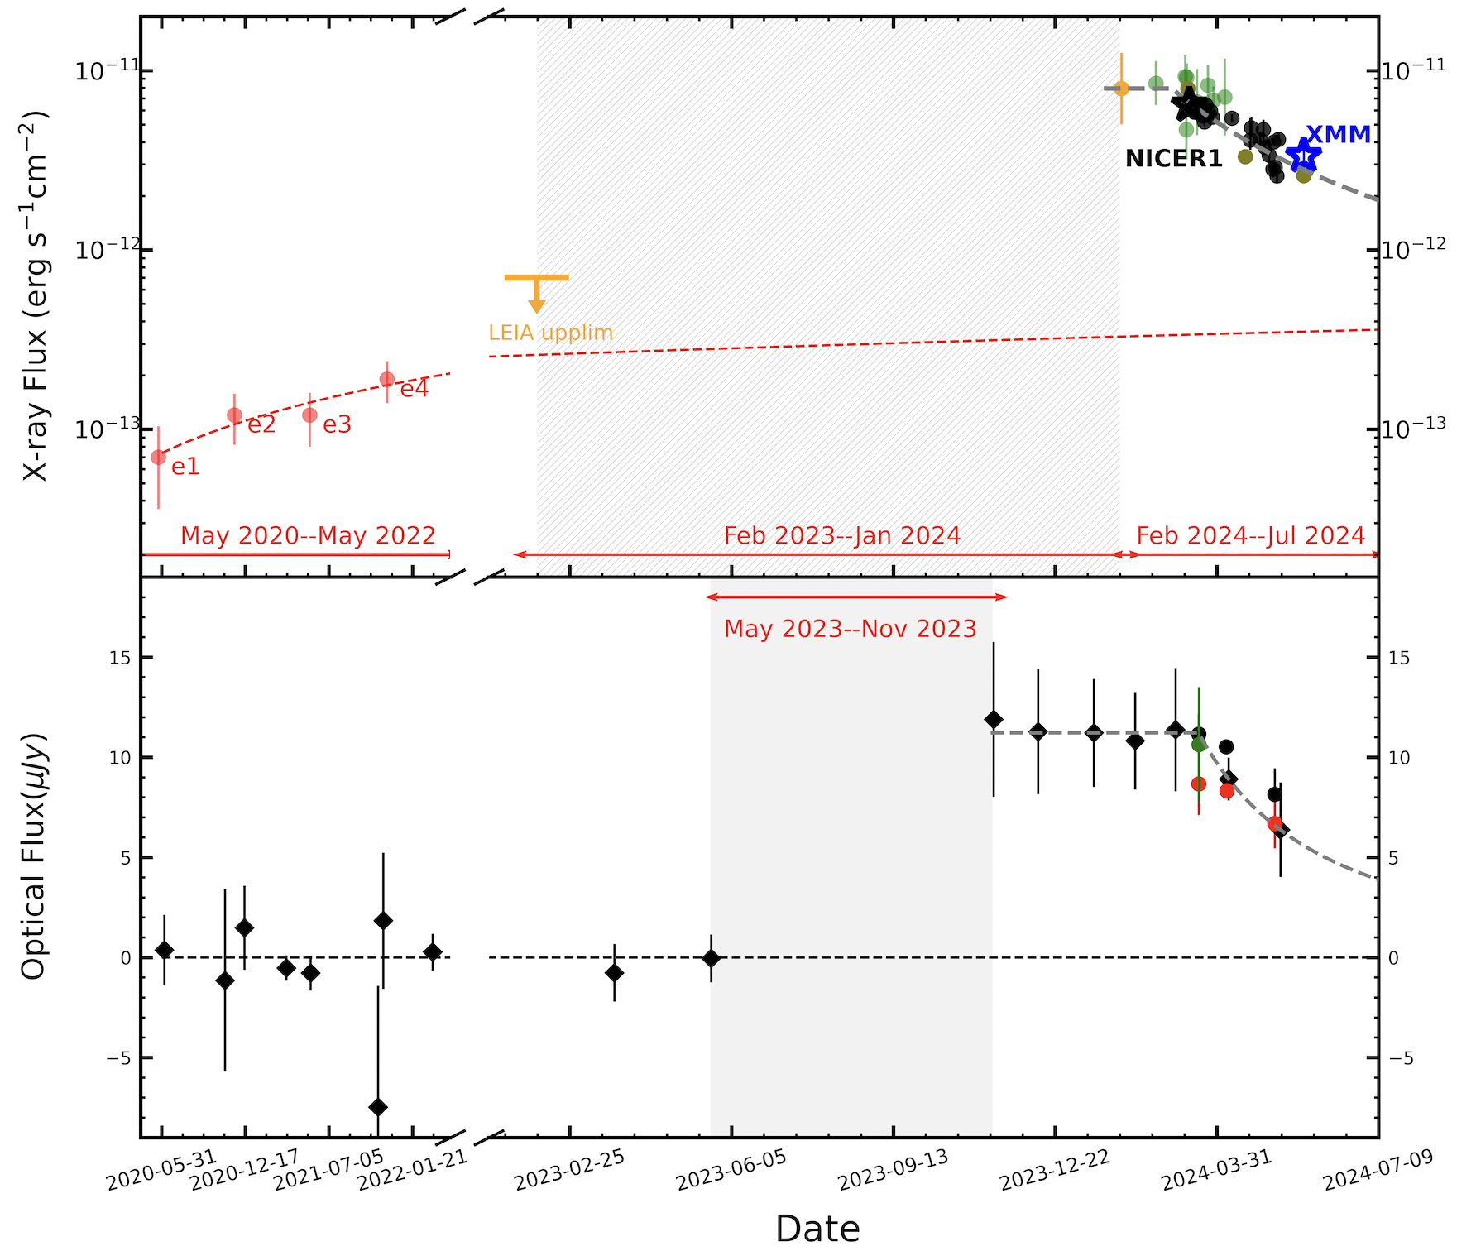
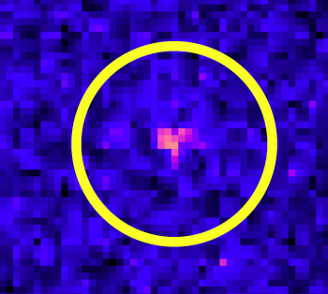
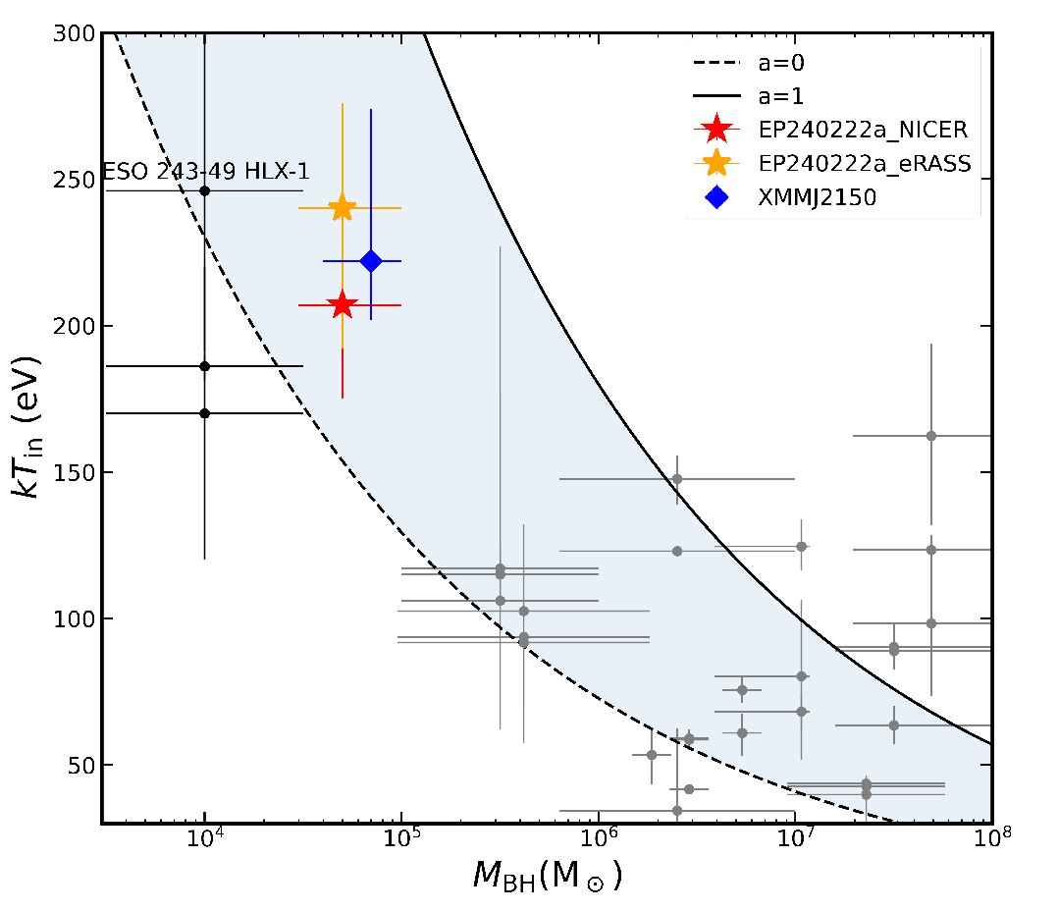
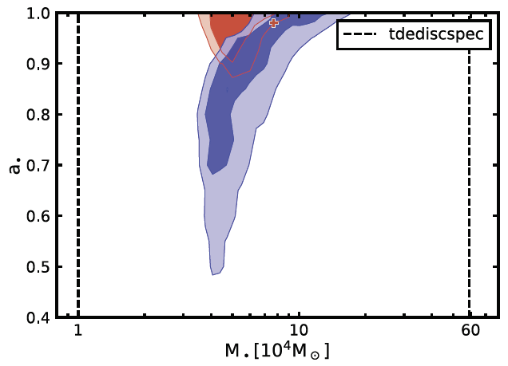
EP240222a: TDE by IMBH in the halo of a large galaxy
EP240222a
X-ray light curve
optical light curve
EP-WXT detection
>4 years; off nucleus: 35 kpc from center of a massive galaxy
BH mass 1e4-1e5 Msun
host stellar mass: ~1e7 Msun
(Jin et al. Science under review)
EP detected 4-6 TDE (2 IMBH)
.
kT: ~ 200 eV

Slide 21
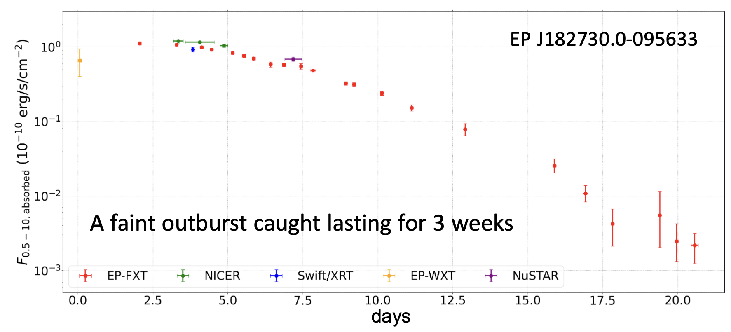
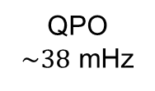
Finding hiding stellar BH & compact objects
Where are the hiding BH XRB in Galaxy? predicted 10³ vs. < 100
Most in quiescent or faint activities, important to constrain stellar evolution, accretion
EP has found 16 new XRB candidates (2 BH, 4 NS, …)
Very faint X-ray transients: ~ 5 /year
magnetars, fireball phase of novae, …
X-ray power spectrum
detected by EP-FXT
a new BH binary candidate found by detecting its faint outburst
QPO
$\sim 38$ mHz
Cheng et al 2025 ApJL

Slide 22
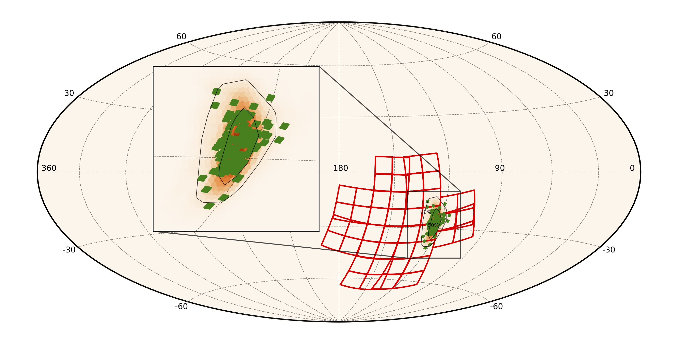
Prospects: multi-messenger, GW events
Important to search for EM counterparts of GW events
  Only GW170817 so far
  Counterparts of NS-BH never detected
EP suited to search for X-ray sources associated with GW events
  search for X-ray likely from newly formed magnetar
  WXT: large FoV, good sensitivity
  FXT: rapid response, 1deg FoV and depth
EP has performed several searches, giving X-ray upper limits
waiting for LIGO O5

Slide 23
Summary
Core science objectives largely accomplished
197 X-ray transients of many types
  > 462 GCN/ATel alerts issued
  triggered follow-up of many telescopes worldwide
Rich non-transient science
  Solar system, stars, X-ray binaries, supernova remnants、clusters、galaxies/AGN、galaxy clusters, all-sky/large-scale X-ray images
Refereed publications (1.5-year operations)
  70 published (based on EP sources/observations)
  EP has the highest citation indices among all telescopes in astrophysics in 2025
Too Observations are increasing.
distribution of EP transients (Gal. coord.)
according to Lewis et al. 2026 (arXiv2602.12303)
http://ep.bao.ac.cn

