Slide 1
Large Segmented Optics Paper proposal
Kristin K. Madsen
Goddard Space Flight Center

Slide 2
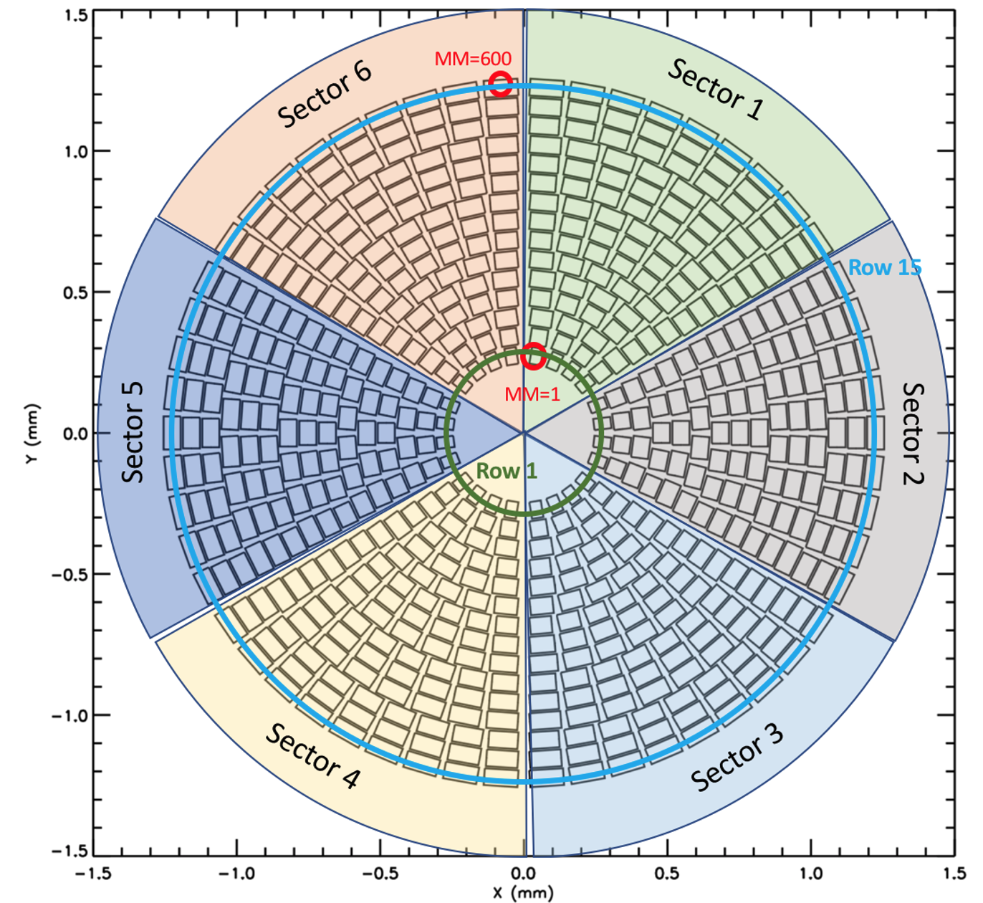
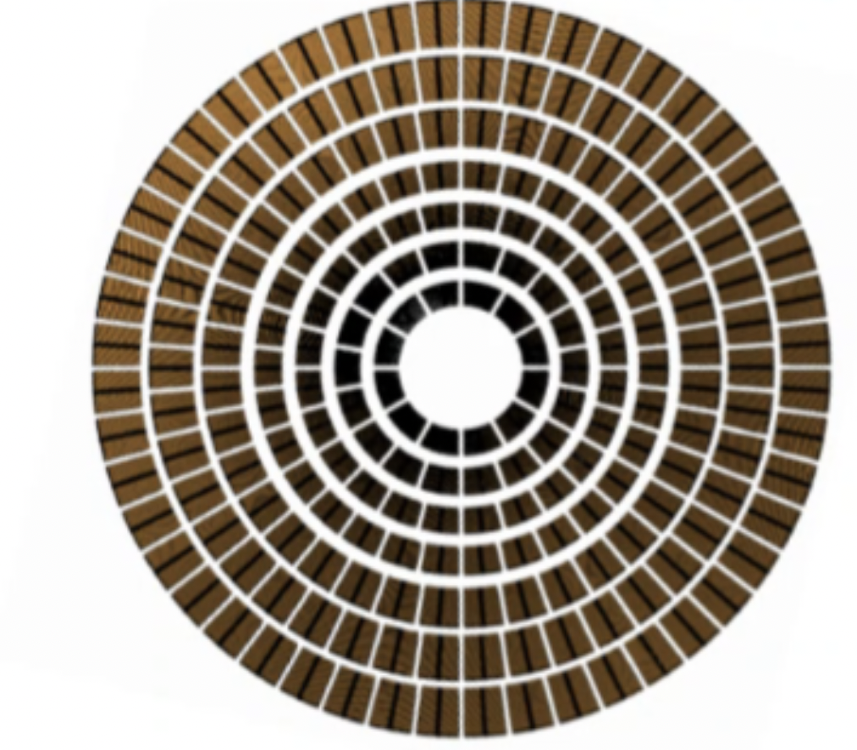
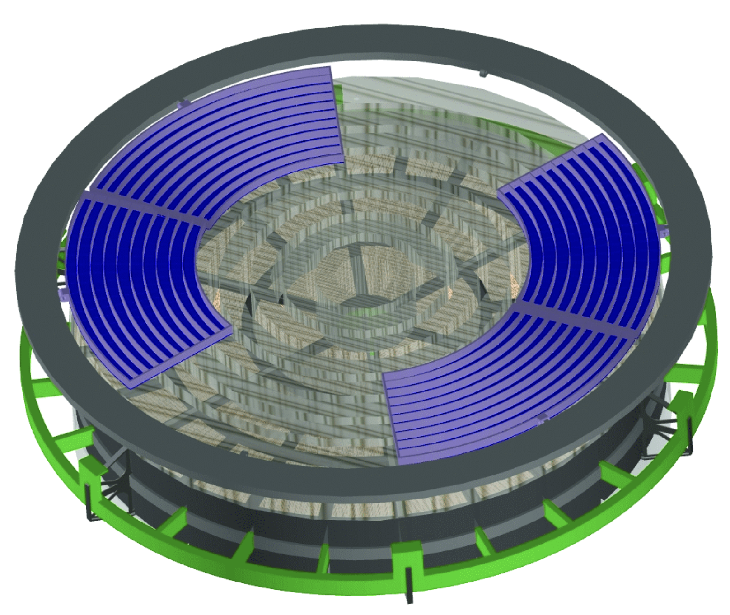
Large segmented optics
AXIS, NASA probe
NewAthena, ESA flagship
Lynx, NASA Flagship concept
1.7m
(Not selected)
2.4 m
(launch 2039)
3 m
(Earliest selection 2030)

Slide 3


Assembly and Calibration
Optical axis
Focal length
Mirror Module

Slide 4
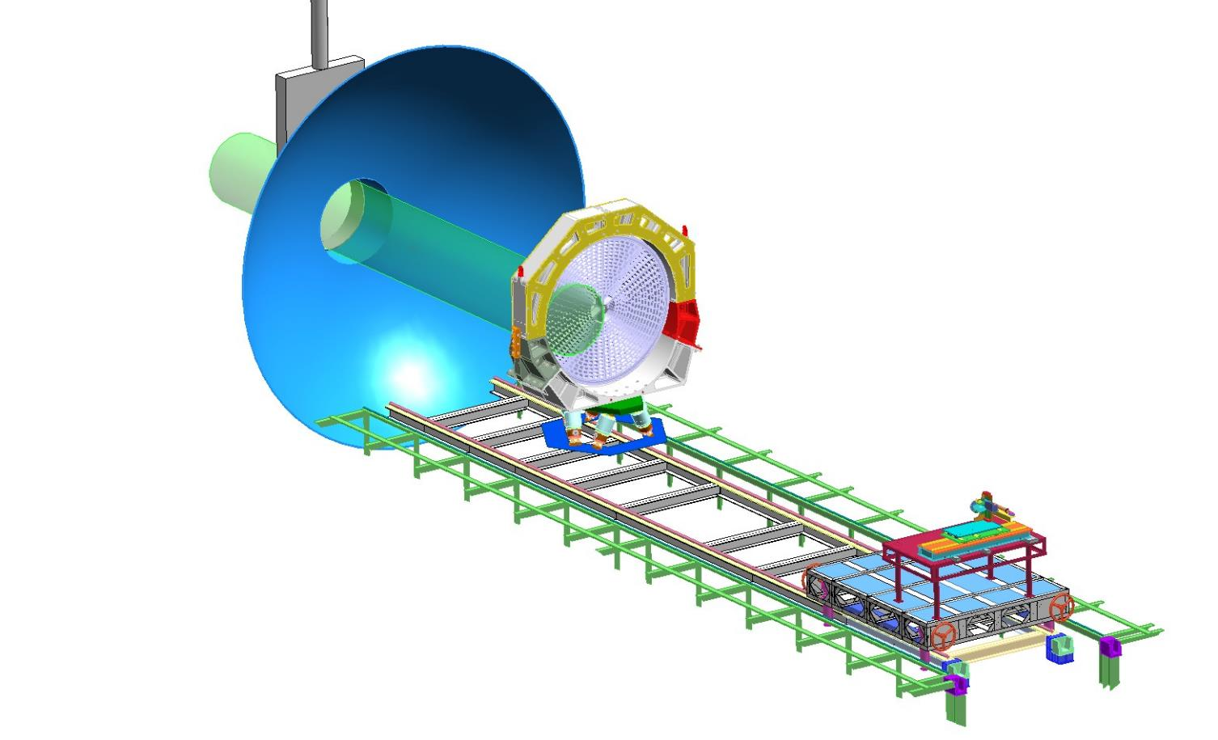
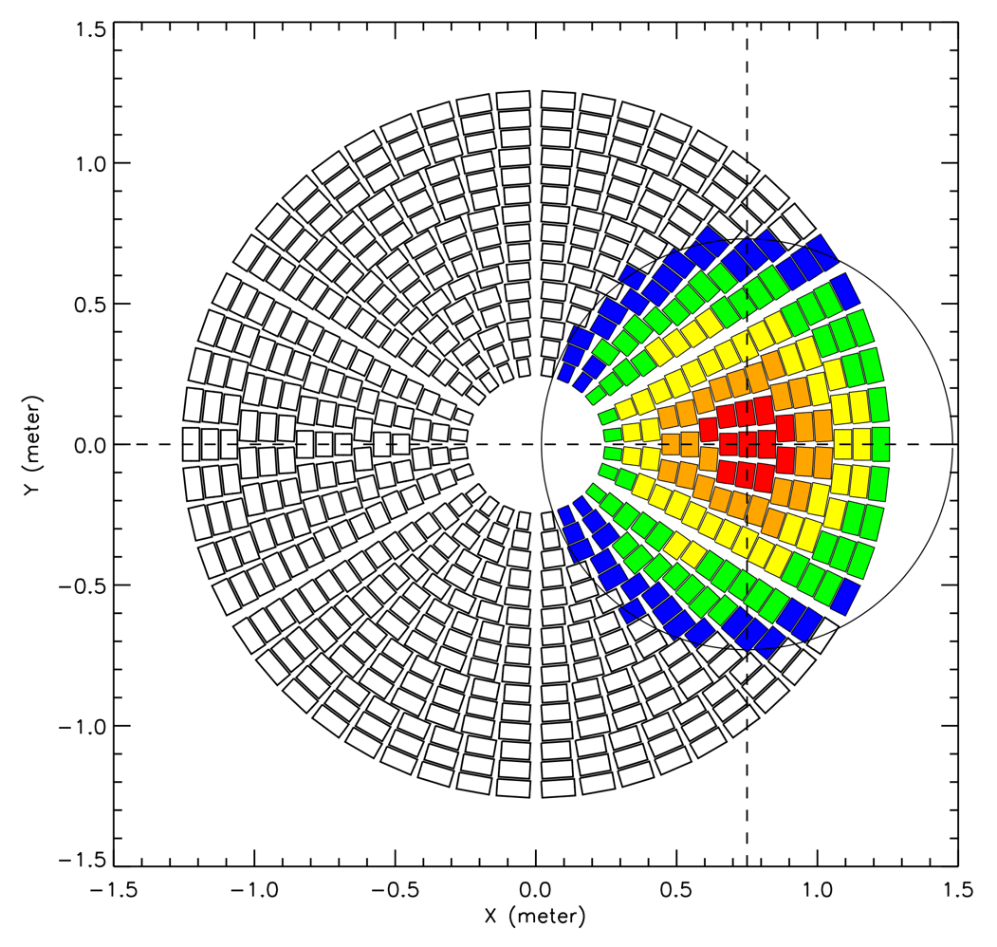
Horizontal beamline: XRCF
Each of the six mirror sectors would be tested individually, with the results combined (‘stitched’) to obtain the full mirror performance
Athena X-ray optic 2.4m diameter
Simulated X-Ray Beam
X-ray beam 1.47m diameter
Sized for Chandra

Slide 5
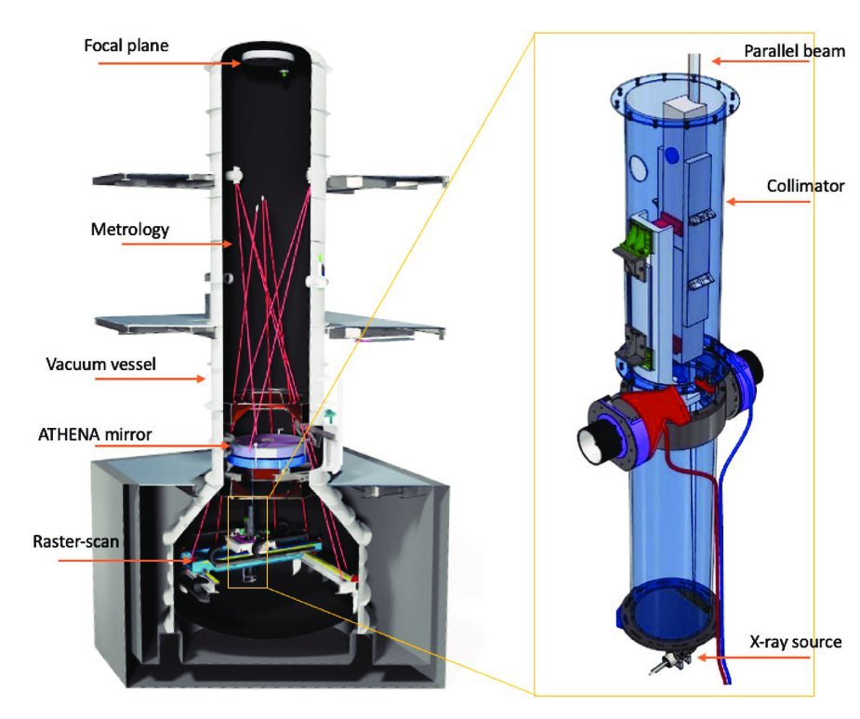
Vertical beamline: VERT-X

Slide 6
System optical axis
OA vector
x
x
*
*
Mirror node
Mirror Assembly Axis
RF
OA
X-ray

Slide 7
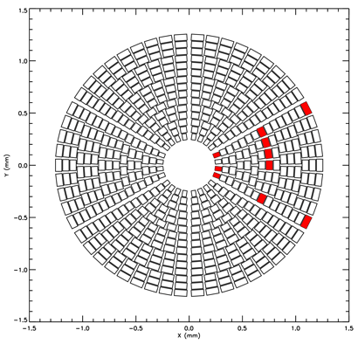
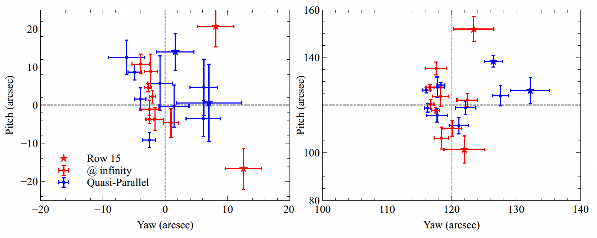
Mirror Node and Optical axis: XRCF
Mirror
The determination of the optical axis is the most challenging measurement.
mirror node location with respect to the MCS
tilt of the OA with respect the MCS.
MCS = Mirror Coordinate System is defined by metrology
OA_{system}
Misaligned MM
Must use vignetting curves to determine the OA_{sys} direction
Mirror node location by 150 µm
Determine OA direction by 10”

Slide 8
Calibration Requirements
Each mirror module needs OA and Focal length measured to XX and YY
Needed for installation to obtain target PSF
The system must measure OA and Focal length to XX and YY
Requires the re-measurement of each mirror module as installed in the mirror assembly to KK and ZZ with respect to a mirror coordinate system
Example requirements:
Parameter | Functionality & Core Test | FM calibration
Xray Optical axis | ≤20'' with 68% confidence | ≤30'', with 99.7% confidence
Focal length | ≤ 1mm with 99.7% confidence | ≤1 mm, with 99.7%

Slide 9
Demands on facilities
Number of mirror modules can be in the hundreds!
Mirror modules are generally small
Can be done at multiple and smaller beamlines
Could mount multiple mirror modules in chamber/beamline at same time
Still, it will take at least a day to characterize each module
Example: NewAthena (15 rows) has 600 mirror modules, which would take >2 years assuming 250 workdays a year
Then after integration the system OA and focal length must be determined
Requires a large specialized calibration facility
High in cost

Slide 10
To what degree can simulations replace actual measurements?
Can we device accurate enough metrology to skip steps?
To what degree do we need to X-ray characterize individual mirror modules?
Can we rely on X-ray measurements from individual mirror modules together with metrology to predict the integrated system performance?

Slide 11
Paper Proposal
Have the WG produce a paper that discusses:
The challenges with segmented optics calibration
Makes predictions
Makes recommendations
Helps NewAthena
Helps future proposals for large segmented optics

