Slide 1
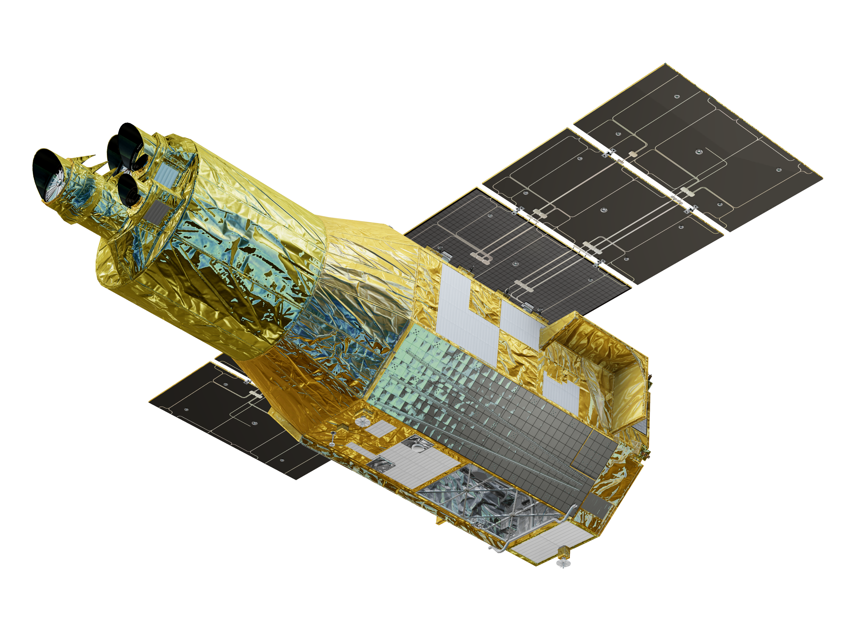
The XRISM mission status
Y. Terada (XRISM Science Operations Lead), S. Watanabe (XRISM PM), M. Tashiro (XRISM PI),
On behalf of XRISM Collaboration

Slide 2
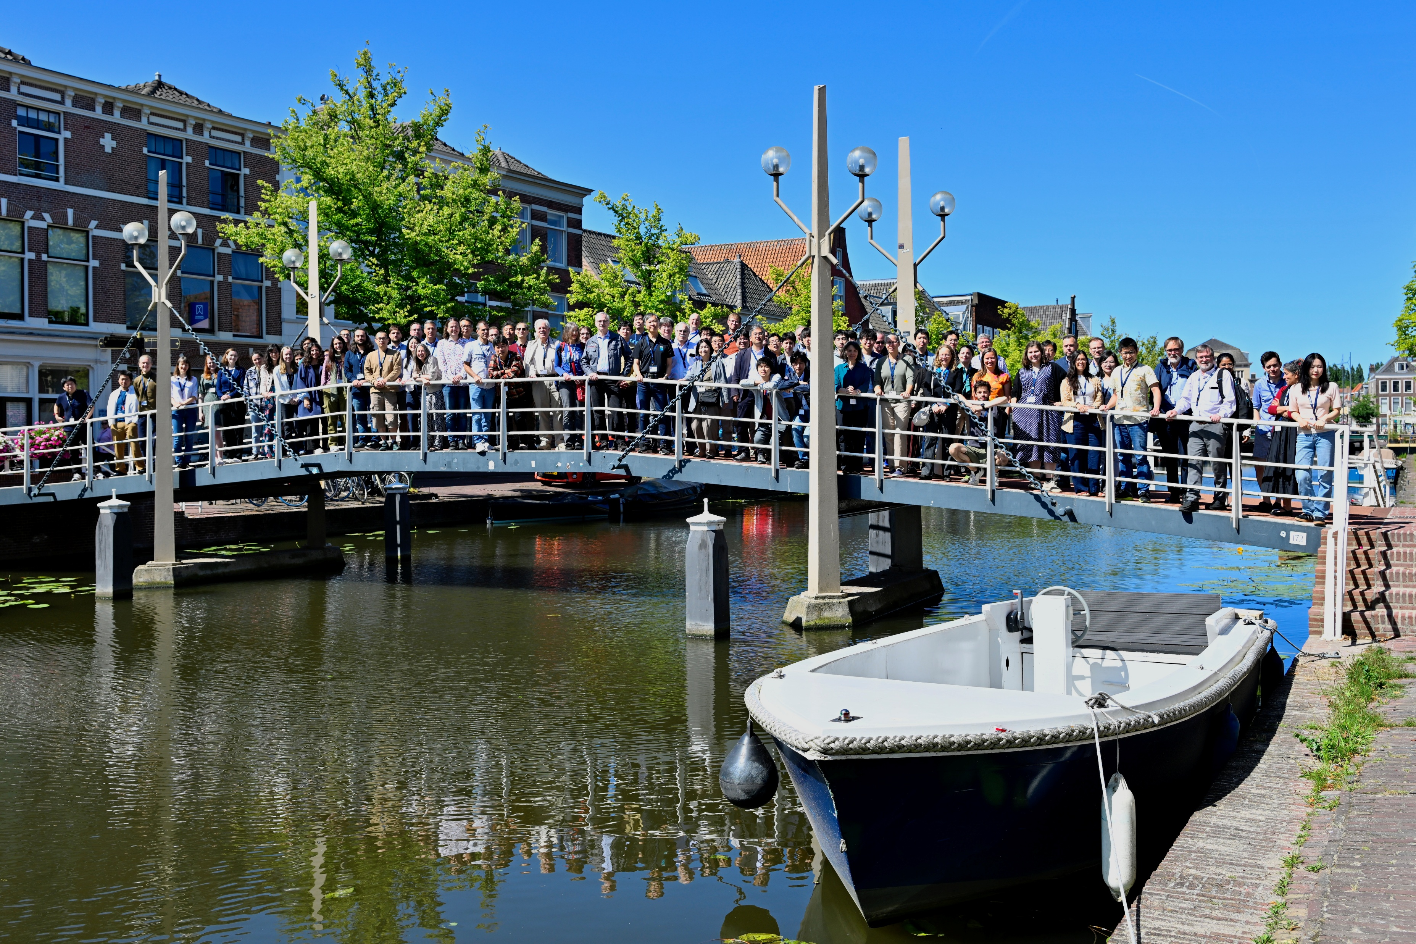
XRISM collaboration
-- CLOSED for Performance Verification Publication
2025.7.7-11, XRISM Science Meeting #8 (last)
Open for everybody now.
354 Scientists
134 XRISM Science Team (79 JAXA, 43 NASA,12 ESA),
39 XRISM Guest scientist, 48 PD, and 133 Graduated students

Slide 3
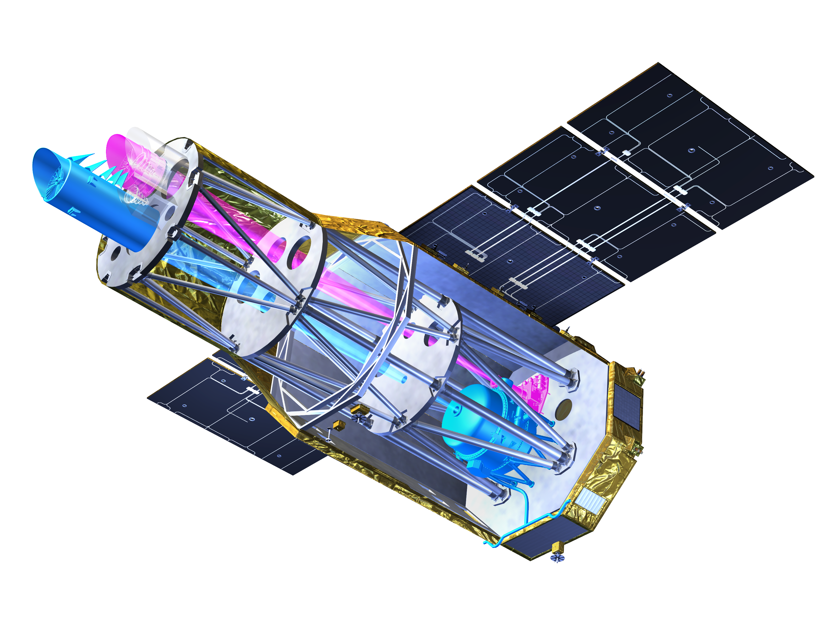
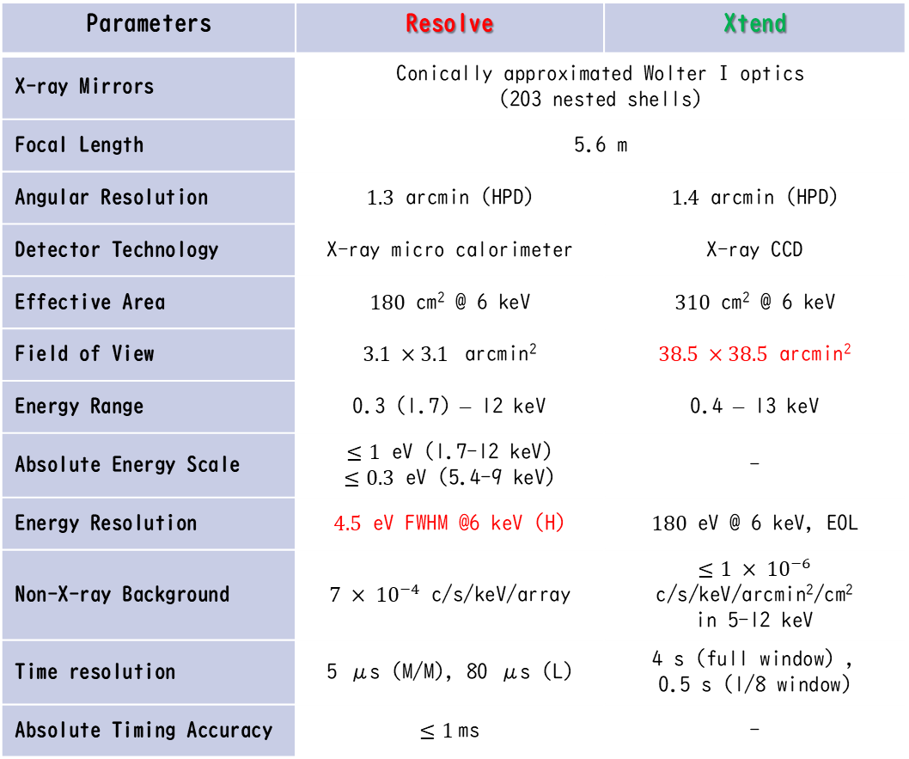
XRISM Payload Instruments
Tashiro et al. PASJ 2025
Parameters | Resolve | Xtend
X-ray Mirrors | Conically approximated Wolter I optics (203 nested shells)
Focal Length | 5.6 m
Angular Resolution | $1.3$ arcmin (HPD) | $1.4$ arcmin (HPD)
Detector Technology | X-ray micro calorimeter | X-ray CCD
Effective Area | $180$ cm² @ 6 keV | $310$ cm² @ 6 keV
Field of View | $3.1 ×3.1$ arcmin² | $38.5 ×38.5$ arcmin²
Energy Range | 0.3 (1.7) – 12 keV | 0.4 – 13 keV
Absolute Energy Scale | $≤1$ eV (1.7-12 keV) $≤0.3$ eV (5.4-9 keV) | -
Energy Resolution | $4.5$ eV FWHM @6 keV (H) | $180$ eV @ 6 keV, EOL
Non-X-ray Background | $7 × {10}^{−4}$ c/s/keV/array | $≤1 × {10}^{−6}$ c/s/keV/arcmin²/cm² in 5-12 keV
Time resolution | 5 μs (M/M), 80 μs (L) | 4 s (full window) , 0.5 s (1/8 window)
Absolute Timing Accuracy | $≤1$ms | -
Japan-US X-ray mission with ESA
Launch on 7 Sep 2023
Instruments; Resolve and Xtend
High-energy-resolution spectroscopy & large FOV imaging in keV band

Slide 4

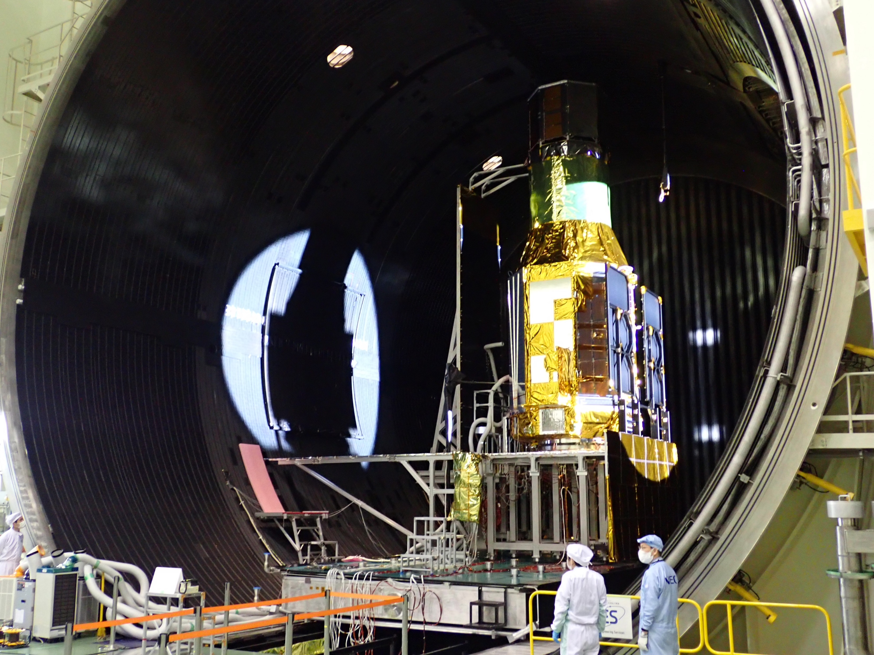
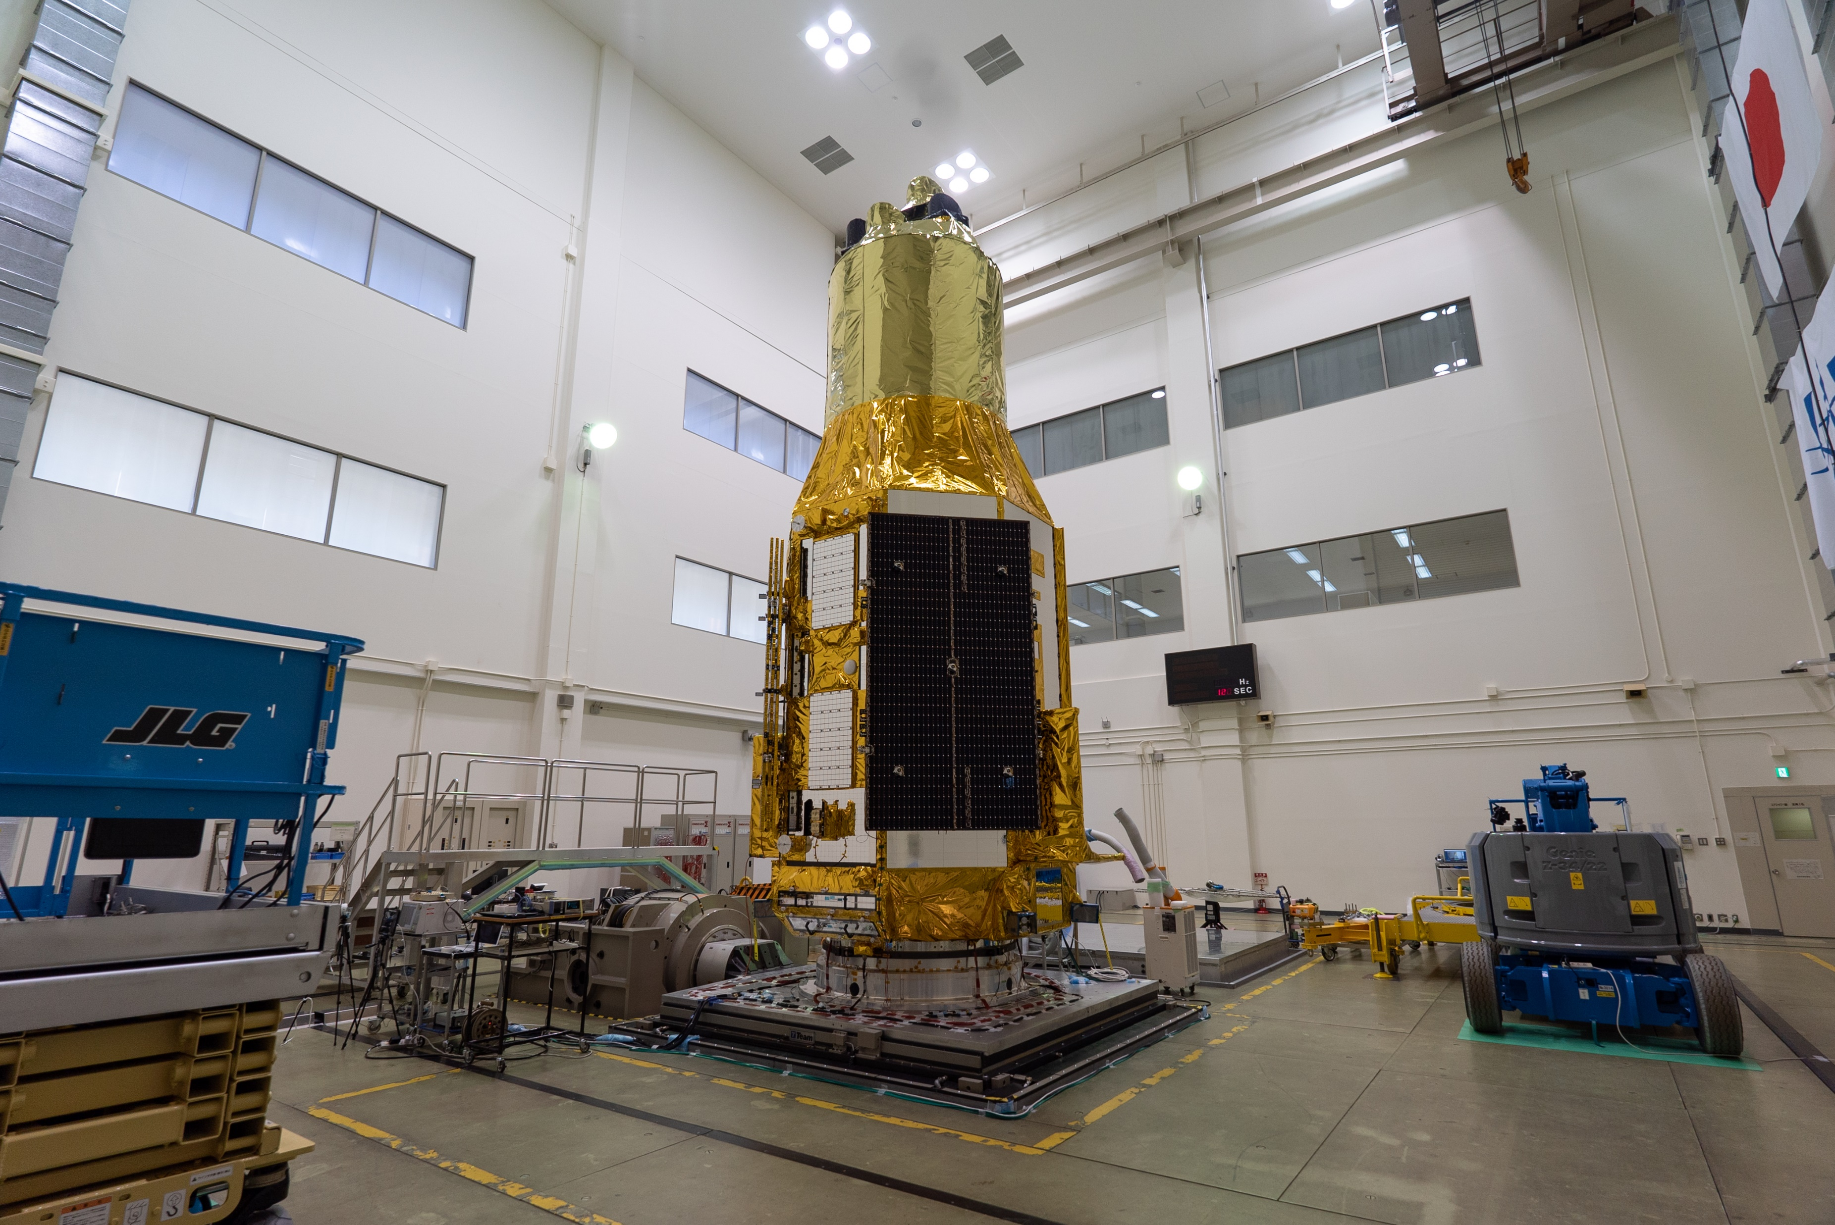
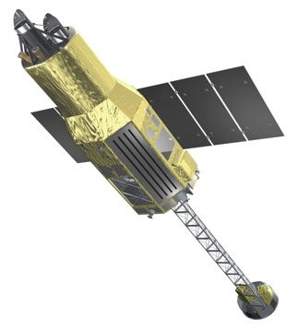
Ground development since 2017
JAXA PQR/PSR
Launch!
JAXA CDR/MOR
2023
Verification Tests
JAXA CDR
2022
JAXA PDR
Integration
JAXA MDR/SRR
JAXA pre-project start
NASA project start / NASA CDR
Fabrication
2021
Ground Calibration
Detail design
2020
Basic design
Ship to TNSC
Hitomi Lessons
XARM proposal
JAXA-NASA collaboration
2019
NASA-JAXA
XARM Proposal
Lessons & Close
Investigation
Hitomi Failure
2018
XARM→ XRISM
2017
2016
© JAXA
Thermal Vacuum test @TKSC
Vibration test @TKSC

Slide 5
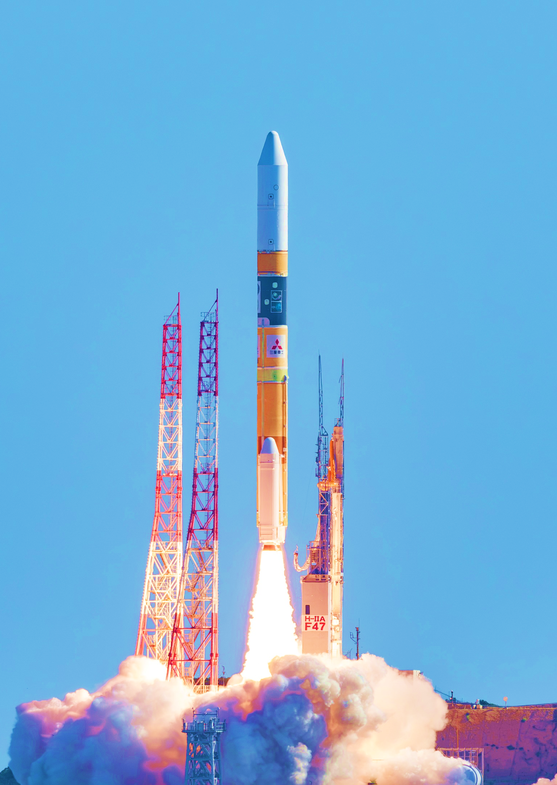
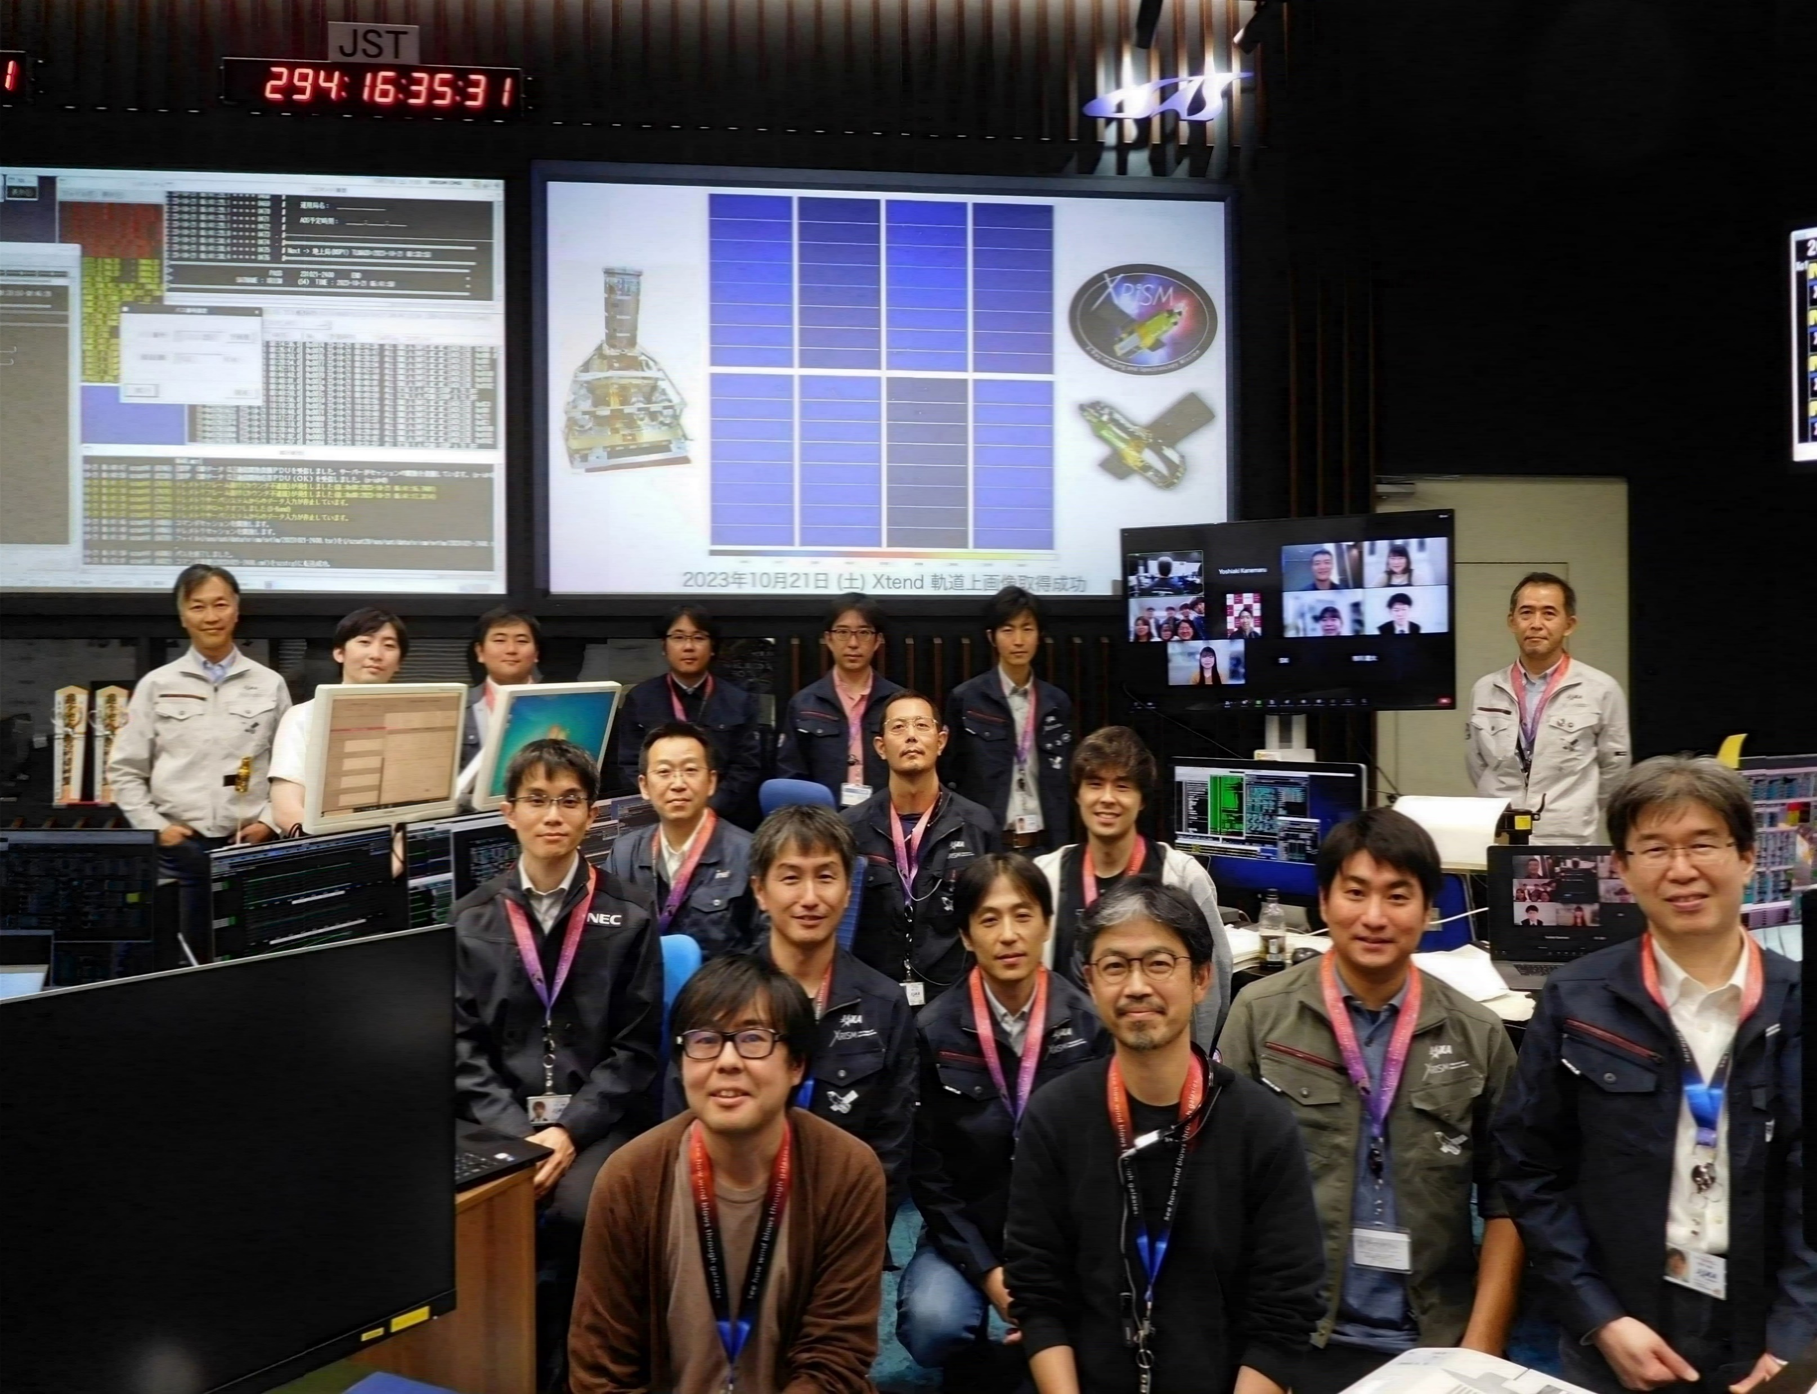
Now, in Nominal Operation Phase
We are here.
Sep
2023
Feb
2024
Aug
2024
Aug
2025
Oct
2025
Jun
2026
Sep
2026
May
2027
Jun
2027
Initial
Nominal Operation phase
Nominal Operation
Time
Launch
Critical
Commissioning
(cycle 4?)
GV open operation & Calibration
Guest Observation prog. (cycle 3)
Guest Observation prog. (cycle 1)
Guest Observation prog. (cycle 2)
Performance Verification & Calibration
next
Thank you for IACHEC collaboration
AO-2 observations are on going (AO-3 coming soon)
Official Nominal operation phase ends in Aug 2026 (3 yr after launch)
– extension : under review

Slide 6
Sep 2025: Resolve Gate Valve Open operation #4
Fujimoto et al JATIS 2017
Midooka et al JATIS 2021
Gate Valve
Detector
He tank
Resolve Dewar & cryocoolers
We performed GV Open operation #4 in Sep 2025 (between AO-1 and AO-2)
Vibrate GV under warm (0℃/28 min) & cold (-15℃/37 min) conditions
– GV is still closed. No damage on instruments

Slide 7
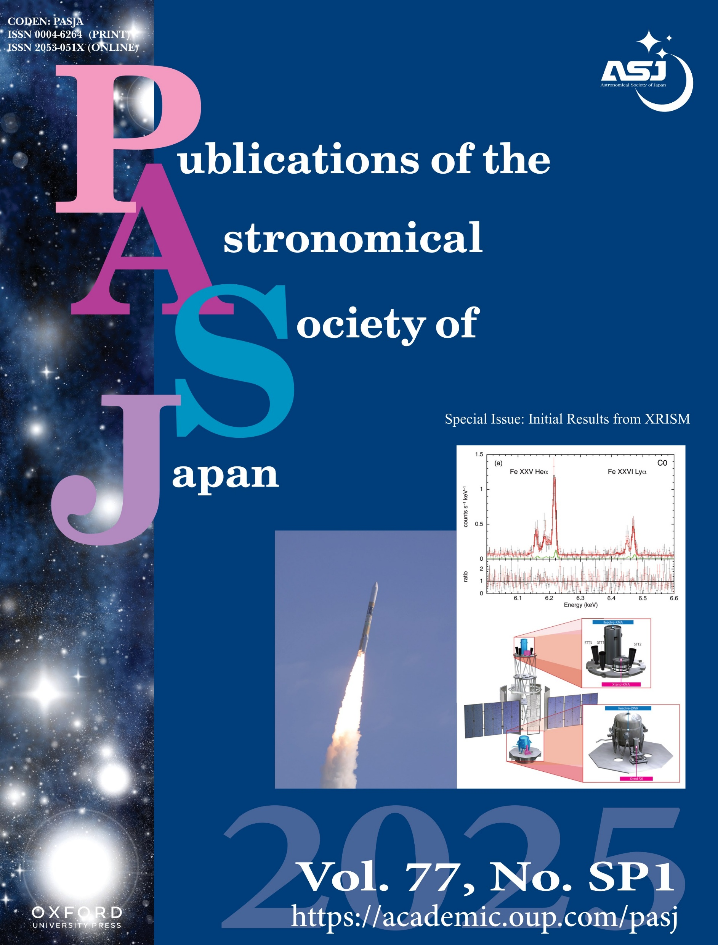
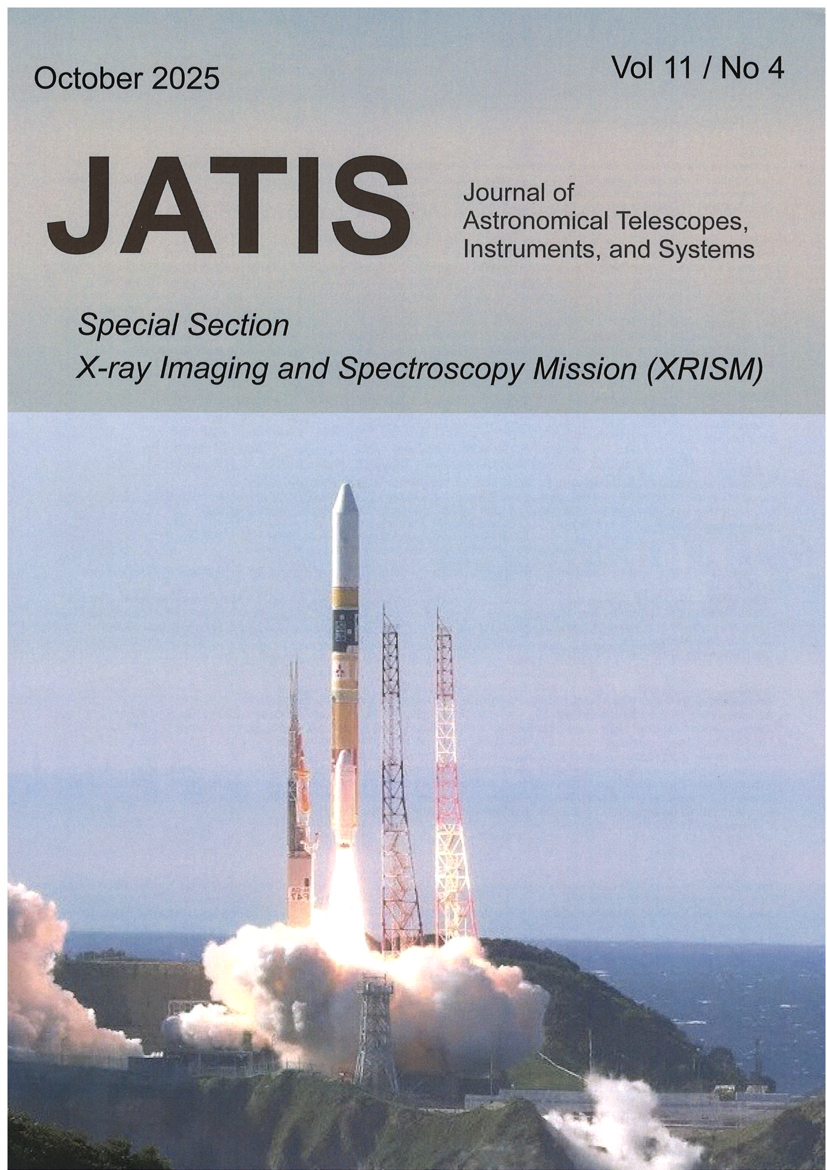

Publication on XRISM instruments / science
XRISM related papers: Total 120
Nature:
5 papers
Nature Astronomy:
2 papers
Ph.D Thesis
> 9 PhD
PASJ XRISM Special Issue 2026
https://academic.oup.com/pasj/issue/77/Supplement_1
JATIS XRISM Special Section 2026
https://www.spiedigitallibrary.org/journals/Journal-of-Astronomical-Telescopes-Instruments-and-Systems/volume-11/issue-4#SpecialSectionontheXRISMXRayObservatory
22 Papers
26 Papers
Coming soon…
The Dynamic Universe through High-Resolution X-Ray Spectroscopy (Springer, 2026-2027)

Slide 8
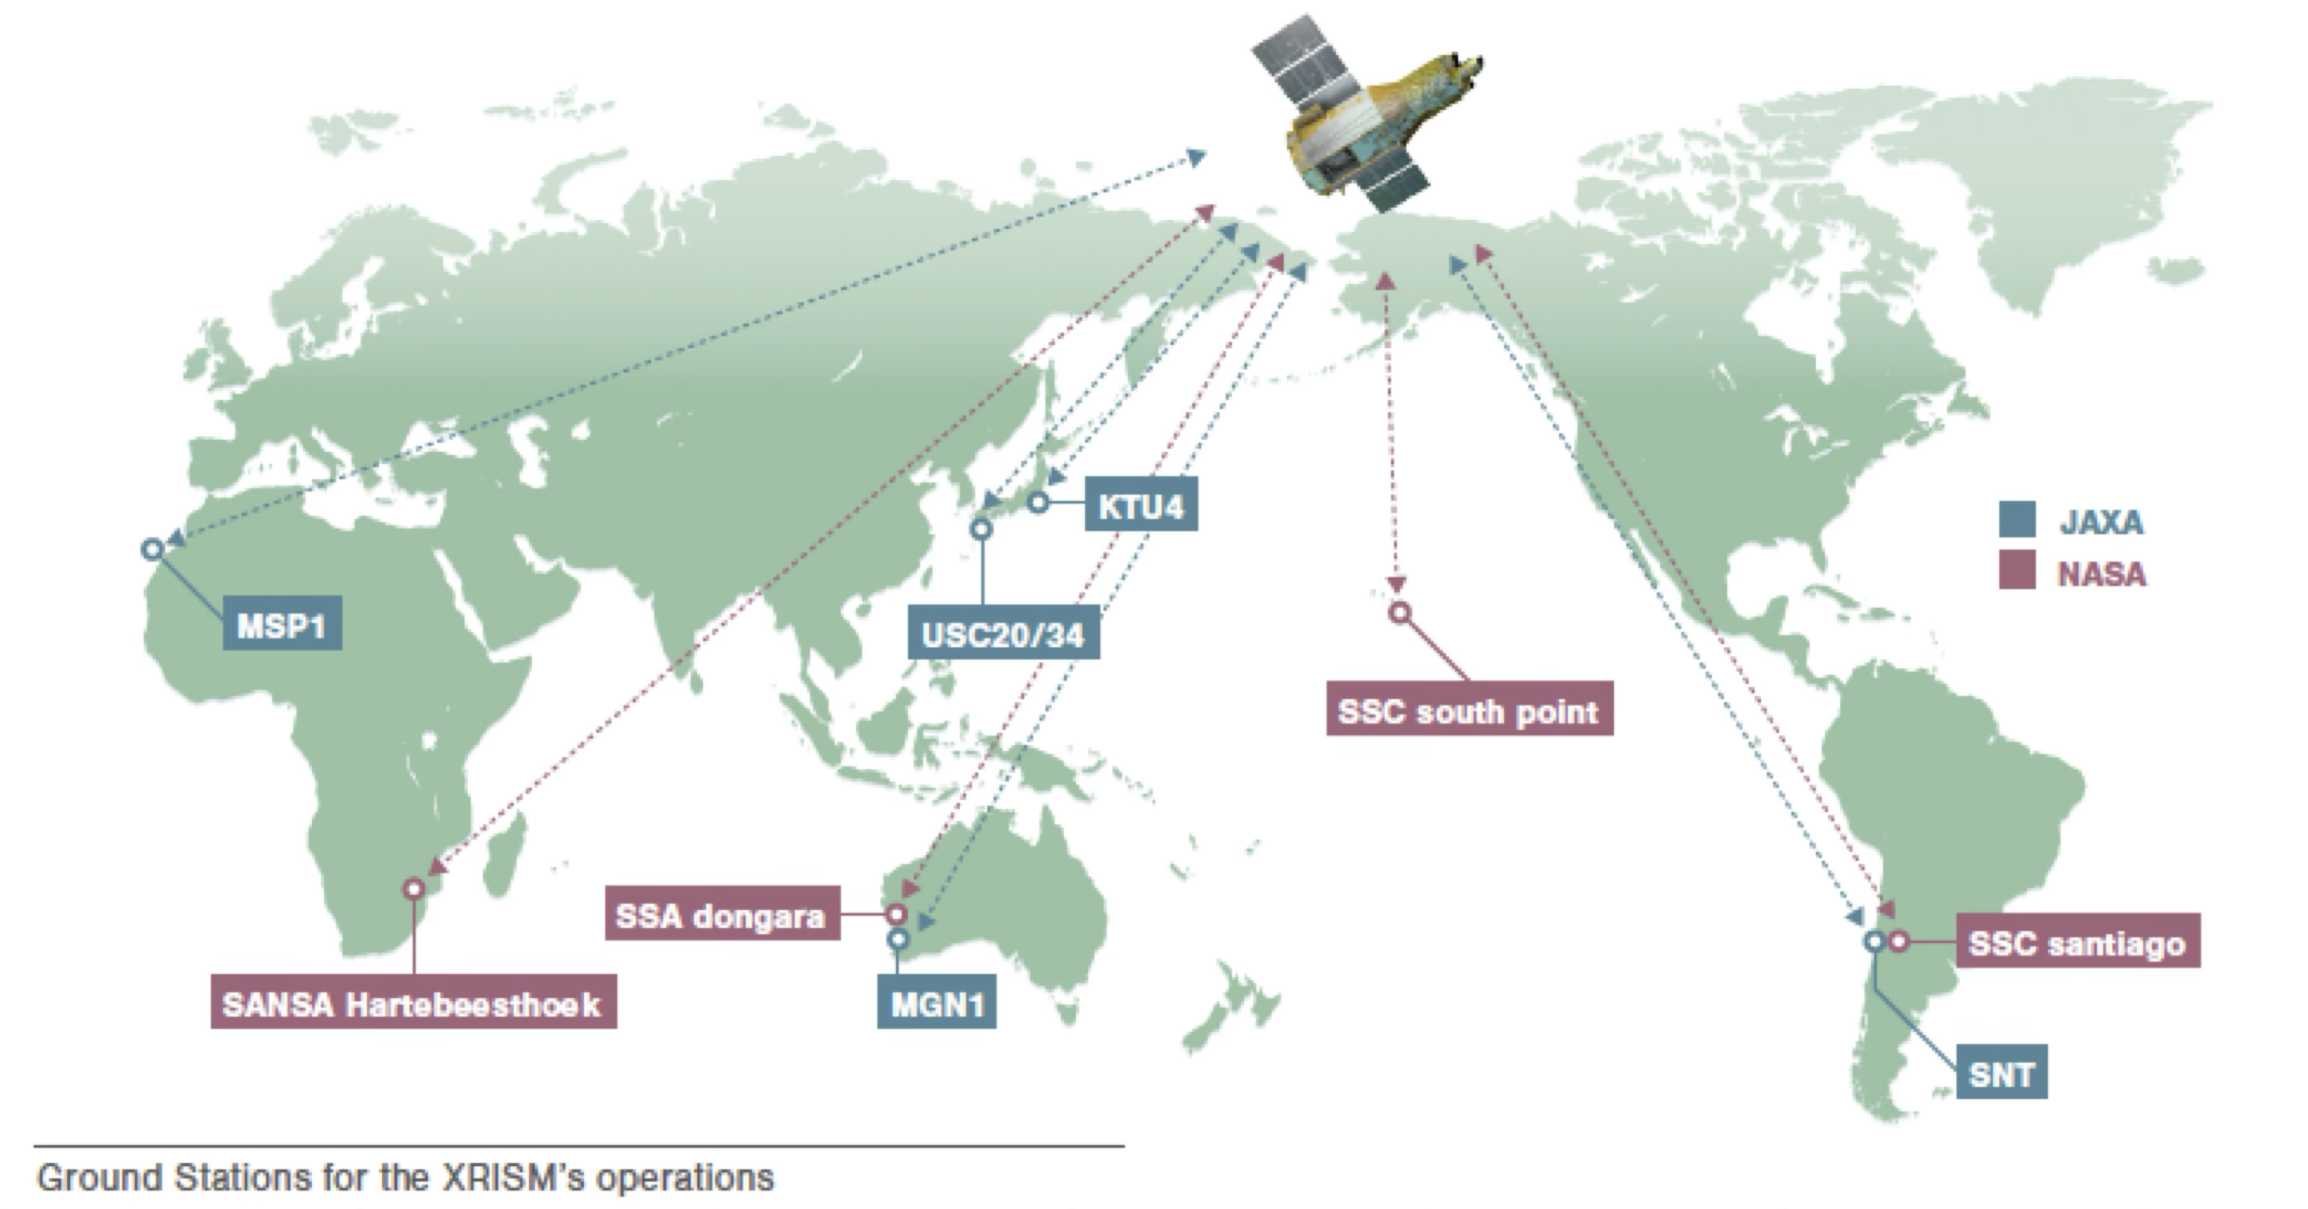
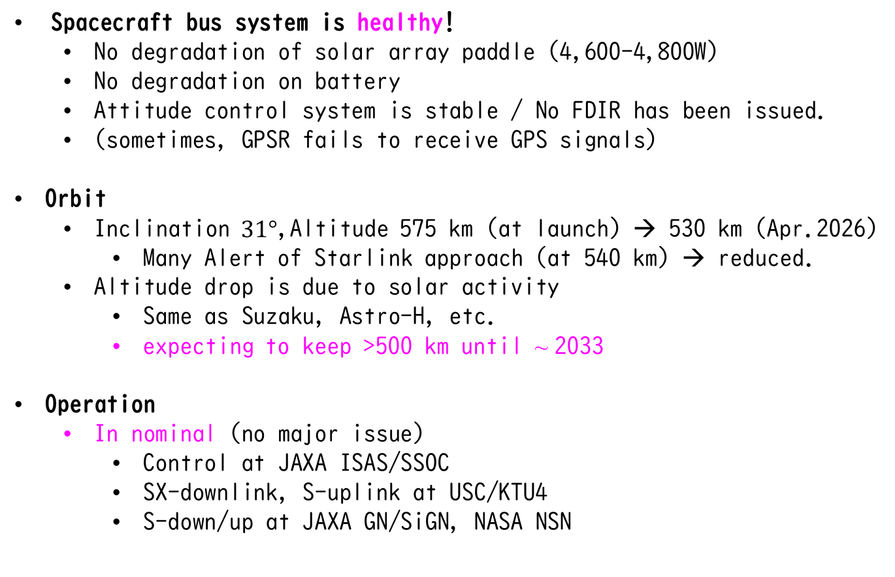
Status (Spacecraft / Operation)
Spacecraft bus system is healthy!
No degradation of solar array paddle (4,600-4,800W)
No degradation on battery
Attitude control system is stable / No FDIR has been issued.
(sometimes, GPSR fails to receive GPS signals)
Orbit
Inclination $31°$,Altitude 575 km (at launch) → 530 km (Apr.2026)
Many Alert of Starlink approach (at 540 km) → reduced.
Altitude drop is due to solar activity
Same as Suzaku, Astro-H, etc.
expecting to keep >500 km until ~ 2033
Operation
In nominal (no major issue)
Control at JAXA ISAS/SSOC
SX-downlink, S-uplink at USC/KTU4
S-down/up at JAXA GN/SiGN, NASA NSN

Slide 9
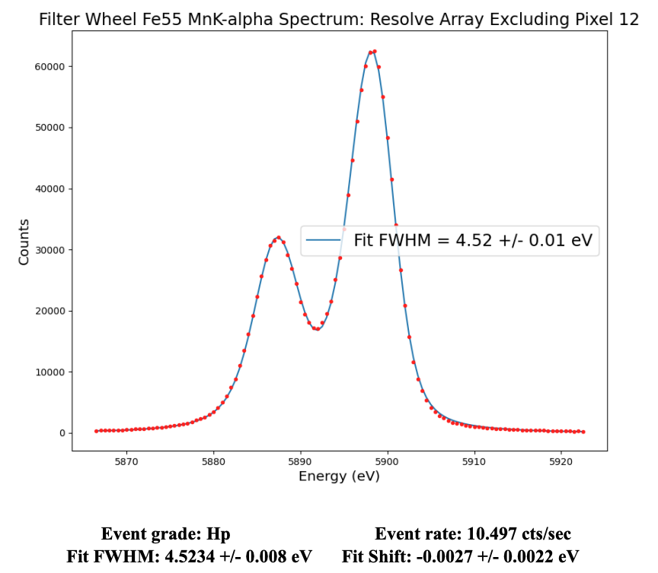
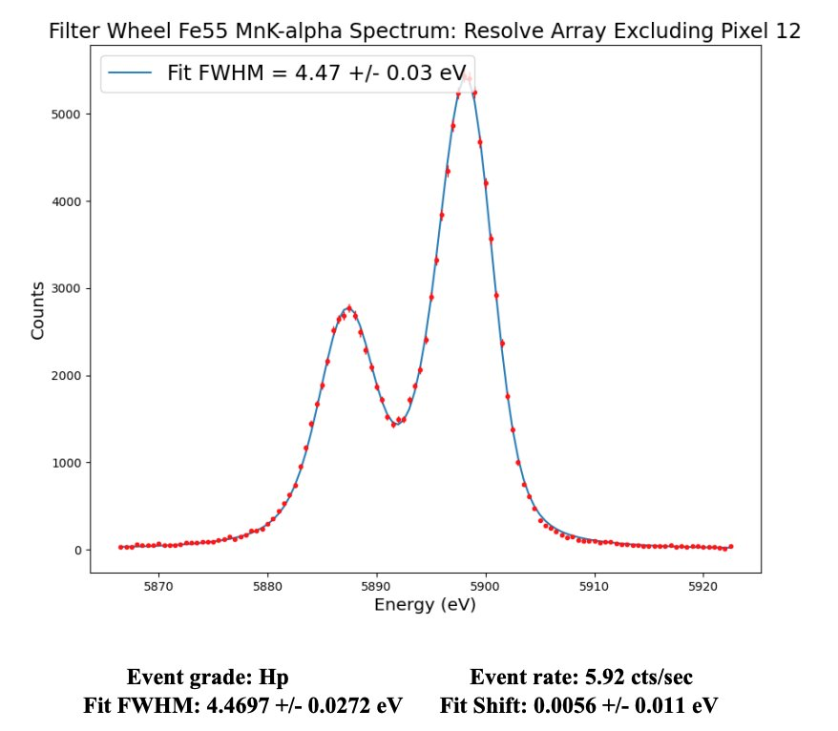
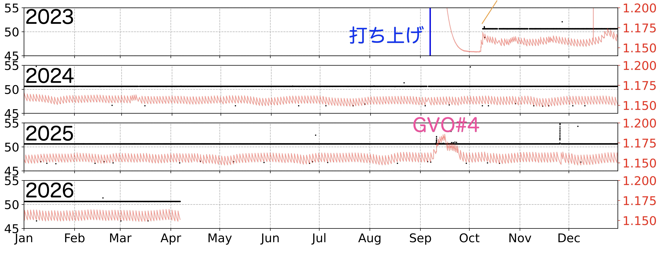
Quick Status of Resolve
See presentations by Eckart, Porter, Kilbourne etal
Continue to meet energy-resolution requirement < 5 eV
12 Oct 2023 2 Apr 2026
No degradation on ADR recycle / coolers
Lifetime of liquid He : ~ 2029-2030 → Then, Cryogen free mode
Launch
Resolve commissioning
Sensor Temperature (mK)
He Tank Temperature (K)

Slide 10
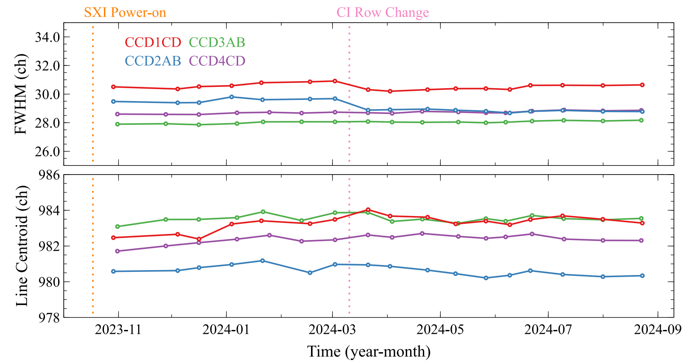
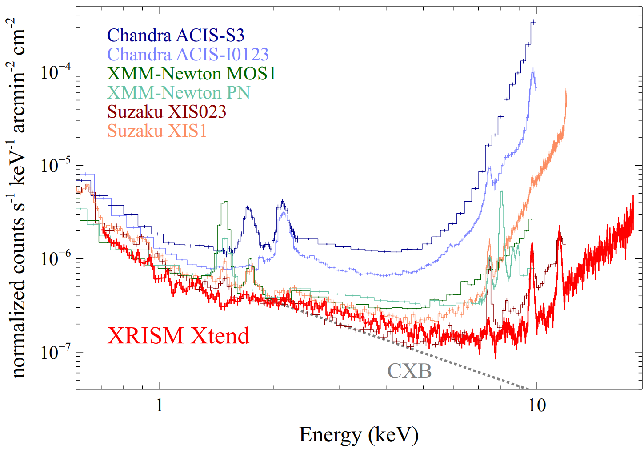
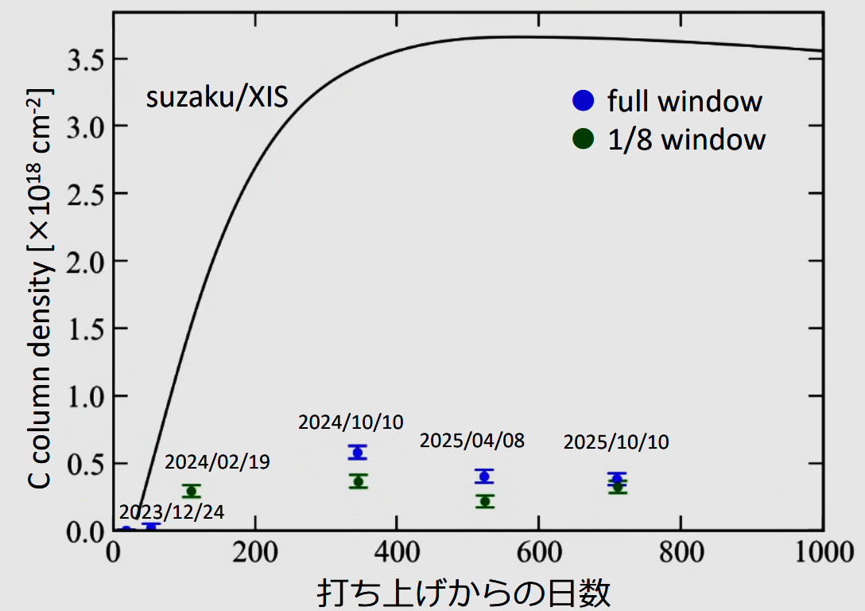
Quick Status of Xtend
See presentations by Suzuki, Yoneyama, Inoue, etal
No unexpected degradation
Energy resolution 170 - 180 eV
Effective area, quantum efficiency
No major contamination
Keep lowest background level
Days after launch

Slide 11
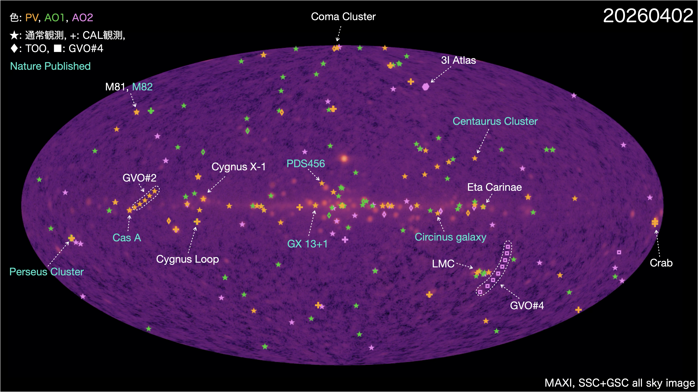
Quick Status of Science Operations
See presentations by Terada, Yoshimoto etal

Slide 12
19 Presentations in this IACHEC workshop
Mission/Science Operations Status
XRISM mission status Yukikatsu Terada
XRISM Science Operations detail and latest status Yukikatsu Terada
Current status of XRISM/Xtend Transient Search Marina Yoshimoto
XRISM/Resolve
Resolve’s energy scale calibration and associated uncertainties Megan Eckart
Reconstructing the time dependent energy scale for XRISM/Resolve Scott Porter
XRISM/Resolve Mid-res Analysis Hiromitsu Takahashi
The In-Orbit Instrumental Background of the Resolve X-ray Spectrometer on the XRISM Observatory Caroline Kilbourne
XRISM Resolve Spectra of N132D Hiromasa Suzuki
Spectral Models for Cas A based on XRISM Resolve Manan Agarwal
XRISM/Xtend
XRISM/Xtend calibration status: effective area, contamination, energy resolution, and pile-up Tomokage Yoneyama
XRISM/Xtend calibration status: detector response and non-X-ray background Hiromasa Suzuki
Flaring events seen by XRISM/Xtend during night‑Earth observations Hiromasa Suzuki
XRISM + IACHEC collaboration
XRISM-NuSTAR-XMM-Newton-Chandra Effective Area Cross-calibration using 3C 273 Aysegul Tumer
XRISM Microcalorimeter View of Cassiopeia A: A Bayesian Analysis with UltraSPEX Manan Agarwal
In-orbit cross-calibration of the effective area and quantum efficiency of the Soft X-ray Imager for Xtend onboard XRISM Shun Inoue
Tycho's SNR: Bayesian insights based on Chandra and XRISM Resolve data Leila Godinaud
Cross-Calibration of XRISM Resolve and Xtend with Several Nearby Galaxy Clusters Itsuki Aihara
Verification of the Timing Accuracy of XRISM/Resolve with the Updated CALDB Yugo Motogami
Relative Energy Calibration Accuracy of XRISM/Resolve and NuSTAR Megumi Shidatsu
Many XRISM members are here in this room. Let’s discuss.

Slide 13
Thank you.

