Slide 1
Reconstructing the time dependent energy scale for XRISM/Resolve
F. Scott Porter
XRISM/Resolve Instrument Scientist
NASA Goddard Space Flight Center
R. Cumbee, M. E. Eckart, R. Fujimoto, Y. Ishisaki, R. L. Kelley, C. A. Kilbourne, M.A. Leutenegger, M. Loewenstein, M. Mizumoto, M. Sawada, R. Shipman, Y. Takei, M. Tsujimoto, S. Yamada, Y. Uchida, Y. Maeda, K. Sato, Y. Kanemaru
IACHEC, April 21, 2026
Chandra image
Hitomi/SXS spectrum

Slide 2
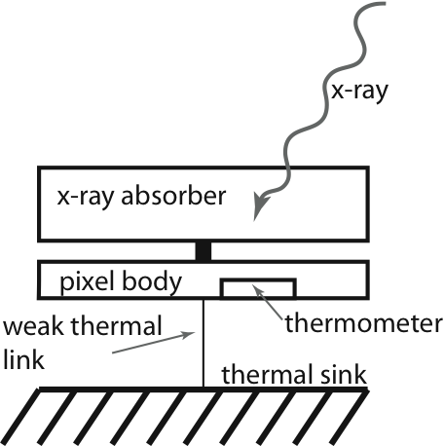
X-ray calorimetry
An x-ray calorimeter is a thermal measurement of the photon energy
High resolution non-dispersive spectrometer
linear detectors: large bandpass
Must operate at low temperatures for high resolution
IR/microwave

Slide 3
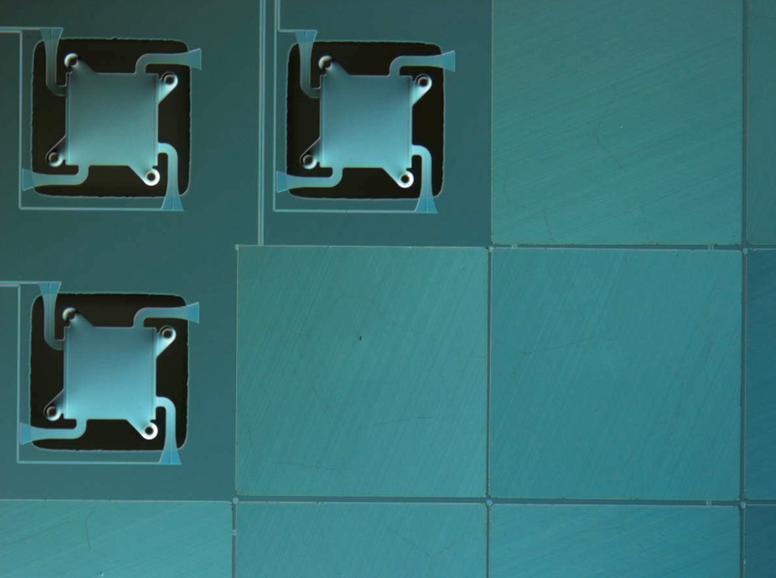
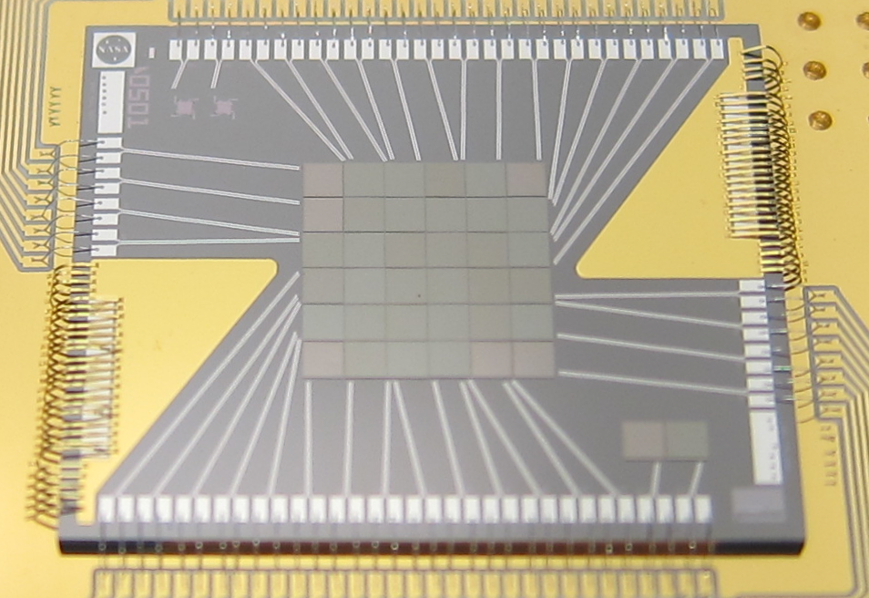
The XRISM/Resolve Detector
X-ray absorbers attached
XRISM detector:
Pixel pitch = 0.82 mm

Slide 4
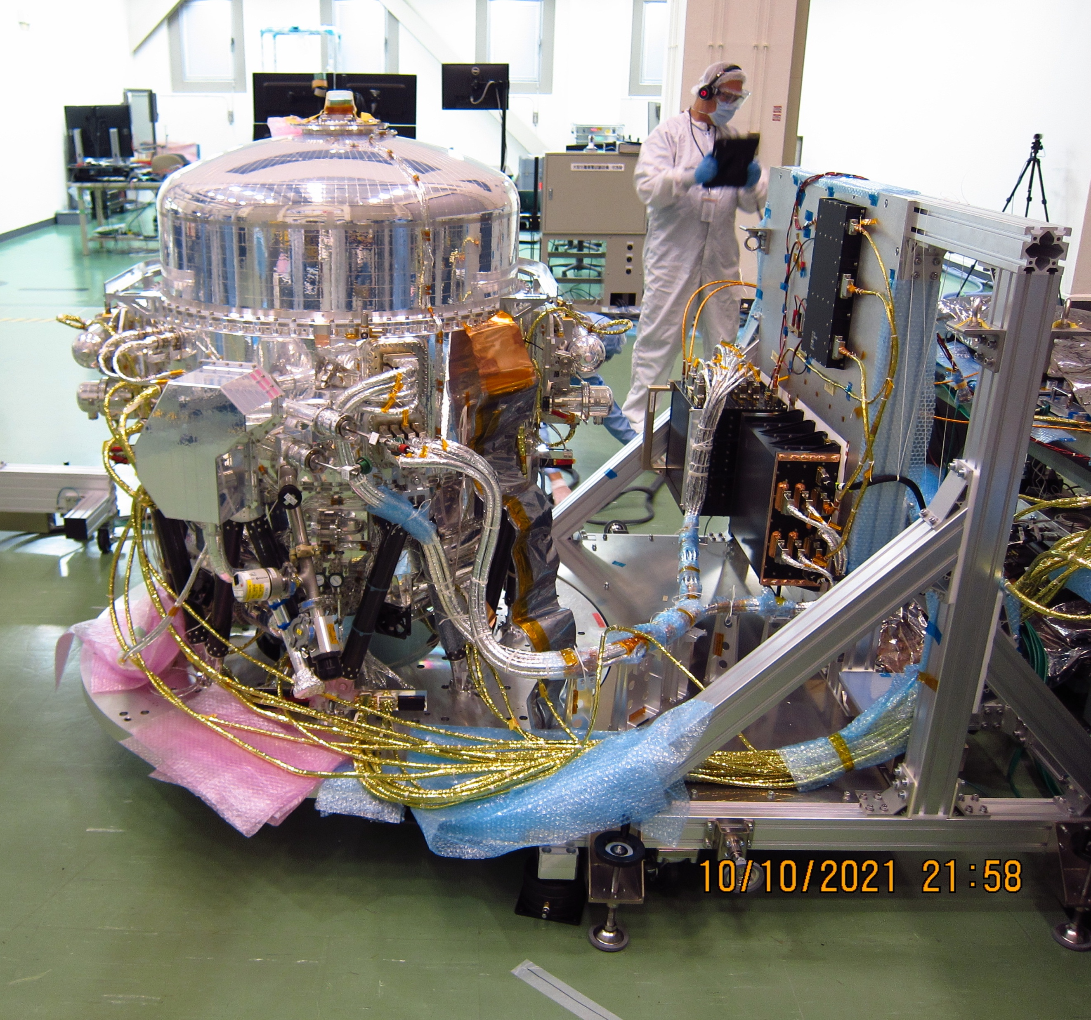
Resolve – Cryostat

Slide 5
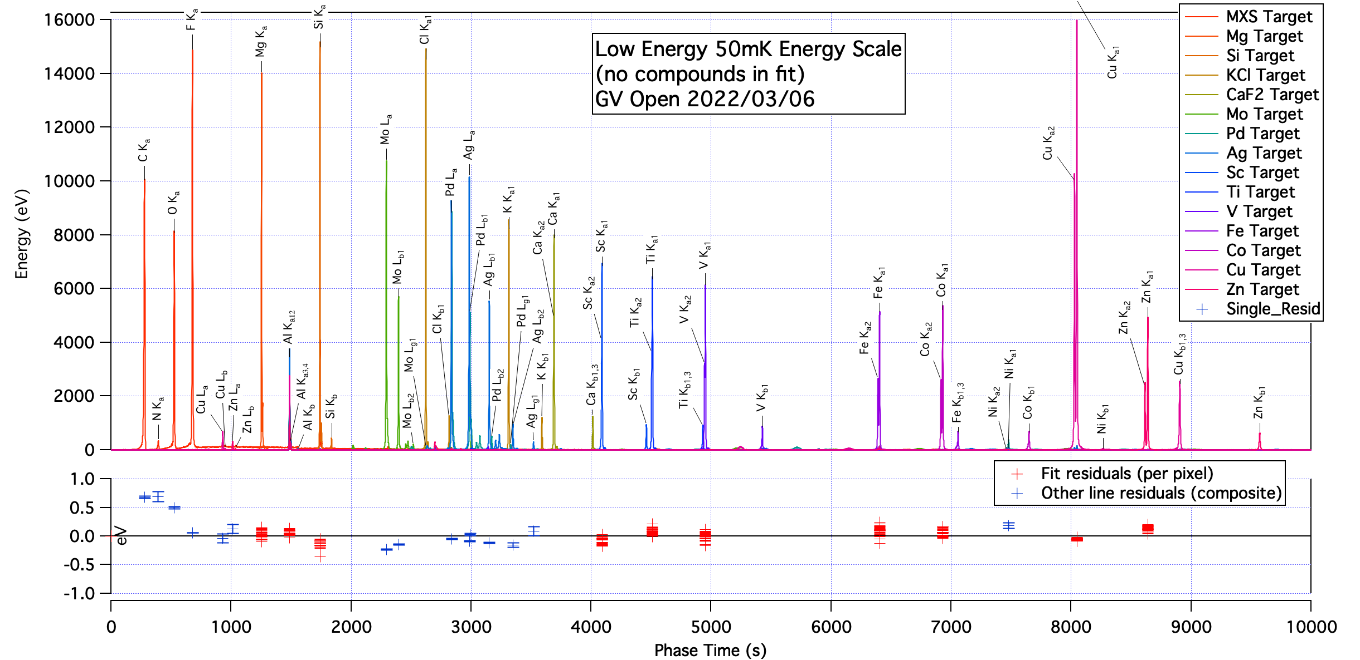
Ground energy scale calibration
Energy scales measured parametrically as a function of temperature:
Counts/0.5 eV bin
Residuals (eV)
Energy (eV)

Slide 6
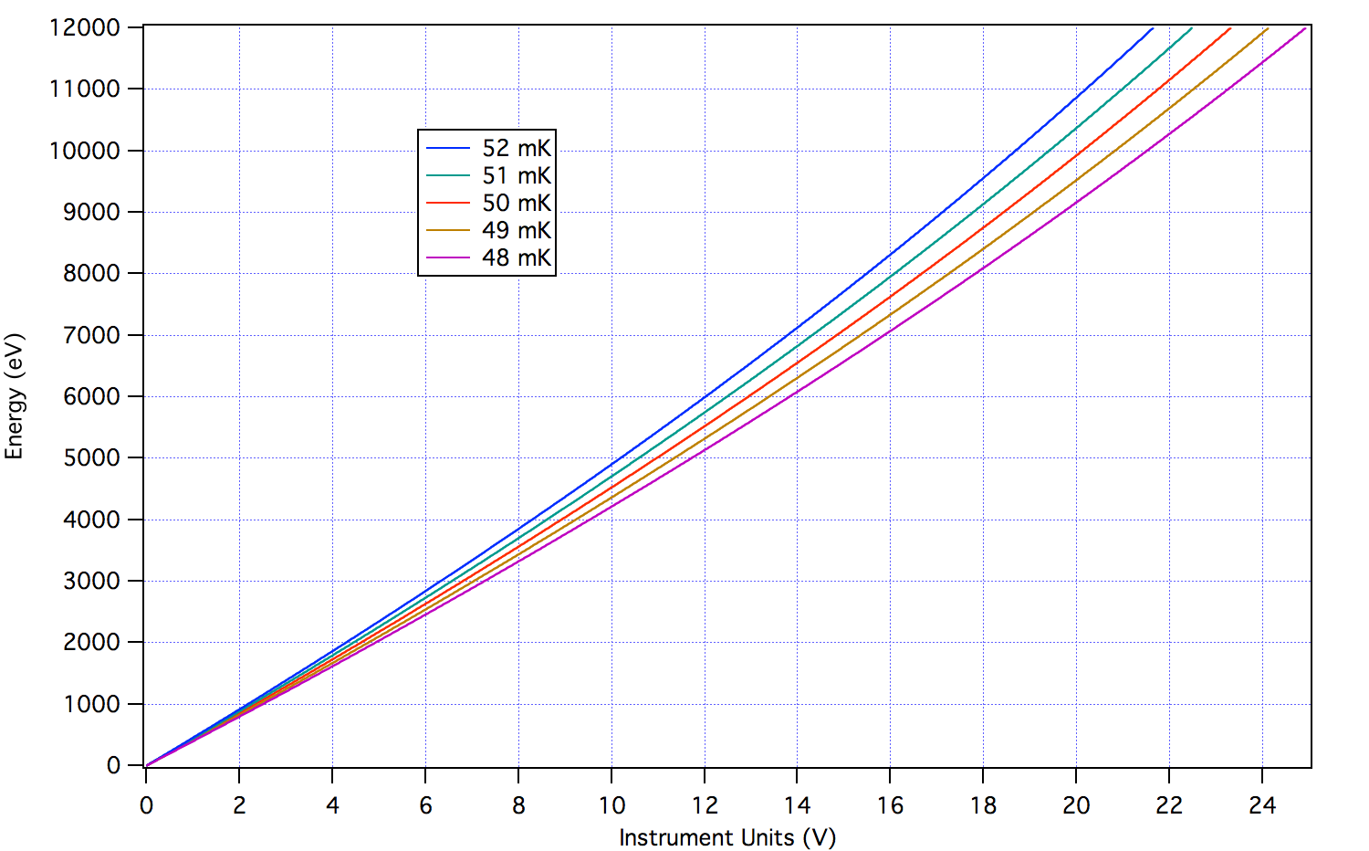
A couple of words about calibration
Detector gain is not intrinsically stable
These are thermal detectors
They measure energy and power
  Very sensitive to their environment
Thermal response of the electronics
  Thermometer/temperature control
  Amplifier gain
  Detector bias
→ Result is that gain is time dependent
Gain is non-linear
Detectors are intrinsically non-linear
Pulse analysis method adds nonlinearity
Measured energy scales parametrically in ground calibration:

Slide 7
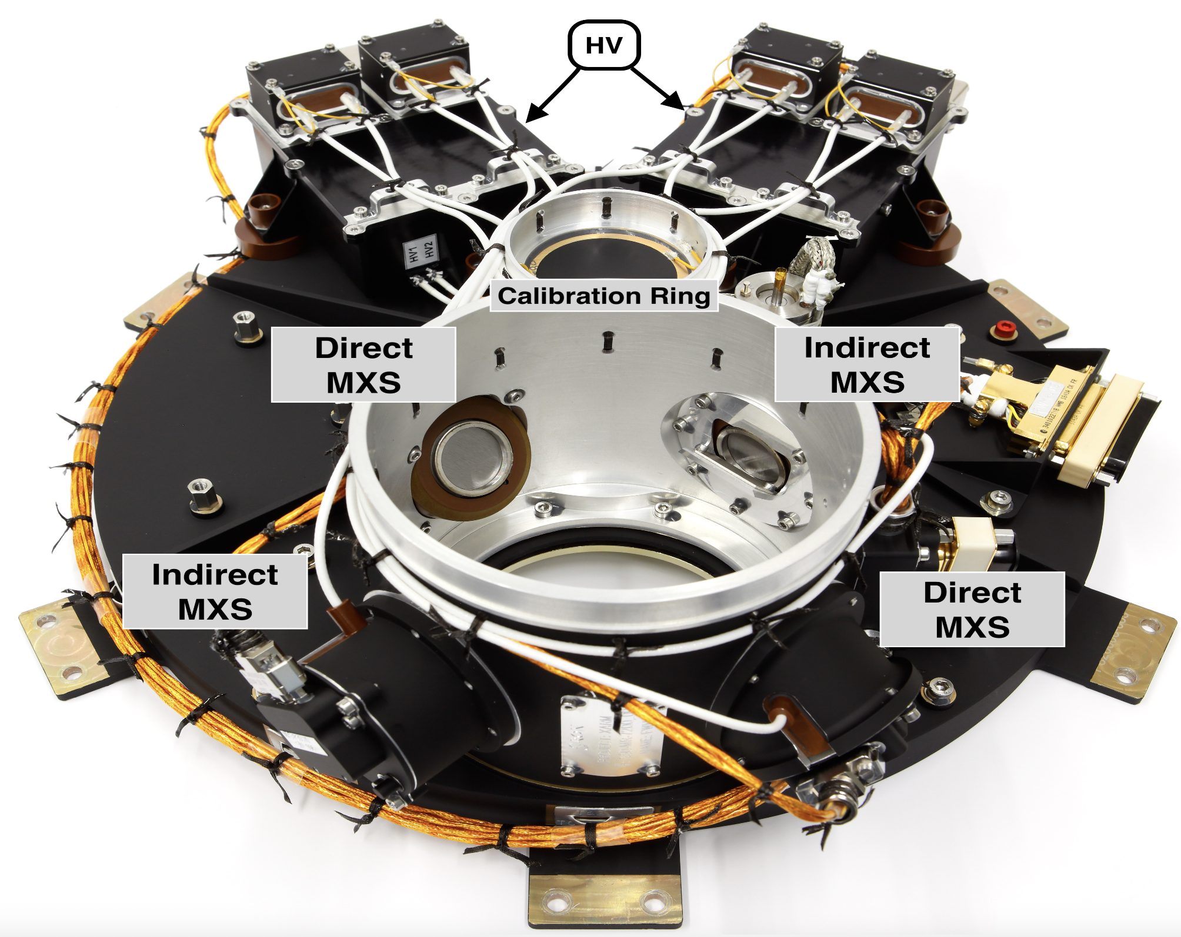
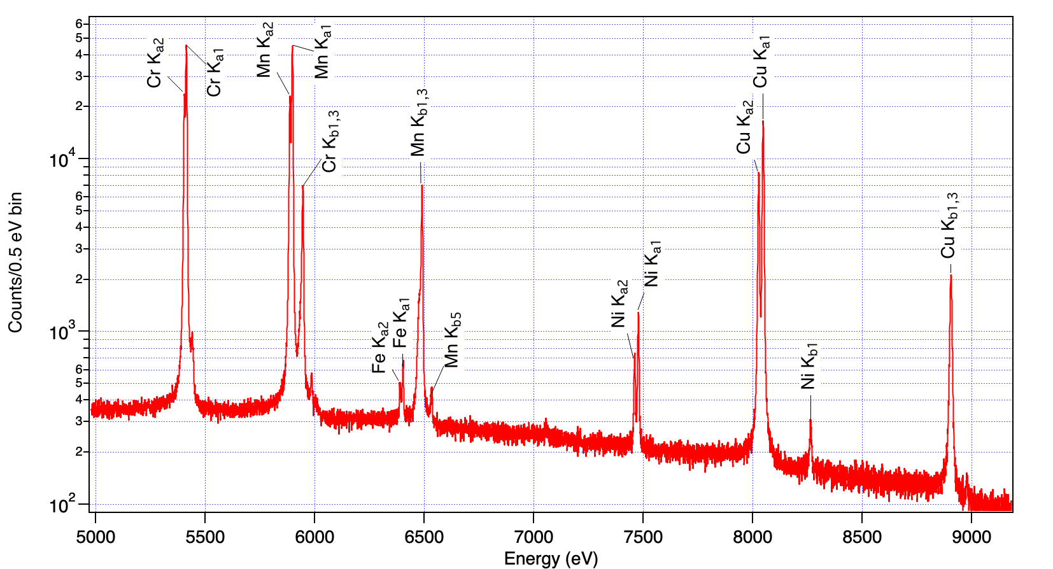
Need to track the gain and reconstruct the energy scale as a function of time
On-board calibration sources:
Calibration pixel + collimated ⁵⁵Fe
⁵⁵Fe on the Filter wheel
Modulated x-ray sources on the FW
April 2026
Cal pixel

Slide 8
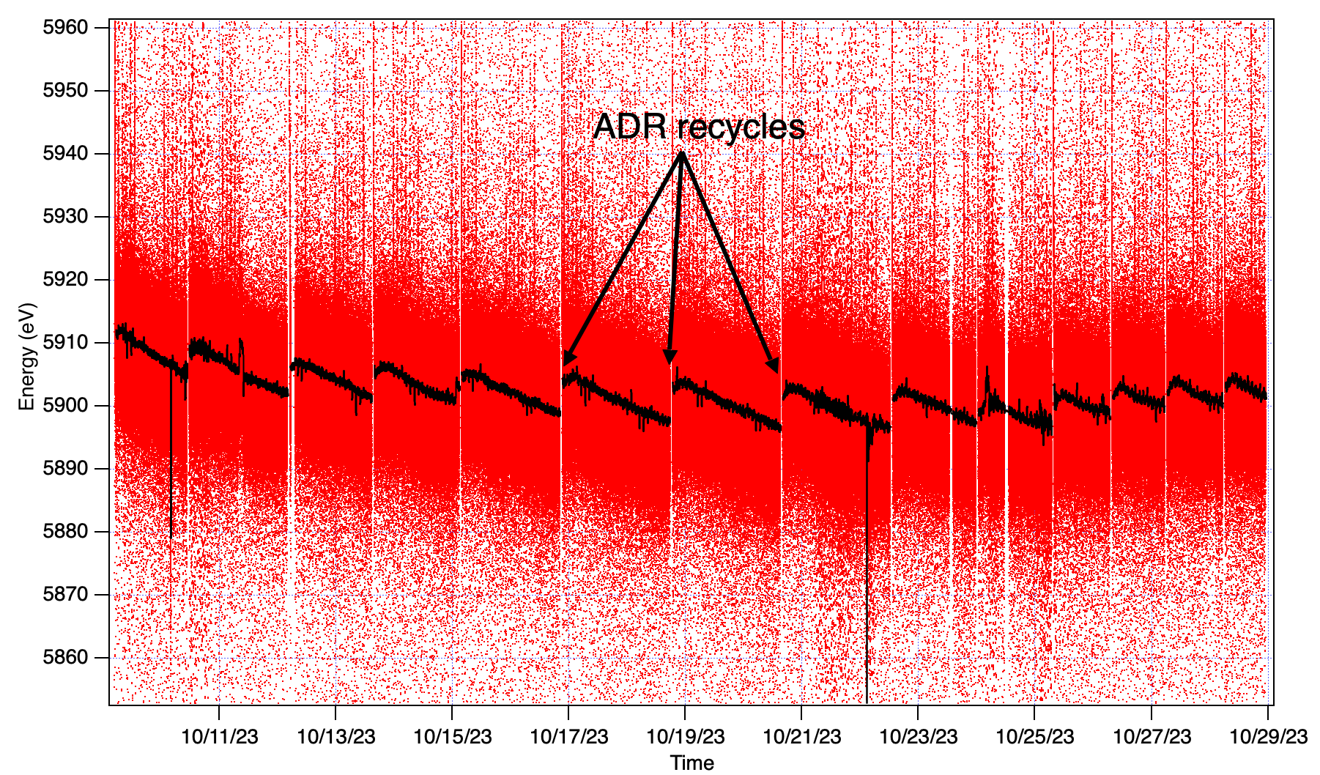
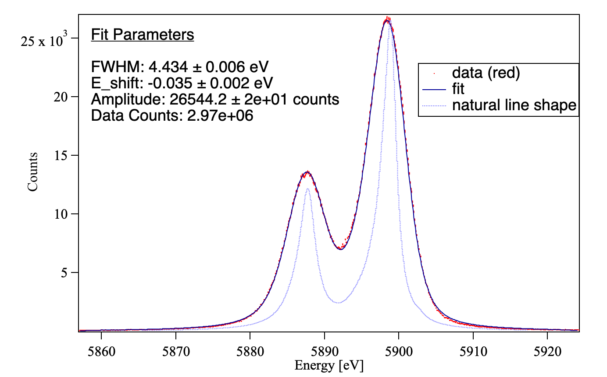
Energy scale reconstruction
XRISM on orbit
Gain tracking function

Slide 9
Reconstruction algorithm
Parameterize all changes in gain as the “effective” temperature of the pixel
Based on apparent “energy” of the fiducial measurement
  Derive effective temperature
  Synthesize new energy scale for each pixel for each time step
XRISM: Porter et al., JLTP (2016)
XIFU: Cucchetti et al., JLTP (2024)

Slide 10
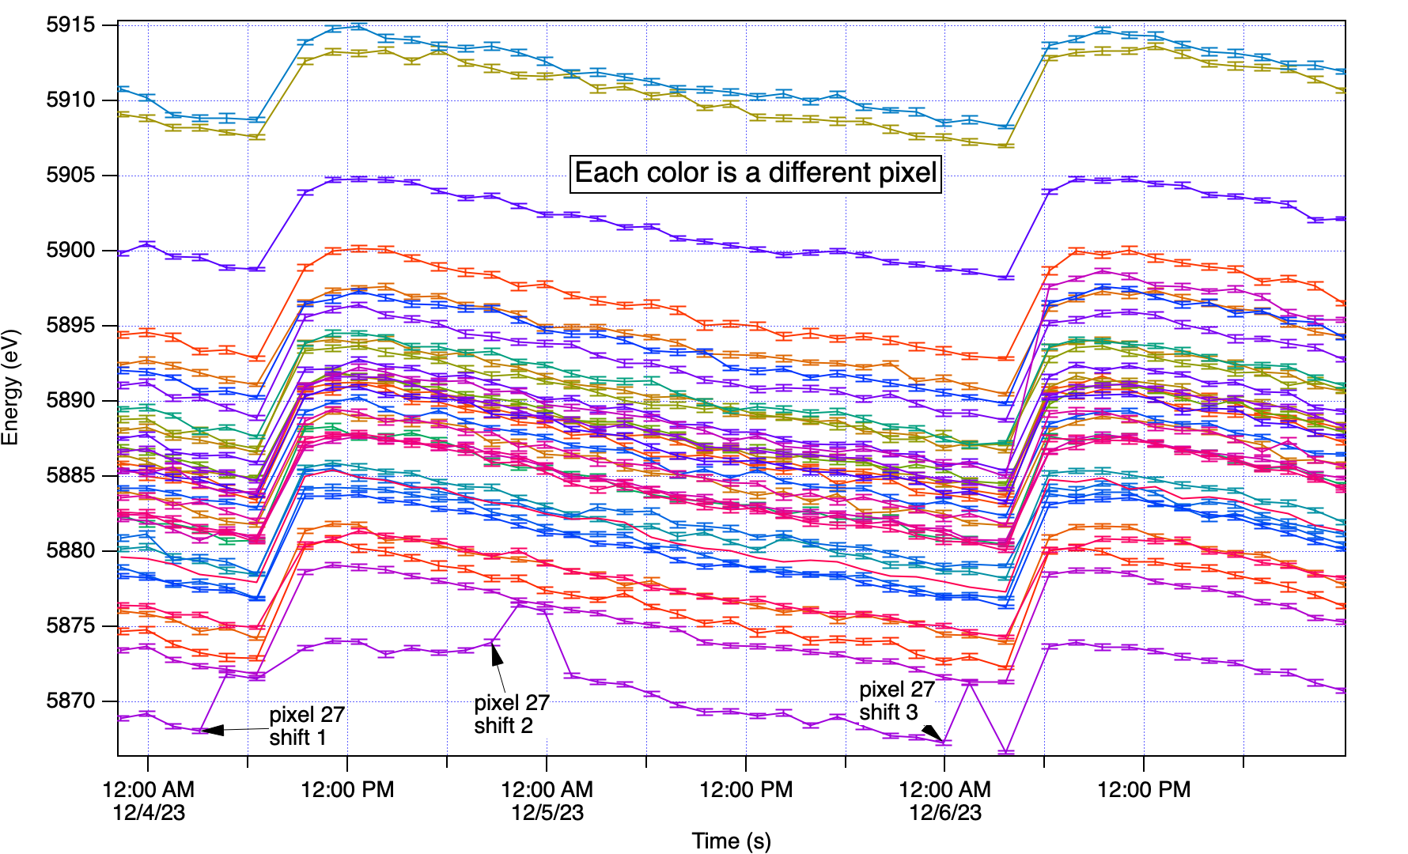
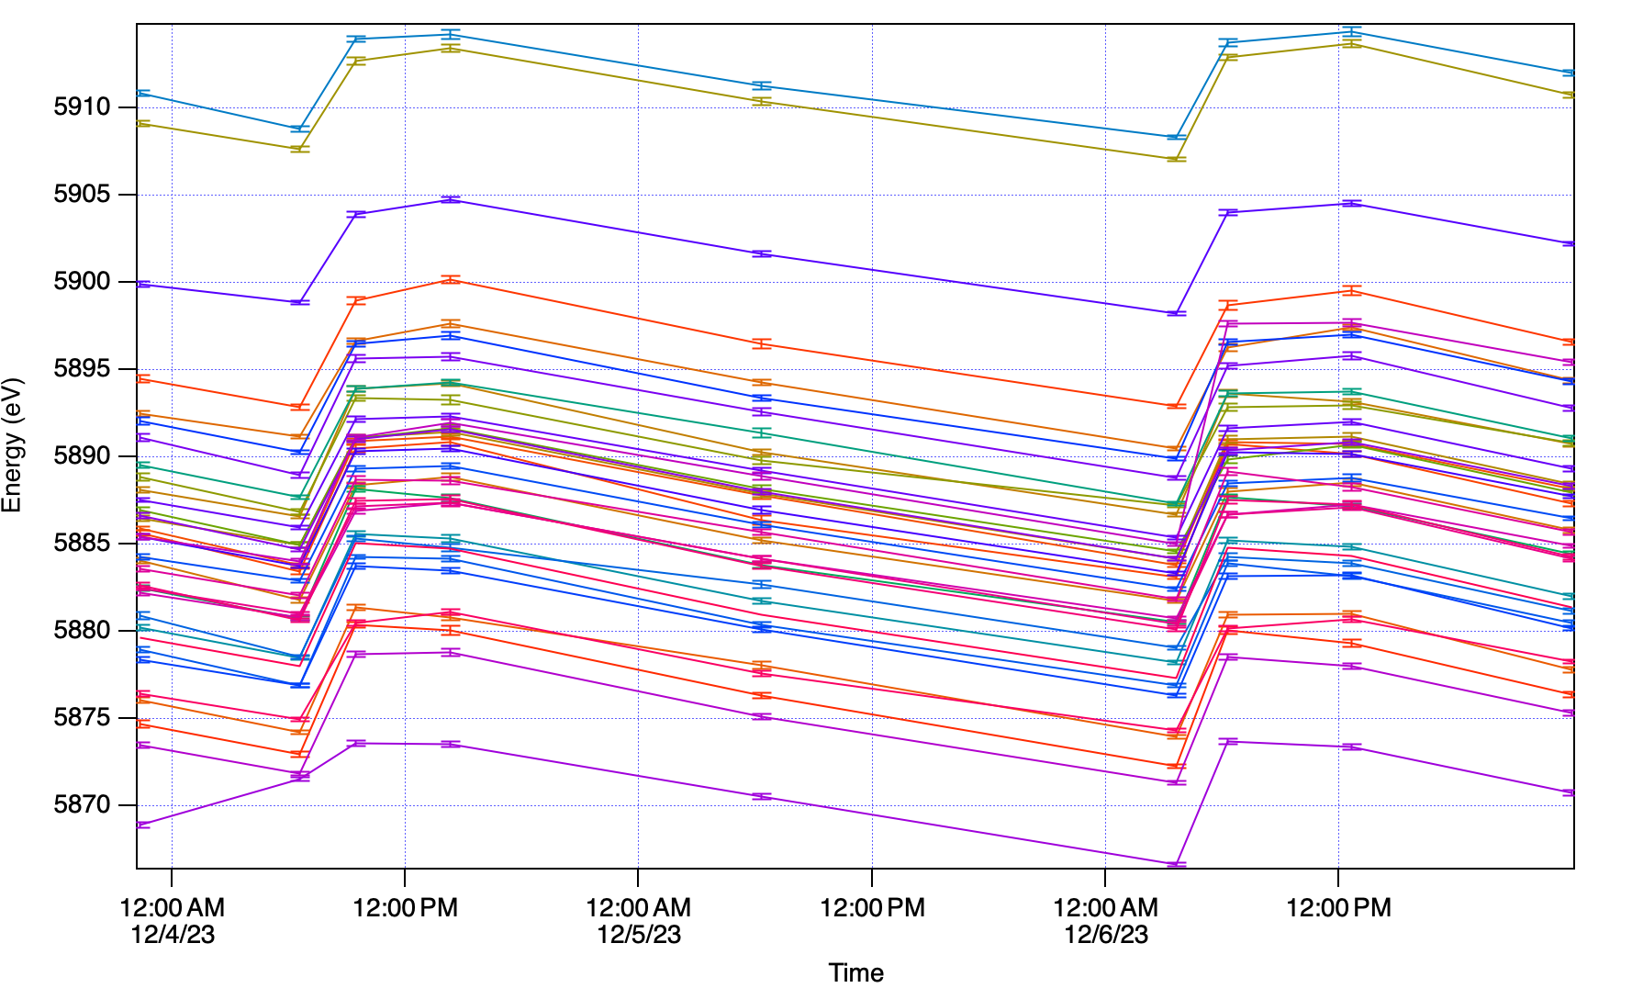
Energy Scale reconstruction in-flight
MXS only covers ~half the array at a time
Currently using the FW ⁵⁵Fe sources
  Would dominate the instrument background
  → Intermittent gain fiducials
Observation of N132D
Only need to sample when things are changing

Slide 11
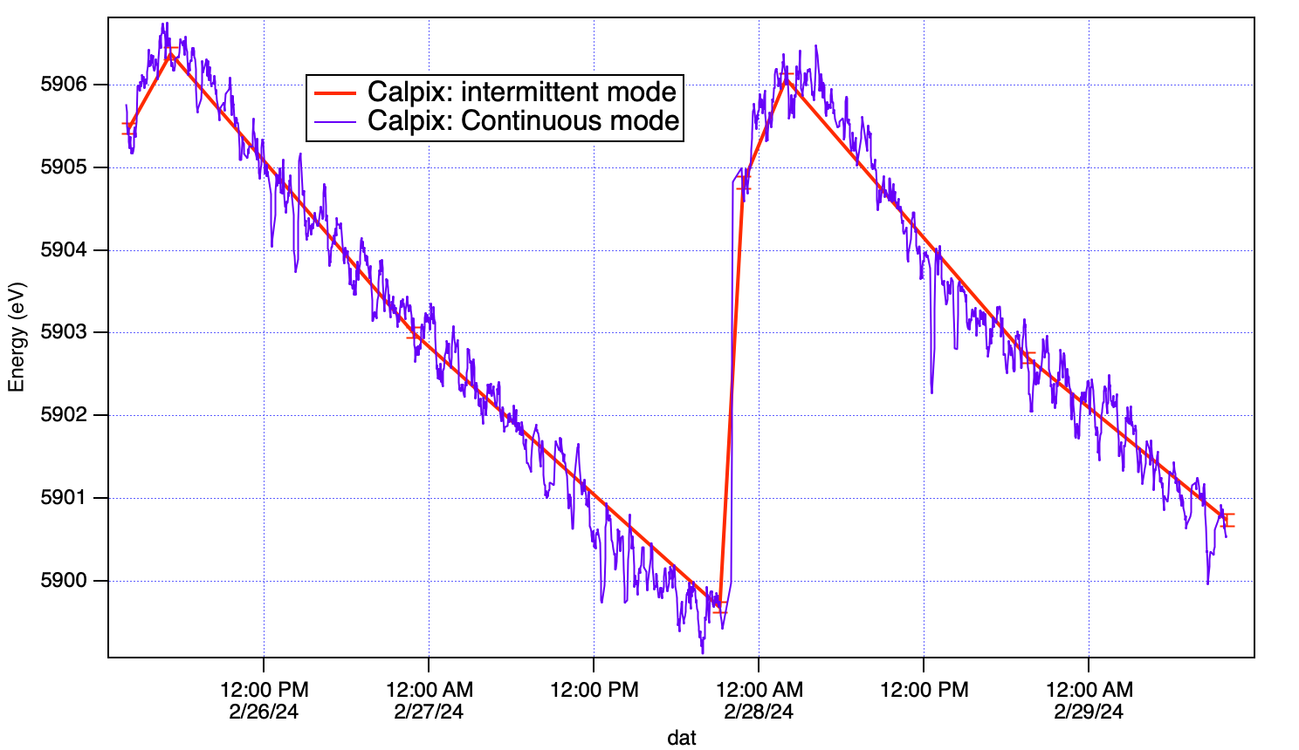
Efficacy on orbit
Two methods of double checking:
Reconstruct the energy scale of the onboard modulated X-ray sources (5.4-8.9 keV)
  Performed every 6 months
Use the same intermittent sampling method for the calibration pixel which is continuously illuminated
Example during observation of the galactic center:
  Largest source of error is the phase of the fiducial measurements against the orbital gain variation of ~0.8 eV (peak-to-peak)
  Continuous: 4.42 eV FWHM, energy scale error: -0.06 eV @ 6 keV
  Intermittent: 4.43 eV FWHM, energy scale error: -0.06 eV @ 6 keV

Slide 12
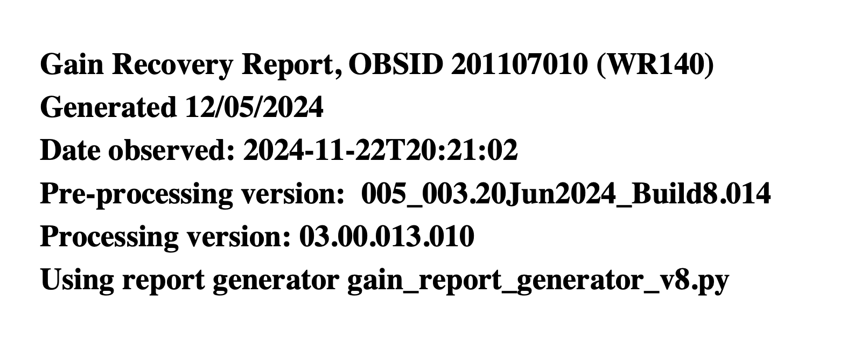
Gain reconstruction reports
SDC provides energy scale (gain) reconstruction reports
Reviewed by the instrument team for every observation

Slide 13
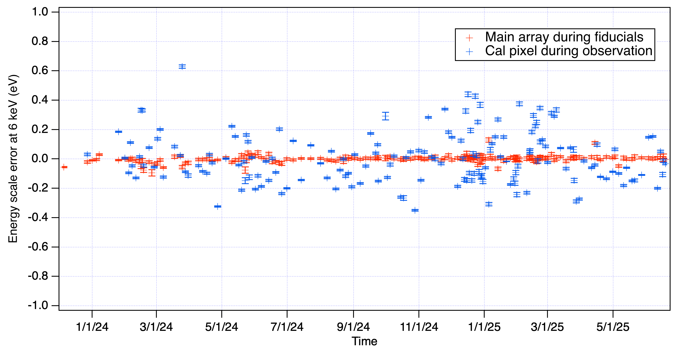
Benchmarking
Energy scale offset @5.9 keV: during fiducials, and cal pixel during observations
RED: Efficacy of fiducial fits → should be very near 0 offset
BLUE: Cal pixel during the observation: Efficacy of energy scale reconstruction.
Normally distributed around 0 eV, std deviation: 0.175 eV

Slide 14
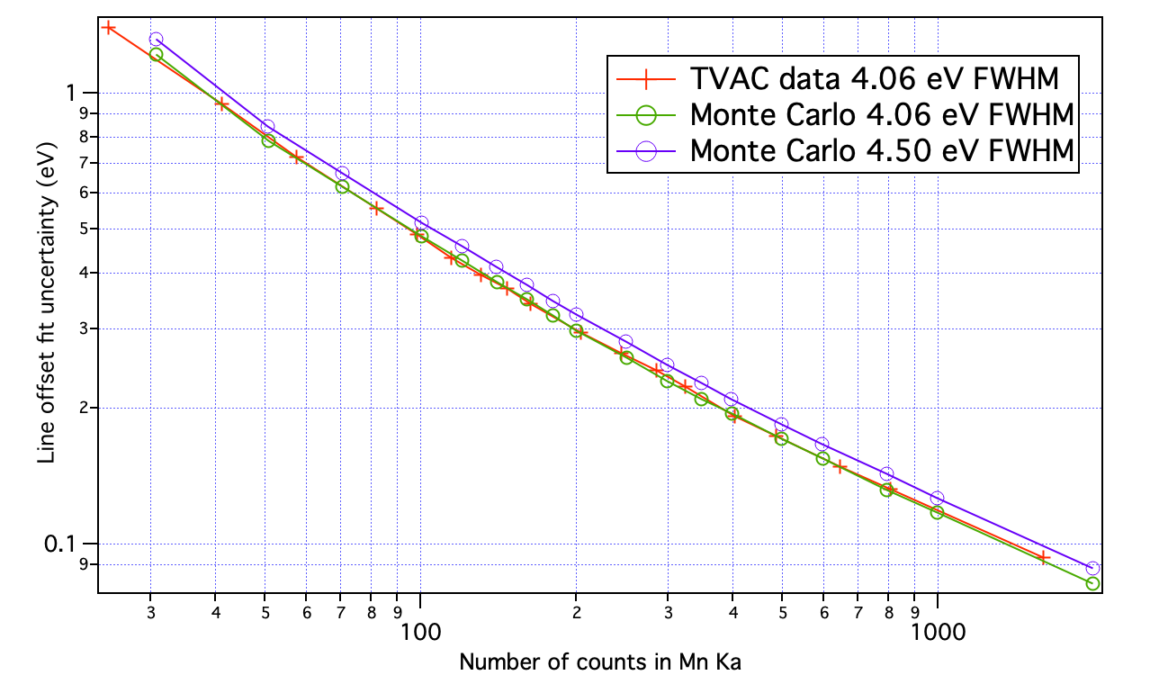
But, the half-life of ⁵⁵Fe is 2.6 years
Eventually will need a new method:
Longer, fewer fiducials
  Fill in with Cal pixel
  But less insight
Use MXS
  Also longer, fewer fiducials
Use similarity + one fiducial/ADR cycle
Use housekeeping
  Electronics temperatures
  Thermal shield temperatures
We are currently about here

Slide 15
Conclusions
The XRISM/Resolve detector gain is not intrinsically stable and varies with time
  This was expected and planned for
  Much more benign on orbit than on the ground
  We planned for worse
Energy scale reconstruction on-orbit is working extremely well
  Uses Filter-wheel mounted ⁵⁵Fe sources
  Intermittent sampling and interpolation of detector gain
Eventually will have to move to a new fiducial method due to decay of ⁵⁵Fe sources
  Several choices, many of which we have used in corner cases where the standard regime was problematic
NewAthena/XIFU will be very similar except
  Detectors are more non-linear
  Additional complication of magnetic field susceptibility
    Gain reconstruction is parametrized on the Energy-temperature-magnetic field plane
XRISM/Resolve comes close to demonstrating the on-orbit reconstruction performance required by XIFU.

