Slide 1
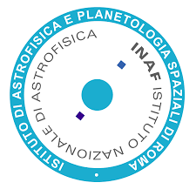
The INTEGRAL/IBIS
View of the Crab
JAMES RODI, A. BAZZANO, L. NATALUCCI, P. UBERTINI
INAF-IAPS (ROME, ITALY)
15TH IACHEC WORKSHOP
Seeblick Pelham, Germany 20-23 April 2026

Slide 2
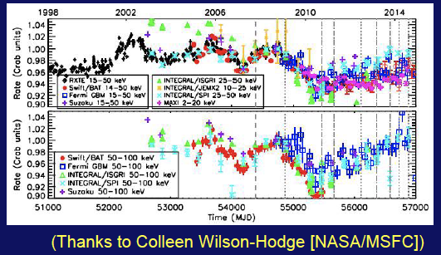
Crab Previous Results
Temporal variability
Earlier IACHEC comparison from Case (2017)
  RXTE, BAT, GBM, Suzaku, ISGRI, SPI, MAXI comparisons
  Flux can change of few % per year
Case (2017)

Slide 3
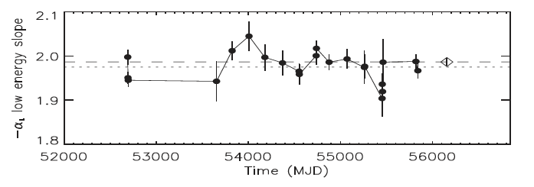
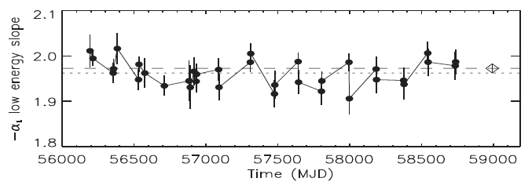
Crab Previous Results
Spectral variability
  Stable hard X-ray spectrum
  Used as standard candle
  Soft gamma-rays ~2.2 – 2.4 in SPI
Jourdain & Roques (2020)

Slide 4
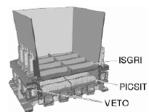
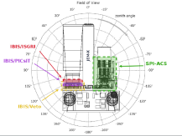
IBIS-PICsIT Instrument Review
IBIS
  ISGRI (INTEGRAL Soft Gamma-ray Imager)
    Energy Range: 18 keV - 1 MeV
  PICsIT (Pixelated Caesium Iodide Telescope)
    Energy range: ~175 keV – 14 MeV imaging
    Spectral-imaging: ~1800 – 3600 sec
Savchenko et al.(2017)
Bird et al.(2003)

Slide 5
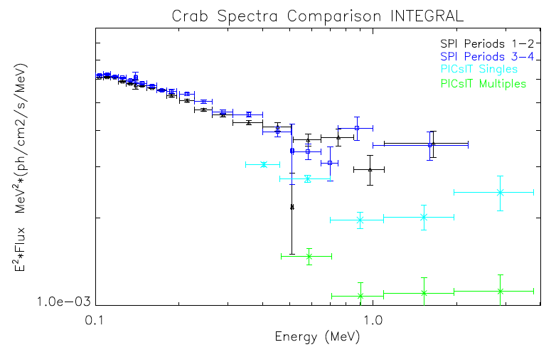
INTEGRAL Crab Spectrum
SPI spectrum (Jourdain & Roque 2020) vs PICsIT single & multiple events
Flux difference between SPI and PICsIT singles ~1.4x
Updated Multiples RMF to extend E-range
PICsIT/Coded mask ratio ~0.76
  Count rate underestimated
Corrected PICsIT count rate

Slide 6
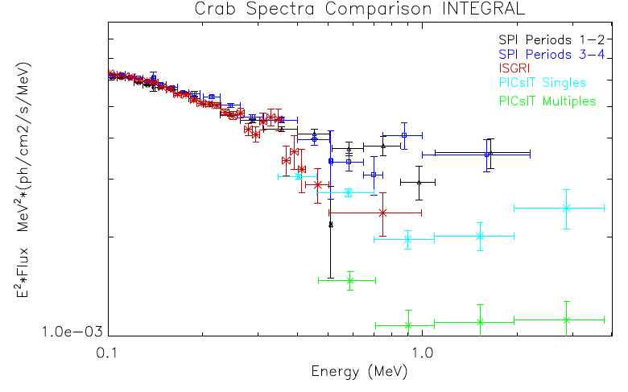
INTEGRAL Crab Spectrum
SPI spectrum (Jourdain & Roque 2020) vs PICsIT vs ISGRI OSA11.2
  ISGRI ~2 Ms from rev 39-1096
  ISGRI cross-calibration with SPI
  until 511 keV (Pedros, ISDC)
  Calibration > 511 keV from
Monte Carlo of IBIS

Slide 7
INTEGRAL Crab Spectrum
So far good agreement between ISGRI and PICsIT from ~400 keV - 1 MeV
  IBIS seem results internally consistent! ✅
  But need to run rest of mission
to confirm
  Currently running next
1700 revs
😁

Slide 8
INTEGRAL Crab Spectrum
But this is IACHEC so in terms of cross-calibration
  ISGRI and SPI diverge ~>350 keV ❌
  GRBM fit with:
  Γ=-1.99 E_{c} = 535 keV
    SPI:Γ = -2.32
    ISGRI:Γ = -2.58
    PICsIT:Γ = -2.44
No agreement between slopes
🙁

Slide 9
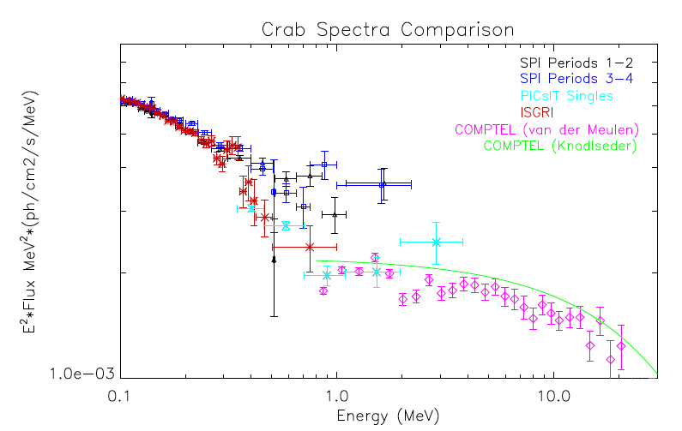
Crab Spectrum
SPI spectrum (Jourdain & Roque 2020) vs ISGRI vs PICsIT single vs COMPTEL (van der Meulen 1998; Knodlseder 2022)
  ISGRI spectrum decreases to COMPTEL
  PICsIT overlaps with COMPTEL
  ~1.7 below SPI at ~1 MeV
MeV behavior is unclear
  So how to modify calibration not obvious
🤔

Slide 10
Conclusion and Future Work
Spectrum:
  ISGRI/PICsIT singles similar, but > 350 keV diverge from SPI
  ISGRI/PICsIT singles slopes similar but not consistent
  IBIS spectrum leads to COMPTEL spectrum
  But COMPTEL ~1.75x lower than SPI and spectrum harder
Next:
  Understand ISGRI and PICsIT singles consistency?
  Understand ISGRI vs SPI discrepancy > 350 keV
  What to do about differences?
  Recalibrate PICsIT multiples to singles
Interesting for COSI in MeV region!
?
?
?

Slide 11
Crab Spectrum
SPI spectrum (Jourdain & Roque 2020) vs PICsIT single vs ISGRI vs COMPTEL (van der Meulen 1998; Knodlseder 2022)
COMPTEL spectrum Γ= 1.97,
E_{c}= 28.9 MeV (van) ;
Γ= 2.00, E_{c}= 39.1 MeV (Knod)

Slide 12
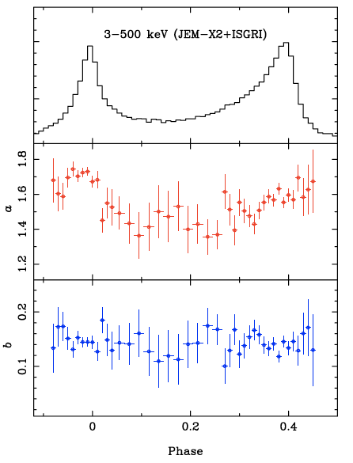
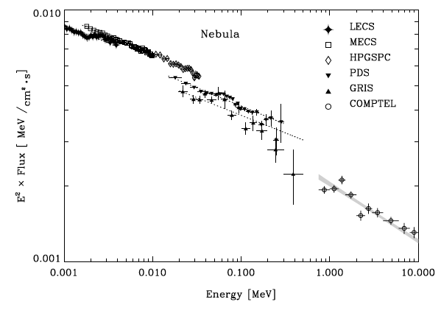
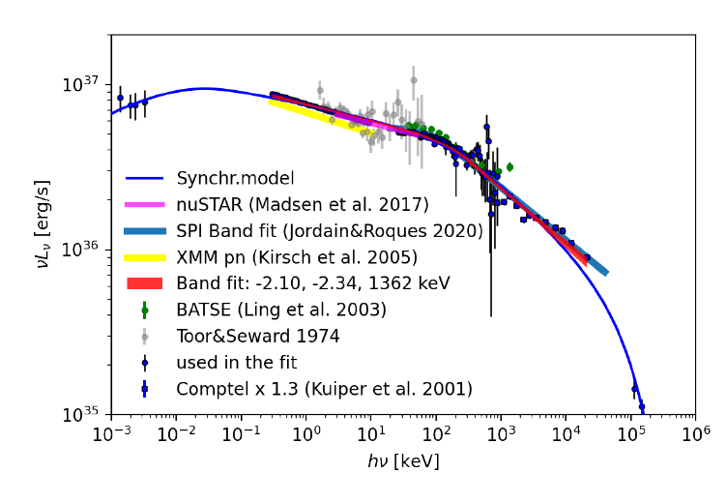
Crab Nebula Spectra
Kuper et al.( 2001)
Dirso & Horns ( 2023)
Mineo ( 2006)

Slide 13
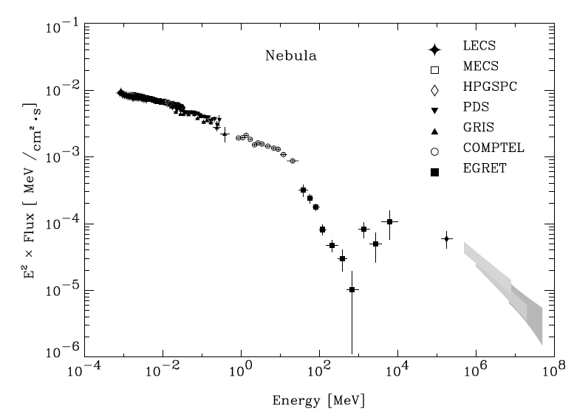
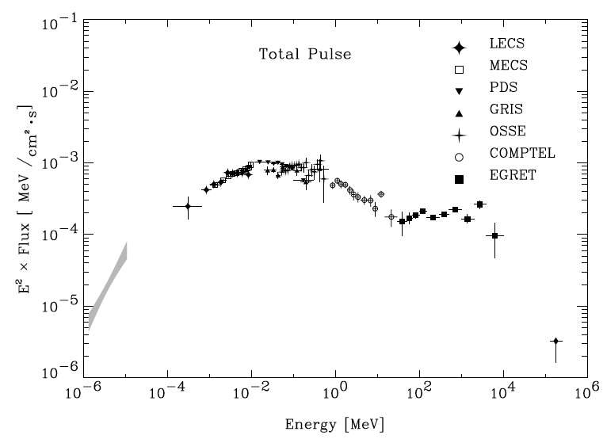
Crab Pulsar/Nebula Spectra
Kuper et al.( 2001)

Slide 14
Crab Pulsar/Nebula Spectra
Kuper et al.( 2001)

Slide 15
INTEGRAL Crab Spectrum
SPI spectrum (Jourdain & Roque 2020) vs PICsIT vs ISGRI OSA11.2
  Cross-calibration with ISGRI
  Flux consistent with Singles
GRBM fit with Γ=-1.99
  SPI:Γ = -2.32 E_{c} = 535 keV
  ISGRI:Γ = -2.8 E_{c} = 427 keV
  Diverge ~400 keV
  PICsIT:Γ = -2.42 E_{c} =530 keV (f)

Slide 16
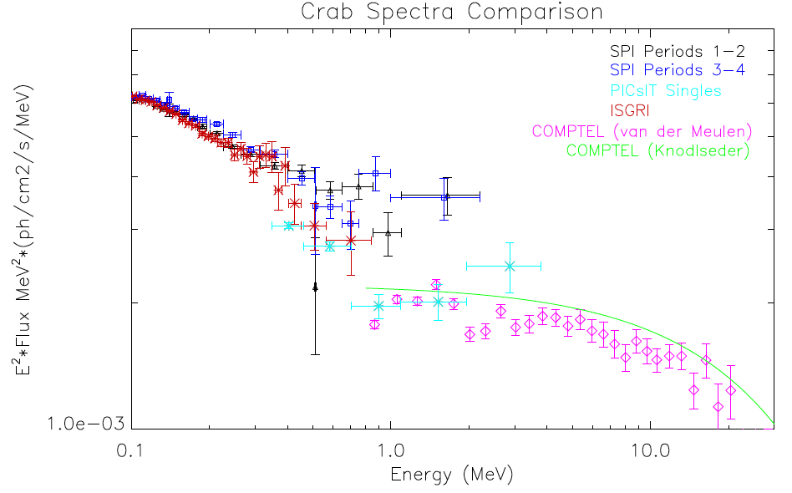
Crab Spectrum
SPI spectrum (Jourdain & Roque 2020) vs PICsIT single vs ISGRI vs COMPTEL (van der Meulen 1998; Knodlseder 2022)
COMPTEL spectrum Γ= 1.97,
E_{c}= 28.9 MeV (van) ;
Γ= 2.00, E_{c}= 39.1 MeV (Knod)
PICsIT >1.2 MeV, Γ=1.7 ± 0.3

Slide 17
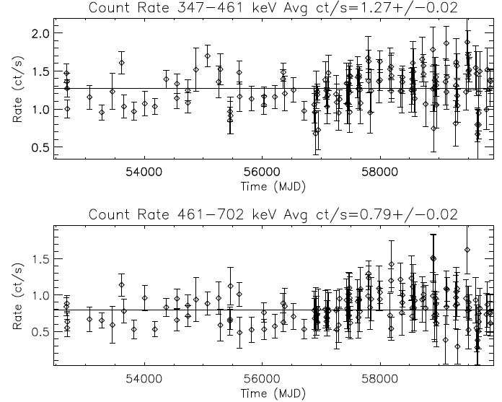
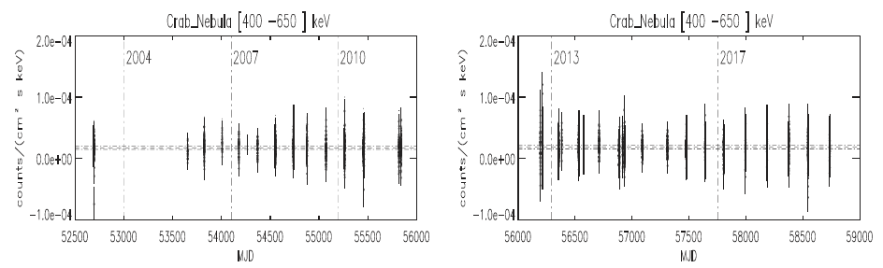
Crab Light Curve
PICsIT light curves in 347 – 461 keV E band
  Revolutions time scale (~2 – 3 days)
  Consistent with constant flux
SPI 400-650 leV light curve
  ~0.5 – 1 hr time scale
  Consistent with constant

