Slide 1
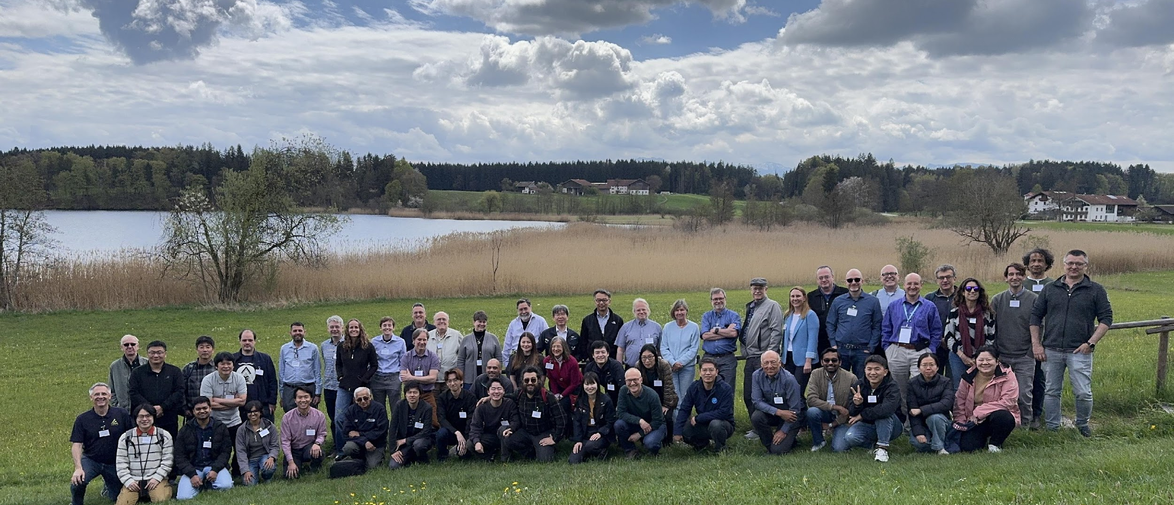
Closing remarks
18th IACHEC workshop

Slide 2
Attendance
IACHEC year | Location | Number of participants | Number of talks
2006 | Iceland | 36 | 26
2007 | California | 35 | 30
2008 | Germany | 36 | 26
2009 | Massachusetts | 35 | 34
2010 | Italy | 45 | 50
2011 | California | 44 | 38
2012 | UK | 40 | 29
2013 | Virginia | 42 | 48 (20)
IACHEC year | Location | Number of participants | Number of talks (plenary)
2014 | PRC | 51 | 54 (24)
2018 | Italy | 57 + 37 students | 45 (30)
2019 | Japan | 65 | 70 (36)
2023 | Germany | 60 | 63 (44)
2024 | Spain | 61 | 65 (40)
2025 | Japan | 74 | 63 (44)
2026 | Germany | 56 (6 cancellations) | 60 (37)

Slide 3
The new cast
2023
Sep. 7th
XRISM
Nov. 11th
NinjaSAT
2nd and 3rd
Jan. 1st
Jan. 9th
2024
XPoSat
Einstein
Probe
Jun. 22nd
SVOM
Jun. 16th
2025
LEXI
2026
Mid 2026
SMILE
2027
2027
COSI

Slide 4

🚑 Swift & ✝︎ Nicer
Chandra, XMM,NuSTAR, MAXI, HXMT, IXPE, eROSITA, XRISM, EP, SVOM

Slide 5


Congratulations
10 years completed in 2025 September

Slide 6

Cross-calibration should never go out of fashion
Cross-calibration never goes out of fashion

Slide 7
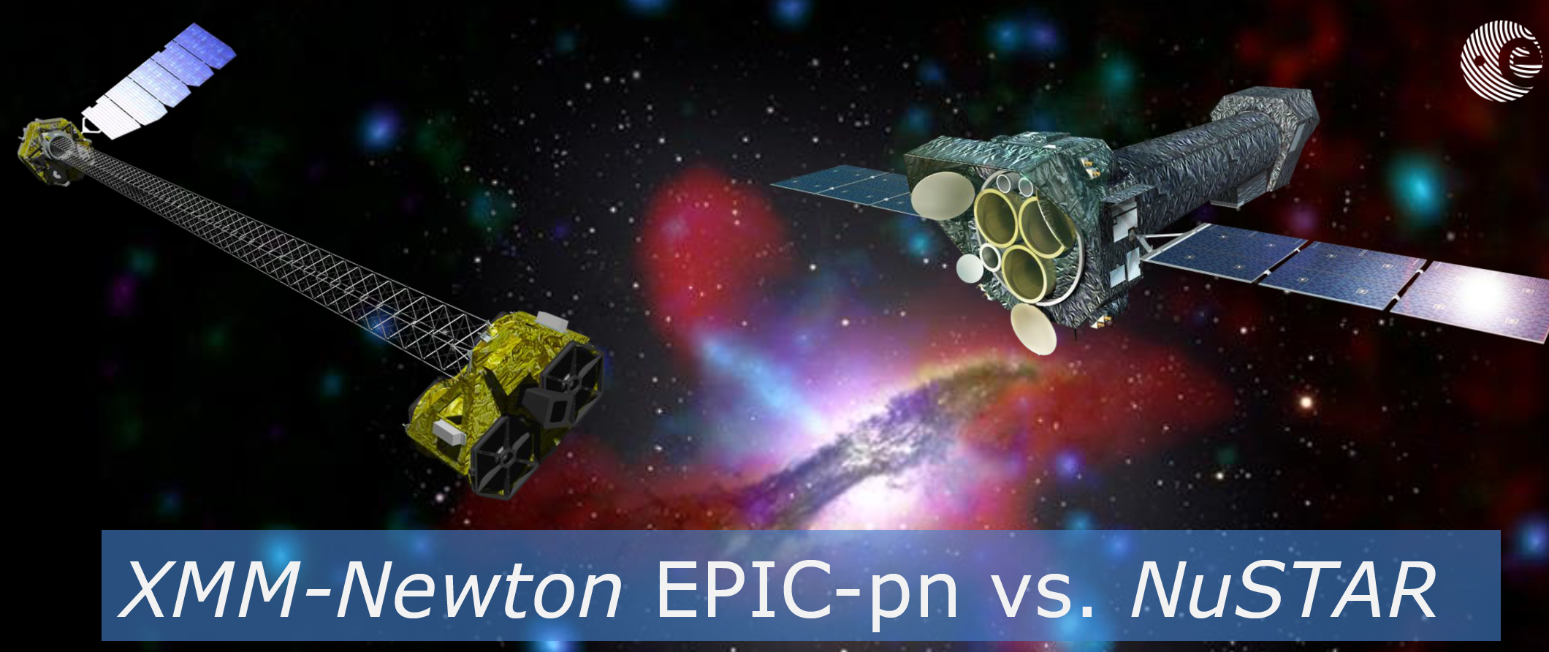
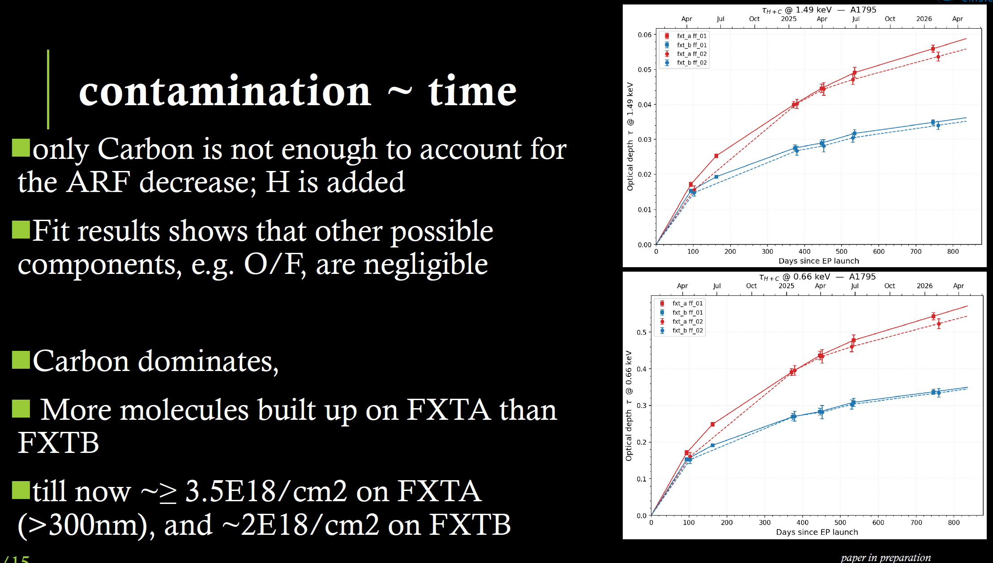
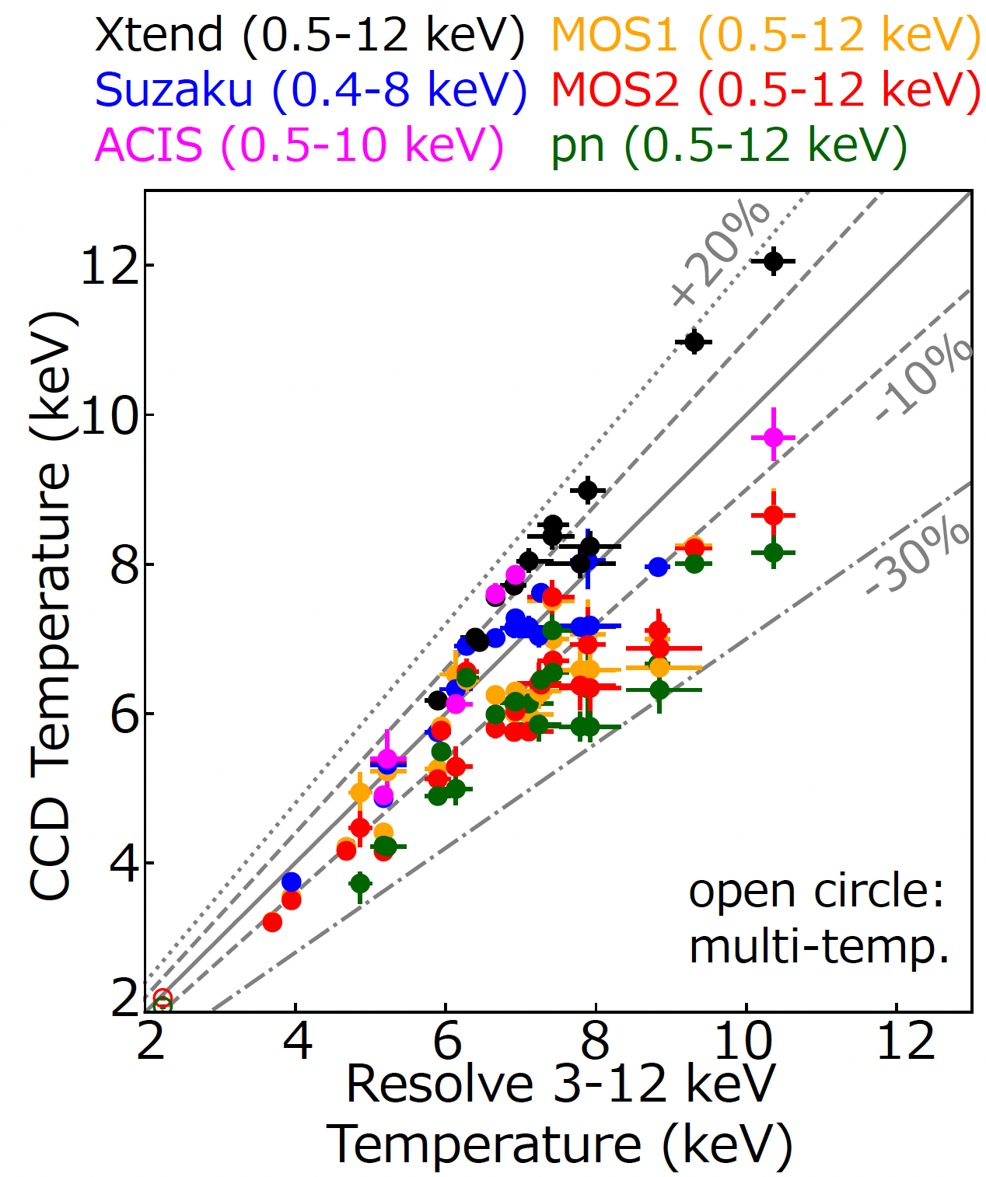
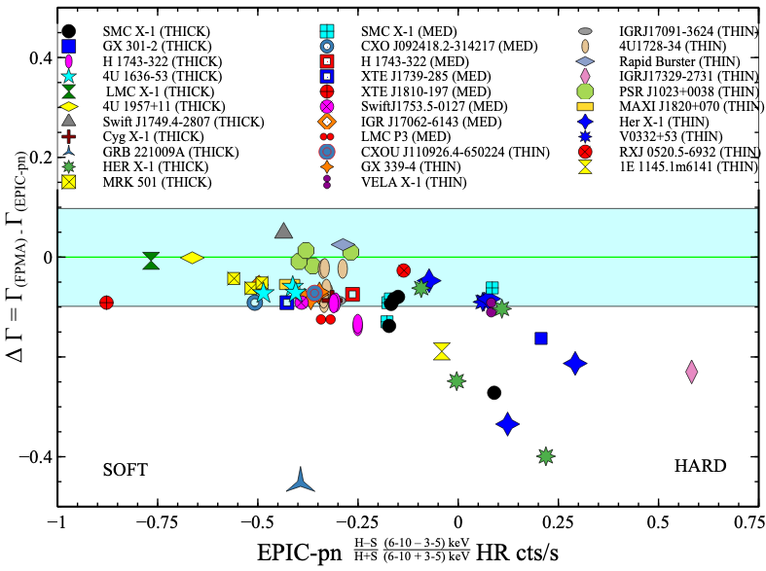
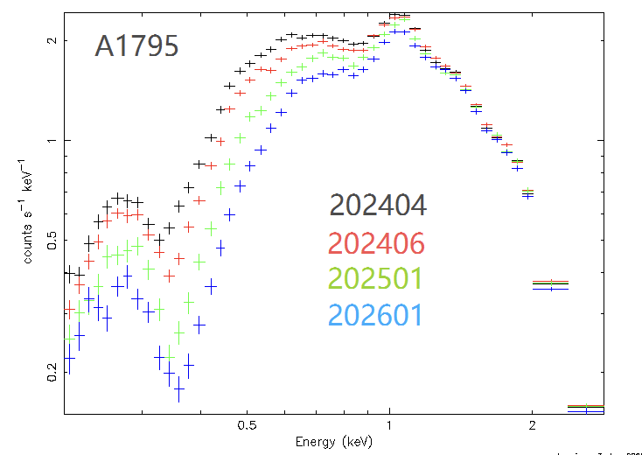
The old classics are still relevant
Clusters discrepancies
Analyzed 38 XRISM observations of 15 galaxy clusters
XMM & eROSITA vs Chandra & XRISM
…The mystery persists
Contamination – possibly new insight
Cross-calibration Challenges

Slide 8
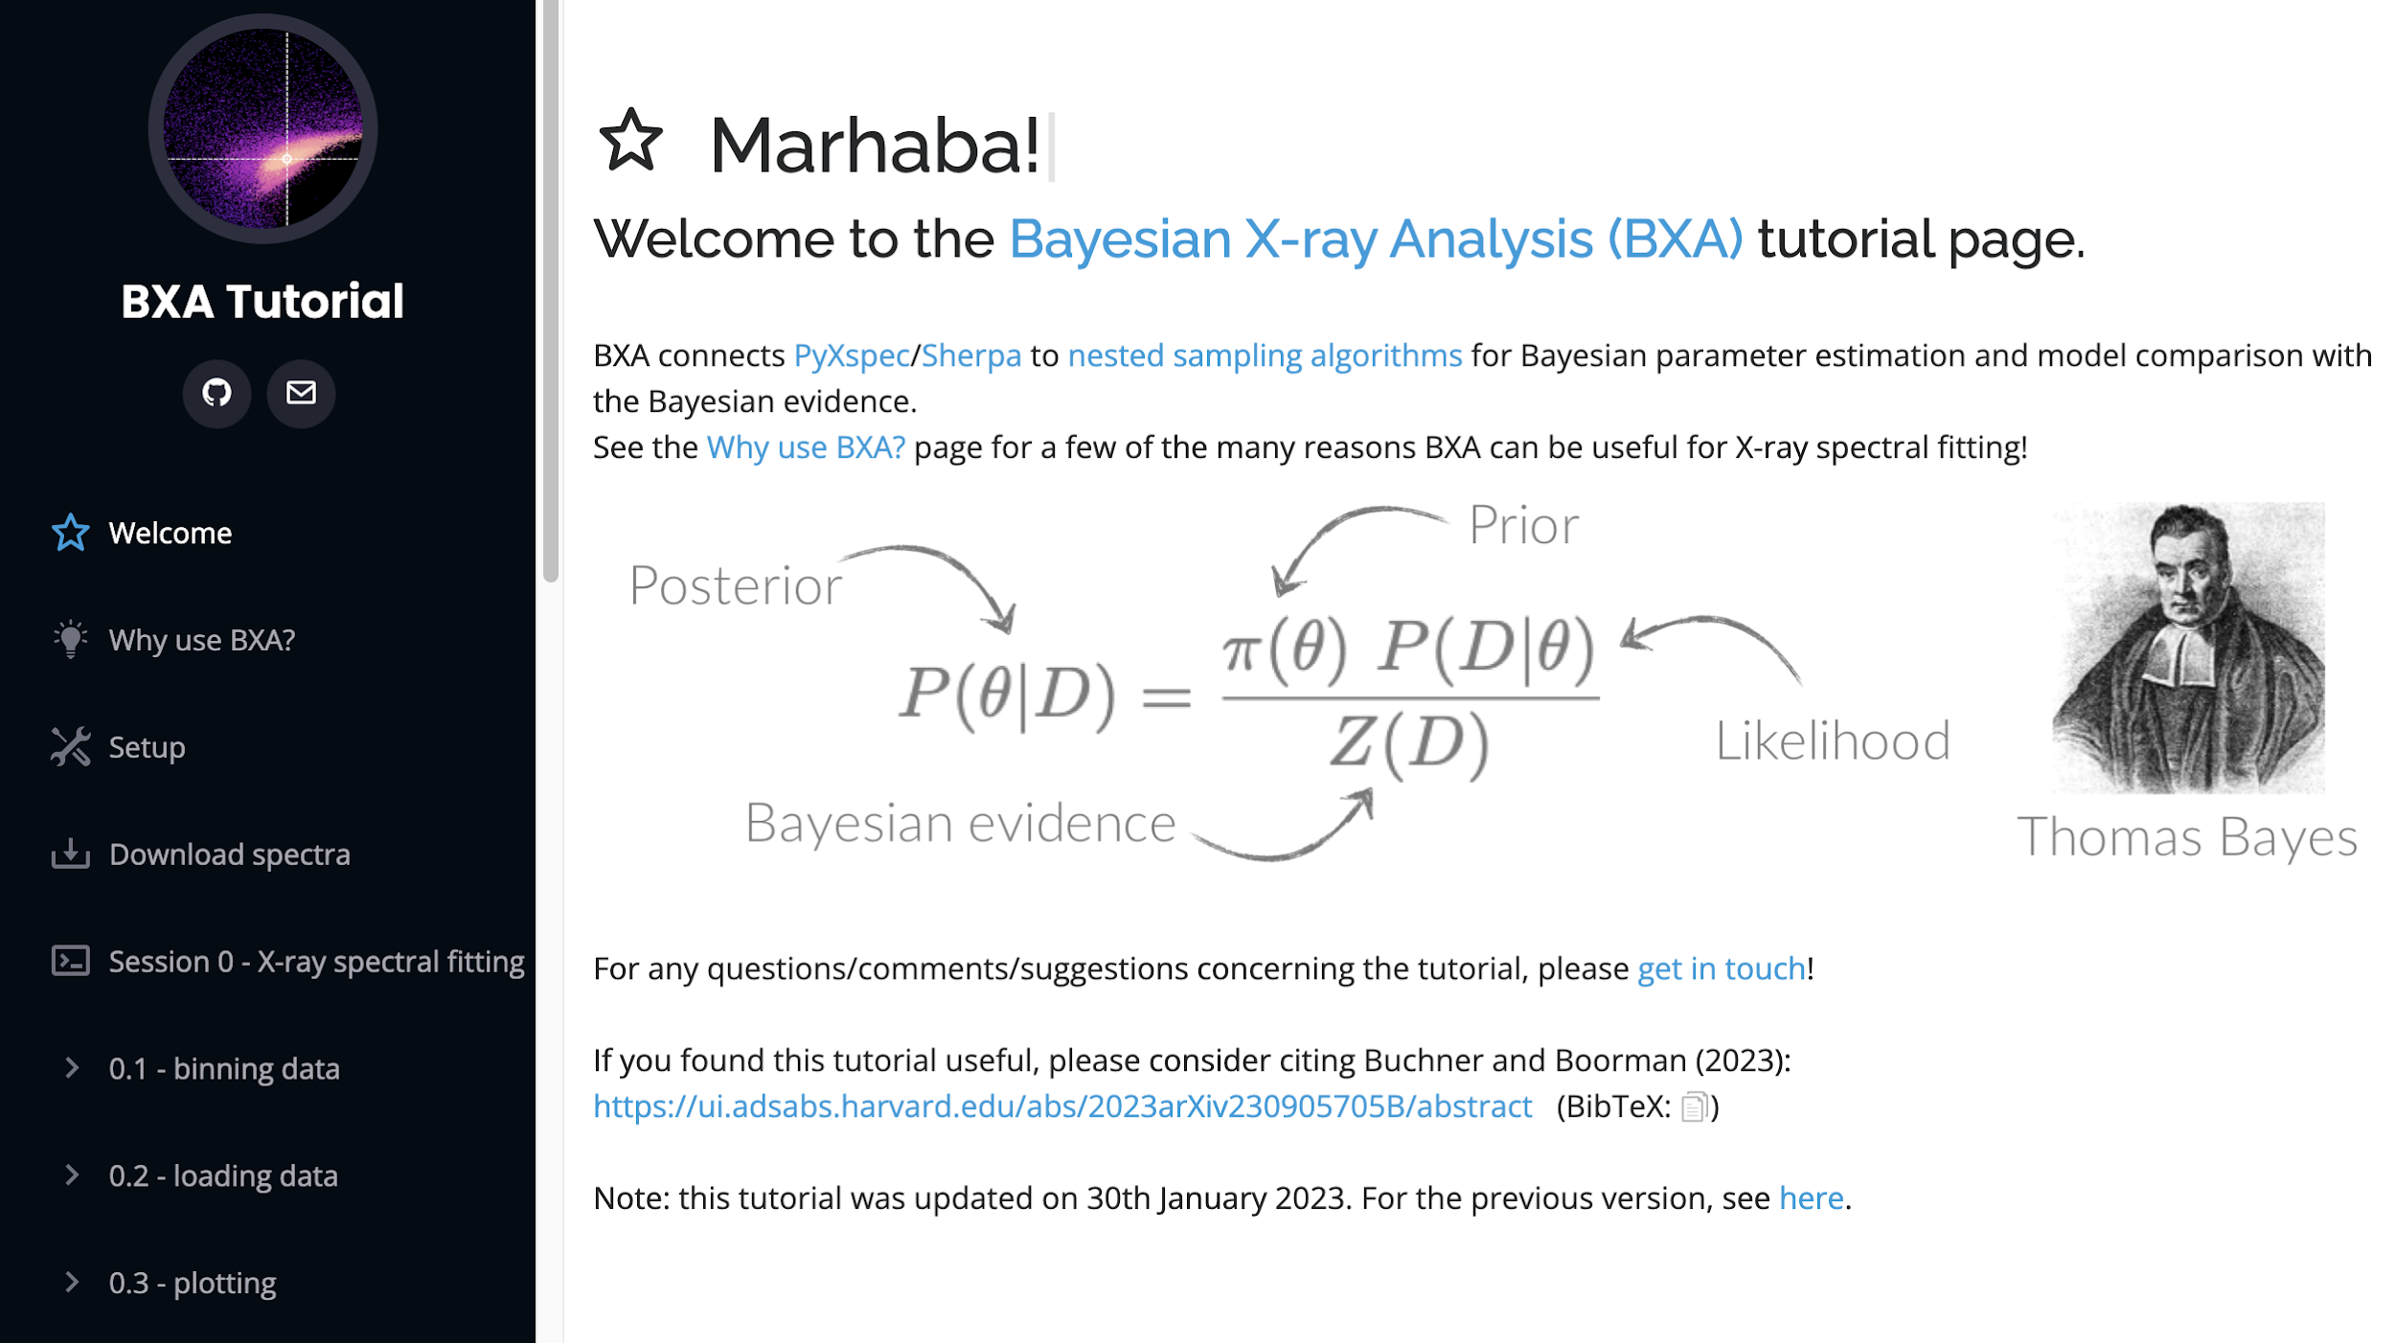
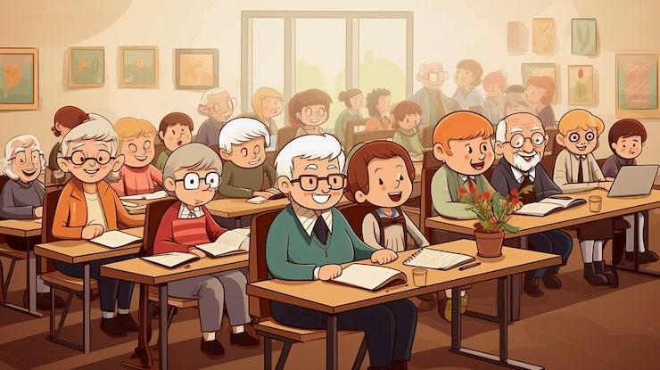
Classroom exercise

Slide 9
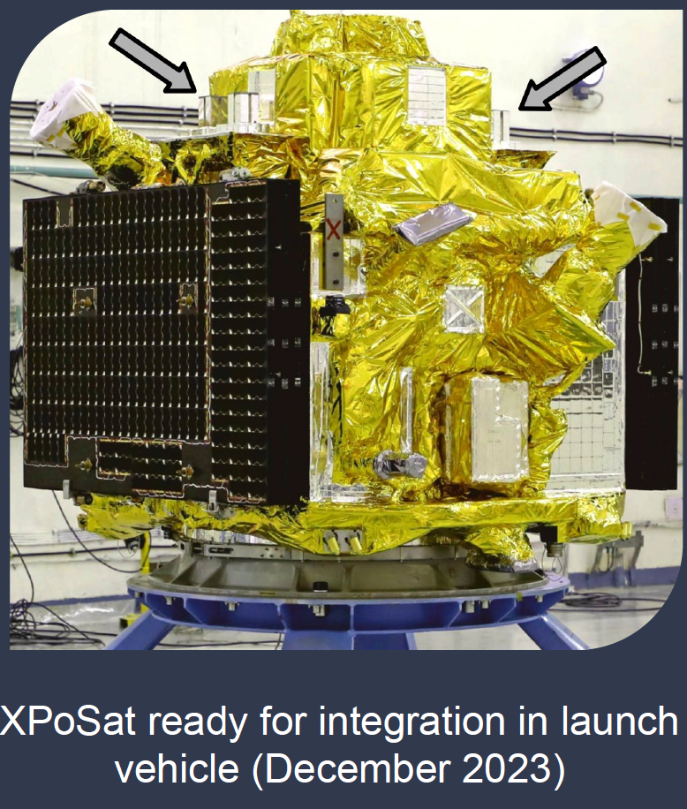
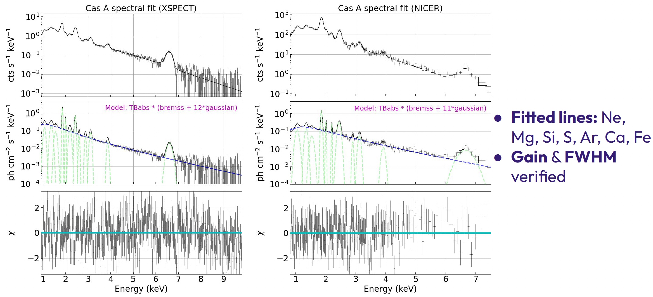
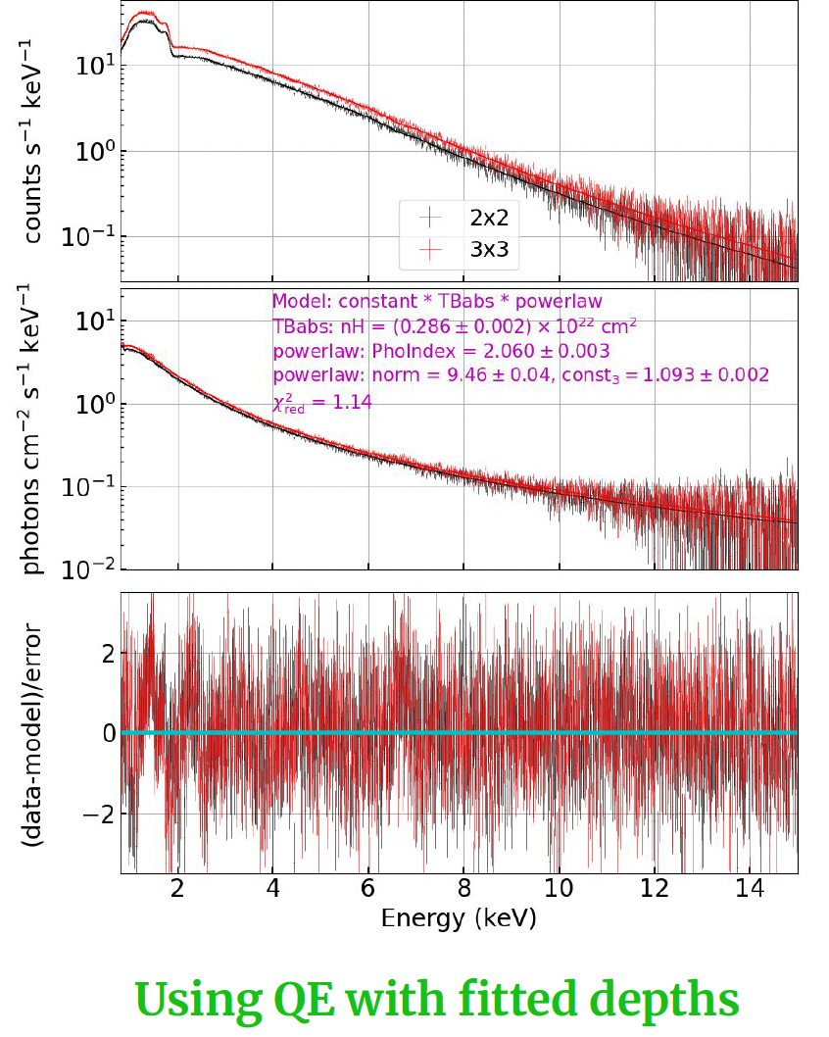
New visitor/member in XPoSat
Joined the Non-thermal WG
Requesting cross-calibration opportunities

Slide 10
New Working Groups
Ground Calibration WG
Chair: Vadim Burwitz (MPE)
Co-chair: Takashi Okajima (GSFC)
2 talks
1 paper proposal
Discussion of goals
  Share of reference optics
  Definition of analysis
  Inclusion of absolute standards
Mission and Science WG
Chair: Felix Fürst (ESA)
Co-chair: Hannah Earnshaw (Caltech)
4 talks!
  XMM
  Nicer
  NuSTAR
  XRISM

Slide 11

After the meeting

Slide 12

2025 Plans derailed…

Slide 13
Initiatives - 2025
Initiatives - 2025 | Action
👍 The two new WG to prepare charters | Chair and co-chair to lay out goals
Heritage WG is chair-less | Look for new chair or discontinue
(👍)Advance papers | WG chair delegate tasks to members
Create ‘current activities’ on the Webpage with easy access to IACHEC products | Include links to background models Include links to stat cal wiki products
Check in to review initiatives and goals | Set up a meeting for October/November time frame with the chairs
Bring Fermi back into the fold | Contact the Fermi team
👍 Get the two new WG included on webpage | send out newsletter and contact info for joining
Update Webpage resources | Add links from published papers

Slide 14
Paper status
Paper | WG shepherd | Status
Concordance #3 | Cal. Stats | To be submitted to RAS soon
Contamination | Contamination | Overleaf outline circulated; start filling in text
3c273 | Coordinated | Data analysis almost done; check analysis (Jeremy Hare)
Background | Detector & Background | Under consideration; discuss next meeting
MMS | Galaxy Custers | Data review/collection
Crab | Non-thermal | On overleaf; mature draft; include data up to 2020
G21.5-0.9 | Non-thermal | Y. Motogami will start organizing meetings
PSR B1509-58 | Non-Thermal | Delayed until further notice
N132D #2 | Thermal | more data for 3-10 keV
Crab cross-timing calibration | Timing | Published; Matteo Bachetti et al
RXJ1856-3754 + WD | WD & INS | Make overleaf outline and circulate (Surodeep Sheth)
Ground Calibration Challenges | Ground Cal | Large segmented optics

Slide 15
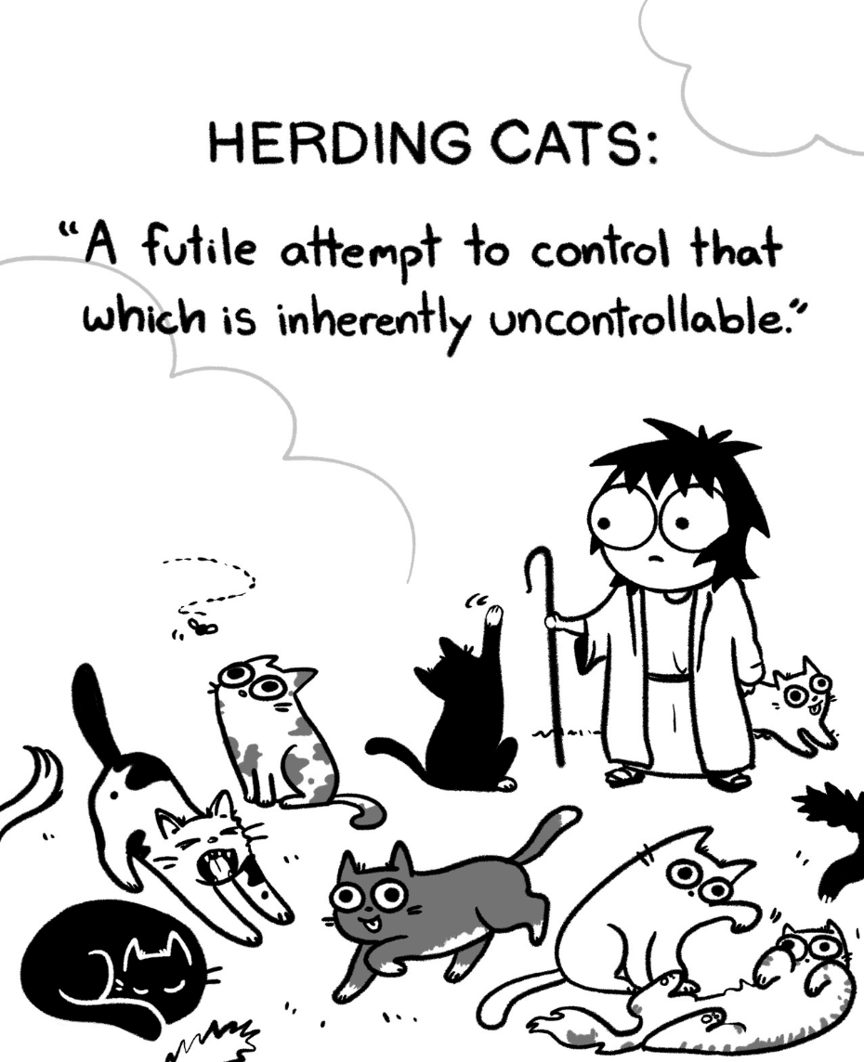
IACHEC WG procedures
Setting yearly goals
Pursue the yearly goals in a timely fashion
  WG management
Write the IACHEC report early!
Inform the community of the progress
Feedback from community
  Involve members

Slide 16
WG 2026 goals
WG | Goals - 2026
Detector & Background | Update background information on wiki and provide links to the “current activities” page solicit info about: large focal planes and handling pixels Improvements in measuring background modeling Review if we can do something about micrometeoroids?
Timing | Update ‘barycen’ to use DE430 , or update ‘barycorr’ to apply Suzaku/Hitomi/XRISM; heasarc to handle: request sent Use Fermi ephemeris for Crab instead of Jordrell Bank Coordinated observations of Crab for timing
Clusters of Galaxies | Find a Deputy WG chair Multi-Mission Study (MMS), review scope and collect data Provide data for Calstats WG concordance effort
High Resolution | Adam and Vinay presented several activities Search for a Co-chair; potential candidate from XRISM resolve

Slide 17
WG 2026 goals
WG | Goals - 2026
Calibration Statistics | Publish paper: Concordance paper #3, MCCal (J. Drake), pileup (Zimmerman, Bayesian; Yang, neural network) Give an AI/ML talk for next year Maintain a library and updated wiki: background; concordance
Thermal SNR | review Tycho vs. CasA N123D
Contamination | White paper draft complete by 2026
WD and iNS | Get data/include from EP and SVOM Search for Co-chair
Non-thermal | Finish the Crab paper: start regular telecons (first one May 14th) Co-authors to add text in sections on calibration of instruments Kick-off G21.5 regular telecons (post July) Concordance data

Slide 18
WG 2026 goals
WG | Goals - 2026
Coordinated Observations | Improve communications with new missions Continued calibration support across missions January 2026 3c273 campaign NuSTAR-SVOM cross-calibration observations Summer to do first draft of “3c273 online” Concordance data
Ground Calibration (Gcal) | Raytrace packages: cross check on reference model/optic circulate overleaf outline for paper on large segmented optics Define a standard for comparing HEW between facilities
Mission and Science Operations | #1 Telecon after summer: keeping missions up to date #2 Telecon early next year: long term planning, scheduling best practices

Slide 19
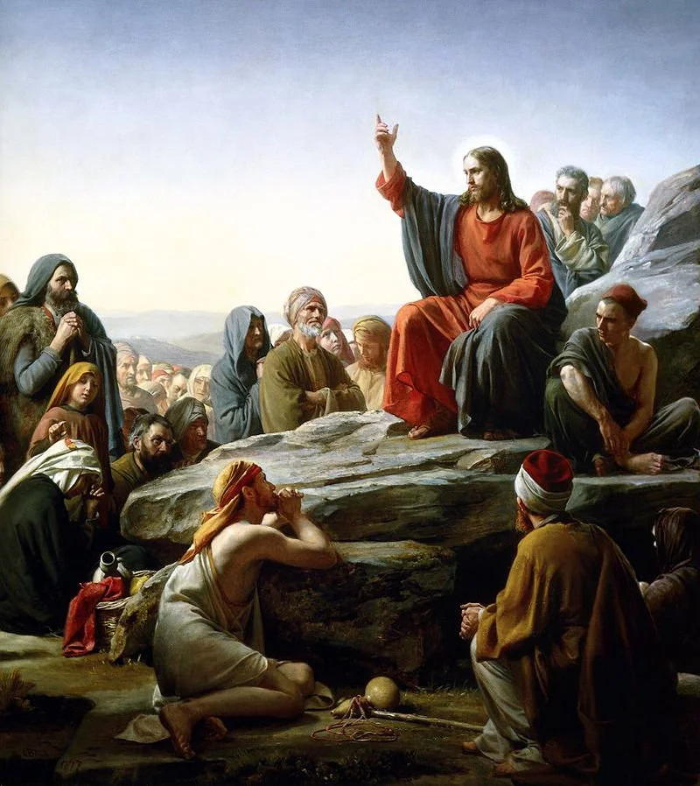
Meeting purpose
Used to be that WG had priority:
Develop standards, cross-calibrate & curate data
However, recently we tend to do less in-meeting work
But the value of the meeting is still the oral tradition:
Hear from missions about their calibrations and problems
  Other missions may share them
  Other missions may learn from them
  Establish connections
  Forum for discussion

Slide 20
Meeting feedback
In 2025 Half day (off or working session) in the middle, with a full day on Thursday
  How well did it work?
Keep days reasonably short: 9-18
Keep long breaks
  Lunch 1.5 hours
  Coffee 30 mins
Monday
Tuesday
Wednesday
Thursday

Slide 21
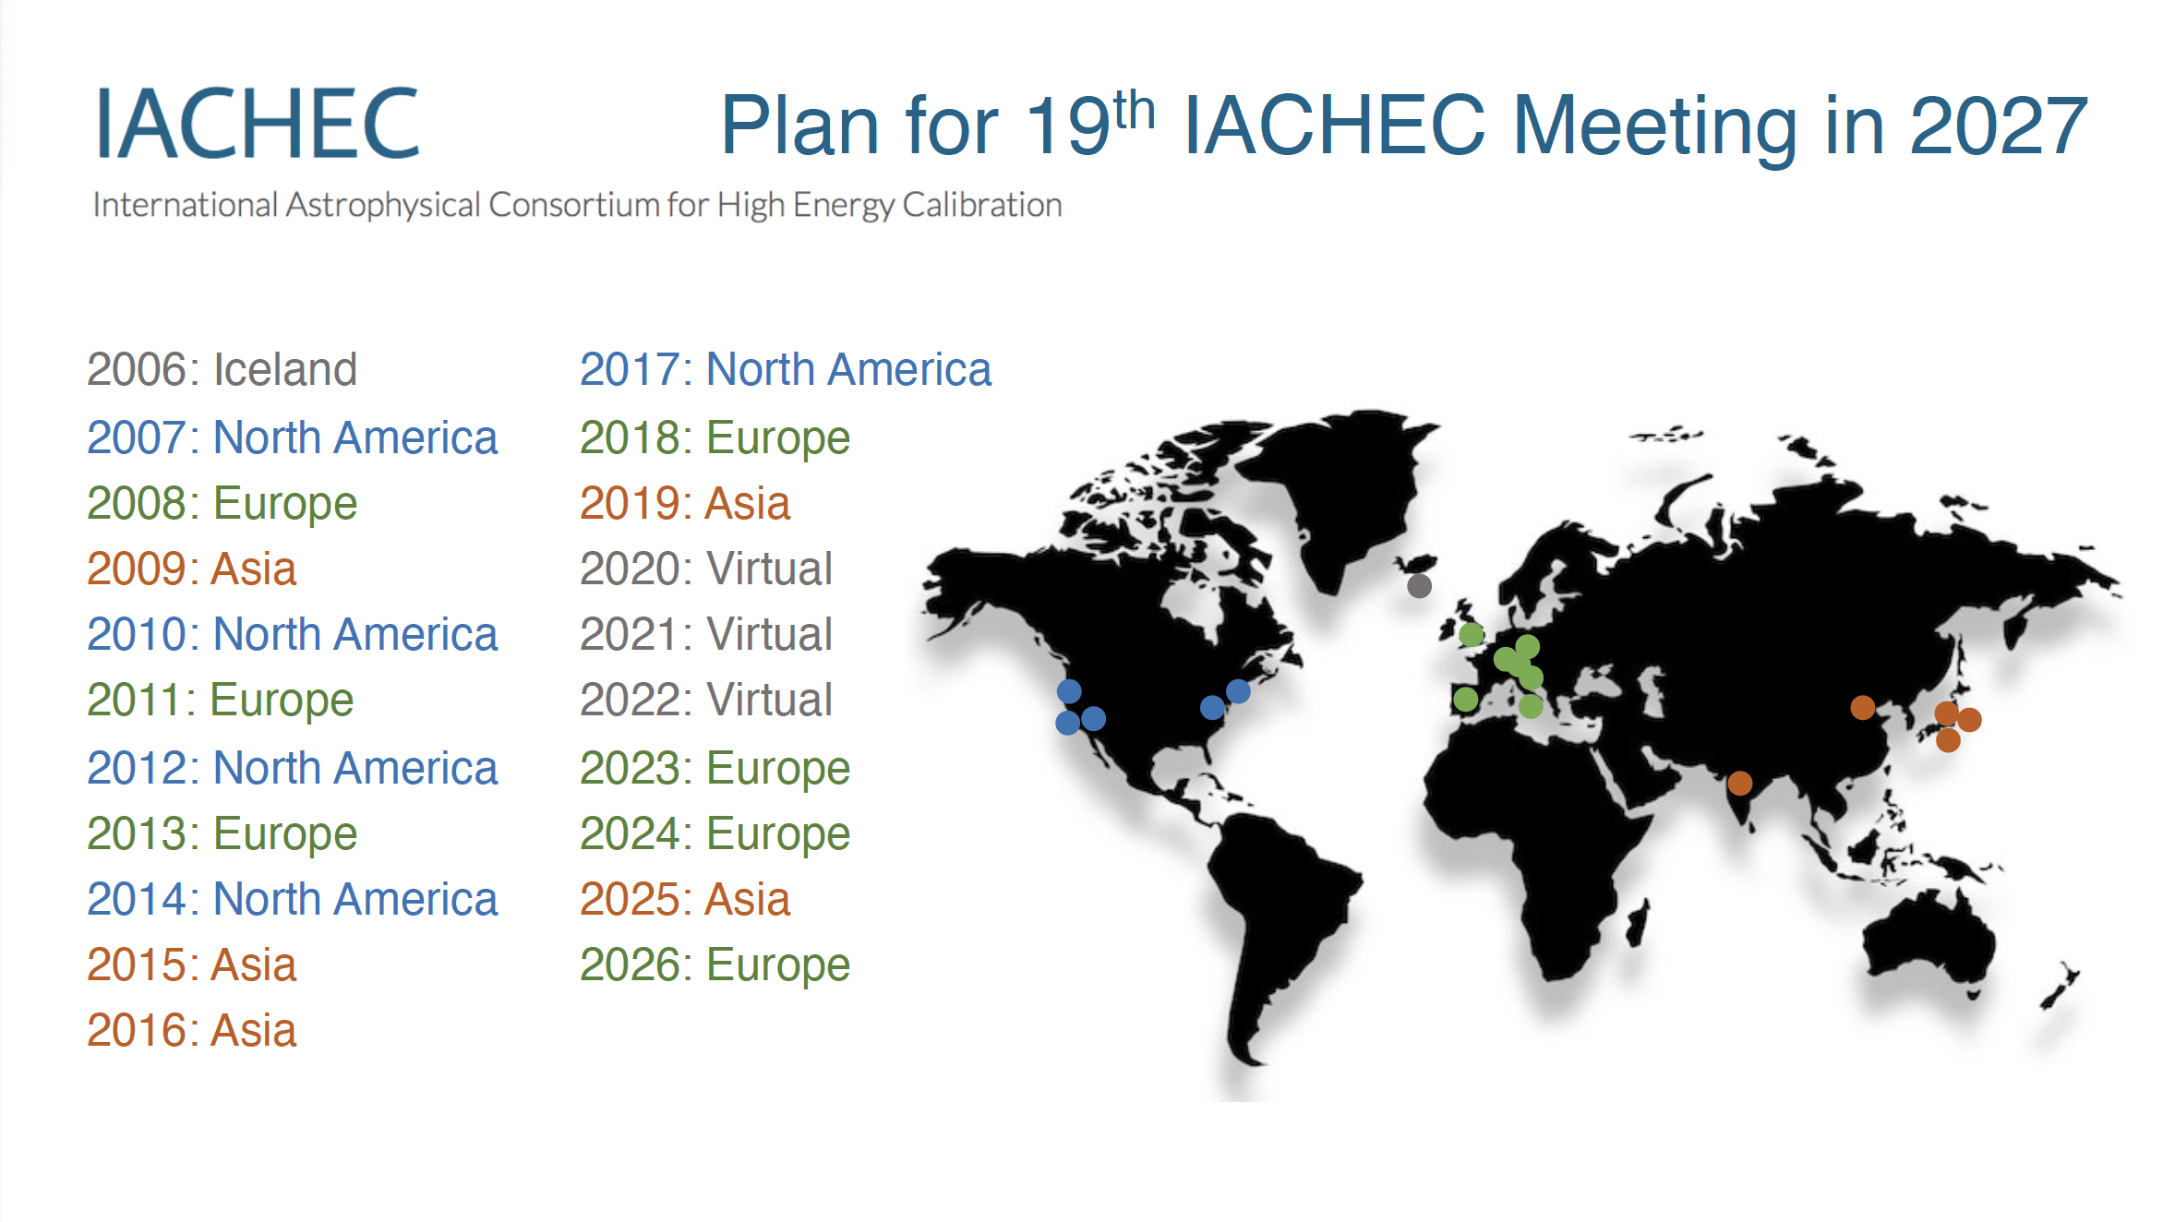

Slide 22
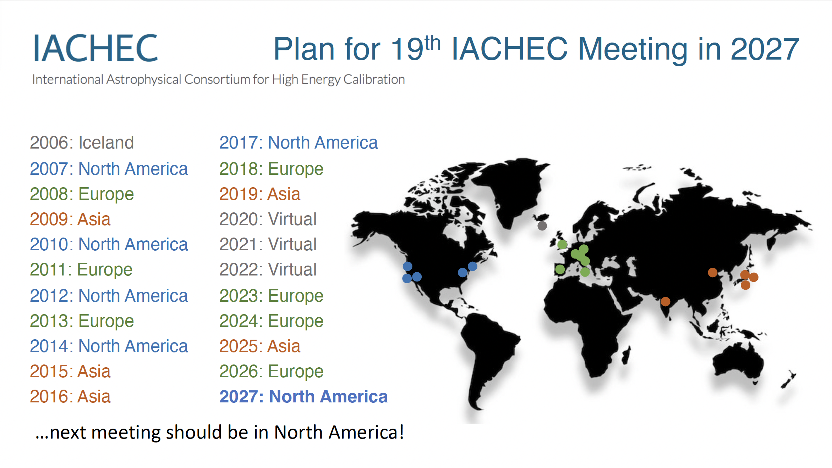

Slide 23
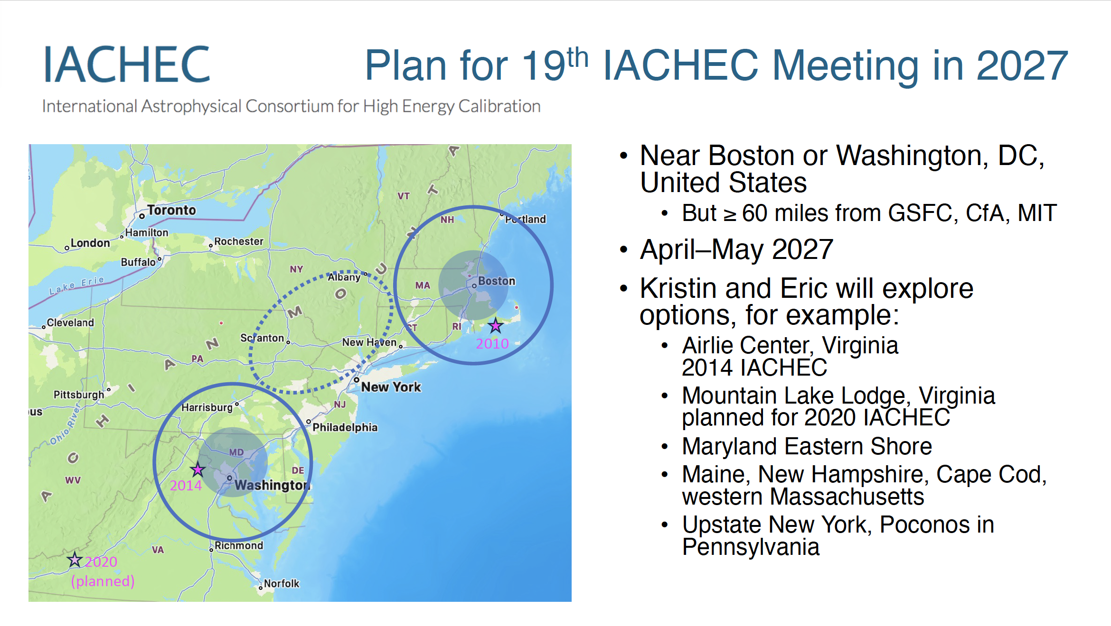

Slide 24

Special Thanks to
Birgit Boller and Vadim Burwitz

Slide 25
18th IACHEC Song
To the tune of "I've been Everywhere" by Johnny Cash
"We've Been Everywhere”
I was totin' my bag to another IACHEC meeting
When a new instrument scientist came a'greeting
If you're going calibrate, you come with me
So we climbed aboard a plane to Germany
They asked me if I'd seen a telescope so new
And I said, "We're calibrators just like you"
We've been everywhere, man.
We've been everywhere, man.
Crossed the oceans there, man.
We've breathed the mountain air, man.
Of travel we've had our share, man.
We've been everywhere.
Pune India; Arrowhead one more time
Umbria, Italy; Shonan Village second time;
Seeblick Pelham, near Munich Deutchland
Segovia, Espana; Osaka Bay in Japan
We've held meetings that were just on-line
And Seeblick Pelham Germany once again
We've been everywhere, man.
We've been everywhere, man.
Crossed the oceans there, man.
We've breathed the mountain air, man.
Of travel we've a-had our share, man.
We've been everywhere.
We've been everywhere.
We've been to
Rekjavik, Iceland; Arrowhead California
Ringberg Germany; Shonan Village in Japan
Woods Hole MA in the USA
Frascati, Italy; Napa California
Leicester, England; Warrenton Virginia
Bejing, Peoples Republic of China
We've been everywhere, man.
We've been everywhere, man.
Crossed the oceans there, man.
We've breathed the mountain air, man.
Of travel we've a-had our share, man.
We've been everywhere.
Lyrics by Herman

