Slide 1
Insight-HXMT/ME payload: Calibration Status and Performance Evolution
A comprehensive review from 2017 to 2026.
PRESENTER
[Ying TAN/IHEP]
DATE
April 23, 2026
Notes:
Hello everyone. Today, I am honored to present a comprehensive review of the on-orbit performance of the Medium Energy, or ME, telescope aboard China's first X-ray astronomy satellite, Insight-HXMT. Launched in 2017, the HXMT mission has been a groundbreaking success. In this talk, we will delve into the calibration status and performance evolution of the ME telescope over its remarkable 9-year journey in orbit, from 2017 to 2026. We'll discuss how the instrument has aged, the stability of its key parameters, and what this means for its continued scientific contributions.

Slide 2
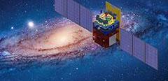
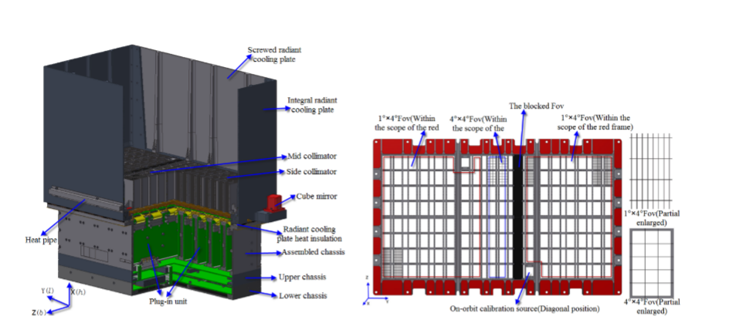




Insight-HXMT: China's First X-ray Astronomy Satellite
The Insight-HXMT Mission
The Medium Energy (ME) Telescope
Mission Launch:June 15, 2017. China's first dedicated X-ray astronomy satellite, marking a new era in high-energy astrophysics.
Energy Coverage:5 - 30 keV. A crucial energy window for studying the accretion processes onto compact stellar remnants.
Primary Science Goal:Observing violent high-energy phenomena from black holes, neutron stars, and gamma-ray bursts across the cosmos.
Long-term Operation:Operational for over 9 years (as of April 2026), providing a unique long baseline dataset for instrument stability analysis.
Notes:
Let's start with a brief introduction to the mission itself. Insight-HXMT, launched in June 2017, is China's pioneering X-ray astronomy satellite. Its primary mission is to explore the violent high-energy universe. It carries three complementary telescopes, and today we focus on the Medium Energy, or ME, telescope. Operating in the 5 to 30 keV band, ME is vital for understanding the physics of compact objects like black holes and neutron stars. After more than 9 years in space, HXMT has provided us with an invaluable long-term dataset to assess the performance and aging of its instruments.

Slide 3
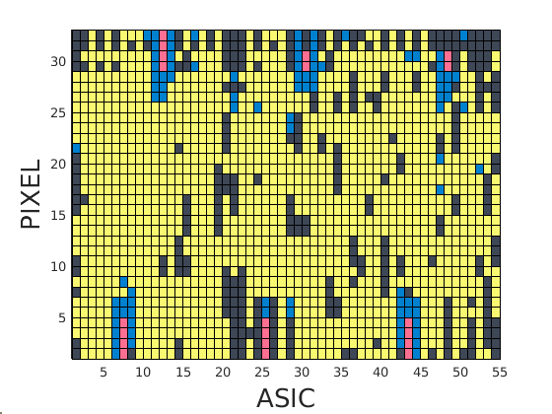
Current Operational Status of the ME Telescope
Detector Health Overview
Total Pixels:1728(Si-PIN Detector Array)
Operational (2026):1319 (76.3%)| Eff. Area:742 cm²
Non-Operational: 298 (Noise) | 91 (Unreliable) | 20 (Calibration)
ASIC Threshold Distribution
The 54 front-end ASICs maintain a stable, well-calibrated threshold distribution. This ensures consistent data acquisition and minimal trigger inefficiency across the entire focal plane.
Figure 1: ME Detector Pixel Status Map (2026) Yellow: Operational | Black: Off | Red: Calibration | Blue: Unreliable
Notes:
Now, let's look at the current health of the ME telescope. The instrument was designed with 1728 detector pixels. After 9 years in the harsh space environment, about 76% of these pixels, or 1319, are still operating nominally for science. This gives us an effective area of 742 cm². The pie chart on the right shows the status of all pixels: the yellow portion represents the healthy ones, while black, red, and blue represent pixels that are off, used for calibration, or unreliable, respectively. This high operational rate is a testament to the robust design of the instrument.

Slide 4
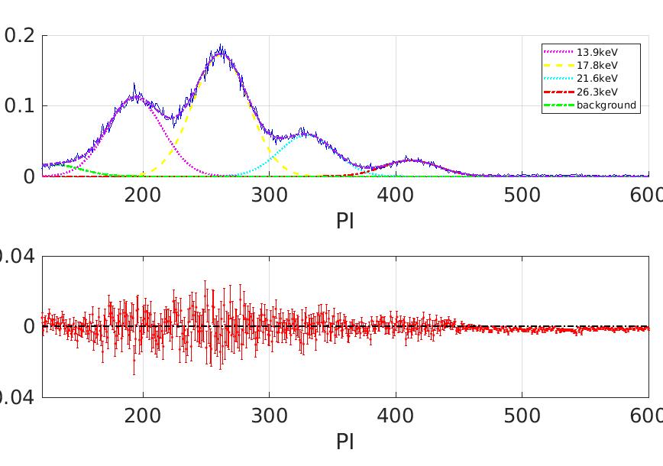




On-Orbit Calibration Strategy
Monitoring Long-Term Performance
Internal Calibration:6 Am-241 sources continuously illuminate 20 dedicated pixels, enabling precise tracking of gain and energy resolution over time.
Astrophysical Calibration:Regular observations of the Crab Nebula (a stable X-ray source) validate the instrument's overall energy response and effective area.
Method: Am-241 PI Spectrum Analysis
Spectral Fitting:PI spectra are fitted with four Gaussian lines corresponding to the Am-241 emission lines (13.9, 17.8, 21.6, 26.3 keV).
PI Spectrum of the Am-241 internal calibration source. The distinct Gaussian components allow us to accurately monitor the stability of the instrument's energy response.
Quantification:Tracking peak positions (energy scale) and FWHM (resolution) reveals long-term instrument evolution.
Notes:
To ensure the accuracy of our scientific data, we employ a robust on-orbit calibration strategy. This involves two key components. First, we use internal Am-241 radioactive sources to continuously monitor 20 special calibration pixels. As shown in the figure on the right, by analyzing the spectra from these pixels, we can precisely track changes in the instrument's energy scale and resolution. Second, we regularly observe the Crab Nebula, a cosmic "standard candle," to cross-validate our instrument's overall response and effective area. This dual approach ensures the highest data quality.

Slide 5
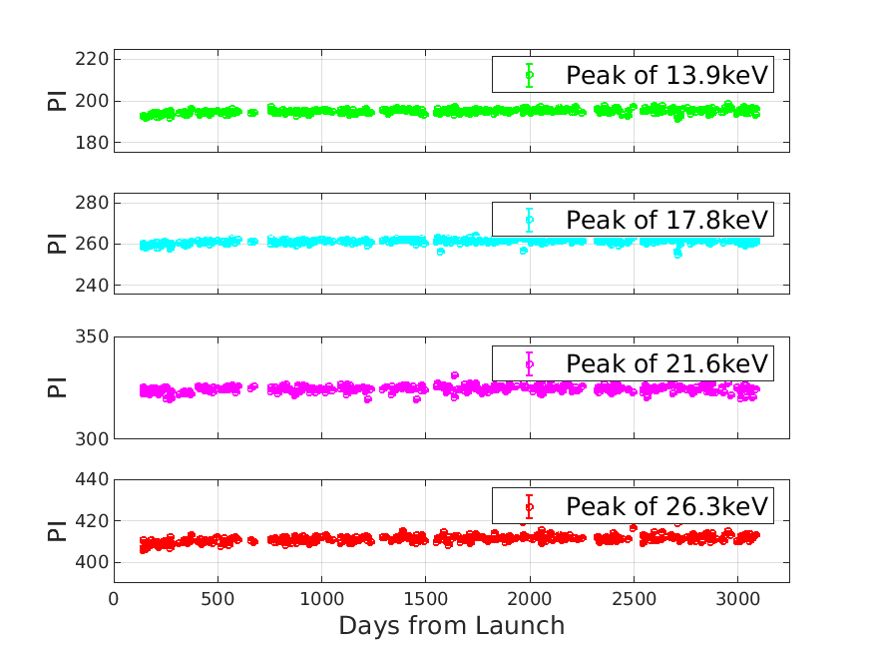
Performance Evolution: Energy Scale (Gain)
Key Observation
The peak positions of Am-241 lines in the PI spectrum show a gradual increase over time, indicating a slow rise in the instrument's gain (or a decrease in the E-C slope).
Long-term Evolution Trend
Gain increased relatively fast in the first ~400 days, then slowed down. After ~1200 days, the rate further diminished, demonstrating remarkable long-term stability.
Total Variation (2017-2026)
Average gain increase across 20 pixels is approximately1.43%over 9 years. This small, manageable drift is accurately corrected in the processing pipeline.
Notes:
Now let's examine the first key performance parameter: the energy scale, or gain. By tracking the peak positions of the Am-241 calibration lines, we observe a slow, steady increase in the PI channel number, as shown in the plots. This means the instrument's gain has increased slightly over time. The overall change over 9 years is about 1.43%. This is a very small shift, indicating excellent long-term stability of the instrument's energy response, and it can be easily corrected for in our data analysis.

Slide 6
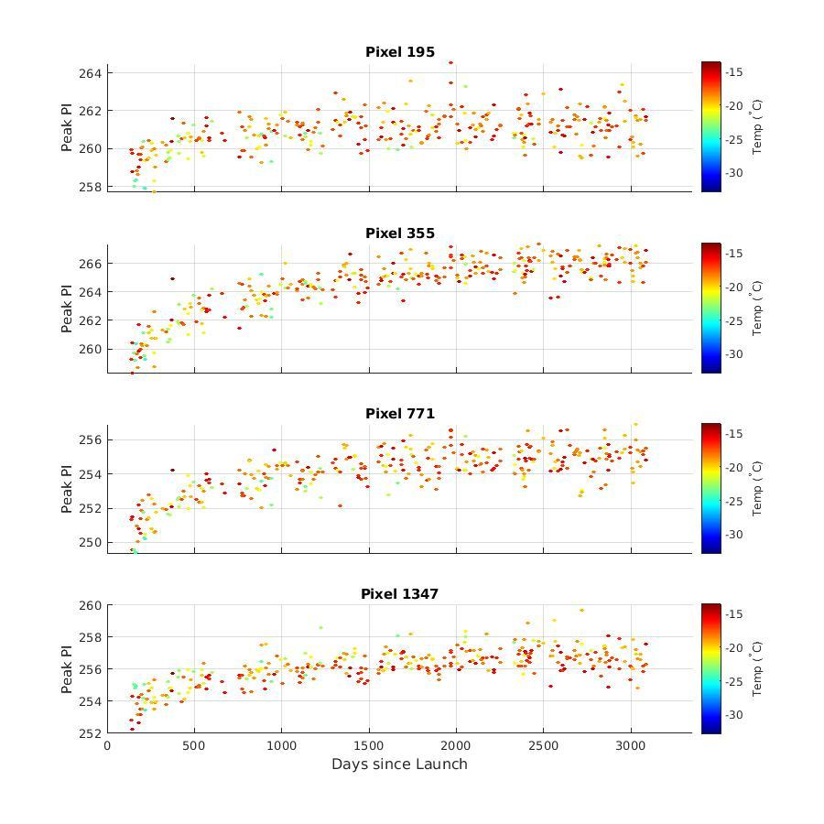




Performance Evolution: PI Peak Position (Detailed Pixel View)
Long-term Gain Stability of Key Pixels
Target Pixel Monitoring
Tracking the 17.8 keV Am-241 line peak position across four representative calibration pixels (195, 355, 771, 1347).
Gradual Gain Rise
Plots reveal a steady, slow increase in the PI channel value over time, confirming a consistent gain rise throughout the mission.
Pixel-to-Pixel Variability
Slight variations in the rate of increase reflect minor differences in individual pixel operating environments and aging characteristics.
Temperature Correlation & Correction
Color coding shows clear temp-PI correlation, which is accurately corrected in our data analysis pipeline.
Notes:
Let's zoom in on the gain stability by looking at four specific calibration pixels. This plot shows the evolution of the PI peak position for the 17.8 keV line over the entire mission. We see a slow, steady increase in the PI channel for all four pixels, which confirms our earlier finding of a gradual gain rise. The different colors represent different operating temperatures, and we can see that temperature has a direct, but well-understood, effect on the PI position, which we accurately correct for in our data processing.

Slide 7
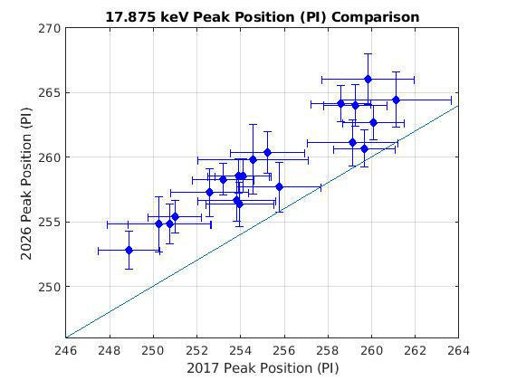




Performance Evolution: PI Peak Position (2017 vs. 2026)
Gain Evolution Overview
Compares the 17.8 keV line PI peak positions for all 20 calibration pixels at launch (2017) and after 9 years of operation (2026).
Pixel Distribution Analysis
Each plotted point represents a single detector pixel. The diagonal reference line on the plot indicates a theoretical scenario with zero gain change.
System-Wide Gain Increase
All data points lie consistently above the diagonal line, providing clear evidence of a universal gain increase across the entire detector array.
Response Stability (1.43% Avg)
The average PI peak increase is ~1.43%, matching previous analysis and demonstrating excellent long-term detector stability.
Notes:
To get a broader view, this slide compares the PI peak positions of all 20 calibration pixels at the start of the mission in 2017 versus now in 2026. Each dot is a pixel. If there were no change, all points would lie on the diagonal line. Instead, we see a clear shift upwards for all pixels, confirming a system-wide gain increase. The average shift is about 1.43%, which is a very small and manageable change, highlighting the excellent long-term stability of the entire detector system.

Slide 8
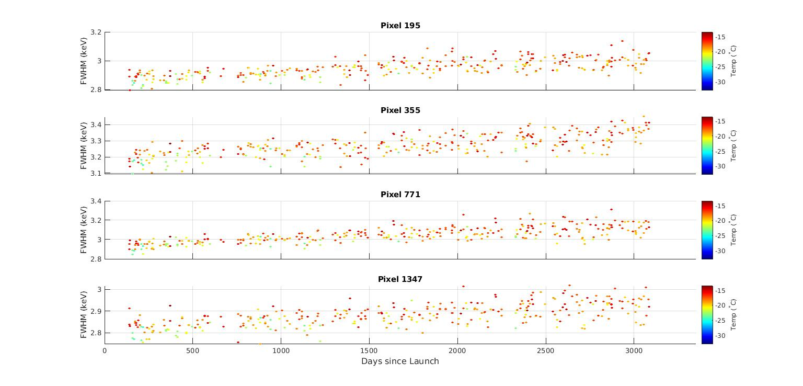

Performance Evolution: Energy Resolution (FWHM)
KEY OBSERVATION
The FWHM of Am-241 lines shows a gradual increase over time, indicating slow energy resolution degradation. This is a common effect in semiconductor detectors caused by radiation damage and increased leakage current.
PIXEL DEGRADATION RATES (2017-2026)
Pixel 195:+5.94%
Pixel 771:+8.14%
Pixel 355:+5.79%
Pixel 1347:+5.00%
OVERALL PERFORMANCE CHANGE
Average FWHM Degradation:2.35% |Actual Loss (Gain Corrected):0.91%
Notes:
Next, let's look at the energy resolution, measured by the FWHM. We see a slow degradation over time, which is expected for detectors in space. The plots show the FWHM increasing for several representative pixels. For example, pixel 771 shows the most significant degradation at 8.14%, while pixel 1347 is the most stable at 5.00%. Overall, the average degradation is about 2.35%, which, when corrected for the gain change, translates to a real performance loss of only about 0.91%. This is a very minor effect for most scientific analyses.

Slide 9
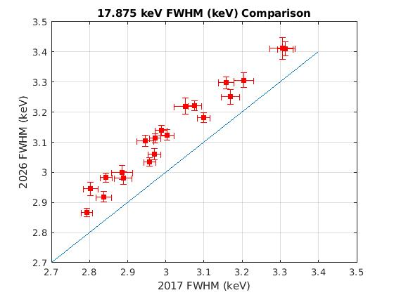

Performance Evolution: Energy Resolution (2017 vs. 2026)
Pixel-Wide Comparison
Compares the FWHM of the 17.8 keV line for all 20 calibration pixels, with each point representing a single detector element.
Reference Benchmark
The diagonal line on the plot indicates a theoretical "no change" state, serving as a direct visual reference for stability.
Degradation Trend
Most data points lie above the diagonal, confirming a clear trend of energy resolution degradation across the entire array.
Key Finding:Average FWHM increased by ~2.35%, verifying the gradual aging effect on detectors.
Notes:
This slide provides a cross-sectional view of the energy resolution degradation. It compares the FWHM of all 20 calibration pixels in 2017 versus 2026. Again, points above the diagonal line indicate a change, in this case, a degradation. We see a general trend of increasing FWHM, with an average increase of about 2.35%. This confirms the slow, predictable aging of the detector array, which we can account for in our data analysis.

Slide 10
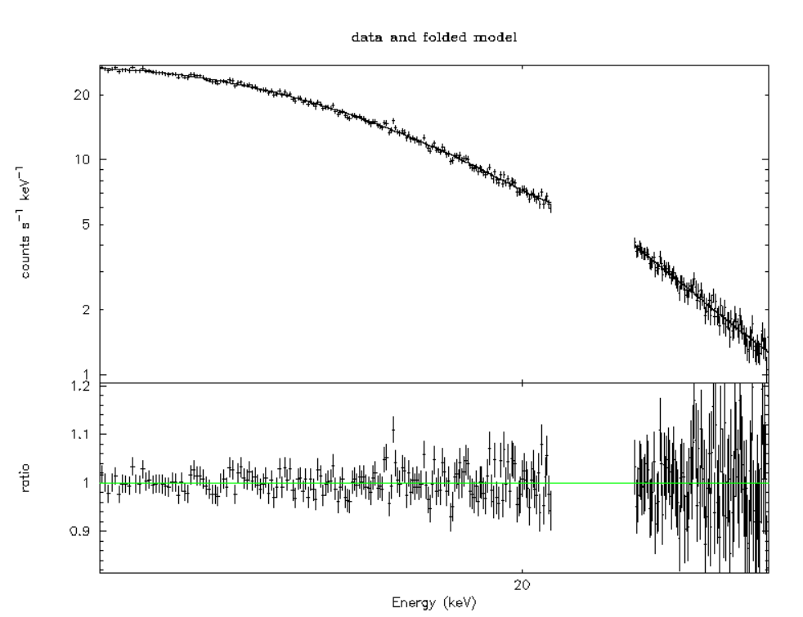
Performance Evolution: Energy Response & Crab Spectrum
Crab Nebula: A Standard Calibrator
The Crab Nebula's stable spectrum verifies the ME's energy response (RMF) and auxiliary response (ARF). We compare ME's observed spectrum with the expected theoretical model.
Key Evolution Metrics (2017 vs. 2026)
Photon Index (Γ) Shift
Flux Normalization (N)
+2.81%(Consistent with gain)
+18.17%(Area degradation)
Validation Conclusion
The ME's energy response (RMF) remains scientifically reliable. All observed changes are well understood and predictable, confirming the validity of our long-term calibration model.
Notes:
To assess the overall energy response, we turn to the Crab Nebula. By fitting its spectrum, we can check the health of our response matrices. The figure shows the Crab spectrum observed by ME in 2017 and 2022. Our analysis up to 2026 reveals a 2.81% change in the measured photon index, which is consistent with our gain measurements. The normalization, or flux, shows a larger 18.17% change, which we attribute to the gradual loss of effective area. Importantly, these changes are understood and predictable, meaning our core response model remains valid for scientific analysis.

Slide 11
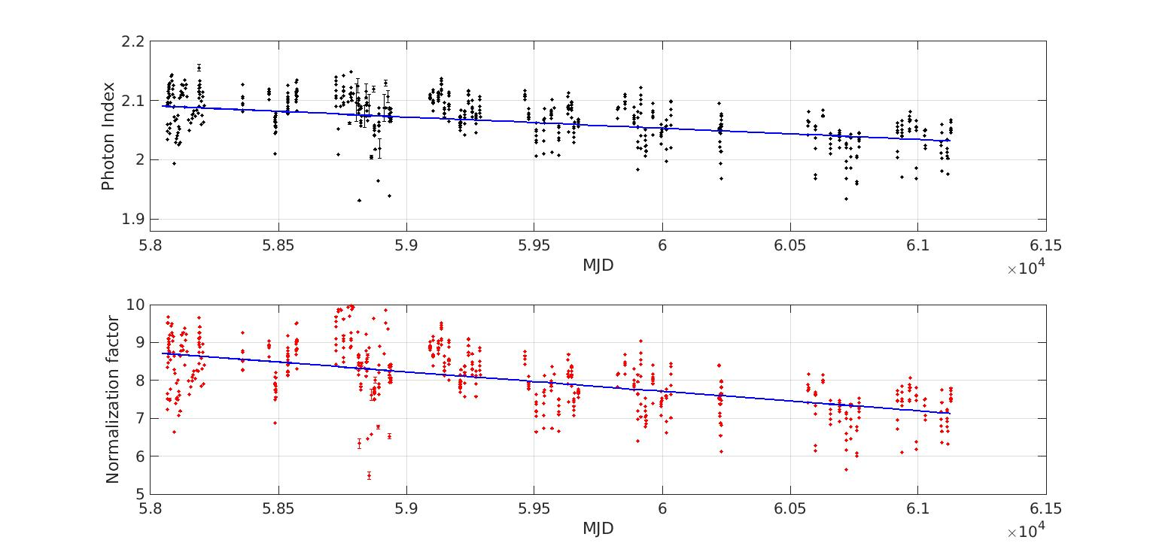
Long-term Evolution of Crab Spectrum Parameters
Tracking the Cosmic Standard Candle
We have analyzed 677 observations of the Crab Nebula over 9 years to monitor the long-term evolution of the ME's spectral response and performance.
Photon Index (Γ):A slight decrease of2.81%is observed, consistent with gain shifts and energy resolution degradation over time.
Normalization (N):A significant decrease of18.17%in flux normalization, primarily due to detector aging and window contamination.
Conclusion:The strong Γ-N correlation indicates changes areinstrumental effects, not intrinsic variations of the Crab Nebula.
Notes:
Now, let's look at the results from our primary astrophysical calibrator, the Crab Nebula. By fitting its spectrum over 9 years, we track two key parameters: the photon index and the normalization.
The top plot shows the normalization, or flux, decreasing by about 18%. The bottom plot shows the photon index decreasing by about 2.8%.
The strong correlation between these two parameters, seen in the bottom panel, tells us these changes are due to the instrument's aging, not changes in the Crab itself. This confirms our understanding of the ME's performance evolution.

Slide 12
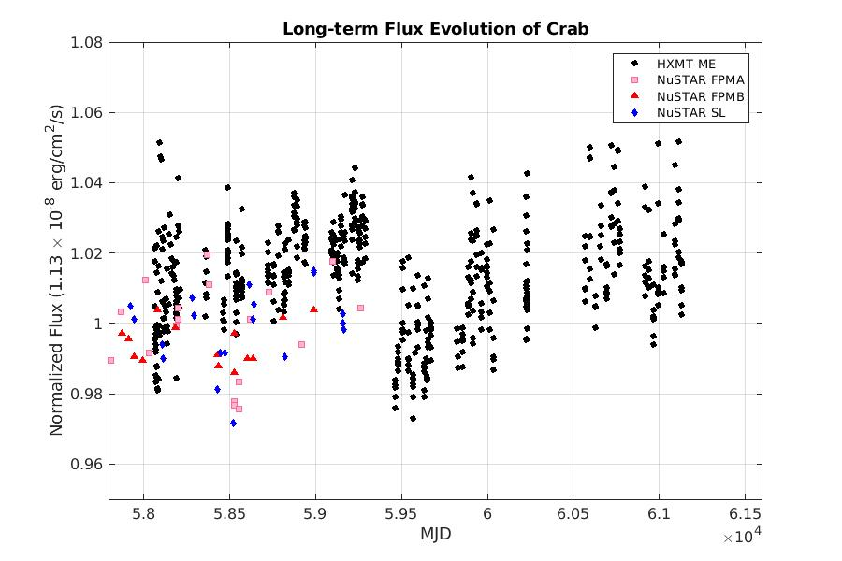


Cross-Validation: ME vs. NuSTAR Flux
Independent Verification of Stability
We compare the ME's Crab Nebula light curve with NuSTAR's data, normalizing both to a standard astrophysical model for direct comparison.
Over a 9-year observation period, the ME light curve (black) shows excellent agreement with NuSTAR's multi-filter data (red/pink/blue).
This confirms observed ME response changes are real instrumental effects, not source variability or analysis errors, providing strong confidence in long-term calibration.
Notes:
To provide an independent check on our results, we compared the Crab's light curve as seen by ME with that from another X-ray mission, NuSTAR. After normalizing both to a standard model, as shown in this plot, the agreement is excellent.
This confirms that the changes we see in the ME data are indeed due to the instrument itself and not some unknown astrophysical variation or error in our analysis. This cross-validation gives us great confidence in the reliability of our calibration and performance assessment.

Slide 13
Summary of Key Findings
Excellent Long-Term Stability
Predictable Performance Evolution
The ME telescope has demonstrated exceptional stability over 9 years in orbit. Key parameters like energy scale and resolution show only minor, predictable changes.
Observed degradation in energy resolution and effective area is gradual and well-understood. Accurate corrections ensure the long-term integrity of scientific data.
Uncompromised Scientific Capability
A Valuable Data Archive
Despite minor changes, ME remains a powerful instrument for high-resolution X-ray spectroscopy. Its unique long-term monitoring capability is a key asset to the community.
The 9-year dataset enables studies of long-term variability in compact objects. It provides a stable, unique reference for calibration and future X-ray missions.
Notes:
Thank you for your attention. I would now be happy to answer any questions you may have about the performance and future of the Insight-HXMT ME telescope.

Slide 14
Q & A
THANK YOU
FOR YOUR ATTENTION
Insight-HXMT ME Telescope Project
Notes:
Thank you for your attention. I would now be happy to answer any questions you may have about the performance and future of the Insight-HXMT ME telescope.

