Slide 1
Ground calibration of the New ATHENA optics
Alberto Moretti (INAF-OAB)
on behalf of the New ATHENA Telescope WG
D.Spiga, G.Sironi, B.Salmaso, S. Basso, B. Dalla Barba, M. Uslenghi, M. Fiorini, G. Pareschi (INAF)
K. Madsen (NASA)
V. Burwitz, M. Freybergh (MPE)
J.W. den Herder (SRON)
D. DellaMonica Ferreira, A. S. Jegers, S. Massahi, S. Svendsen (DTU)
M. Guainazzi, M. Bavdaz, E. Kuulkers, P. Schmidt (ESA)

Slide 2

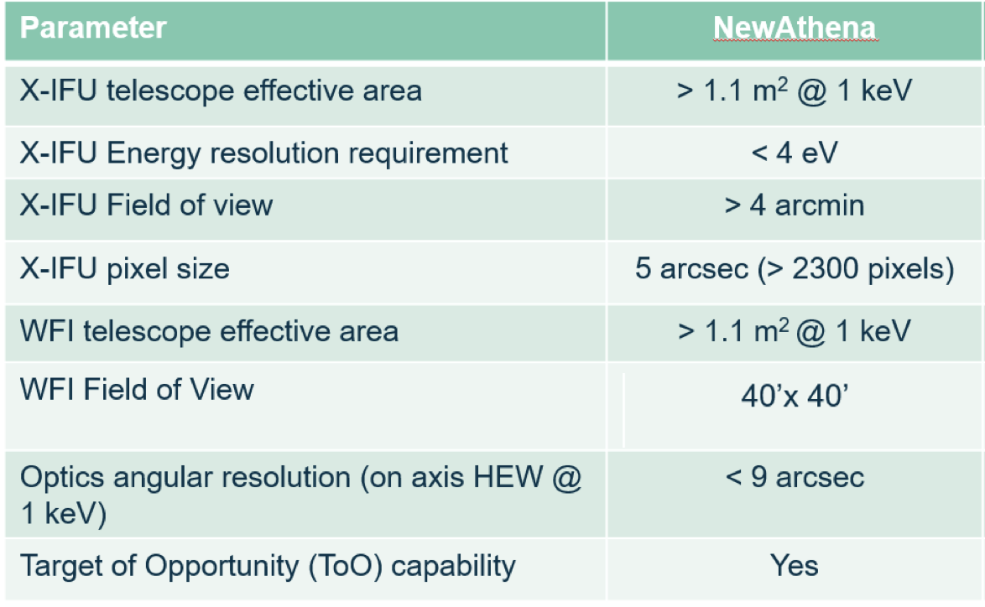
New ATHENA : ESA large class mission
Phase A restarted in 2024 ; adoption is expected in 2027, with a planned launch in 2037
Very large mirror
XIFU : high resolution spectrometer with 5” pixel
WFI : very large GRASP

Slide 3
New ATHENA optics
Bavdaz+25

Slide 4
Calibration requirements

Slide 5
Requirement on calibration
CAL-PSF-R-001
The absolute knowledge error (AKE) of the encircled photon (enclosed energy) fraction of the mirror PSF shall be smaller than 0.1 arcsec with a confidence level of at least 68.27% in the "core".
HEW error of 0.1’’ and e 5% PSF error keep the error of PSF flux below 1%
(from calibration requirement document)

Slide 6
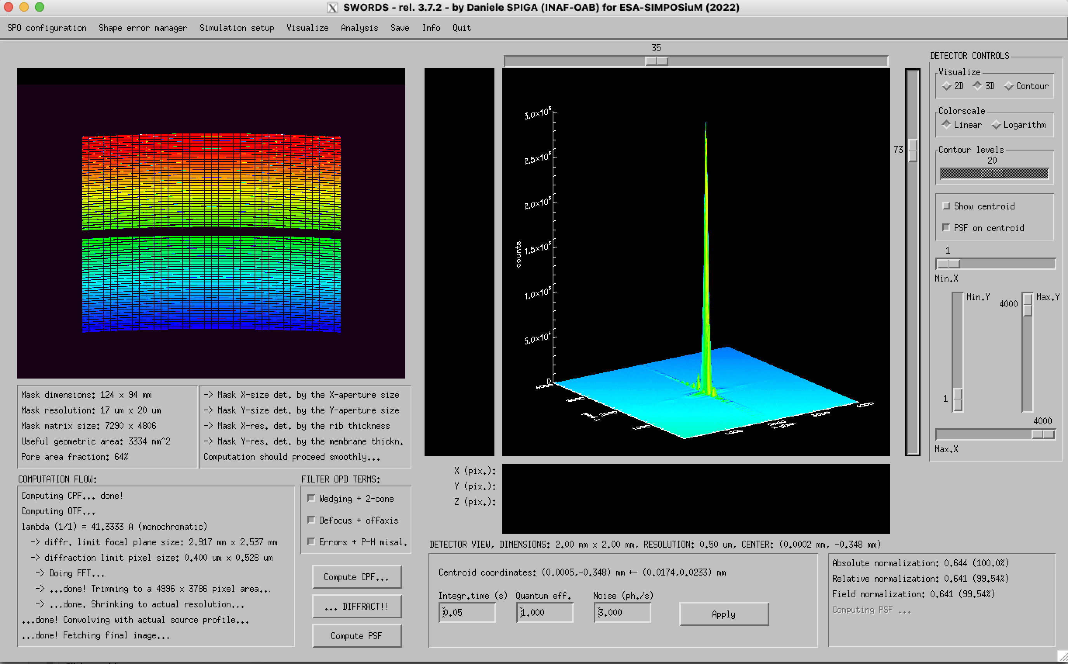
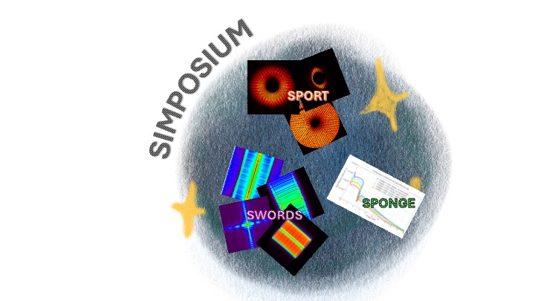
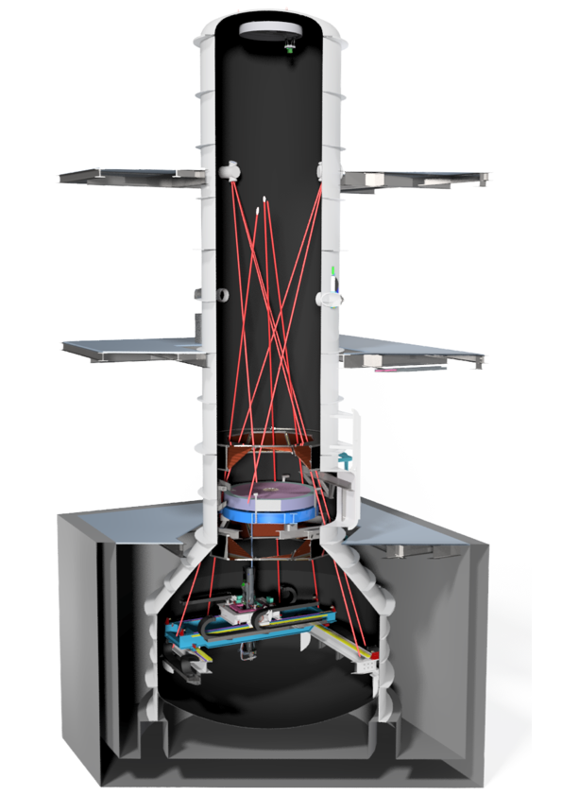
Calibration facilities
BEaTriX faciltiy has been built at the Brera Observatory with the aim of the fast MM calibration operating since 2022.
SIMPOSIUM
• Ingests metrology data from all
production steps
• Uses X-ray metrology data
obtained at various facilities
• Validated with VERT-X
• Simposium activity ongoing
VERT-X is a new facility under construction to the verification and the calibration of the entire mirror assembly

Slide 7
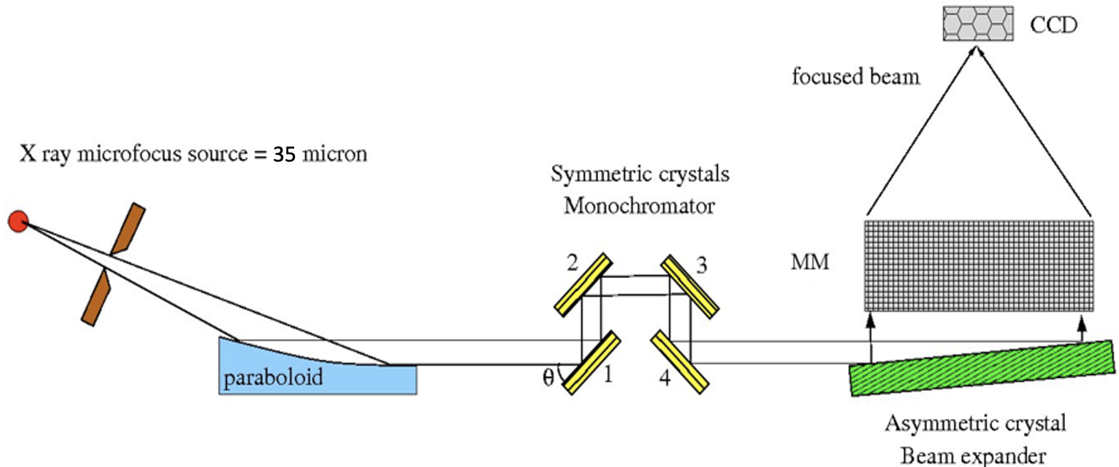
BEaTriX: MM calibrations
The BEaTriX faciltiy has been built at the Brera Observatory with the aim of the fast MM calibration operating since 2022.
In BEaTriX a micro-focus X-ray source in the focus of a paraboloidal mirror generates a parallel beam.
A crystal monochromator selects the Ti 4.5 keV or Al 1.5 lines
The beam is expanded to the final size by a crystal asymmetrically cut with respect to the crystalline planes.
Compact design allows test and acceptance (before integration), of the 492 Mirror Modules, at their production rate (2MM/day).
Credits to B.Salmaso, D.Spiga, S. Basso

Slide 8
BEaTriX : X-ray beam
Flux 10-50 photons/ s /cm2

Slide 9
BEaTriX : Calibration of the first coated MM

Slide 11
Mirror integration
Once the modules are test and accepted by BEaTriX, they will be assembled
on the mirror structure
The integration facility is under construction at the Media Lario premisis (20 km form
the Brera Observatory, near the Como Lake)

Slide 12
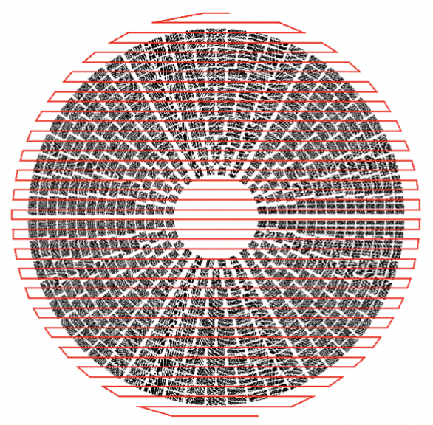
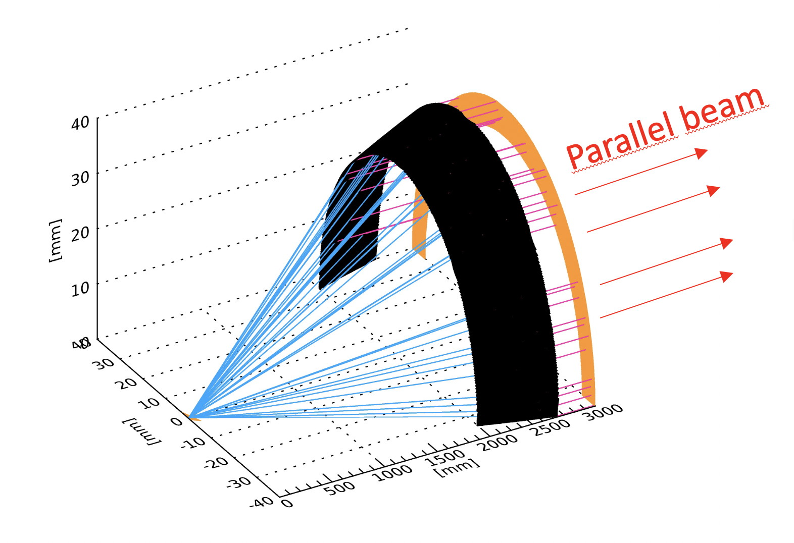
The VERT-X concept
Low-divergence beam
Vertical geometry (no lateral gravity)
Possibility of characterizing each MM
Notes:
We started from the well known problem of the finite distance source in ground calibration .

Slide 13

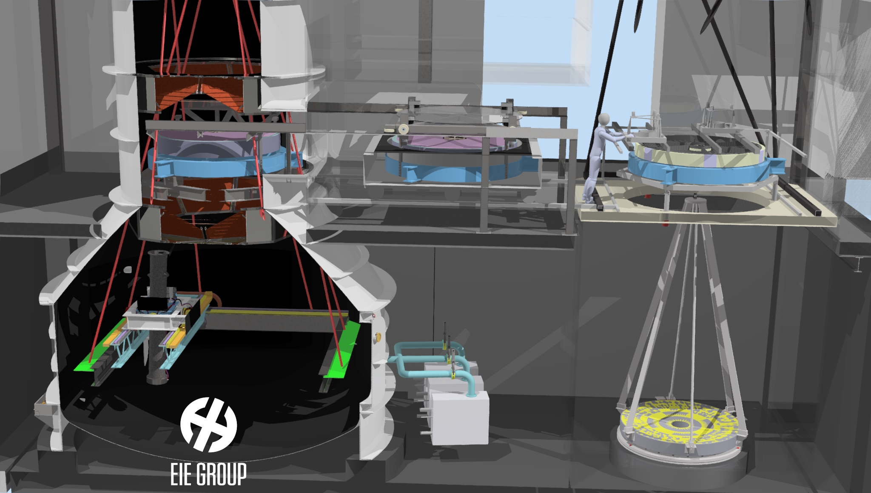

VERT-X and the integration facility
Notes:
These are the characteritstics of the mirror …. In the design we fully exploited the exoerience of beatrix …

Slide 14
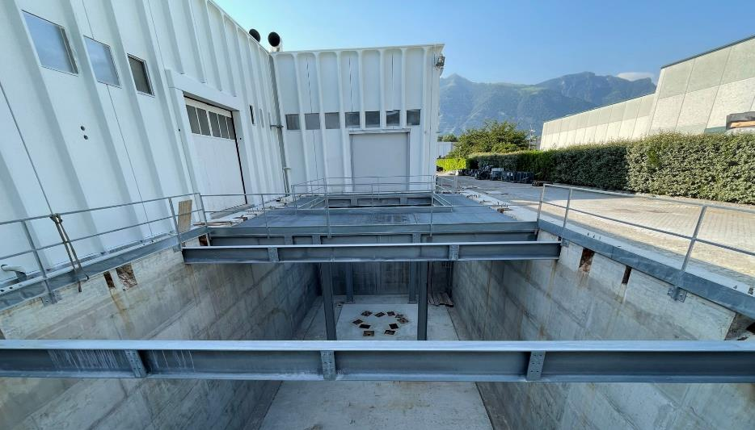
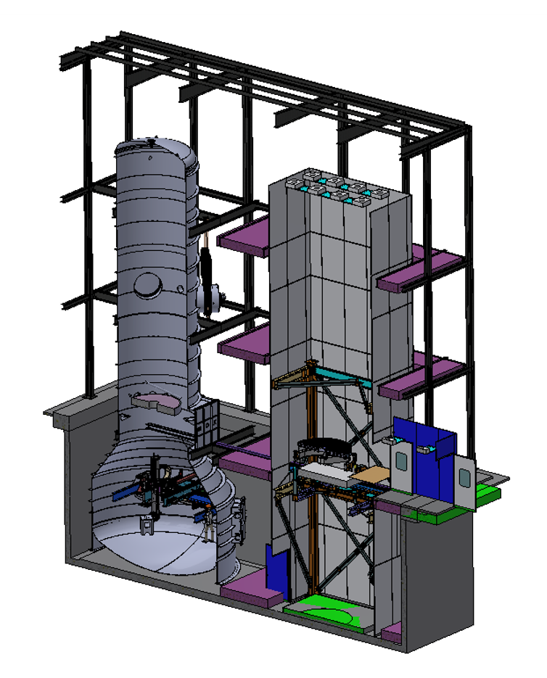
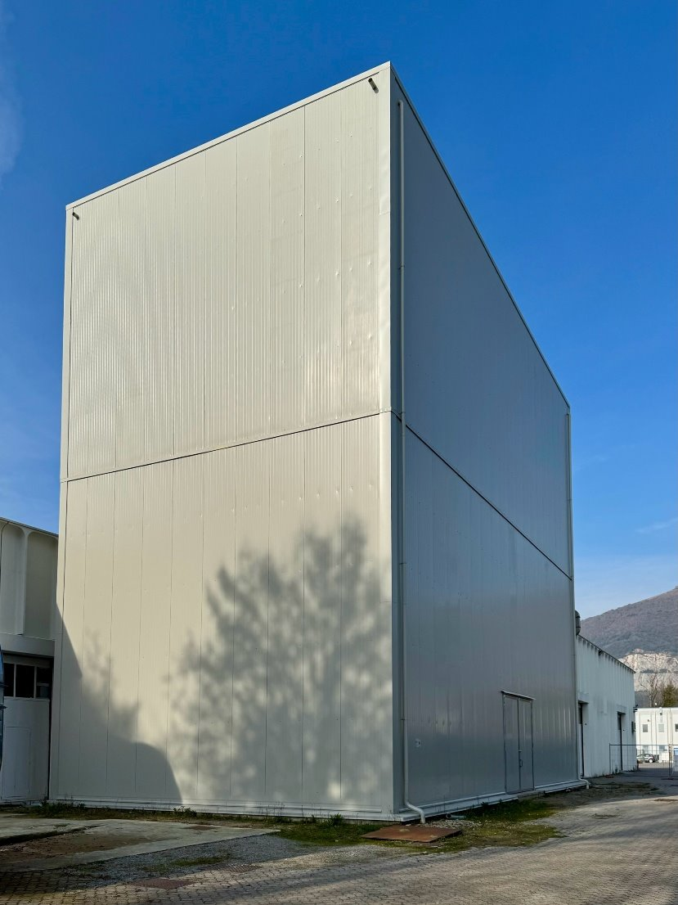
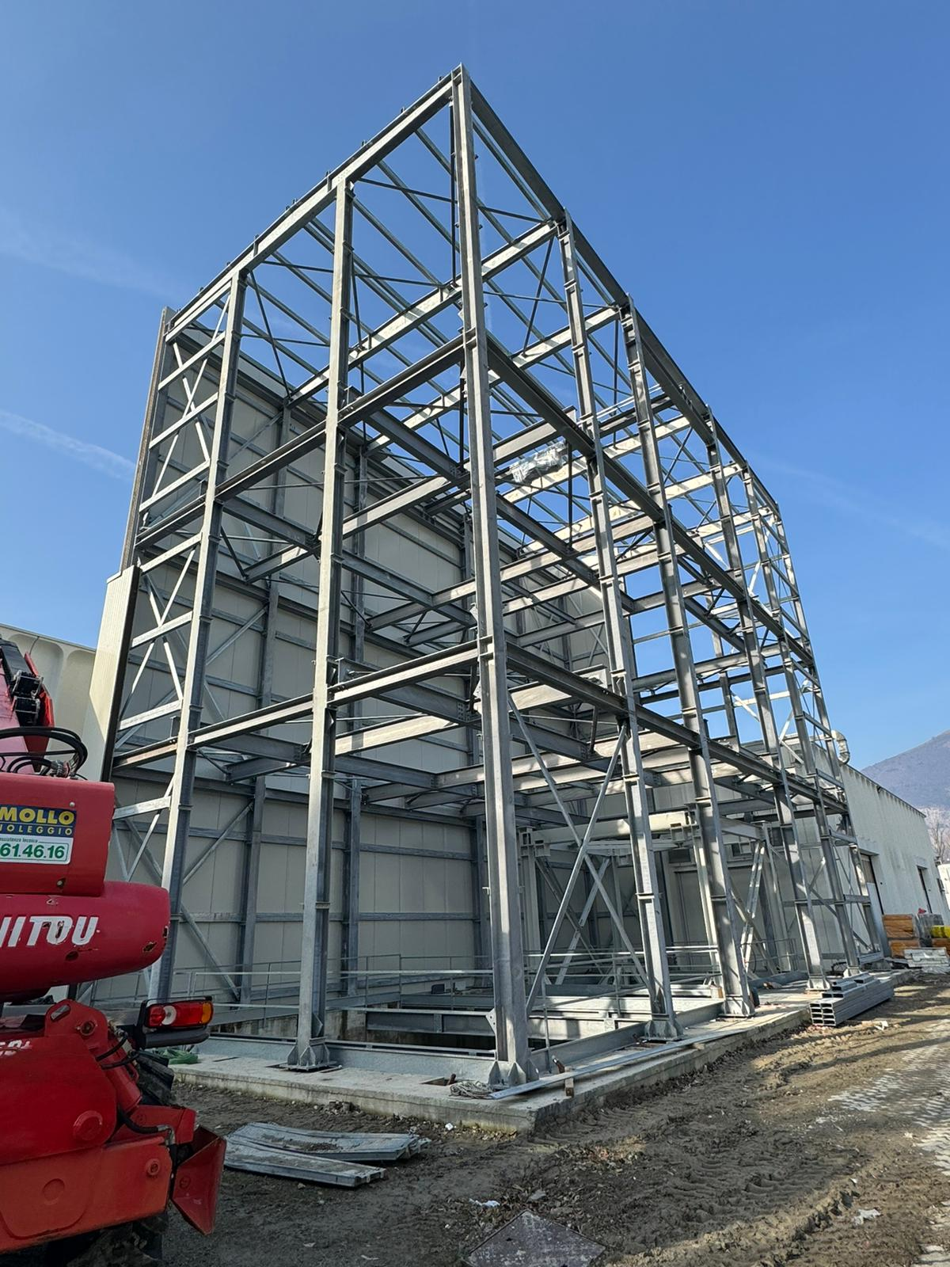
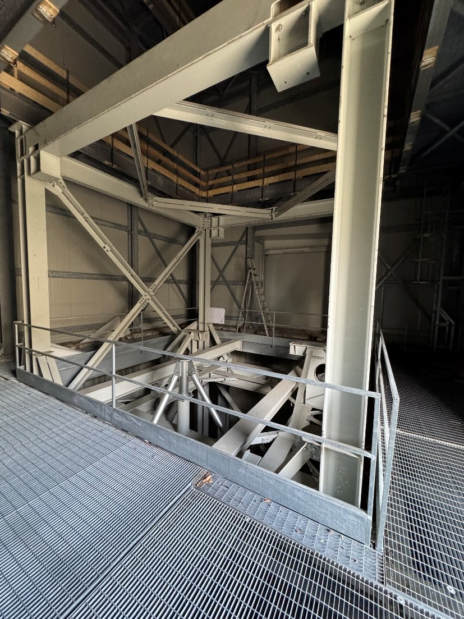
Mirror integration and VERT-X building
Notes:
These are the characteritstics of the mirror …. In the design we fully exploited the exoerience of beatrix …

Slide 15
The VERT-X critical items
Focal plane
ATHENA mirror
Raster
scan
Notes:
These are the characteritstics of the mirror …. In the design we fully exploited the exoerience of beatrix …

Slide 16
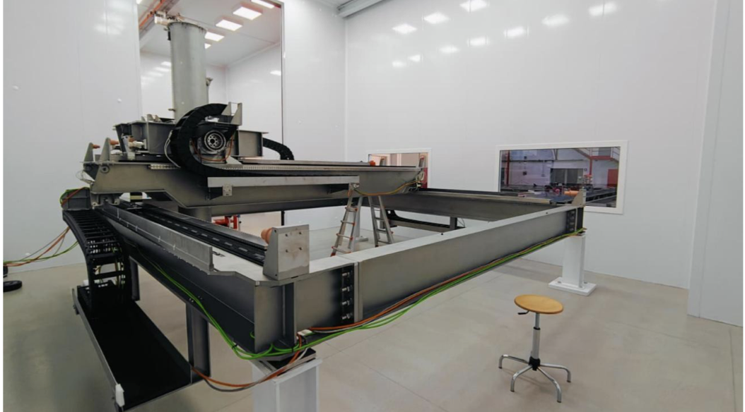
VERT-X raster-scan
The base in stainless steel is the fixed part. It lays on rigid points of the vessel and discharge the loads directly on the vessel foundations.
The bridge is the first moving part of the Raster Scan (translation along X).
The trolley is the second moving part of the Raster Scan (translation along Y). It slides over the Bridge and it constitutes the fixed part of the Gimbal mount.

Slide 17
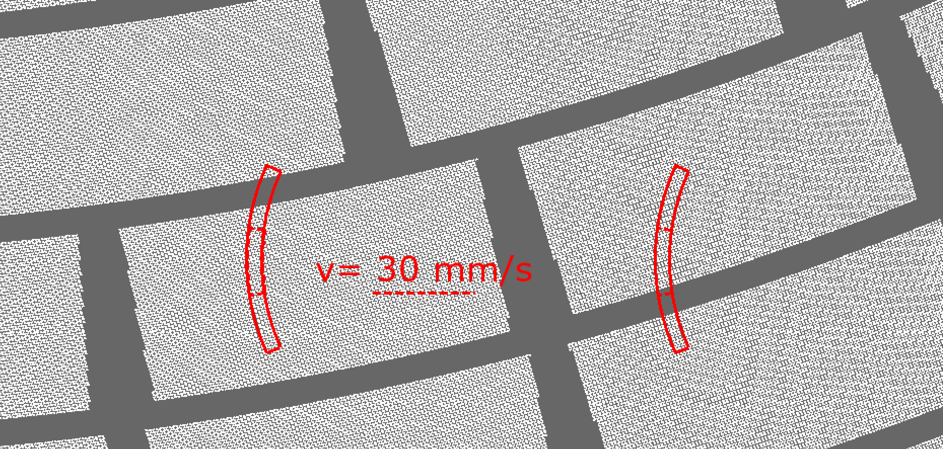
VERT-X raster-scan
Scan velocity 30 mm/s
Beam size 60 mm
40 steps 100 m
Tot.scan time 1.0 hr
Accel. time 10 s
Settling time 4 s
Inclination 3 deg.
Tracking error < 0.5’’

Slide 18
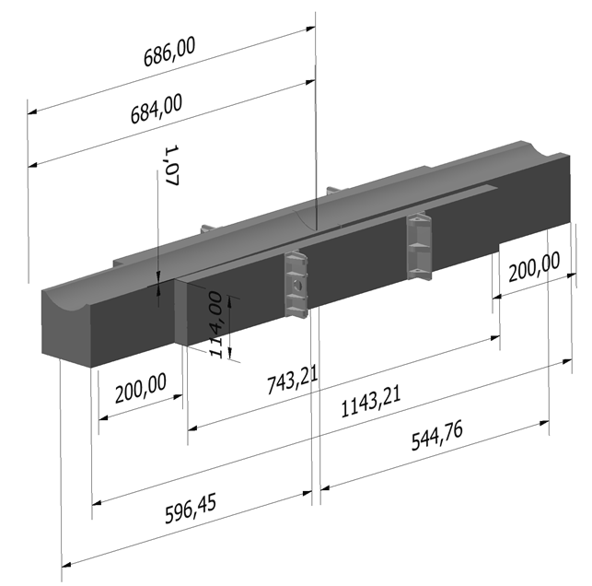
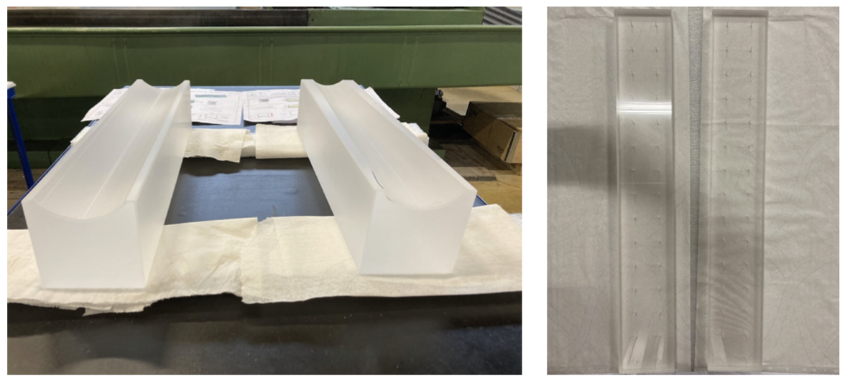
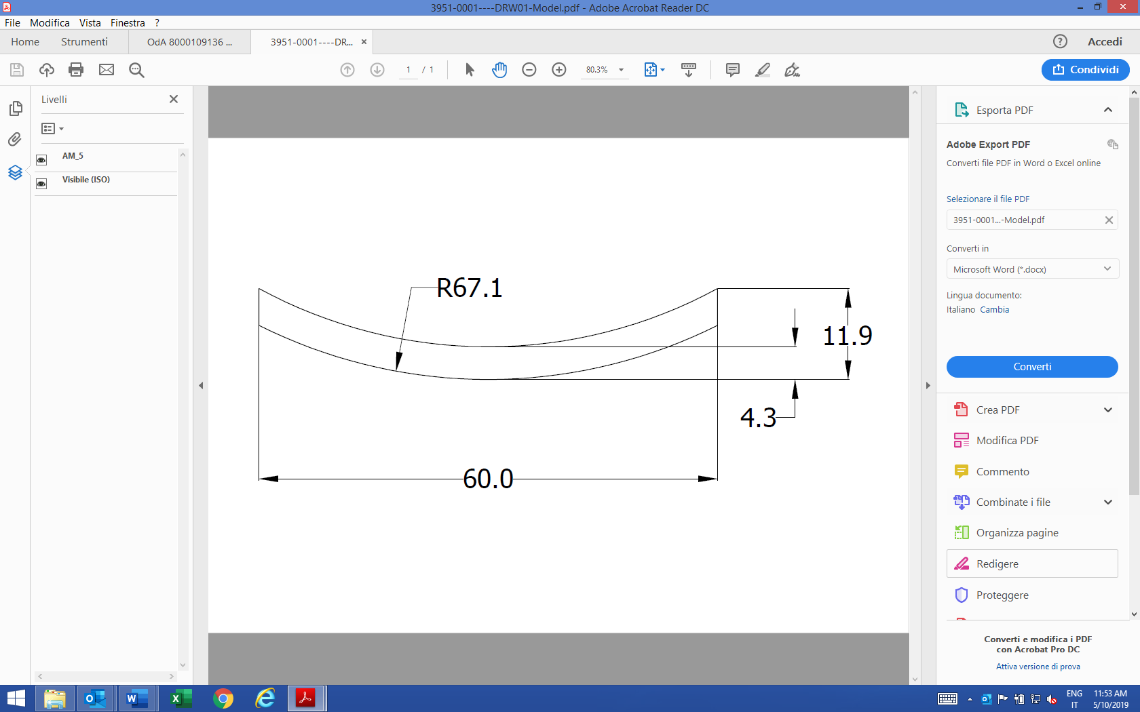
The VERT-X collimator
Wolter design
Hyp and Parab manufactured separately
1.1 m long
Focal length ~ 2m
Eff. 83% (1keV) 52% at 10keV
HEW ~ 1’’
Notes:
These are the characteritstics of the mirror …. In the design we fully exploited the exoerience of beatrix …

Slide 19
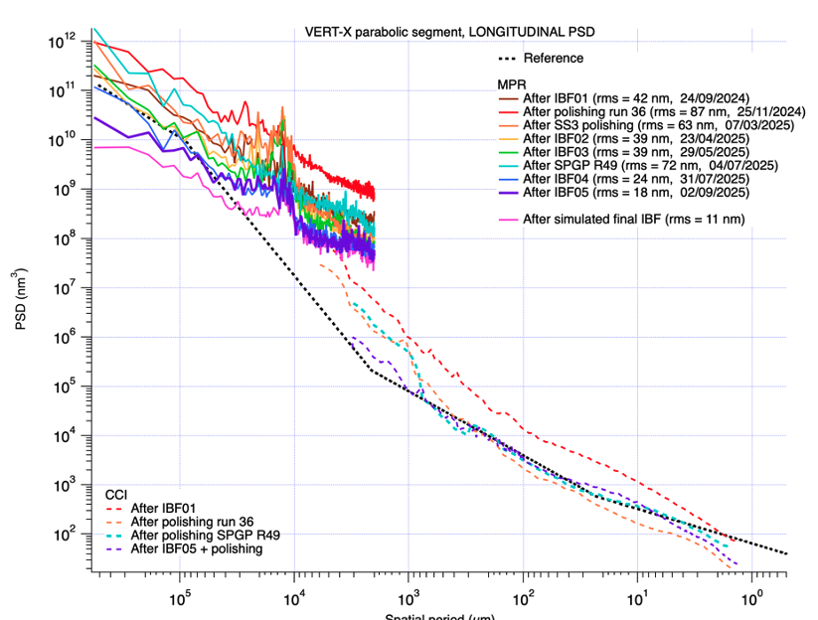
The VERT-X collimator
Blank (Cornig fused silica)
grinding
grolishing
Zeeko polishing
super polishing
IBF
Notes:
These are the characteritstics of the mirror …. In the design we fully exploited the exoerience of beatrix …

Slide 20
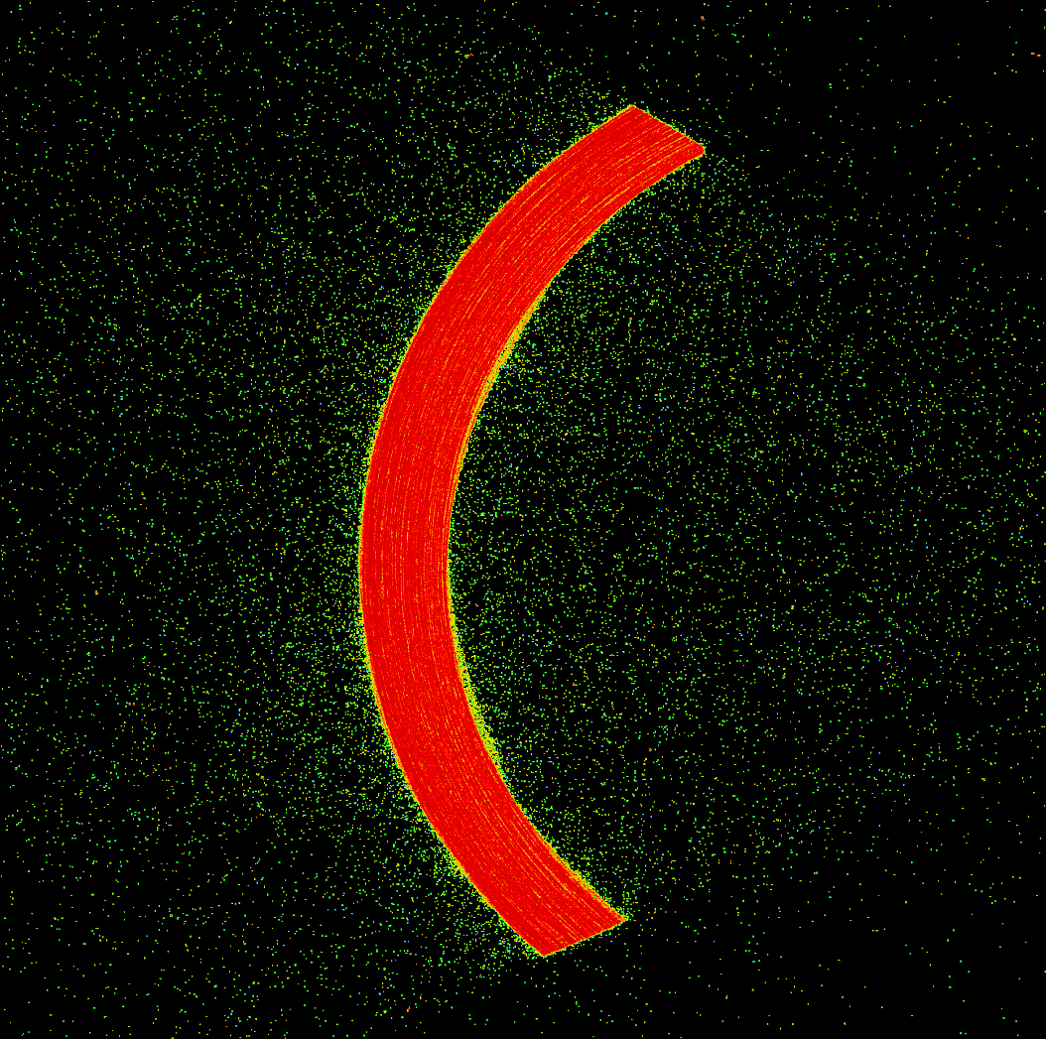
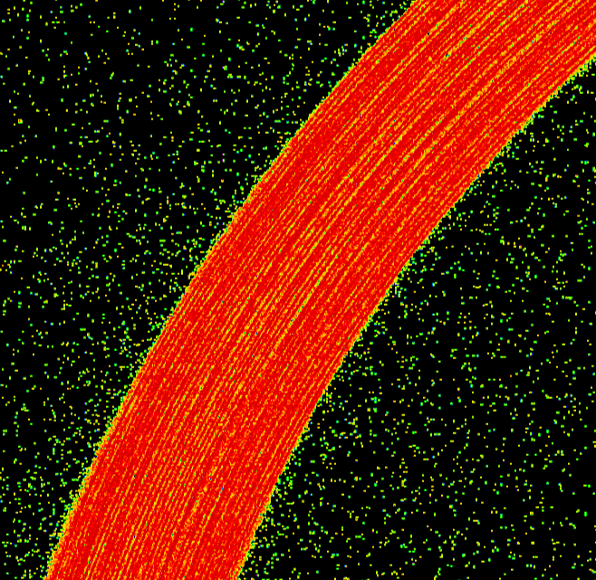
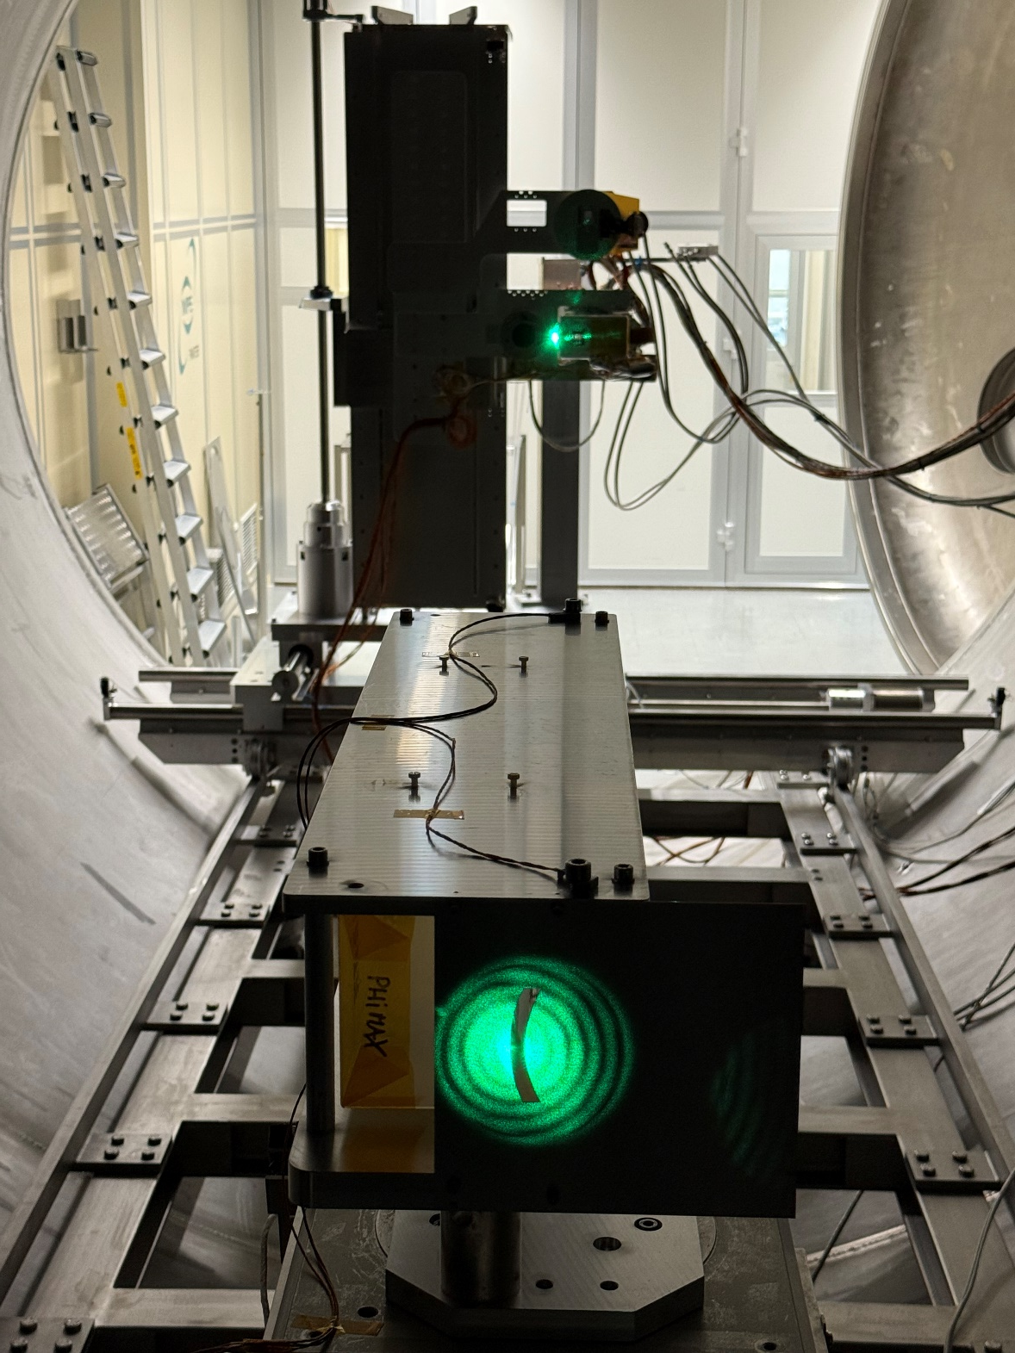

The VERT-X collimator
Credits to V.Burwitz and Panter
The Parabola segment has been tested in X-ray at Panter facility Oct 2025

Slide 21
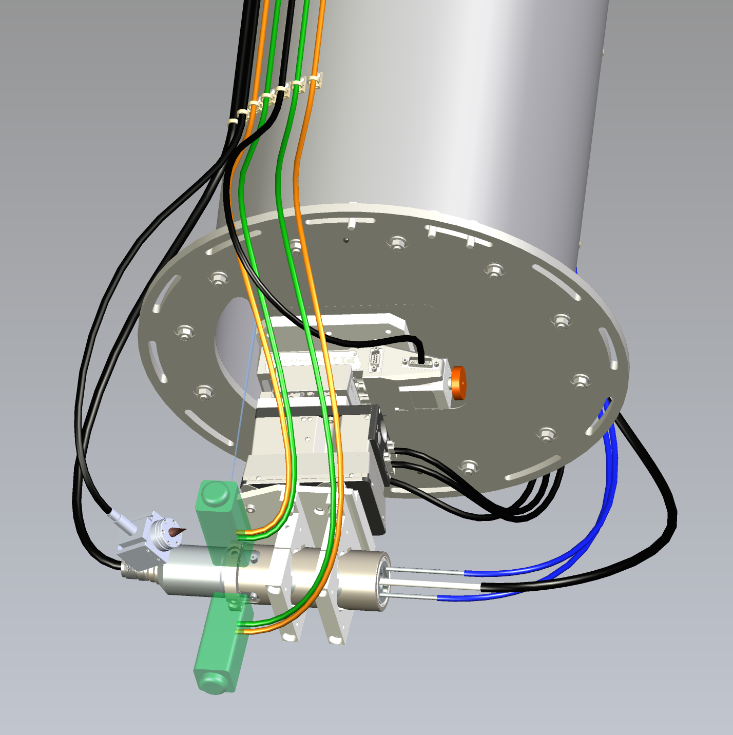
The VERT-X X-ray source
Sigray FAAST Reflection X-ray Source
Non-standard requirements:
micro-focus (~10 micron)
fully operational and movable in vacuum
liquid based cooling system
ion-pump vacuum system
very long and flexible vacuum cables
2 anode targets (Cr, W), 25 micron Be window
X-ray source will be movable to be positioned in the collimator focus. Movement along the 3 axis will be provided by a combination of three linear stages.
Compliant with verification requirements
Upgrade is necessary for the final calibration: window change + 3 target addition

Slide 22
The VERT-X HEW error budget
CAL-PSF-R-001: The absolute knowledge error (AKE) of the encircled photon (enclosed energy) fraction of the mirror PSF shall be smaller than 0.1 arcsec with a confidence level of at least 68.27% in the "core".
${{HEW}_{VTX}^{2} = HEW}_{MA}^{2} +$ ${HEW}_{BEAM}^{2}$
$σ_{HEWMA}^{2}=\frac{{HEW}_{VTX}^{2}}{{HEW}_{MA}^{2}} σ_{HEWVTX}^{2} +$ $\frac{{HEW}_{BEAM}^{2}}{{HEW}_{MA}^{2}} σ_{HEWBEAM}^{2} <0.1”$ calibration requirement
statistical [0.07”]
Systematic [~1.5”+/-0.2]
BEAM DIVERGENCE
Source size (0.8”)
Collimator errors (1.2”)
Raster-scan tracking accuracy (0.4”)
Sou/coll. displacement (heat induced) (0.1”)
ACCUMULATED PHOTONS
Exposure time
Detector sustainable rate
Operation strategy

Slide 23
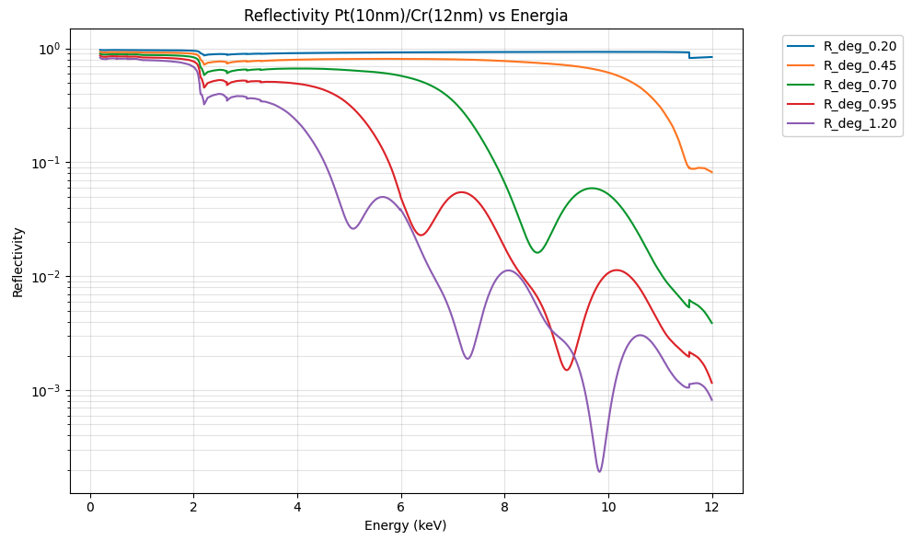
SIMPOSIUM: the physical model
Credits to G.Sironi, D.Spiga, A. Jegers

Slide 24
SIMPOSIUM: the physical model
SIMPOSIUM will be informed by metrology and data taken at BEaTRiX and VERT-X.
It will cover the energy band and off-axis range not captured by direct measurements to produce the ARF, PSF, vignetting CALDB files and estimation of the stray-light component of the background.

Slide 25
EXTRA slides

Slide 29
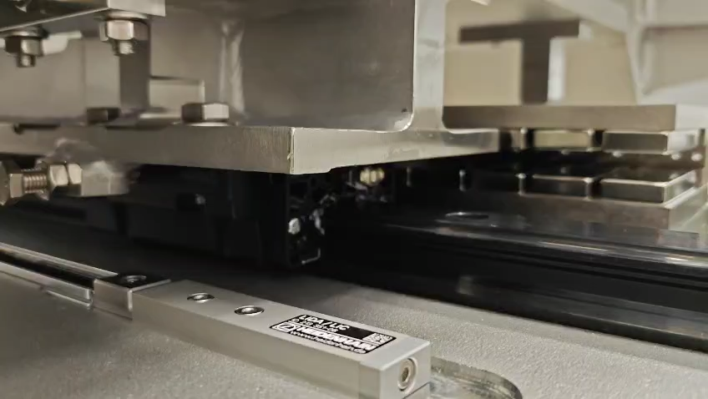

Slide 30
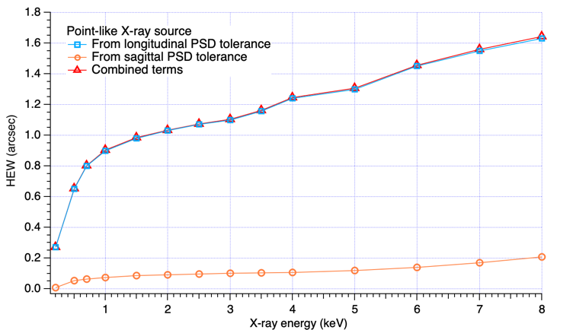
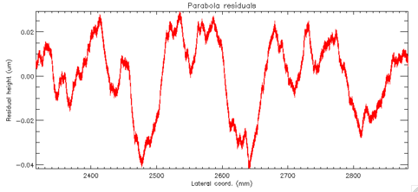
Error Power spectrum density
D.Spiga+21
rms : 14 nm

Slide 31
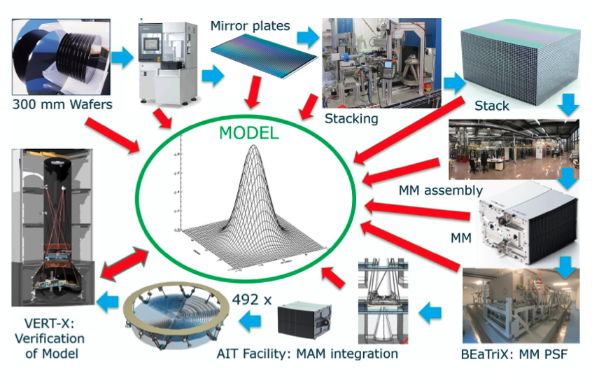
Model-based Calibration Plan

