Slide 1


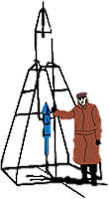






IACHEC April 2026
NICER Calibration Status Craig Markwardt (NASA/GSFC) on behalf of NICER Team (esp. Jeremy Hare & Keith Gendreau)
GSFC

Slide 2
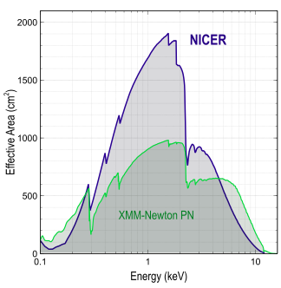
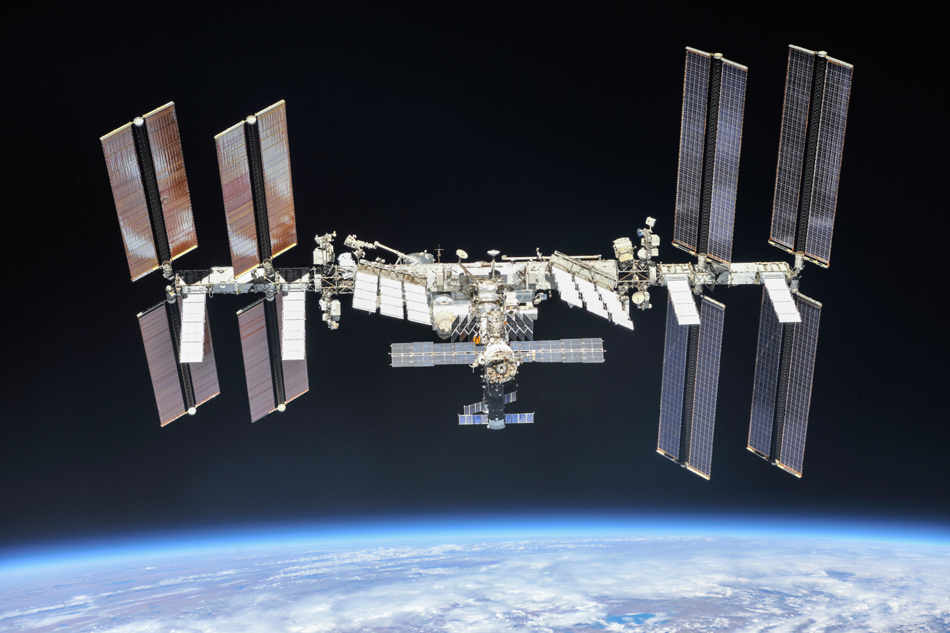
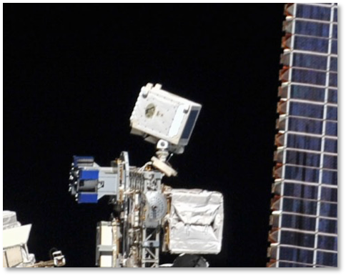
NICER’s Unique Capabilities
Launched June 2017 to International Space Station
Spectral band: 0.2–12 keV (52 silicon detectors)
Energy resolution: < 150 eV @ 6 keV
Timing resolution: 100 nsec RMS absolute
Non-imaging field of view (“single-pixel”)
6 arcmin diam. (half-max)
High throughput (3.5 Crabs with no pileup)

Slide 3
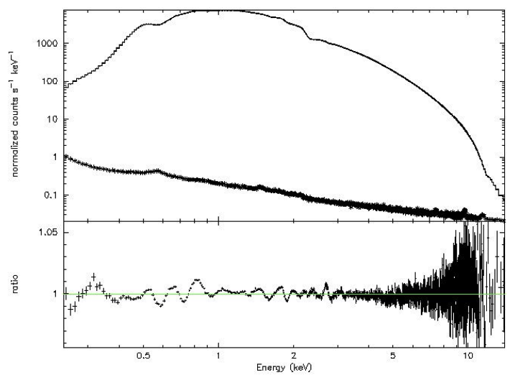
NICER Calibration Status
NICER calibration very stable
Major impact of optical light leak & repair
Expected gain shifts
Expected ARF adjustments
Other calibration aspects
Energy scale: monitoring drifts of few eV / yr
ARF: systematic feature errors <1.5% (0.4-10 keV)
RMF: Scholze & Procop X-ray silicon model performs well
NICER Crab

Slide 4
Outline
NICER Mission Status
NICER Calibration Status
Optical Light Leak, Repair and Mitigation
NICER repair spacewalk successfully patched the largest optical leaks
Additional optimizations significantly improve NICER performance during orbit day
Future Calibration Plans

Slide 5
NICER Mission Status
As of June, 2025, NICER has suspended scientific operations
NICER operations is focused on maintaining a safe environment aboard the International Space Station for crew and robotic vehicles
NICER continues to fund US observers through its GO program, at least for the coming year
NICER science operations will focus on providing the best science calibration and archival data access

Slide 6
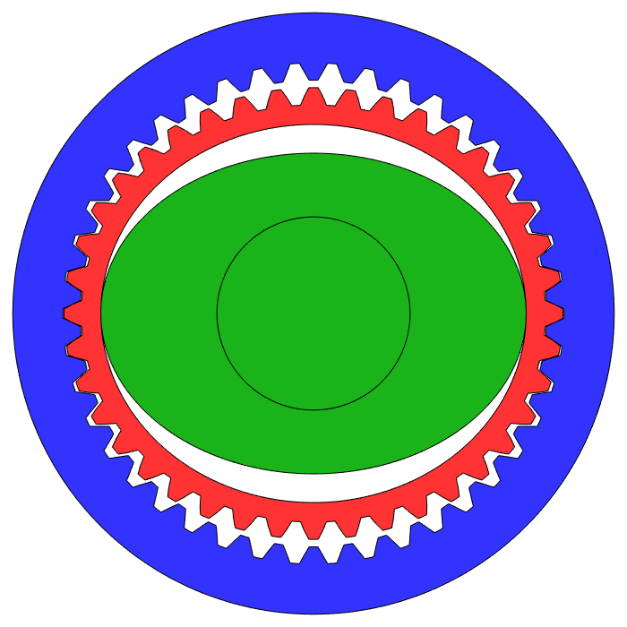
Loss of Pointing Control
In June, 2025, NICER’s azimuth drive no longer fully responded to pointing commands
This axis is driven by harmonic drive gearing
No longer possible to track astrophysical targets
NICER detectors were operated in a fixed-pointing mode for about two weeks
Gather additional sky and particle background data
Science operations were suspended in August, 2025
Team is working on a procedure to place NICER in a “safe” stowed position
Example of Harmonic Drive
Wikipedia

Slide 7
NICER Science Calibration and Pipeline Efforts
Although NICER science operations are suspended, the NICER team will continue to improve the science calibration using existing data sets
The NICER team will improve the science data processing software
Final archival processing of mission science data with best software and calibration
This effort will take place over the next ~year
Other closeout activities related to supporting grant-holders may extend into following years

Slide 8
NICER Big Events
May 2023 – Optical Light Leak
Jan 2025 – Optical Light Leak Repair Mission
Partially successful, but additional damage discovered
Feb-Mar 2025 – Additional MPU configuration changes
Worked extremely well
June 2025 – Azimuth drive failure

Slide 9
Light Leak Impacts for Scientists
Increased optical light loading: much higher telemetry loads and data losses
NICER team improved automatic screening
Extreme loading pushed energy scale out of calibration
NICER team improved energy scale calibration at high loading
Reduced ToO and long-term monitoring opportunities
NICER avoided targets within ~100 deg of sun during orbit day
Lower level X-ray threshold increased to ~0.43 keV during orbit day to avoid noisy telemetry
NICER team implemented MPU configuration changes to reduce deadtime, streamline on-board event production, and telemeter more accurate information
X-ray performance changed as expected because of repair patches
Data during orbit night was still excellent, much of orbit day data is excellent as well, within observing constraints
No detectable change to X-ray throughput for modules because of known holes, to within few percent (Jeremy Hare work)
X-ray throughput changed because of crew-installed patches
NICER team validated changes (Jeremy Hare work)

Slide 10
Nick Hague and Repair Kit on ISS

Slide 11
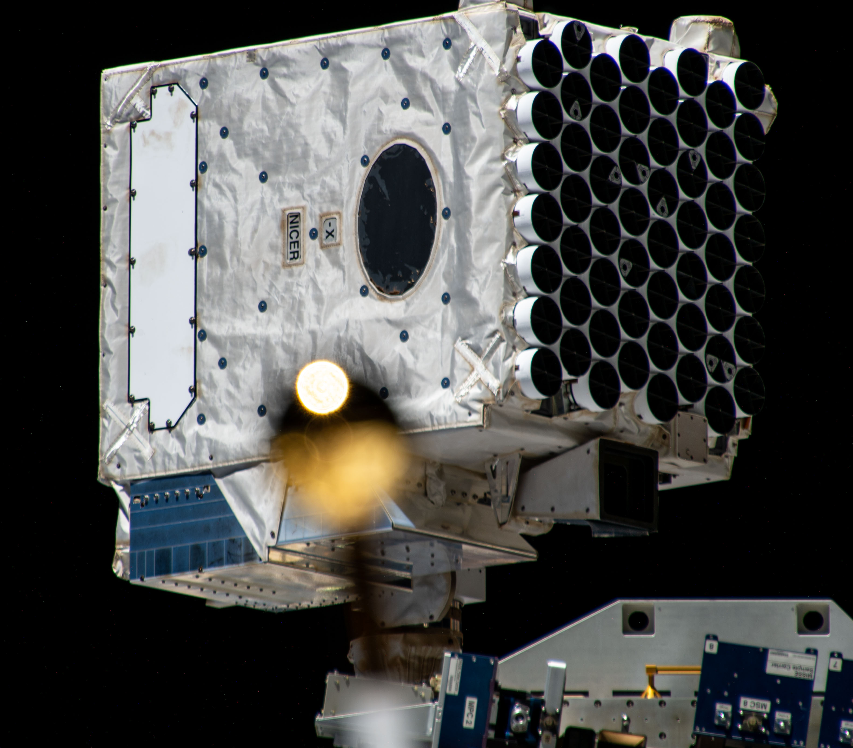
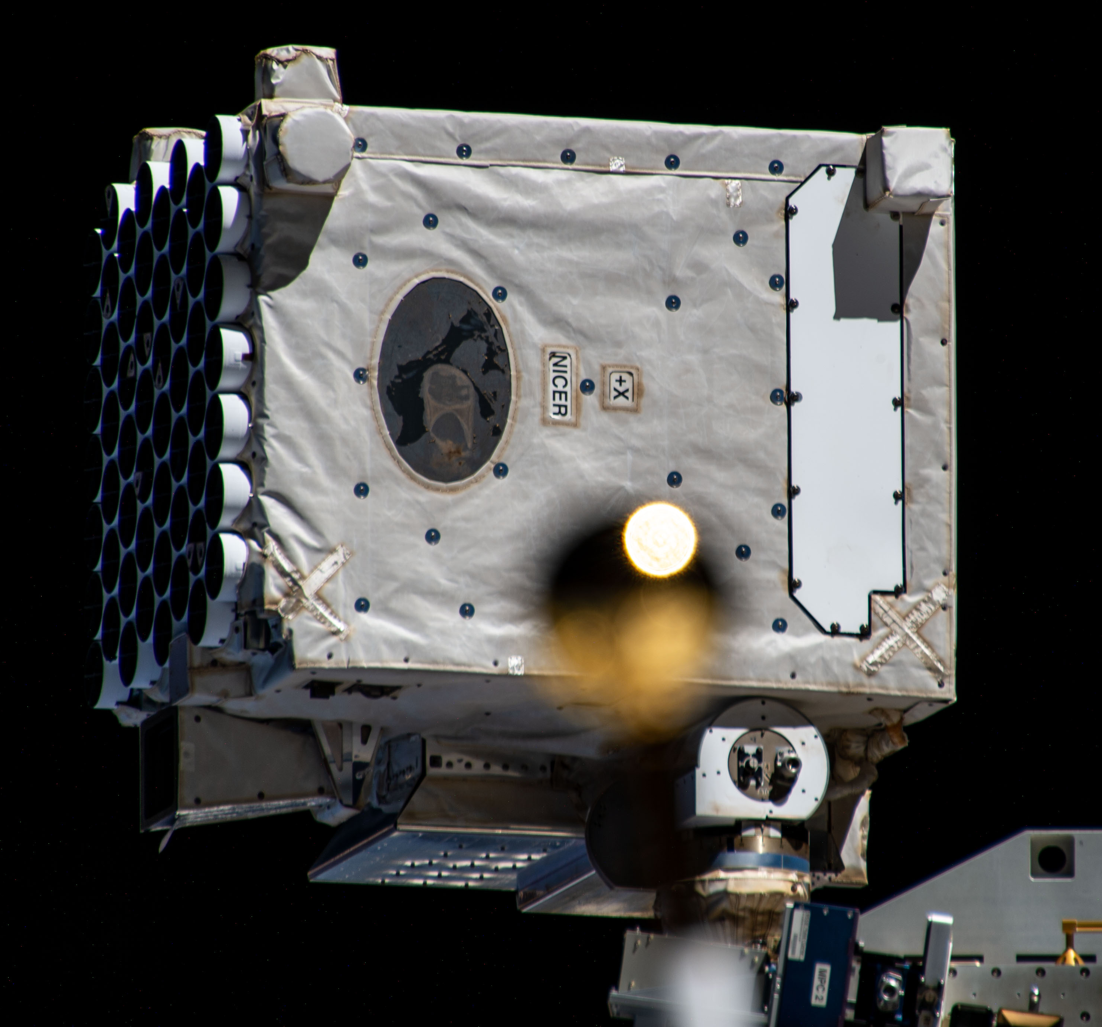
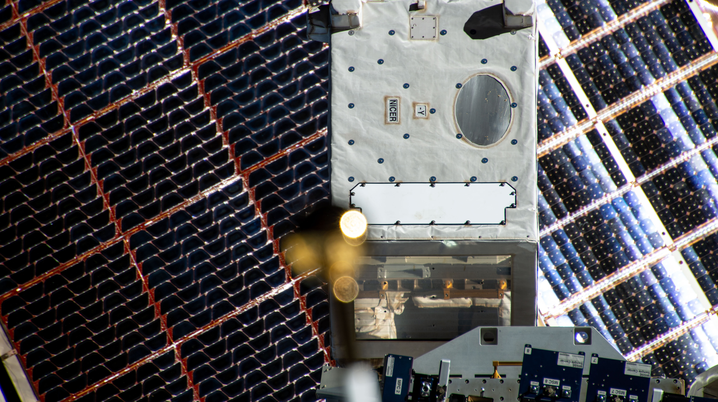
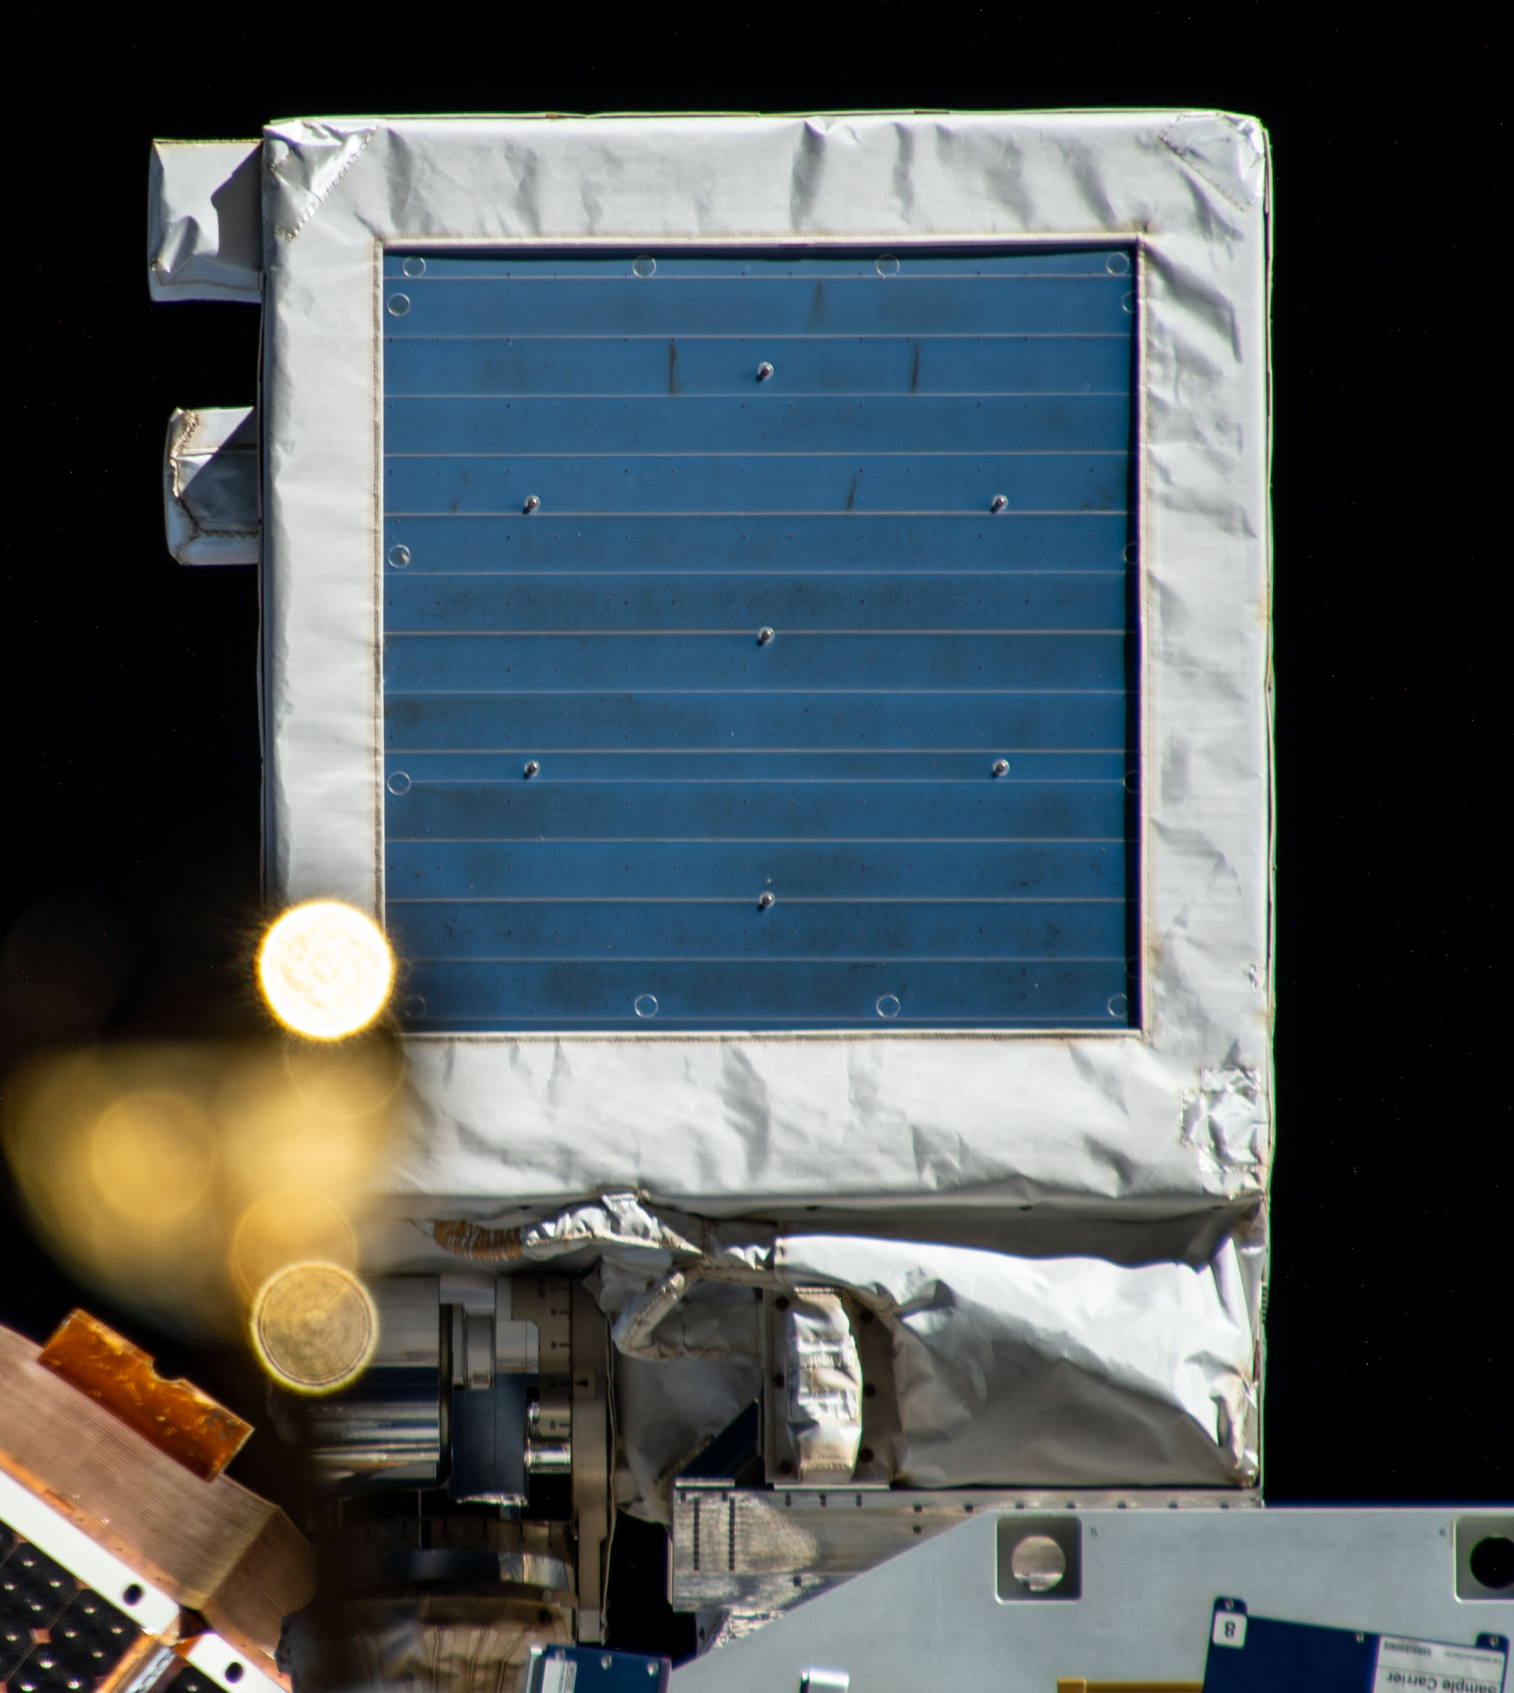
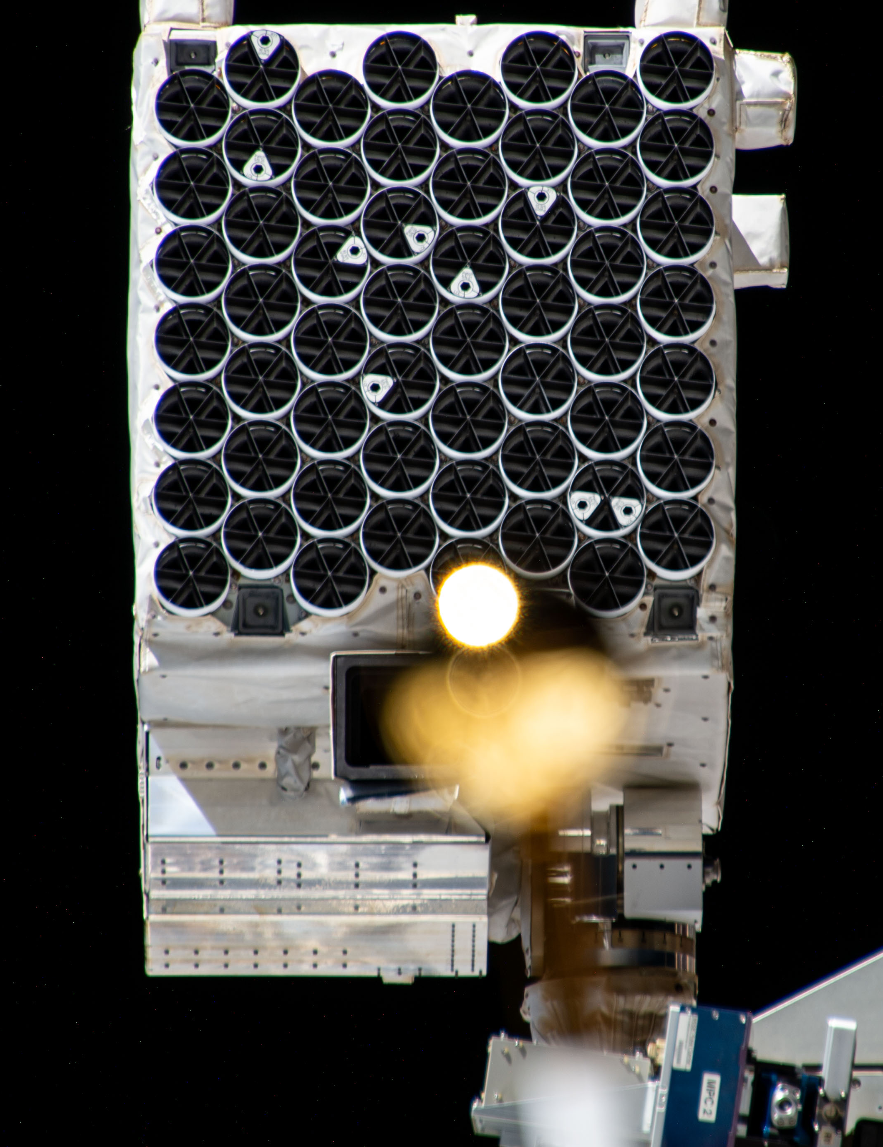

Slide 12
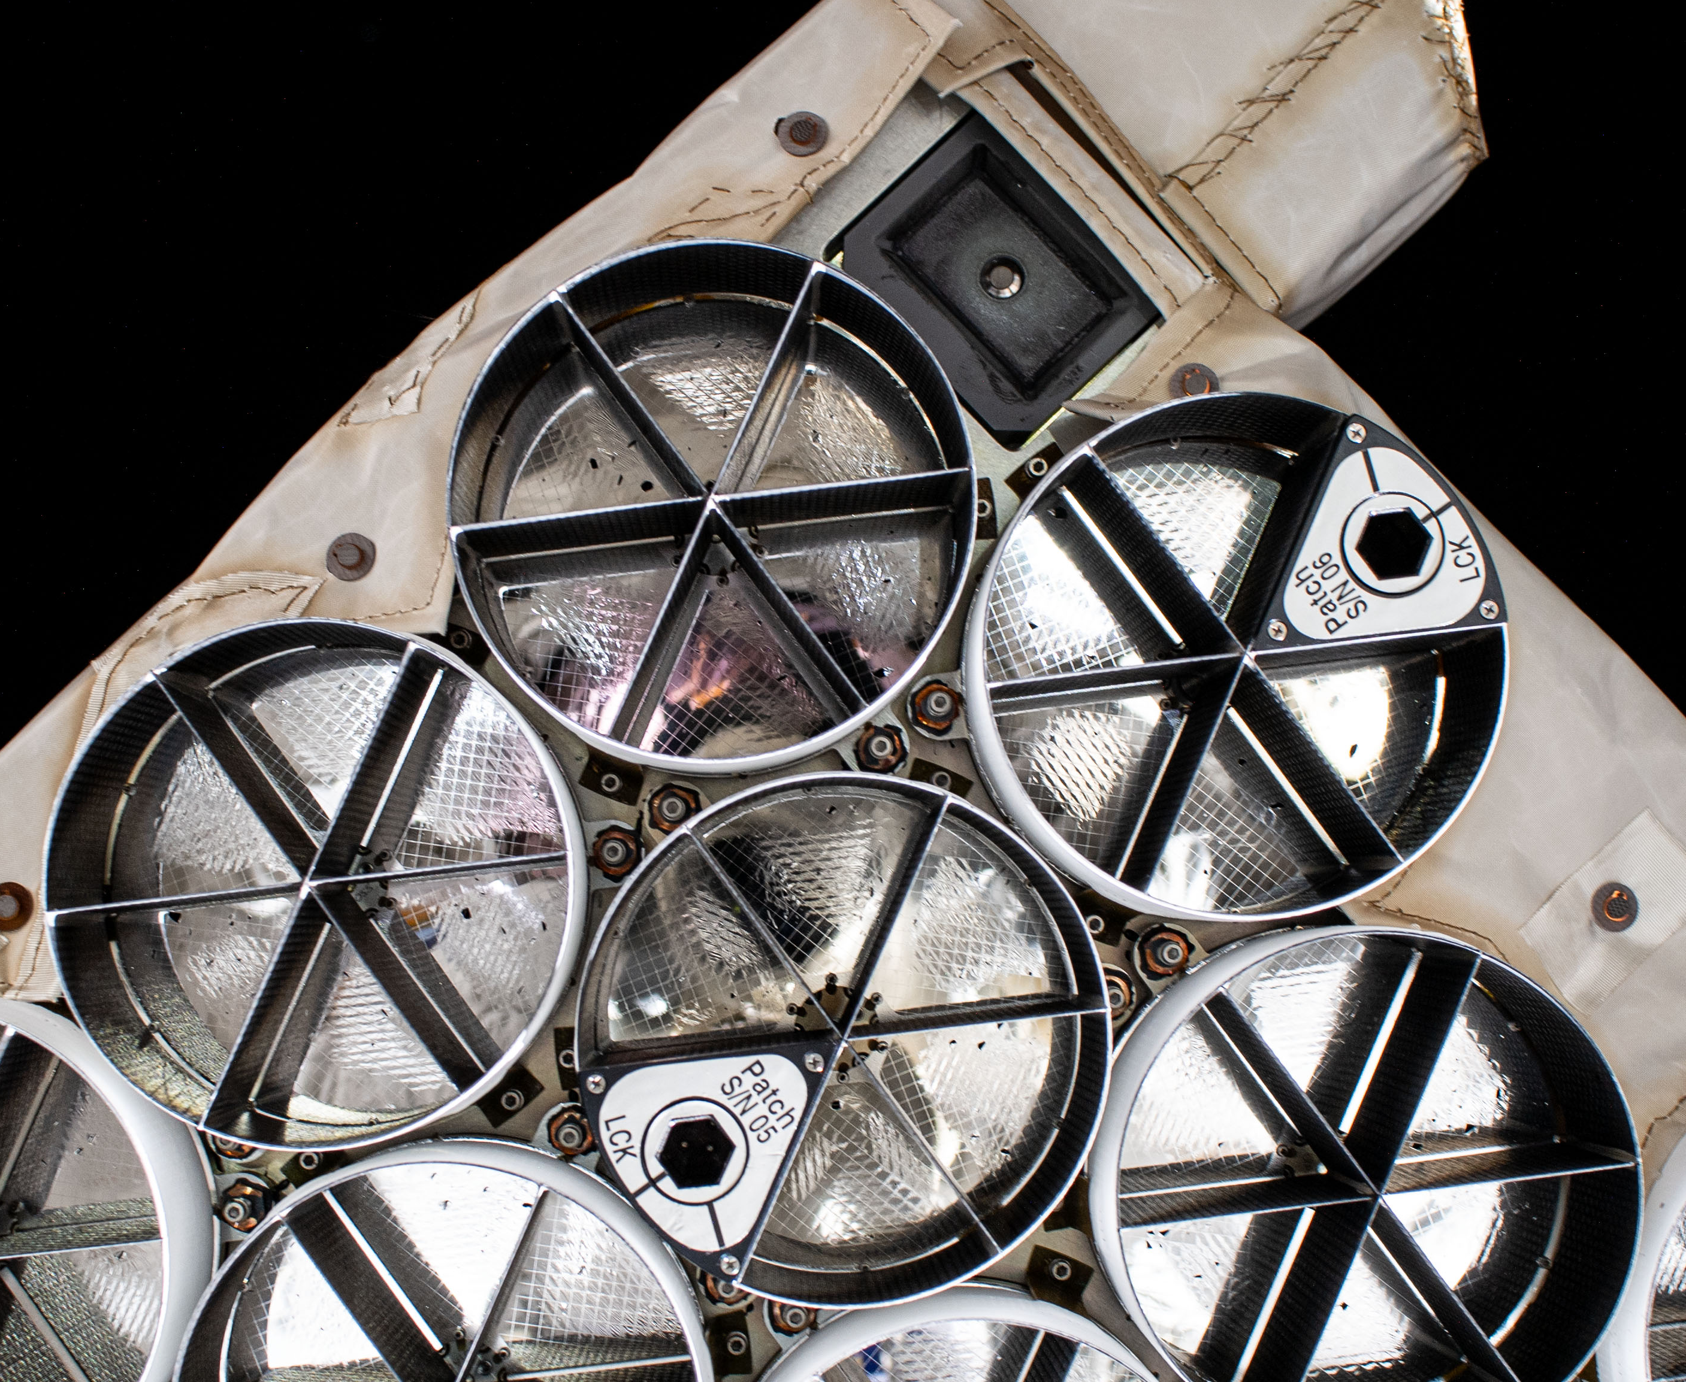
High Resolution Digital Imagery Reveals Details
Over 400 digital pictures taken by Nick Hague showed many details including many small pin holes as well as possible stress on the thermal films

Slide 13
Additional Read-Out Optimizations
The NICER team did a deep scrub of the MPU parameters, and developed optimized settings
Tested & verified in the laboratory February 2025
Table upload in March 2025
These new optimizations do not reduce optical loading, but do
Reduce telemetry rate
Reduce onboard MPU processing deadtime
Improve accuracy of onboard housekeeping for use in science analysis software
Greatly enhance recovery of good science data
Allowed productive NICER observations during orbit day over a much larger field of regard (sun angle > 80 deg instead of >110 deg)

Slide 14
Post-Repair Calibration Work
Revised ARF to science community
Overall ~2% change due to patch blockages
Validation observations of Crab agree with expectations within a few percent
Improved screening for observers
Separate criteria for orbit day and night
Improved automatic screening that attempts to keep the good data amongst the bad, rather than excluding any data with bad quality

Slide 15
Further Calibration Updates (~Year)
Several known minor problems in response generation
Expect ~5% change in flux scale
Based on improved deadtime understanding
Expect 0.05 change in power law shape
Remove non-physical fit of optic geometric area
Expect low energy threshold shift ~5 eV
Based on observations of HZ43, RX J1856, Crab

Slide 16
Swift Observatory Update
Swift spacecraft predicted for re-entry in ~August this year!
NASA approved a reboost operation
LINK rendezvous spacecraft provided by Katalyst
Launch June – last Pegasus vehicle
Rendezvous ~4 weeks later, reboost operation taking few weeks
Swift instruments have been idled or powered down since Feb/March in order to conserve power
Significant commissioning effort required after reboost complete and instruments powered on

