Slide 1


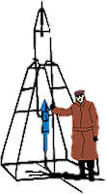






Working Groups
SCORPEON for Modeling NICER Background
Craig Markwardt (NASA/GSFC)
on behalf of NICER Team
GSFC

Slide 2
SCORPEON Background Modeling
SCORPEON Model
Major goals
  Break down background into physically-motivated components
  Assume that these components can be modeled with simple spectral models so they are easy to implement
(Inspired by Eric Millers work on Suzaku background)

Slide 3
Summary Up Front
To a large extent the background is predictable a priori
The power of SCORPEON is that the a priori norms can be adjusted by fitting to data while simultaneously fitting to your source data
  Better fit
  Better capture of covariance between background uncertainty and science model parameter uncertainty

Slide 4
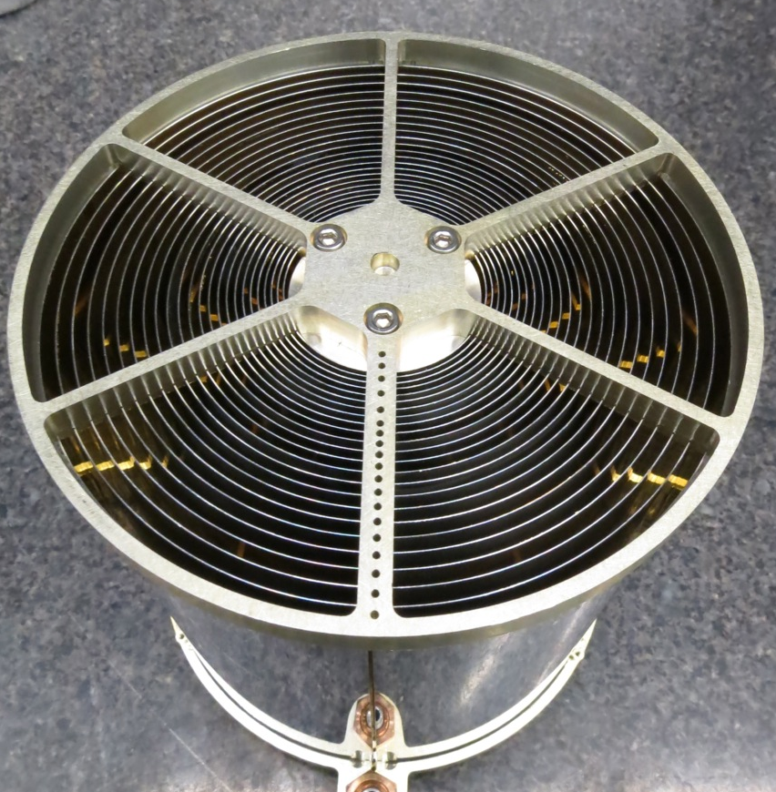
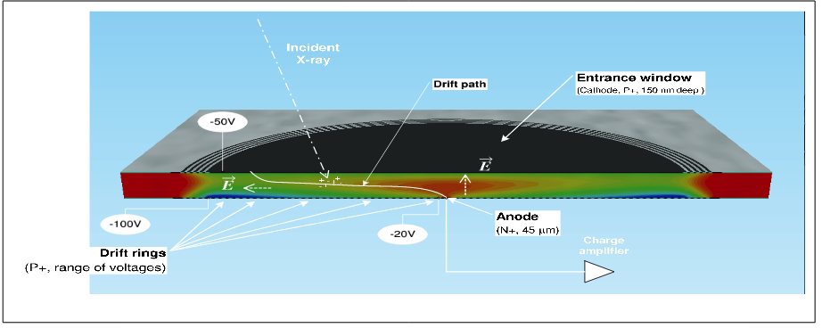
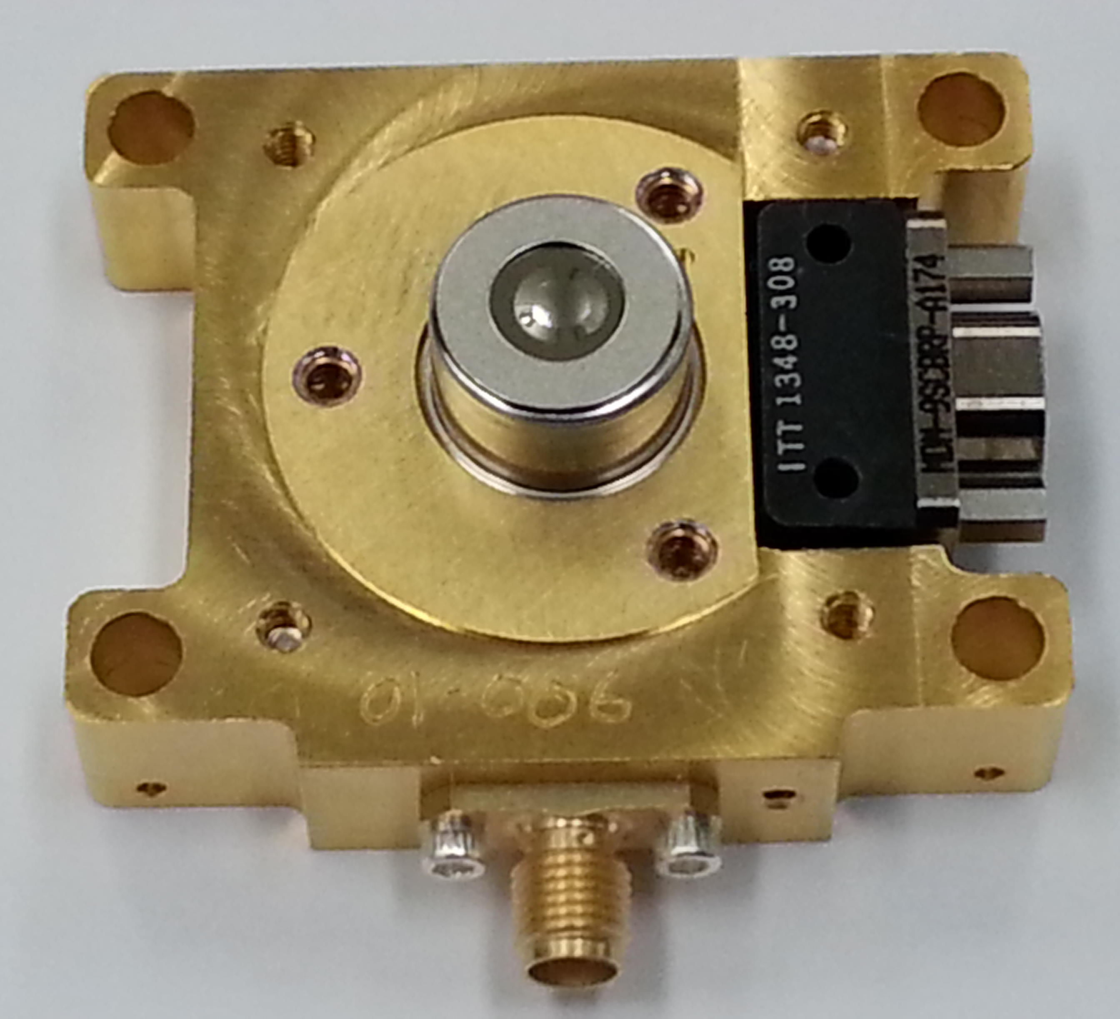
NICER Calibration Elements (x52!)
X-rays
Thermal Film
X-ray Concentrator
(Note: No “Magnetic Broom”)
Detector Window
FPM Silicon Drift Detector

Slide 5
Unique Features of NICER
Above ~25 keV deposited energy, an ADC overshoot is registered instead of a pulse height
    Rate of overshoots can use as background proxy
Two pulse-height measurements
  Slow pulse shaper and Fast pulse shaper
    Ionizing particles are spatially and geometrically distinct from X-ray interactions, two pulse heights respond differently!
    Pulse height ratio PI_RATIO used as background diagnostic
NICER is not outfitted with a “magnetic broom,” and orbit is 55 degree inclination
  Higher electron-related backgrounds

Slide 6
Sources of NICER Background
Optical photon
Low Energy Electron
Ionizing
Particle
X-ray photon
Cathode
SDD
Leakage Current
Anode
Ionizing particles - ~300 keV – Cosmic Ray (COR), Trapped Energetic Electrons/Protons (TREL,SAA)
Optical Photons, Leakage Current – Noise Peak
X-ray Photons – CXB, LHB, Halo
Lower Energy Electrons – Precipitating & Forbidden Electrons - 1-20 keV (PREL,LEEL)

Slide 7
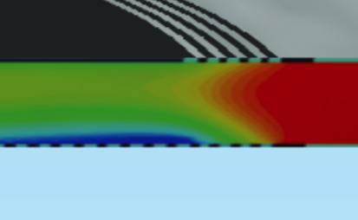
Ionizing Particles
Active Volume
Dead Volume
Particle Tracks
Both tracks will deposit ~300 keV of energy in silicon
  Depends on particle type, energy, angle
  This is above the ~25 keV overshoot threshold

Slide 8
Ionizing Particles and Overshoots
Active Volume
Dead Volume
200 keV
20 keV
Tracks that clip the <10% of the active region provide the primary background due to ionizing particles (“corner clippers”)
  Other parts of deposited energy track are lost to dead volume
We use overshoots as a diagnostic for corner clippers

Slide 9
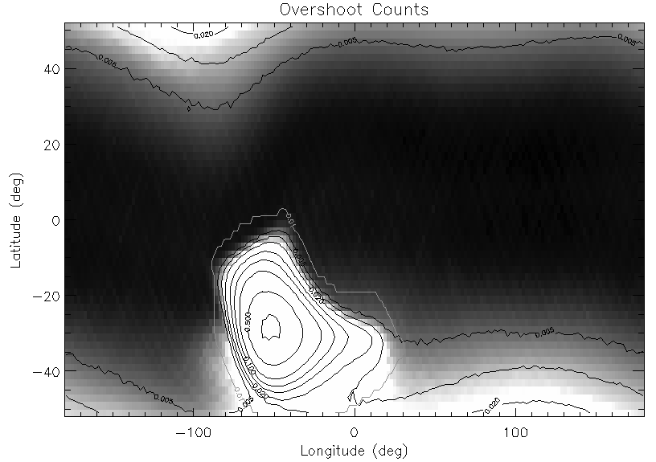
Geographic View of Overshoots
Cosmic Ray (COR)
SAA
“Polar Horns”
(TREL/PREL)

Slide 10
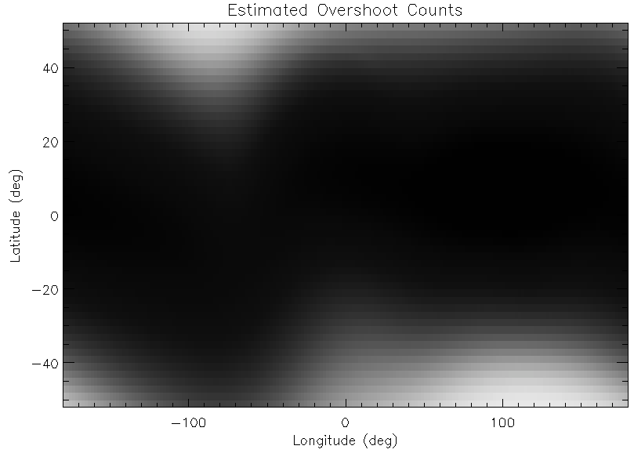
The Cosmic Ray Component is Predictable
Predictions based upon “COR_SAX”

Slide 11
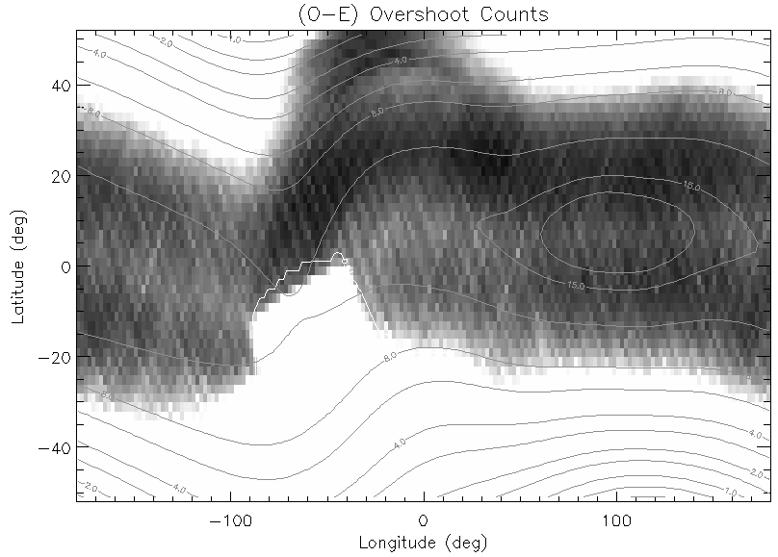
Residuals After Subtracting COR
SAA
Trapped Electrons

Slide 12
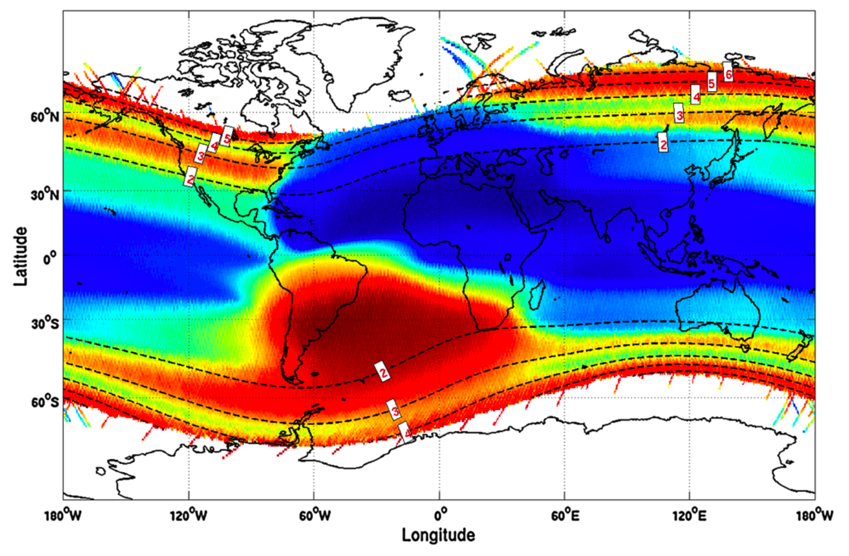
Trapped Electron Population
DEMETER IDP Instrument Electron Map, Whittaker et al 2013

Slide 13
Basic Recipe
Start with quiescent part of orbit, model with Constant (CON) plus linear Cut-Off Rigidity (COR) dependence
Subtract COR model, and consider remainder as trapped electrons (TREL) and South Atlantic Anomaly (SAA) with linear dependence on overshoots
Identify remaining flares as precipitating electrons (PREL) and “low-energy electrons” (LEEL)
Separate model for astrophysical X-ray background terms (CXB, SWX, LHB, Halo) and electronic noise peak
We also see neutral oxygen from polar cusps
Dujakovich et al 2026, currently unmodeled

Slide 14

SCORPEON Name
S COR PE O N
  S = SAA
  COR = COsmic-Ray (COR_SAX)
  PE = Precipitating & trapped Electrons
    Precipitating electron population (PREL)
    Trapped electron population (TREL)
    Low energy electrons (LEEL) – solar storms
  O = cOnstant
    Astrophysical: CXB + Halo + LHB + SWCX
    Non-varying Non-X-ray background
  N = Electronic Noise peak

Slide 15
Types of Background Components
CON
Constant
NXB, Sky
SAA
Trapped Protons
COR
Cosmic Ray
Hadron-Dominated
TREL
Trapped Electrons
PREL
Precipitating Electrons
LEEL ★
Low-Energy Electrons
Electron-Dominated

Slide 16
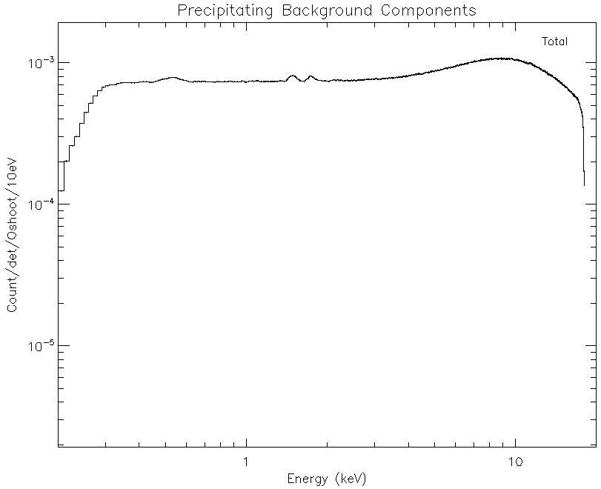
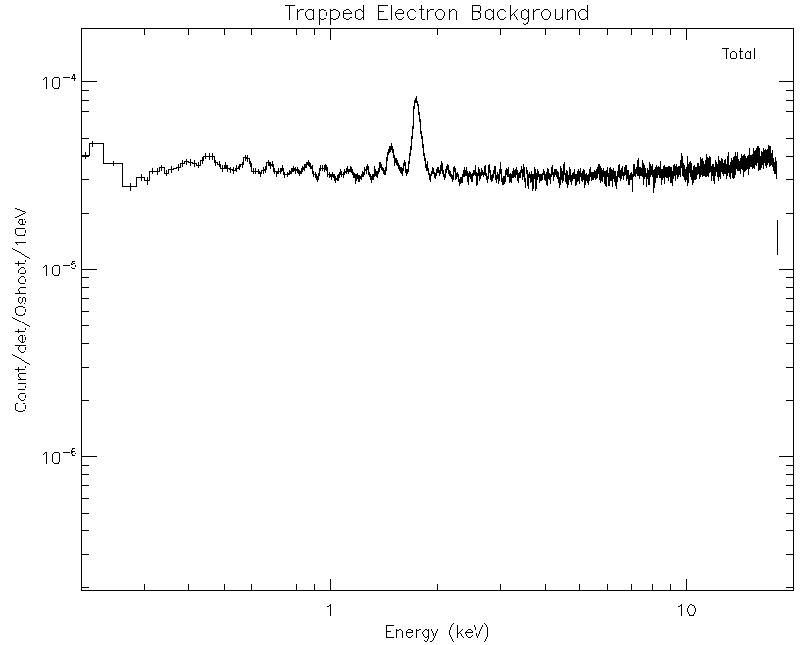
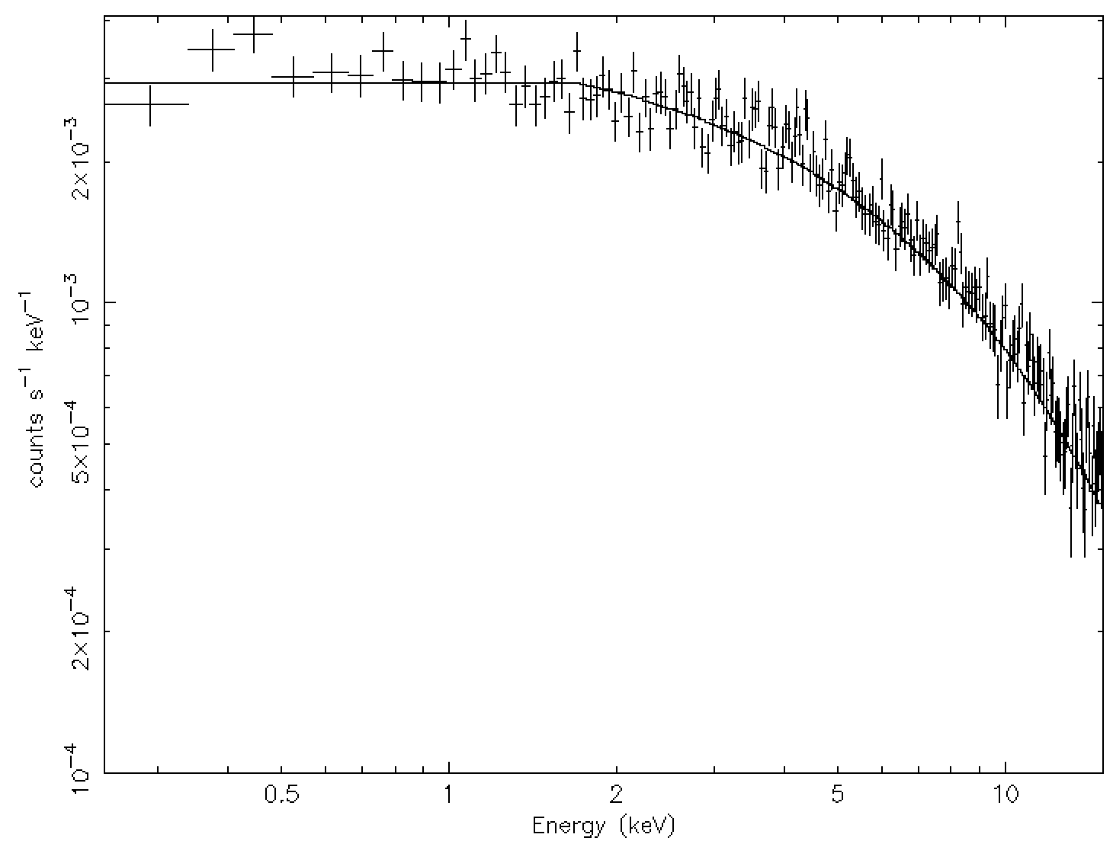
Electron-Dominated Components
PREL
Geo: COR < 1.5
Temp: ~1 s Flares
Spect: Cut 10keV
TREL
Geo: COR ≲ 8
Temp: Hourly
Spect: Flat
LEEL ★
Geo: Anywhere
Temp: Hourly
Spect: Cut 2keV

Slide 17
Electron-Dominated Components
PREL
Geo: COR < 1.5
Temp: ~1 s Flares
Spect: Cut 10keV
TREL
Geo: COR ≲ 8
Temp: Hourly
Spect: Flat
LEEL ★
Geo: Anywhere
Temp: Hourly?
Spect: Cut 2keV

Slide 18
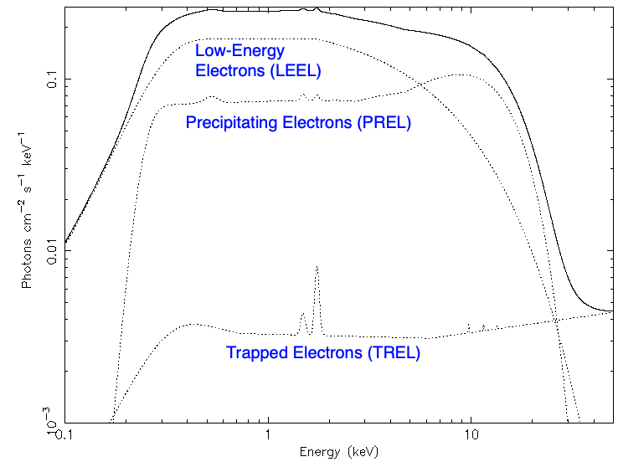
Spectral Comparison of Electron Components
OSHOOT
For same overshoot, greatly different < 10 keV counts

Slide 19
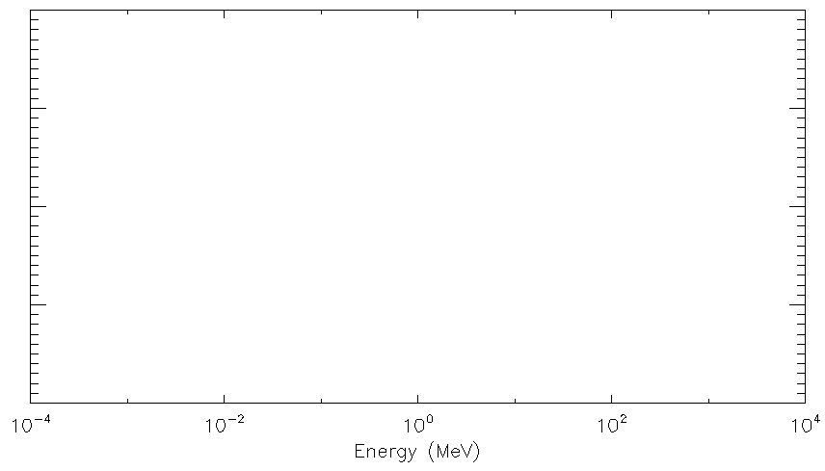
Energy Ranges of Components
NICER Band → Overshoots
Penetrate NICER Shielding
→ Trumpet-rejected
(Slow/Fast Ratio)
LEEL
PREL
Trapped Electrons (TREL)
SAA
Minimum Ionizing
Cosmic Rays (COR)

Slide 20
Our Solution
Predict as best we can the counts in each component
Allow the model norms to vary during spectral fitting, along with the source spectrum
Benefit to keep the entire energy range, which allows spectral fitter to better distinguish components
Better captures the interaction between source spectral parameters and background uncertainties

Slide 21
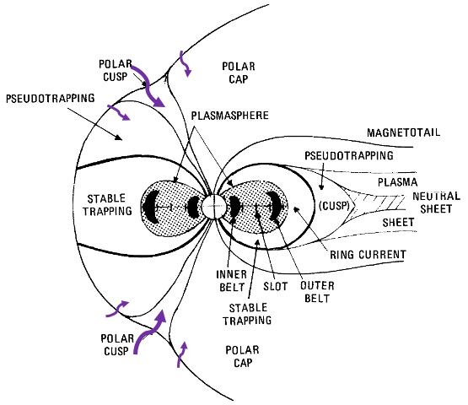
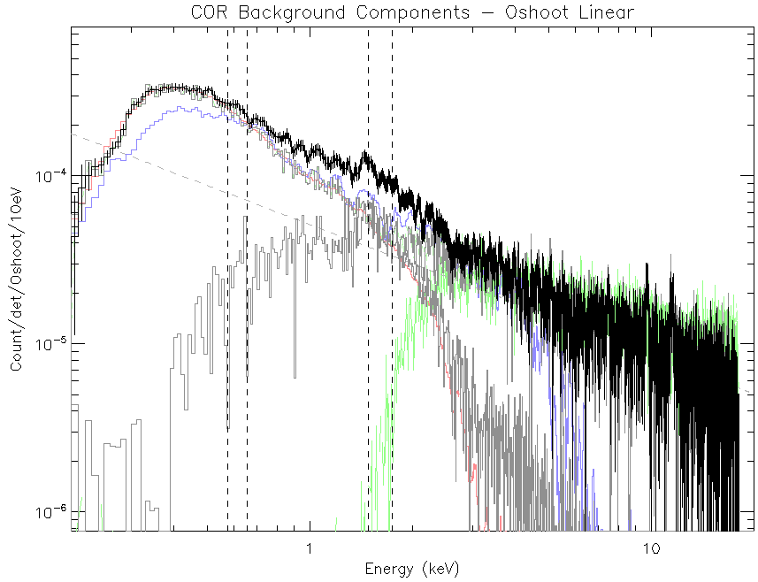
Cosmic Ray (COR)
Very predictable
  ~GeV (penetrating)
  Modulated by COR_SAX
  Additional solar modulation

Slide 22
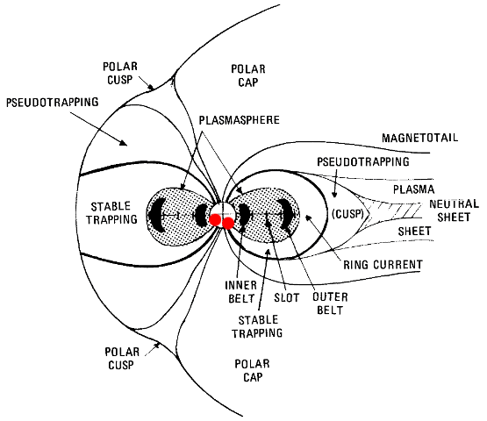
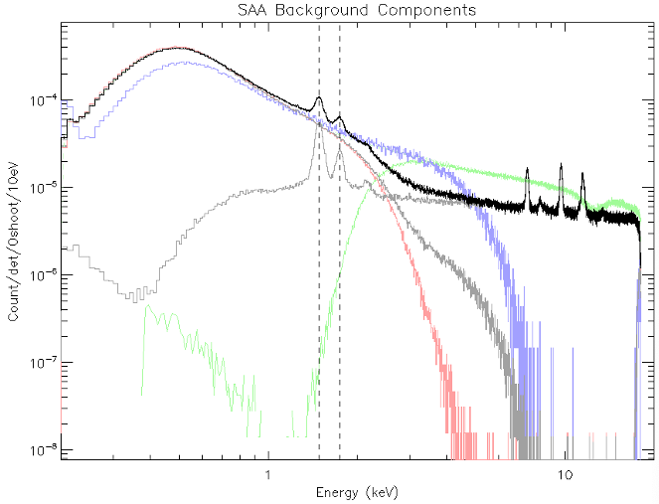
South Atlantic Anomaly (SAA)
Trapped Protons
  ~500 MeV (penetrating)
  Smooth temporal behavior
  Overshoot dependence with geographic template

Slide 23
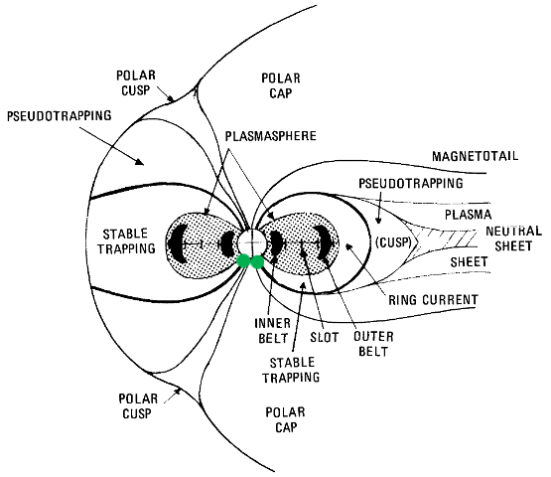
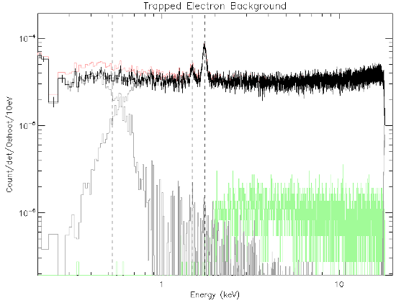
Trapped Electrons (TREL)
Trapped Electrons
  <2 MeV (partially penetrating)
  Highly variable,
  modulated by solar activity
  Overshoot dependence with geographic template

Slide 24
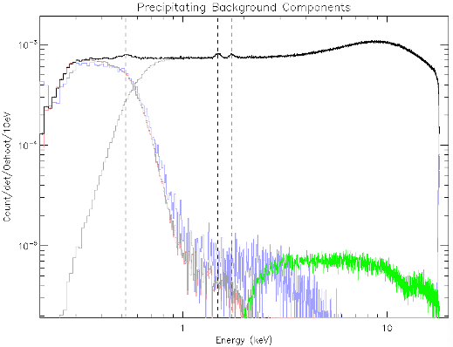
Precipitating Electrons (PREL)
Precipitating Electrons
  < 50 keV
  Extreme flares
  Only high magnetic latitude (COR < 1.5)
  Not modeled: screened, or flare heuristic

Slide 25

Low-Energy Electrons (LEEL)
Low Energy Electrons
  < 5 keV
  ~Daily Variation, ”Rare”
  ~Equatorial
  Could be ”forbidden” electron population
  (e.g. Suvorova et al 2014)
?

Slide 26
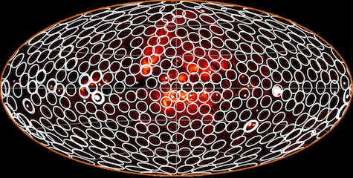
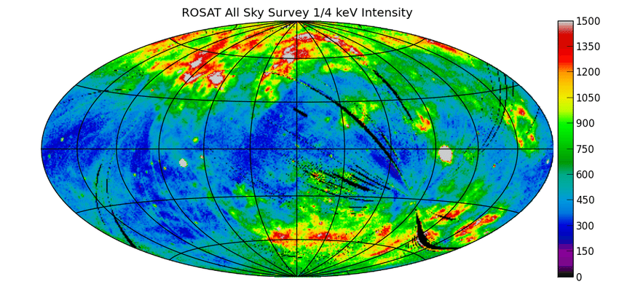
Astrophysical & Terrestrial X-rays
Galactic
Halo
Local Hot Bubble
Credit: HaloSat
Credit: ROSAT
CXB – Cosmic X-ray Background shape & norm (Chandra: Cappelluti et al 2017)
Halo – Galactic halo emission temperature & emission measure (HaloSat: Kaaret et al 2019)
LHB – Local Hot Bubble emission temperature & emission measure (ROSAT: Liu et al 2017)
SWCX – Solar Wind Charge Exchange lines (O VII, O VIII, Ne IX, default 0)
OK – neutral Oxygen K emission from terrestrial cusp environment (default 0)
All estimated background norms have reasonable estimates and limits based on published results, but are adjustable for better match to data

Slide 27
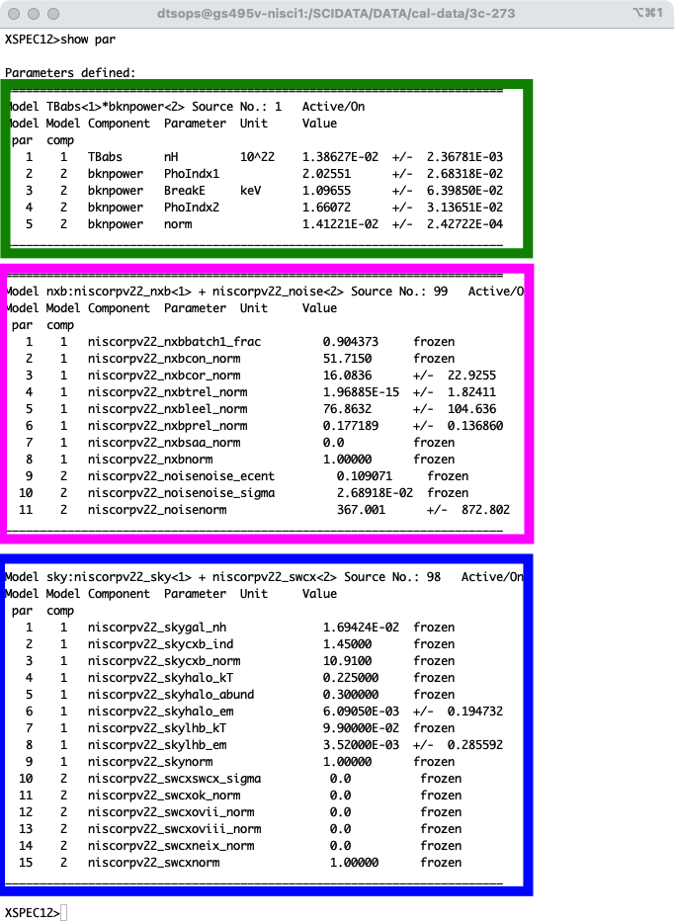
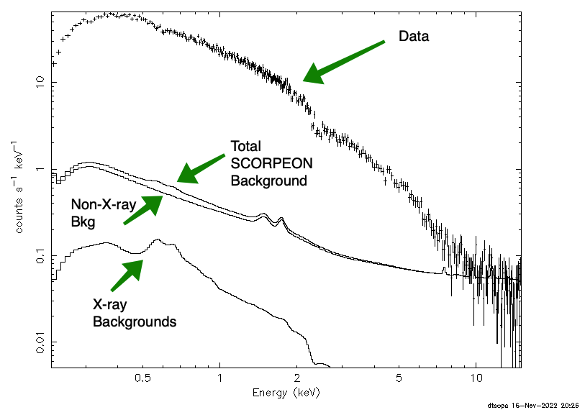
XSPEC Fitting Example

Slide 28
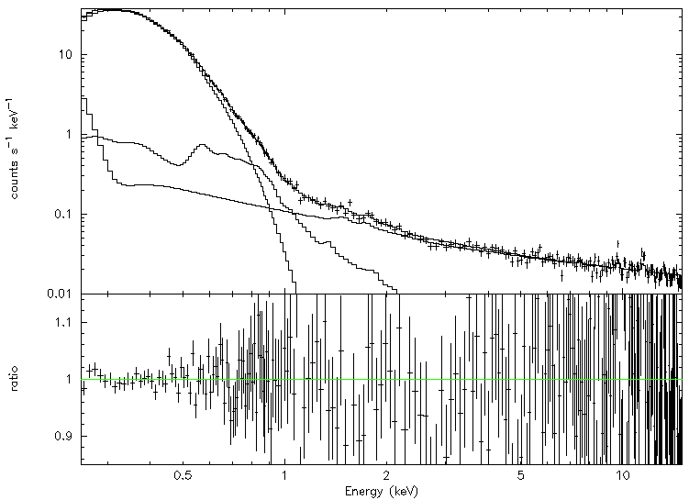
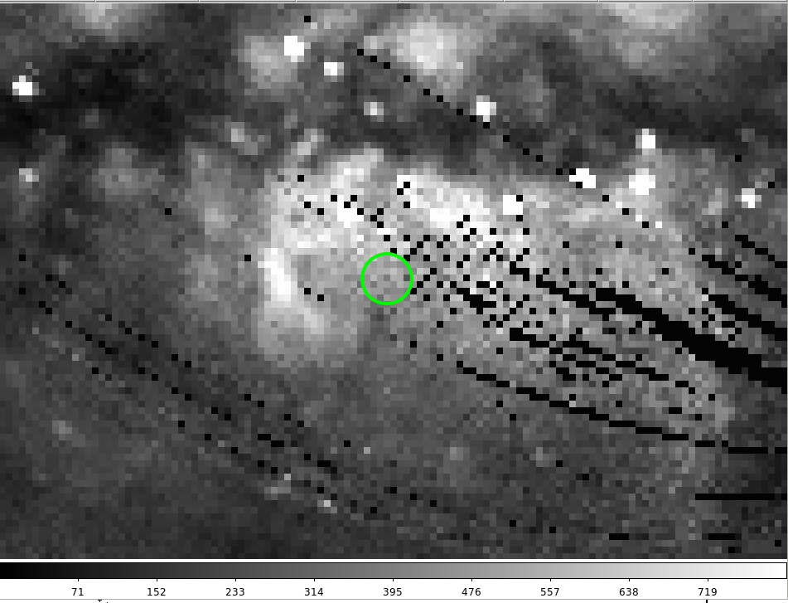
NICER Modeling of RX J1856
J1856
1BB Fit - NICER
nH = 11.9(1.3) x 10⁻¹⁹ cm⁻²
kT = 63.48(65) eV
Norm = 0.89(7) x Chandra
J1856 Embedded in Bulge Diffuse Emission
Diffuse
NXB
ROSAT PSPC ¾ keV Survey
NICER consists of 52 non-imaging X-ray modules with nearly 2x effective area as EPIC-pn @ 1keV and ~3’ radius FOV
New analysis of existing J1856 data with in-development cal products
  Includes 1BB for J1856 and Galactic Bulge, CXB, Local Hot Bubble, Galactic Halo, and other NXB components
  NICER statistical error bars are ~1%
J1856 parameters are coupled with background parameters but are reasonable overall; no evidence of ~1 keV excess

