Slide 1









Working Groups
PCA and Sky Monitors for Crab Flux Transfer Craig Markwardt (NASA/GSFC)
GSFC

Slide 2
Motivation
X-ray Instruments with ”Absolute” calibration for bright sources may not be frequent
Desire to transfer a flux standard to a different date
Use sky monitors as a relative transfer standard

Slide 3
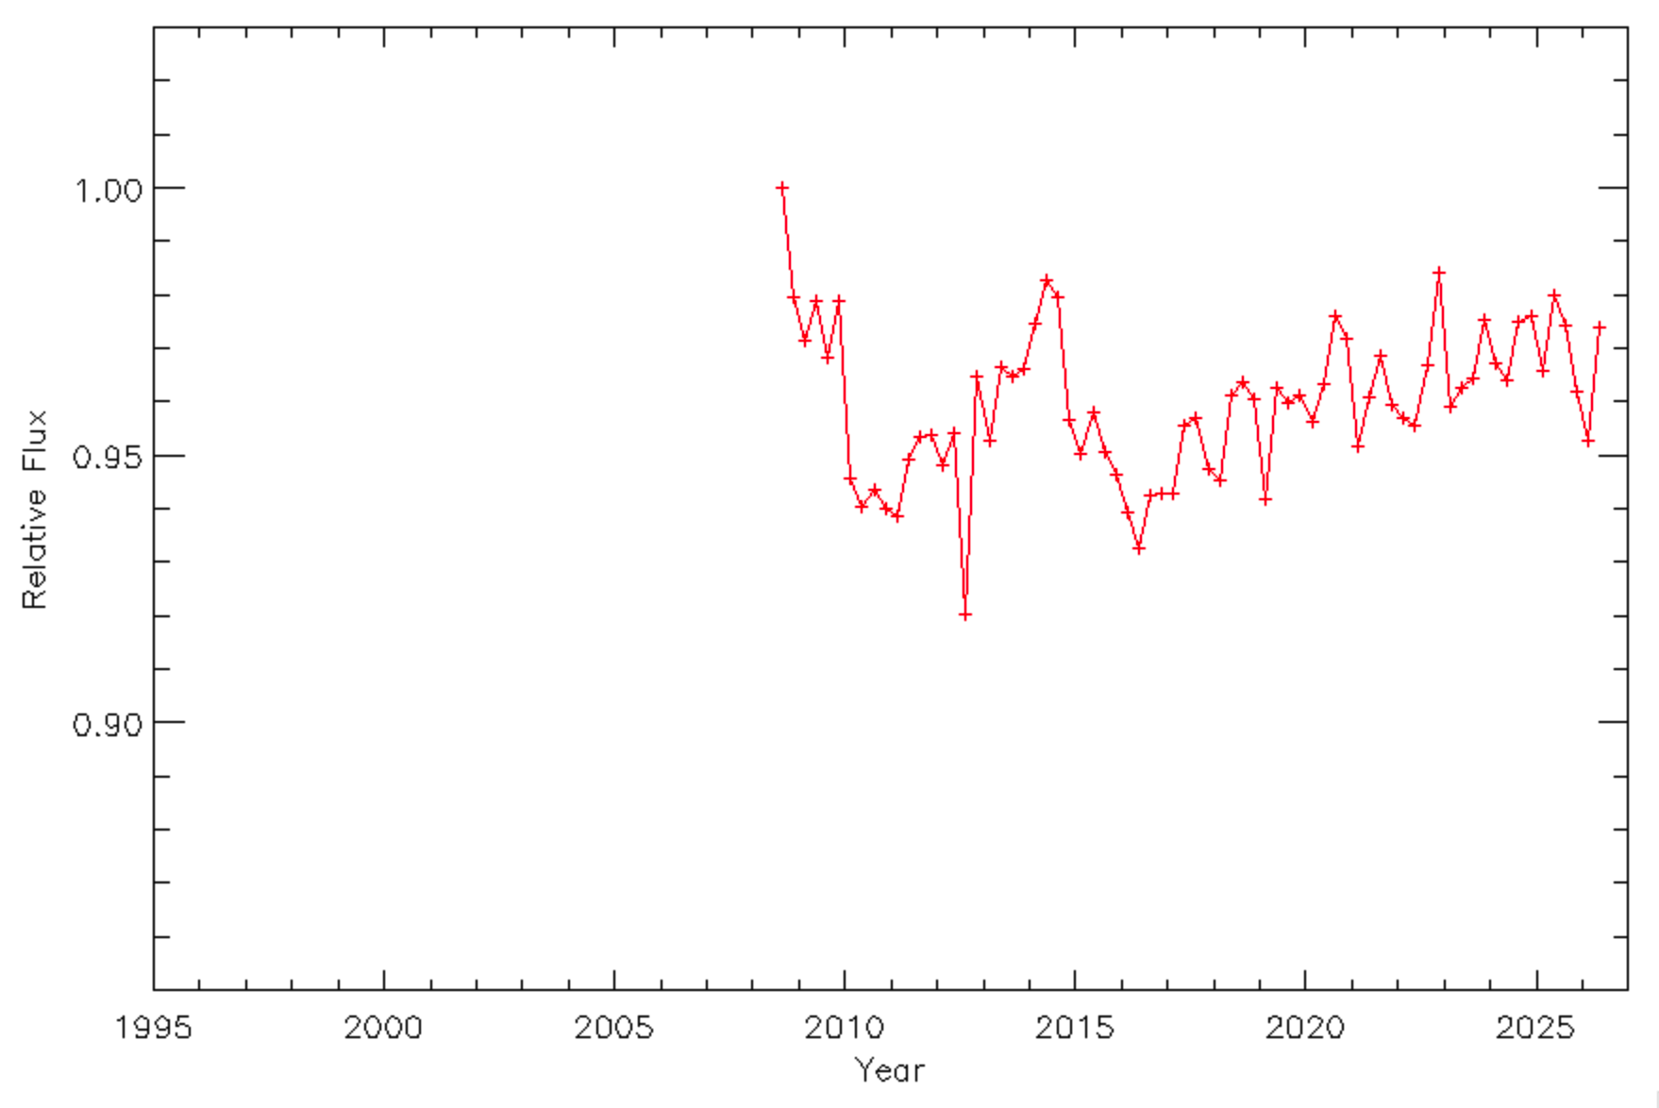
Fermi GBM: Crab (15-50 keV)

Slide 4
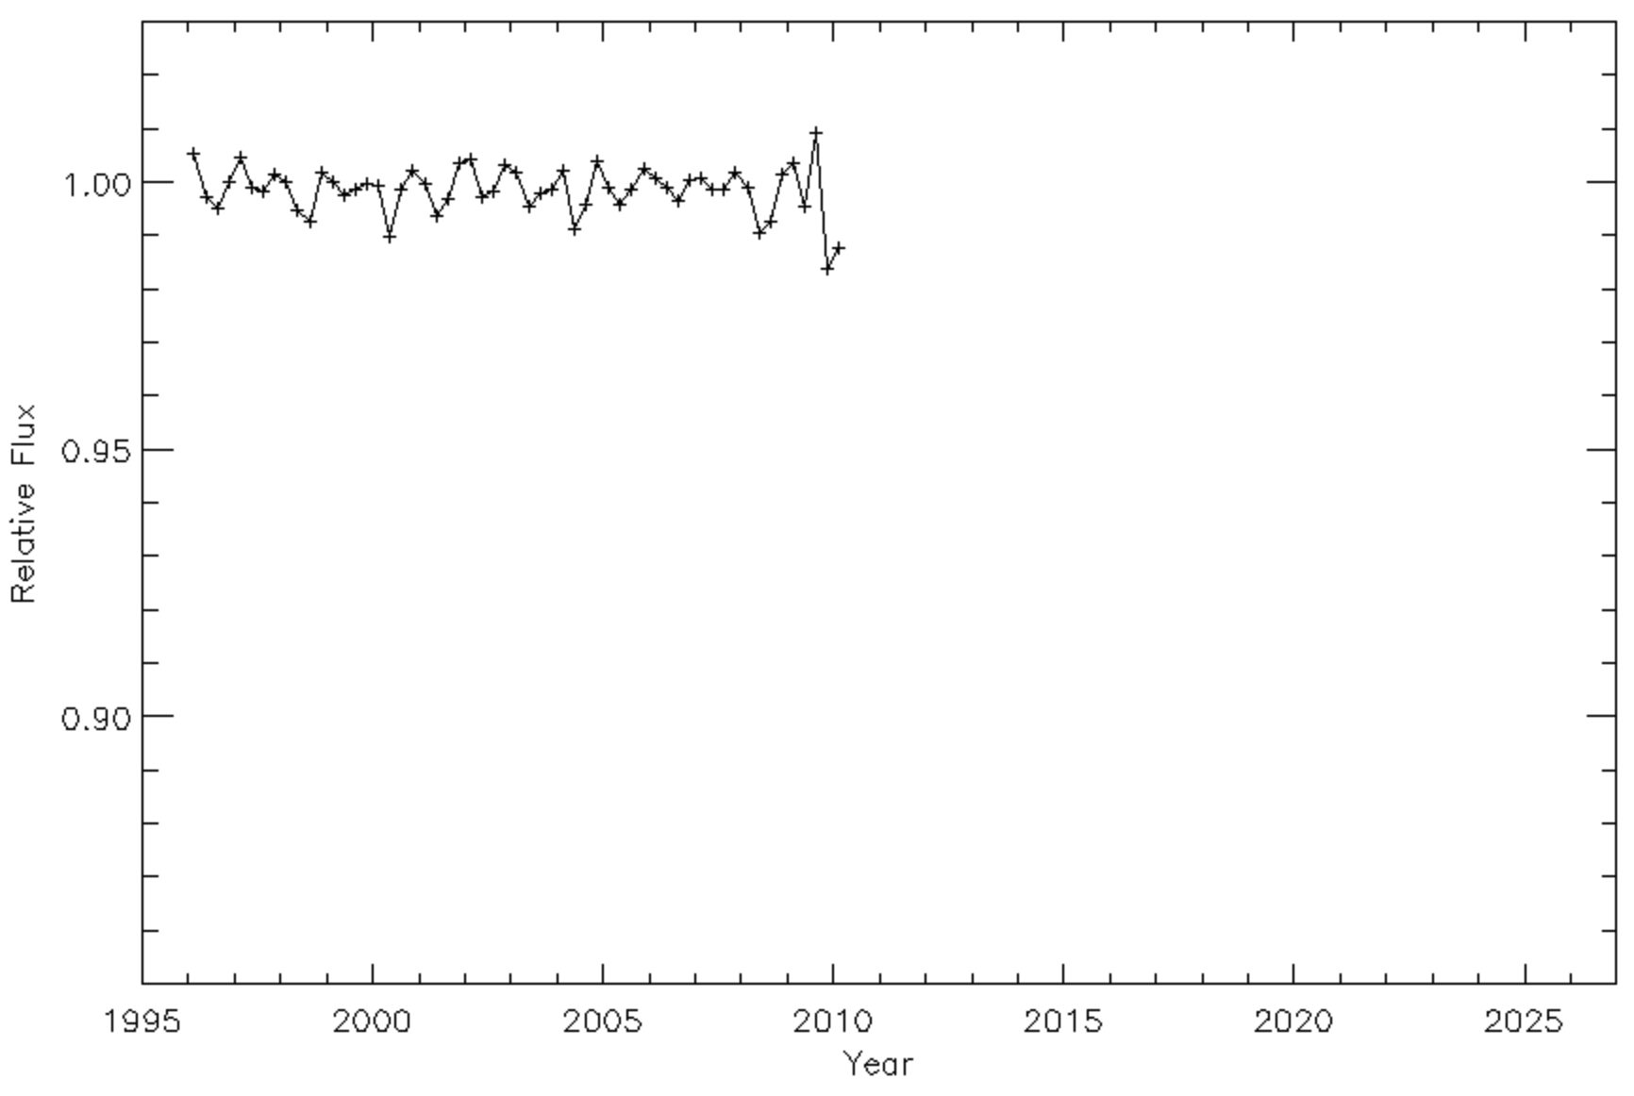
RXTE ASM: Crab (1.5-12 keV)

Slide 5
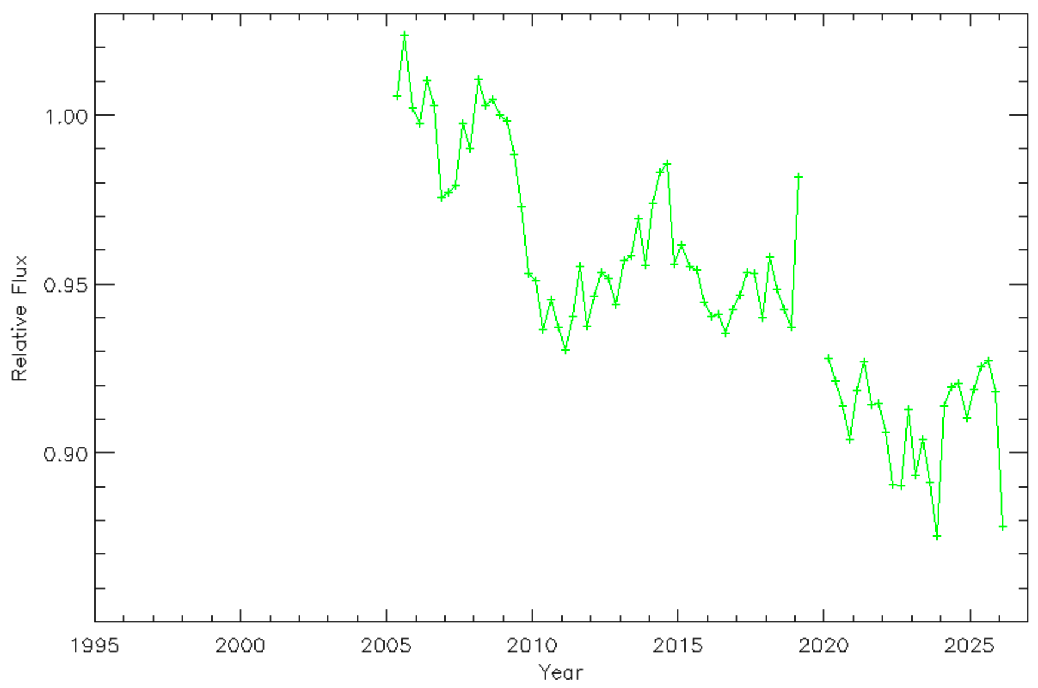
Swift BAT: Crab (15-50 keV)

Slide 6
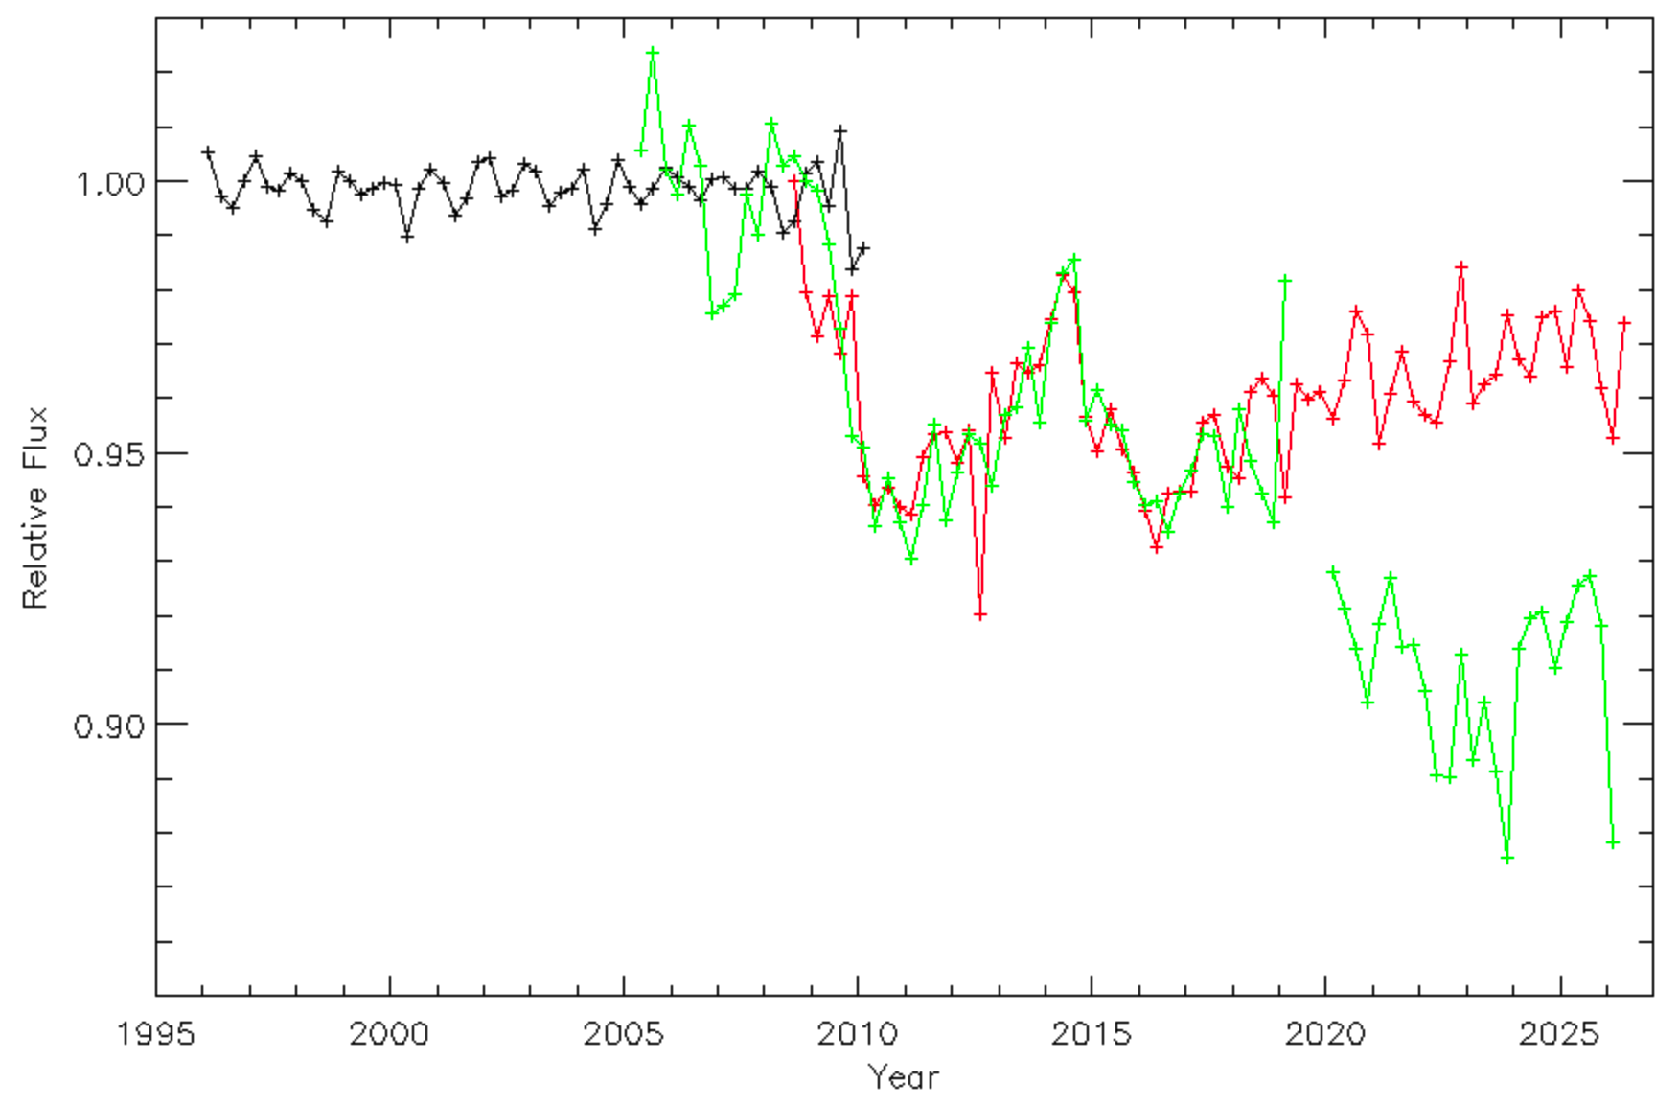
Sky Monitors Combined
ASM
GBM
Crab-Normalized?
BAT
Clear Break

Slide 7
Long Term Flux Transfer
NuSTAR Stray Light: 2013-present
RXTE PCA: 1996-2012
Swift BAT: 2005-2018
Femi GBM: 2008-present
Relative errors ~1%

Slide 8
Example Application: PCA+GBM
Use GBM to “extend” PCA flux solution to the NuSTAR epoch: ~4% difference between two solutions

