Slide 1

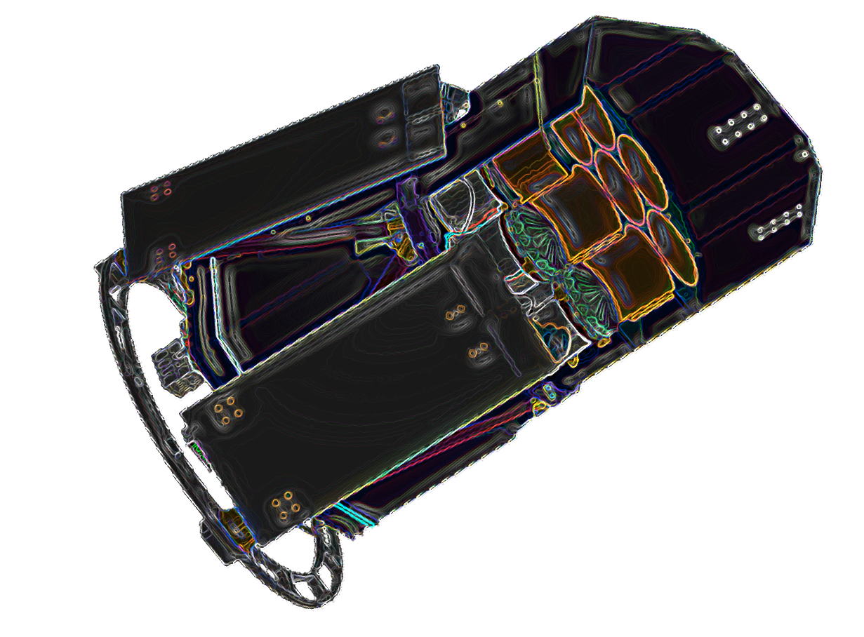
Behind the scenes of eROSITA:
how we transmit the data
Pelham/Germany 18th IACHEC meeting, 20-23 April 2026 K. Dennerl / MPE
Notes:
20 min

Slide 2
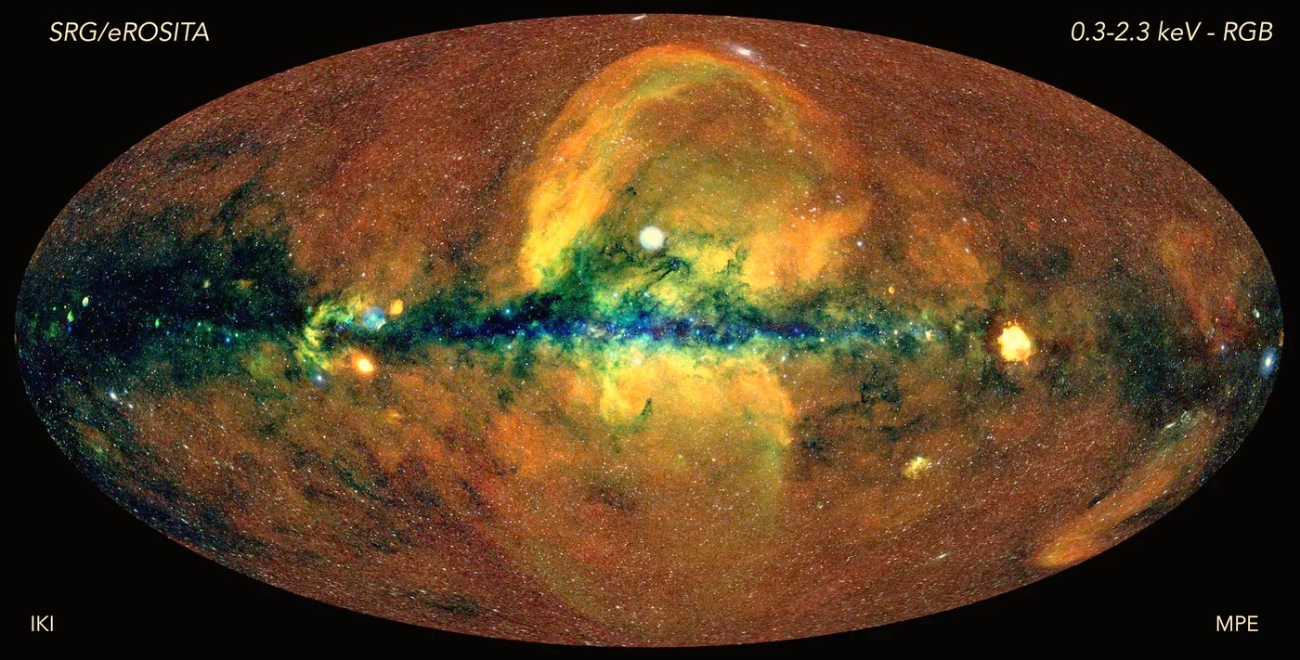
Why is the transmission of X-ray CCD data challenging ?
~170 million photons in 6 months → ~11 photons per second → easy to transmit

Slide 3
X-ray CCDs and the
low energy threshold
~170 million photons in 6 months → ~11 photons per second → easy to transmit

Slide 4
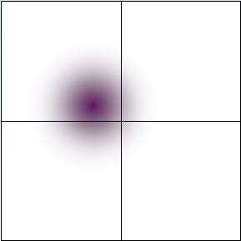
X-ray CCDs and the low energy threshold
The absorption of an X-ray photon generates a charge cloud which may extend over several pixels.
In order to reconstruct the energy of the incoming photon, it is necessary to collect all the charge components.

Slide 5
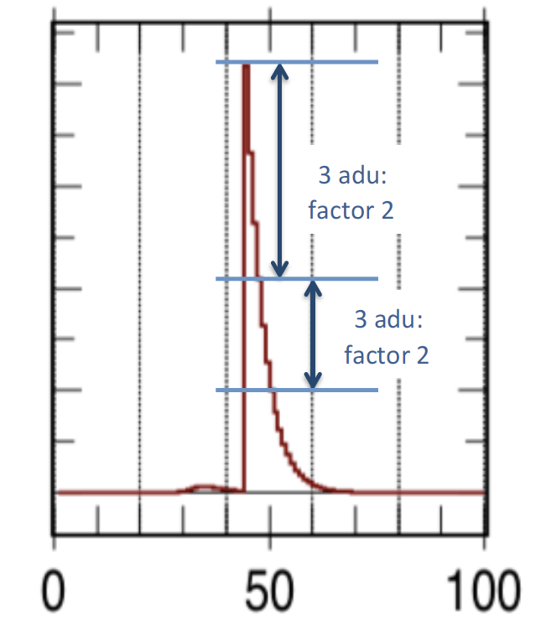
X-ray CCDs and the low energy threshold
eROSITA CCD
The absorption of an X-ray photon generates a charge cloud which may extend over several pixels.
In order to reconstruct the energy of the incoming photon, it is necessary to collect all the charge components.
This, however, is limited by the presence of noise, which is steeply rising towards the lowest energies.
It becomes necessary to introduce a low energy threshold and to ignore the charges below.
event rate
charge [adu,≈eV]

Slide 6
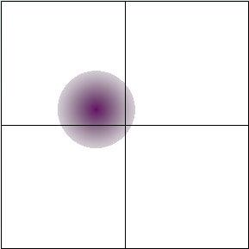


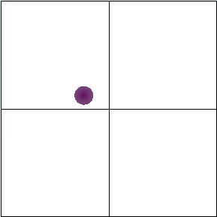
X-ray CCDs and the low energy threshold
The low energy threshold may influence the pixel pattern which we see
very low threshold
low threshold
high threshold
very high threshold
quadruple
triple
double
single
low energy threshold

Slide 7
X-ray CCDs and the low energy threshold
The low energy threshold may influence the pixel pattern which we see
very low threshold
low threshold
high threshold
very high threshold
quadruple
triple
double
single
→ the observed pixel pattern depends on the low energy threshold

Slide 8
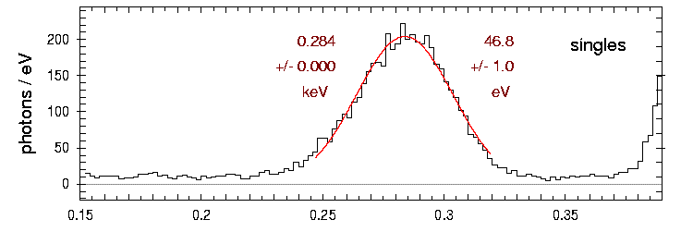
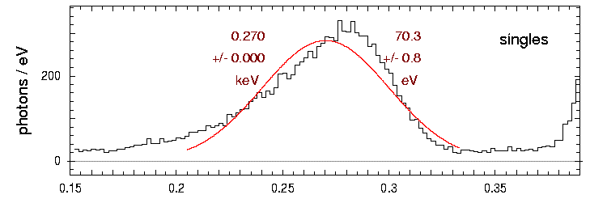
X-ray CCDs and the low energy threshold
low energy threshold: ≈ 40 eV
very low threshold
very high threshold
low threshold
high threshold
low energy threshold: ≈ 100 eV
TRoPIC spectrum of C-K (0.28 keV), derived from single pixel events
→ the spectral resolution depends on the low energy threshold

Slide 9
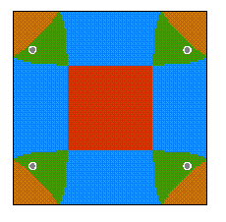
X-ray CCDs and the low energy threshold
singles:
no spatial resolution
doubles:
spatial resolution in one dimension
triples:
spatial resolution in two dimensions
quadruples:
spatial resolution in two dimensions
illustration for a low energy threshold of 1%
the spatial resolution is better than the pixel size

Slide 10
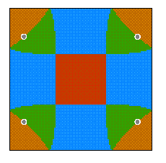

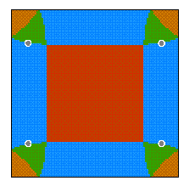
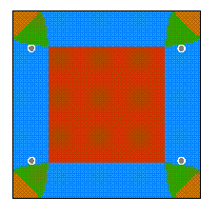
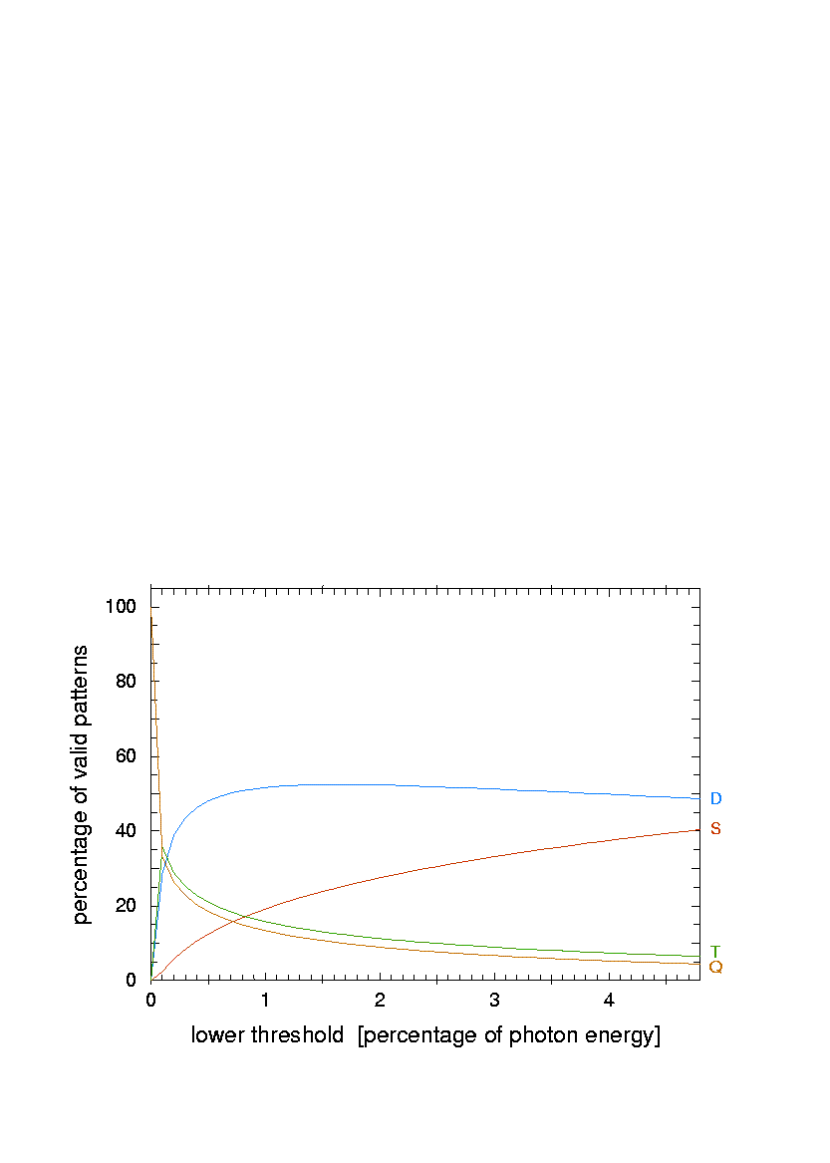
X-ray CCDs and the low energy threshold
singles
only one parameter: low energy threshold [%]
doubles
triples
quadruples
0.5%
1%
2%
3%
4%
doubles
singles
triples
quadruples
→ the spatial resolution depends on the low energy threshold

Slide 11
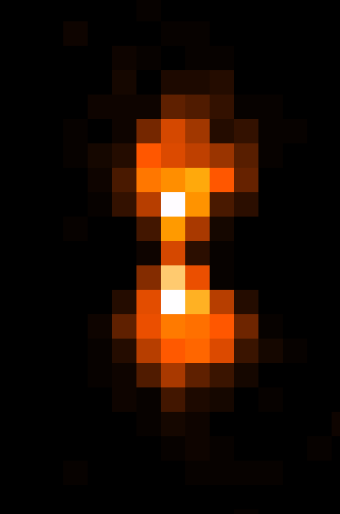
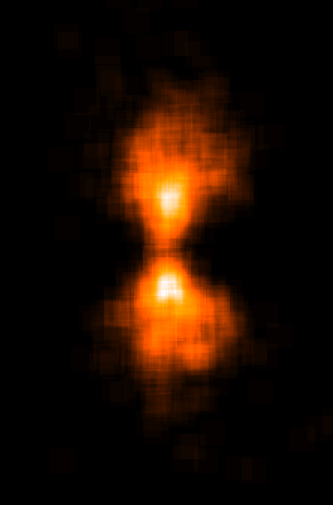
Comparison of X-ray CCD images without and with subpixel resolution

Slide 12
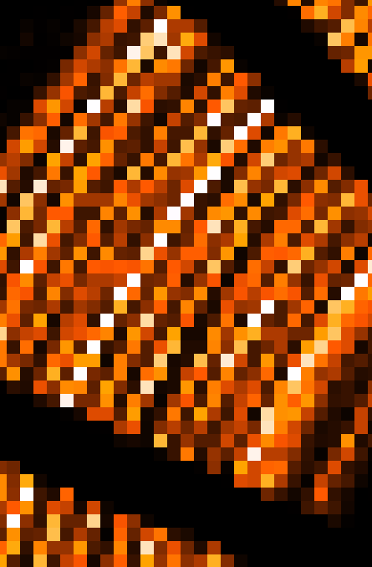
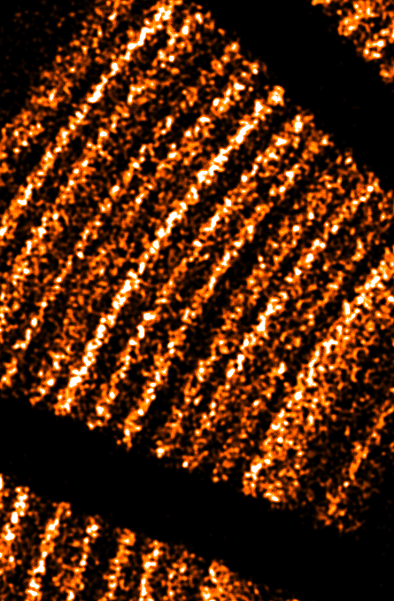
Comparison of X-ray CCD images without and with subpixel resolution

Slide 13
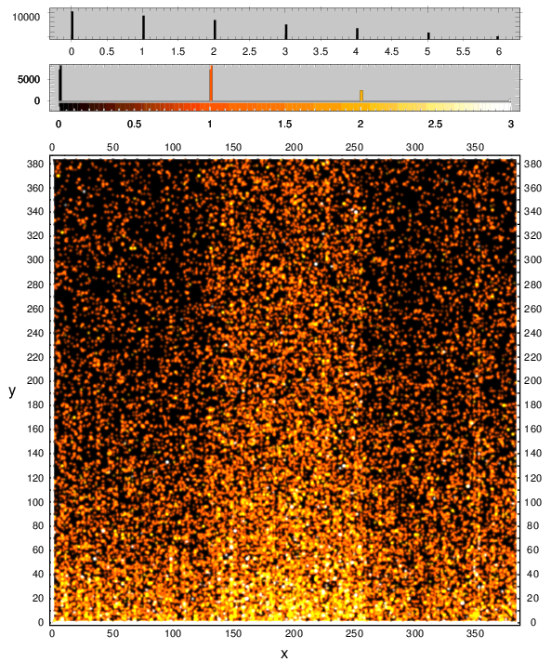
X-ray CCDs and the low energy threshold
The problem with a spatially constant low energy threshold:
noise is not uniformly distributed
over the CCD
a subset of pixels may occupy
a major fraction of telemetry
the low energy threshold has to
be set to an unnecessarily high
value for the majority of the pixels
event rate
charge [adu,≈eV]
ground calibration of TM6: all events with PHA above 67 adu

Slide 14
X-ray CCDs and the low energy threshold
Motivation for applying adaptive thresholds:
By slightly reducing the low energy thresholds
in noisier regions,
a lot of telemetry can be saved.
The saved telemetry can be utilized
for reducing the thresholds
in larger area.
event rate
better spectral and spatial resolution
(though not homogeneous over the CCD)
determination of pixel specific thresholds
so that each (unexposed) pixel uses about
the same telemetry
charge [adu,≈eV]

Slide 15
Determination of adaptive „threshold maps“
We can transmit ~ 5 events/frame per CCD → ~ 0.68 events/ks per pixel
an average pixel may produce ‚signal‘ above the event threshold only once every ~25 min
exposure times of ~hours are required to find suitable thresholds
computation not possible in space
upload not feasible after launch
thresholds need to be determined before launch and uploaded into onboard memory
Noise may be higher in space by an unknown amount
possibility to scale uploaded threshold maps by a commandable factor
computation of threshold maps:
for each individual pixel
determine the minimum adu value above which a rate of ~0.68 events/ks results

Slide 16
Determination of adaptive „threshold maps“
take long ‚dark‘ measurements on ground
determine for each pixel the event rate as a function of the low energy threshold
find a value which yields an event rate of ~0.68 events/ks
insert this value into a ‚threshold map‘
side remark: MIPs rate: ~2 MIPs per frame, each MIP affecting n pixels
→ event rate: n x 4 x 10⁴ / ks
→ regions affected by MIPs have to be excluded from telemetry;
the effect of area removal can be approximated by deadtime

Slide 17
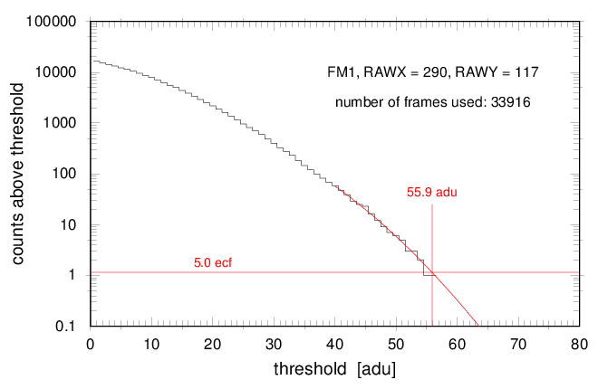
X-ray CCDs and the low energy threshold
total event rate of one specific pixel (290,117) as a function of the low energy threshold:
corresponding
threshold
5.0 efc
acceptable event rate
28.3 min ‘dark’ exposure in ground calibration

Slide 18
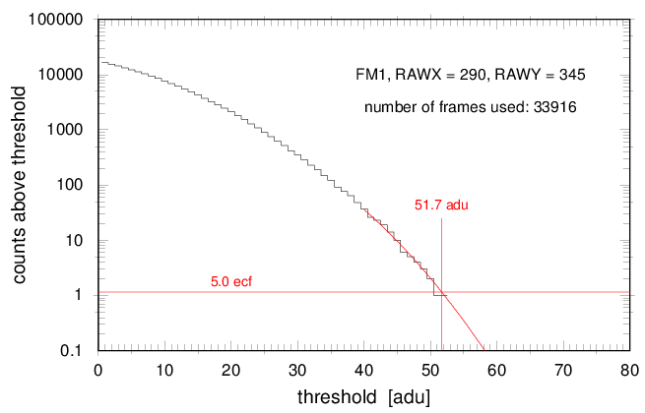
X-ray CCDs and the low energy threshold
total event rate of one specific pixel (290,345) as a function of the low energy threshold:
corresponding
threshold
5.0 efc
acceptable event rate
28.3 min ‘dark’ exposure in ground calibration

Slide 19
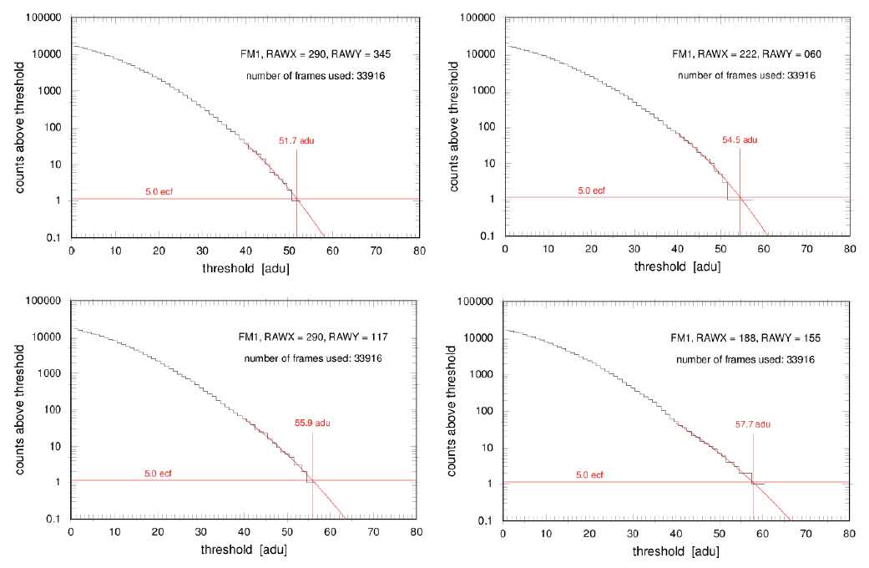
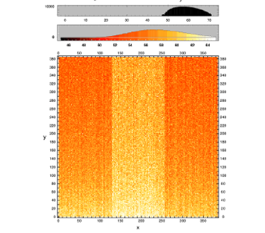
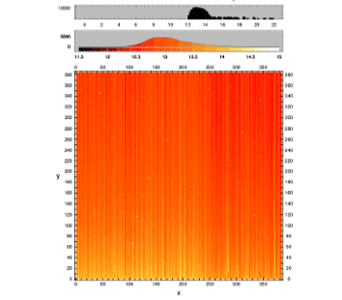
X-ray CCDs and the low energy threshold
5.0 efc
5.0 efc
TM5 threshold map
5.0 efc
5.0 efc
TM5 ‘noise‘ map
(measures the event rate variability)

Slide 20
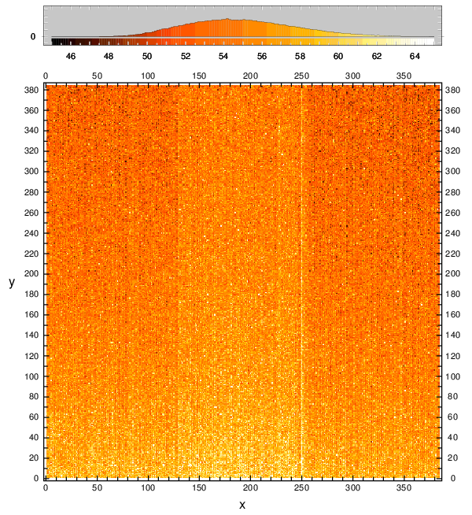
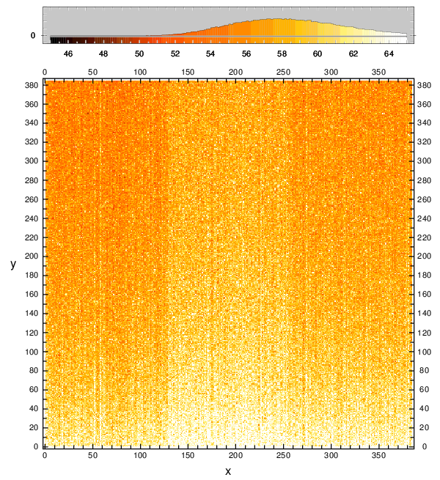
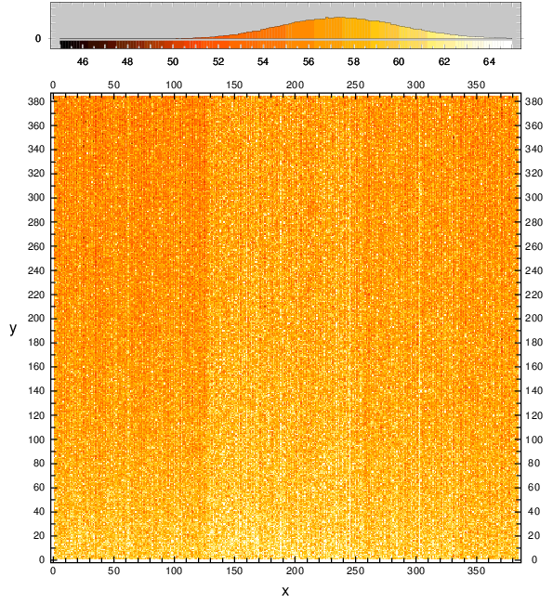
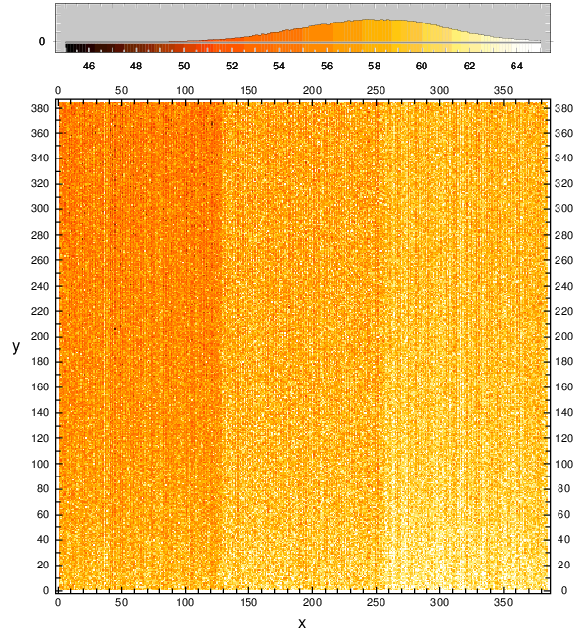
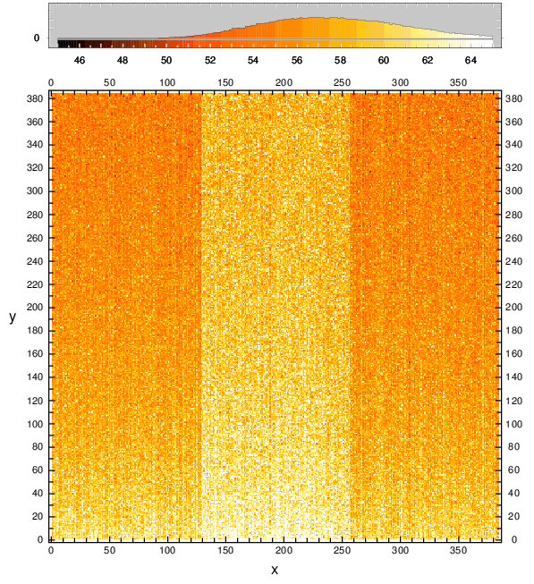
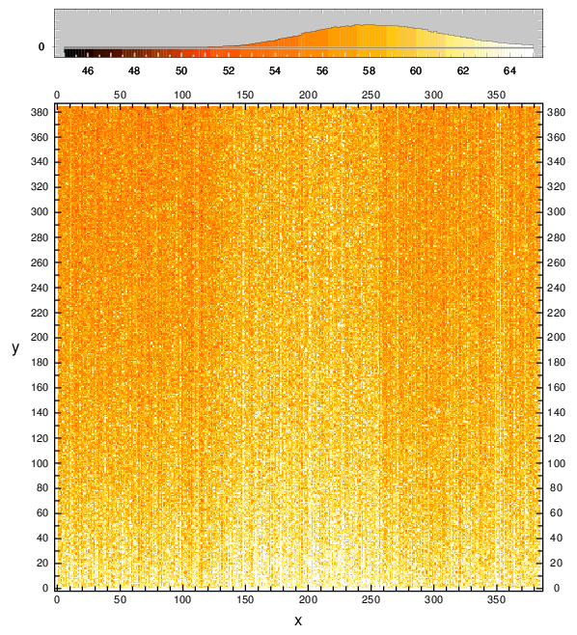
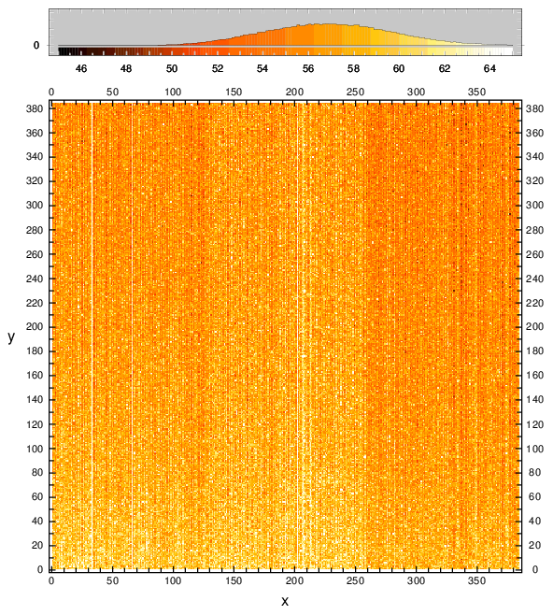
X-ray CCDs and the low energy threshold
TM 1
TM 2
TM 3
TM 4
threshold maps determined on ground for 5 events/frame/camera, and uploaded
to the onboard memory before launch
TM 5
TM 6
TM 7

Slide 21

Situation before launch:
concept of adaptive threshold maps promising.
BUT: would we be able to downlink an event rate
of ~ 5 events/frame/camera just for the noise
plus the real X-ray photons ?
5 events/frame/camera would need
about 2 hours of antenna time per day,
exceeding the guaranteed time.
Risk that the performance of the instrument cannot
be fully utilized due to telemetry limitations.

Slide 22
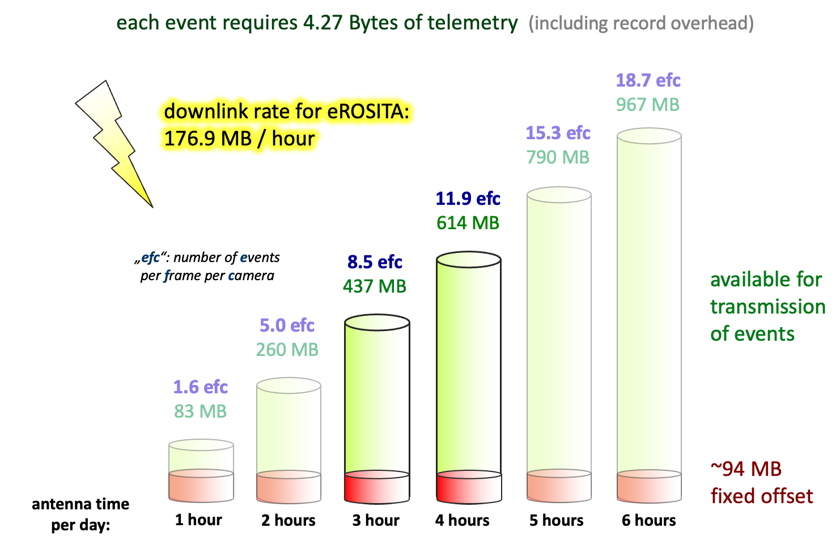
What can be transmitted per day without compression
guaranteed downlink rate
for eROSITA: 176.9 MB/hour

Slide 23
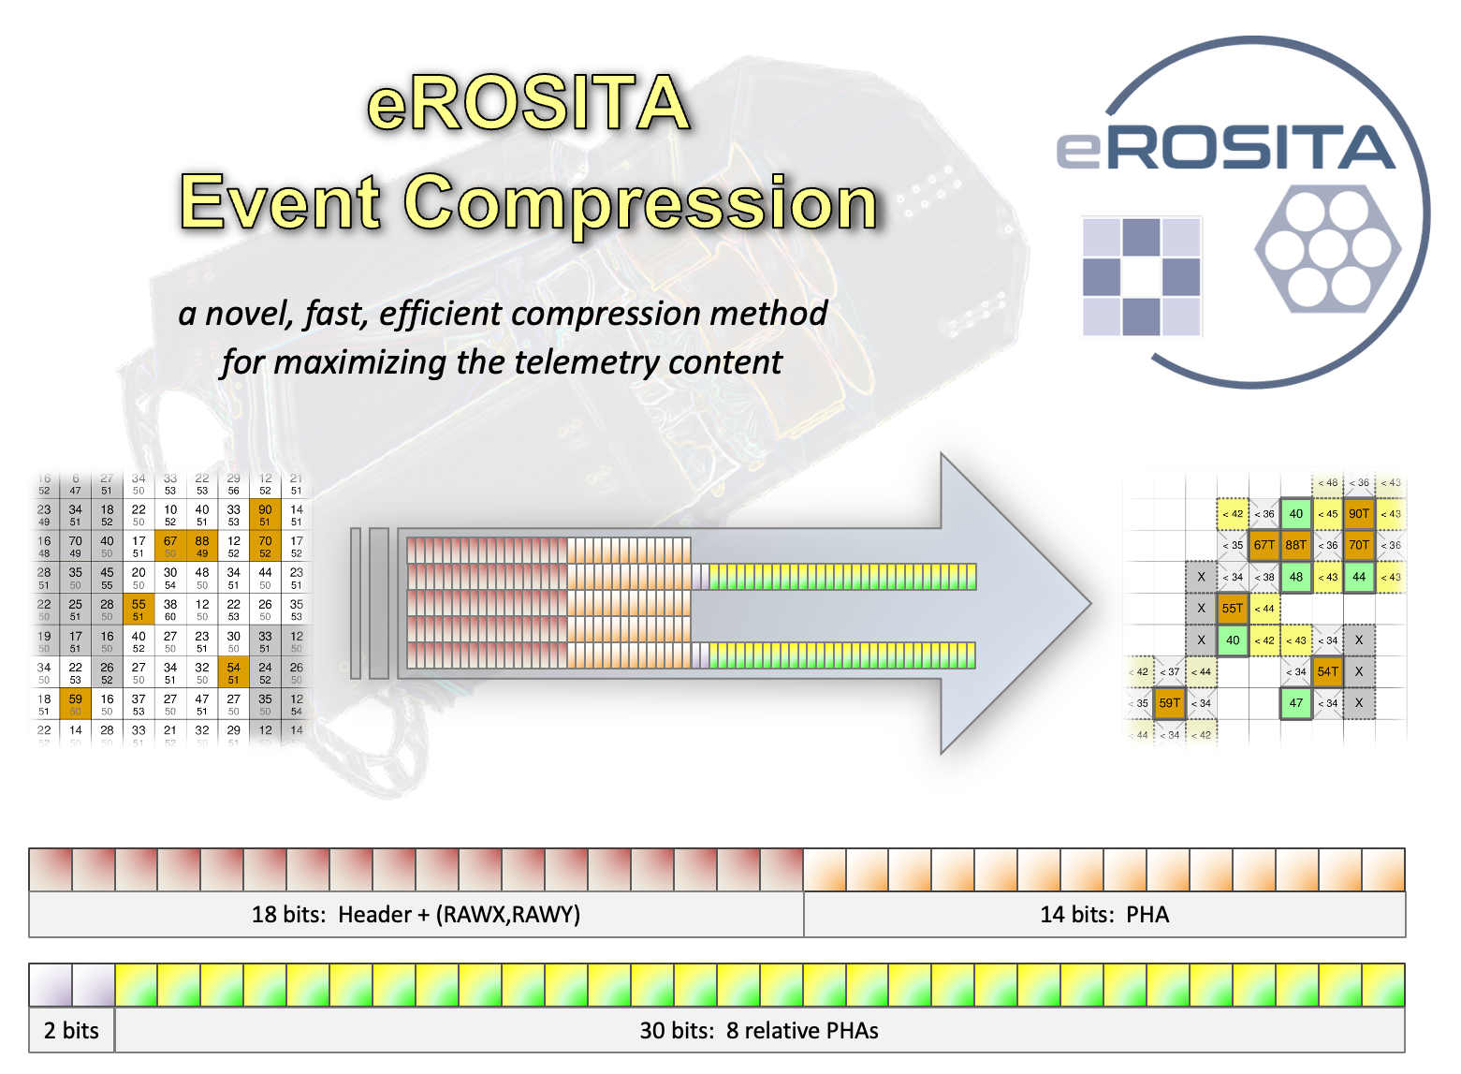

Slide 24
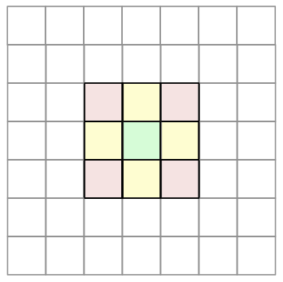
Event compression: general concept
Save telemetry by transmitting only the „important“ regions,
i.e. the regions around charges which are likely to have been
released by X-ray photons
concept of „event islands“ (also applied in other X-ray missions)
concept of two low energy thresholds:
a trigger threshold for locating a major charge
a split threshold for locating secondary ( = minor = supplementary )
charges around a major charge
good to know:
in the case of eROSITA, the maximum observable pattern size
which can be created by an X-ray photon is 2 x 2 pixels

Slide 25
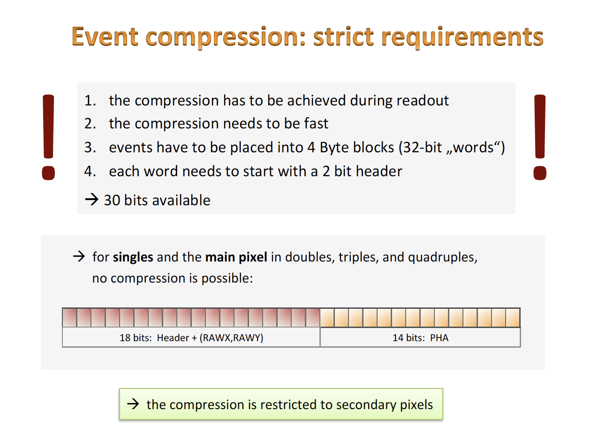

Slide 26
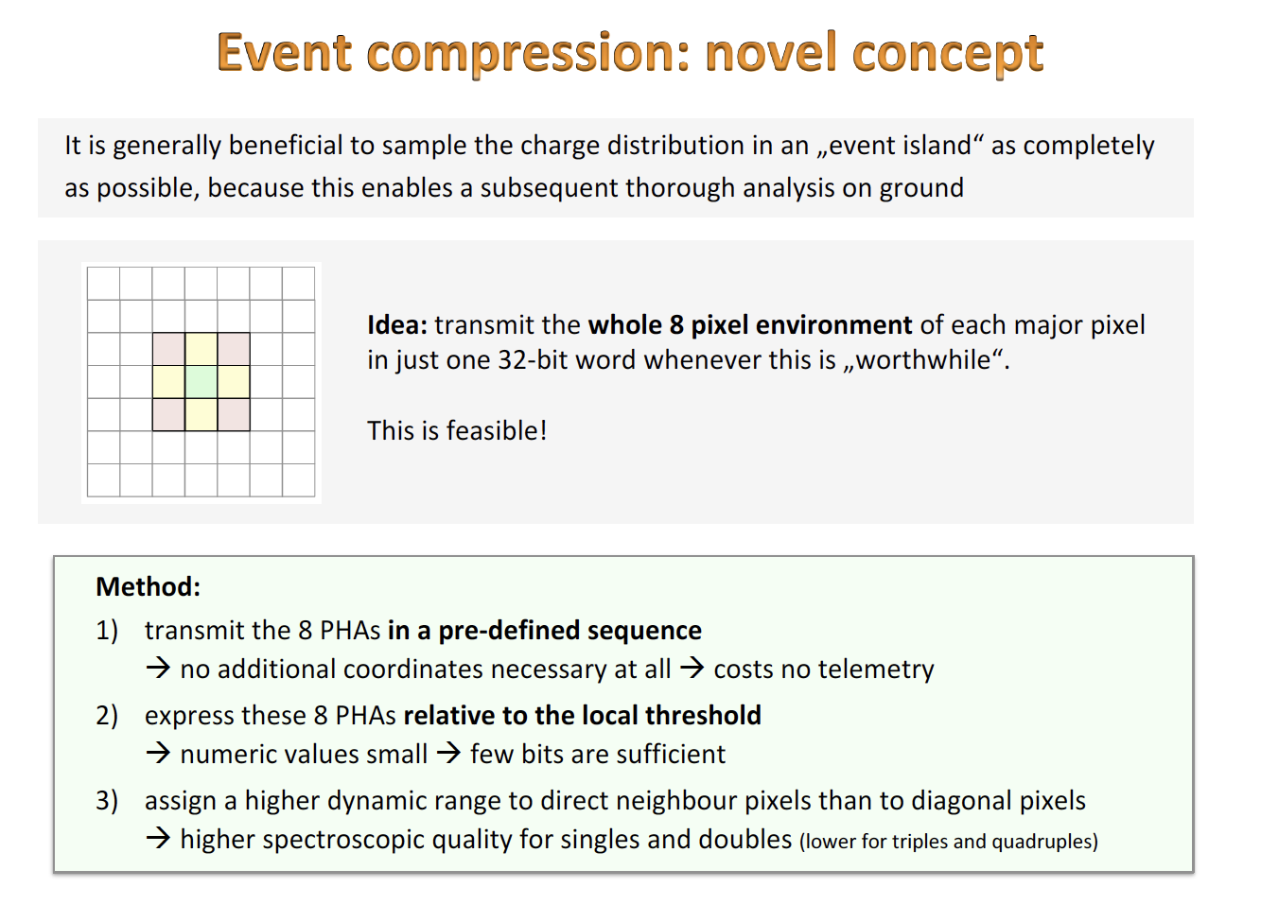

Slide 27
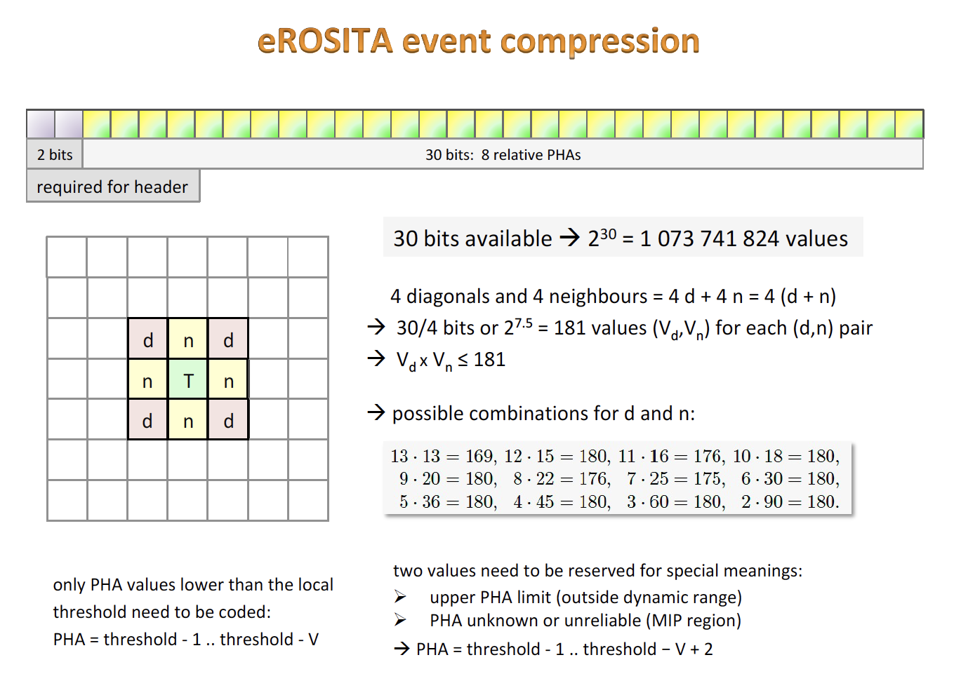

Slide 28
Energy thresholds applied in the onboard processing mode ‚PMENV2‘
Two threshold approach:
primary (`trigger‘) threshold: applied to all pixels
secondary (`split‘) threshold: applied only around `trigger‘ pixels
Data compression: transmission of whole 8 pixel environment
does not require more bits than transmission of triggering pixel
Restriction: available adu range restricted, 10 combinations supported
„ENVTAB“ = 0
„ENVTAB“ = 3
„ENVTAB“ = 4
„ENVTAB“ = 9
13
18
20
45
13
10
9
4

Slide 29
Example: event compression for the „10|18“ case
direct neighbour
dynamic range: 18 → 0 .. 17
0: charge 1 adu below threshold
or primary pixel
1: charge 2 adu below threshold
15: charge 16 adu below thr.
16: charge at least 17 adu below thr.
17: charge unknown (edge, bad, MIP)
18
diagonal neighbour
10
dynamic range: 10 → 0 .. 9
0: charge 1 adu below threshold
or primary pixel
1: charge 2 adu below threshold
7: charge 8 adu below thr.
8: charge at least 9 adu below thr.
9: charge unknown (edge, bad, MIP)

Slide 30
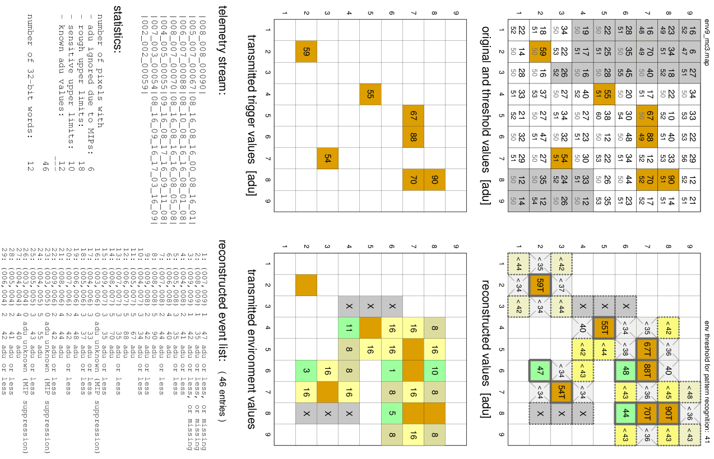
Example: event compression for the „10|18“ case
direct neighbour
dynamic range: 18 → 0 .. 17
0: charge 1 adu below threshold
or primary pixel
1: charge 2 adu below threshold
15: charge 16 adu below thr.
16: charge at least 17 adu below thr.
17: charge unknown (edge, bad, MIP)
18
diagonal neighbour
10
dynamic range: 10 → 0 .. 9
0: charge 1 adu below threshold
or primary pixel
1: charge 2 adu below threshold
7: charge 8 adu below thr.
8: charge at least 9 adu below thr.
9: charge unknown (edge, bad, MIP)

Slide 31
Example: event compression for the „18|10“ case
values in one CCD frame [adu]
(after offset and common mode subtraction)

Slide 32
Example: event compression for the „18|10“ case
values in the threshold map [adu]

Slide 33
Example: event compression for the „18|10“ case
insensitive pixel
(edge, bad, MIP)
trigger pixel
(charge at or
above threshold)

Slide 34
Example: event compression for the „18|10“ case

Slide 35
Example: event compression for the „18|10“ case
pixel (008_007_00070) is a triggering
pixel which will be transmitted anyway
no other pixel in the environment
contains charge within the
available dynamic range
→ no environment transmitted
→ lack of transmitted environment
contains information (and does
not cost any telemetry!)
telemetry stream:
|008_008_00090|

Slide 36
Example: event compression for the „18|10“ case
pixel (006_007_00088) is not considered
in the decision whether the environment
should be transmitted, because it is a
triggering pixel which will be transmitted
anyway
but pixel (006_006_00048) contains charge
within the available dynamic range
→ environment transmitted
telemetry stream:
|008_008_00090|
|005_007_00067|08_16_08_16_00_08_16_01|

Slide 37
Example: event compression for the „18|10“ case
pixel (005_007_00067) is not considered
in the decision whether the environment
should be transmitted, because it is a
triggering pixel which has already been
transmitted
but 2 pixels contains charge
within the available dynamic range
→ environment transmitted
telemetry stream:
|008_008_00090|
|005_007_00067|08_16_08_16_00_08_16_01|
|006_007_00088|08_10_08_00_16_08_01_08|

Slide 38
Example: event compression for the „18|10“ case
pixel (008_008_00090) is not considered
in the decision whether the environment
should be transmitted, because it is a
triggering pixel which has already been
transmitted
but pixel (008_006_00044) contains charge
within the available dynamic range
→ environment transmitted
telemetry stream:
|008_008_00090|
|005_007_00067|08_16_08_16_00_08_16_01|
|006_007_00088|08_10_08_00_16_08_01_08|
|008_007_00070|08_00_08_16_16_08_05_08|

Slide 39
Example: event compression for the „18|10“ case
Result:
0..15|0..7: adu value in telemetry
16|08: upper adu limit
(value outside dynamic range)
17|09: pixel in insensitive area
(additional diagnostic information)
telemetry stream:
|008_008_00090|
|005_007_00067|08_16_08_16_00_08_16_01|
|006_007_00088|08_10_08_00_16_08_01_08|
|008_007_00070|08_00_08_16_16_08_05_08|
|004_005_00055|09_16_08_17_16_09_11_08|
|007_003_00054|08_16_09_16_17_03_16_09|
|002_002_00059|

Slide 40
Example: event compression for the „18|10“ case
number of pixels with
adu ignored due to MIPs: 6
rough upper limits: 11
sensitive upper limits: 17
known adu values: 12
---
46
number of 32-bit words: 12
same telemetry as that required for the uncompressed transmission of
12 pixels, but information about 46 pixels
telemetry stream:
|008_008_00090|
|005_007_00067|08_16_08_16_00_08_16_01|
|006_007_00088|08_10_08_00_16_08_01_08|
|008_007_00070|08_00_08_16_16_08_05_08|
|004_005_00055|09_16_08_17_16_09_11_08|
|007_003_00054|08_16_09_16_17_03_16_09|
|002_002_00059|
transmitted environment values

Slide 41
Example: event compression for the „18|10“ case
result from pattern recognition for a constant threshold for of 41 adu
(everything below 41 adu is ignored)
trigger pixel, charge known
neighbour pixel, charge known
‘critical’ pixel, charge ≥ 40 adu may be present
x
insensitive area
uncritical diagonal neighbour pixel
uncritical upper limit, ’clean’ pixel
reconstructed adu values

Slide 42
Example: event compression for the „18|10“ case
result from pattern recognition for a constant threshold for of 41 adu
(everything below 41 adu is ignored)
invalid because of shape
charge cannot be reconstructed,
potentially invalid shape
invalid because next to insensitve area
invalid because no triggering pixel
(only present in telemetry because next
to triggering pixel)
→ only two valid photon events recognizable
reconstructed adu values

Slide 43
Testing the event compression algorithm
Data taken in parallel in uncompressed and compressed mode (in April 2018).
After decoding the compressed data, all 3.2 million events agreed exactly in position and charge.

Slide 44
on ground
X-ray CCDs and the low energy threshold
TM 1
TM 2
TM 3
TM 4
threshold maps determined on ground for 5 events/frame/camera, and uploaded
to the onboard memory before launch
TM 5
TM 6
TM 7

Slide 45
in space
X-ray CCDs and the low energy threshold
TM 1
TM 2
TM 3
TM 4
x 1.18
x 1.14
x 1.16
x 1.20
scaling factors applied
since eROday 43421
TM 5
TM 6
TM 7
constant thresholds
used for TM 5 and TM 7
== 125 adu
x 1.14
== 145 adu

Slide 46
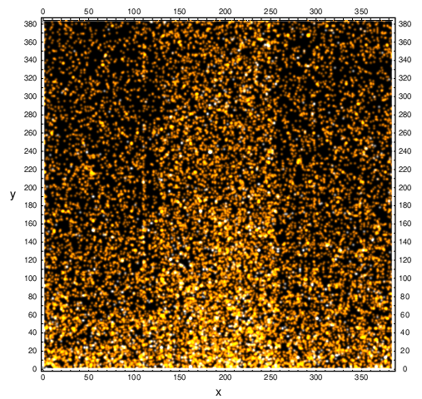
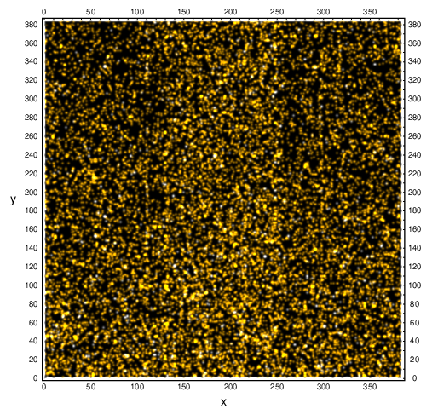
in space
X-ray CCDs and the low energy threshold
result of the spatially variable threshold applied to in-flight data:
spatially constant threshold
spatially variable threshold

Slide 47
Dynamic range setting after launch
18
45
10
4

Slide 48
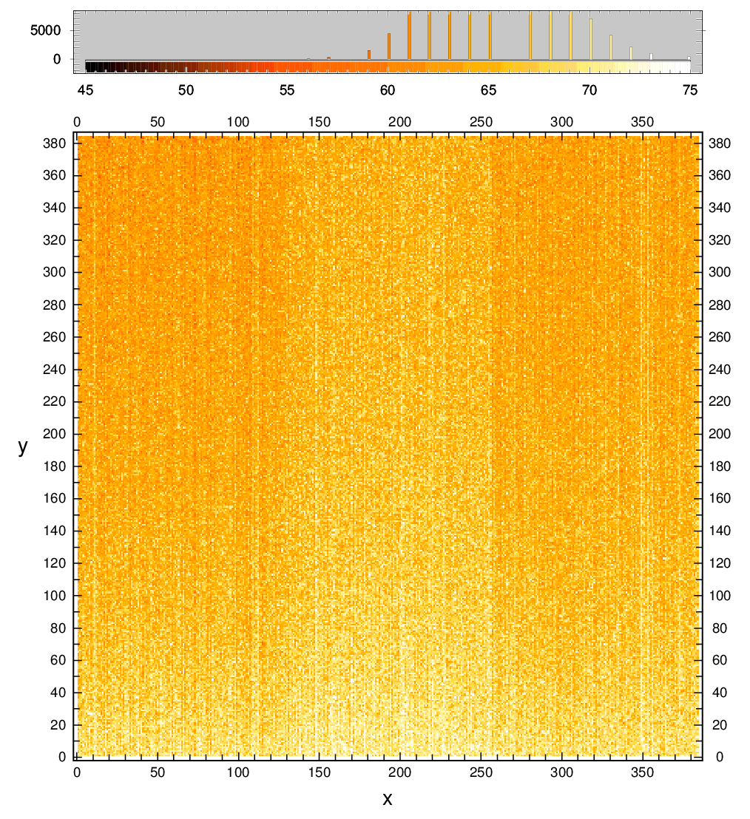
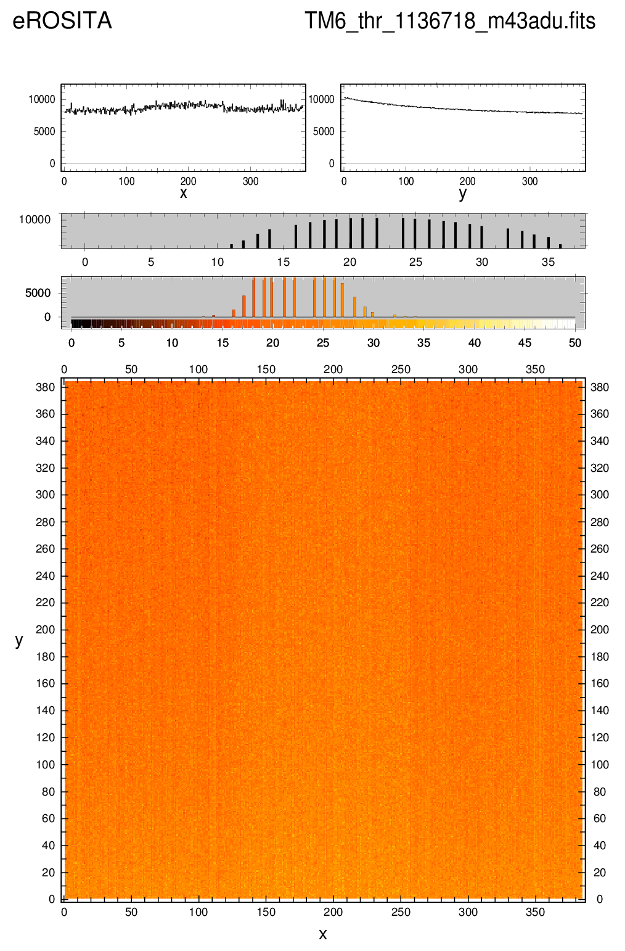
Energy thresholds applied in the onboard processing mode ‚PMENV2‘
adu
adu
„ENVTAB“ = 9
45
4
TM6 primary thresholds:
5 ecf threshold map, multiplied with 1.14
TM6 secondary thresholds for main directions:
ENVTAB = 9: primary thresholds – 44 adu

Slide 49
Energy thresholds applied in the onboard processing mode ‚PMENV2‘
adu
adu
primary threshold: ~73 adu
secondary threshold: ~30 adu
TM6 primary thresholds:
5 ecf threshold map, multiplied with 1.14
TM6 secondary thresholds for main directions:
ENVTAB = 9: primary thresholds – 44 adu

Slide 50
Data processing on ground:
general idea: remove spatial threshold inhomogeneities
before ‘eSASS_947‘ processing: constant threshold of 46 adu applied
consistent processing of TM12346 data possible for almost all threshold settings,
however:
for many data, split threshold cut unnecessarily high
constant adu threshold does not mean constant eV threshold (gain, CTI)
(→ spectral and spatial resolution still position dependent)
improvement in ‚eSASS_947‘: apply threshold which is constant in eV

Slide 51
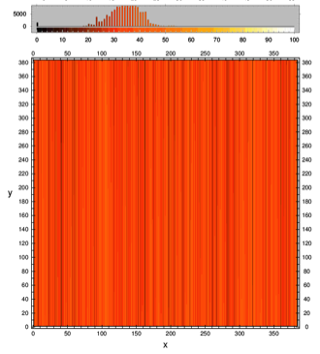
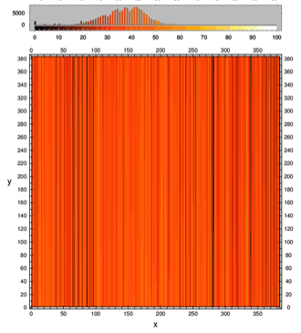
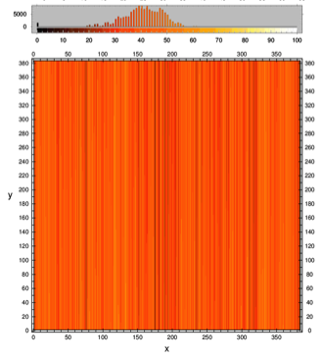
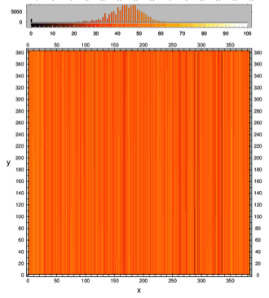
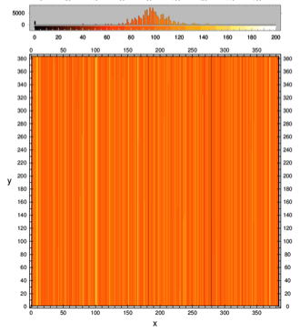
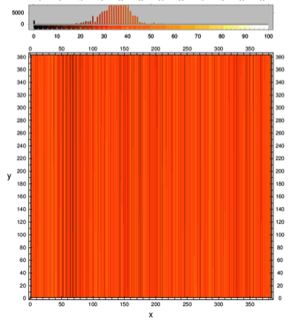
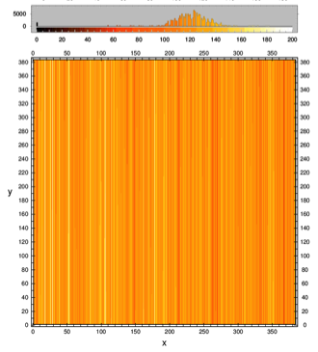
Threshold maps
(in adu)
used in „947“ and
„948“ processing
TM1: 50 eV
TM2: 60 eV
TM3: 60 eV
TM4: 55 eV
TM5: 105 eV
TM6: 50 eV
TM7: 125 eV
(this is not the lower end of the eROSITA bandpass - it is the lower limit to which secondary charges can be collected)

Slide 52
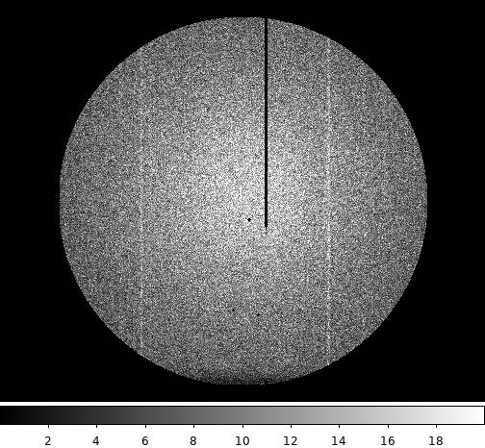
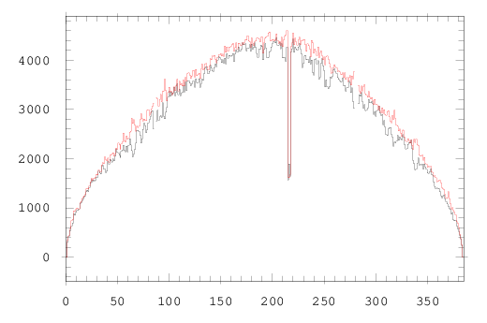

threshold map consequences: TM2, all valid patterns, eROdays 48144 – 48199
worst case
0.5 – 2.5 keV
224 hours (9.3 days)
exposure
946
946
947
948
947
948
6% less flux in 947 & 948 compared to 946

Slide 53
Threshold maps
(in adu)
used in „947“ and
„948“ processing
TM1: 50 eV
TM2: 60 eV
TM3: 60 eV
TM4: 55 eV
TM5: 105 eV
TM6: 50 eV
TM7: 125 eV

Slide 54







Threshold maps
(in adu)
used after
„948“ processing
TM1: 60 eV
TM2: 70 eV
TM3: 70 eV
TM4: 65 eV
TM5: 105 eV
TM6: 60 eV
TM7: 125 eV

Slide 55


Consequences of threshold map choice
TM2
0.4 - 0.6 keV
70 eV 46 adu
60 eV 46 adu
ç√
ç√
94.9 % of ‘46 adu’ photons
100.0 % of ‘46 adu’ photons

Slide 56

eROSITA event compression
in the ‚947‘ and ‚948‘ processing, the thresholds had been choosen by ≈10 eV too low
noise events made otherwise valid pixel patterns invalid
≤ 6% flux loss and spatial inhomogeneities (but higher spectral resolution)
effect can be exactly quantified
correction straightforward, but requires reprocessing
the onboard event compression algorithm PMENV2 works so efficiently
that the performance of eROSITA is not limited by telemetry (!)

Slide 57

Behind the scenes of eROSITA:
how we transmit the data
Pelham/Germany 18th IACHEC meeting, 20-23 April 2026 K. Dennerl / MPE

