Slide 1

Stacking sources to improve the eROSITA in-flight calibration
Jeremy Sanders
Max Planck Institute for Extraterrestrial Physics (MPE)
and the eROSITA calibration working group

Slide 2
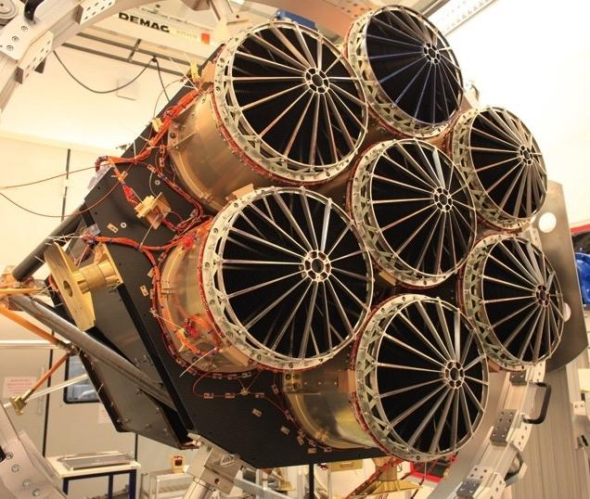
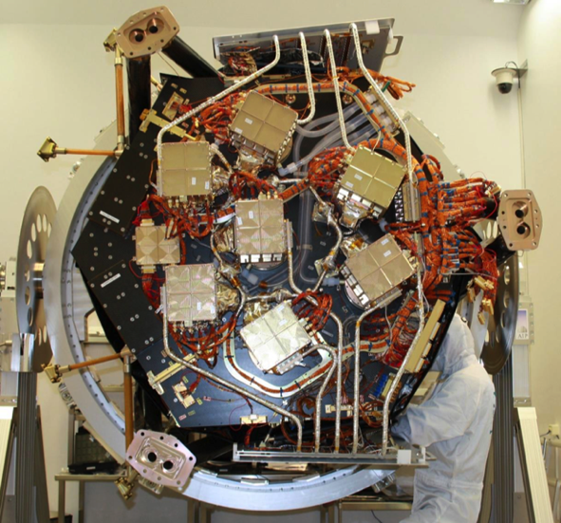
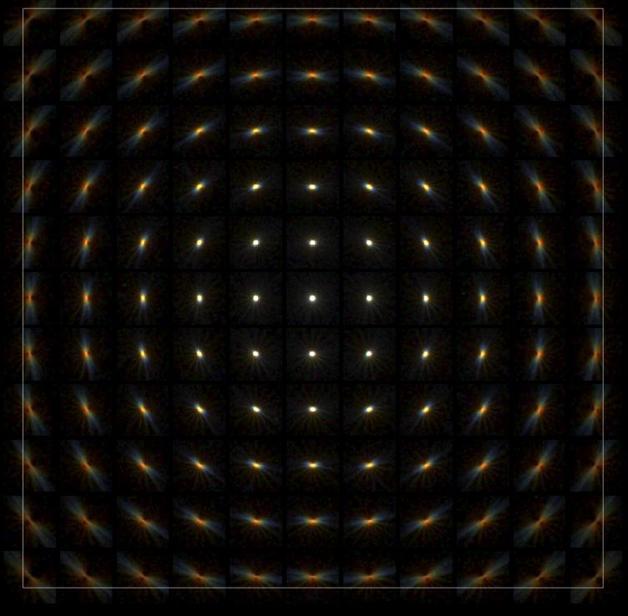
eROSITA – an X-ray telescope suited to surveys
Large effective area around 1 keV (~ 1300 cm² @ 1keV, ~ XMM-Newton)
Large field of view: 1 degree diameter
Half-Energy Width (HEW): ~18" on-axis and ~30" FoV avg. survey
X-ray baffle: 92% stray light reduction
pn-CCD with framestore: 384×384×7 ~ 10⁶ pixels (9.4"), no chip gaps, no ‘out of time’ events
Good CCD spectral resolution (~ 80eV @1.5keV)

Slide 3

SRG survey
eROSITA aboard SRG observatory
SRG in large L2 halo orbit (Sunyaev et al. 2021)
Surveys whole sky every 6 months
Completed around 4.5 full surveys
One great circle scan every 4 hours
Sources scan across FoV in 40s or less
Sources are typically scanned 6 times per survey
Survey progression in first 6 months (counts, 0.3-2.3 keV)

Slide 4
Source stacking and calibration
Multiple scans and surveys for each source sample well the characteristics of the telescopes and detector
By stacking sources (as a function of detector position) we can help characterise several aspects of calibration for each TM
PSF (survey averaged, as a function of off-axis angle, or across det. plane)
Vignetting (as a function of off-axis angle or as an image)
Plate scale or rotation
Optical axis

Slide 5
Potential issues with source stacking
Source might not be a point source
Check by comparing profile with PSF
Other nearby contaminating sources
Source detection and masking/dropping
Pile up
Make lightcurves and exclude centre (given rate as a function of time)
Background variation
Compute background images around each source
Dust halo scattering
Look at N_{H}, compare with PSF, and do not use source, or use at high energies only

Slide 6
Some source stacking details
Stacking around 2800 sources (out of 3500), using both halves of eROSITA sky
We need to normalise each source by its brightness in each band to do stacking (due to masking, etc)
Discovered later problem caused by assumption of source PSF being survey average – update in progress
eroimgtool: make eROSITA source detector plane images and exposures with masking, GTIs, etc.: https://github.com/jeremysanders/eroimgtool

Slide 7
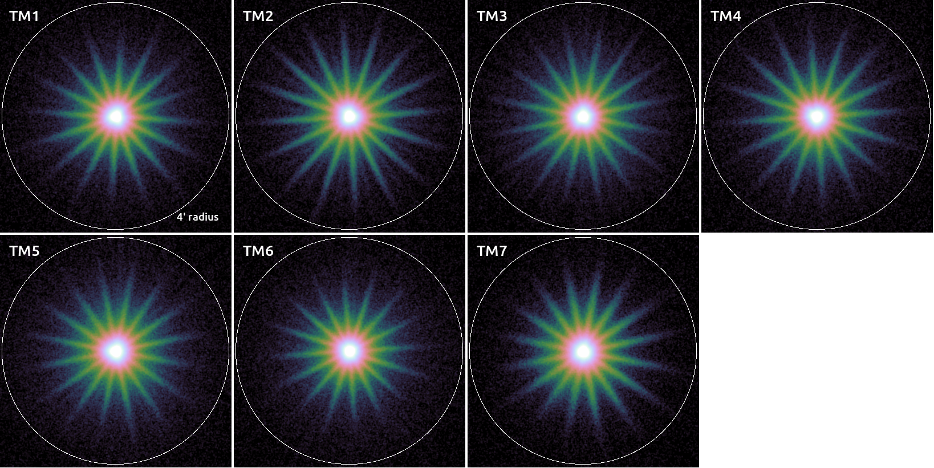
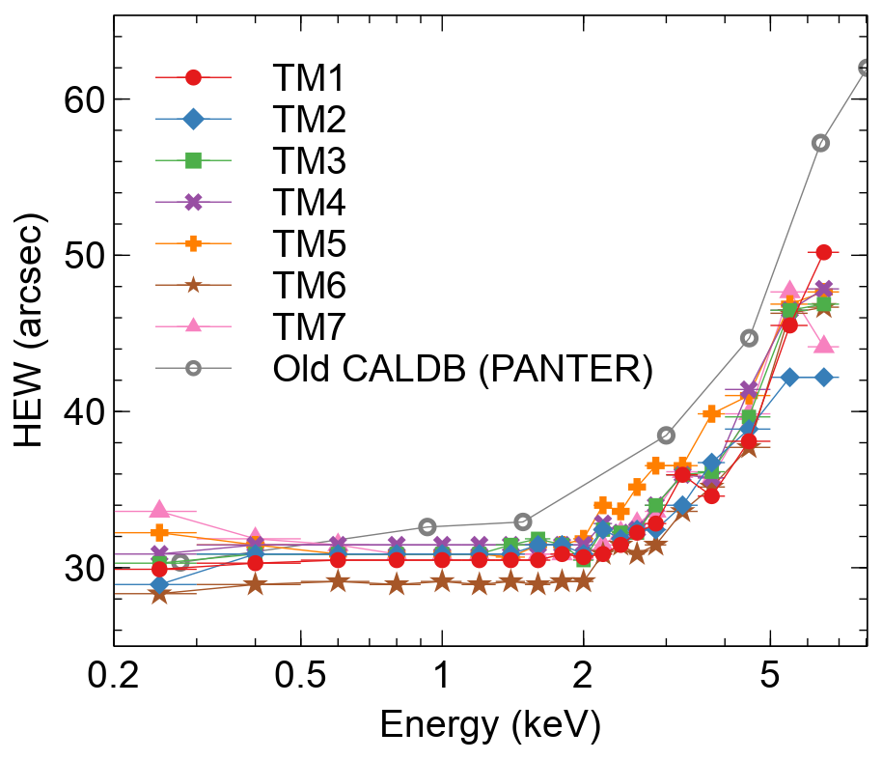
Survey-averaged PSF
Possible reasons for differences:
Sub pixel resolution in space
Divergent vs parallel beams at PANTER?
Pile up at PANTER?
Vignetting differences?
Problem with this analysis?
0.3-2.3 keV, here around 7.7M cts within 4 arcmin radius

Slide 8
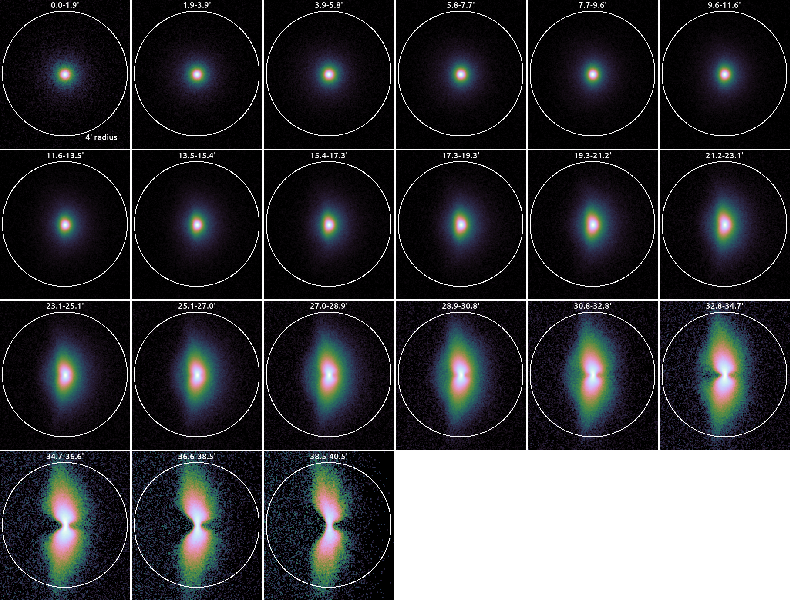
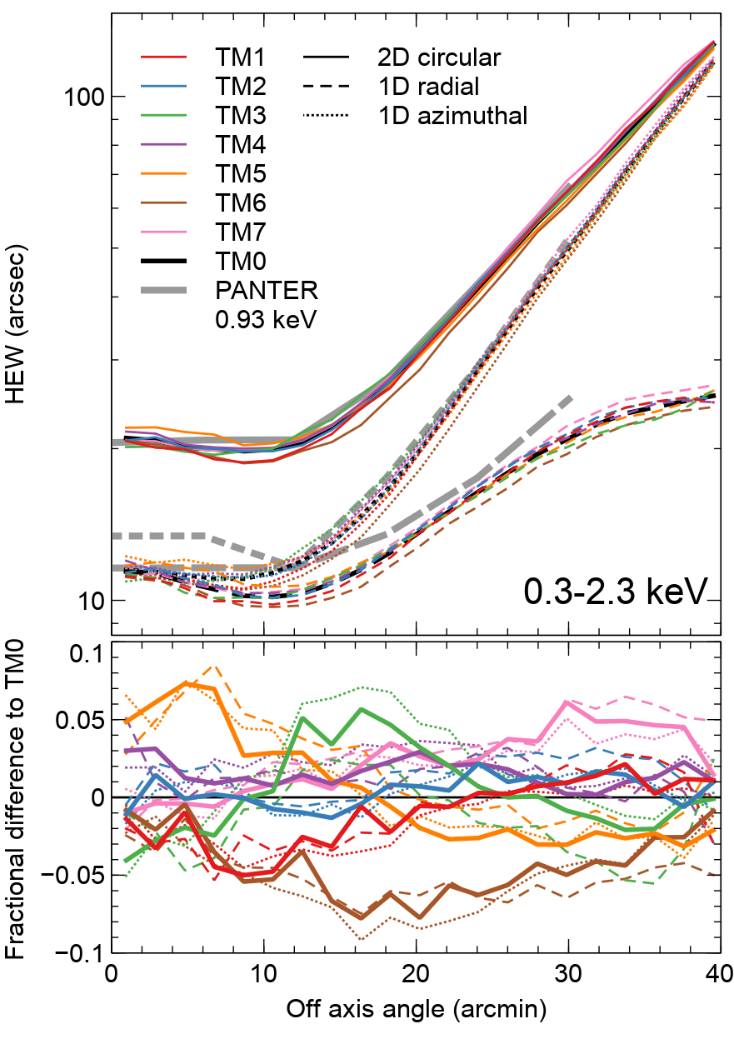
PSF as a function of off-axis angle
0.3-2.3 keV images for combined TMs (called TM0), averaged in azimuth
Circles are 4 arcmin radius

Slide 9
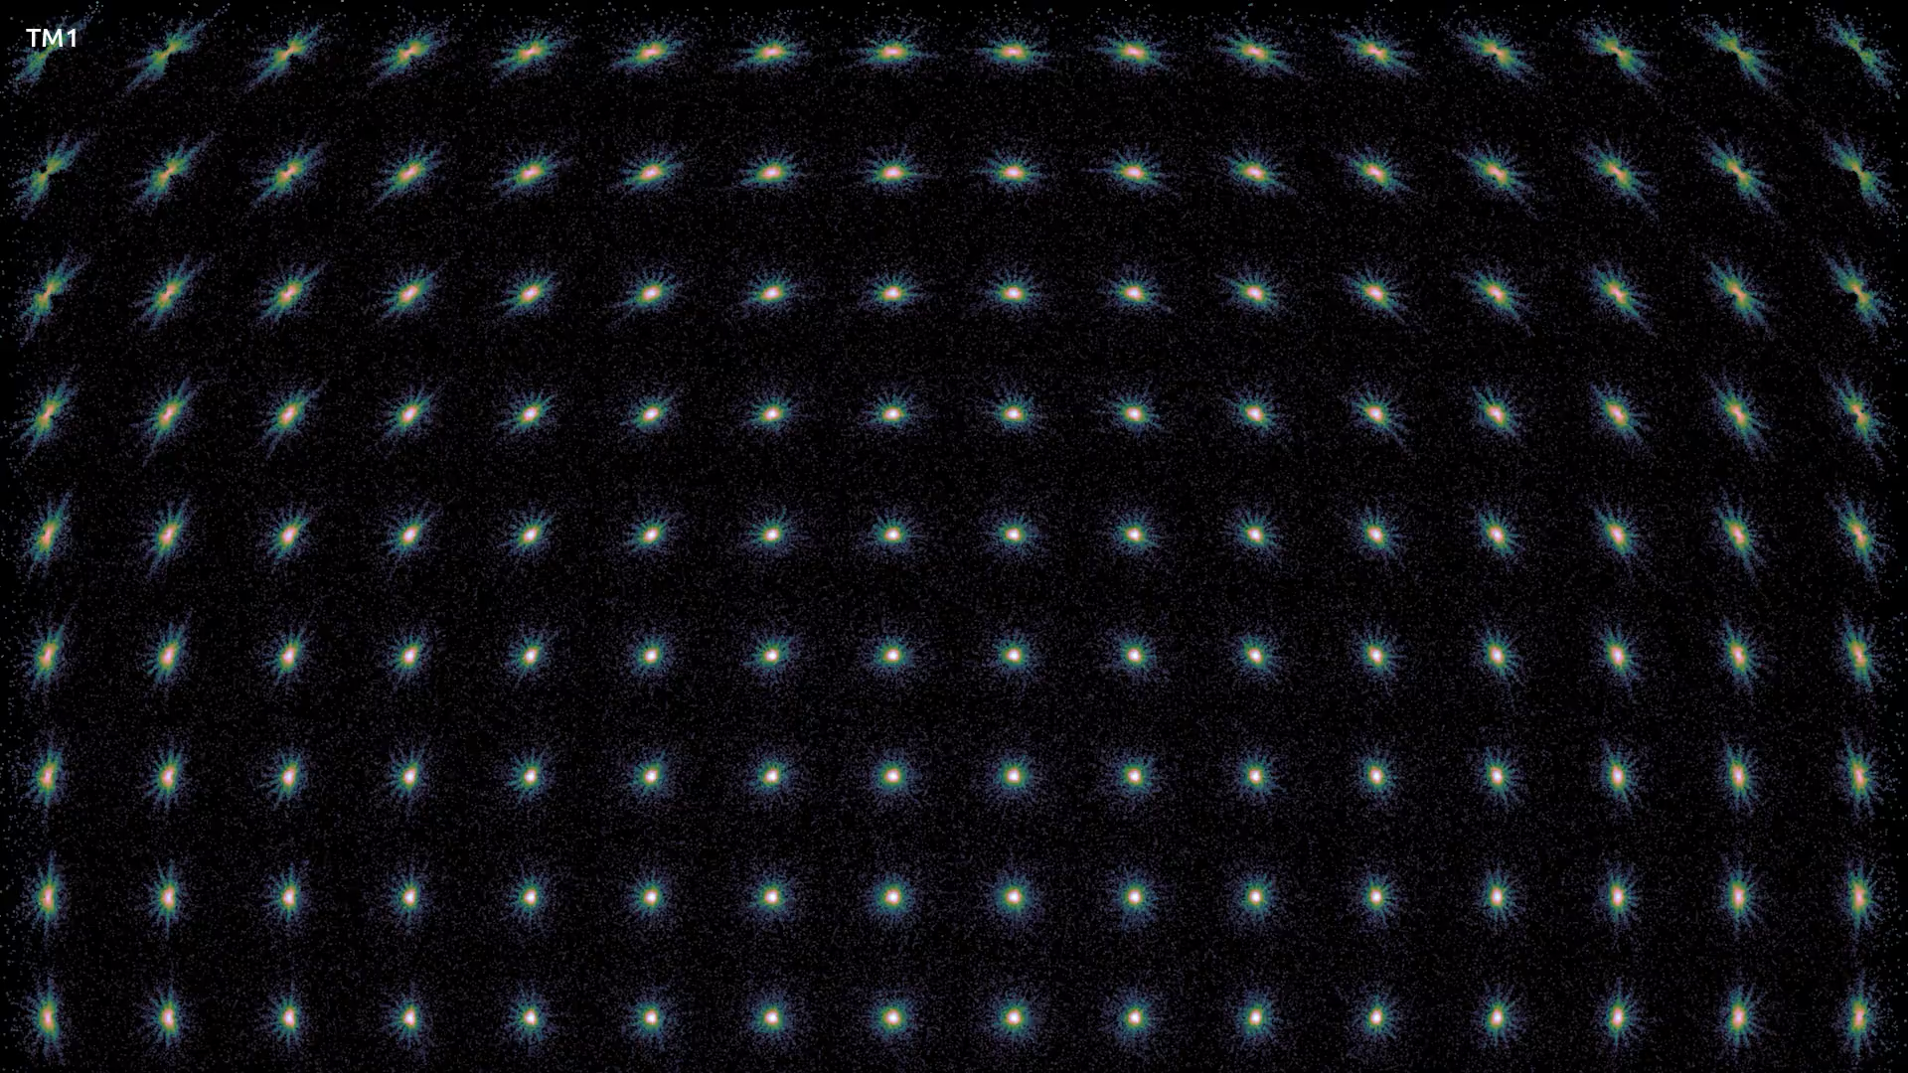
Top part of focal plane, 0.3-2.3 keV
16x16 PSFs covering focal plane of each TM
Each image is 8x8 arcmin

Slide 10
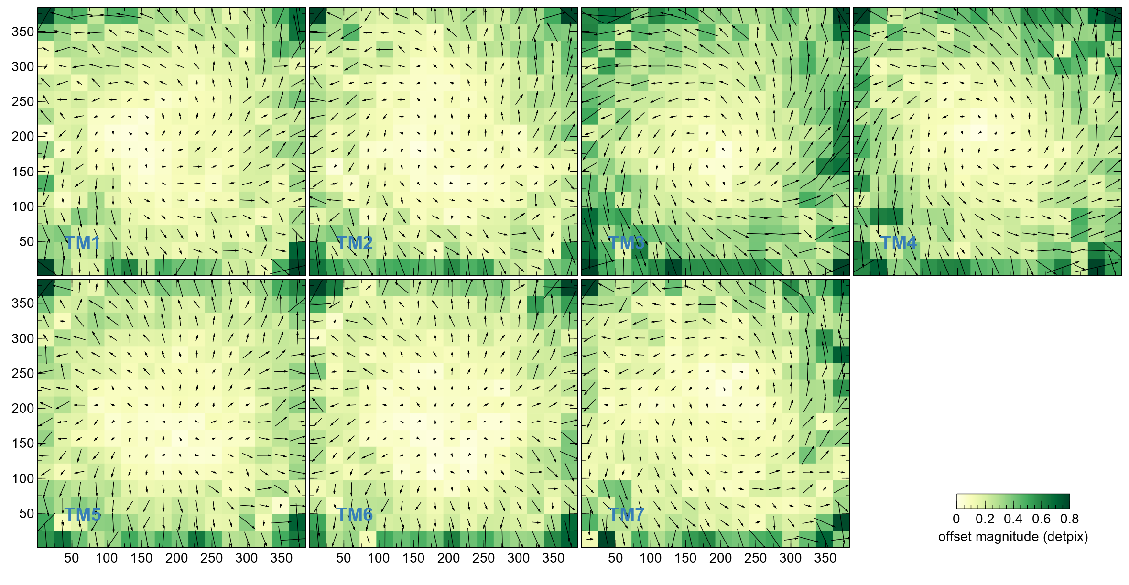
Improving focal plane source positions
TM Rotation (°) Stretch factor
TM1 0.042 0.00097
TM2 0.038 0.00093
TM3 0.093 0.00136
TM4 0.081 0.00107
TM5 0.019 0.00134
TM6 0.010 0.00118
TM7 0.062 0.00074
Arrows show shift of each PSF from on-axis source position, for each TM
Dominated by rotation and stretch, for which we fit a model and implement in the CALDB

Slide 11
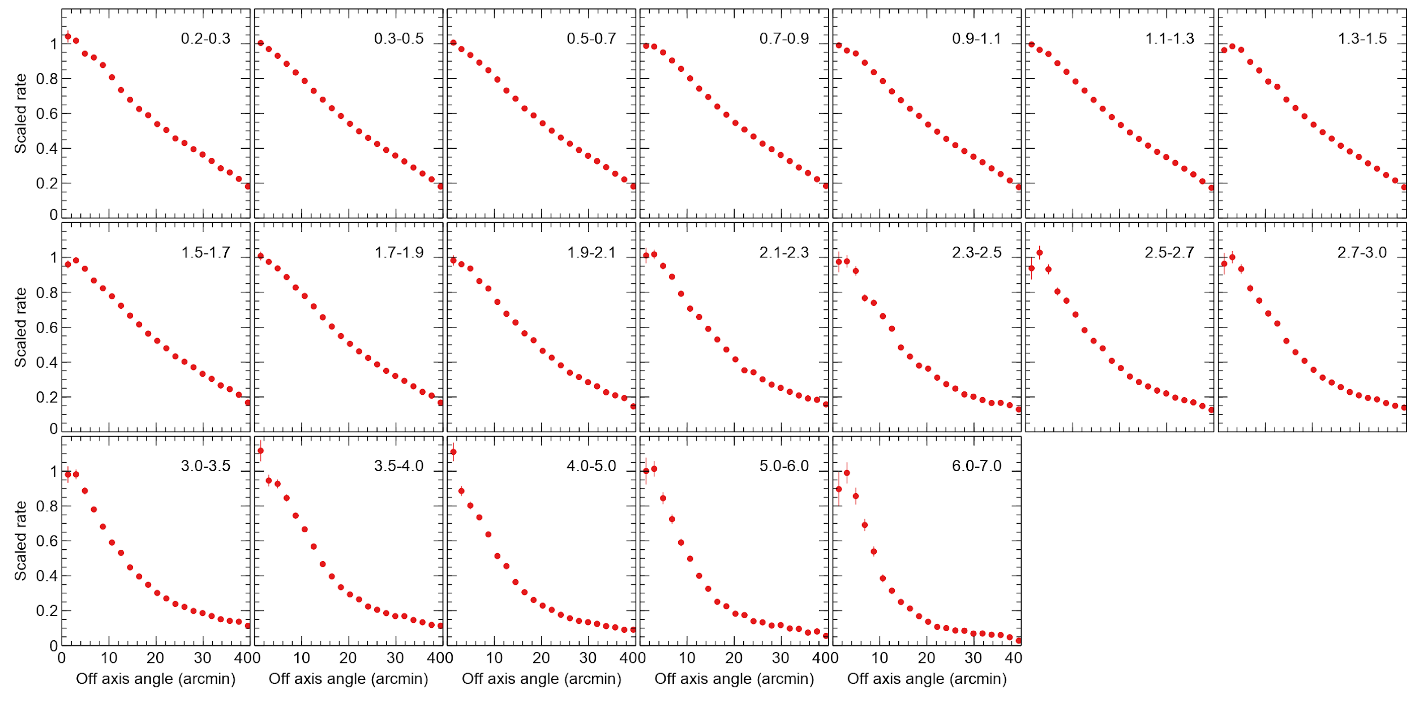
Source rate as a function of off axis angle
Combined TMs
4 arcmin aperture
Energy band shown in keV
Stacking also can be used to get vignetting, if we assume source variation cancels out
Need to fit model to account for measurement errors, get normalisations and interpolate

Slide 12
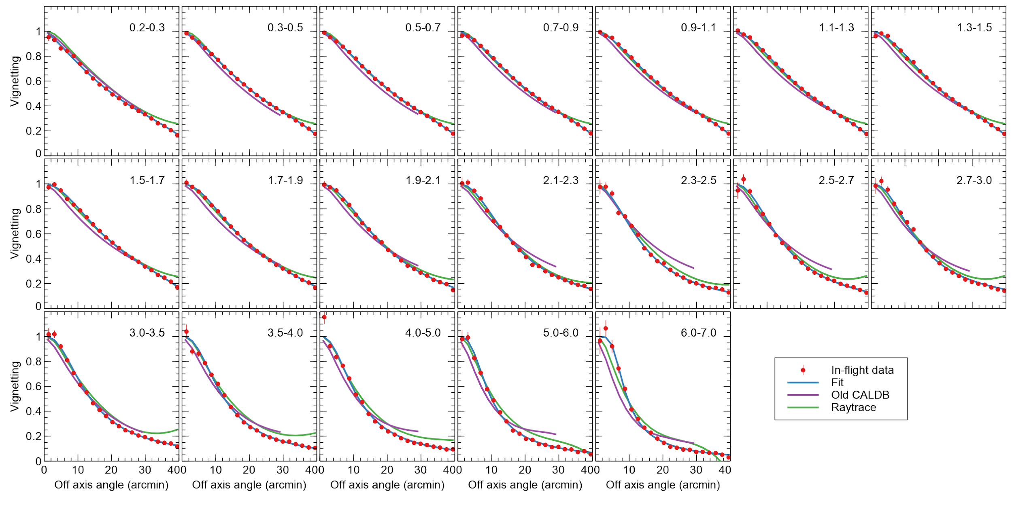
Vignetting curves after model fit
Fitting function, V = (1+[θ/θ₀]^{⍺₀})^{β₀} (1+[θ/θ₁]^{⍺₁})^{β₁},
where θ is off-axis angle
All parameters are fns. of energy, ε = (E/2.3 keV)^{1/2} − 1, e.g. θ₀ = p₀ + p₁ ε + p₂ ε² + p₃ ε³ + p₄ ε⁴ + p₅ ε⁵

Slide 13
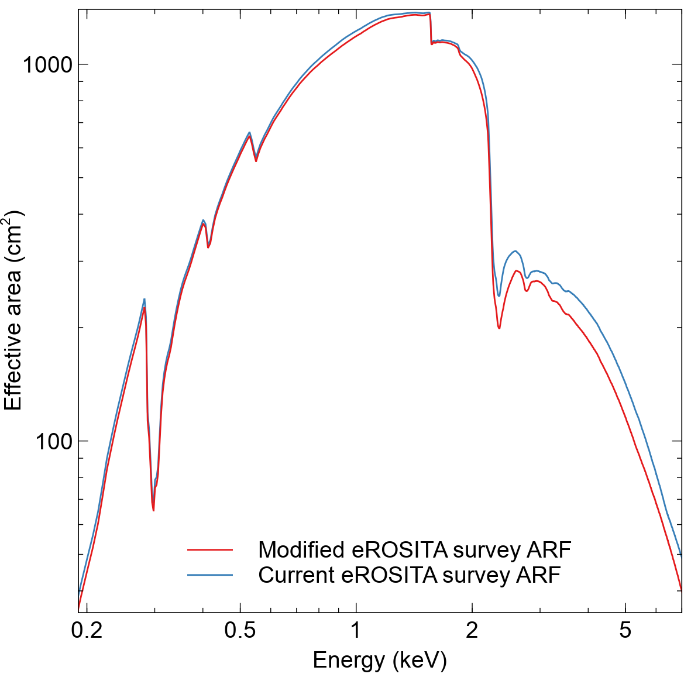
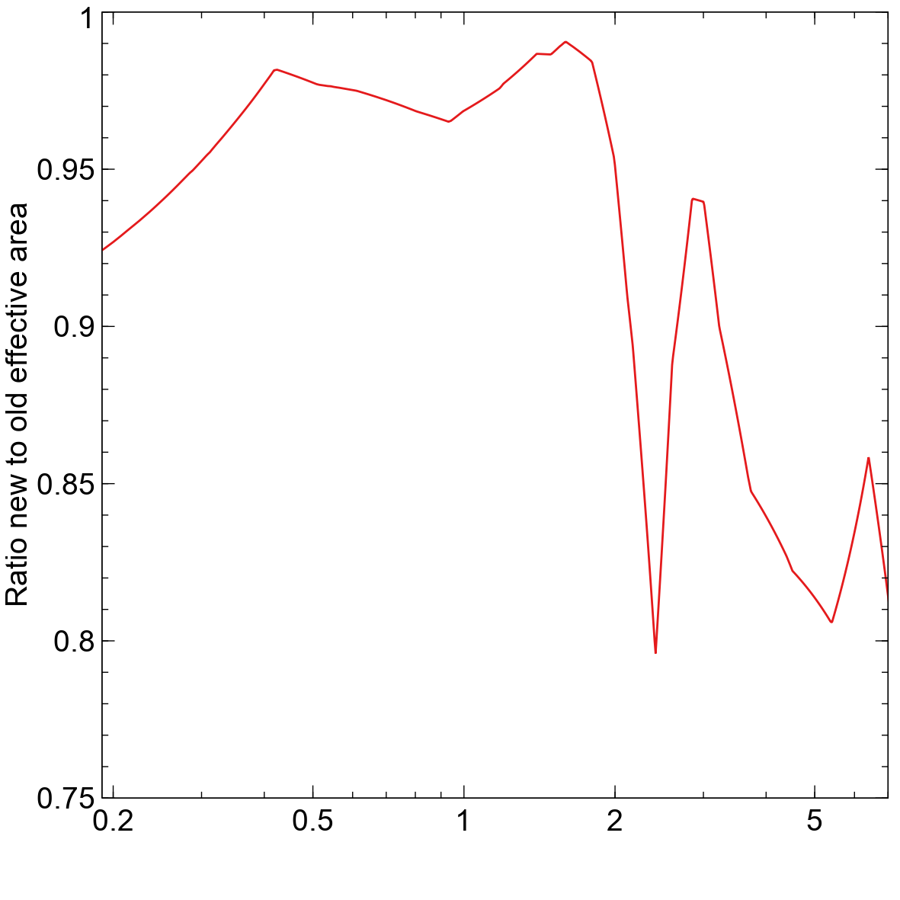
Change to effective area for survey

Slide 14
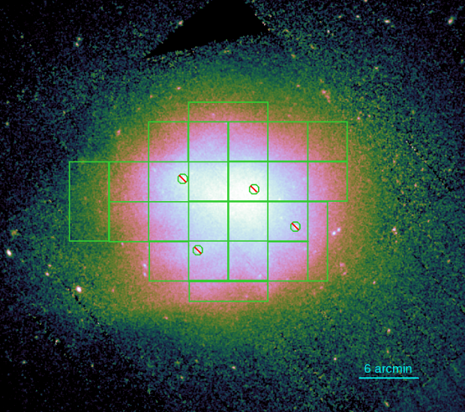
Spectral fitting tests using the Coma cluster
XMM EPIC image
Extract spectra from different cluster regions and fit for temperature (tbabs*apec model), using 0.3-9.0 keV band (with background model). N_{H} fixed to 9.32×10¹⁹ cm⁻².
Fit spectrum from
Whole detector
Annular detector regions
If vignetting is correct, these temperatures should be consistent
Annular detector regions
Coma cluster, a hot galaxy cluster
eROSITA RU PV data in scanning mode – regions sample whole detector

Slide 15
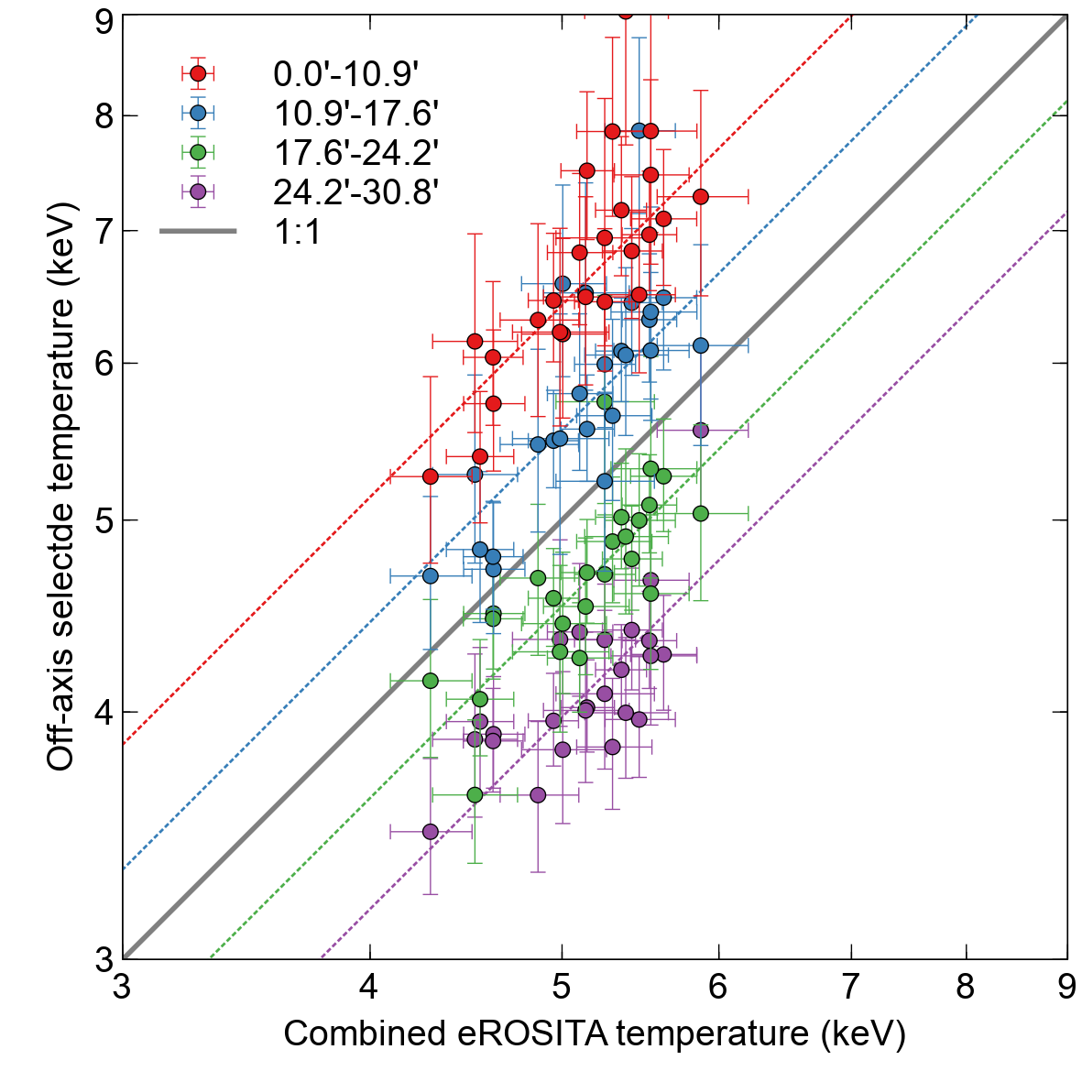
Coma cluster: 030 (old) vignetting
Fit constant ratio
Inconsistent temperatures indicate issue!
Detector annular regions

Slide 16
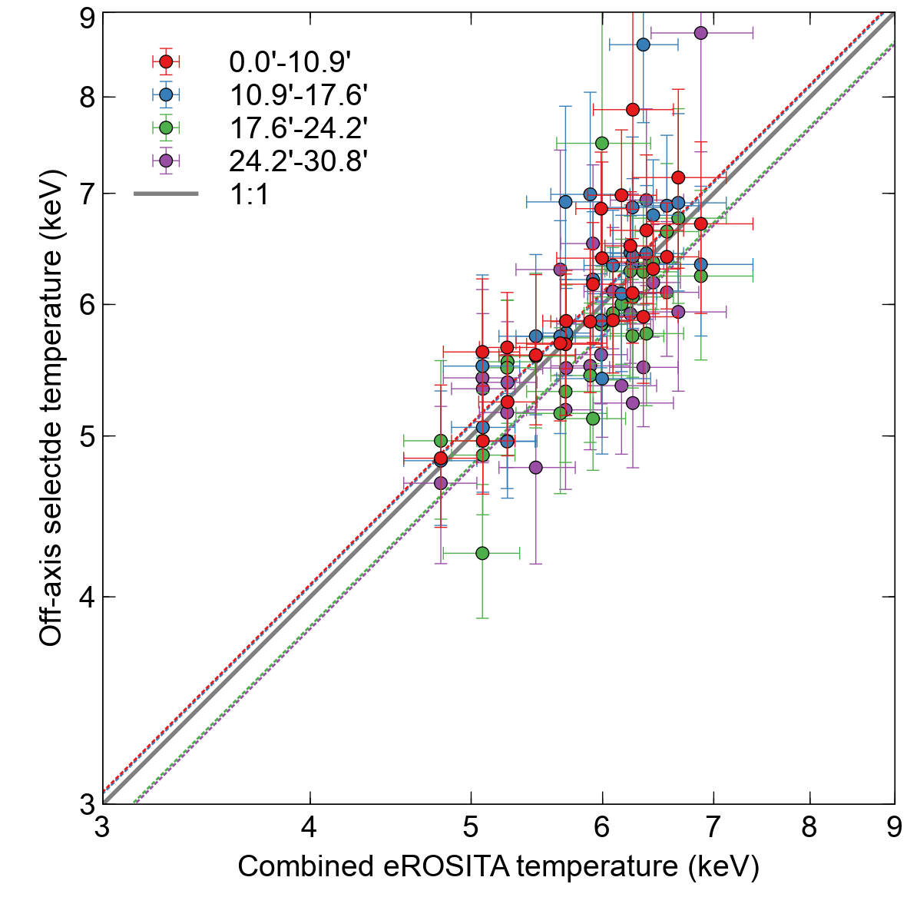
Coma cluster: 040 (new) vignetting
Detector annular regions
Consistent temperatures!

Slide 17
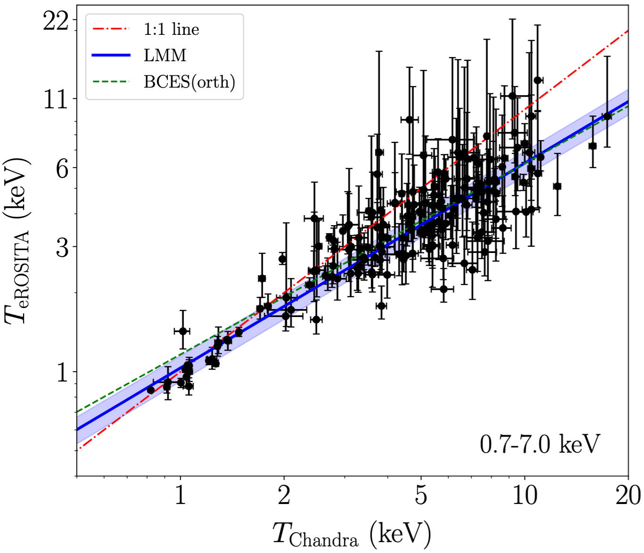
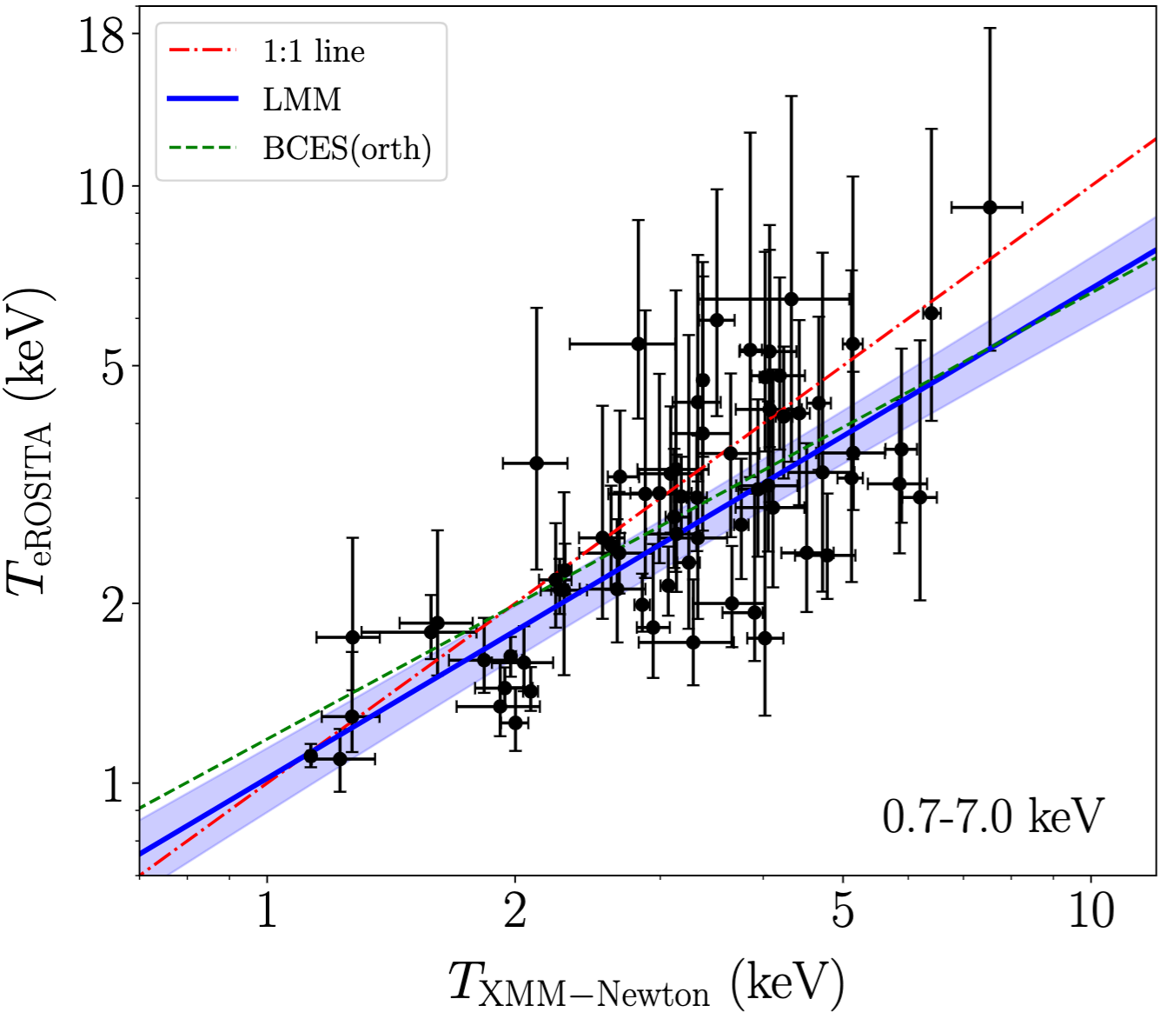
eROSITA vs XMM and Chandra
Migkas et al. (2024) – fitted temperatures for a sample of clusters observed by XMM or Chandra
note hard energy band!
eROSITA cluster temperatures are systematically lower than XMM or Chandra
Could this be due to calibration problems?
Test with Coma cluster (multiple regions instead of multiple clusters)

Slide 18
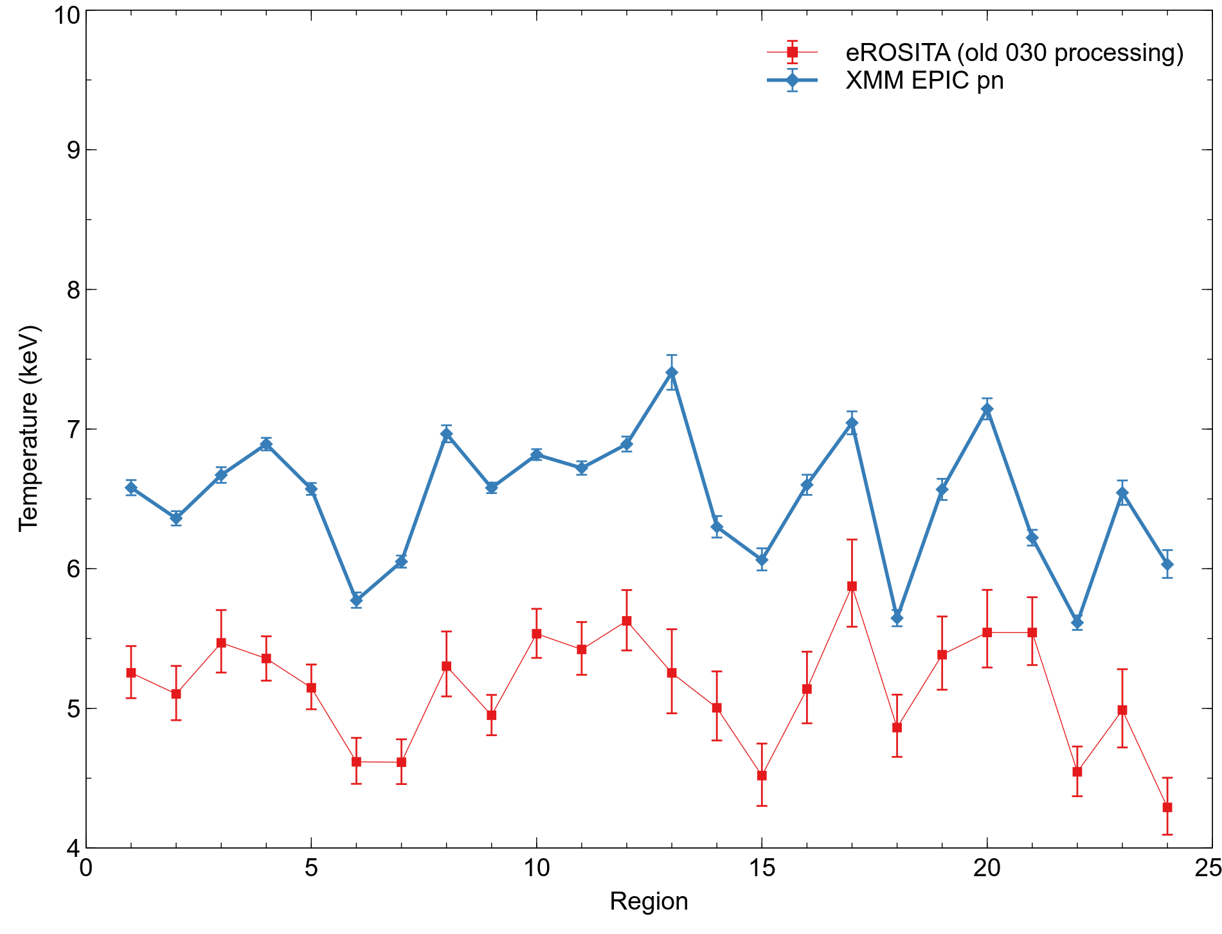
Comparison with other telescopes
tbabs(apec) model fits, fixed N_{H}
eROSITA: 0.3-9.0 keV range
EPIC-pn: 0.3-7.0 keV range

Slide 19
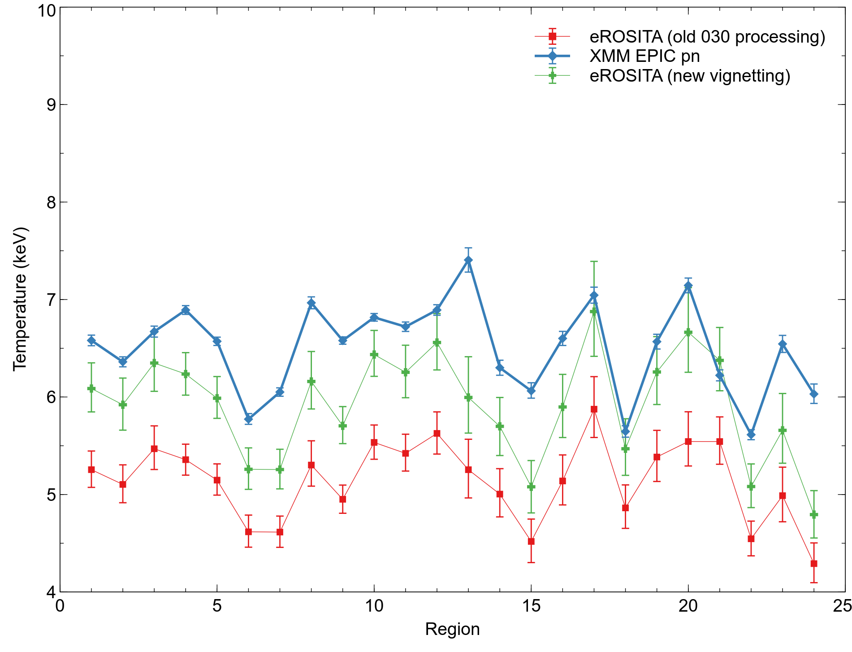
Comparison with other telescopes
tbabs(apec) model fits, fixed N_{H}
eROSITA: 0.3-9.0 keV range
EPIC-pn: 0.3-7.0 keV range

Slide 20
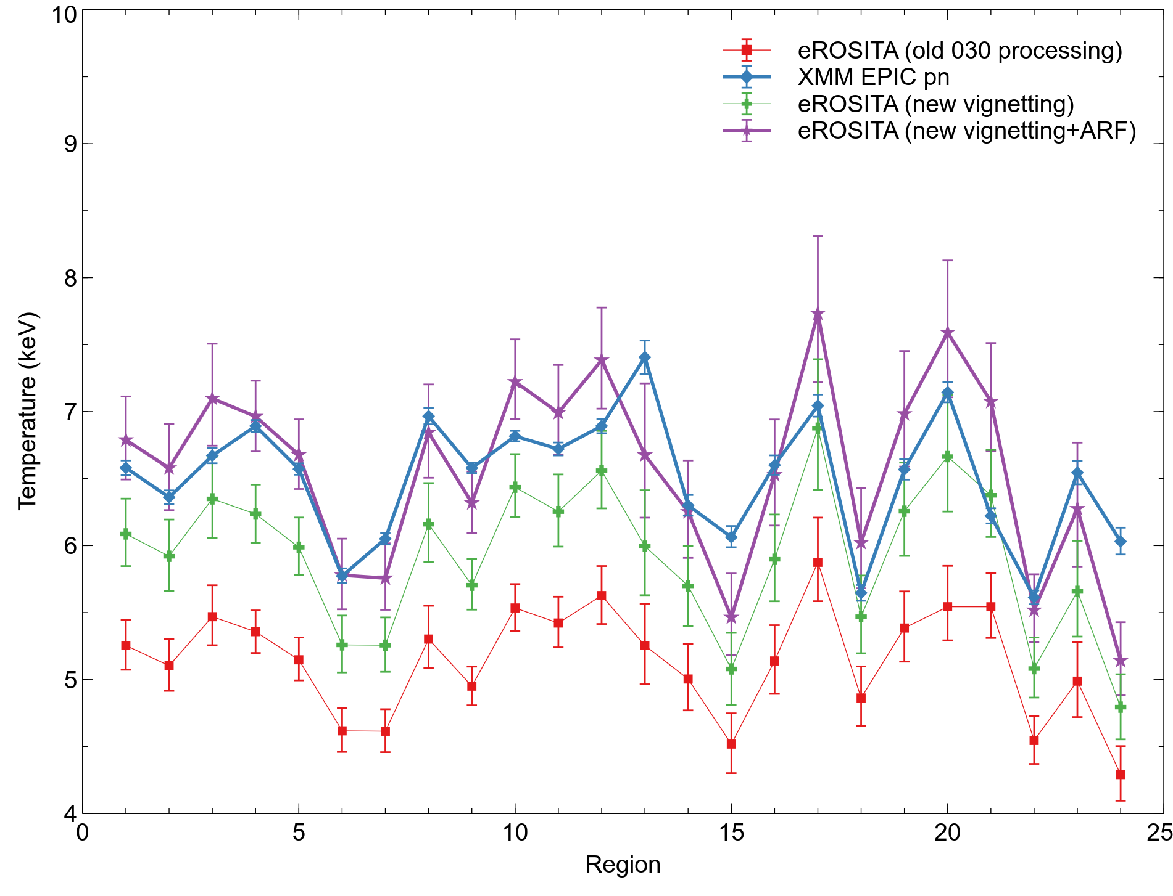
Comparison with other telescopes
New on-axis ARF is from Konrad Dennerl, using fits to known sources and ground calibration

Slide 21
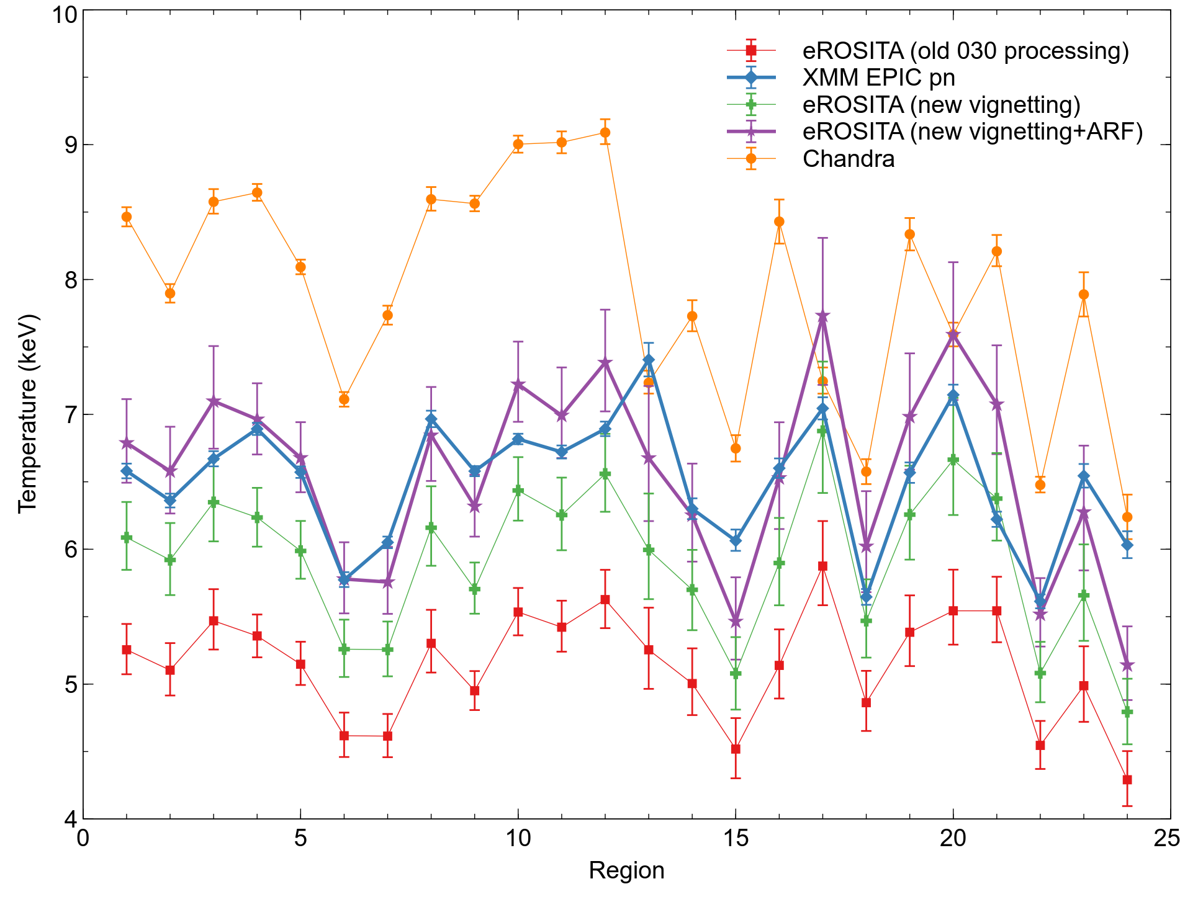
Comparison with other telescopes
tbabs(apec) model fits, fixed N_{H}
eROSITA: 0.3-9.0 keV range
EPIC-pn: 0.3-7.0 keV range
Chandra: 0.5-7.0 keV range

Slide 22
Conclusions
Source stacking for a survey missing like eROSITA very helpful to improve in-flight calibration
Sufficient statistics to measure PSF, vignetting and focal plane distortion
Improvements to vignetting function make eROSITA spectral fitting more self consistent
Improvement to on-axis ARF and vignetting bring Coma cluster temperatures in line with EPIC-pn, although Chandra temperatures appear significantly hotter

Slide 23
Backup slides

Slide 24
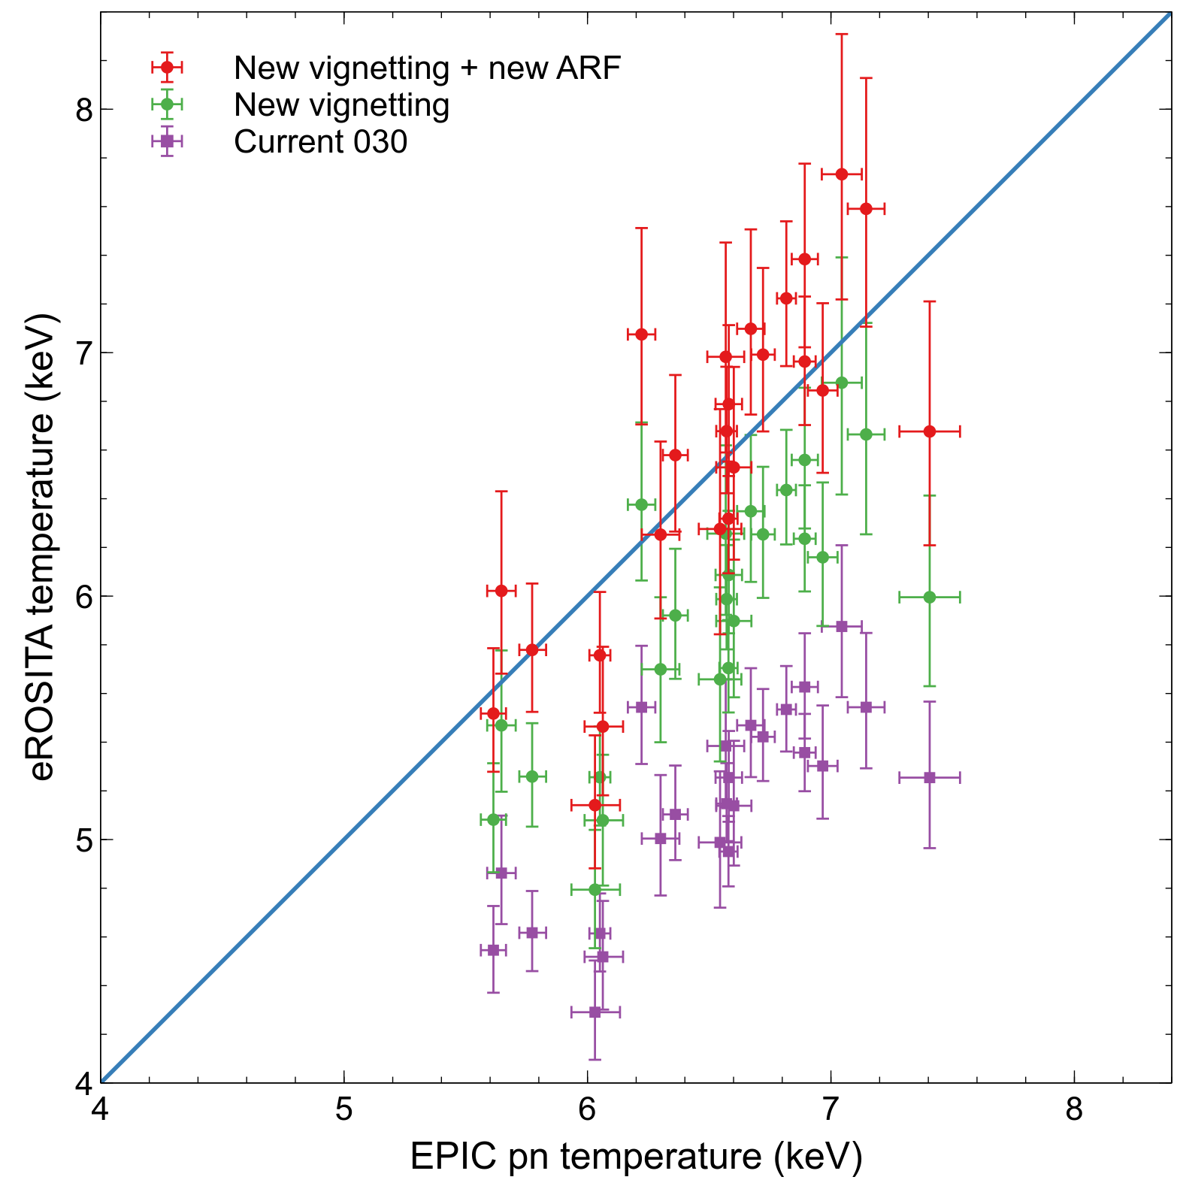
EPIC pn compared to eROSITA

Slide 25
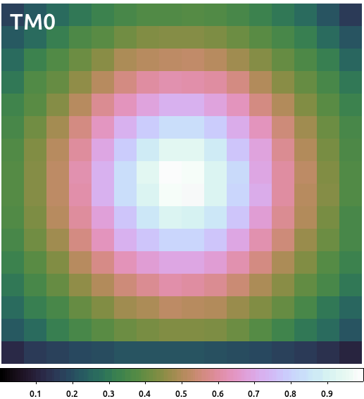
2D vignetting map

Slide 26
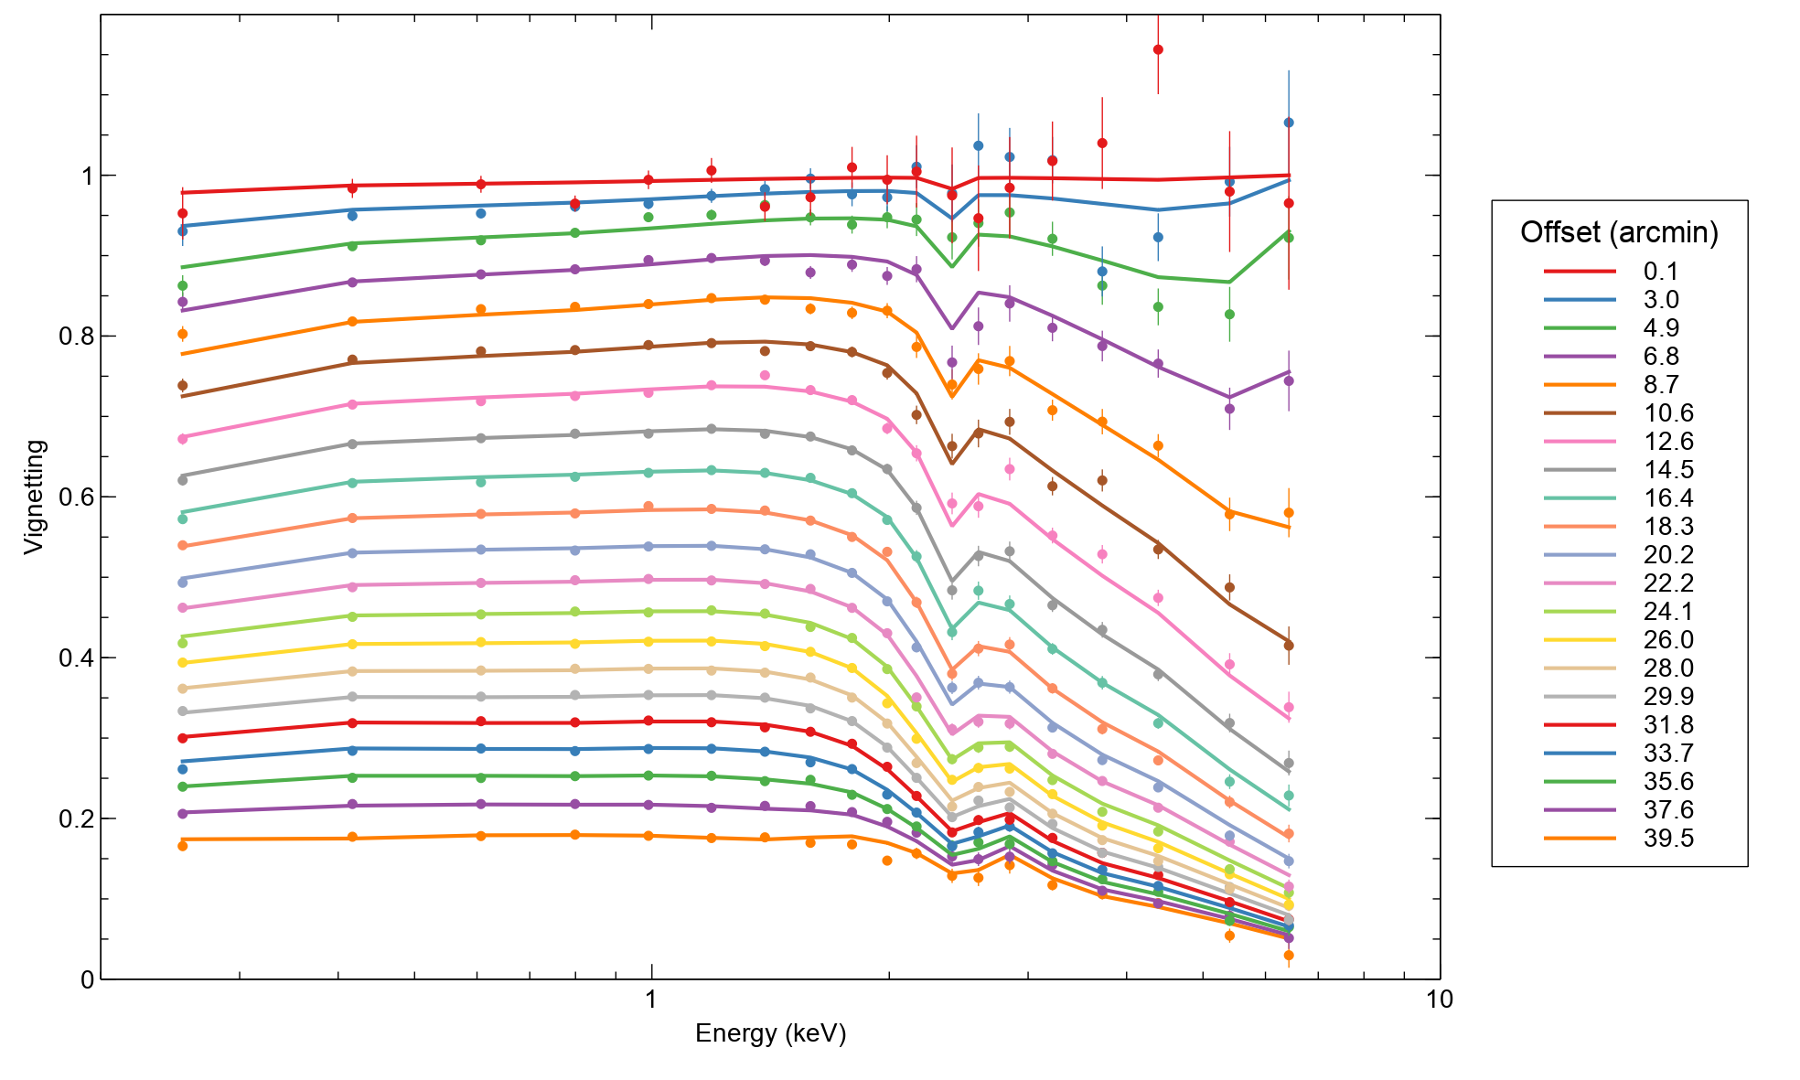
Vignetting fit as a function of energy

Slide 27
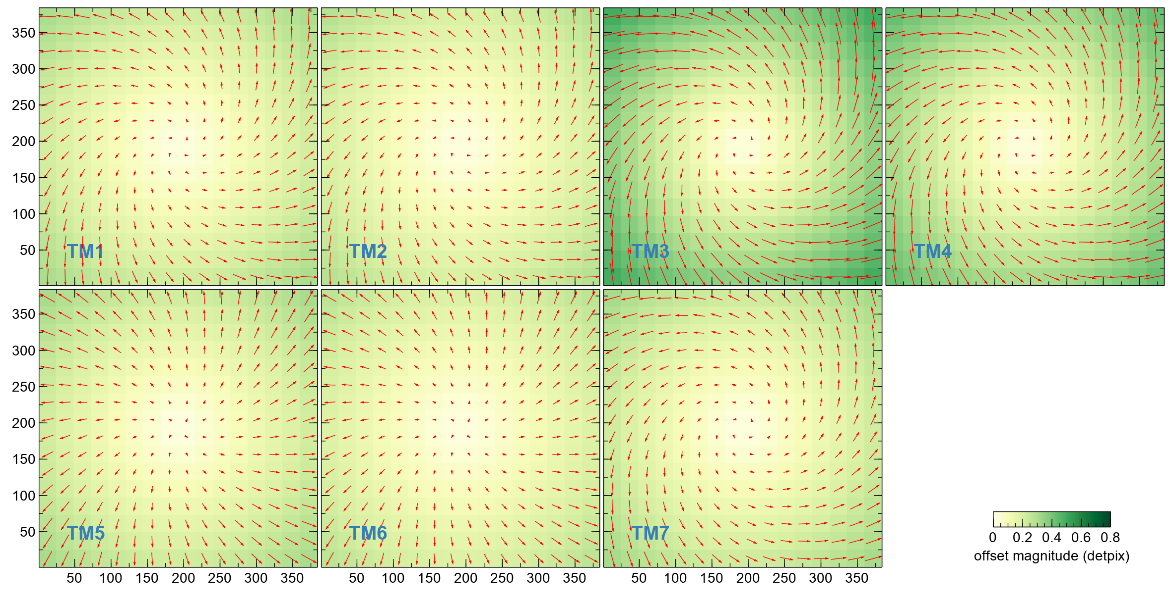
Best fitting model for distortion

Slide 28
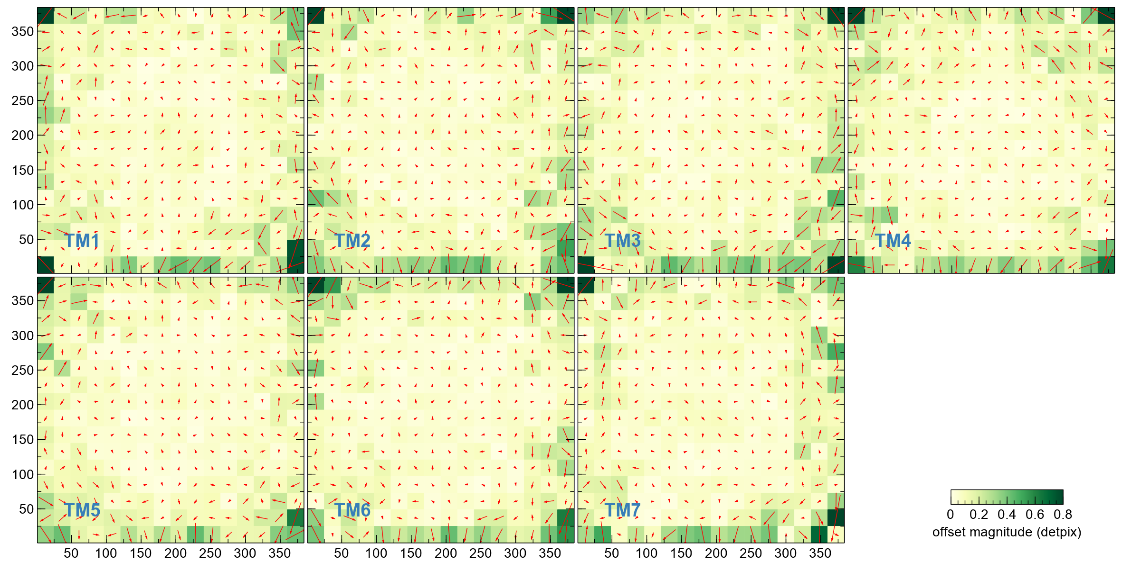
Residuals of model for distortion

Slide 29
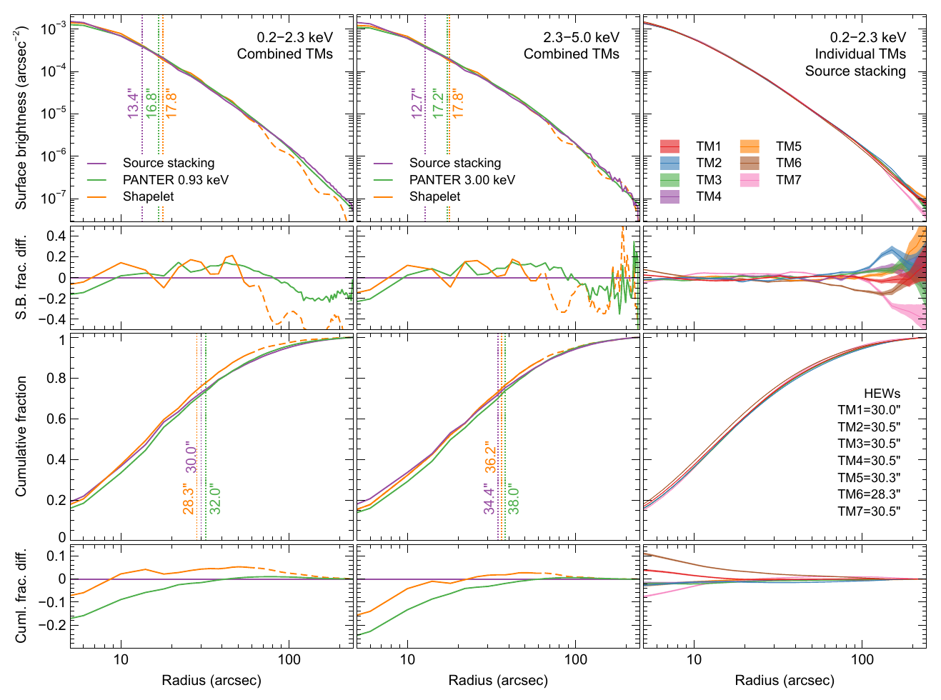
Previous source stacking PSF from
Merloni et al. (2024)

Slide 30
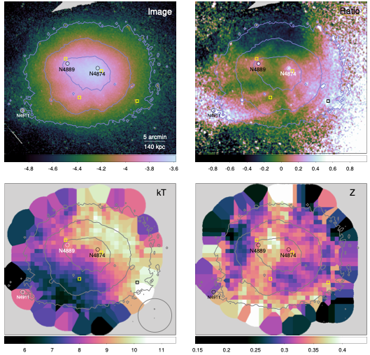
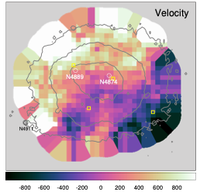
Coma cluster EPIC-pn spectroscopic maps – Sanders et al. (2020)

